Slide 1
Simple Linux operating system Real Mode switch to protected mode

Slide 2
Environment/Builds
Virtual Machine/Ubuntu 14.04
QEMU or Bosch
NASM
GMP, MPFR, LIBMPC, (dependency packages)
MAKE, FLEX, TEXINFO, BISON
Binutils – 2.30
Cross-Compiler – i686-elf-gcc

Slide 3
Basic build of an operating system
BIOS
Boot Sector
GDT
CPU
Disk
Kernel

Slide 4
Bootloader
Is a small program that is executed under boot up in 16-bit Real Mode. It is very small, in fact, it is only 512 bytes and it resides on the very first sector of a boot device. The bootloader is used to load more complex programs like an OS Kernel. The 512 byte bootloader code is stored with the Master Boot Record (MBR) and is loaded by the Basic Input/Output System (BIOS) via Interrupt.

Slide 5
What are interrupts?
The hardware of a computer provides a mechanism called interrupts to handle events.
For example, when a mouse is moved, the mouse hardware interrupts the current program to handle the mouse movement (to move the mouse cursor, etc.) Interrupts cause control to be passed to an interrupt handler.
Interrupt handlers are routines that process the interrupt. Each type of interrupt is assigned an integer number. At the beginning of physical memory, a table of interrupt vectors resides that contain the segmented addresses of the interrupt handles. The number of interrupt is essentially an index into this table.

Slide 6
RAM MEMORY
Bootloader executing at 0x7c00
Jumps to 0x1000 to execute kernel
Kernel
BIOS
ROM
CHIP
Bootloader
MAX:
512 bytes
BIOS reads the bootable device and loads the bootsector to address 0x7c00 in RAM memory and jumps to 0x7c00 to execute it
Bootloader is programmed so that it loads the kernel residing on FAT formatted bootable drive onto RAM memory address 0x1000 and jumps to 0x1000 to execute kernel

Slide 7
32-bit protected mode switch-over
Disable interrupts using the cli (clear interrupt). CPU will simply ignore any future interrupts that may happen, at least until interrupts are later enabled.
Tell the CPU about the GDT. i.e. lgdt [gdt_descriptor]
(The Global Descriptor Table contains entries telling the CPU about memory segments. )
3. Once both the GDT and the GDT descriptor have been prepared within our boot sector, we are ready to instruct the CPU to switch from 16-bit real mode into 32-bit protected mode.

Slide 8
Switch 32 bit
[bits 16]
switch_to_pm:
cli ; disable interrupts
lgdt [gdt_descriptor] ; load the GDT descriptor
mov eax, cr0
or eax, 0x1 ; set 32-bit mode bit in cr0
mov cr0, eax
jmp CODE_SEG:init_pm ; far jump a different segment
[bits 32]
BEGIN_PM:
call KERNEL_OFFSET ; Give control to the kernel
jmp $ ; Stay here, if kernel returns the control (does not happen)
[bits 32]
init_pm: ; now using 32-bit instructions
mov ax, DATA_SEG ; update data segment registers
mov ds, ax
mov ss, ax
mov es, ax
mov fs, ax
mov gs, ax
mov ebp, 0x90000 ; 6. update the stack right at top
mov esp, ebp
call BEGIN_PM ; defined in bootsector.asm

Slide 9
Executing our Kernel Code
The involved steps are as follows:
Write and compile the kernel code.
Write and assemble the boot sector code
Create a kernel image that includes not only our boot sector but our compiled kernel code
Load our kernel code into memory
Switch to 32-bit protected mode
Begin executing our kernel code

Slide 10
Kernel entry point code
jmp $
[bits 32] ; protected mode by now , so use 32-bit instructions.
(Call kernel.c file which currently only prints a string msg)
[extern main] ; Declare that we will be referencing the external symbol ’main ’,
define call point

Slide 11
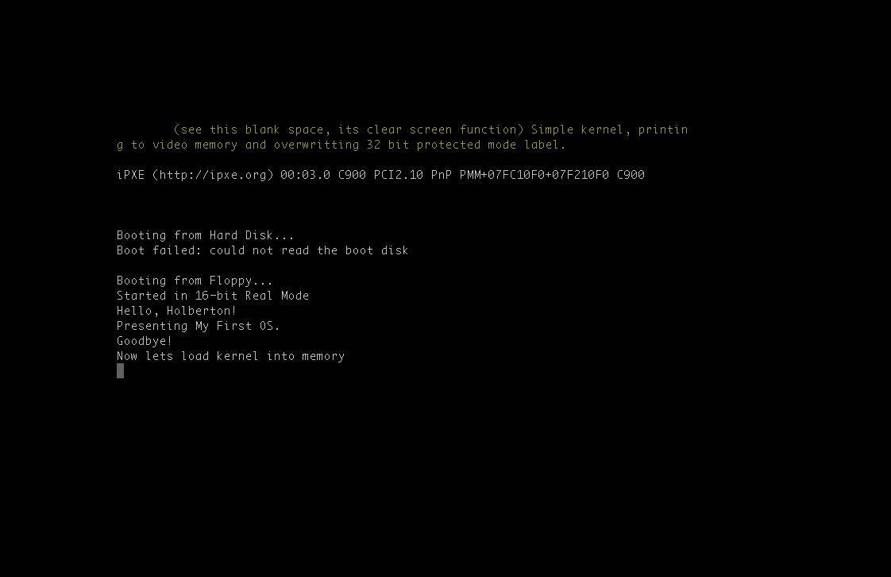

Slide 12
references
http://fisnikhasani.com/building-your-own-bootloader/
https://github.com/cfenollosa/os-tutorial/
http://www.cs.bham.ac.uk/%7Eexr/lectures/opsys/10_11/lectures/os-dev.pdf
https://wiki.osdev.org/BIOS#Common_functions
http://www.pravaraengg.org.in/Download/MA/assembly_tutorial.pdf

