Slide 1
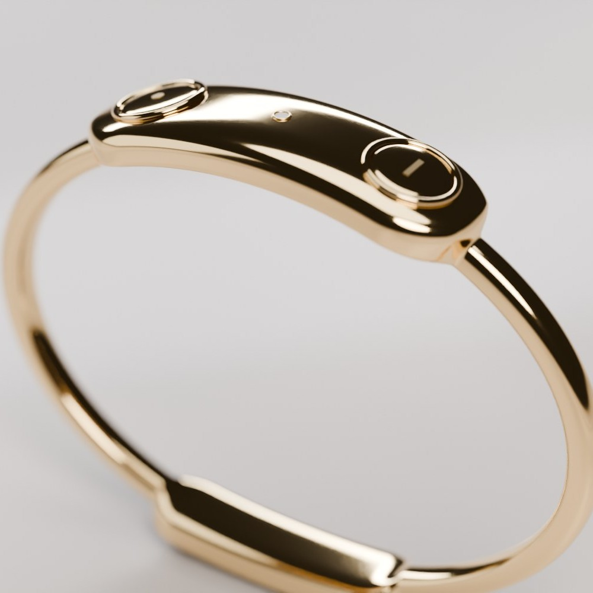
Firefly
A slim bracelet that finds your friends and tells them you’re home, even when your phones die
Stay connected. Go further together.
Wendy, Ava, Yvonne, Lucas
Notes:
0:00–0:10. One sentence: “Firefly is a slim bracelet that finds your friends and tells them you’re home, even when your phones die.” Then straight into the story.

Slide 2
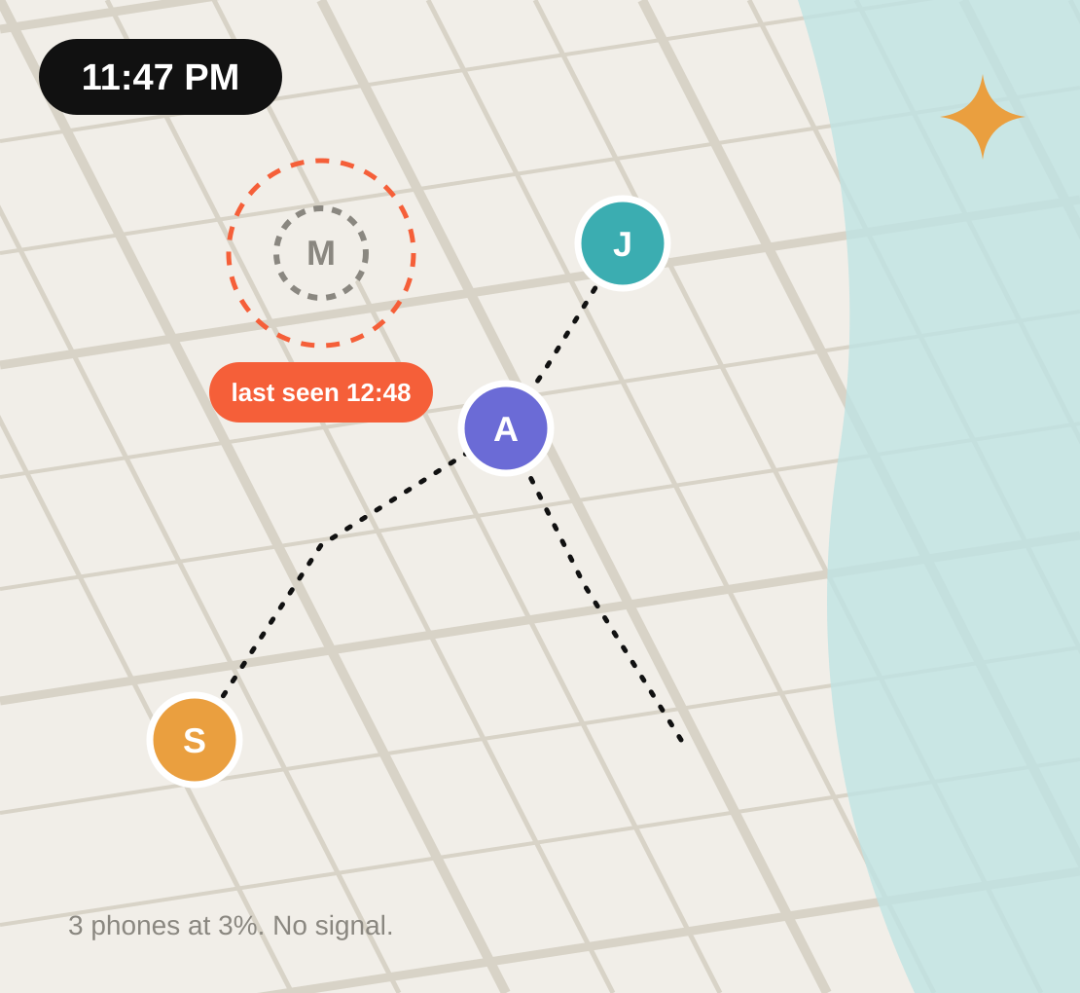
11:47 PM
Your phone is at 3%.
No signal.
Where did Maya go?
Notes:
0:10–0:25. Tell it as a story: phones die, signal fails in packed bars, the group splits for Ubers and restrooms. Pause on the question.

Slide 3
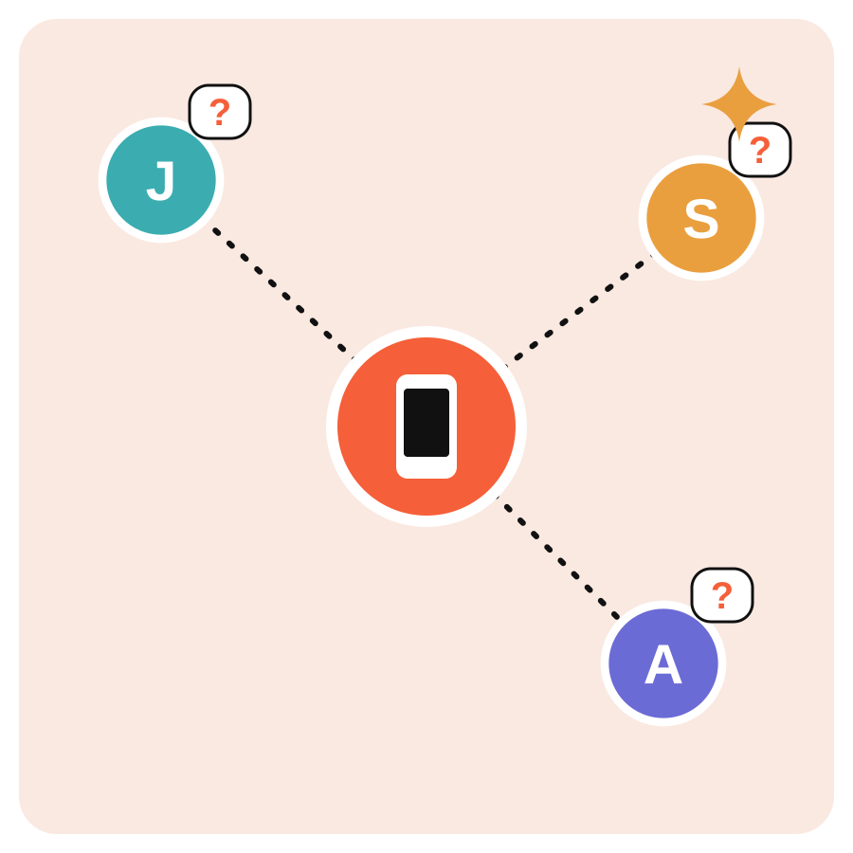
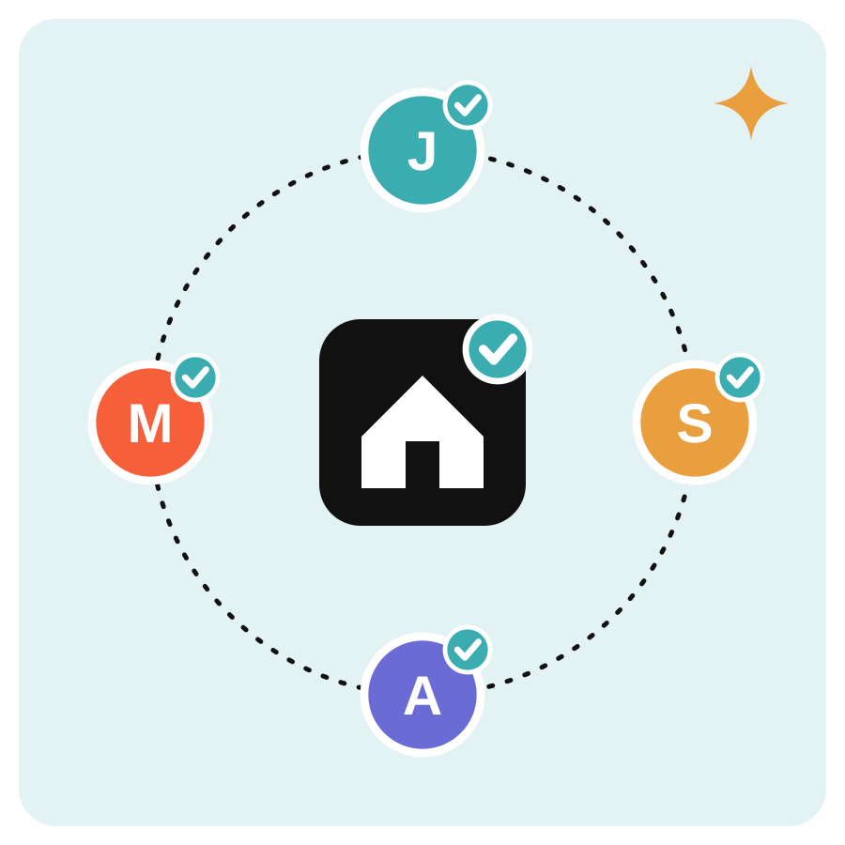
From Discovery to Building
DISCOVERY · 12 INTERVIEWS
One friend chases everyone home
PIVOT
Everyone checks in themselves, even with a dead phone
Notes:
0:25–0:40. Key pivot from 12 Sprint 1 interviews. Finding friends already exists (Totem, Lynq, mostly festival products). The unsolved part: knowing everyone got home, and asking for help without a phone. Today one 'group parent' chases everyone.

Slide 4
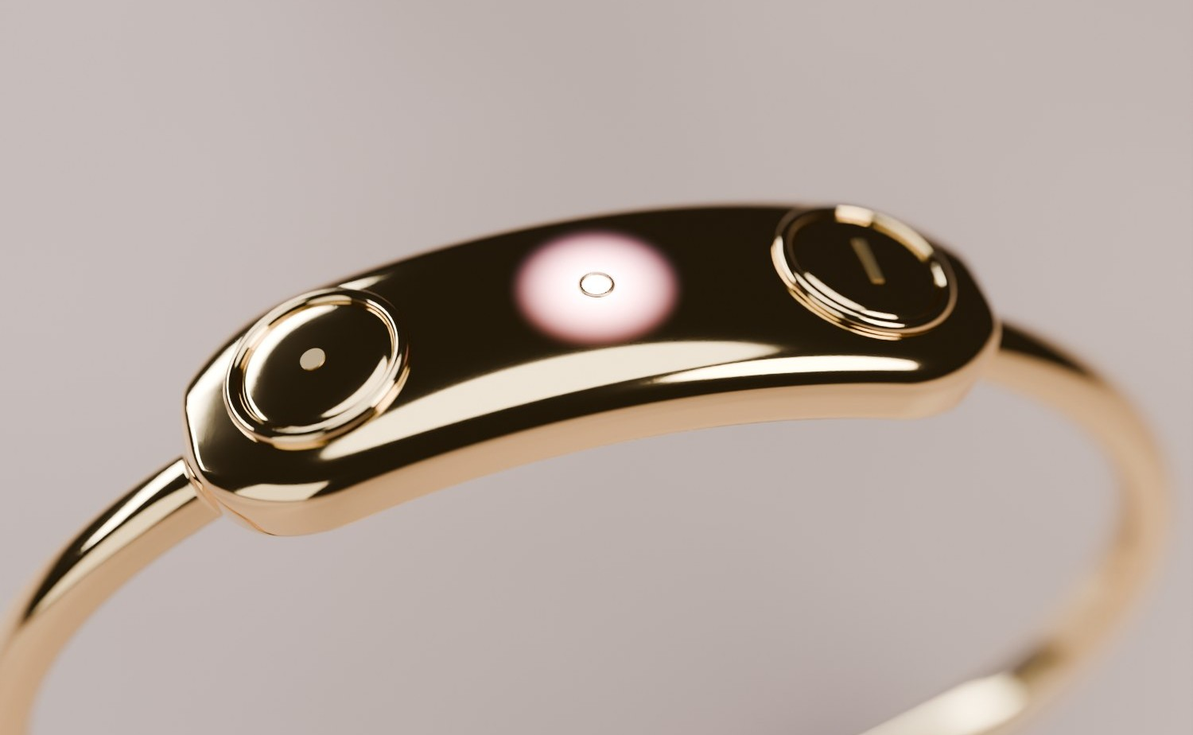
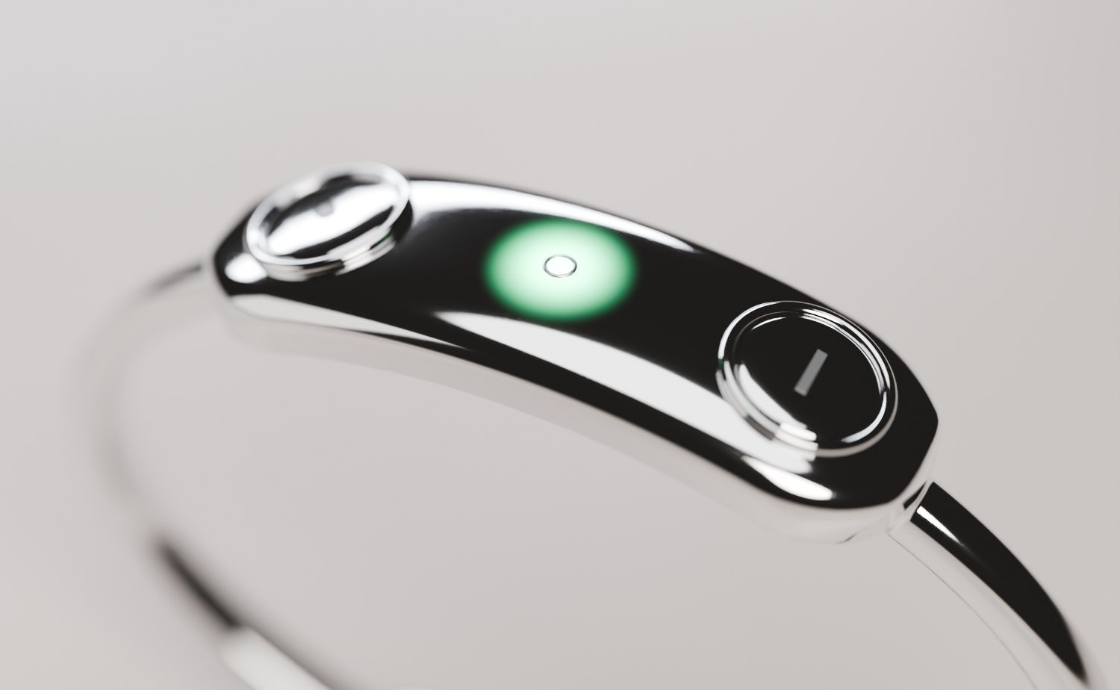
Two Bets, Two Bars
H1
Find a friend, no map?
H2
Say “I’m home” unprompted?
≥ 8/10 find a hidden friend using only the buzz / light / distance, no hints, in ≤ 120 s
≥ 8/10 press I’m home as their first action when the night ends
Notes:
0:40–0:55. H1 and H2 come from our usability test (Firefly_User_Test). Success bar for each: at least 8 of 10 testers. Say the bar, then move on: results come on the validation slide.

Slide 5
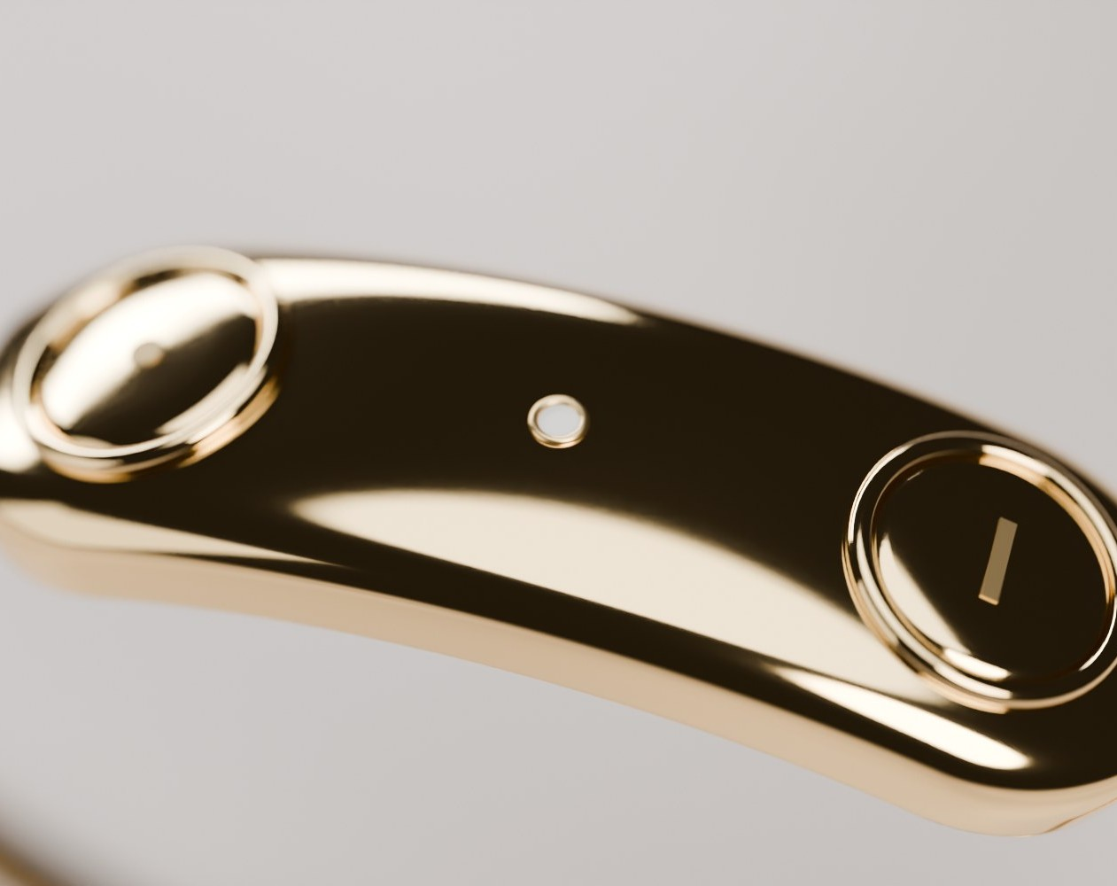
Meet Firefly
1
Button 1 · engraved dot
Press = find friends. Press twice = come find me.
2
The light
Pink (finding), amber (come find me), green (home), red (SOS).
3
Button 2 · engraved line
Press = I’m home. Hold both 3 s = quiet SOS.
4
Radios in the capsule
UWB · LoRa · LTE-M. The band is the antenna; 2nd battery in the clasp.
40 mm capsule · ~15 g · ~9 h heavy night
Notes:
0:55–1:15. Walk the four numbers. Everything you see is in the repo: 3D model, Cycles renders, technical design and parts list. 40 mm capsule · ~15 g · ~9 h heavy night.

Slide 6
Two Buttons, Zero Screens
BUTTON 1 · FIND
BUTTON 2 · HOME
BOTH · SOS
●
Press
●
Press
▬ 3 s
Hold both
Find friends
I’m home
Quiet SOS
●●
Press twice
●●
Twice ≤ 5 s
●●
Either, twice
Come find me
Cancel
Cancel in grace
Automatic: separation alert (10–30 m radius, 1/2/5 min delay) · Colours: gold, silver, rose gold, black
Notes:
1:15–1:35. Point at each row. Button 1: press to find friends (buzz and light pulse faster as you get closer), press twice for come find me. Button 2: I'm home. Hold both for 3 s: quiet SOS, with a grace window to cancel. The separation alert is automatic.

Slide 7
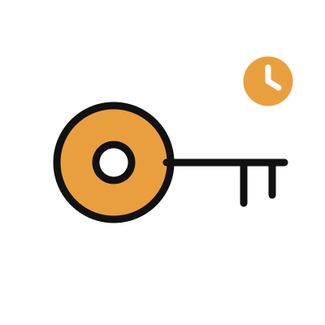

How It Reaches 6+ Miles
0–30 m
30 m–1 km
1 km–6+ mi
UWB
LoRa
LTE-M cellular
you
Distance to the metre
Device to device, no network
Built for one bar, basements
Fallback when there’s no signal at all: Amazon Sidewalk and passing phones · I’m home and SOS never need your phone
♥
Only your group sees you
Key expires at end of night
Nothing stored on a server
Notes:
1:35–1:50. No wrist-sized radio reaches 6 miles directly, so the device picks the best link: ultra-wideband up close, LoRa across a venue, LTE-M cellular beyond 1 km. LTE-M and NB-IoT are built for weak signal (about 20 dB more reach than phone LTE), so they get into basements. Fallback: Amazon Sidewalk. None of it needs the wearer's phone. Privacy: only your group, key expires at the end of the night, encrypted on the device.

Slide 8
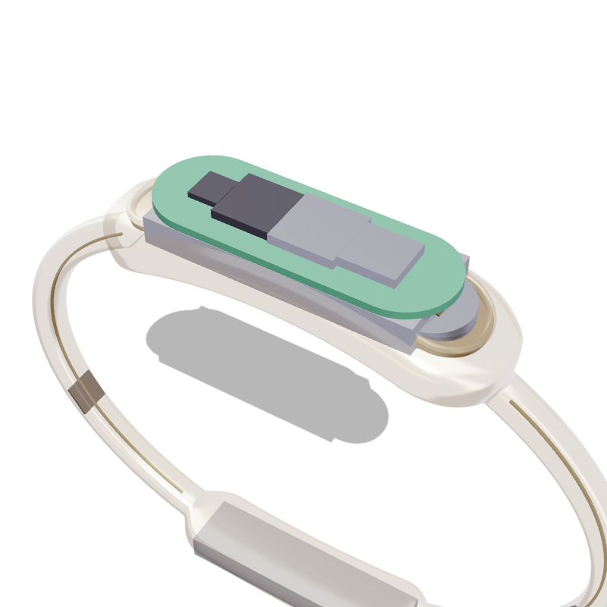
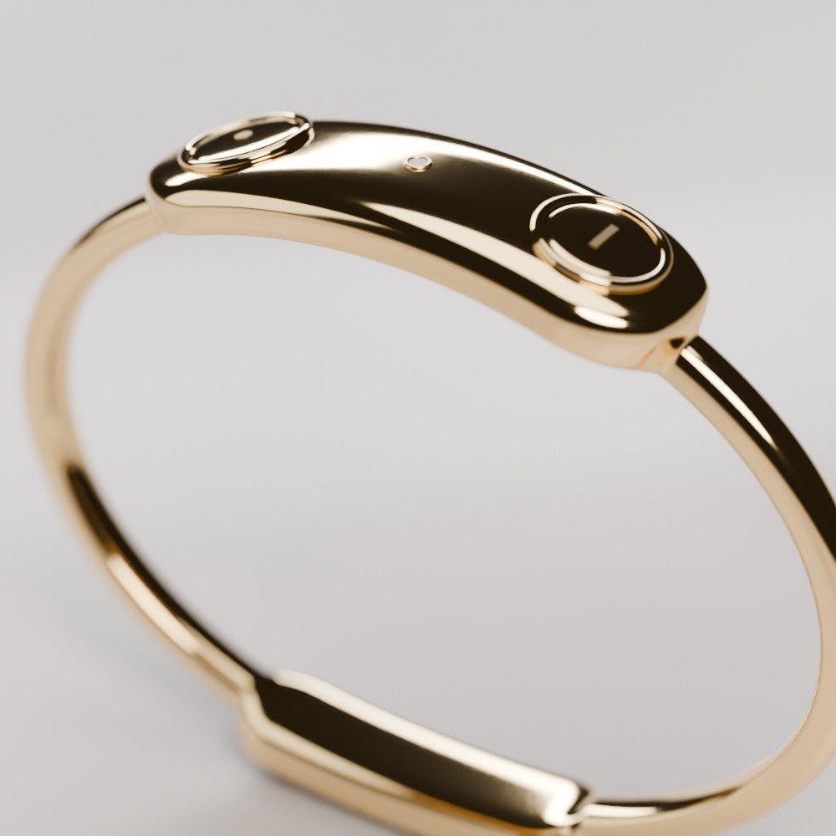
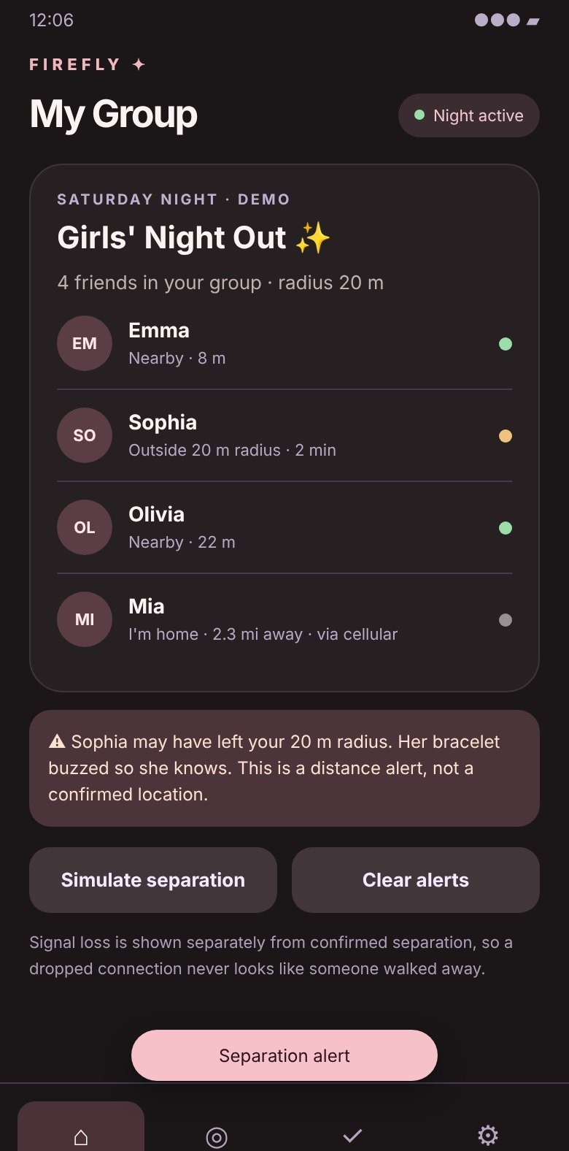
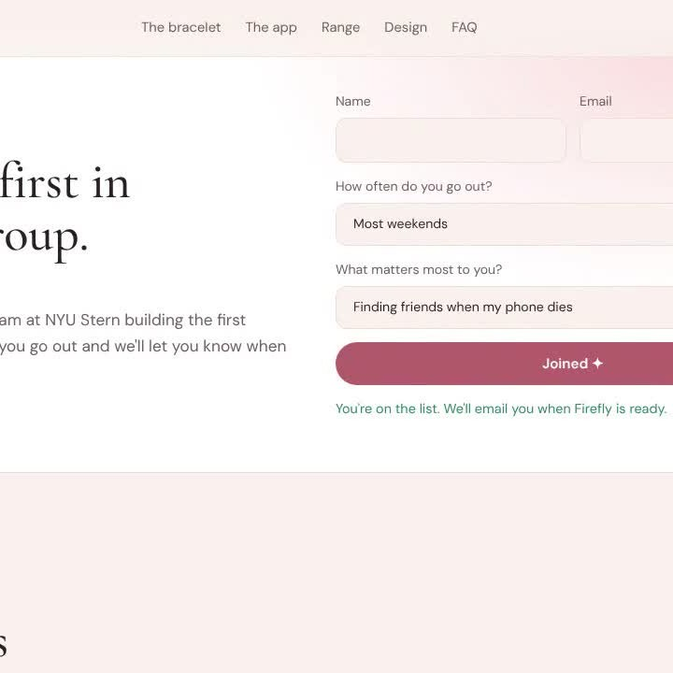
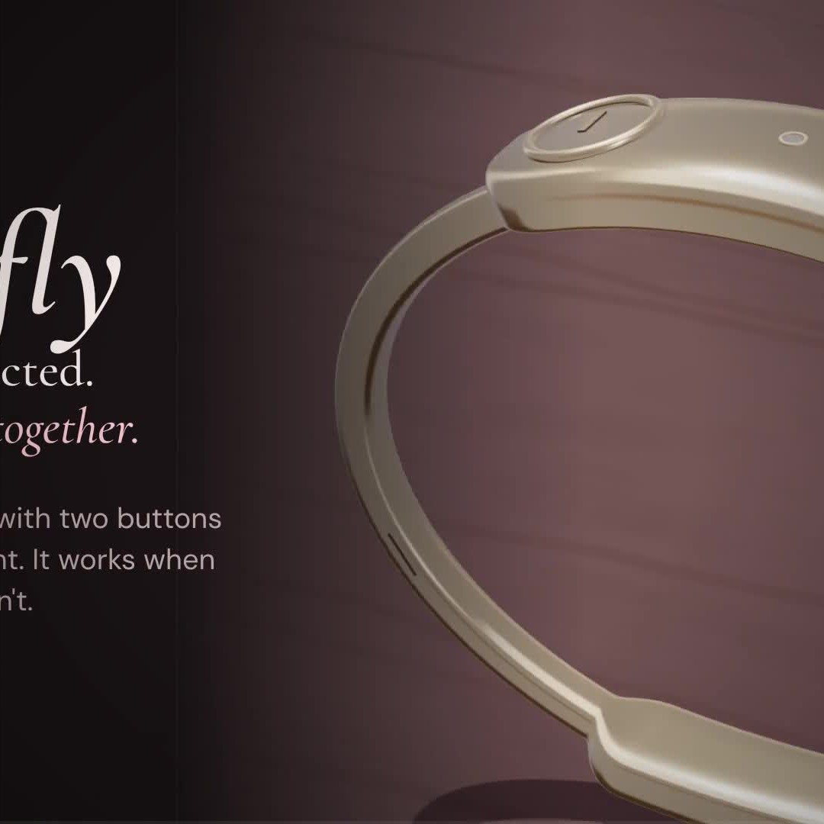
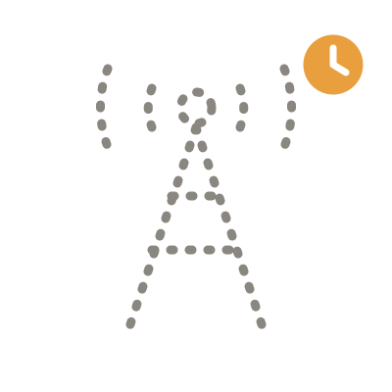
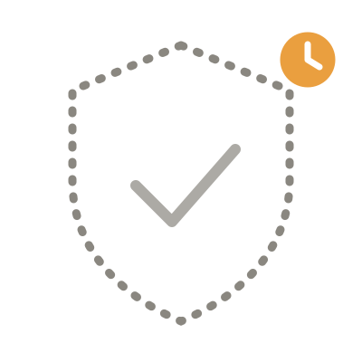
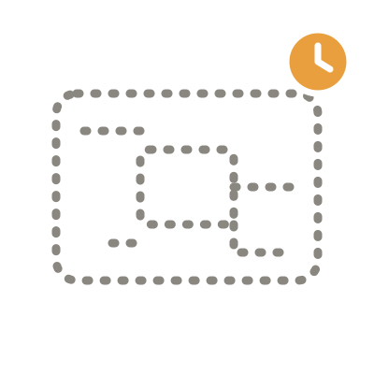
What We Built (and Didn’t)
BUILT
NOT YET
Hardware prototype
FCC + carrier
Custom PCB
3D model
Cycles renders
App (PWA)
Site + waitlist
Promo film
STACK
Claude Code (agents) · three.js · Blender Cycles · HTML/JS PWA + Web Bluetooth · Google Forms · GitHub Pages · Playwright + ffmpeg
CUT ON PURPOSE
A screen, maps up close, accounts and logins, a separate SOS button.
Notes:
1:50–2:05. Built, all live in the GitHub repo: the 3D model, photoreal Cycles renders, the installable app, the website with a working waitlist, the promo film, and a technical design + parts list (~$247 per prototype). Not yet: a hardware prototype, FCC/carrier certification, a custom PCB. Cut on purpose: accounts and logins, app-store release, maps up close: none of them test our two bets.

Slide 9
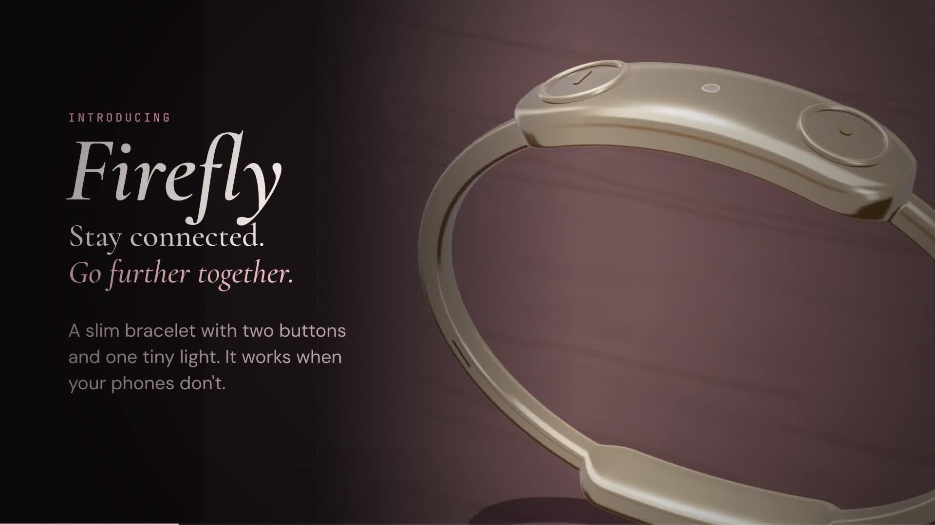
The Film
▶
Notes:
2:05–2:35. Click the video to play the 28-second cut (the full 68-second film is at https://wendyxlin.github.io/firefly-band/v2-bracelet/media/firefly-v2-promo.mp4). Say nothing over it.

Slide 10
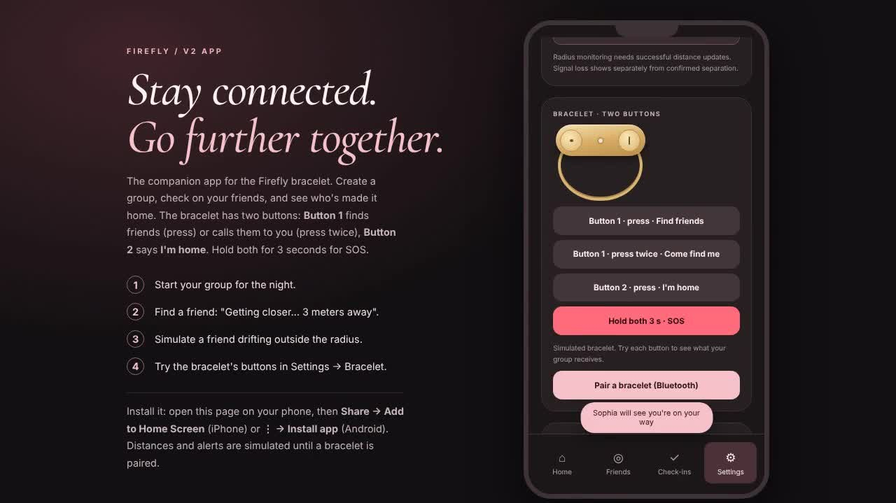
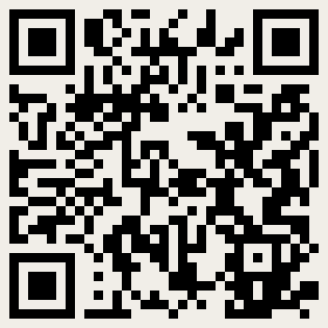
Live Demo: the App
01
Start the night
Create the group
02
Drift + find
Separation alert, distance to the metre
▶
03
Home + SOS
From the bracelet, no phone needed
Try it on your phone
wendyxlin.github.io/firefly-band/v2-bracelet/app/
Recording of the app (click to play), backup for the live demo
Notes:
2:35–3:15. Live: open https://wendyxlin.github.io/firefly-band/v2-bracelet/app/ on a phone (or this laptop). Flow: start the night → simulate a friend drifting away → find a friend (distance counts down) → I'm home → SOS from the bracelet. If the live demo fails, click the recording on the right.

Slide 11
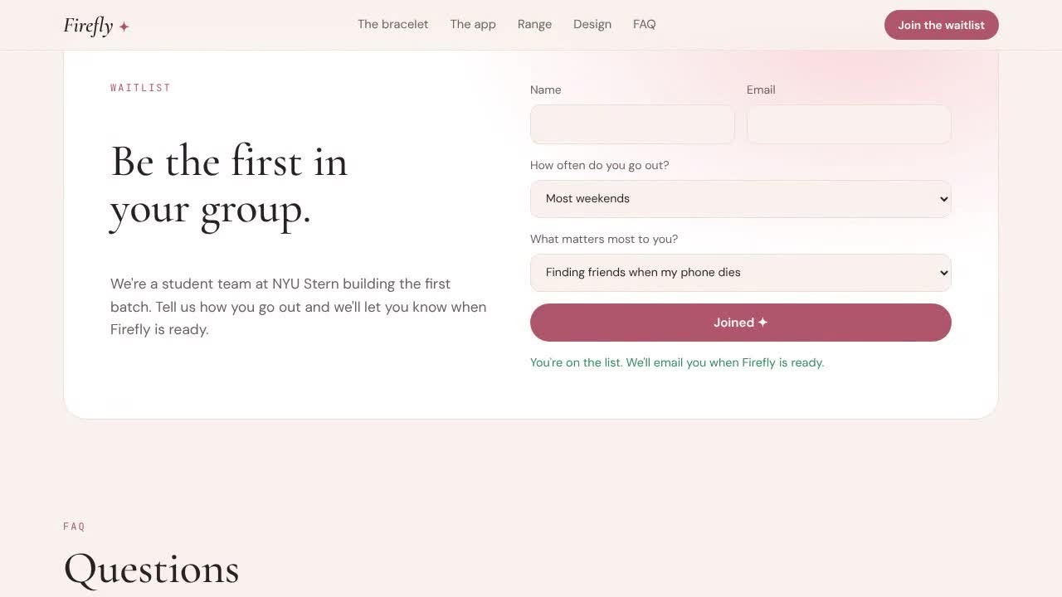
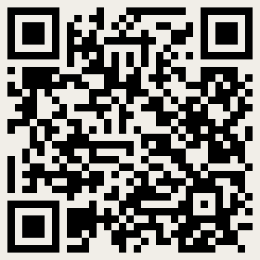
Live Demo: Website + Waitlist Test
WAITLIST = DEMAND TEST
[ N ] sign-ups
Same Google Form for every version: name, email, how often they go out, what matters most
▶
Open the site
wendyxlin.github.io/firefly-band/v2-bracelet/
Recording: scroll the site, then submit a test sign-up (click to play)
Notes:
3:15–3:35. Show https://wendyxlin.github.io/firefly-band/v2-bracelet/: scroll to the buttons, the app, range, design. Then the waitlist test: type a test name, submit, and show the confirmation. The recording submits 'Test - Sprint 2 demo' (intercepted, so it didn't add a row). Live, submit a test entry and show it arriving in the Firefly waitlist Google Form responses. Say the real number of sign-ups so far.

Slide 12
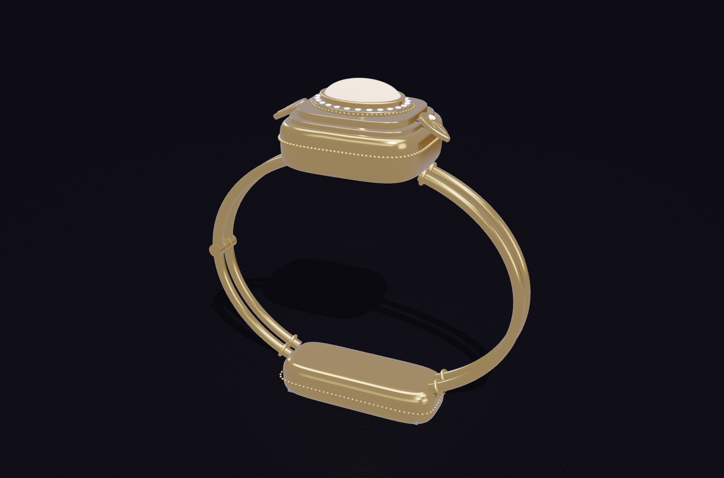
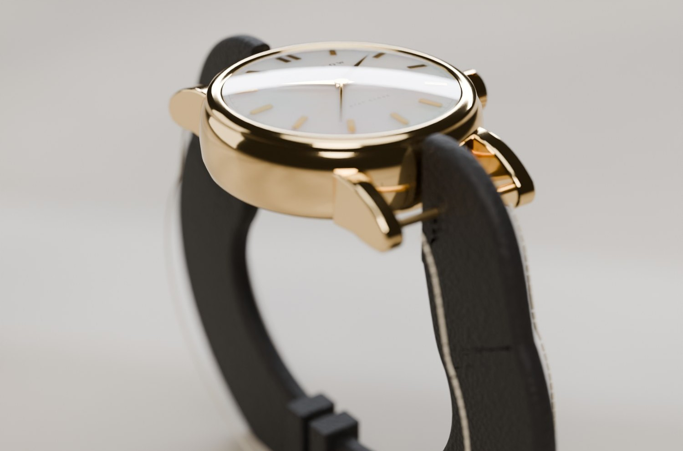
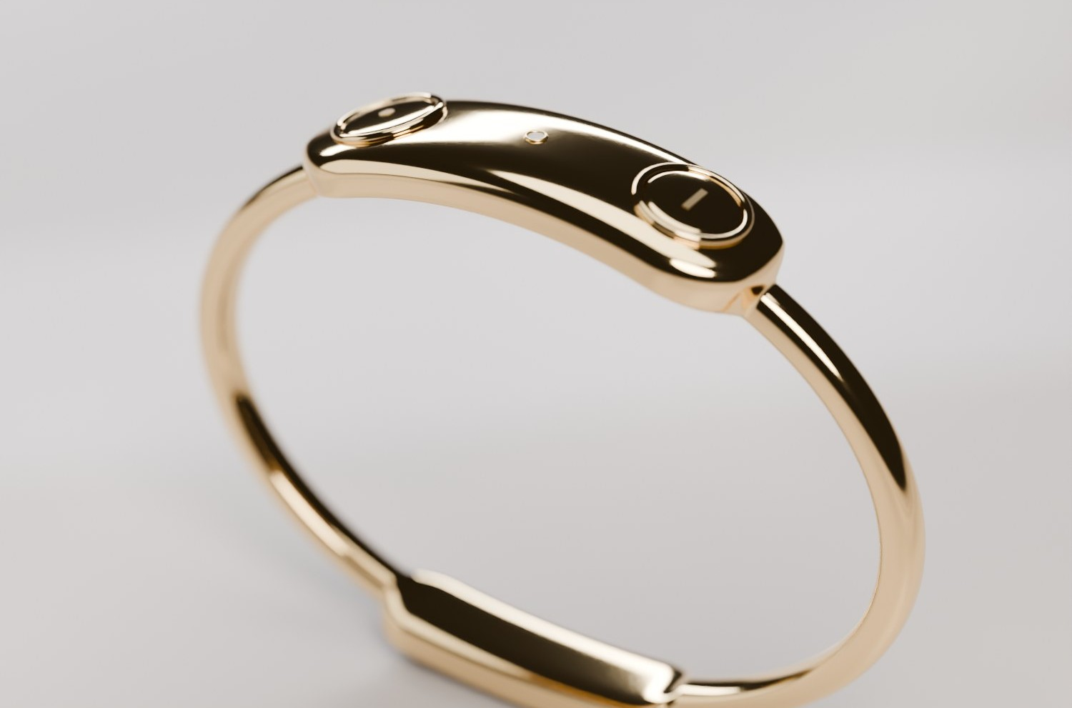
Process: Three Designs, One Product
v1 · Bangle
Watch direction
v2 · Bracelet
DECISION
Back to jewelry: two buttons + one light. SOS hidden as a both-buttons hold, so no third button.
BIGGEST CHALLENGE
6 miles with a dead phone. Fix: LTE-M cellular + Sidewalk, new battery and weight budgets.
CUT
A screen, maps up close, accounts and logins, a separate SOS button.
Notes:
3:35–3:48. We iterated the form factor three times with agents doing the rebuilds (3D model, renders, app, site, film each time). Biggest technical challenge: 6-mile range with no phone. A wrist radio can't do it, so we added LTE-M cellular with Sidewalk as a fallback, and re-did the battery and weight budgets each time.

Slide 13
How We Tested
1
2
3
4
P01
Clarity ●●●●○
Useful ●●●●●
Wear? Yes · Maybe · No
“…in their words”
✓
FIND
HOME
LED
Consent + code
Task 1 · Find a friend
Task 2 · Night is over
Quick survey
Anonymous P01–P10. No names, no tracking.
Phone dead in a packed club. Move with arrows; the LED flashes faster as you get closer. 120 s, hints recorded.
“What would you naturally do?” No prompt. The first button pressed is recorded.
Clarity 1–5 · usefulness 1–5 · would you wear it? · one direct quote · what to change.
WHAT WE MEASURE
H1 · found the friend with no hint in ≤ 120 s (+ time, hint use)
H2 · first action = I’m home (+ time to first action)
HONEST LIMITS
A simulation: fictional distances (not UWB), and no real check-in is sent. It tests whether the interaction is understandable, not radio range.
Notes:
3:48–4:05. Our test is the Firefly_User_Test page: same laptop, same researcher, 10 testers, no hints. Consent and an anonymous code (P01–P10), no names. Task 1: phone dead in a crowded club, find a hidden friend on a 7×7 floor plan using only the LED, which flashes faster as you get closer; 120 s limit, asking for a hint is recorded. Task 2: the night is over, what do you naturally do? The first button pressed is recorded. Then a short survey and one direct quote. Be upfront: it is a simulation, so it tests whether people understand the interaction, not radio range.

Slide 14

10 People Tried It
[ _ /10]
H1 · found the hidden friend, no hints, ≤ 120 s (bar: 8/10)
[ _ /10]
H2 · pressed I’m home first, unprompted (bar: 8/10)
[ _ /10]
would wear it on a night out
Median find time
[ _ s]
Asked for a hint
[ _ /10]
“[Strongest tester quote]”
Tester, [age, how often they go out]
Avg clarity
[ _ /5]
Avg usefulness
[ _ /5]
Notes:
4:05–4:25. FILL IN before presenting: the numbers come from the Firefly_User_Test dashboard (Export CSV: h1WithoutHelp, h1Seconds, h1HelpUsed, h2Independent, clarity, usefulness, wouldWear, directQuote). Colour one person orange per tester who passed (replace the grey icon with the orange one from the template). Read ONE quote; all ten are in the appendix. Our bar was 8/10 for H1 and H2.

Slide 15



What We Learned
Validated
Surprised us
Would redo
[from the 10 tests: which bet held up]
No wrist radio reaches 6 miles, so we added LTE-M cellular. The battery had to split into capsule + clasp.
Lock the form factor before building every output: we rebuilt them three times.
Notes:
4:25–4:37. One line per icon. 'Validated' comes from the test results; fill it in. The other two are from the build itself.

Slide 16
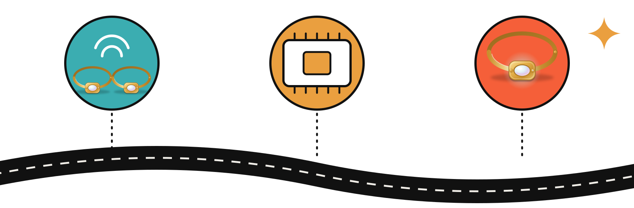
What’s Next
Dev-board prototype
Bar test
Shrink + certify
UWB + LoRa + LTE-M on two wrists
10 testers, real venue, real basement
Custom PCB, FCC, carrier approval
Biggest risk: Battery: 145 mAh across capsule + clasp gives ~9 h on a heavy night. · GTM: friend groups first, $149–199, no monthly fee
Notes:
4:37–4:53. Top three next steps. Biggest risk: Battery: 145 mAh across capsule + clasp gives ~9 h on a heavy night. Go-to-market: start with friend groups that already go out together (club teams, Greek life, roommates), price $149–199 with no monthly fee (data bundled), convert the waitlist into pre-orders. Reorder the steps if testers asked for something else.

Slide 17
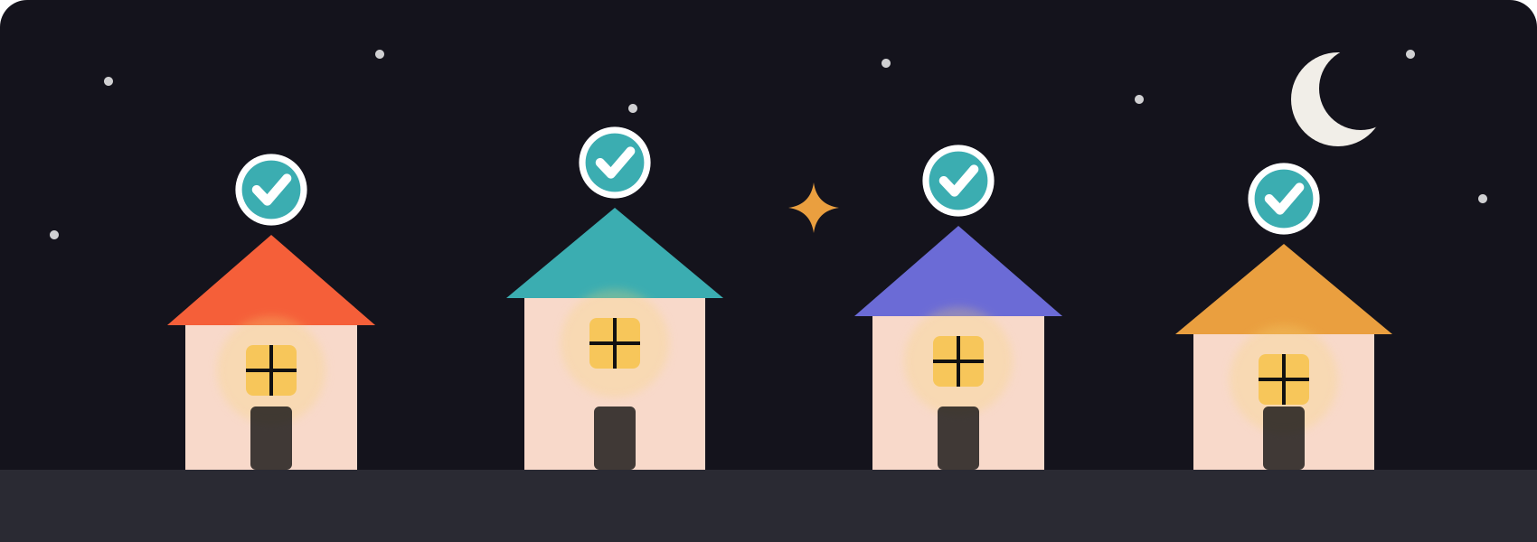
2:47 AM
Everyone’s home.
Notes:
4:53–5:00. Close the loop with the opening story: same night, everyone accounted for. End on the image, then stop.

Slide 18
Appendix: 10 Tester Quotes
“[Quote 1]” Tester 1
“[Quote 2]” Tester 2
“[Quote 3]” Tester 3
“[Quote 4]” Tester 4
“[Quote 5]” Tester 5
“[Quote 6]” Tester 6
“[Quote 7]” Tester 7
“[Quote 8]” Tester 8
“[Quote 9]” Tester 9
“[Quote 10]” Tester 10
Notes:
Not presented. The rubric requires 10 direct user quotes: paste them from the user-test CSV (directQuote column).

Slide 19
Appendix: Is It Buildable?
Range ≥ 6 mi, weak signal
Feasible: LTE-M/NB-IoT (nRF9151), ~20 dB better than phone LTE
Up-close distance
UWB (DW3110): reliable 10–20 m in a crowd
Battery
85 mAh capsule + 60 mAh clasp: ~9 h heavy night, ~31 h typical
Weight
~15 g in titanium, ~22 g in gold-plated brass
Open risks
Band as antenna needs RF tuning; UWB through ceramic underside
Prototype cost
~$247 per bracelet on dev boards
Notes:
For Q&A. Full numbers and sources: technical/TECHNICAL_DESIGN.md in the repo.

