Slide 1


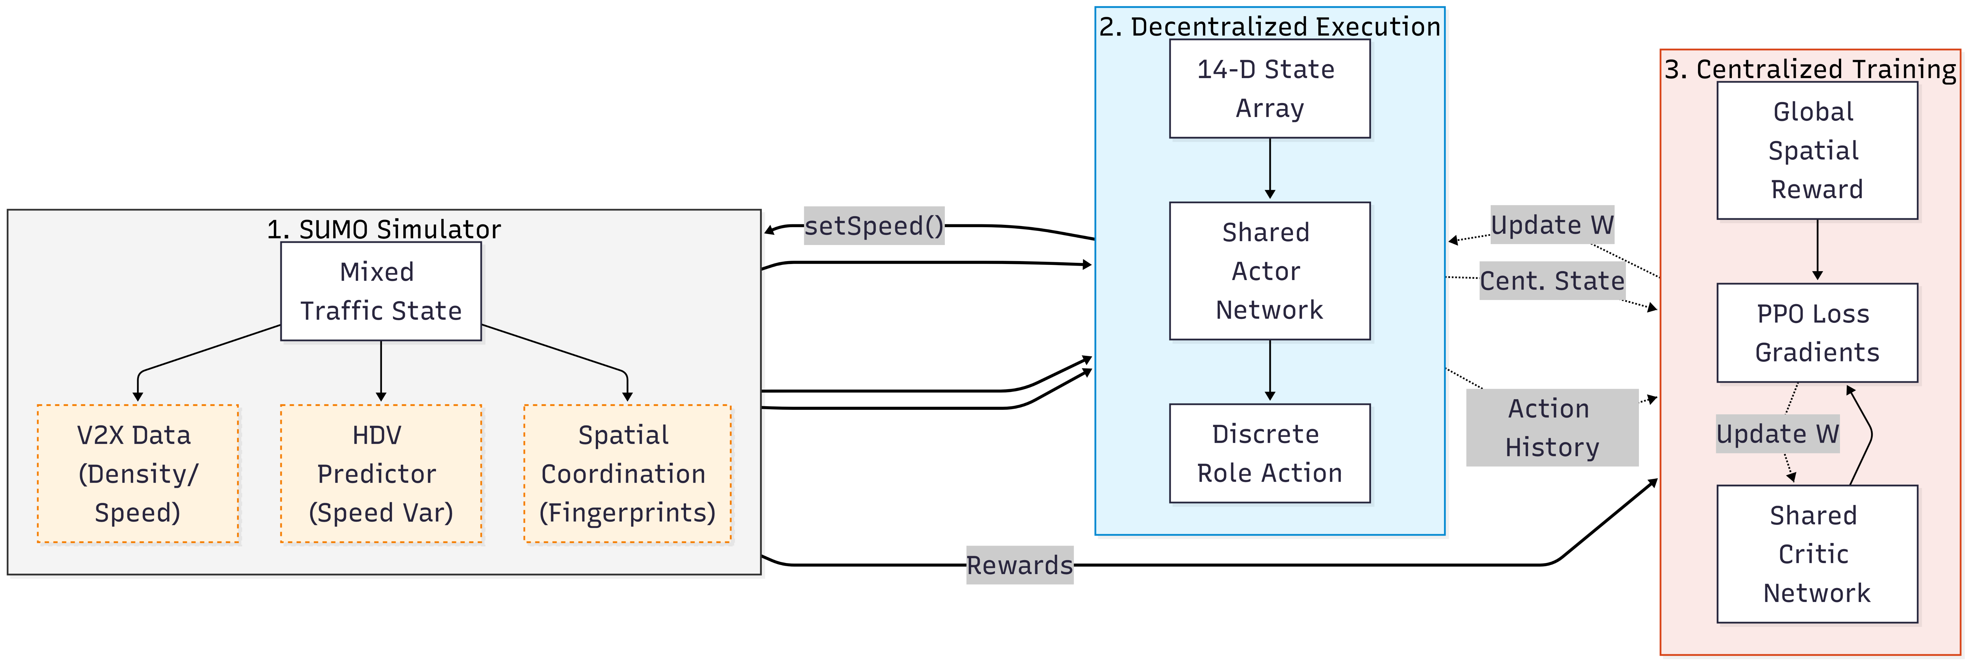
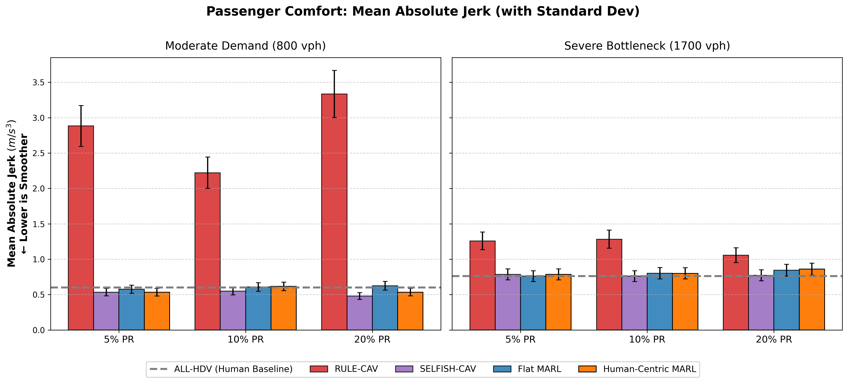
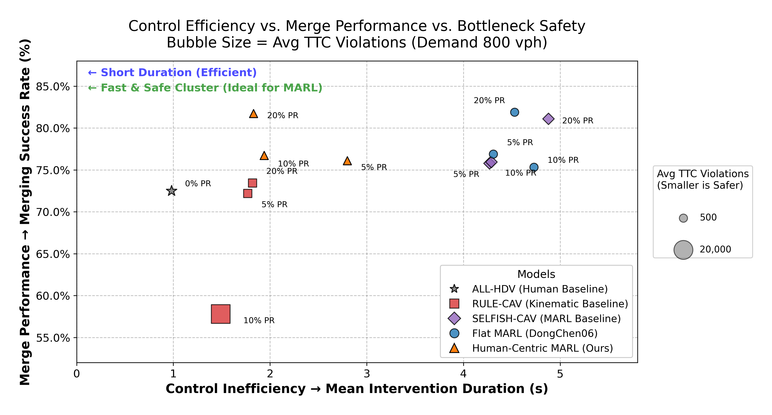
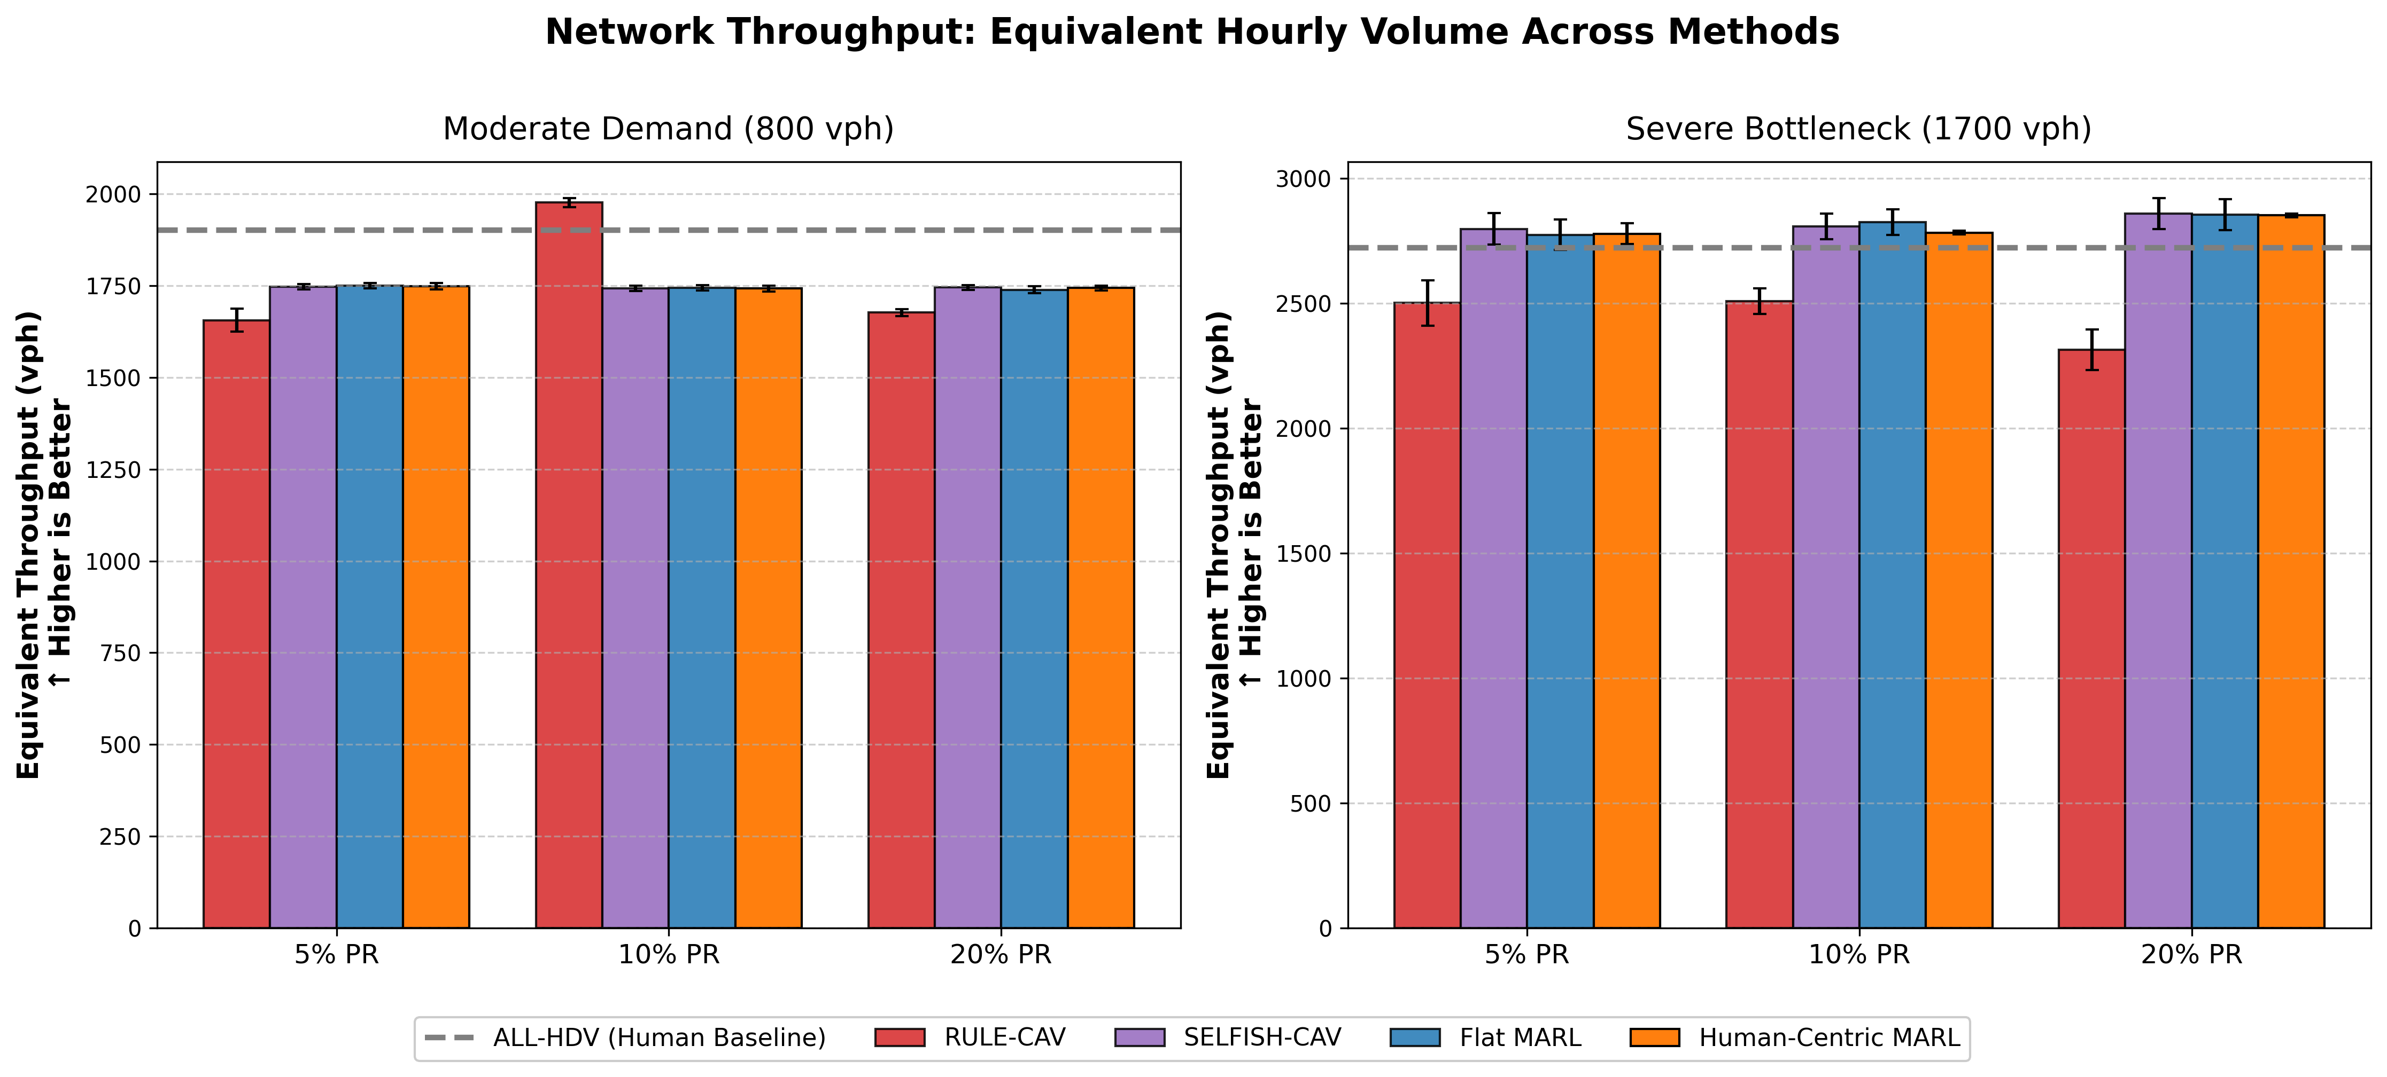
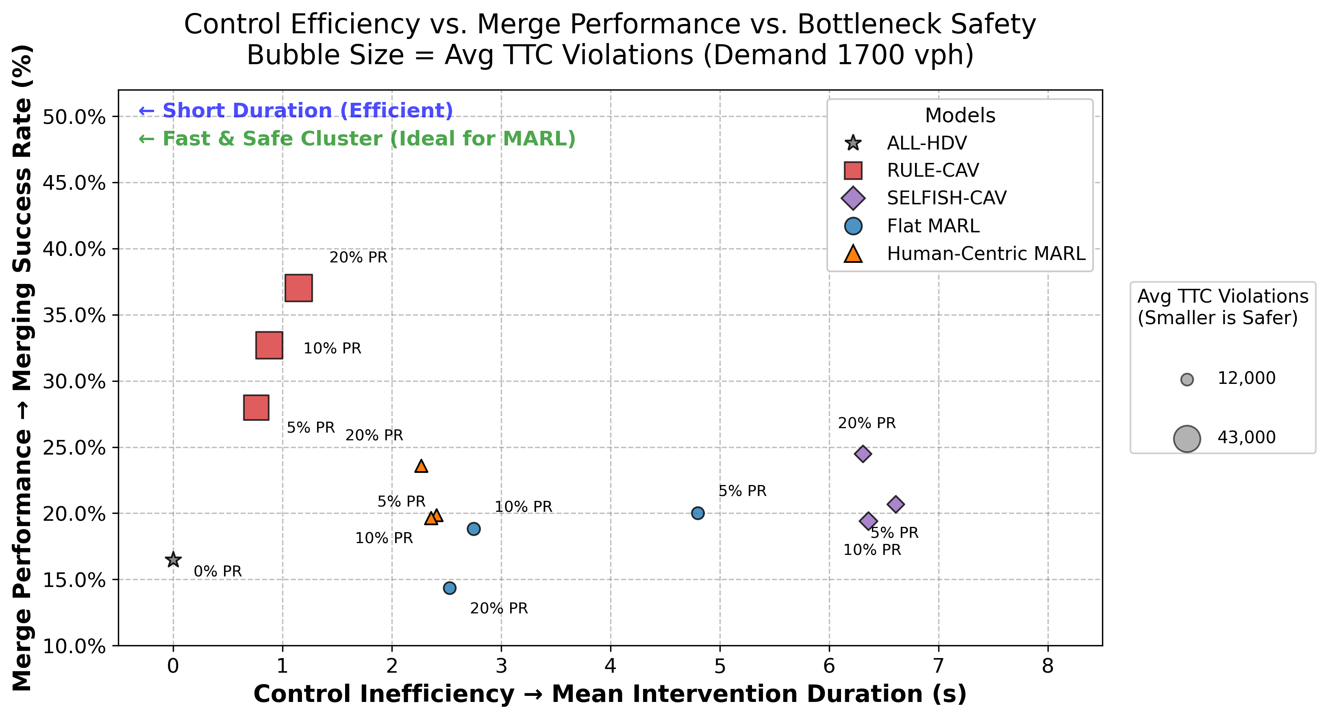
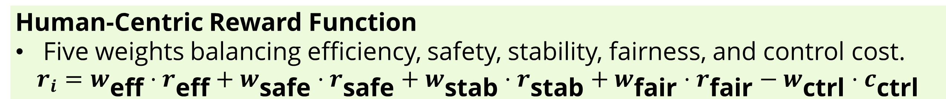
A Human-Centric MARL Framework for On-Ramp Merging in Mixed-Autonomous Traffic
Justin Weng (University of North Carolina-Chapel Hill), Supervisor: Dr. Dongkun Han
Introduction
The Idea
We formulate the problem as a sparse control problem.
Can a small fraction of cooperative CAVs help guide and improve human-dominated traffic flow?
CAVs act as “Traffic Shepherds”; they help shape local interactions to improve general traffic dynamics instead of dominating the system.
The Approach
We propose a human-centric multi-agent reinforcement learning (MARL) framework where CAVs learn high level interaction roles.
The goal is to shift importance from individual CAV efficiency to improving overall traffic flow.
The Reality
The near-future is mixed-autonomy traffic, where Connected and Automated Vehicles (CAVs) make up only 5% to 20% [CAV penetration rate] of vehicles.
The Issue
Most traditional research assume either full observability and/or a high CAV penetration rate.
When CAV PR becomes low, these models fail, triggering hard brakes or causing stop and go traffic.
Methodology
Environment.
2-lane main highway with an on-ramp and merging lane simulated via SUMO and TraCI.
Mixture of HDVs: cautious (green), normal (white), and aggressive (blue), and CAVs (red)
Human-Centric Reward Function
Five weights balancing efficiency, safety, stability, fairness, and control cost.
$$r_{i}=w_{\text{eff}}⋅r_{\text{eff}}+w_{\text{safe}}⋅r_{\text{safe}}+w_{\text{stab}}⋅r_{\text{stab}}+w_{\text{fair}}⋅r_{\text{fair}}−w_{\text{ctrl}}⋅c_{\text{ctrl}}$$
Evaluation
Tested in different traffic densities (800 and 1700 veh/hr/lane) with varying CAV penetration rates (5%, 10%, 20%).
Data is recorded and compared against other policies (All-HDV, Rule-CAV, Selfish-CAV, Flat-MARL).
Training
Centralized Training with Decentralized Execution (CTDE) framework utilizing Multi-Agent Proximal Policy Optimization (MAPPO).
Multi-density curriculum pipeline across traffic densities of 800, 1200, and 1700 veh/hr/lane, and CAV penetration rates of 5%, 10%, and 20%.
Results
Flow chart representing the human-centric MARL framework.
RULE-CAV recorded a noticeably higher average jerk values, signifying severe ride discomfort.
Human-Centric MARL achieved an 84.0% better passenger comfort score compared to RULE-CAV and is comparable to the other baselines.
Human-Centric MARL also achieved very similar throughput compared to baselines.
Human-Centric MARL recorded 69.9% less Time-to-Collision (TTC) violations compared to RULE-CAV in 1700 vph demand conditions.
At both 800 vph and 1700 vph, Human-Centric MARL averaged an intervention duration of around 2.3 seconds, lower than both Flat-MARL and SELFISH-CAV.
Compared against the ALL-HDV baseline, the Human-Centric MARL achieved higher overall merging success rate.
Conclusion
Overall, the Human-Centric MARL maintains strong traffic efficiency, collision safety, and comfort metrics in both low and high demand conditions.
It delivers these results using significantly shorter intervention windows that respect human driving dynamics, making it more viable for real-world usage.
More training and testing is still on-going as more data is collected and analyzed.
References
[1] Y. Ibork, M. Won, and L. Das, "Z-Merge: Multi-Agent Reinforcement Learning for On-Ramp Merging with Zone-Specific V2X Traffic Information," arXiv:2511.14910, 2025. doi: 10.48550/arXiv.2511.14910.
[2] J. Pan, T. Wang, C. Claudel, and J. Shi, "Trust-MARL: Trust-Based Multi-Agent Reinforcement Learning Framework for Cooperative On-Ramp Merging in Heterogeneous Traffic Flow," arXiv:2506.12600, 2025. doi: 10.48550/arXiv.2506.12600.
[3] T. Chu, J. Wang, L. Codecà, and Z. Li, "Multi-Agent Deep Reinforcement Learning for Large-scale Traffic Signal Control," IEEE Transactions on Intelligent Transportation Systems, vol. 21, no. 3, pp. 1086–1095, 2020. doi: 10.1109/TITS.2019.2901791.
[4] D. Chen, M. R. Hajidavalloo, Z. Li, K. Chen, Y. Wang, L. Jiang, and Y. Wang, "Deep multi-agent reinforcement learning for highway on-ramp merging in mixed traffic," IEEE Transactions on Intelligent Transportation Systems, 2023.
Acknowledgments: Sincere gratitude to Dr. Dongkun Han (supervisor, CUHK), Dr. Xiangrui Kong (UWA), Ning Liu (PhD Student, UWA), and Sen Shen (PhD Student, CUHK) for their guidance and support during my research.

