Slide 1
Presentation material
1st version: Cweng, August 2022

Slide 2



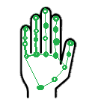



Procedure of hand sign processing
OpenCV
MediaPipe
Fully-connected
neural network
Hand ID
Command executor (e.g., PyAutogui)

Slide 3
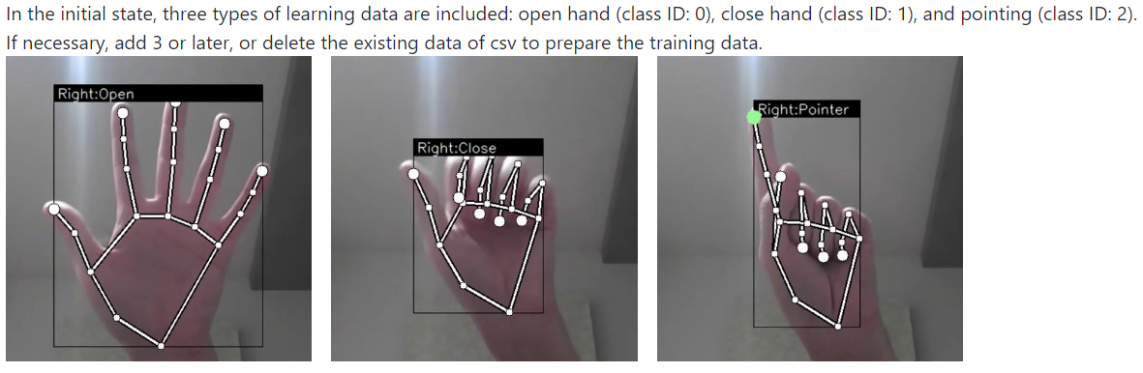



Added classifications (trained with the same neural network as in the original Kazuhito00 model).
Hand sign recognition model
The Python code by Kazuhito00 is used to train models that recognize hand signs captured by the camera.
ID 0
ID 1
ID 2
ID 3
ID 4
ID 5
Currently the data are cleaned manually; see screen_control__manual_check_data.py
N.B., left and right hands with the same sign share the same hand sign ID.
The hand drawings, with modifications by the current author, are originally from http://www.freepik.com, designed by rawpixel.com

Slide 4
Train new hand signs
Run external/Kazuhito00/keypoint_classification_screen_control.py
Press "k" to enter the mode to save key points. Then, let the camera see your hand sign, and press "0" to "9” (i.e., the corresponding hand id) to append the key points to "model/keypoint_classifier/keypoint.csv“
Run external/Kazuhito00/keypoint_classification_screen_control.py to train the model. The final model is first saved to .hdf5, but later converted to .tflite to make the inference process faster by using TFLite.

Slide 5
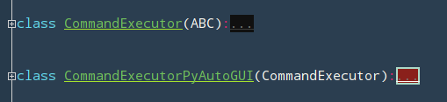
Add new command function
This can be done within command_executor.py:
If the user wants to control the computer/app with an API other than PyAutoGUI, then he may create a new subclass inherited from CommandExecutor and implement the abstract classes.
If the user simply wants to add a new command function that corresponds to a given hand sign, then
Create and edit a new command function (e.g., pyautogui_new_func), and add the function name to map_command_id_to_method, with a command ID assigned to the function (e.g., 888).
In get_command_id_from_hand_signs, specify which hand sign ID(s) would trigger the command with the assigned command ID
def map_command_id_to_method(self): return { ... 9: self.pyautogui_ctrl_scroll_two_hands, 888: self.pyautogui_new_func,
... }
def get_command_id_from_hand_signs(self, left_hand_sign_id=None, right_hand_sign_id=None) -> Union[int, None]: # See presentation_materials.pptx for details if self._is_single_hand_command(left_hand_sign_id, right_hand_sign_id): # pragma: no cover ... if left_hand_sign_id == 1 or right_hand_sign_id == 3: return 888 ... else: # pragma: no cover ... return None

Slide 6


Supported multiscreen display settings
2nd display
2nd display
Main display
2nd display
2nd display
2nd display
2nd display
Main display
2nd display

Slide 7
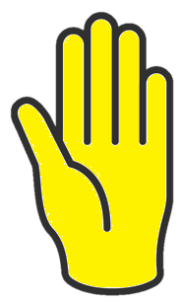
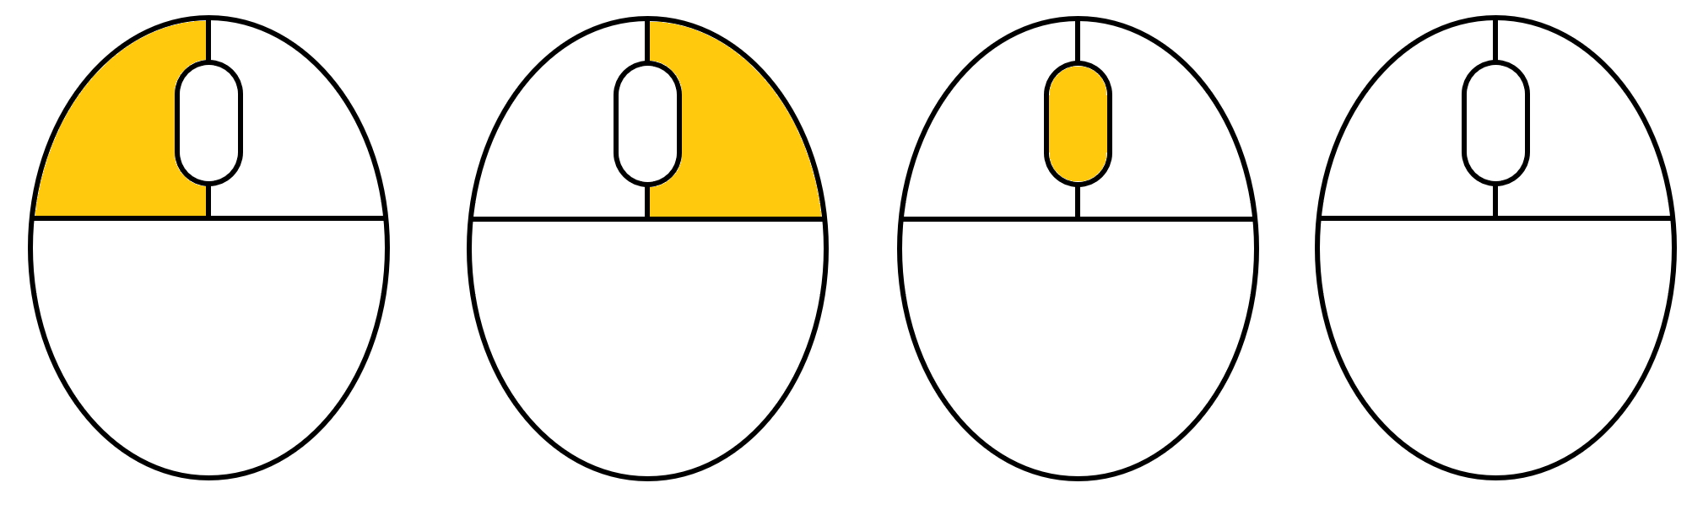


Hand-action map (ver 1)
Wake up
Click
Click
Double click
Ctrl
Ctrl
L
+
Ctrl
-
The hand drawings, with modifications by the current author, are originally from http://www.freepik.com, designed by rawpixel.com

Slide 8
Hand-action map (ver 2, as of 2022-09-07)
Activate
gesture control
Deactivate
gesture control
Click
Ctrl
Ctrl
Ctrl
L
Ctrl
The hand drawings, with modifications by the current author, are originally from http://www.freepik.com, designed by rawpixel.com

Slide 9
From hand ID(s) to command ID
Command id | Command detail | Left OR right hand ID | Left AND right hand ID
0 | Move mouse | ID 2
1 | Click left button once if the new command is different than the previous | ID 4
2 | Double click if the new command is different than the previous |  | ID 2 AND ID 2
3 | Scroll | ID 3
4 | Ctrl + drag (“pan” in TeamCenter) |  | ID 1 AND ID 1
5 | Activate the hand recognition system | ID 0 | ID 0 AND ID 0
6 | Drag | ID 1
7 | Ctrl + Scroll (Zoom in/out in most editors) |  | ID 1 AND ID 3
8 | Ctrl + L (MS PPT laser shortcut) |  | ID 1 AND ID 4
9 | Ctrl + Scroll (Zoom in/out in most editors) |  | ID 4 AND ID 4
10 | Click right button once if the new command is different than the previous | ID 5
11 | Deactivate the hand recognition system |  | ID 5 AND ID 5
Hand IDs:
ID 0
ID 1
ID 2
ID 4
ID 3
ID 5

