Slide 1
Lecture 4
Structure – Array, Records and Alignment
Memory- How to allocate memory to speed up operation

Slide 2
Structure
Strings and Arrays
Records (structures)
Alignment

Slide 3
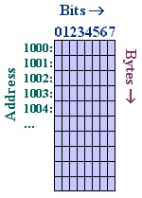
Memory Representation
In this diagram, bit 0 is most significant, not least
An integer 0x40 0x30 0x20 0x10 occupies the address of 1000. The data
1000: 10 1001: 20 1002: 30 1004: 40
The value of 10 is
0(bit 0) 001 (bit 3) 0000

Slide 4
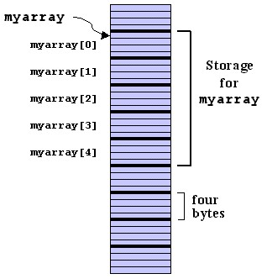
Array – memory location by Compiler
Int myarray[5] (means from 0 to 4)
Since it is int, it occupies 4 bytes
If the address is 1000, myarray[0] starts from 1000, myarray[1] from 1004 (note a multiple of 4, not 1)
Address 1000 + 4*n (where n is myarray[n])

Slide 5
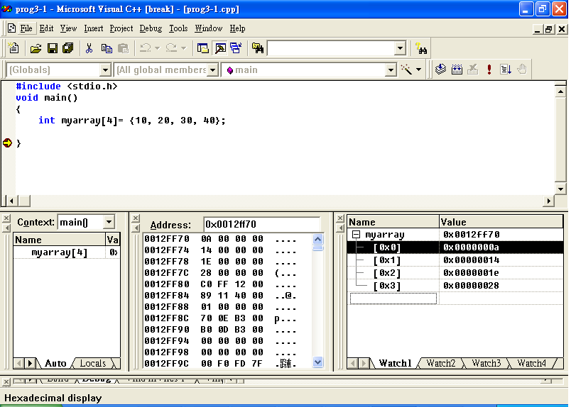
Example
0x0012ff78
.......
0x0012ff7c

Slide 6
Array and Pointer
The address of myarray[0] is &(myarray[0]) or in visual C++, &myarray (no need to specify [0])
The address of myarray[1] is myarray + 1 (not 4, as it is defined as int), or myarray + N for &myarray[N]

Slide 7
Value and relationship – an example
int myarray[4] ={101, 102, 103, 104};
&myarray[0] contains 101 or
&myarray[1] contains 102
myarray contains 101
The value of myarray[0] is 101
  *(int *)(myarray + 0) contains 101
  *(int *)(myarray + 1) contains 102
  *(int *)(myarray + 2) contains 103

Slide 8
String
Is an array of character and is terminated by a null character (0x00)
char a[4] = “Hi?”;
a[0] = H;
a[1] = I;
a[2] =?;
a[3] = 0x00
Incorrect declaration: char char[3] = “Hi?”, as 0x00 is missing

Slide 9
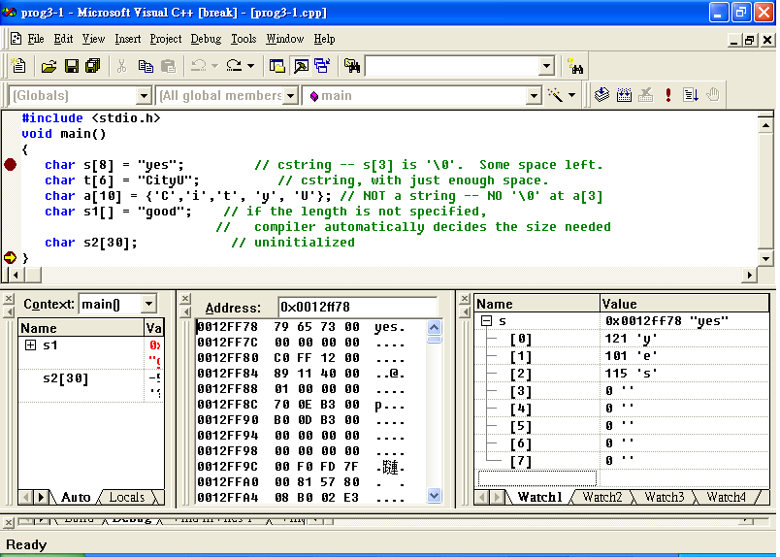
Example (1)

Slide 10
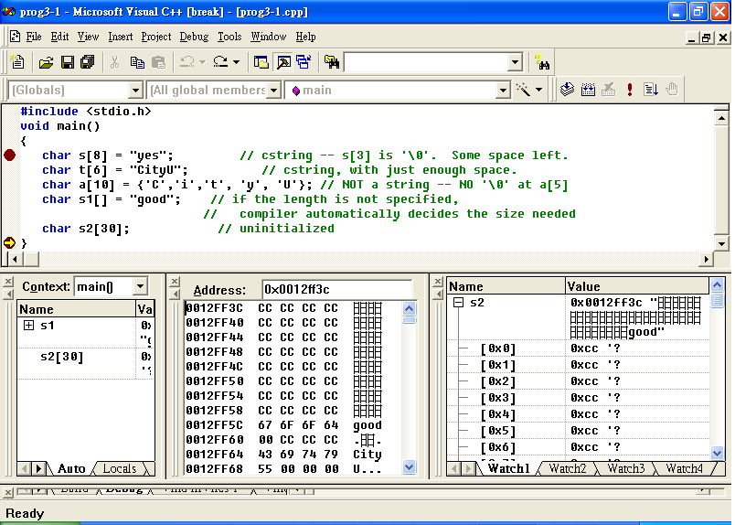
Example (2)
0xcc -> 1010 1010

Slide 11
Records (structures)
Records store a collection of arbitrary elements that are accessed by name
Records are declared using the struct keyword in C or C++
If you group the types (character, integer, double), you can maximize the utilisation
It is to group a few structures together.

Slide 12
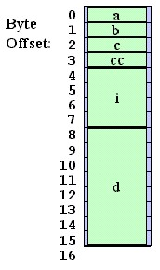
An example
struct {
char a, b, c, cc;
int i;
double d;
} mystruct;
Name is mystruct
You can see that it perfectly uses all space.

Slide 13
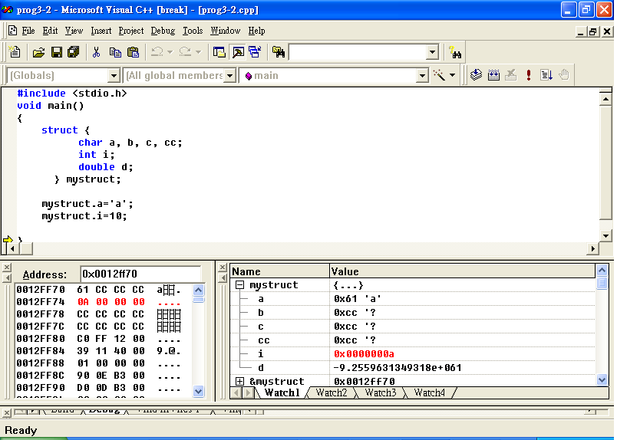
Example – A program

Slide 14
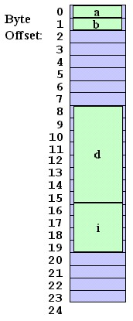
Alignment – rearrange the struct
char: 1 byte
int: 4 bytes
double: 8 bytes
struct {
char a, b;
double d;
int i;
} mystruct;
You can see a few bytes are missing between b and d, in memory it is represented in cccccccc

Slide 15
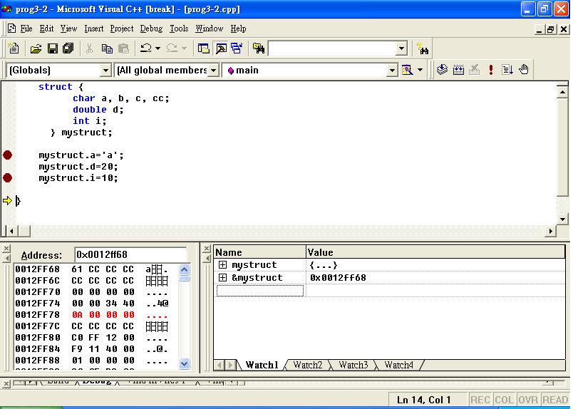
Example
as double occupy 8 bytes, the rest
(char and int) are 8 bytes as well
cccccccc is wasted

Slide 16
Memory Layout and
Allocation
Several Uses of Memory
Heap Allocation
Memory Bugs

Slide 17
Several uses of Memory
Static Allocation (assigned by compiler, such as char a[5] =‘1234’;) (fixed, you cannot modify during program execution)
Dynamic Allocation (requested by program, enter value from your keyboard)
Program Memory Layout (memory arrangement for a program)

Slide 18
Static Allocation
The word static (fix) refers to things that happen at compile time (compile) and link (link) time when the program is constructed.
For example, you can define
  char a[9] =“12345678”; //assign 9 bytes for array a
The compiler will assign 9 bytes during compilation
Linker will assign the correct address for array a
You cannot change it even you think you need 10 bytes while running this program
Of course, you can change it by modifying the program and re-compile it

Slide 19
Static Allocation vs. C++ static Declarations
There is static in C++, but not the same meaning
A “C or C++” variable declared as static is allocated statically. For example
static bool my_var_initialized = false;
static int i = 4; //will remain unchanged
We can define variables as global so that it can be accessed by others. Global and static variables have in common that the memory locations are permanent.
Local variables are allocated temporarily on a stack.

Slide 20
An example
int my_var[128]; // a statically allocated variable
static bool my_var_initialized = false; //static declaration
int my_fn(int x)
{
if (my_var_initialized) return;
my_var_initialized = true;
for (int i = 0; i < 128; i++)
my_var[i] = 0;
}
Initially, it is false

Slide 21
Explanation to previous example
int my_var[128]; // a statically allocated variable
int my_fn(int x)
{
// note that the initialization of my_var_initialized
// takes place only once, not every time my_fn() is called:
static bool my_var_initialized = false;
if (my_var_initialized) return;
my_var_initialized = true;
for (int i = 0; i < 128; i++)
my_var[i] = 0;
}

Slide 22
Dynamic allocation
Limitations of Static Allocation
  If two procedures use a local variable named i, there will be a conflict if both i's are globally visible.
  If i is only declared once, then i will be shared by the two procedures. One might call the other, even indirectly, and cause i to be overwritten unexpectedly.
  It would be better if each procedure could have its own copy of i.

Slide 23
Limitations of static allocation
programs do not always know how much storage is required until run time, so static allocation is inaccurate. For example, you allocated 5 bytes, but later you find that you need 6 bytes.
static allocation reserves memory for the duration of the program, but often a data structure is only needed temporarily

Slide 24
Stack Allocation
It is the most common form of dynamic allocation.
It is a standard feature of modern programming languages, including C and C++, as stacks support recursion and dynamic allocation.
When a function is called, memory is allocated on the stack to hold parameter values, local variables, and the address of the calling function

Slide 25
Grab memory
To grab memory, we have to use malloc(size). For example
  ptr = malloc(4) will return a pointer with memory size of 4 bytes
  ptr = malloc(4*int) will return a pointer with 16 bytes = 4 x 4 (integer) = 16 bytes
  malloc(4*long) will return a pointer with 16 bytes = 4 x 4 (long) = 16 bytes
free(ptr), free this pointer to the memory

Slide 26
Program Interfaces - two
void *malloc(size_t size);
Allocates a block of memory of size
  Size_t : type
  Size: the actual size
Example ptr = (int *)malloc(512); //allocate 512*4
  ptr= (char *)malloc(512);// allocate 512 bytes
  ptr = (short *)malloc(512*sizeof(short)); //allocate 512*2
void free(void *ptr);
//return the pointer
Example: free(ptr);

Slide 27
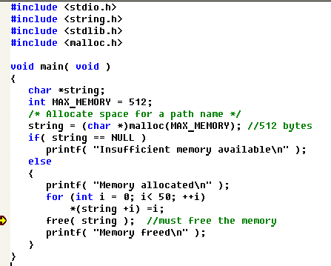
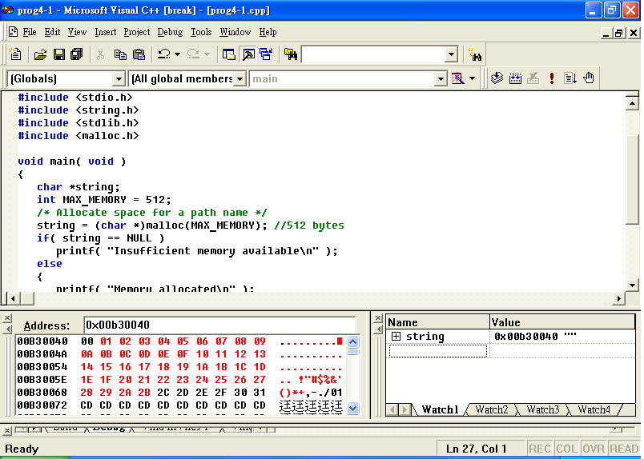
Example
free memory

Slide 28
Activation Record - Example – foo()->bar()->baz(), determine the return address
int foo()
{
int b;
b = bar();
return b;
}
int bar()
{
int b = 0;
b = baz(b);
return b;
}
int baz(int b)
{
if (b < 1) return baz(b + 1);
else return b;
}

Slide 29
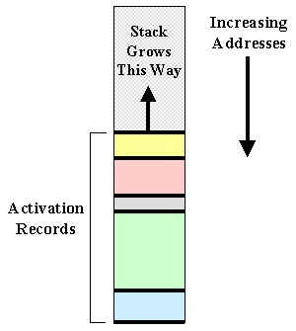
Activation record
When a function / subroutine is called, it will create an activation record.
This record contains the location of local variable, return address etc.

Slide 30
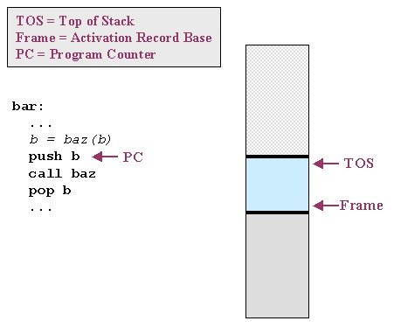
An example – bar()

Slide 31
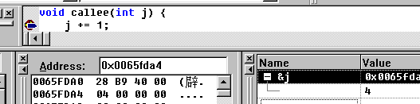
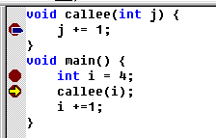
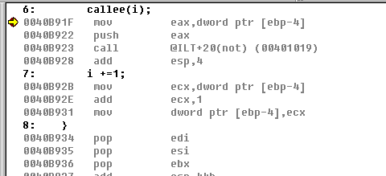
Example of a simple program
variable and return
address are in activation record
return address
variable j

Slide 32
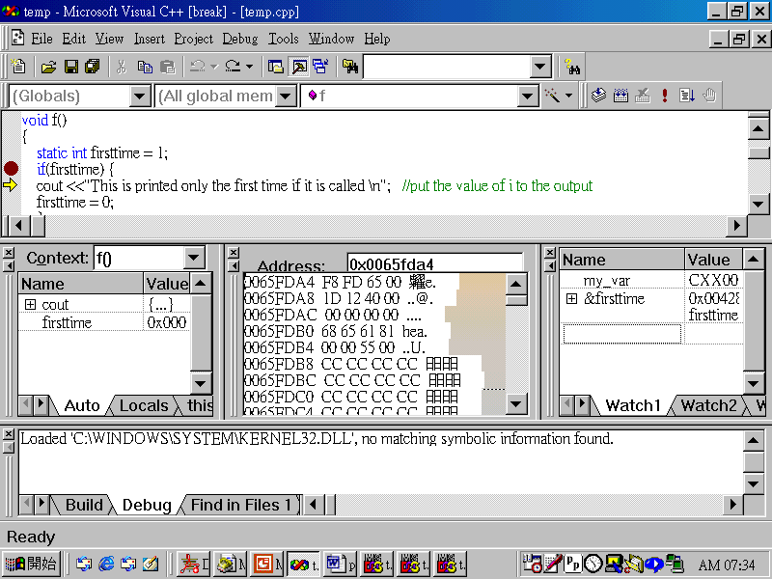
An example – return address

Slide 33
Returning From a Function Call
Function returns are almost identical to function calls, except that everything runs in reverse.
Before a function returns, it loads a particular register with the computed return value.

Slide 34
Difficulties of memory allocation
malloc() will have to allocate the memory that has been used before.
There must be a method to determine which memory blocks can be used. They are:
  First free(or first fit) (the first block in the list that meets the requirement )
  Best fit (the block that perfectly meets the requirements
  Worst fit( the largest one in the list)

Slide 35
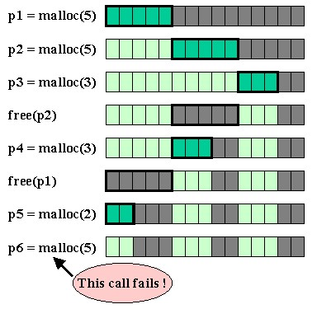
Fragmentation –means holes
Although it has memory

Slide 36

Example of First fit
I need 20K bytes
15K
25K
20K
45K
free blocks

Slide 37
Example of Best fit
I need 20K bytes
15K
25K
20K
45K
free blocks

Slide 38
Example of Worst fit
I need 20K bytes
15K
25K
20K
45K
free blocks

Slide 39
External Fragmentation
Fragmentation is undesirable because it means that memory is used inefficiently.
A program tries to call operating system to get memory but it does not return even there are blocks of memory. It is because:
  The blocks of memory are are too small.
It causes external fragmentation. For example, I need 12K. There are two 10Ks, but none of them fits me.
10K
free
10K
free
10K
10K
10K
occupied

Slide 40
Simple Algorithms
Block Sizes
  Finding Free Blocks
  Splitting a Free Block
  Finding a Suitable Block
  Coalescing Free Blocks (combine)
  Searching for Free Blocks
No need to memorise, very difficult to understand

Slide 41
Simple Algorithms (1)
How do you find free blocks from which to allocate?
How do you select a free block to allocate? Pick the first one or best one?
If you need fewer bytes than you find in a free block, should you split the block or use the whole?

Slide 42
Simple Algorithms (2)
Only a pointer is passed to free(). How do you know how many bytes are in the block?
When a block is freed, should you join it to neighboring free blocks (if any) to make a larger one? If so, how do you find neighboring blocks?

Slide 43
Summary (1)
Structure: group a few declarations together
Record: group structures
Static allocation (char[8]) and dynamic memory (malloc())
Static declaration, like global variable (static int i)
Stack memory – a temporary memory for subroutine

Slide 44
Summary (2)
Heap: is a large block of data, char a[513]
Malloc(sie_t size) to return a pointer pointing to the memory block
Free(ptr), remember to free memory
Fragmentation: memory is available but is not continuous for use

