Slide 1

2023 Spring 作業系統導論
Lab 2. Mutex & Semaphore
教授: 李皇辰
助教: 夏子聰

Slide 2

在FreeRTOS中關於Mutexes / Semaphores 已經有寫好的API可以直接使用(semphr.h)，
相關的 API (Application Programming Interface) 如下:
SemaphoreHandle_t xSemaphoreCreateMutex( void );
SemaphoreHandle_t xSemaphoreCreateCounting( UBaseType_t uxMaxCount, UBaseType_t uxInitialCount );
void _t xSemaphore, TickType_t xTicksToWait );
void xSemaphorexSemaphoreTake( SemaphoreHandleGive( SemaphoreHandle_t xSemaphore );
詳細請參考: https://www.freertos.org/a00113.html

Slide 3
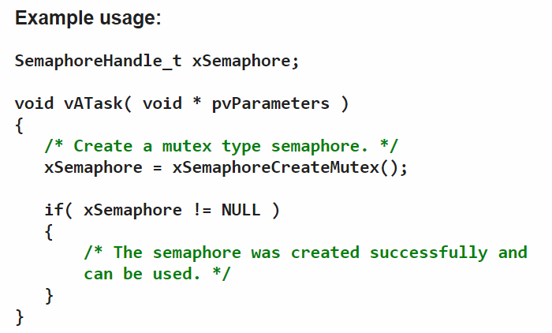
Mutex
Mutex is a way to implement simple mutual exclusion. In FreeRTOS, there provide an API: xSemaphoreCreateMutex() to creates a mutex, and returns a handle by which the created mutex can be referenced.

Slide 4
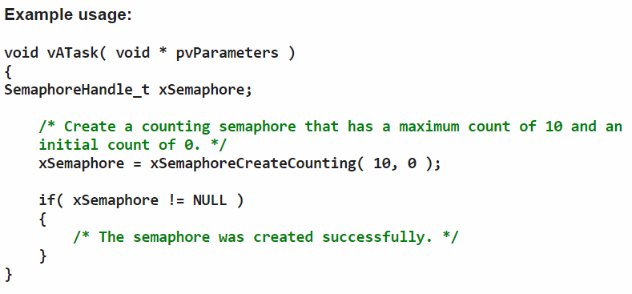
Semaphore
Semaphore is a way to implement synchronization (between tasks or between tasks and an interrupt) and it is typically used for two things: 1. Counting events, 2. Resource management. In FreeRTOS, there provide an API: xSemaphoreCreateCounting(uxMaxCount, uxInitialCount) to creates a Semaphore, and returns a handle by which the created semaphore can be referenced.
uxMaxCount : The maximum count value that can be reached.
uxInitialCount: The count value assigned to the semaphore when it is created.

Slide 5
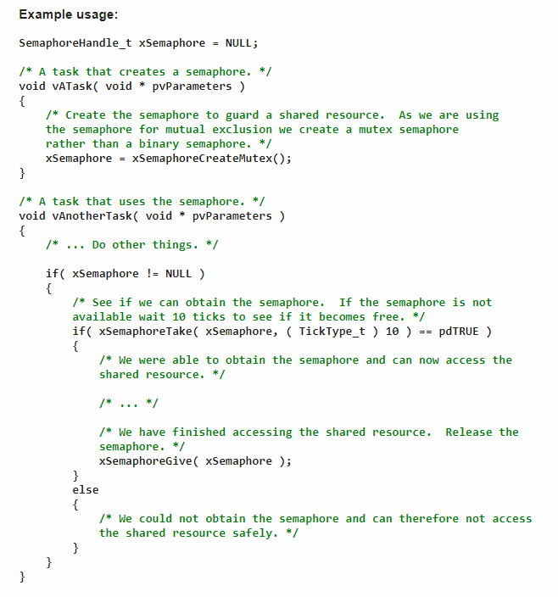
xSemaphoreTake( SemaphoreHandle_t xSemaphore, TickType_t xTicksToWait );
Taking a semaphore / mutex
This operation is equivalent to a P() or wait() operation.
xSemaphore : is the semaphore to take
xTicksToWait : Is the time for the task to wait before it gives up with taking the semaphore. If xTicksToWait equals MAX_DELAY then the task won't stop waiting.
Giving a semaphore / mutex
This operation is equivalent to a V() or signal() operation.
xSemaphoreGive( xSemaphoreHandle xSemaphore );

Slide 6







Lab2. assignment
有一間廁所(toilet)，有兩間隔間(compartment)可以使用，
A, B, C, D四位同學每過一段時間就會想上廁所，
一位清潔工(Cleaner)定期將廁所關閉，進行全面清掃(closed for cleaning)
toilet
students
1
2
cleaner

Slide 7
Requirement
建立6個task分別表示Student A, B, C, D, Cleaner和一個負責顯示時間的task，參考上課投影片p6.6 Readers – Writers Problem，建立一個function來處理清掃廁所(參考writer)，另一個function處理學生使用廁所 (參考reader)
一共有兩間廁所隔間可以讓學生輪流使用
清潔工要等到都沒有學生想上廁所才能開始清掃
清掃廁所時，所有學生都不能使用
在計算廁所有多少學生使用(count++ / count--)時，用 mutex 保護 (參考ppt 6.6 - reader)
每次占用廁所的時間
每隔多久想上一次廁所
每次占用廁所的時間
每隔多久清理一次廁所
 | duration time | period
Student A | 100 ms | 400 ms
Student B | 200 ms | 500 ms
Student C | 400 ms | 300 ms
Student D | 500 ms | 600 ms
 | duration time | period
Cleaner | 300 ms | 1000 ms

Slide 8
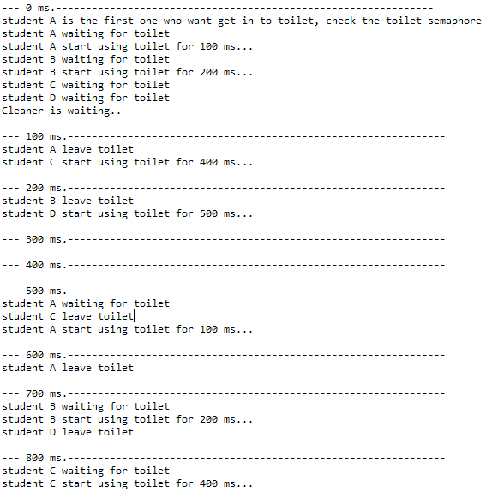
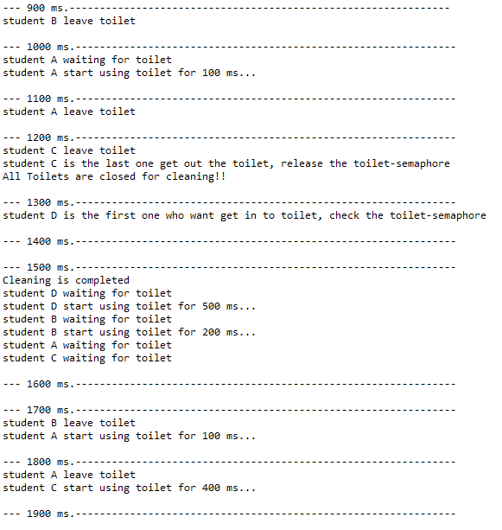
Sample result

Slide 9
Question
1. 在第 6600ms 時，誰在使用廁所?
2. 當 Student D 的 period改為 200ms 時, 會發生什麼問題, 為什麼?

Slide 10
Demo
Place: 創新大樓515找助教 夏子聰
Demo Time:(二)、(四) 15:00~17:00
Report deadline: 5/5(五)
Report format:
請將報告存成LABx_StudentID_Name.pdf，並把main.c、及其他有修改到的程式檔都壓成LABx_StudentID_Name.rar(zip亦可)，格式有誤會斟酌扣分，請注意。
Demo必須在Report deadline前完成
Demo前須先上傳程式碼(上傳main所在的.c檔即可)

Slide 11

Graded
Basic : 70%
Report & Code : 30%

