Slide 1
Lab3: Timer
2023.11.16

Slide 2
Timer:
TimerHandle_t xTimerCreate
( const char * const pcTimerName, const TickType_t xTimerPeriod,
const UBaseType_t uxAutoReload, void * const pvTimerID,
TimerCallbackFunction_t pxCallbackFunction );
BaseType_t xTimerStart
( TimerHandle_t xTimer, TickType_t xBlockTime );
vTaskStartScheduler();

Slide 3
Timer:
xTimerStop
( TimerHandle_t xTimer, TickType_t xBlockTime );
xTimerChangePeriod
( TimerHandle_t xTimer, TickType_t xNewPeriod, TickType_t xBlockTime );
xTimerDelete
( TimerHandle_t xTimer, TickType_t xBlockTime );
xTimerReset
( TimerHandle_t xTimer, TickType_t xBlockTime );

Slide 4
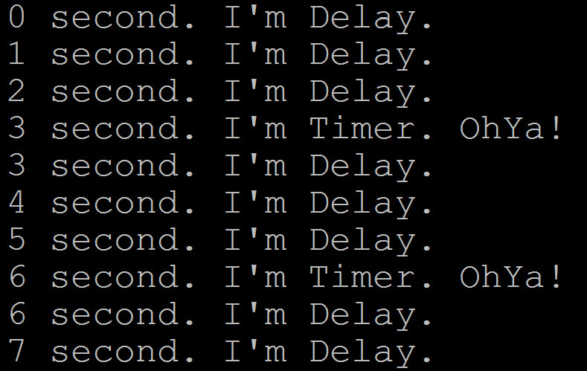
Homework
Basic
Task 1: count per second (use vTaskDelay)
Task 2: Create a periodic timer
per 3 second return

Slide 5
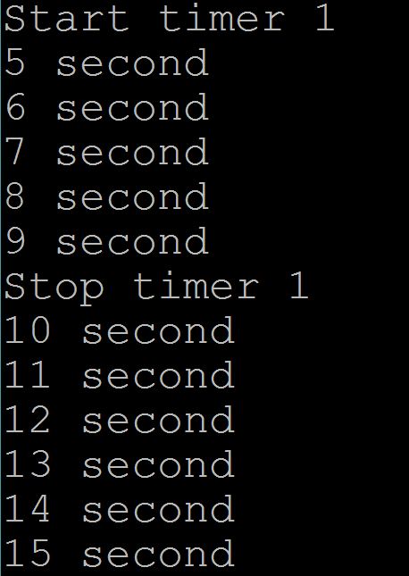
Bonus
Create periodic timers which can be started by button (When you press the keypad, timer starts. Otherwise, timer stops.)
Keypad 1: press and stop after 5 seconds
Keypad 2: press and stop after 10
seconds

Slide 6
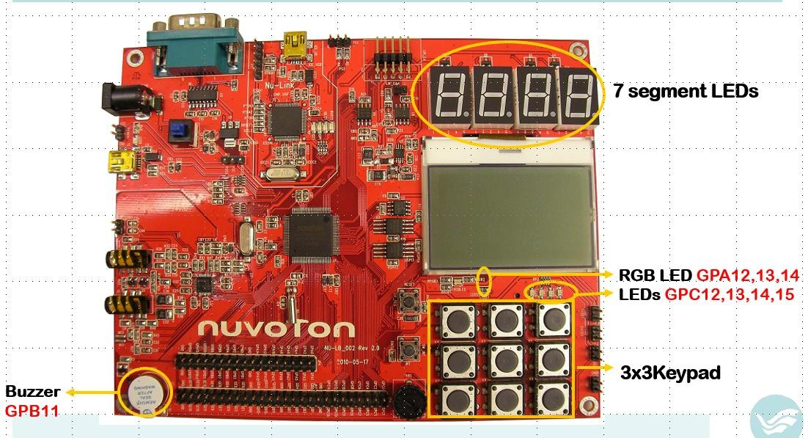
Scankey:
#include “Scankey.h”
OpenKeyPad()
ScanKey()
1
2
詳情請參考 Scankey.zip

Slide 7
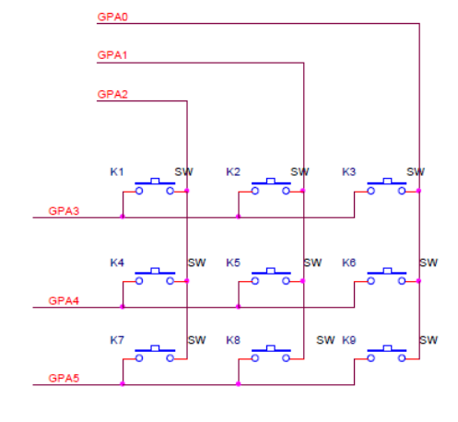
Use K1 to be input:
For example: pull low
Set GPA3 as OUTPUT and set its value as 1
Set GPA2 as INPUT. Set up
a resistor on the GPA2 and pulling it to ground (or its value will be unstable)

Slide 8
Demo Time
Place : 創新大樓515 助教 林聖培 (門口有貼座位)
Time :
Tuesday 16:00~ 17:30
Thursday 14:30~ 15:30
Report deadline : 12/1(五) PM 11:59
Demo 必須在 Report deadline 前完成
Demo 前需先上傳程式碼
程式碼上傳格式: LABX_ID_NAME.zip
→ main.c + LABX_ID_NAME.docx

Slide 9
Graded
Basic functions 70%
Bonus 15%
Report & Code 15%

