Slide 1
Lab4: Semaphore/Mutexes
2023.11.30

Slide 2
Semaphore/Mutexes:
SemaphoreHandle_t xSemaphoreCreateBinary( void );
SemaphoreHandle_t xSemaphoreCreateCounting
( UBaseType_t uxMaxCount, UBaseType_t uxInitialCount);
SemaphoreHandle_t xSemaphoreCreateMutex( void )
void vSemaphoreDelete
( SemaphoreHandle_t xSemaphore );

Slide 3
xSemaphoreTake
( SemaphoreHandle_t xSemaphore, TickType_t xTicksToWait );
xTicksToWait:
Specifying the block time as portMAX_DELAY will cause the task to block indefinitely (without a timeout).
Returns:
pdTRUE if the semaphore was obtained.
pdFALSE if xTicksToWait expired without the semaphore becoming available.

Slide 4
xSemaphoreGive
( SemaphoreHandle_t xSemaphore );
Returns:
pdTRUE if the semaphore was released.
pdFALSE if an error occurred. Semaphores are implemented using queues. An error can occur if there is no space on the queue to post a message - indicating that the semaphore was not first obtained correctly.

Slide 5
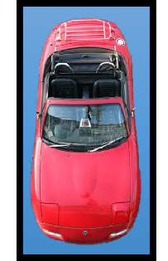

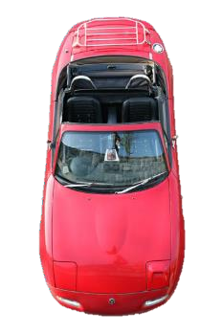

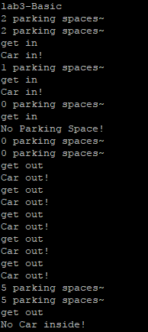
Homework
Basic (semaphore)
Create a semaphore(parking lot)
5 parking spaces
3 cars in the parking lot
Print out how many parking spaces per 5 seconds
2 keypads for car to “get in” and “get out”
If you press the “get in” button but there is no parking
space, print “No Parking Space!”
If you press the “get out” button but there is no car inside, print “No Car inside!”
Turn on the LED if there is no parking space.

Slide 6


Bonus (mutex)
Create a mutex (toilet)
4 people are using one toilet
A: go to toilet per 1 second and use it 1 second (priority: 4)
B: go to toilet per 3 seconds and use it 1 second (priority: 3)
C: go to toilet per 6 seconds and use it 3 seconds (priority: 2)
D: go to toilet per 10 seconds and use it 4 seconds (priority: 1)
In the 103rd second, who is in the toilet? (Write in the report and take a picture for it, NOT NEED TO DEMO)

Slide 7
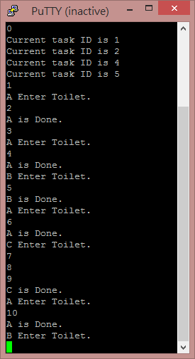
The 0 second
After 1 second, A gets into the toilet
After another 1 second, A leaves the toilet.
The 3rd second, B is waiting in line. But A has higher priority, A gets into the toilet again.
The 4th second, A leaves the toilet and B gets in.
The 5th second, B leaves the toilet and A gets in.
The 6th second, A leaves the toilet and C gets in.
C needs 3 seconds to finish his poop. The 9th second, C leaves the toilet and A
gets in.

Slide 8
Demo Time
Place : 創新大樓515 助教 林聖培 (門口有貼座位)
Time :
Tuesday 16:00~ 17:30
Thursday 14:30~ 15:30
Report deadline : 12/15(五) PM 11:59
Demo 必須在 Report deadline 前完成
Demo 前需先上傳程式碼
程式碼上傳格式: LABX_ID_NAME.zip
→ main.c + LABX_ID_NAME.docx

Slide 9
Graded
Basic functions 70%
Bonus 15%
Report & Code 15%

