Slide 1
Lab2: Queues
2022.10.27

Slide 2
Queue:
#include “queue.h”
QueueHandle_t xQueueCreate
( UBaseType_t uxQueueLength, UBaseType_t uxItemSize );
//maximum number of items
//each item size, in bytes
BaseType_t xQueueSend
( QueueHandle_t xQueue, const void * pvItemToQueue, TickType_t xTicksToWait);
//queue handle
//a pointer to the item
//waiting time

Slide 3
BaseType_t xQueueReceive ( QueueHandle_t xQueue, void *pvBuffer,
TickType_t xTicksToWait);
BaseType_t xQueueReset
( QueueHandle_t xQueue );

Slide 4
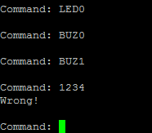





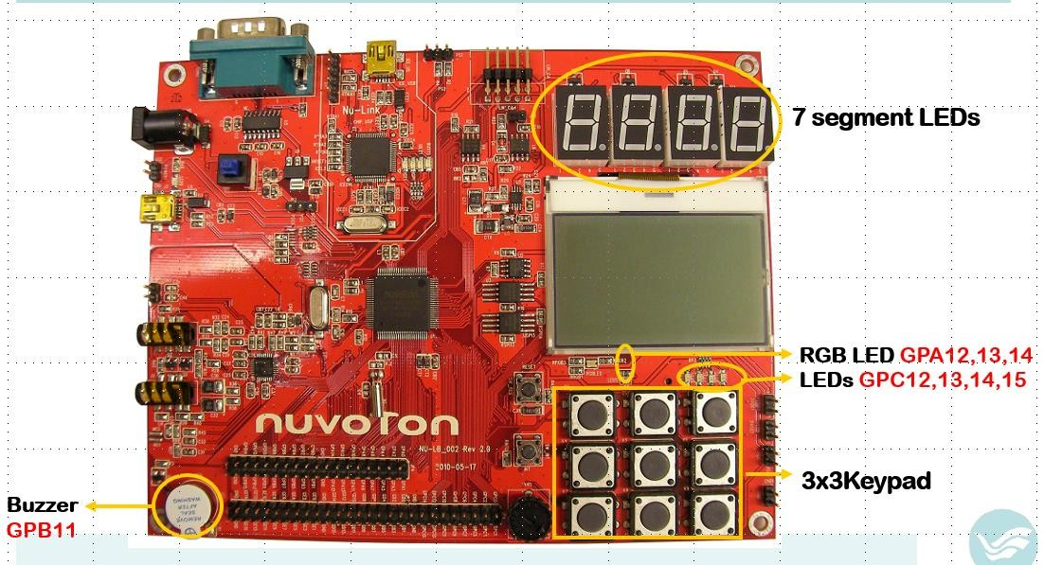
Homework
Turn on LEDs
Turn on buzzer
Type Command 4
1
Turn off buzzer Wrong
command
Send Command
Basic
Task A
Task B
3
2
2 tasks :
Execute Command
Task A : After reading the command typed
by keyboard, send the command to Task B
Task B : After receiving the command from Task A, execute the command
Command :
LED0/LED1: LEDs on/off
BUZ0/BUZ1: buzzer on/off
BLU0/BLU1/GRE0/GRE1/RED0/RED1 : change the color of RGB LED

Slide 5
Bonus
2 tasks :
Task A : After reading the command typed by keyboard, send the command to Task B
Task B : After receiving the command from Task A, execute the command. Ask mode and send it to Task A
Command :
LED0 : turn on all LEDs(except the RGB LED)
BLU0/GRE0/RED0/RGB1 : change the color of the RGB LED/turn off the RGB LED
Task A : After receiving the mode, execute it and return to the beginning
Normal LED mode (0/1) : 4 LEDs blink (left to right / right to left)
RGB LED mode (y/n) : change the color into white or not

Slide 6
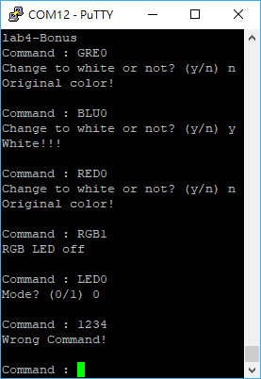





Enter Command and turn LED to green
If mode = n, green color
Enter Command and turn LED to blue
₆ Type Command
1
Send Command
If mode = y, white color
Enter Command and turn LED to red
5
Task
A
2
Task
B
3
Enter Command and turn off the RGB LED
4
Send Mode
Execute Mode
Execute Command
Enter Command and turn on 4 LEDs
If mode = 0, LEDs blink from left to right
Wrong Command

Slide 7
Demo Time
Place :
Time :
Tuesday
創新大樓515 助教 吳柏叡 (門口有貼座位)
15:00~ 17:00
Thursday 15:00~ 17:00
Report deadline :11/18(五) PM 11:59
Demo 必須在 Report deadline 前完成
Demo 前需先上傳程式碼
程式碼上傳格式: LABX_ID_NAME.zip
→ main.c + LABX_ID_NAME.docx

Slide 8
Graded
Basic functions 70%
Bonus 15%
Report & Code 15%

