Slide 1
General Purpose I/O
3/27/2014
Richard Kuo
Assistant Professor

Slide 2
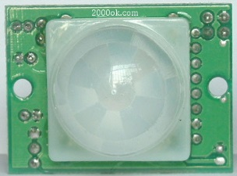
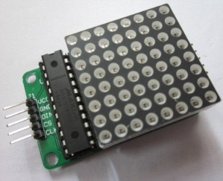
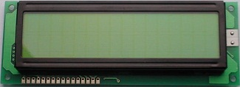
Outline
MCU Programming (General Purpose I/O Programming)
3.NuMicro_GPIO.ppt
Exercise : GPIO to control on-board LEDs (Smpl_GPIO_LED1, Smpl_GPIO_RGBled)
Exercise : GPIO control Buzzer (Smpl_GPIO_Buzzer)
Exercise : GPIO control 7-segment display (Smpl_7seg)
Exercise : GPIO interrupt (Smpl_GPIO_Interrupt)
Exercise : GPIO to scan 3x3 keypad (Smpl_7seg_Keypad)
Exercise : GPIO read Sensor (Smpl_GPIO_BodyInfrared)
Exercise : GPIO interfacing with LCM (Smpl_GPIO_LCM16x2)
Exercise : GPIO to control LED matrix (Smpl_GPIO_LED8x8)
Project : Electronic Safe

Slide 3
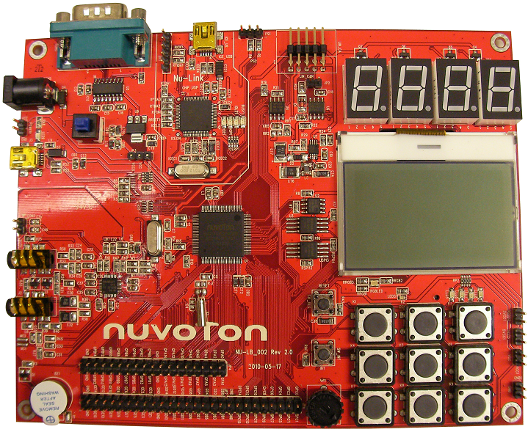
Nu-LB-NUC140 Learning Board
7 segment LEDs
RGB LED GPA12,13,14
LEDs GPC12,13,14,15
3x3Keypad
Buzzer
GPB11

Slide 4
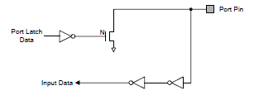
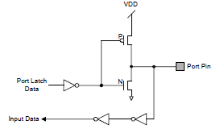
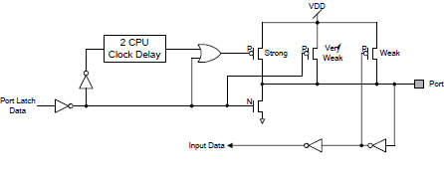
I/O Modes
Input only with high impedance
  Set GPIOx_PMD (PMDn[1:0]) to 00b the GPIOx port [n] pin is in Input mode and the I/O pin is in tri-state (high impedance) without output drive capability
Push-Pull Output
Open-Drain Output
Quasi bi-direction

Slide 5
Mode 0 : Input Only
Input only with high impedance
  Set GPIOx_PMD (PMDn[1:0]) to 00b
  the GPIOx port [n] pin is in Input mode and
  the I/O pin is in tri-state (high impedance) without output drive capability

Slide 6
Mode 1 : Push-Pull Output
Push-Pull Output
  Set GPIOx_PMD (PMDn[1:0]) to 01b
  the GPIOx port [n] pin is in Output mode

Slide 7
Mode 2 : Open-Drain Output
Open-Drain Output
  Set GPIOx_PMD (PMDn[1:0]) to 10b
  the GPIOx port [n] pin is in Open-Drain Output mode

Slide 8
Mode 3 : Quasi Bi-direction
Open-Drain Output
  Set GPIOx_PMD (PMDn[1:0]) to 11b
  the GPIOx port [n] pin is in Quasi Bi-direction mode

Slide 9
Setting I/O Modes
GPIO Driver : DrvGPIO.c
Function Call to set up I/O modes
DrvGPIO_Open(E_GPA, 0, E_IO_OUTPUT);
I/O groups : E_GPA, E_GPB, E_GPC, E_GPD, E_GPE
port no = 0~15
I/O modes
    E_IO_INPUT : input only mode
    E_IO_OUTPUT : push-pull output mode
    E_IO_OPENDRAIN : open-drain output mode
    E_IO_QUASI : quai bi-direction mode

Slide 10
Driving GPIO pins to 0 / 1
GPIO Driver : DrvGPIO.c
Function Call to drive GPIO output to 0
DrvGPIO_SetBit(E_GPA, 0);
Function Call to drive GPIO output to 1
DrvGPIO_ClrBit(E_GPA, 0);
I/O groups : E_GPA, E_GPB, E_GPC, E_GPD, E_GPE
port no : 0~15

Slide 11
Reading from GPIO pins for 0/1
GPIO Driver : DrvGPIO.c
Function Call to read GPIO input
DrvGPIO_GetBit(E_GPA, 0);
I/O groups : E_GPA, E_GPB, E_GPC, E_GPD, E_GPE
port no : 0~15

Slide 12
DrvGPIO function calls
DrvGPIO_Open(E_GPA, 0, E_IO_OUTPUT); // set GPA0 pin to output mode
  I/O group : E_GPA, E_GPB, E_GPC, E_GPD, E_GPE
  Port number : 0~15
  I/O mode : E_IO_INPUT, E_IO_OUTPUT, E_IO_OPENDRAIN, E_IO_QUASI
DrvGPIO_SetBit(E_GPA, 0); // write GPA0 pin to high
  I/O group : E_GPA, E_GPB, E_GPC, E_GPD, E_GPE
  Port number : 0~15
DrvGPIO_ClrBit(E_GPA, 0); // write GPA0 pin to low
  I/O group : E_GPA, E_GPB, E_GPC, E_GPD, E_GPE
  Port number : 0~15
DrvGPIO_GetBit(E_GPA, 0); // read GPA0 pin to input
  I/O group : E_GPA, E_GPB, E_GPC, E_GPD, E_GPE
  Port number : 0~15

Slide 13
Smpl_GPIO_LED1
//
// Smpl_GPIO_LED : GPC12 to control on-board LEDs
// low-active output to control Red LEDs
//
#include <stdio.h>
#include "NUC1xx.h"
#include "GPIO.h"
#include "SYS.h"
void Init_LED() // Initialize GPIO pins
{
DrvGPIO_Open(E_GPC, 12, E_IO_OUTPUT); // GPC12 pin set to output mode
DrvGPIO_SetBit(E_GPC, 12); // output Hi to turn off LED
}
include Driver header files
LED circuit is controlled by GPC12
set up GPC12 to output mode
set GPC12 to Hi ( = turn off LED)

Slide 14
Smpl_GPIO_LED1
int main (void)
{
UNLOCKREG(); // unlock register for programming
DrvSYS_Open(50000000); // set System Clock to run at 48MHz
// 12MHz crystal input, PLL output 48MHz
LOCKREG(); // lock register from programming
Init_LED(); // Initialize LEDs (four on-board LEDs below LCD panel)
while (1) // forever loop to keep flashing four LEDs one at a time
{
DrvGPIO_ClrBit(E_GPC, 12); // output Low to turn on LED
DrvSYS_Delay(300000); // delay
DrvGPIO_SetBit(E_GPC, 12); // output Hi to turn off LED
DrvSYS_Delay(300000); // delay
}
}
set CPU clock to 50MHz
Initialize on-board LED
Keep flashing LED
Output Low to turn on LED
Output High to turn off LED

Slide 15
DrvGPIO_Open
int32_t DrvGPIO_Open(E_DRVGPIO_PORT port, int32_t i32Bit, E_DRVGPIO_IO mode)
{ volatile uint32_t u32Reg;
if ((i32Bit < 0) || (i32Bit > 16))
{ return E_DRVGPIO_ARGUMENT; }
u32Reg = (uint32_t)&GPIOA->PMD + (port*PORT_OFFSET);
if ((mode == E_IO_INPUT) || (mode == E_IO_OUTPUT) || (mode == E_IO_OPENDRAIN))
{ outpw(u32Reg, inpw(u32Reg) & ~(0x3<<(i32Bit*2)));
if (mode == E_IO_OUTPUT)
{ outpw(u32Reg, inpw(u32Reg) | (0x1<<(i32Bit*2))); }
else if (mode == E_IO_OPENDRAIN)
{ outpw(u32Reg, inpw(u32Reg) | (0x2<<(i32Bit*2))); }
}else if (mode == E_IO_QUASI)
{ outpw(u32Reg, inpw(u32Reg) | (0x3<<(i32Bit*2)));
}else
{ return E_DRVGPIO_ARGUMENT; }
return E_SUCCESS;
}
calculate GPIO Reg address
set I/O modes (2-bit)
00: INPUT,
01: OUTPUT,
10: OPENDRAIN,
11: QUASI
Shift 2 bits by (i32bit *2) GPIO port no.

Slide 16
DrvGPIO_SetBit
#define PORT_OFFSET 0x40
int32_t DrvGPIO_SetBit(E_DRVGPIO_PORT port, int32_t i32Bit)
{
GPIO_T * tGPIO;
if ((i32Bit < 0) || (i32Bit > 16)) { return E_DRVGPIO_ARGUMENT; }
tGPIO = (GPIO_T *)((uint32_t)GPIOA + (port*PORT_OFFSET));
tGPIO->DOUT |= (1 << i32Bit);
return E_SUCCESS;
}
Calculate the GPIO register index address
Port number * Port Offset
GPIOA is the beginning address of GPIO registers
Set Output to 1

Slide 17
DrvGPIO_ClrBit
#define PORT_OFFSET 0x40
int32_t DrvGPIO_ClrBit(E_DRVGPIO_PORT port, int32_t i32Bit)
{
GPIO_T * tGPIO;
if ((i32Bit < 0) || (i32Bit > 16)) { return E_DRVGPIO_ARGUMENT; }
tGPIO = (GPIO_T *)((uint32_t)GPIOA + (port*PORT_OFFSET));
tGPIO->DOUT &= ~(1 << i32Bit);
return E_SUCCESS;
}
Calculate the GPIO register index address
Port number * Port Offset
GPIOA is the beginning address of GPIO registers
Set Output to 0

Slide 18
DrvGPIO_GetBit
#define PORT_OFFSET 0x40
int32_t DrvGPIO_GetBit(E_DRVGPIO_PORT port, int32_t i32Bit)
{
volatile uint32_t u32Reg;
if ((i32Bit < 0) || (i32Bit > 16)) { return E_DRVGPIO_ARGUMENT; }
u32Reg = (uint32_t)&GPIOA->PIN + (port*PORT_OFFSET);
return ((inpw(u32Reg)>>i32Bit) & 0x1);
}
Calculate the GPIO register index address
Port number * Port Offset
GPIOA is the beginning address of GPIO registers
read the pin value & return the value

Slide 19
Smpl_GPIO_LED4_macro (Function-Call Macro)
#define INIT_LED0 DrvGPIO_Open(E_GPC, 12, E_IO_OUTPUT)
#define INIT_LED1 DrvGPIO_Open(E_GPC, 13, E_IO_OUTPUT)
#define INIT_LED2 DrvGPIO_Open(E_GPC, 14, E_IO_OUTPUT)
#define INIT_LED3 DrvGPIO_Open(E_GPC, 15, E_IO_OUTPUT)
#define LED0_ON DrvGPIO_ClrBit(E_GPC, 12)
#define LED0_OFF DrvGPIO_SetBit(E_GPC, 12)
#define LED1_ON DrvGPIO_ClrBit(E_GPC, 13)
#define LED1_OFF DrvGPIO_SetBit(E_GPC, 13)
#define LED2_ON DrvGPIO_ClrBit(E_GPC, 14)
#define LED2_OFF DrvGPIO_SetBit(E_GPC, 14)
#define LED3_ON DrvGPIO_ClrBit(E_GPC, 15)
#define LED3_OFF DrvGPIO_SetBit(E_GPC, 15)
#define DELAY DrvSYS_Delay(300000)
Define function calls into macro

Slide 20
Smpl_GPIO_LED4_macro
// Initial GPIOs
void Init_LED()
{
// initialize GPIO pins to OUTPUT mode
INIT_LED0;
INIT_LED1;
INIT_LED2;
INIT_LED3;
// set GPIO pins to output Low
LED0_OFF;
LED1_OFF;
LED2_OFF;
LED3_OFF;
}
int main (void) {
UNLOCKREG(); // unlock register for programming
DrvSYS_Open(48000000);// set to run at 48MHz
LOCKREG(); // lock register from programming
Init_LED(); // Initialize LEDs (four on-board LEDs)
while(1) {
LED0_ON;
DELAY;
LED0_OFF;
DELAY;
LED1_ON;
DELAY;
LED1_OFF;
DELAY;
LED2_ON;
DELAY;
LED2_OFF;
DELAY;
LED3_ON;
DELAY;
LED3_OFF;
DELAY;
}
}
Using defined Macro
Using defined Macro

Slide 21
Smpl_GPIO_LED1_macro (Register-Access Macro)
// directly programming GPIO register bits
#define PORT_OFFSET 0x40
#define u32Reg (uint32_t)&GPIOA->PMD
#define u32RegD (uint32_t)&GPIOA->DOUT
#define DrvGPIO_Open_GPC12_OUTPUT outpw(u32Reg+ (E_GPC*PORT_OFFSET), inpw(u32Reg + (E_GPC*PORT_OFFSET))| (0x1<<(12*2)))
#define DrvGPIO_Set_GPC12 outpw(u32RegD+ (E_GPC*PORT_OFFSET),
inpw(u32RegD+ (E_GPC*PORT_OFFSET))| (0x1 << 12 ))
#define DrvGPIO_Clr_GPC12 outpw(u32RegD+ (E_GPC*PORT_OFFSET), inpw(u32RegD+ (E_GPC*PORT_OFFSET))& ~(0x1<< 12 ))
Calculate the GPIO index register address
Calculate the GPIO data register address
Set GPIO port to output mode
Set GPIO port output to 1
Set GPIO port output to 0

Slide 22
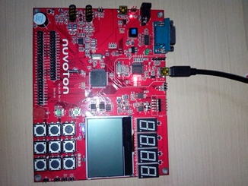
Smpl_GPIO_RGBled
RGB LED low-active driven
by GPA12 for blue color
by GPA13 for green color
by GPA14 for red color

Slide 23
Smpl_GPIO_RGBled
int main (void)
{
UNLOCKREG(); // unlock register for programming
DrvSYS_Open(48000000); // set System Clock to run at 48MHz
LOCKREG(); // lock register from programming
while (1)
{
// Initial GPIO GPA12,13,14 to output mode
DrvGPIO_Open(E_GPA, 12, E_IO_OUTPUT); // initial GPIO pin GPA 12 to output mode
DrvGPIO_Open(E_GPA, 13, E_IO_OUTPUT); // initial GPIO pin GPA 13 to output mode
DrvGPIO_Open(E_GPA, 14, E_IO_OUTPUT); // initial GPIO pin GPA 14 to output mode
// set RGBled to Blue
DrvGPIO_ClrBit(E_GPA,12); // GPA12 = Blue, 0 : on, 1 : off
DrvGPIO_SetBit(E_GPA,13);
DrvGPIO_SetBit(E_GPA,14);
// set RGBled to off
DrvGPIO_SetBit(E_GPA,12); // GPA12 = Blue, 0 : on, 1 : off
DrvGPIO_SetBit(E_GPA,13); // GPA13 = Green, 0 : on, 1 : off
DrvGPIO_SetBit(E_GPA,14); // GPA14 = Red, 0 : on, 1 : off
Delay(1000000);
}
}
RGBLED is low-active driven
Set System Clock to 48MHz
Initialize RGB LED control pins
Set 1 to turn on Blue color of RGBled
Set 0 to Turn off Blue color of RGBled

Slide 24
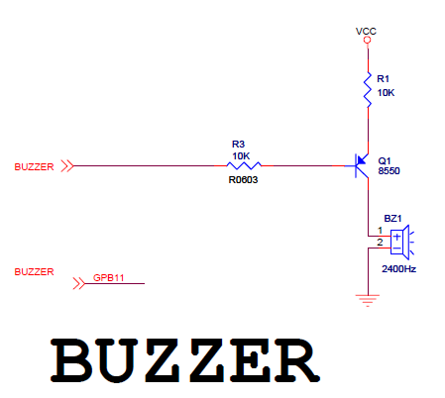
Buzzer schematic
0 ohm

Slide 25
Smpl_GPIO_Buzzer
//
// Smpl_GPIO_Buzzer : GPB11 low-active output control Buzzer
// Note: Nu-LB-NUC140 R1 should be 0 ohm
#include <stdio.h>
#include "NUC1xx.h"
#include "SYS.h"
#include "GPIO.h"
#include "ADC.h"
int main (void)
{
UNLOCKREG(); // unlock register for programming
DrvSYS_Open(48000000);// set System Clock to run at 48MHz
LOCKREG(); // lock register from programming
DrvGPIO_Open(E_GPB, 11, E_IO_OUTPUT); // initial GPIO pin GPB11 for controlling Buzzer
while(1) {
DrvGPIO_ClrBit(E_GPB,11); // GPB11 = 0 to turn on Buzzer
DrvSYS_Delay(100000); // Delay
DrvGPIO_SetBit(E_GPB,11); // GPB11 = 1 to turn off Buzzer
DrvSYS_Delay(100000); // Delay
}
}
Set CPU clock to 48 MHz
Set GPIO for Buzzer control pin

Slide 26
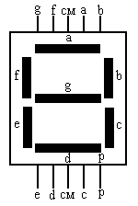










7-segment display

Slide 27
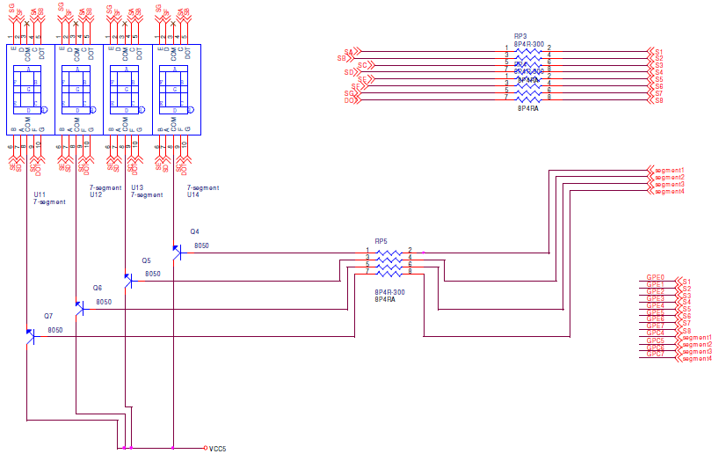
7 segment LED schematic

Slide 28
Control Pins used for 7-segment Display
GPC4~7 control which 7-segment to turn on (1 = on, 0 = off)
GPC4 : First 7-segment (LSB)
GPC5 : Second 7-segment
GPC6 : Third 7-segment
GPC7 : Forth 7-segment (MSB)
GPE0~7 control each segment to turn on (0 = on, 1 = off)
GPE0 : c
GPE1 : dot
GPE2 : f
GPE3 : a
GPE4 : b
GPE5 : d
GPE6 : e
GPE7 : g

Slide 29
7-Segment LED Driver
NUC100SeriesBSP/NuvotonPlatform_Keil/Src/NUC1xx-LB002/Seven_Segment.c
#define SEG_N0 0x82 // define segment led on/off for digit 0
#define SEG_N1 0xEE // define segment led on/off for digit1
…
SEG_BUF[10] // array of segment led on/off value for digit 0~9
show_seven_segment (no, number)
  no : select 1st/2nd/3rd/4th 7-segment LED
  number : value of the digit (0~9)
close_seven_segment (void)
  // turn off all four 7-segment LEDs
  DrvGPIO_ClrBit(E_GPC,4);
  DrvGPIO_ClrBit(E_GPC,5);
  DrvGPIO_ClrBit(E_GPC,6);
  DrvGPIO_ClrBit(E_GPC,7);

Slide 30
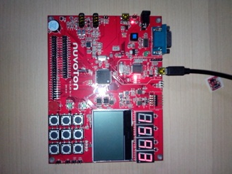
Smpl_7seg
Counting
7 segment LEDs

Slide 31
seg_display routine
// display 4-digit value (0~9999) on 7-segment LEDs
void seg_display(int16_t value)
{
int8_t digit;
digit = value / 1000;
close_seven_segment();
show_seven_segment(3,digit);
delay(5000);
value = value - digit * 1000;
digit = value / 100;
close_seven_segment();
show_seven_segment(2,digit);
delay(5000);
value = value - digit * 100;
digit = value / 10;
close_seven_segment();
show_seven_segment(1,digit);
delay(5000);
value = value - digit * 10;
digit = value;
close_seven_segment();
show_seven_segment(0,digit);
delay(5000);
}
Calculate the digit of 1000s &
display it on 7-segment
Calculate the digit of 100s &
display it on 7-segment
Calculate the digit of 10s &
display it on 7-segment
Calculate the digit of 1s &
display it on 7-segment

Slide 32
Smpl_7seg
int32_t main (void)
{
int32_t i =0;
UNLOCKREG();
DrvSYS_Open(48000000);
LOCKREG();
while(i<10000)
{
seg_display(i); // display i on 7-segment display
DrvSYS_Delay(10000); // delay for keeping display
i++; // increment i
}
}
set System Clock to run at 48MHz
CPU, Host Bus, Periperal Bus all run at 48MHz
Display 4 digits on 7-segment LEDs

Slide 33
MCU IRQs
NVIC_EnableIRQ(WDT_IRQn);
  vector defined in startup_NUC1xx.s
  IRQ type defined in NUC1xx.h
typedef enum IRQn
{
//****** Cortex-M0 Processor Exceptions Numbers
//NonMaskableInt_IRQn = -14, /*!< 2 Non Maskable Interrupt
//HardFault_IRQn = -13, /*!< 3 Cortex-M0 Hard Fault Interrupt
//SVCall_IRQn = -5, /*!< 11 Cortex-M0 SV Call Interrupt
//PendSV_IRQn = -2, /*!< 14 Cortex-M0 Pend SV Interrupt
//SysTick_IRQn = -1, /*!< 15 Cortex-M0 System Tick Interrupt
//******************* NUC1xx Interrupt Numbers ******************
BOD_IRQn = 0,
WDT_IRQn = 1,
…
RTC_IRQn = 31
} IRQn_Type;

Slide 34
Interrupt Types
Level-triggered Interrupt
  an interrupt signaled by maintaining the interrupt line at a high or low level
Edge-triggered Interrupt
  interrupt signaled by a level transition on the interrupt line, either a falling edge (high to low) or a rising edge (low to high), or both edges.

Slide 35
Interrupt Handler (in startup_NUC1xx.s)
DCD GPCDE_IRQHandler
DCD PWMA_IRQHandler
DCD PWMB_IRQHandler
DCD TMR0_IRQHandler
DCD TMR1_IRQHandler
DCD TMR2_IRQHandler
DCD TMR3_IRQHandler
DCD UART02_IRQHandler
DCD UART1_IRQHandler
DCD SPI0_IRQHandler
DCD SPI1_IRQHandler
DCD SPI2_IRQHandler
DCD SPI3_IRQHandler
DCD I2C0_IRQHandler
DCD I2C1_IRQHandler
DCD CAN0_IRQHandler
DCD Default_Handler
DCD Default_Handler
DCD USBD_IRQHandler
DCD PS2_IRQHandler
DCD ACMP_IRQHandler
DCD PDMA_IRQHandler
DCD I2S_IRQHandler
DCD PWRWU_IRQHandler
DCD ADC_IRQHandler
DCD Default_Handler
DCD RTC_IRQHandler
__Vectors DCD __initial_sp ; Top of Stack
DCD Reset_Handler ; Reset Handler
DCD NMI_Handler ; NMI Handler
DCD HardFault_Handler ; Hard Fault Handler
DCD 0 ; Reserved
DCD 0 ; Reserved
DCD 0 ; Reserved
DCD 0 ; Reserved
DCD 0 ; Reserved
DCD 0 ; Reserved
DCD 0 ; Reserved
DCD SVC_Handler ; SVCall Handler
DCD 0 ; Reserved
DCD 0 ; Reserved
DCD PendSV_Handler ; PendSV Handler
DCD SysTick_Handler ; SysTick Handler
; External Interrupts
; maximum of 32 External Interrupts are possible
DCD BOD_IRQHandler
DCD WDT_IRQHandler
DCD EINT0_IRQHandler
DCD EINT1_IRQHandler
DCD GPAB_IRQHandler
Every on-chip controller has its assigned
interrupt vector
connected to CPU’s
Interrupt controller

Slide 36
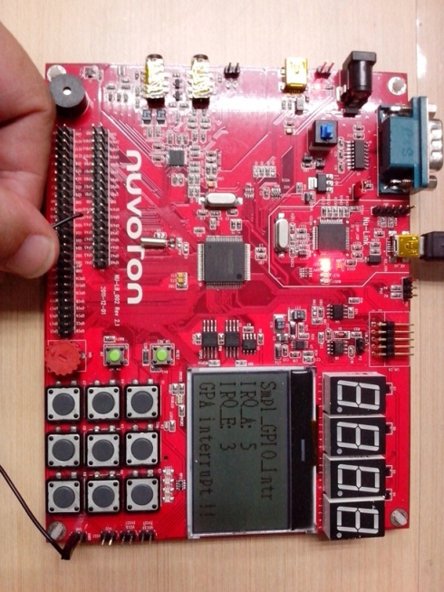
Smpl_GPIO_Interrupt

Slide 37
Smpl_GPIO_Interrupt
//
// smpl_GPIO_Interrupt
//
// GPA15 to input interrupt
// GPE15 to input interrupt
#include <stdio.h>
#include "NUC1xx.h"
#include "UART.h"
#include "GPIO.h"
#include "SYS.h"
#include "LCD.h"
volatile uint32_t irqA_counter = 0;
volatile uint32_t irqE_counter = 0;
void GPIOAB_INT_CallBack(uint32_t GPA_IntStatus, uint32_t GPB_IntStatus)
{
if ((GPA_IntStatus>>15) & 0x01) irqA_counter++;
print_lcd(3,"GPA interrupt !!");
}
void GPIOCDE_INT_CallBack(uint32_t GPC_IntStatus, uint32_t GPD_IntStatus, uint32_t GPE_IntStatus)
{
if ((GPE_IntStatus>>15) & 0x01) irqE_counter++;
print_Line(3,"GPC interrupt !!");
}
int32_t main()
{
char TEXT[16];
UNLOCKREG();
SYSCLK->PWRCON.XTL12M_EN=1;
DrvSYS_Delay(5000); // Waiting for 12M Xtal stalble
SYSCLK->CLKSEL0.HCLK_S=0;
LOCKREG();
// setup GPA15 & GPE15 to get interrupt input
DrvGPIO_Open(E_GPA,15,E_IO_INPUT);
DrvGPIO_Open(E_GPE,15,E_IO_INPUT);
DrvGPIO_EnableInt(E_GPA, 15, E_IO_RISING, E_MODE_EDGE);
DrvGPIO_EnableInt(E_GPE, 15, E_IO_RISING, E_MODE_EDGE);
DrvGPIO_SetDebounceTime(5, 1);
DrvGPIO_EnableDebounce(E_GPA, 15);
DrvGPIO_EnableDebounce(E_GPE, 15);
DrvGPIO_SetIntCallback(GPIOAB_INT_CallBack, GPIOCDE_INT_CallBack);
init_LCD();
clear_LCD();
print_Line(0,"Smpl_GPIO_Intr");
while(1)
{
sprintf(TEXT,"IRQ_A: %d",irqA_counter);
print_Line(1, TEXT);
sprintf(TEXT,"IRQ_E: %d",irqE_counter);
print_Line(2, TEXT);
}
}
GPIO interrupt setup
rising edge-trigger
& debounce
Callback function of GPIO A/B group interrupts
Set interrupt Callback
Callback function of GPIO C/D/E group interrupts

Slide 38
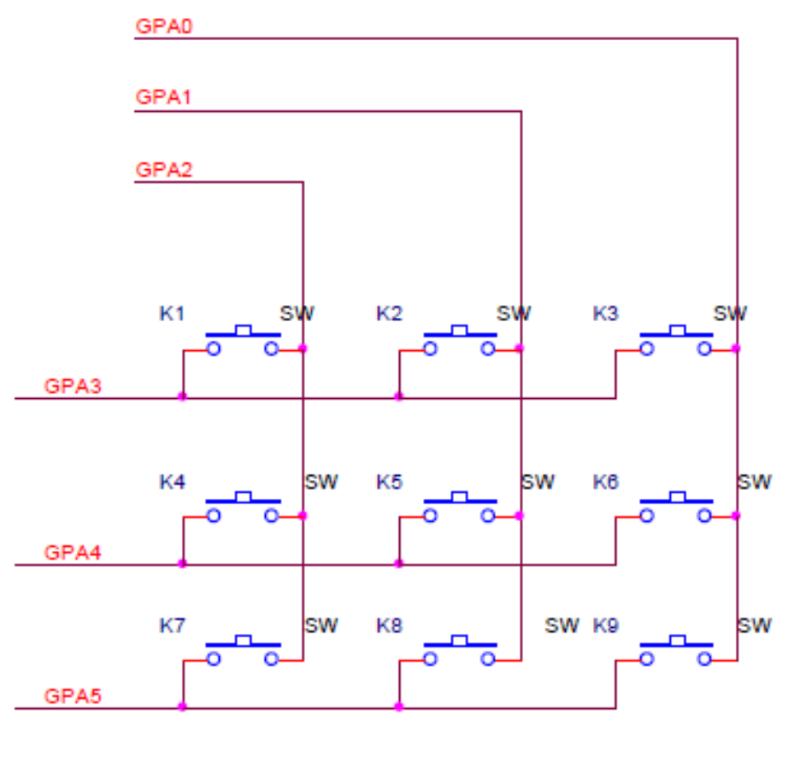
3x3 Keypad schematic

Slide 39
Control Pins used for 3x3 Keypad
Column control : GPA 2, 1, 0
Raw control : GPA 3, 4, 5
Key1 = GPA3 & GPA2
Key2 = GPA3 & GPA1
Key3 = GPA3 & GPA0
Key4 = GPA4 & GPA2
Key5 = GPA4 & GPA1
Key6 = GPA4 & GPA0
Key7 = GPA5 & GPA2
Key8 = GPA5 & GPA1
Key9 = GPA5 & GPA0

Slide 40
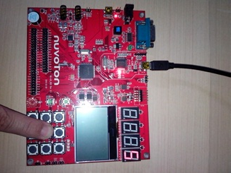
Smpl_7seg_Keypad
7-segment display number = 5
Press middle key
of 3x3 keypad
Scankey.c : function calls for scanning keypad 3x3

Slide 41
Keypad Driver – Scankey.c
#include <stdio.h>
#include "GPIO.h"
#include "Scankey.h"
void delay(void)
{
int j;
for(j=0;j<1000;j++);
}
void OpenKeyPad(void)
{
uint8_t i;
/* Initial key pad */
for(i=0;i<6;i++)
DrvGPIO_Open(E_GPA, i, E_IO_QUASI);
}
void CloseKeyPad(void)
{
uint8_t i;
for(i=0;i<6;i++)
DrvGPIO_Close(E_GPA, i);
}
Initialize 3x3 keypad GPIO pins
close 3x3 keypad GPIO pins

Slide 42
Keypad Driver – Scankey.c
uint8_t ScanKey(void)
{
uint8_t act[4]={0x3b, 0x3d, 0x3e};
uint8_t i,temp,pin;
for(i=0;i<3;i++)
{
temp=act[i];
for(pin=0;pin<6;pin++)
{
if((temp&0x01)==0x01)
DrvGPIO_SetBit(E_GPA,pin);
else
DrvGPIO_ClrBit(E_GPA,pin);
temp>>=1;
}
delay();
if(DrvGPIO_GetBit(E_GPA,3)==0)
return(i+1);
if(DrvGPIO_GetBit(E_GPA,4)==0)
return(i+4);
if(DrvGPIO_GetBit(E_GPA,5)==0)
return(i+7);
}
return 0;
}
Driving GPIO to 0 or 1
for scanning 3x3 keypad
Read GPIO to scan key press
Output = 1 ~ 9
if keypad is not pressed
Output = 0

Slide 43
Smpl_7seg_Keypad
int32_t main (void)
{
int8_t number;
UNLOCKREG();
DrvSYS_Open(50000000);
LOCKREG();
OpenKeyPad();
while(1)
{
number = ScanKey(); // scan keypad to get a number (1~9)
show_seven_segment(0,number); // display number on 7-segment LEDs
DrvSYS_Delay(5000); // delay time for keeping 7-segment display
close_seven_segment(); // turn off 7-segment LEDs
}
}
Set CPU clock to 50MHz
Scan 3x3 keypad
7-segment LED to display the number
Delay for seeing 7-segment display
Turn off 7-segment & go for next display value

Slide 44
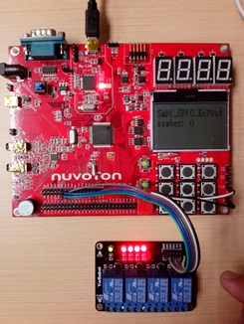
Smpl_GPIO_Keypad
Vcc/Gnd
Press key
Using GPIO outputs to control relays
GPIOs control 4-port Relay

Slide 45
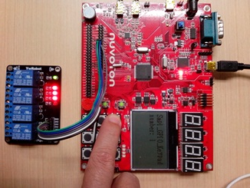
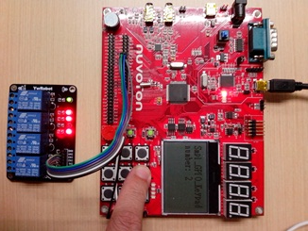
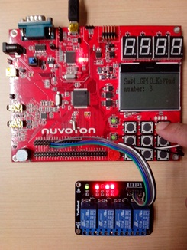

Smpl_GPIO_Keypad
Press key1
Press key2
Press key3
Press key4
Relay #1 off
Relay #2 off
Relay #3 off
Relay #4 off
Vcc = 3.3V, GPIO output hi (base) → Relay Control pin = low (collector)

Slide 46
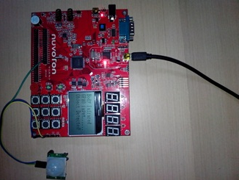
Smpl_GPIO_BodyInfrared
display Detection message
Passive Infrared Detector
detecting human body

Slide 47
Smpl_GPIO_BodyInfrared
int main(void)
{
UNLOCKREG();
SYSCLK->PWRCON.XTL12M_EN = 1; //Enable 12Mhz crystal and set HCLK=12Mhz
SYSCLK->CLKSEL0.HCLK_S = 0;
LOCKREG();
DrvGPIO_Open(E_GPA, 0, E_IO_INPUT); // set GPA0 to input mode
init_LCD();
clear_LCD();
print_Line(0, "Body Infrared ");
print_Line(1, "GPA0 input......");
while(1) {
if (DrvGPIO_GetBit(E_GPA,0)==0) print_Line(2, "Object Detected!");
else print_Line(2, "No Detection! ");
}
}
Reading GPA0 for PIR status

Slide 48
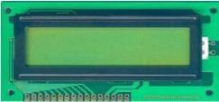
LCD MODULE - PC1602
Pin no. | Name | Function
1 | Vss | Ground
2 | Vdd | Power Supply (+5V)
3 | Vo | Contrast Adjust
4 | RS | Register Select
5 | R/W | Data Read/Write
6 | E | Enable signal
7 | DB0 | Data Bus 0
8 | DB1 | Data Bus 0
9 | DB2 | Data Bus 0
10 | DB3 | Data Bus 0
11 | DB4 | Data Bus 0
12 | DB5 | Data Bus 0
13 | DB6 | Data Bus 0
14 | DB7 | Data Bus 0
15 | A | LED Backlight + (+5V)
16 | K | LED Backlight – (Gnd)

Slide 49
LCM16x2.c
// pin1 Gnd (to Gnd)
// pin2 Vcc: (to +5V)
// pin3 Vo : brightness control (to Gnd)
// pin4 RS : 1=Data, 0=Instruction (to GPA0)
// pin5 RW : 1=Read, 0=Write (to GPA1)
// pin6 E : Chip Enable (to GPA2)
// pin7~14 : D0~D7 (to GPE0~7)
// pin15 A : backlight+ (to Vcc) no backlight, no coonection
// pin16 K : backlight- (to Gnd) no backlight, no connection
#include <stdio.h>
#include <string.h>
#include "NUC1xx.h"
#include "GPIO.h"
#include "SYS.h“
#define LCD_DATA GPIOE->DOUT // D0~7 pin = GPE0~7
#define LCD_RS_SET DrvGPIO_SetBit(E_GPA,0) // RS pin = GPA0
#define LCD_RS_CLR DrvGPIO_ClrBit(E_GPA,0)
#define LCD_RW_SET DrvGPIO_SetBit(E_GPA,1) // RW pin = GPA1
#define LCD_RW_CLR DrvGPIO_ClrBit(E_GPA,1)
#define LCD_E_SET DrvGPIO_SetBit(E_GPA,2) // E pin = GPA2
#define LCD_E_CLR DrvGPIO_ClrBit(E_GPA,2)
Pin connection description comment on top of main.c
Include C header files
Header file of NUC1xx chip
Header file of GPIO driver
Header file of NUC1xx clock & system tick
GPE[7:0] to D[7:0] of LCM16x2
GPA0,1,2 to RS,RW,E of LCM16x2

Slide 50
LCM16x2.c
void lcdWriteData(unsigned char wdata)
{
LCD_DATA=wdata | 0xFF00;
LCD_RS_SET;
LCD_RW_CLR;
LCD_E_CLR;
DrvSYS_Delay(100);
LCD_E_SET;
}
void lcdWriteCommand(unsigned char wdata)
{
LCD_DATA=wdata;
LCD_RS_CLR;
LCD_RW_CLR;
LCD_E_CLR;
DrvSYS_Delay(100);
LCD_E_SET;
}
Write Data to LCM16x2
Write Command to LCM16x2

Slide 51
LCM16x2.c
void init_LCM16x2(void)
{
init_GPIO();
LCD_DATA=0;
DrvSYS_Delay(40000);// wait time >40ms after Vcc>4.5V
lcdWriteCommand(0x38);
DrvSYS_Delay(1000);
lcdWriteCommand(0x38);
DrvSYS_Delay(37);
lcdWriteCommand(0x06); // Cursor Move to right, no shift
DrvSYS_Delay(37);
lcdWriteCommand(0x0C); // Display ON, Cursor Off, Blinking off
DrvSYS_Delay(37);
lcdWriteCommand(0x01); // Display Clear
DrvSYS_Delay(1520);
}
Initialization of LCM16x2

Slide 52
LCM16x2.c
void lcdSetAddr(uint8_t x,uint8_t y)
{
if(y==1) x+=0x40;
x+=0x80;
lcdWriteCommand(x);
}
void printC(uint8_t x, uint8_t y, unsigned char dat)
{
lcdSetAddr(x,y);
lcdWriteData(dat);
}
void print_Line(int8_t line, char text[])
{
int8_t i;
for (i=0;i<strlen(text);i++)
printC(i*8,line*16,text[i]);
}
void printS(int16_t x, int16_t y, char text[])
{
int8_t i;
for (i=0;i<strlen(text);i++)
printC(x+i*8, y,text[i]);
}

Slide 53
Smpl_GPIO_LCM16x2
#include <stdio.h>
#include "NUC1xx.h"
#include "GPIO.h"
#include "SYS.h"
main()
{
char TEXT0[16]= "Welcome to NTOU ";
char TEXT1[16]= "Cortex-M0 MCU !!";
init_LCM16x2();
printS(0,0,TEXT0);
printS(0,1,TEXT1);
}
declare char array for string
Initialize LCM16x2
display string

Slide 54
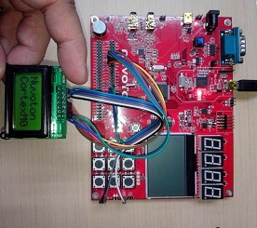
Smpl_GPIO_LCM8x2

Slide 55

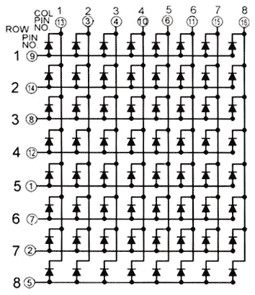
8x8 LED Matrix
MAX7219
N1588

Slide 56
MAX7219.c
//
// MAX7219 Driver : drive 8x8 LEDs
//
#include <stdio.h>
#include "NUC1xx.h"
#include "SYS.h"
#include "GPIO.h"
// Define GPA2,1,0 as CLK, CS, DIN pins
#define CLK_HI DrvGPIO_SetBit(E_GPA, 2)
#define CLK_LO DrvGPIO_ClrBit(E_GPA, 2)
#define CS_HI DrvGPIO_SetBit(E_GPA, 1)
#define CS_LO DrvGPIO_ClrBit(E_GPA, 1)
#define DIN_HI DrvGPIO_SetBit(E_GPA, 0)
#define DIN_LO DrvGPIO_ClrBit(E_GPA, 0)
// Initialize GPIOs for connecting MAX7219
void init_GPIO(void)
{
DrvGPIO_InitFunction(E_FUNC_GPIO);
DrvGPIO_Open(E_GPA, 0, E_IO_OUTPUT);
DrvGPIO_Open(E_GPA, 1, E_IO_OUTPUT);
DrvGPIO_Open(E_GPA, 2, E_IO_OUTPUT);
// set to default
DrvGPIO_ClrBit(E_GPA, 0);
DrvGPIO_ClrBit(E_GPA, 1);
DrvGPIO_ClrBit(E_GPA, 2);
}
Define for CLK,CS,DIN signals of MAX7219

Slide 57
MAX7219.c
void WriteData_MAX7219(uint8_t DATA)
{
uint8_t i;
CS_LO;
for(i=8;i>=1;i--) {
CLK_LO;
if (DATA&0x80) DIN_HI;
else DIN_LO;
DATA=DATA<<1;
CLK_HI;
DrvSYS_Delay(10);
}
}
void write_MAX7219(uint8_t address,uint8_t dat)
{
CS_LO;
WriteData_MAX7219(address);
WriteData_MAX7219(dat);
CS_HI;
}
void init_MAX7219(void)
{
init_GPIO();
write_MAX7219(0x09, 0x00);
write_MAX7219(0x0a, 0x03);
write_MAX7219(0x0b, 0x07);
write_MAX7219(0x0c, 0x01);
write_MAX7219(0x0f, 0x00);
}

Slide 58
Smpl_GPIO_LED8x8_MAX7219 main.c
Font 8x8 table
//
// Smpl_GPIO_LED8x8_MAX7219
//
// LED Matrix 8x8 is driven by MAX7219
// pin connection
// VCC : to Vcc +5V
// GND : to Gnd
// DIN : to GPA0
// CS : to GPA1
// CLK : to GPA2
#include <stdio.h>
#include "NUC1xx.h"
#include "SYS.h"
#include "GPIO.h"
#include "MAX7219.h"
unsigned char Font8x8[38][8]={
{0x3C,0x42,0x42,0x42,0x42,0x42,0x42,0x3C},//0
{0x10,0x18,0x14,0x10,0x10,0x10,0x10,0x10},//1
{0x7E,0x02,0x02,0x7E,0x40,0x40,0x40,0x7E},//2
{0x3E,0x02,0x02,0x3E,0x02,0x02,0x3E,0x00},//3
{0x08,0x18,0x28,0x48,0xFE,0x08,0x08,0x08},//4
{0x3C,0x20,0x20,0x3C,0x04,0x04,0x3C,0x00},//5
{0x3C,0x20,0x20,0x3C,0x24,0x24,0x3C,0x00},//6
{0x3E,0x22,0x04,0x08,0x08,0x08,0x08,0x08},//7
{0x00,0x3E,0x22,0x22,0x3E,0x22,0x22,0x3E},//8
{0x3E,0x22,0x22,0x3E,0x02,0x02,0x02,0x3E},//9
{0x08,0x14,0x22,0x3E,0x22,0x22,0x22,0x22},//A
{0x3C,0x22,0x22,0x3E,0x22,0x22,0x3C,0x00},//B
{0x3C,0x40,0x40,0x40,0x40,0x40,0x3C,0x00},//C
{0x7C,0x42,0x42,0x42,0x42,0x42,0x7C,0x00},//D
{0x7C,0x40,0x40,0x7C,0x40,0x40,0x40,0x7C},//E
{0x7C,0x40,0x40,0x7C,0x40,0x40,0x40,0x40},//F
{0x3C,0x40,0x40,0x40,0x40,0x44,0x44,0x3C},//G
{0x44,0x44,0x44,0x7C,0x44,0x44,0x44,0x44},//H
{0x7C,0x10,0x10,0x10,0x10,0x10,0x10,0x7C},//I
{0x3C,0x08,0x08,0x08,0x08,0x08,0x48,0x30},//J
{0x00,0x24,0x28,0x30,0x20,0x30,0x28,0x24},//K

Slide 59
Smpl_GPIO_LED8x8_MAX7219
select on-chip 22MHz RC oscillator as clock source
{0x40,0x40,0x40,0x40,0x40,0x40,0x40,0x7C},//L
{0x81,0xC3,0xA5,0x99,0x81,0x81,0x81,0x81},//M
{0x00,0x42,0x62,0x52,0x4A,0x46,0x42,0x00},//N
{0x3C,0x42,0x42,0x42,0x42,0x42,0x42,0x3C},//O
{0x3C,0x22,0x22,0x22,0x3C,0x20,0x20,0x20},//P
{0x1C,0x22,0x22,0x22,0x22,0x26,0x22,0x1D},//Q
{0x3C,0x22,0x22,0x22,0x3C,0x24,0x22,0x21},//R
{0x00,0x1E,0x20,0x20,0x3E,0x02,0x02,0x3C},//S
{0x00,0x3E,0x08,0x08,0x08,0x08,0x08,0x08},//T
{0x42,0x42,0x42,0x42,0x42,0x42,0x22,0x1C},//U
{0x42,0x42,0x42,0x42,0x42,0x42,0x24,0x18},//V
{0x00,0x49,0x49,0x49,0x49,0x2A,0x1C,0x00},//W
{0x00,0x41,0x22,0x14,0x08,0x14,0x22,0x41},//X
{0x41,0x22,0x14,0x08,0x08,0x08,0x08,0x08},//Y
{0x00,0x7F,0x02,0x04,0x08,0x10,0x20,0x7F},//Z
{0x08,0x7F,0x49,0x49,0x7F,0x08,0x08,0x08},//?
{0xFE,0xBA,0x92,0xBA,0x92,0x9A,0xBA,0xFE} //?
};
int main(void)
{
uint8_t i,j;
UNLOCKREG();
SYSCLK->PWRCON.OSC22M_EN = 1; // clock source select
SYSCLK->CLKSEL0.HCLK_S = 7; // HCLK select
LOCKREG();
init_MAX7219();
while(1)
{
for(j=0;j<38;j++)
{
for(i=1;i<9;i++)
write_MAX7219(i,Font8x8[j][i-1]);
DrvSYS_Delay(100000); // 100ms
}
}
}
Initialize 8x8 LED driver IC
Lookup Font8x8
& write to MAX7219

Slide 60
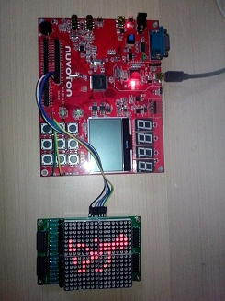
16x16 LED Matrix
Interface Signals
VCC → Vcc
GND → Gnd
P24 → GPA4
P23 →GPA3
P22 → GPA2
P21 → GPA1
P20 → GPA0
http://youtu.be/3ishmBLFjmA

Slide 61
LED16x16.c
//
// LED16x16 Driver
//
#include <stdio.h>
#include "NUC1xx.h"
#include "SYS.h"
#include "GPIO.h"
#define CLK_Hi DrvGPIO_SetBit(E_GPA,4)
#define CLK_Lo DrvGPIO_ClrBit(E_GPA,4)
#define AB_Hi DrvGPIO_SetBit(E_GPA,3)
#define AB_Lo DrvGPIO_ClrBit(E_GPA,3)
#define RCK_Hi DrvGPIO_SetBit(E_GPA,2)
#define RCK_Lo DrvGPIO_ClrBit(E_GPA,2)
#define SRCK_Hi DrvGPIO_SetBit(E_GPA,1)
#define SRCK_Lo DrvGPIO_ClrBit(E_GPA,1)
#define SER_Hi DrvGPIO_SetBit(E_GPA,0)
#define SER_Lo DrvGPIO_ClrBit(E_GPA,0)
void init_LED16x16(void)
{
DrvGPIO_InitFunction(E_FUNC_GPIO);
DrvGPIO_Open(E_GPA, 4, E_IO_OUTPUT);
DrvGPIO_Open(E_GPA, 3, E_IO_OUTPUT);
DrvGPIO_Open(E_GPA, 2, E_IO_OUTPUT);
DrvGPIO_Open(E_GPA, 1, E_IO_OUTPUT);
DrvGPIO_Open(E_GPA, 0, E_IO_OUTPUT);
// set to default
CLK_Lo;
AB_Lo;
RCK_Lo;
SRCK_Lo;
SER_Lo;
}
Define macro using GPIO driver function call
Setup GPIO pins as output
For driving interface signals to LED16x16

Slide 62
LED16x16.c
void display_LED16x16(uint8_t data[32])
{
uint8_t i,ia,j,tmp;
AB_Lo;
for(i=0;i<16;i++)
{
CLK_Lo;
RCK_Lo;
SRCK_Lo;
for(ia=2; ia>0; ia--)
{
tmp = ~ data[i*2+ia-1]; // even-byte will shift to Right, odd-byte at Left
for(j=0; j<8; j++) {
SRCK_Lo;
if ((tmp>>j) & 0x01) SER_Hi;
else SER_Lo;
SRCK_Hi; }
}
RCK_Hi;
CLK_Hi;
AB_Hi;
}
SRCK_Lo;
RCK_Lo;
CLK_Lo;
}
Sending data to LED16x16 module
LED driving sequence is per circuit connection from its schematic

Slide 63
main.c
int32_t main (void)
{
int i,j;
int16_t r;
uint8_t temp[32];
UNLOCKREG(); // unlock protected registers
DrvSYS_Open(48000000);
LOCKREG(); // lock protected registers
init_LED16x16();
while(1) {
for (i=0;i<8;i++) {
for(j=0;j<32;j++) temp[j]=greenman[i*32+j];
for (r=0;r<REPEAT;r++)
display_LED16x16(temp);
}
}
}
array of bitmap data
Send data to LED16x16 to display

Slide 64
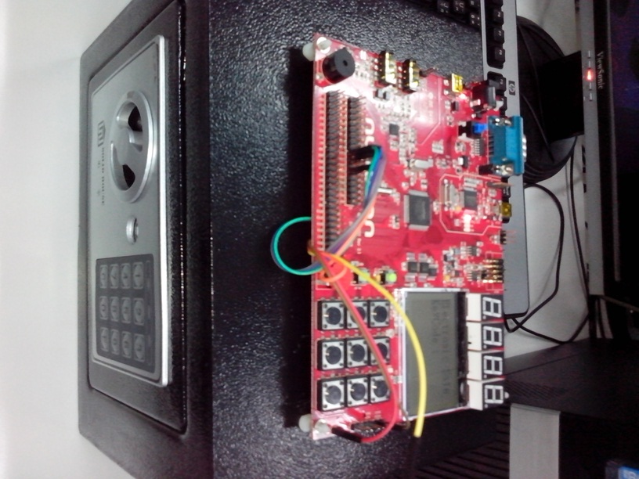
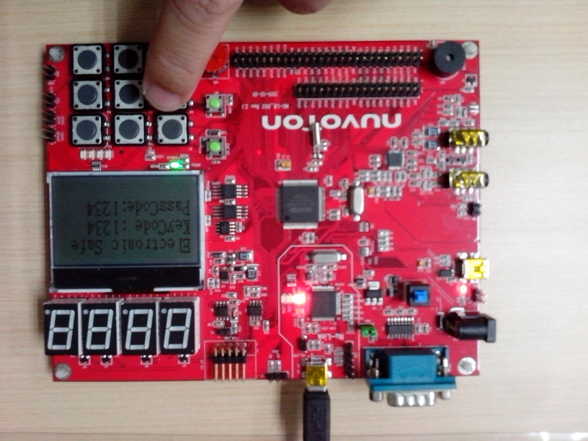
Project : Electronic Safe
D:\Nuvoton\NUC140BSP_EDU\SampleCode\EduProject\proj_ElectronicSafe
Platform : http://goods.ruten.com.tw/item/show?21110021890926
Ex.Video : http://youtu.be/PUKqQM0oIIo Samsung Door Lock

Slide 65
Electronic Safe : Functional Description
Project Objectives
  To use Cortex-M0 learning board to control the electronic safe
  To study/trace the PCB & circuit of Electronic Safe
  To draw the flow chart & implement the firmware of MCU
Functional Description
  Input six keycode by pressing 3x3 keypad
  Buzz when each keycode pressed
  Compared with passcode when six keycodes are entered
  If passcode equal to entered keycode, buzz few times and output to (drive electronic magnet) open the door
  SWInt button to change the passcode

Slide 66
Flow Chart
Start
while(1)
Keycode
==
passcode
Setup HCLK
number=Scankey()
Y
N
Init_RGBLED
Init_Buzzer
InitLock
Init SWInt
N
number!=0
print_LCD
RGBLED(GREEN)
Buzz(3)
OpenLock
print_LCD
RGBLED(RED)
Buzz(2)
CloseLock
Y
print_LCD
RGBLED(BLUE)
Buzz(1)
OpenKeyPad
Initial LCD
Print 2 lines
N
i==4
print_LCD to clear code
i=0
i=0
Y

Slide 67
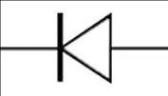

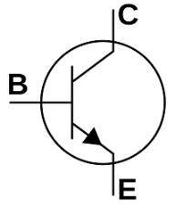

Electronic Safe : Interface Circuit
Vcc
+6V (1.5V AA x4)
Gnd
Ground
GPB15
GPA11
2N2222

Slide 68
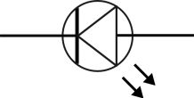



Electronic Safe : Interface Circuit
GPA12
+6V
GPA13
GPA14
GPA15
2N2222
Gnd

Slide 69
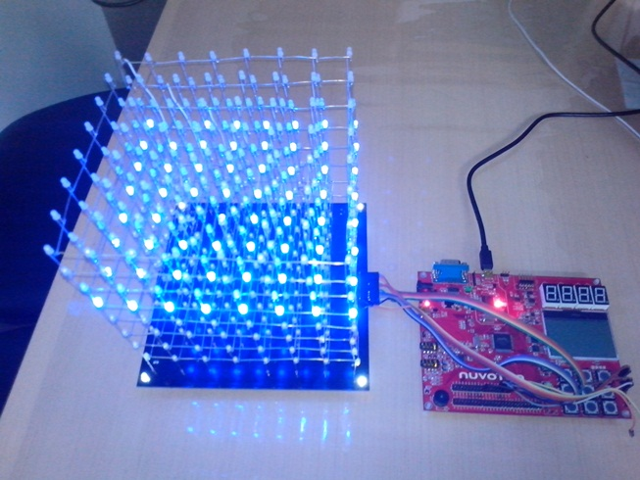
Project : LED Cube
D:\Nuvoton\NUC140BSP_EDU\SampleCode\EduProject\proj_LEDCube
Platform : http://goods.ruten.com.tw/item/show?21212185092946
Ex. Video: http://youtu.be/6mXM-oGggrM

Slide 70
LEDCube interface waveform
Y0
1
0
Y1
1
0
Y2
1
0
CLK
SDI
Serial Data
LE
Latch every 64 LEDs
OE
Output Enable

Slide 71
Important Notice !
This educational material are neither intended nor warranted for usage in systems or equipment, any malfunction or failure of which may cause loss of human life, bodily injury or severe property damage. Such applications are deemed, “Insecure Usage”.
Insecure usage includes, but is not limited to: equipment for surgical implementation, atomic energy control instruments, airplane or spaceship instruments, the control or operation of dynamic, brake or safety systems designed for vehicular use, traffic signal instruments, all types of safety devices, and other applications intended to support or sustain life.
All Insecure Usage shall be made at user’s own risk, and in the event that third parties lay claims to the author as a result of customer’s Insecure Usage, the user shall indemnify the damages and liabilities thus incurred by using this material.
Please note that all lecture and sample codes are subject to change without notice. All the trademarks of products and companies mentioned in this material belong to their respective owners.

