Slide 1
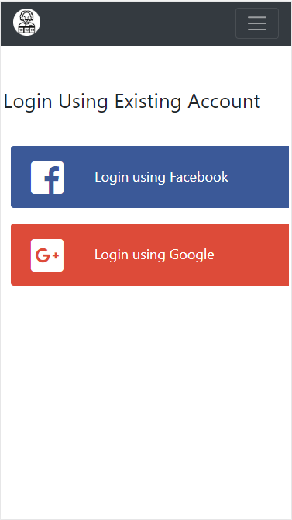
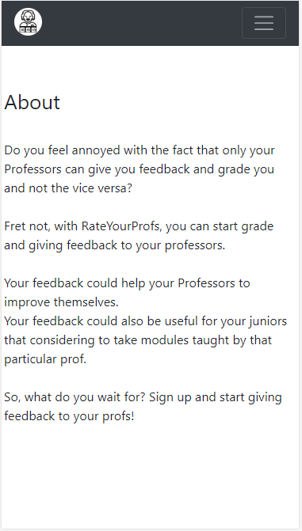
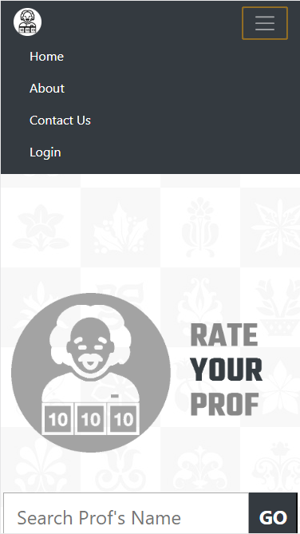
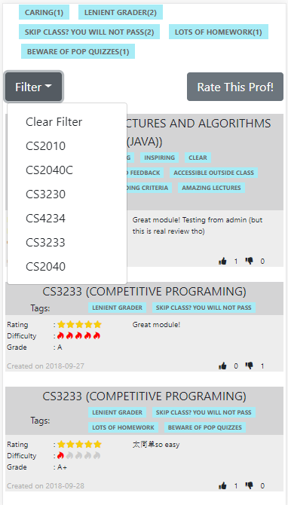
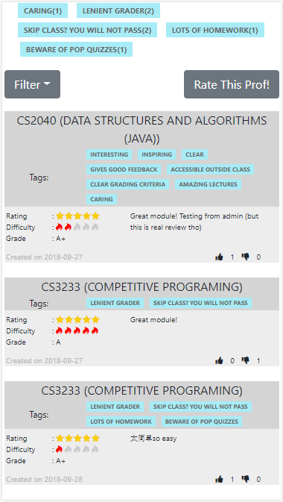
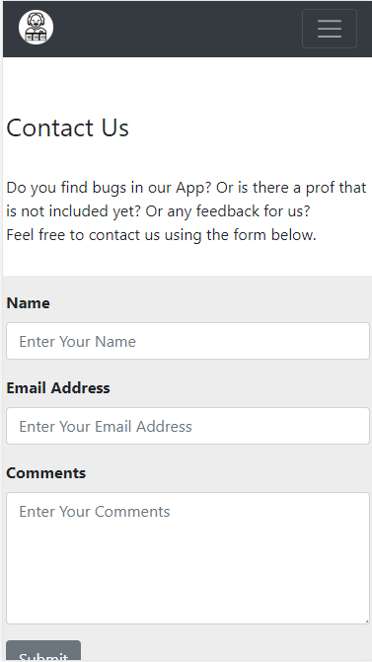

Slide 2
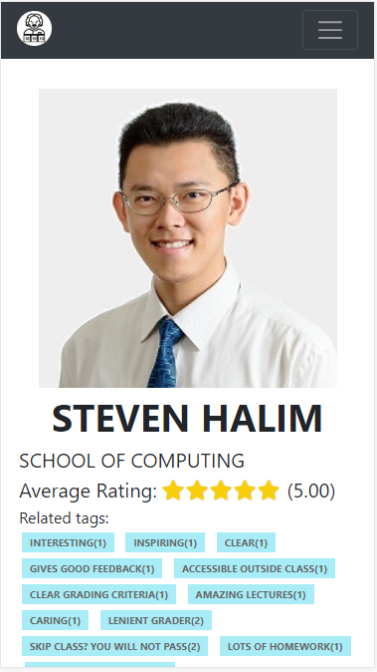
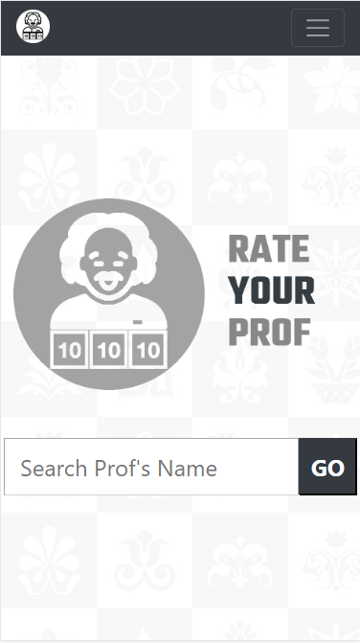
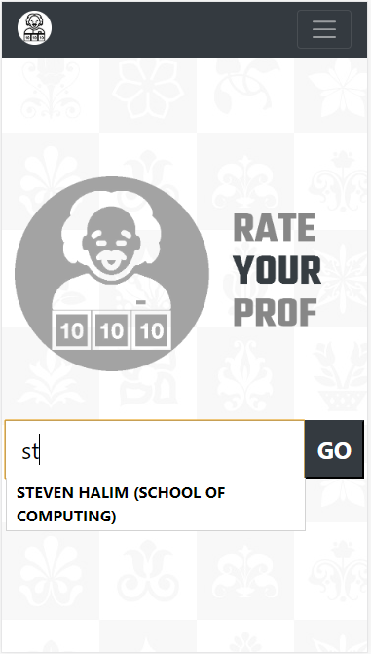
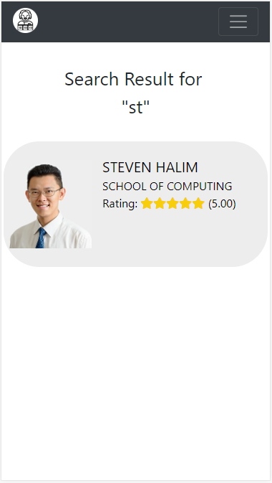
There will be autocomplete feature when user type a string
Pressing in the autocomplete suggestion box will immediately redirect user to the professor’s page
User can type to search professors
Pressing anywhere in the professor’s box will redirect user to the professor’s page
Pressing the “GO” button will lead user to search page

Slide 3
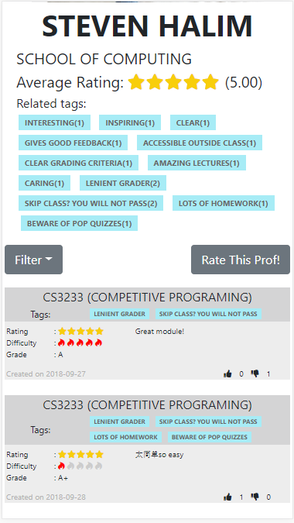
User can read comments for that particular professors, and even upvote/downvote that particular comment
When filter button is pressed, list of dropdown modules to filter will appear
Pressing a module will showing comments for that particular module only (filtered)
User can scroll down to view comments
Upvote Button
Downvote Button

Slide 4
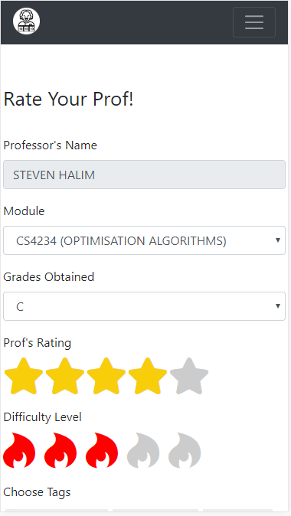
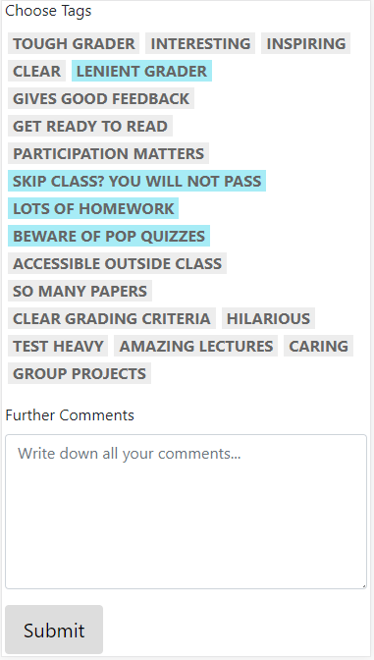
User can choose which module he has taken under the prof and what grade the user received from the prof.
After that, user can rate the prof and pick a difficulty level that the user thinks about this particular module by this particular professor
Pressing “Rate This Prof” will take the user to form to rate the professor (if the user not logged in yet, the user will be redirected to google login first) before can access the form
User can also pick tags that is fit for the prof, and some essay comments if the user want to rant further
After submitted the form, the user will be redirected to the professor page (the rating and tag list will be updated immediately, where the user can also immediately see his own post)

