Slide 1
Introduction
Dynamic Programming &
Greedy Algorithm
Notes:
In this module, we’ll discuss design patterns concerned with the process of creating non-trivial objects (which typically aggregate multiple other objects_.

Slide 2
Introduction
Dynamic Programming: Solve an optimization problem by caching subproblem solutions (memoization) rather than recomputing them. An optimal policy has the property that whatever the initial state and initial decision are, the remaining decisions must constitute an optimal policy with regard to the state resulting from the first decision.

Slide 3
Introduction
Greedy Algorithm: take the best immediate, or local, solution while finding an answer. Greedy algorithms find the overall, or globally, optimal solution for some optimization problems, but may find less-than-optimal solutions for some instances of other problems.

Slide 4
Example
10
20
15
4
12
19
11
6
3
9

Slide 5
Greedy
10
20
15
4
7
19
17
1
3
9
Greedy Algorithm: 10 + 20 + 7 + 3 = 40

Slide 6
Dynamic Programming
10
20
15
4
12
19
11
6
3
9
Pass 1： 15(11+4)， 18(6+12)， 28(9+19)
Pass 2： 38(18+20)， 33(28+15)
Pass 3： 48(38+10)

Slide 7
Solution
Dynamic Programming: 6 + 12 + 20 + 10 = 48, so in this problem, dynamic programming is the optimial solution.

Slide 8
Number of Swing Subsequence
A sequence of numbers is called a Swing sequence if the differences between successive numbers strictly alternate between positive and negative. The first difference (if one exists) may be either positive or negative. A sequence with fewer than two elements is trivially a swing sequence.
For example: [2,7,4,9,2,5] is a swing sequence because the differences (5,-3,5,-7,3) are alternately positive and negative.

Slide 9
Number of Swing Subsequence
Problem: return the number of the longest subsequence that is a wiggle sequence.
For example: Input: [2,17,5,10,13,15,10,5,16,8] Output: 7 There are several subsequences that achieve this length. One is [2,17,10,13,10,16,8].

Slide 10
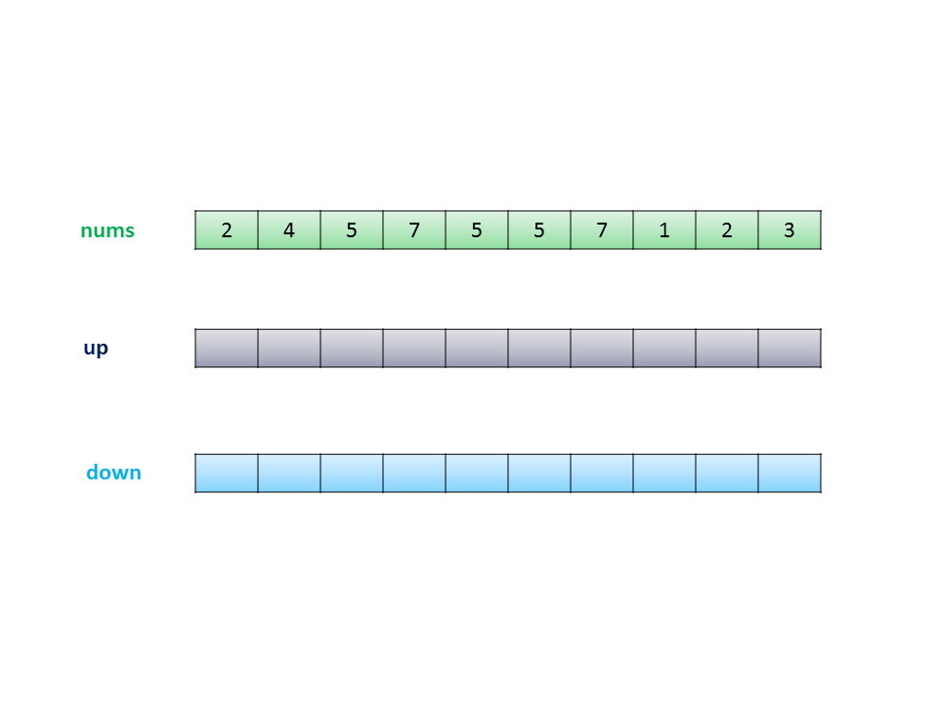
Dynamic Programming

Slide 11
Dynamic Programming
Up: it means nums[i] > nums[i−1]
Down: it means nums[i] < nums[i−1]
Equal: it means nums[i] == nums[i−1]
If nums[i]>nums[i−1], that means it swings up. The element before it must be a down position. So up[i]=down[i−1]+1 down[i] remains the same as down[i−1].
If nums[i]<nums[i−1], that means it swings down. The element before it must be a up position. So down[i]=up[i−1]+1, up[i] remains the same as up[i−1].

Slide 12
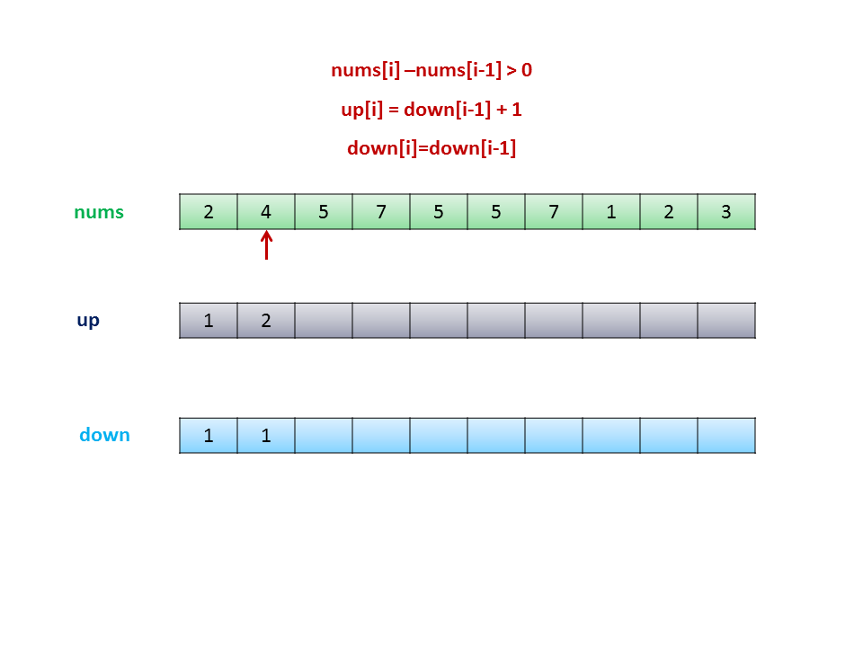
Dynamic Programming

Slide 13
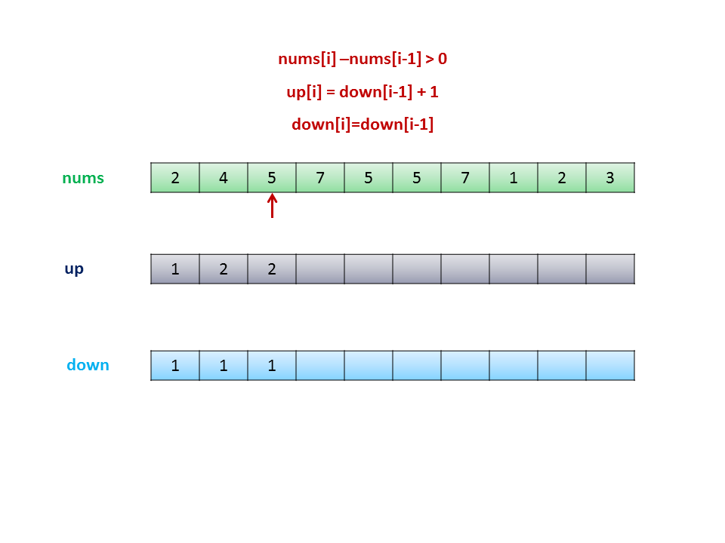
Dynamic Programming

Slide 14
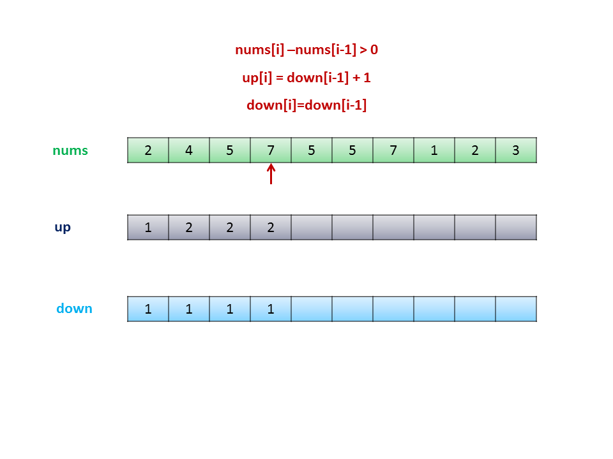
Dynamic Programming

Slide 15
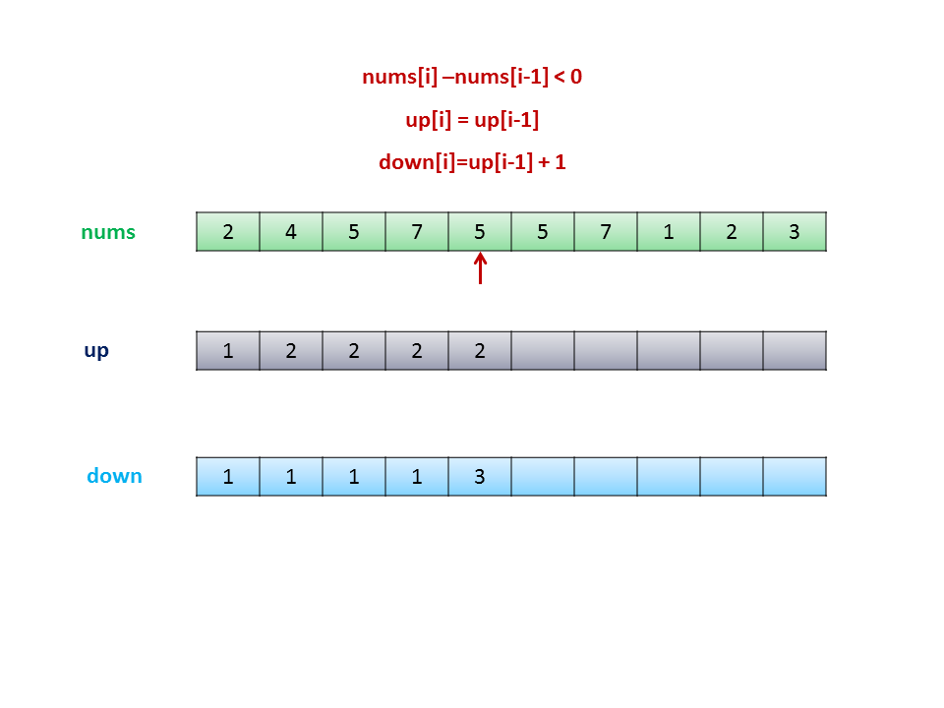
Dynamic Programming

Slide 16
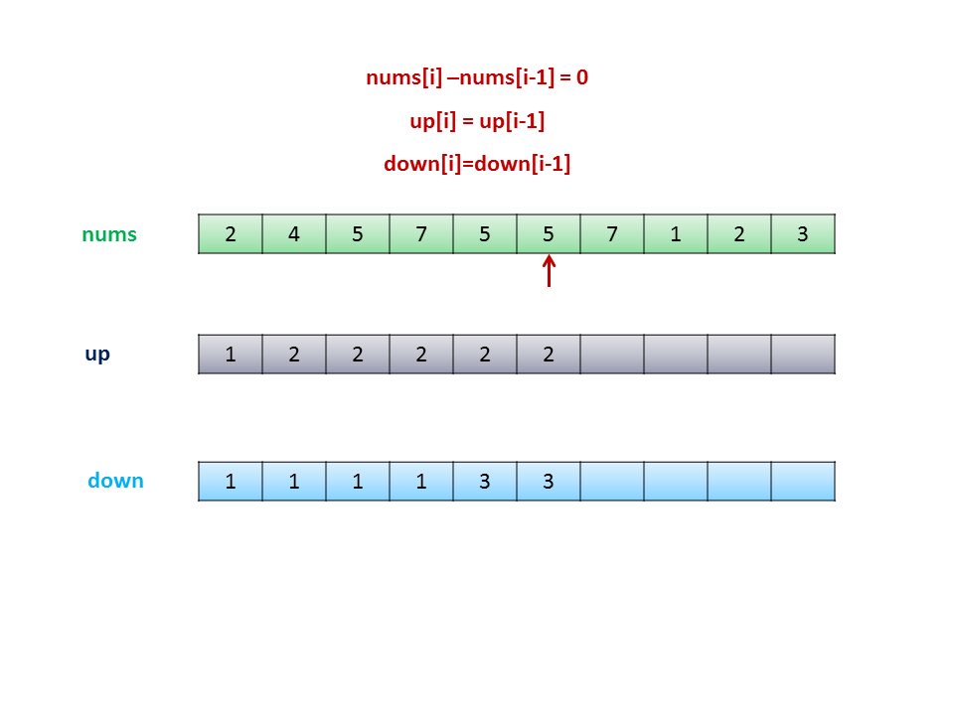
Dynamic Programming

Slide 17
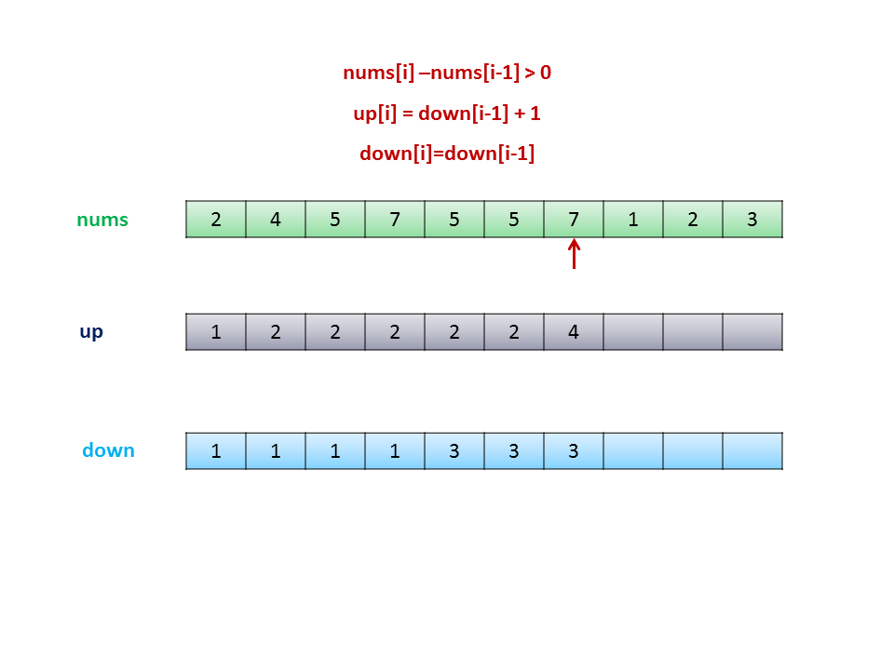
Dynamic Programming

Slide 18
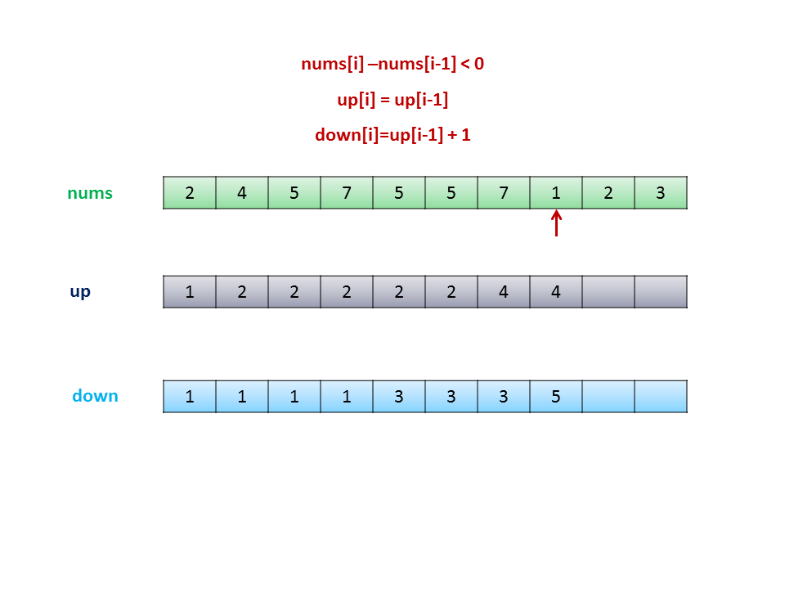
Dynamic Programming

Slide 19
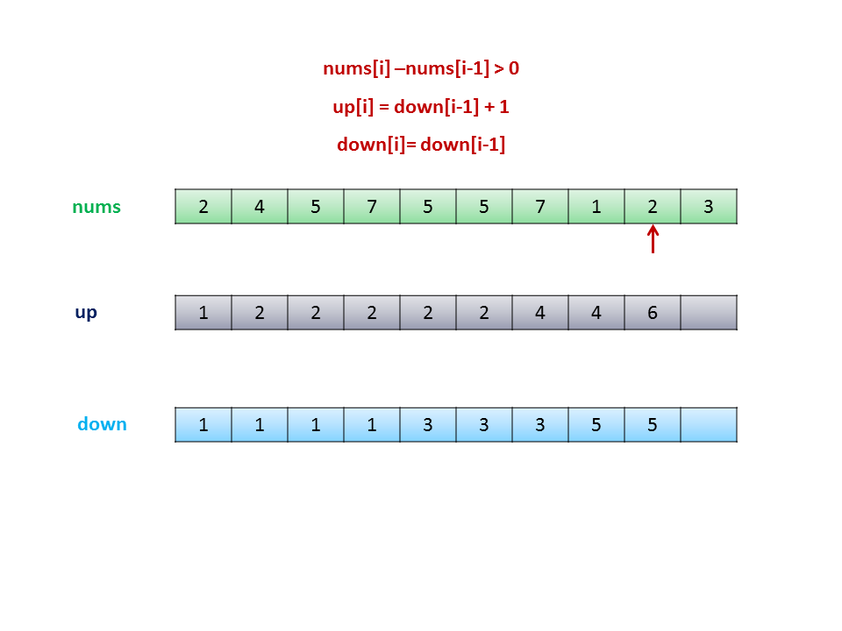
Dynamic Programming

Slide 20
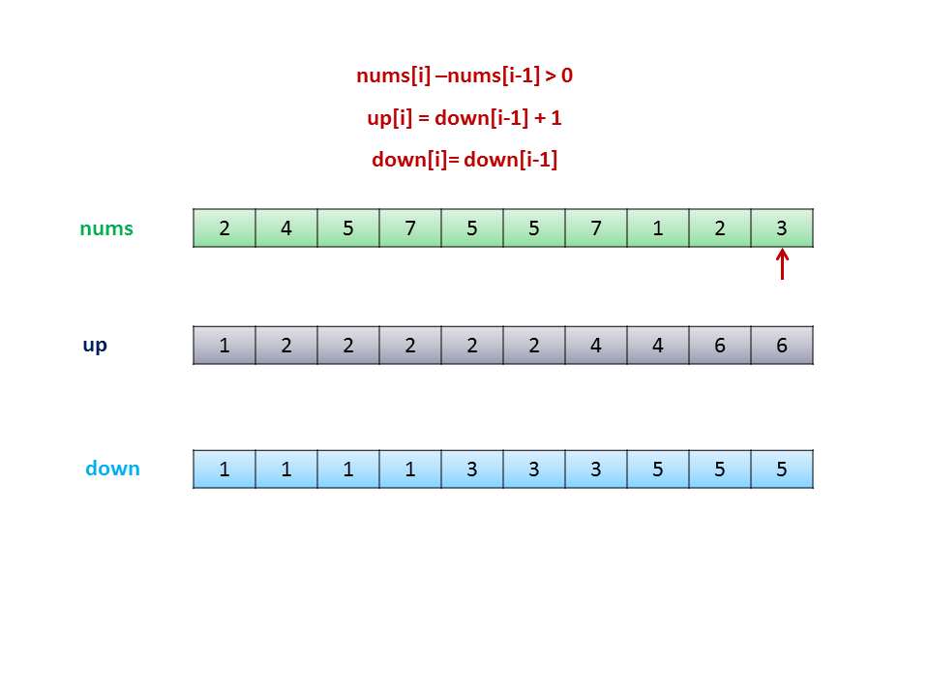
Dynamic Programming

Slide 21
Dynamic Programming
Result： Find Max(up, down), which is 6
Time complexity : O(n) Only one pass over the array length.
Space complexity : O(n) Two arrays of the same length are used for Dynamic programming

Slide 22
Greedy Algorithm
For swing sequence, since it always in three conditions: increase, decrease and equal.
To solve the issue locally, we can introduce a pointer: current, which is to indicate whether the current subsequence of numbers lies in an increasing or decreasing wiggle
If current > 0, it means that it is in an increasing swing, and we need to find the next decreasing swing.
If current < 0, it means that it is in a decreasing swing, and we need to find the next increasing swing.

Slide 23
Pseudocode
Initialization:
current = nums[1] - nums[0], diff = nums[i] - nums[i - 1];
for i = 2; i < nums.length; i++
if ((diff > 0 and current <= 0) or (diff < 0 and current >= 0))
prevdiff ← diff;
Number++;

Slide 24
Greedy Algorithm
Time complexity : O(n). It traverses the array once.
Space complexity : O(1). No extra space is used.

