Slide 1
Git: Distributed Version Control
Lecture 8

Slide 2
Merge: Bringing History together
Bring work from another branch into current branch
Implemented features, fixed bugs, etc.
Updates current branch, not other
HEAD
HEAD
current
other
other
current

Slide 3






Merge – Case 1: Ancestor
HEAD is an ancestor of other branch
HEAD
maint
master
$$α$$
$$β$$
$$γ$$
$$δ$$
$$ε$$
a
b
c
d
e
$$β$$
wt

Slide 4

Fast-Forward Merge
$ git merge master
HEAD
maint
master
$$α$$
$$β$$
$$γ$$
$$δ$$
$$ε$$
a
b
c
d
e
$$ε$$
wt

Slide 5


Merge – Case 2: No Conflicts
HEAD
maint
master
$$θ$$
f
$$α$$
$$β$$
$$γ$$
$$δ$$
$$ε$$
a
b
c
d
e
$$ε$$
wt

Slide 6


Merge Automatically Commits
$ git merge maint
HEAD
maint
master
$$θ$$
f
$$μ$$
g
$$α$$
$$β$$
$$γ$$
$$δ$$
$$ε$$
a
b
c
d
e
$$μ$$
wt

Slide 7


Merge – Case 3: Conflicts Exist
$ git merge maint
HEAD
maint
master
$$θ$$
f
$$α$$
$$β$$
$$γ$$
$$δ$$
$$ε$$
a
b
c
d
e
$$ε′$$
$$ε′′$$
files with
conflicts
marked
files that could
be merged
automatically
wt
ind

Slide 8
Merge: Resolve Conflicts
$ emacs somefile
HEAD
maint
master
$$θ$$
f
$$α$$
$$β$$
$$γ$$
$$δ$$
$$ε$$
a
b
c
d
e
files with
conflicts
resolved
$$μ$$
$$ε′′$$
wt
ind

Slide 9

Merge with Conflicts: Add
$ git add somefile
HEAD
maint
master
$$θ$$
f
$$α$$
$$β$$
$$γ$$
$$δ$$
$$ε$$
a
b
c
d
e
$$μ$$
$$μ$$
wt
ind

Slide 10


Merge with Conflicts: Commit
$ git commit
HEAD
maint
master
$$θ$$
f
$$μ$$
g
$$α$$
$$β$$
$$γ$$
$$δ$$
$$ε$$
a
b
c
d
e
$$μ$$
$$μ$$
wt
ind

Slide 11
(Distributed)VCS
HEAD
master
Sarah
wt
a
b
c
d
e

Slide 12
And Matt's Repository
HEAD
master
Sarah
wt
a
b
c
d
e
HEAD
Matt
master
wt
a
b
f
g

Slide 13
Some Shared History
HEAD
master
Sarah
wt
a
b
c
d
e
HEAD
Matt
master
wt
a
b
f
g

Slide 14
What Does "D" Stand For?
Distributed version control
Multiple people, distributed across network
Each person has their own repository!
Everyone has their own store (history)!
Big difference with older VCS (eg SVN)
Units of data movement: snapshots!
Communication between teammates is to bring stores in sync
Basic operators: fetch and push

Slide 15
Fetch: Remote Store → Local
HEAD
sarah$ git fetch mt
master
Sarah
wt
a
b
c
d
e
working
tree
unaffected!
f
g
mt/master
new changesets
added to store
remote
branch

Slide 16
Remote Repository Unchanged
HEAD
Matt
master
a
b
f
g

Slide 17
Workflow: Merge After Fetch
HEAD
sarah$ git merge mt/master
master
Sarah
a
b
c
d
e
h
f
g
mt/master

Slide 18
Remote Repository Unchanged
HEAD
Matt
master
a
b
f
g

Slide 19
View of DAG with All Branches
$ git log --oneline --graph --decorate --all
* 1618849 (HEAD, origin/master, master) clean up css
* d579fa2 (alert) merge in improvements from master
|\
| * 0f10869 replace image-url helper in css
* | b595b10 (origin/alert) add buckeye alert notes
* | a6e8eb3 add raw buckeye alert download
|/
* b4e201c wrap osu layout around content
* e9d3686 add Rakefile and refactor schedule loop
* 515aaa3 create README.md
* eb26605 initial commit

Slide 20
Your Turn
Show the state of Matt's repository after each of the following steps
Fetch (from Sarah)
Merge
Aside: "pull" combines fetch & merge
Advice: Prefer explicit fetch, merge
After fetch, examine changes
Easier to adopt more complex workflows (e.g., rebasing instead of merging)

Slide 21
Sarah and Matt's Repositories
HEAD
master
Sarah
a
b
c
d
e
h
f
g
HEAD
mt/master
Matt
master
a
b
f
g

Slide 22
Some Shared History
HEAD
master
Sarah
a
b
c
d
e
h
f
g
HEAD
mt/master
Matt
master
a
b
f
g

Slide 23
Fetch: Remote Store → Local
matt$ git fetch sr
HEAD
master
sr/master
Matt
a
b
f
g
h
c
d
e

Slide 24
Workflow: Merge After Fetch
matt$ git merge sr/master
HEAD
master
sr/master
Matt
a
b
f
g
h
c
d
e

Slide 25
Push: Local Store → Remote
Push sends local commits to remote store
Usually push one branch (at a time)
sarah$ git push mt fix
Advances Matt's fix branch
Advances Sarah's mt/fix remote branch
Requires:
Matt's fix branch must not be his HEAD
Matt's fix branch must be ancestor of Sarah's
Common practices:
Only push to bare repositories (ie no working tree, so no HEAD)
Get remote store's branch into local DAG (ie fetch, merge, commit) before pushing

Slide 26
Remote's Branch is Ancestor
HEAD
mt/fix
fix
Sarah
a
b
c
d
e
HEAD
Matt
master
fix
a
b
c
d
wt

Slide 27
Push: Local Store → Remote
HEAD
sarah$ git push mt fix
fix
mt/fix
Sarah
a
b
c
d
e
working
tree
unaffected!
HEAD
Matt
master
fix
a
b
c
d
wt
e

Slide 28
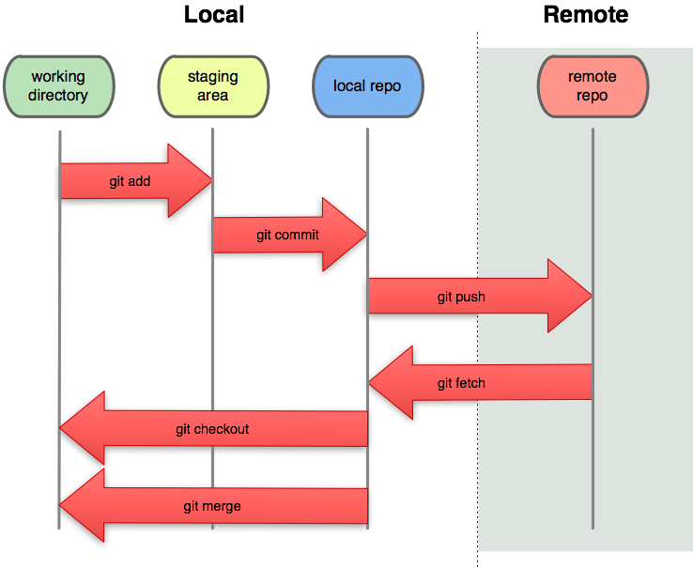
Commit/Checkout vs Push/Fetch

Slide 29
Common Topology: Star
Team has n+1 repositories
1 shared central repository (bare)
1 local repository / developer
Each developer clones central repository
Cloning creates a remote called "origin"
Default source/destination for fetch/push
Variations for central repository:
Everyone can read and write (ie push)
Everyone can read, but only 1 person can write (responsible for pulling and merging)

Slide 30
Workflow: Configure Git
Each team member, in their own VM
Set identity for authoring commits
$ git config --global user.name "Brutus Buckeye"
$ git config --global user.email bb@osu.edu
Optional: diff and merge tool (eg meld)
$ sudo apt-get install meld # to get tool
$ git config --global merge.tool meld
$ git config --global diff.tool meld
# example use:
$ git difftool e9d36

Slide 31
Workflow: Initialize Central Rep
One person, once (ssh'ed to stdlinux):
Create central repository in group's project directory (/project/c3901aa03)
$ cd /project/c3901aa03
$ mkdir rep.git # ordinary directory
Initialize central repository as bare and shared within the group
$ git init --bare --shared rep.git

Slide 32
Workflow: Initialize Repository
Each team member, once, in their VM
Create local repository by cloning the central repository
$ git clone ssh://brutus@stdlinux.cse.ohio-state.edu//project/c3901aa03/rep.git mywork
You will be prompted for your (stdlinux) password (every time you fetch and push too)
To avoid having to enter your password each time, create an ssh key-pair (see VM setup instructions)

Slide 33
Ignoring Files from Working Tree
Use file .gitignore in root of project
# Ignore auto-saved emacs files
*~
# Ignore bundler config
/.bundle
# Ignore the default SQLite database
/db/*.sqlite3
# Ignore all logfiles and tempfiles
/log/*.log
/tmp

Slide 34
Workflow: Local Development
Each team member repeats:
Edit and commit (to local repository) often
$ git status/add/rm/commit
Pull others' work when can benefit
$ git fetch origin # bring in changes
$ git log/checkout # examine new work
$ git merge, commit # merge work
Push to central repository when confident
$ git push origin master # share

Slide 35
Git Clients and Hosting Services
Recommended client: Command line!
Various GUIs:
Linux: gitg, git-gui, git-cola, giggle
Win/mac GUI: SourceTree
Lots of sites for hosting your repos:
GitHub, Bitbucket, SourceForge, Google Code,…
These cloud services provide
Storage space
Pretty web interface
Issues, bug tracking
Workflow with "forks" and "pull requests" to promote contributions from others

Slide 36
Warning: Academic Misconduct
GitHub is a very popular service
But only public repo's are free
Edu discount gives you 5 private repo's
3901 has an account for creating more private repo's (see class web site)
Bitbucket has free private repo's, for small teams (< 5 collaborators)
Public repo's containing coursework can create academic misconduct issues
Problems for poster
Problems for plagiarist

Slide 37
Mercurial (hg): Another DVCS
Slightly simpler mental model
Some differences in terminology
git fetch/pull ~= hg pull/fetch
git checkout ~= hg update
Some (minor) differences in features
No rebasing (only merging)
No octopus merge (#parents <= 2)
But key ideas are identical
Repository = working directory + store
Send/Receive changes between stores

Slide 38
Summary
Repository = working tree + store
Store contains history
History is a DAG of commits
References, tags, and HEAD
Commit/checkout are local operations
Former changes store, latter working tree
Push/fetch to share your store with remote repositories
Neither working tree is affected
Branches everywhere
Commit when HEAD is not a leaf
Fetch can create remote branches

Slide 39






Advanced: Undoing Mistakes
Say you want to throw away all your uncommited work
Ie "Roll back" to last commited state
Checkout won't work!
$$ε$$
wt
HEAD
maint
master
uncommited
changes
$$α$$
$$β$$
$$γ$$
$$δ$$
a
b
c
d
$$δ$$
ind

Slide 40

Reset: Discarding Changes
$ git reset --hard
$ git clean –-dry-run # list untracked files
$ git clean –-force # remove untracked files
$$δ$$
wt
HEAD
maint
master
replaced to be same as HEAD
$$α$$
$$β$$
$$γ$$
$$δ$$
a
b
c
d
$$δ$$
ind

Slide 41


Reset: Discarding Commits
$ git reset --hard HEAD~1
# no need to git clean, since wt was already clean
HEAD (and attached
branch) moved
$$γ$$
wt
HEAD
maint
master
replaced to be same as HEAD~1
$$α$$
$$β$$
$$γ$$
$$δ$$
a
b
c
d
$$γ$$
ind
now unreachable

