Slide 1
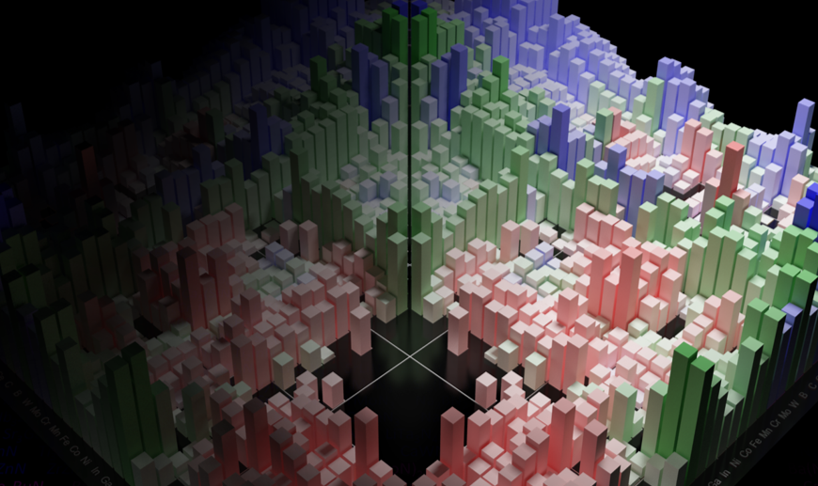
MSE 593 Data-Driven Materials Design and Genomics
MSE 593
Data-Driven
Materials Design
and Genomics
Prof. Wenhao Sun, whsun@umich.edu, H.H. Dow 2001
Prof. Katsuyo Thornton, kthorn@umich.edu, Offices: H.H. Dow 2022
Notes:
Syllabus Wenhao Sun
Set up Canvas – Katsuyo
Google Survey – Katusyo

Slide 2
A tour of the MaterialsProject
Go to www.materialsproject.org
Create an account
Explore Fe
Explore GaN
Explore others
Explore Crystal Toolkit
Important Aspects
Navigating search results
Crystal Structure in DFT
E_above_hull
mp-id

Slide 3
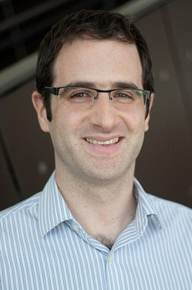
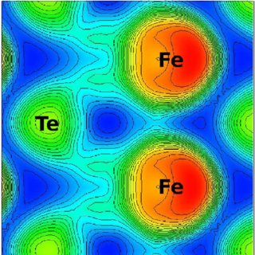
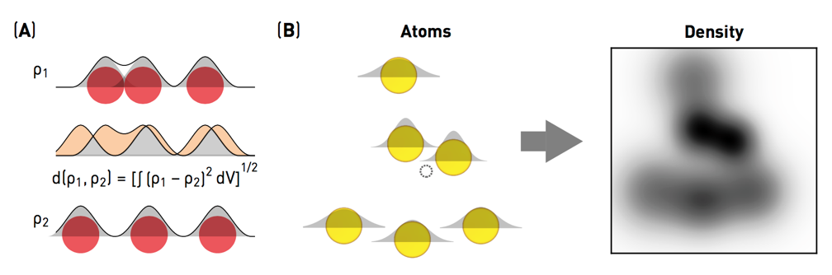
Professor Kioupakis asked me:
“I hypothesize that materials with the high atomic density will have strong overlap of atomic orbitals, which will be correlated with interesting semiconductor properties.”
How might we explore this?

Slide 4
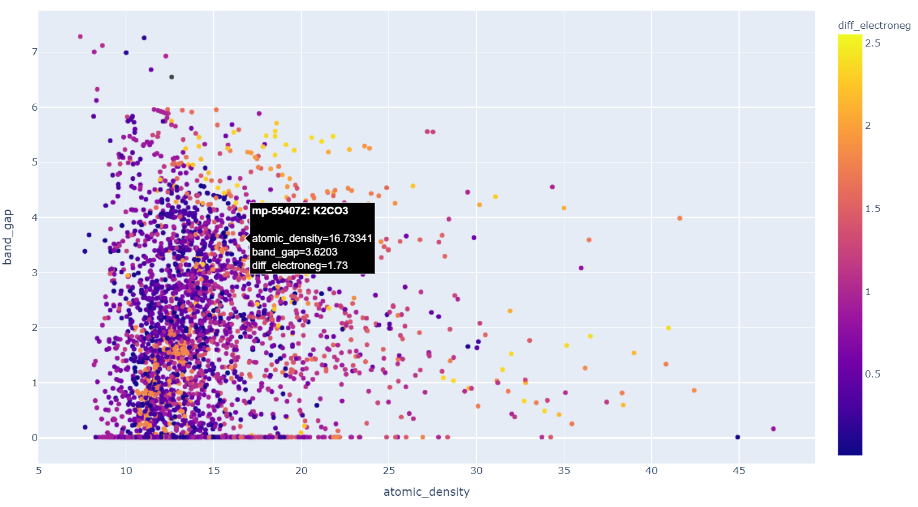
Go to wenhaosun.github.io
Click on MSE 593
Click on Lab 1
Download BandGapvsDensity.html

Slide 5
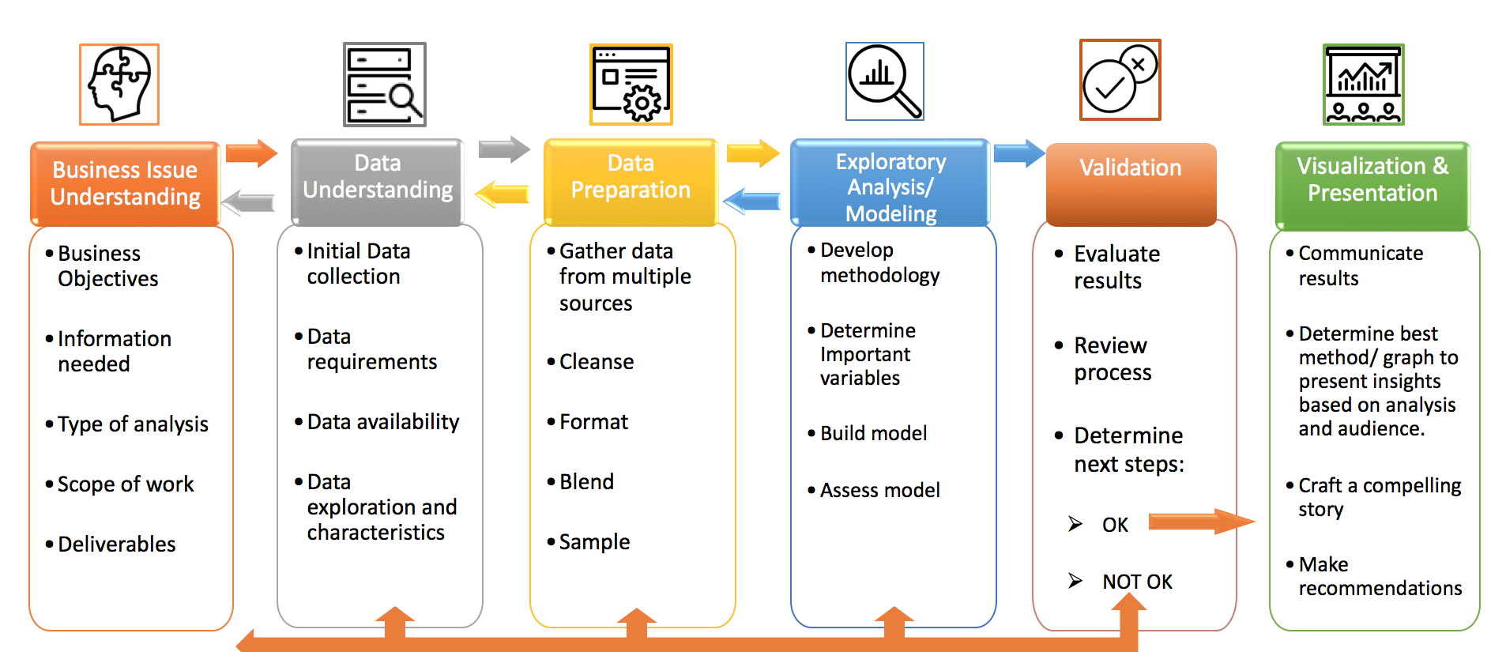
Materials Science and Engineering Version
of Crisp-DM
Materials
55%: Data Collection and Data Preparation
40% Analysis/Interpretation
5% Machine Learning

Slide 6
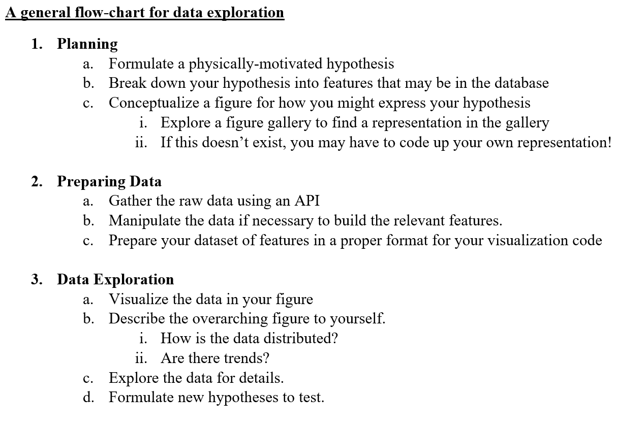

Slide 7
Coding Exercises Today
Gather data using MaterialsProject API
Prepare the data in a Pandas Dataframe
Code new features if needed
Plot the figure in Plotly
Go to wenhaosun.github.io/MSE593 for sample codes

Slide 8
Python Data Structures: https://docs.python.org/3/tutorial/datastructures.html#dictionaries
Materials Project features available via API: https://github.com/materialsproject/mapidoc/tree/master/materials
MongoDB Query Language: https://docs.mongodb.com/manual/reference/operator/query/
Pandas in 10 minutes: https://pandas.pydata.org/pandas-docs/stable/getting_started/10min.html
Object-oriented programming: Bank Account Example: https://www.geeksforgeeks.org/python-program-to-create-bankaccount-class-with-deposit-withdraw-function/
Pymatgen Composition object: https://pymatgen.org/pymatgen.core.composition.html
Figure Galleries:
Plotly Interactive Figures: https://plot.ly/python/
Matplotlib: https://matplotlib.org/gallery.html
Seaborn: https://seaborn.pydata.org/examples/index.html
Bokeh: https://docs.bokeh.org/en/latest/docs/gallery.html

