Slide 1
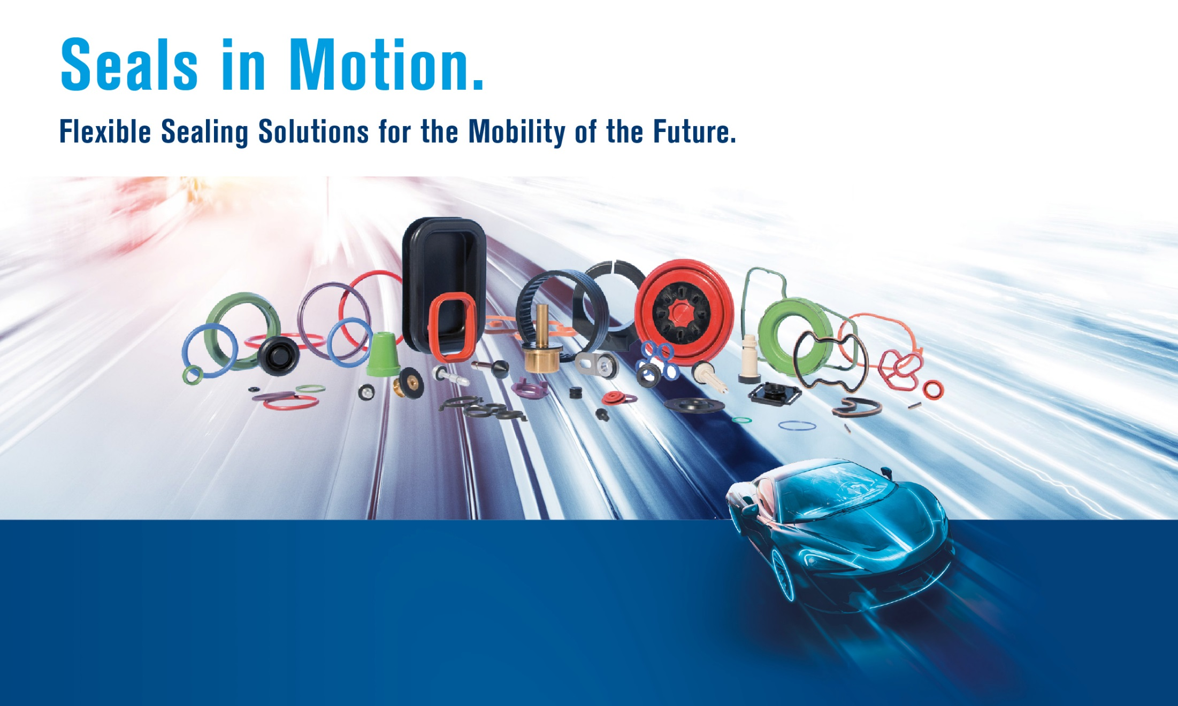
Thesis Progress Report
Niederwinkling, 29.02.24
Wen-Hao Wu
Notes:
Hello and welcome to my presentation Thesis Progress Report. My name is Wen-Hao and I have been working as an AI student in W&S since April 2023. And I started writing my Master Thesis from October 2023. I will be finishing my Master Thesis soon by the middle of next month. Thank you for joining me today to discuss the developments and insights from my research journey

Slide 2
Agenda
Thesis & Project Progress Report
The Present & Future of AI in W&S
Notes:
In this meeting, I will cover 2 main areas which are Thesis & Project Progress Report and I want to talk about the present & future of AI in the company.

Slide 3
Thesis Report
Core Idea of my Thesis in one Sentence
I want to create an AI that can detect defects „better“ than the current inspection machines
What means „better“?
Notes:
First of all, I want to go over again the core idea of my Thesis. To make it short and clear, I summarized the core idea of my Thesis into one sentence, which is: I want to create an AI that can detect defects better than the current inspection machines. But what means better?

Slide 4
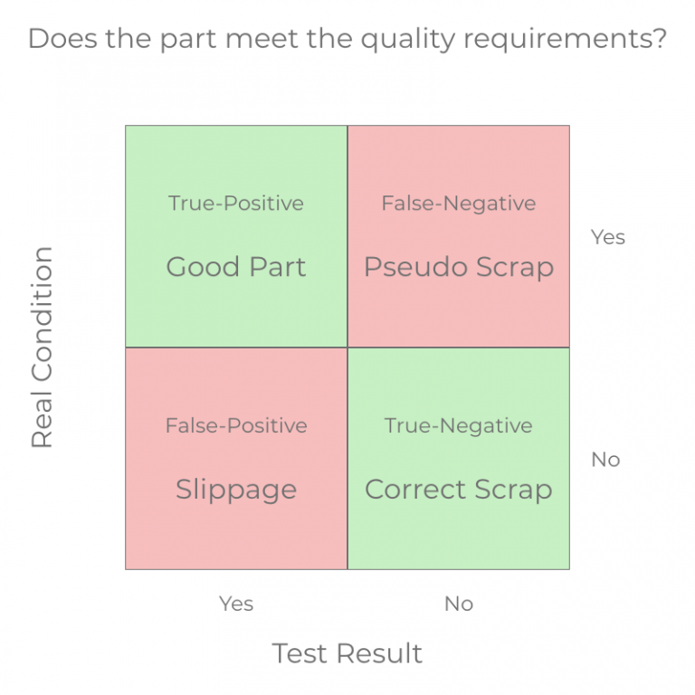
Thesis Report
What means „Better“?
Higher Accuracy
No Escaped Defect (priority)
Less Pseudo Scrap
Faster
Without sacrificing the cost of high-end hardware
Robust
Provide consistent results
KO
Correct Scrap
Escaped Defect
OK
Pseudo Scrap
Good Parts
KO
OK
Notes:
I approach the term better with 3 different critical angles: Higher Accuracy, Faster processing speed, more robust. Higher accuracy meaning lesser pseudo scrap and no escaped defect, which is our priority that our clients do not get defective products. Faster, but with one condition, without sacrificing the cost of high-end hardware. In other words, faster with limited budget. Robust, meaning the AI should provide consistent results. The situation right now with the UTP machines is like this: First, the set up time is very long. You could spend the whole day setting up the defect library, and you feel confident with your library, and you run a new batch and after that, the human inspection department tells you that 30 more defect parts were not found. And this should not be the case.

Slide 5
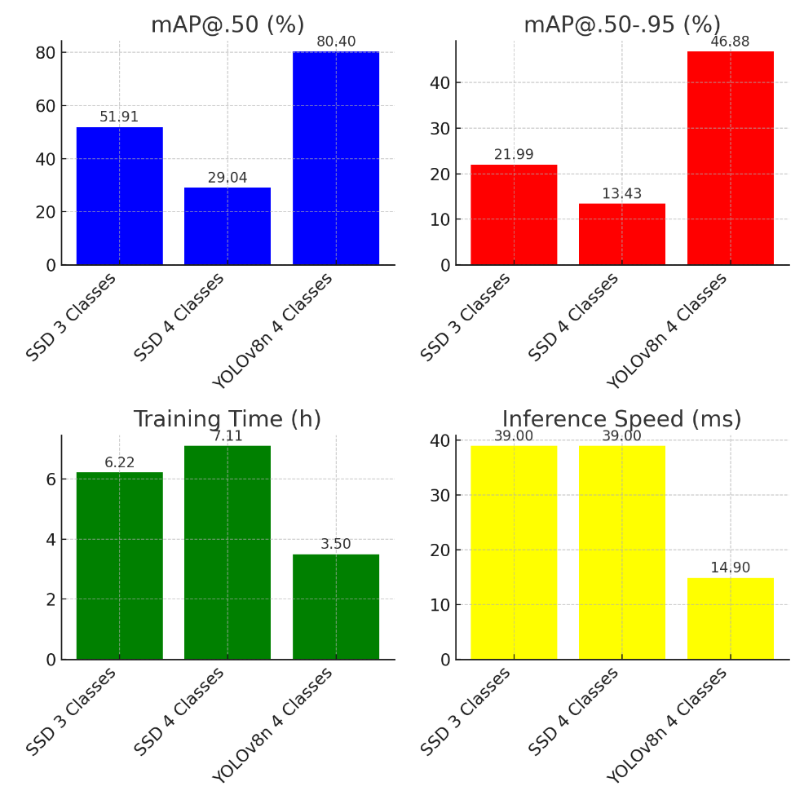
Thesis Report
My Approach to achieve „more Accurate and more Robust“
Comparison of 2 different DL models
YOLOv8 overall superior
Notes:
My approach to achieve “more accurate and more robust” is: First of all, based on my research and my experiences, if I want to achieve more accurate and more robust, I should go for deep learning. And for deep learning, there are several models to be chosen, on the screen, we can see the result of 3 different training experiments. They are SSD trained with three classes, SSD trained with four classes, and YOLOv8n trained with 4 classes. As a result, we can see YOLOv8 just overall outperforms SSD in every perspective. It has higher map score, it has lower training time, faster inference speed

Slide 6
Thesis Report
My Approach to achieve „more Accurate and more Robust“
Many different algorithms and deep learning models were researched and tested
As a result, a collection of open-source deep learning AI models called YOLOv8 are the best-performing ones
YOLOv8 models are tested and documented to be more accurate and robust
Notes:
My approach to achieve “more accurate and more robust” is: First of all I did a lot of research testing regarding different algorithms and deep learning models. And as a result, a collection of open-source deep learning AI models called YOLOv8 are the best-performing ones. I also did a lot of tests documented in my Thesis to proof the effectiveness of YOLOv8.

Slide 7
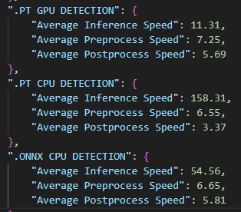
Thesis Report
My Approach to achieve „Faster“
Detection using a GPU is always faster than a CPU
GPUs are costly and CPUs are cheap
The real question is: How to detect faster on a CPU?
Solution: Convert YOLOv8 model to ONNX format (open-sourced by Microsoft)
Inference speed is increased up to 3 times
Notes:
Next let’s talk about my approach to achieve “Faster”. First we need to understand one thing: detection using a GPU is always faster than a CPU. However, GPUs are costly and CPUs are cheap. So this brings us to the real question: How to detect faster on a CPU? My solution to this is I convert YOLOv8 model that I mentioned earlier to ONNX format, which is open-sourced by Microsoft, to boost up the detection speed. Here you can see a small report showing the different detection speed using different models. .PT is the model format of YOLOv8. So you can see .PT format on GPU only takes in average 11 ms. However, .pt format on CPU drastically increase to 158 ms (which is not bad comparing to other deep learning models). And if we convert the .pt to .onnx, the detection speed was decreased to only 54 ms.

Slide 8
Thesis Report
Conclusion
I trained a YOLOv8 model that is fast, accurate, robust
The model is trained on a dataset collected from the BigX machines
To boost up the performance even more, the model is converted to ONNX format
Notes:
In conclusion, I trained the YOLOv8 model for this project because after my research and testing, it turns out to be fast, accurate, and robust. It is just overall superior comparing to other deep learning models. The dataset was collected from the BigX machines. The reason for that is to compare the training results between 2 different systems
Even though YOLOv8 itself is already fast enough, I converted the yolov8 model to onnx format to further boost up the inference speed

Slide 9
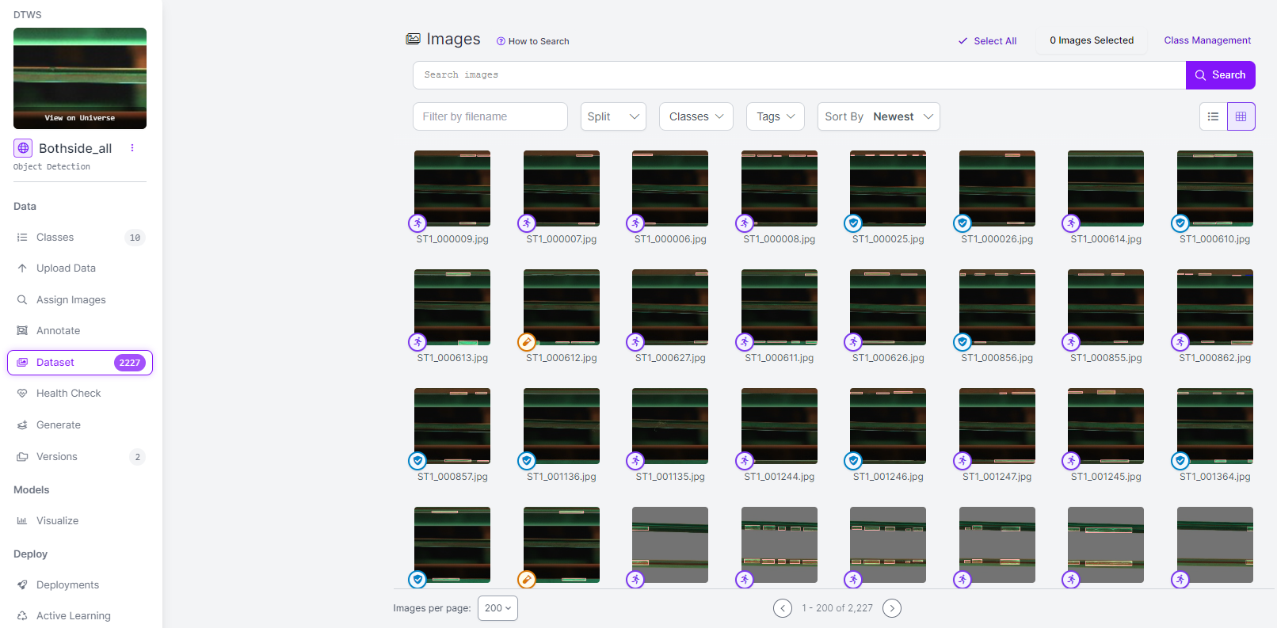
Thesis Report
What else was done?
~2200 pictures with careful markings
Notes:
In conclusion, I trained the YOLOv8 model for this project because after my research and testing, it turns out to be fast, accurate, and robust. It is just overall superior comparing to other deep learning models. The dataset was collected from the BigX machines. The reason for that is to compare the training results between 2 different systems
Even though YOLOv8 itself is already fast enough, I converted the yolov8 model to onnx format to further boost up the inference speed

Slide 10
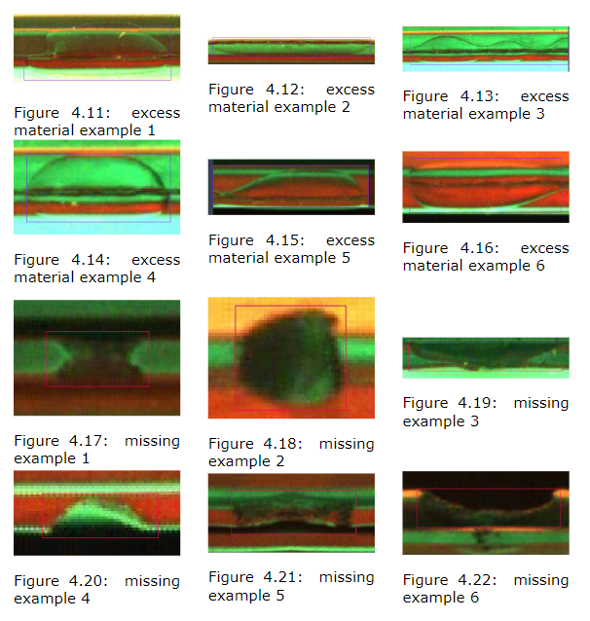
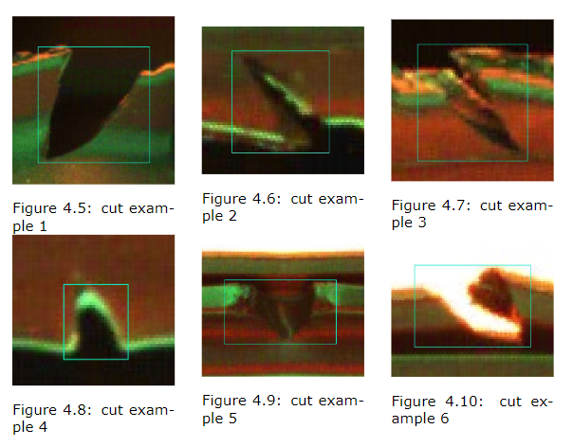
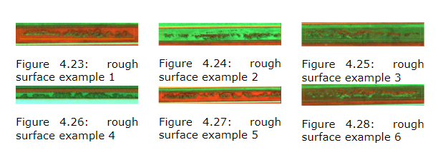
Thesis Report
What else was done?
Cut, Missing, Rough Surface, Excess Material
Notes:
In conclusion, I trained the YOLOv8 model for this project because after my research and testing, it turns out to be fast, accurate, and robust. It is just overall superior comparing to other deep learning models. The dataset was collected from the BigX machines. The reason for that is to compare the training results between 2 different systems
Even though YOLOv8 itself is already fast enough, I converted the yolov8 model to onnx format to further boost up the inference speed

Slide 11
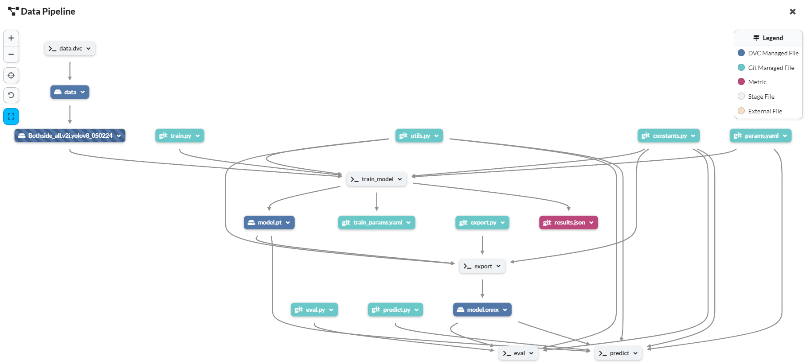
Thesis Report
What else was done?
An operation pipeline that automates the ML Process (Train, Export, Evaluation, Predict)
Notes:
In conclusion, I trained the YOLOv8 model for this project because after my research and testing, it turns out to be fast, accurate, and robust. It is just overall superior comparing to other deep learning models. The dataset was collected from the BigX machines. The reason for that is to compare the training results between 2 different systems
Even though YOLOv8 itself is already fast enough, I converted the yolov8 model to onnx format to further boost up the inference speed

Slide 12
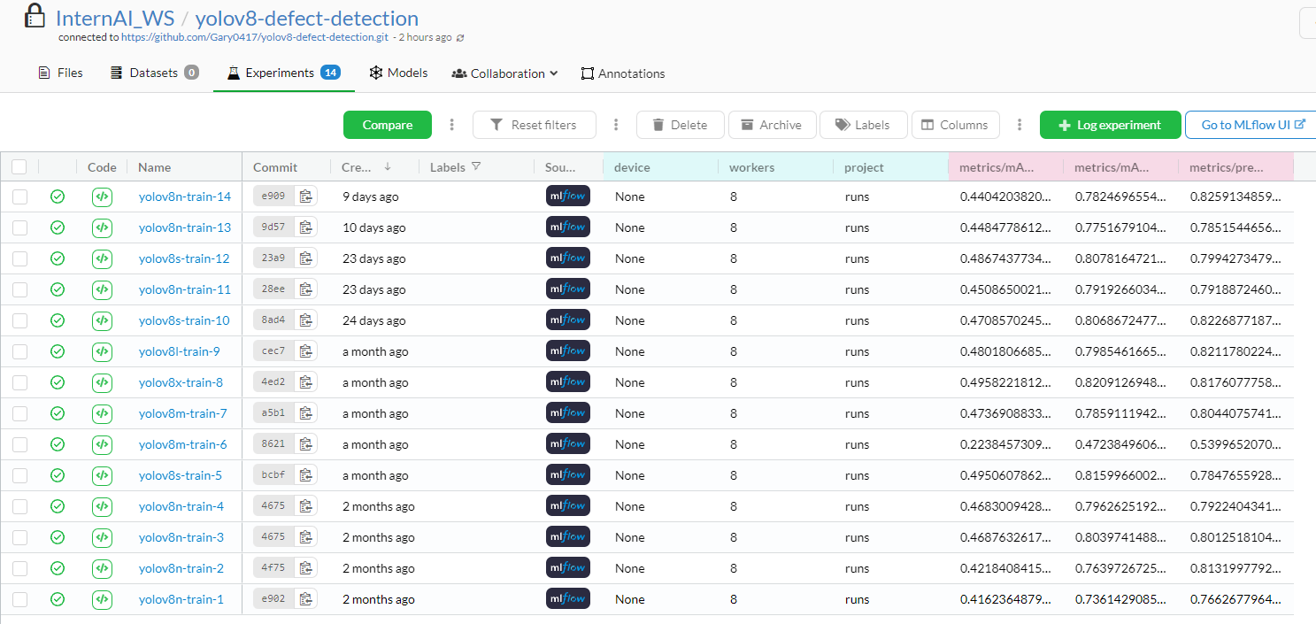
Thesis Report
What else was done?
Store and index training parameters and results in a cloud-based database
Notes:
In conclusion, I trained the YOLOv8 model for this project because after my research and testing, it turns out to be fast, accurate, and robust. It is just overall superior comparing to other deep learning models. The dataset was collected from the BigX machines. The reason for that is to compare the training results between 2 different systems
Even though YOLOv8 itself is already fast enough, I converted the yolov8 model to onnx format to further boost up the inference speed

Slide 13
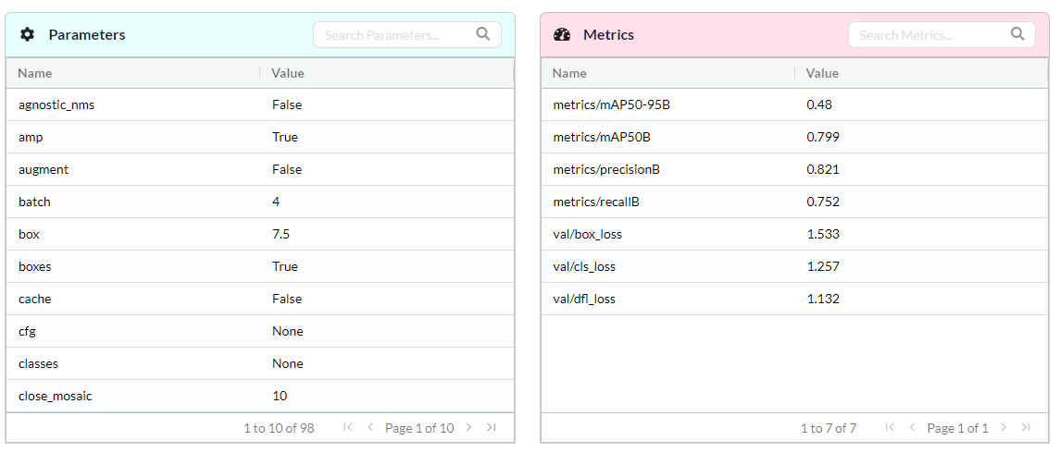
Thesis Report
What else was done?
Store and index training parameters and results in a cloud-based database
Notes:
In conclusion, I trained the YOLOv8 model for this project because after my research and testing, it turns out to be fast, accurate, and robust. It is just overall superior comparing to other deep learning models. The dataset was collected from the BigX machines. The reason for that is to compare the training results between 2 different systems
Even though YOLOv8 itself is already fast enough, I converted the yolov8 model to onnx format to further boost up the inference speed

Slide 14
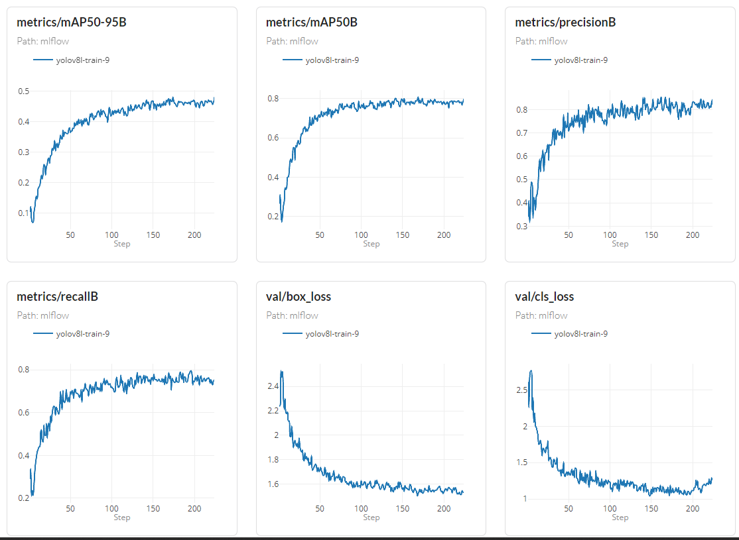
Thesis Report
What else was done?
Store and index training parameters and results in a cloud-based database
Notes:
In conclusion, I trained the YOLOv8 model for this project because after my research and testing, it turns out to be fast, accurate, and robust. It is just overall superior comparing to other deep learning models. The dataset was collected from the BigX machines. The reason for that is to compare the training results between 2 different systems
Even though YOLOv8 itself is already fast enough, I converted the yolov8 model to onnx format to further boost up the inference speed

Slide 15
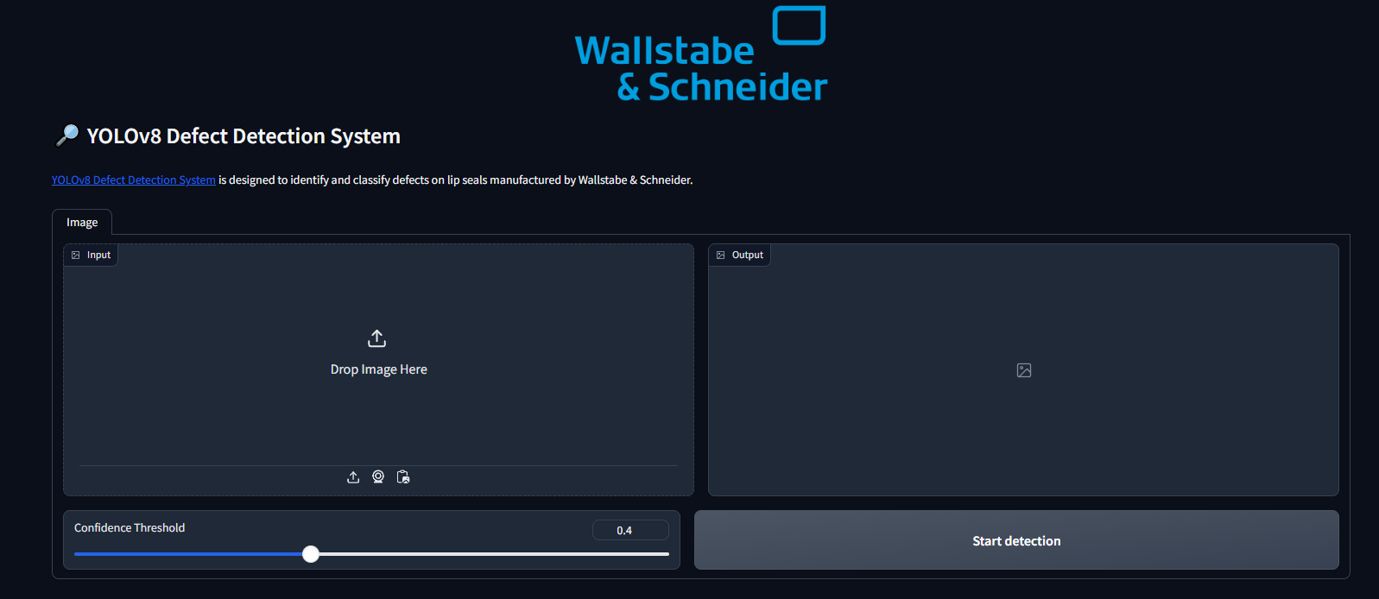
Thesis Report
What else was done?
GUI for training and detection
Notes:
In conclusion, I trained the YOLOv8 model for this project because after my research and testing, it turns out to be fast, accurate, and robust. It is just overall superior comparing to other deep learning models. The dataset was collected from the BigX machines. The reason for that is to compare the training results between 2 different systems
Even though YOLOv8 itself is already fast enough, I converted the yolov8 model to onnx format to further boost up the inference speed

Slide 16
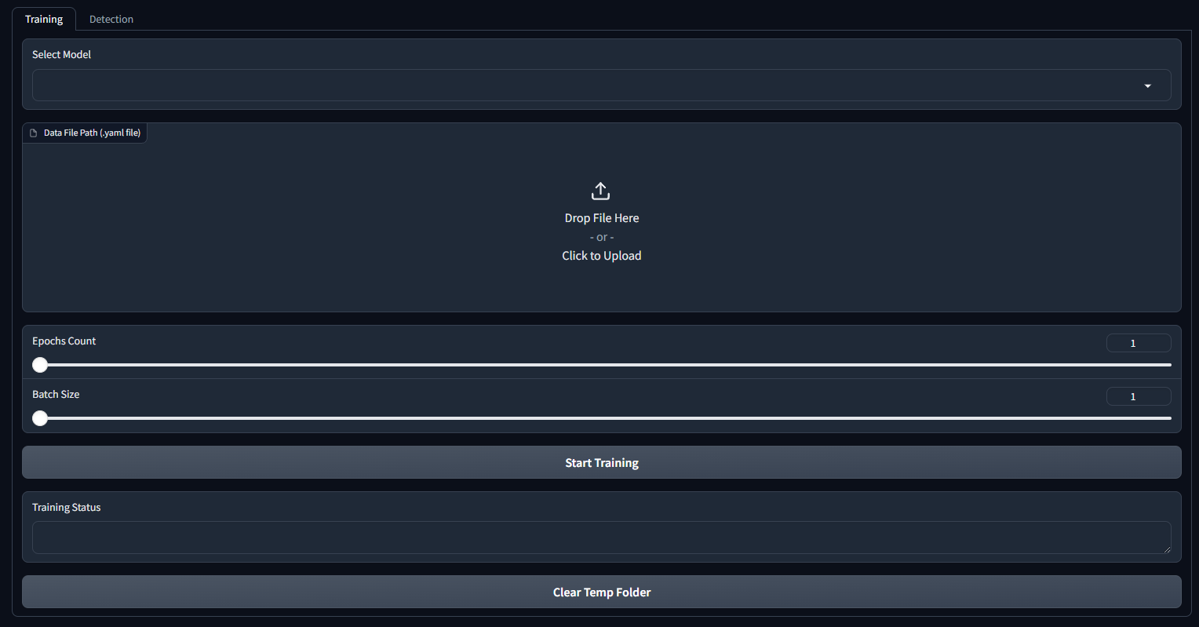
Thesis Report
What else was done?
GUI for training and detection
Notes:
In conclusion, I trained the YOLOv8 model for this project because after my research and testing, it turns out to be fast, accurate, and robust. It is just overall superior comparing to other deep learning models. The dataset was collected from the BigX machines. The reason for that is to compare the training results between 2 different systems
Even though YOLOv8 itself is already fast enough, I converted the yolov8 model to onnx format to further boost up the inference speed

Slide 17
Thesis Report
What else was done?
We implemented an operation pipeline that does several thing
A pipeline that automates the whole Machine Learning Process (Train, Export, Evaluation, Predict)
Store and index training parameters and results in a cloud-based database
A simple GUI to start detection for users who don’t know how to work with the command line
A large amount of time was invested in data acquisition, namely ~2200 pictures with careful markings
Notes:
What else did I do in this project? One of the most improvement achievements I would say is we implemented an operational pipeline that automates the whole machine learning processing, starting from training, export, evaluation, and predict. This means with one command, the system runs through all the important steps of a machine learning life cycle. What is also important is that the all the data generated during the automation were saved in a cloud-based database where it can be checked by any interested party anytime about any experiment done in the past. On top of that, a simple GUI was created to start detection for users who don’t know how to work with the command line.

Slide 18
Thesis Report
What did I write in my Thesis?
I documented the whole journey of my project of my approach to achieve „better“
Motivation and Objectives
Literature Reivew
Methodologies
Results Evaluation
Future Outlook
Notes:
So what did I actually write down in my Thesis? I basically documented the whole journey of my project of my approach to achieve “better”. This includes Motivation and Objectives, Literature Review, Methodologies including details of my workflow, evaluation of different results, and in the end a future outlook of the project.

Slide 19
Thesis Report
Future Outlook
Add more features to the system:
Generating a report after detection
Further improve error handling
Further refine GUI
Further refine unit testing and validation testing
..
Further improve dataset quality
Explore the opportunity to scale the system to detect on other articles
Explore the methods to further improve inference speed
Deploying the system on a Linux environment
Convert the AI model to a different format
Deploy the system onto inspection platforms (prototyping)
Cloud
Locally
Notes:
Talking about future outlook, there are several directions we can progress further. First of all, add more features to the system, this includes maybe: generating a report after detection, further improve error handling, further refine GUI, further unit testing and validation testing, and so on.
Secondly, further improve dataset quality, such as further expand dataset size and refine the marking even more or remove ambiguous training data.
Or we can explore the opportunity to scale the system to detect on other articles. Right now the system focuses on detecting only Lippendichtung. In the future we can maybe also try to use it to detect other types. Another direction could be to explore techniques to further improve inference speed. For example we can consider deploying the system on a Linux environment, or convert the AI model to a different format other than ONNX. When the system is more mature, we can also consider deploying the system onto cloud platforms such as AWS, Azure, or company’s own server. Other alternative will be to deploying onto hardware platforms, but this will be more costly and a relatively large commitment.

Slide 20
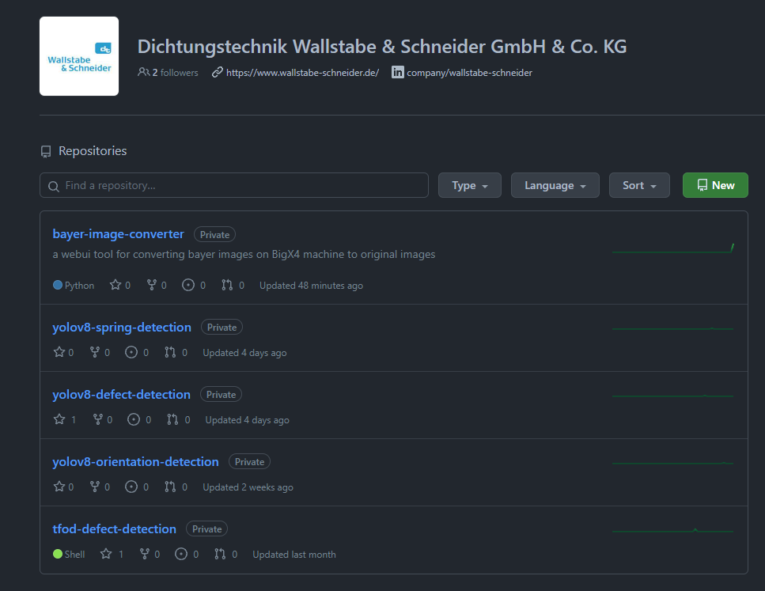
The Present & Future of AI in W&S
Current AI Achievements
A collection of developed software is stored on Github under the W&S page
Bayer-image-converter
Yolov8-spring-detection
Yolov8-defect-detection
Yolov8-orientation-detection
Tfod-defect-detection (deprecated)
…
The source code and user guidelines are stored in each repository
Documentation of UTP AI
Notes:
Moving on the topic “The present & Future of AI in W&S”. I wanna first talk about the present AI achievements. The biggest achievement I would say is we now have a collection of developed software on the W&S github page. It includes some utility software and projects we worked on. The source code and user guidelines can be found in each repository. On top of that, we also created a documentation of the AI of UTP Machines to combine our knowledge of AI and the experience gathered during operating the UTP machines.

Slide 21
The Present & Future of AI in W&S
Current Situation
A small team of 2 students that is located in the Automaten Kontrolle department
Free and creative working environment
Lack of organized project management standards and leadership
Low working efficiency due to lack of admin rights
Notes:
Next I want to talk about the current situation of AI in the company. Right now as far as I know, we are a small but dynamic team of 2 students that is located in the Automaten Kontrolle department. I would say we work in a free and creative working environment where we can brainstorm and come up with solutions all by ourselves. I am personally not against this idea but we sure are lacking organized project management standards and leadership, where someone could guide us on our decision making telling us this is a good idea, this idea is not feasible because of this and that reason. This will certainly boost our working efficiency. Also, a huge problem that we face is lack of admin rights to install packages, install software, access to hardware like camera. For example in Gary’s project, where he needs access to webcams to take photos for detection. However, camera access is blocked by the firewall therefore everytime he needs camera access he will have to make an appointment with the IT-Technik. And IT-Technik is also very busy, they cannot respond to our requests in a timely fashion. I want address the solution to these situations in the up coming slides.

Slide 22
The Present & Future of AI in W&S
Strategic Steps Towards the Future (my opinion)
AI team as a sub-department/ focus-team
Cross-departmental collaboration
Leadership and organizational structure
Senior AI-experienced leadership to guide the AI team
Establish best practices
Organize project management
Communicate as a bridge between different departments
Ensure strategic alignment of AI efforts with company goals
Work closer to the IT department
Notes:
Now we have a general Idea of the current situation, and now I would like to talk about the strategic steps towards the future in my opinion.
First I think, making the AI team as a sub-department under IT or as a stand-alone department would be a good idea. The most important thing is we should work closer with the IT department. Then we as a team can take projects from different departments. Second, I think it would be great we have a senior level AI-experienced leader to establish leadership and organizational structure. Where he/she can for example establish best practices, organize project management, communicate between different departments, and ensure what we are doing really align to company goals.
And of course to grant necessary admin rights and provide access to essential tools. And I would like to discuss this topic further in the next slide.

Slide 23
The Present & Future of AI in W&S
Resource Allocation and Empowerment
Requirements:
Flexible software installation and access to essential tools to address project needs and adapt to technological advancements
Secure Workstation Solutions:
IT-Technik suggests building workstations outside the network to install software without risking network security.
For needs like Gary’s Bachelor Thesis, which requires network access and admin rights, the traditional approach is suboptimal.
Proposed solutions:
Virtual Machine
Dual Boot
VPN?
Additional suggestions from Heinz are to be considered.
Notes:
Regarding resource allocation and empowerment, first I would like to talk about the requirements from us. We need flexible software installation and access to essential tools. I want to emphasize the word Flexible here. Because for different project, we might need different software. And during development, trial and error is inevitable. So we cannot just tell IT that we need software 1234 then we are good forever.
Regarding the solution of this problem, IT-Technik suggests building workstations outside the network of the company so we can install anything without risking the network security. But there is a problem, for example in Gary’s Bachelor thesis, he will also need data from SAP, OCQ and so on. Working with a completely isolated working station will be hard for him. I am not sure if I makes sense, since I am not a network security guy, but maybe we can try using virtual machines or dual boot options to have access to company network and isolated working station.

Slide 24
The Present & Future of AI in W&S
Data Storage Challenges
Defect and Product Images:
Utilize Roboflow for image annotation; it's efficient and free.
Public vs. Private:
Continue with a public, free plan.
Opt for privacy at ~€250/month.
Experiment Data (AI Training):
Stored in Dagshub (S3 bucket), outside company storage. Seeking opinions on this approach.
Output Data from Rubber Spring Project:
Anticipated storage issue due to accumulating detection images.
Potential solutions: External or cloud storage to manage the growing library.
Notes:
In the end I want to address some data storage challenges that we have right now. First of all, In our projects, we have a lot of defect and product images that we need to label. And we are currently using a online tool called roboflow for image annotation. It is a really great tool for everything we wanted and it is free. However, one problem is that our dataset will be publicly available. And making it private will cost around 250 euros per month. Right now our data is not very sensitive, they are just defective parts from our products. However, in the future we might encounter projects where we need to work with sensitive data. Then making it private should be considered.
And for experiment data, so basically the data from each AI training, they are currently store in a S3 bucket provided by Dagshub. It is consider safe there, but at the end of the day, it is still stored outside the company storage. If company thinks this is okay, we can continue this approach, or we will have to consider a different approach to this. Such as S3 bucket provide by the company or something similar. And I am asking this question on behalf of Gary: He has a project to detect rubber spring, and he is required to save pictures after every detection. Over time, the library will build up causing storage problem. And this is a problem we need to discuss what is more suitable for the company. Either we can have a super huge disk space or we need to think of cloud storage solution.

Slide 25
Thank you!

