Slide 1

Introduction to AI-Driven Quality Control Inspection in Wallstabe & Schneider
Niederwinkling, 18.04.23
Wen-Hao Wu
Notes:
Hello everyone,
welcome to my presentation Introduction to AI-Driven Quality Control Inspection fin Wallstabe & Schneider. A short introduction to myself, my Name is Wen-Hao Wu. I am a working student here in the quality control department and I support the AI related projects. Thank you for joining me today, and let’s begin.

Slide 2
Agenda
Fundamentals of AI
What is AI?
Why do we need AI?
What kinds of AI are there?
How does AI learn?
Demo
Notes:
In this presentation, first of all, to give you some background knowledge, I will go through some fundamentals of AI. After that I will show you a short demonstration on how to operate the AI in our system.

Slide 3
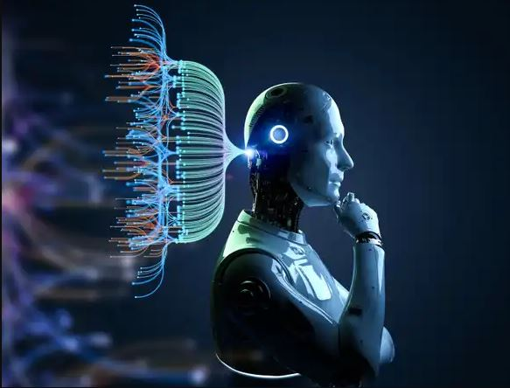
Fundamentals of AI
What is Aritificial Intelligence?
Machines or systems that can perform tasks and make decisions that typically require human intelligence
Source: https://seekingalpha.com/article/4593012-the-softer-side-of-artificial-intelligence
Notes:
First of all, What is AI? AI typically refers to machines or systems that can perform tasks and make decisions that typically require human intelligence.

Slide 4

Fundamentals of AI
Why do we need AI?
Detect defects to ensure product quality
automate the inspection process and improve accuracy
Notes:
Next, I would like to discuss, why do we need AI in our company?
At Wallstabe & Schneider, ensuring the quality of our products is crucial. We need to be able to inspect them accurately and efficiently to maintain high standards. This is where AI comes in as a powerful tool to help us automate the inspection process and improve accuracy. With AI, we can ensure that our products meet the necessary specifications in a timely and precise manner.

Slide 5

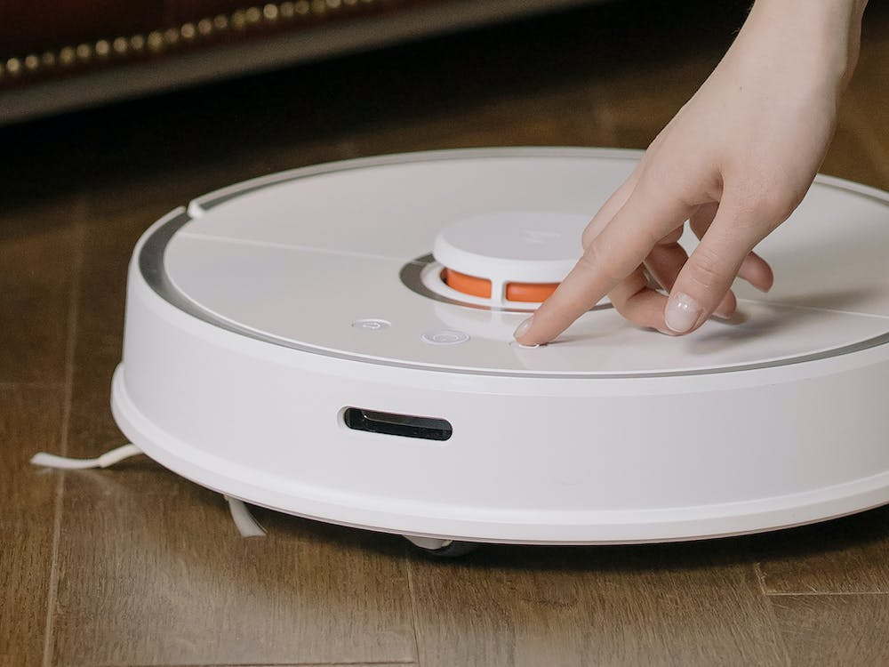
Fundamentals of AI
What kinds of AI are there?
Natural Language Processing (Alexa, Siri)
Robotics (Cleaning Robot)
Computer Vision (Face-recognition, defect pattern recognition)
…
Natural Language Processing
Robotics
Notes:
There are many kinds of AI out there, and we need to understand that there is no one single AI that does all the job. There are many different types of AI, each with its own strengths and weaknesses, and each suited to different kinds of tasks.
For example, there are AI systems that focus on Natural Language Processing, like Alexa and Siri, which are designed to understand and respond to human language. There are also autonomous robots, such as cleaning robots, that use AI to navigate and perform tasks in the physical world. And there are computer vision AI systems that can recognize faces, detect defect patterns, and perform other kinds of image analysis.
Today, we focus on the computer vision AI, because what we are trying to do here is to detect defect pattern.

Slide 6

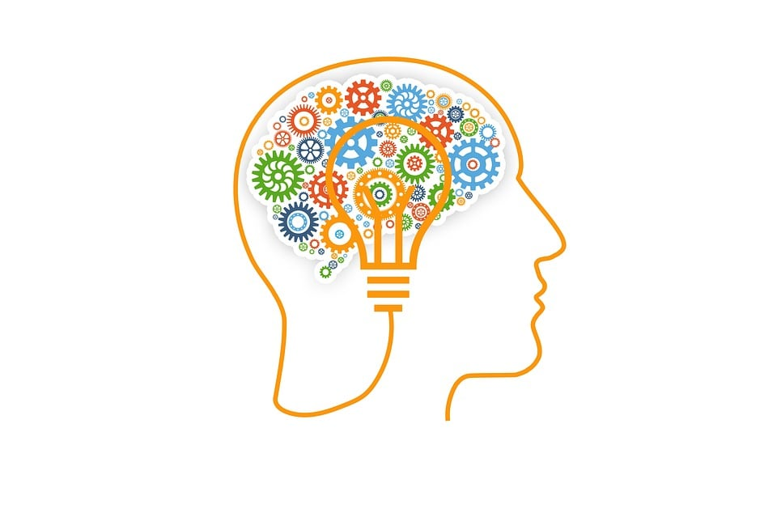
Fundamentals of AI
How does AI learn?
AI learns from (high quality) data
The „data“ it learns from, in our case, are product pictures.
The method we used is so called „Supervised Learning“
Training with labeled data
Notes:
So, How does AI learn? AI learns from data, especially high quality data. What means high quality data? The rule of thumb is we want to teach the AI what is absolutely correct. For example, we want to train an AI to recognize human faces, however, we feed them faces of monkeys, this would be low quality data. Even though monkeys look like human, but it will just confuse the AI and therefore not able to produce meaningful results.
The data it learns from in our case are product pictures. We feed pictures of different defect patterns. And this method is so called supervised learning. Supervised learning involves training with labeled data.
We will see how we do it in practice right away in the demo.

Slide 7
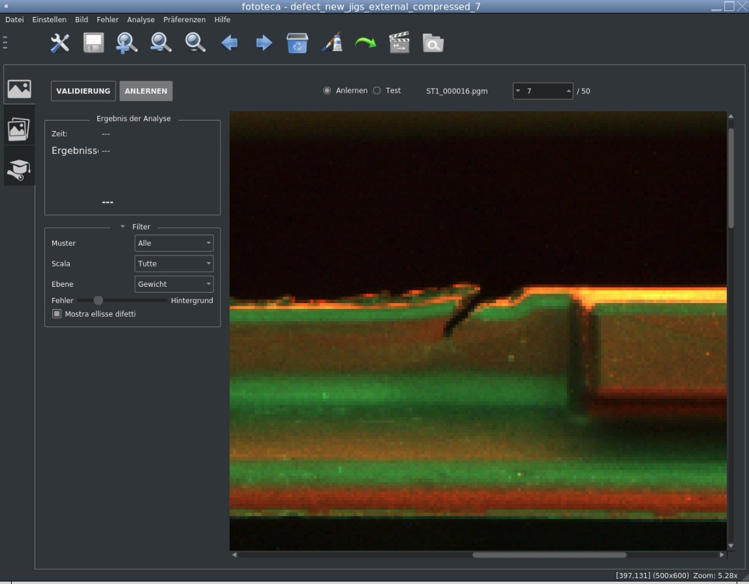
Demo
Take pictures of the defects
Notes:
First of all, we need to take pictures of the defects. In this picture, we have a cut.

Slide 8
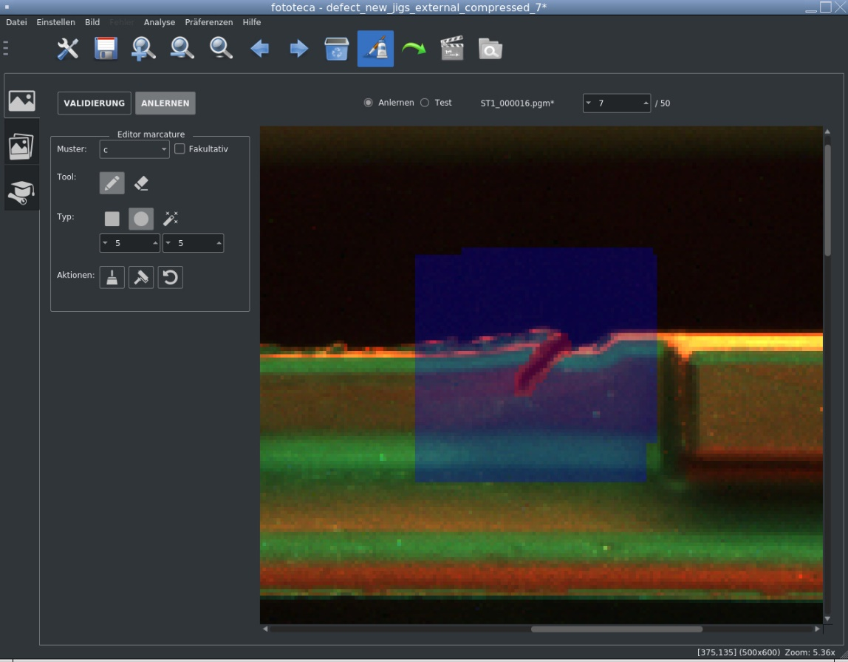
Demo
Mark the defect with the marking tool in the software
This is the labelling process in supervised learning
Notes:
And then we mark the defect using the marking tool in the software. As you can see, the defect is marked as red. And this is the labelling process in so called supervised learning

Slide 9
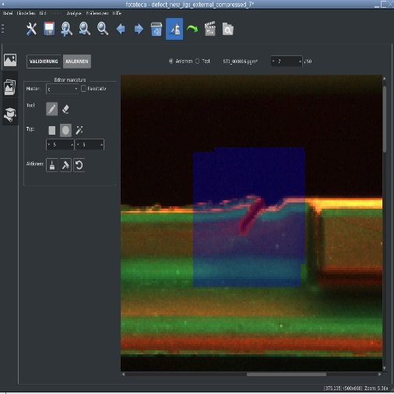
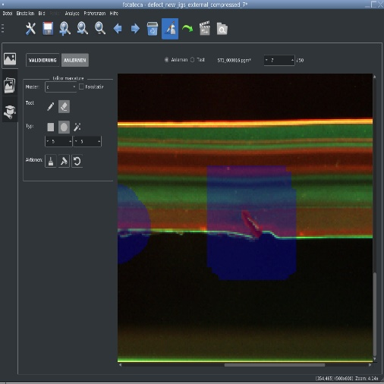

Demo
Iterate the marking process until we have enough training samples
Some examples of cutting defects
Notes:
And then, we repeat the marking process until we have enough training samples. There are some examples of cutting defects that I have marked.

Slide 10



Demo
Avoid bad/missing marking
Avoid „Garbage in Garbage out“
Notes:
Something worth noting is, as I said earlier, we want to ensure the quality of the dataset. So we have to avoid bad marking. Statisticians come up with the term garbage in garbage out. This means if we feed garbage data to the AI, we might as well get garbage results. Here are some examples of bad marking. The rule of thumb is we want to try to be as precise as possible.

Slide 11
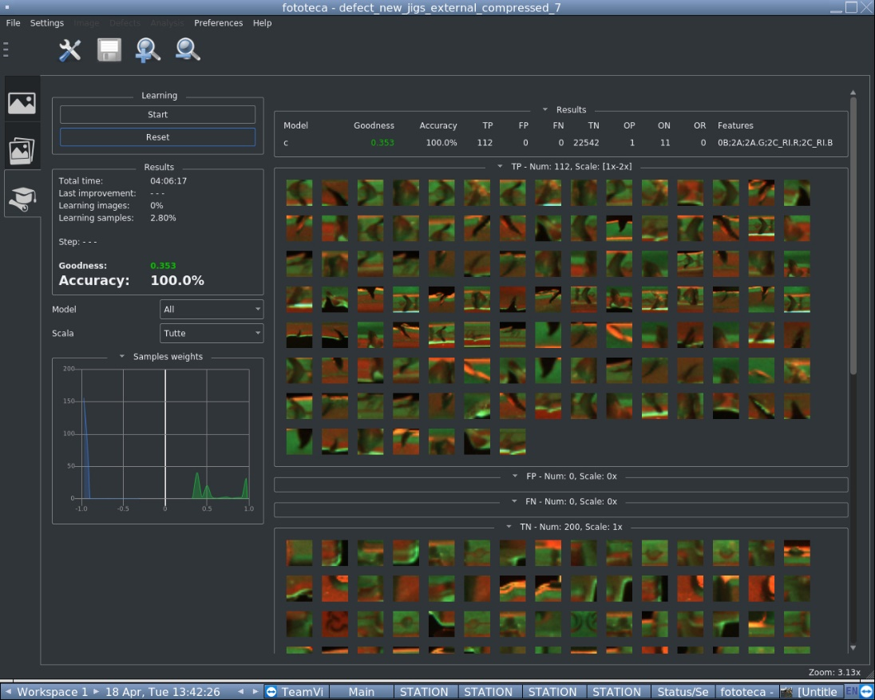
Demo
Training interface
Perfomance stats
Adjust parameters
Train until a satisfied result
Notes:
After we have enough training samples, we can start training in the training interface. Here is where the AI magic happens. We can see the different performance stats, adjust parameters, and so on. The training continues until we get a satisfied result.

Slide 12
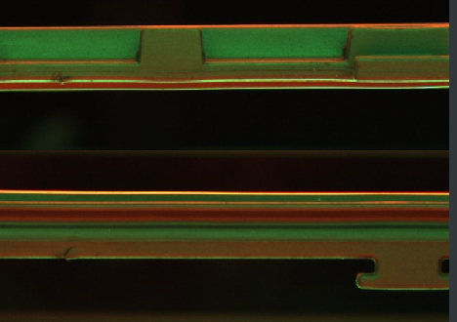
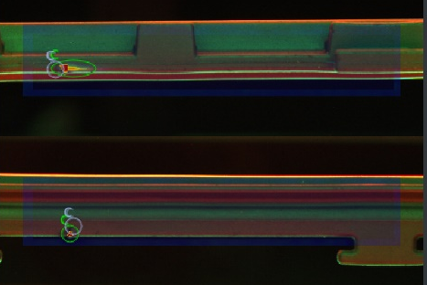
Demo
Analysis after a successful training
Notes:
After training, we can use it for analysis. The photo on the left has two cuts, and the photo on the right is the analysis of the AI. The analysis looks pretty good in this case. However, if the analysis is not accurate, we need to improve the training or improve the quality of the dataset.

Slide 13
Thank you!
Do you have any questions?
Notes:
Thank you for your attention. Do you have any question?
-Can you explain more about the specific AI used in the inspection machine?
-How accurate is the AI in detecting defects compared to human inspectors?
-How does the AI integrate with the rest of the inspection process?
-What kind of hardware or software is required to implement AI in quality control?
-How do you ensure that the data used to train the AI is representative of the entire product line?
-Are there any potential ethical or privacy concerns with using AI in quality control?
-Can the AI be adapted to detect new or previously unknown defect patterns?
-How long does it take to train the AI to accurately recognize defect patterns?
-What kind of cost savings or efficiency gains have you seen since implementing AI in quality control?
-Are there any plans to expand the use of AI to other areas of the company beyond quality control?

