Slide 1

Thesis Defense
Niederwinkling, 12.09.24
Wen-Hao Wu
Notes:
Hello everyone, my name is Wen-Hao. Thank you for joining me today for my thesis defense. Today, I am presenting from Niederwinkling, where my company is located.

Slide 2

Automated Visual Inspection of Sealing Products:
Implementation and Evaluation of an AI-based System
Notes:
The title of my Master Thesis is: Automated Visual Inspection of Sealing Products: Implementation and Evaluation of an AI-based System. Let’s begin.

Slide 3


Agenda
Introduction
Methodology
Results
Conclusion and Future Work
Notes:
The agenda for today’s meeting includes Introduction, Methodology, Results, and finally Conclusion and Future Work.

Slide 4
Agenda
Introduction
Methodology
Results
Conclusion and Future Work
Notes:
First, let’s start with Introduction.

Slide 5
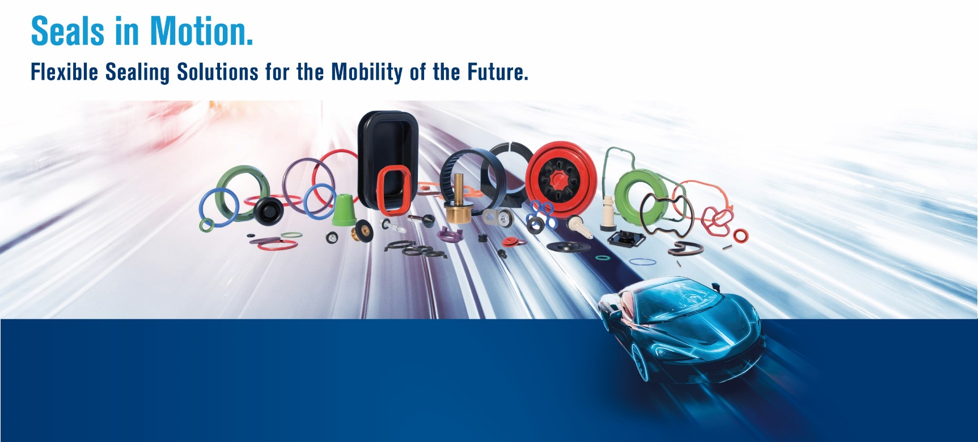
Introduction
Background
Wallstabe & Schneider manufactures different kinds of sealing solutions
Quality Control in Wallstabe & Schneider consists of roughly 50% manual 50% automated
Notes:
Before we start, I want to give you some background information. In Wallstabe & Schneider, we manufactures different kinds of sealing solutions as you can see in the picture. They are mainly for the automobile industry. And roughly half of our parts are inspected manually and the other half is controlled automatically.

Slide 6
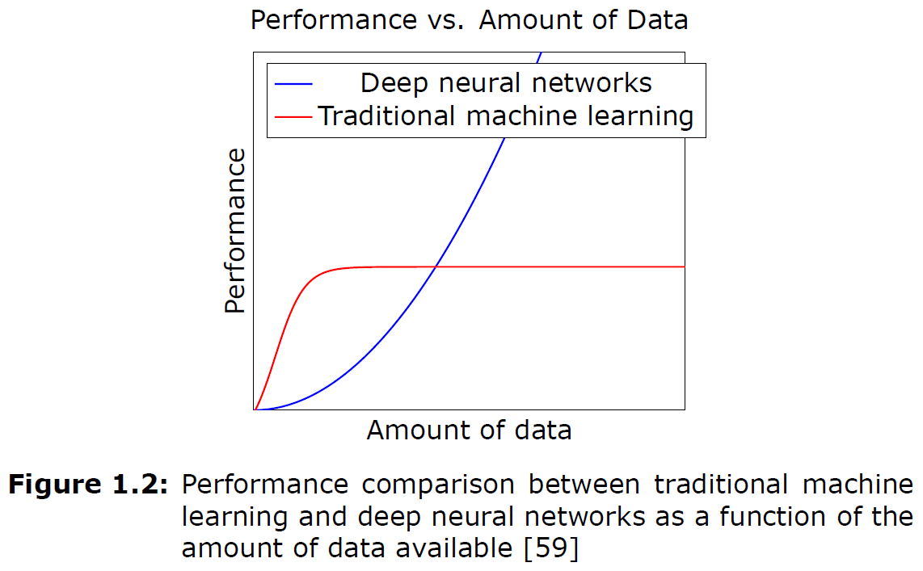
Introduction
Problem Statement
Most of the automatic methods utilize traditional machine learning methods, which have some limitations
Proposed solution: Introduce Deep Learning methods for performance boost
Notes:
The problem is, most of the automatic methods utilize traditional machine-learning methods, which comes with some limitations. Such as needing to set up individually for different articles even though they look identical, only differ in size, which leads to tedious and repetitive adjustments for marginal gains. Another problem is, if we look at the graph below: while traditional machine learning methods could produce meaningful results with limited data, it eventually reaches a saturation point where the performance plateaus as the amount of data increases.
And my proposed solution to this problem is to introduce Deep Learning methods for an overall performance boost. Such as reducing human-involved set-up time, increasing accuracy, increase inference speed, and so on.

Slide 7
Agenda
Introduction
Methodology
Results
Conclusion and Future Work
Notes:
Now let’s move on to the methodology part of my thesis. In this section, I will show you more or less step by step how I conducted my experiments.

Slide 8
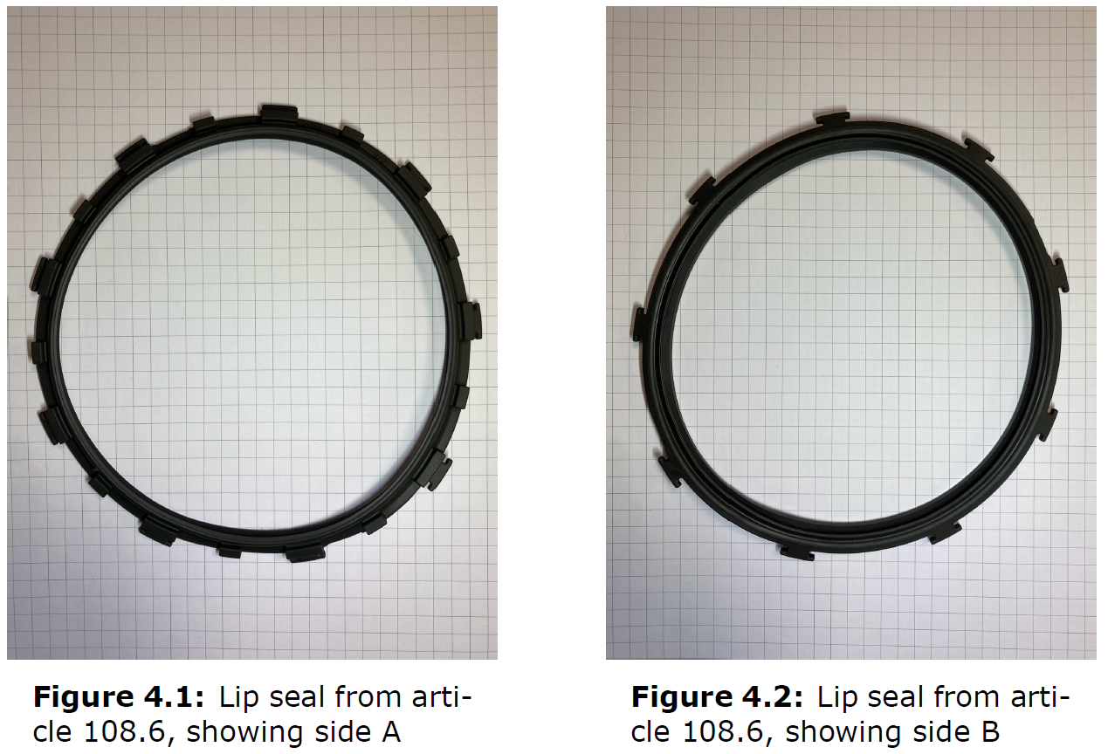
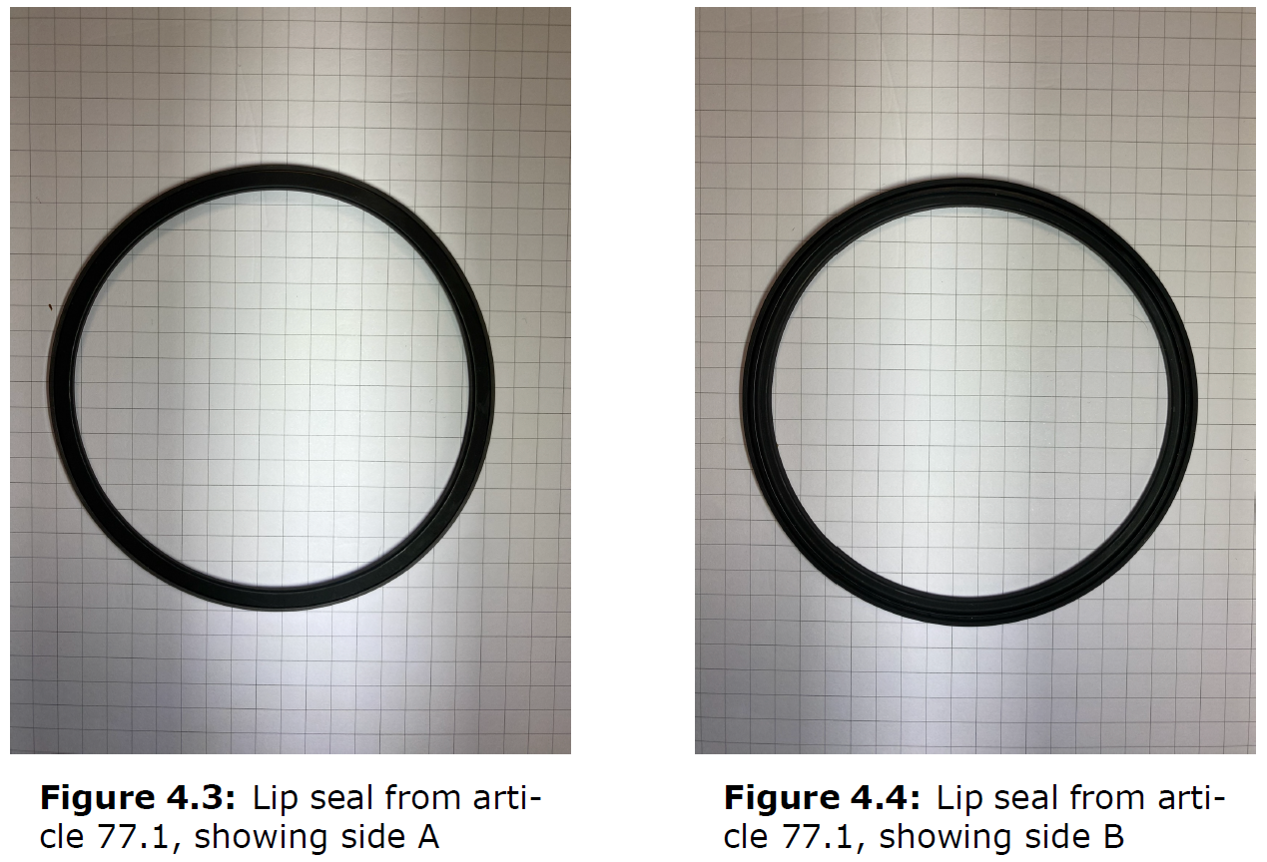
Methodology
Data Collection: Selection of Sealing Products
Lip seals are the study focus
108.6mm
108.6mm
77.1 mm
77.1 mm
Notes:
Lets start with data collection. First of all, Lip seals are one of the seals that we produce, and they are the focus of this study.

Slide 9
Methodology
Data Collection: Selection of Sealing Products
Sealing articles are named after their inner diameter
Lip seals are the study focus
108.6mm
108.6mm
77.1 mm
77.1 mm
Notes:
The seals are categorized based on their inner diameter, and I collected images of these lip seals for further processing. For example, there are article 108.6, 77.1, and a lot more. My idea was to train a singular model that is able to detect on all different kinds of lip seal, which was not possible with the currently employed traditional method.

Slide 10
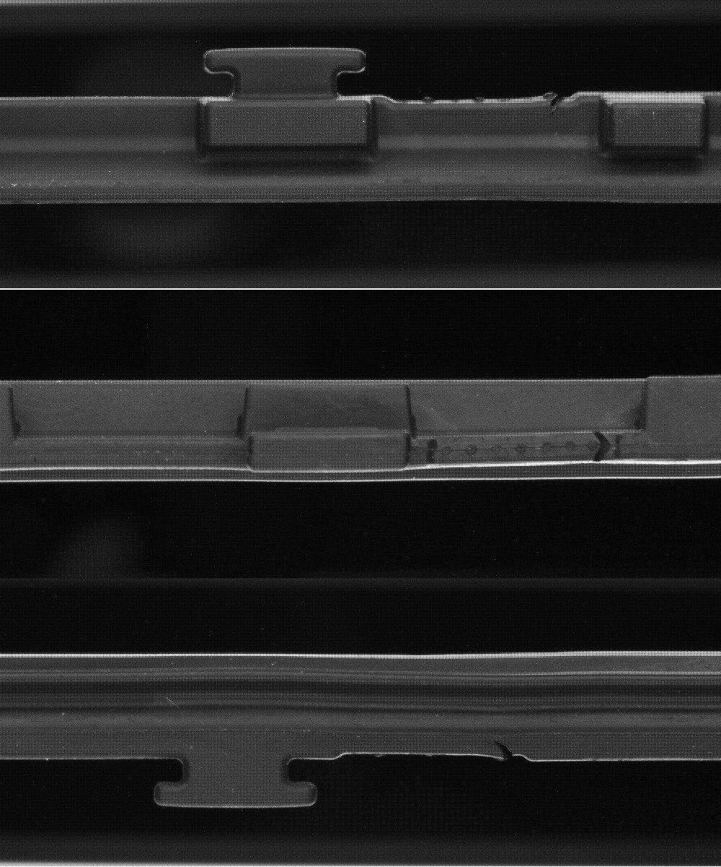
Methodology
Data Collection: Image Acquisition
Images captured from inspection machine
Raw images are saved in .pgm format and does not contain color information
Notes:
The selected articles are then placed in our current inspection machines and images are captured. The raw images are saved in a .pgm format that doesn’t contain any color information, which requires to apply so-called bayer filters to convert to a RGB format.

Slide 11
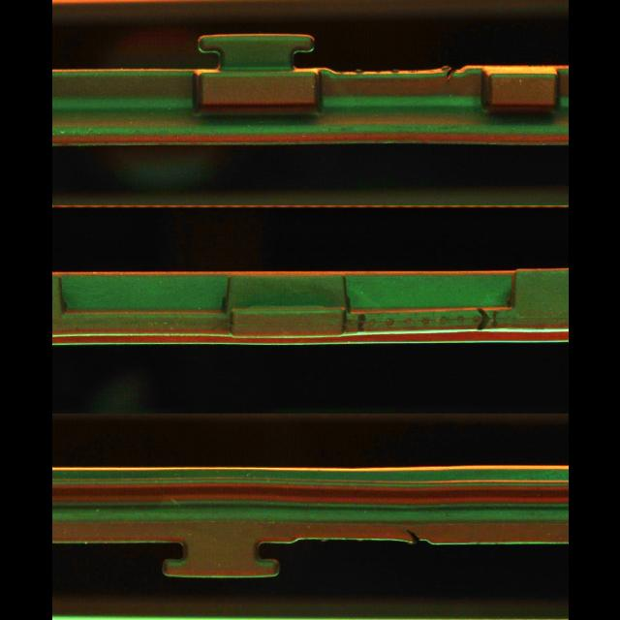
Methodology
Data Collection: Image Preprocessing
Convert .pgm to .jpg
Restore color information
Notes:
after converting the .pgm image to .jpg and application of Bayer filters, the color information is restored, ready for the next steps.

Slide 12
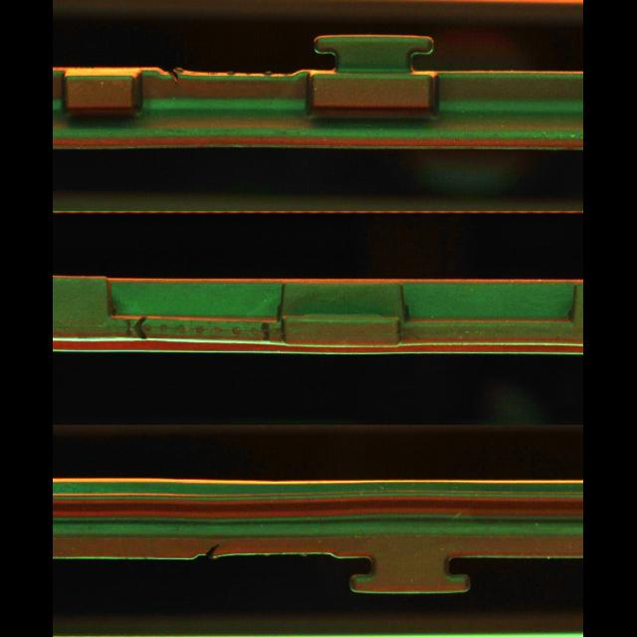
Methodology
Data Collection: Image Preprocessing
Convert .pgm to .jpg
Restore color information
The sides are filled with black
Notes:
If you noticed, now the sides are filled with black, this step is crucial to maintain the aspect ratio. For instance, YOLO requires 640*640 resolution, and without this step, the images will be stretched and cause bias in the training phase, which is something we don’t want to see

Slide 13
Methodology
Data Collection: Image Preprocessing
Horizontal flip applied
Convert .pgm to .jpg
Restore color information
The sides are filled with black
Augmentation applied
Notes:
After that, augmentation is applied to the images to increase the size of the dataset. The main augmentation that I applied was only a horizontal flip, the reason being the images of the sealing parts are always taken from the exact same angle and lighting condition, which gives no necessity to apply any color-based augmentations.

Slide 14
Methodology
Data Collection: Image Preprocessing
Horizontal flip applied
Convert .pgm to .jpg
Restore color information
The sides are filled with black
Augmentation applied
Notes:
If you look closely to the image, you will find already some defects on it. For instance, this one on the top. If we zoom in …

Slide 15
Methodology
Data Collection: Image Preprocessing
Horizontal flip applied
Convert .pgm to .jpg
Restore color information
The sides are filled with black
Augmentation applied
Notes:
If we zoom in, we can see this is a typical cut, which brings us to the next topic, the different defect classes that are considered in this study.

Slide 16
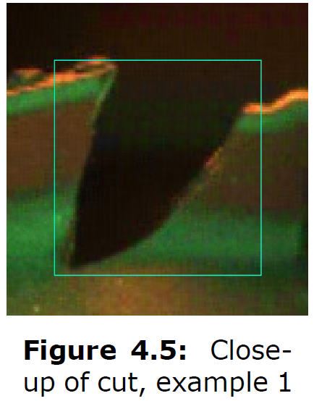
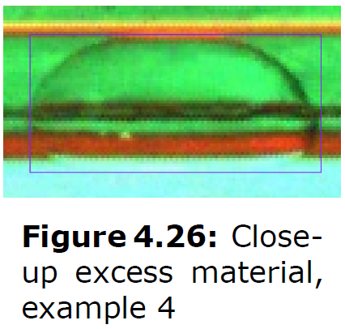
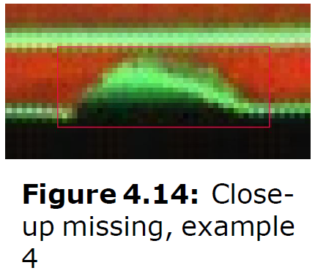
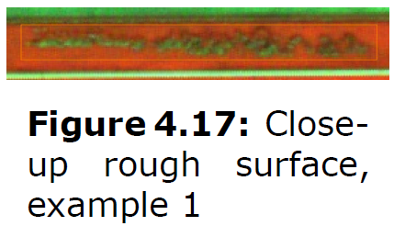
Methodology
Data Collection: Defect Types
Cut
Notes:
The most common defect types that are considered in my study includes 4 classes: Cut, Missing, Rough Surfance, and Excessive Material.

Slide 17
Methodology
Data Collection: Defect Types
Cut, Missing

Slide 18
Methodology
Data Collection: Defect Types
Cut, Missing, Rough Surface

Slide 19
Methodology
Data Collection: Defect Types
Cut, Missing, Rough Surface, Excessive Material
Notes:
A Cut is typically a V-shaped indentation that might be caused by a sharp object during production or transportation.
A Missing is typically a U-shaped void where a portion of the material is absent.
Rough Surface is typically an area that lacks smoothness on the surface.
And finally, excess material is identified as additional material that remains on the surface of the sealing product.

Slide 20
Methodology
Model Training: Transfer Learning
Main technique
Transfers knowledge from one task to a related task
Ideal for scenarios with limited data and computational resources
Reduced training time
Pre-trained Model
Task A
Knowledge
Task B
New Model
Notes:
The main technique that was used in Model Training is Transfer Learning. Transfer learning is a technique in machine learning where knowledge from one task is applied to improve learning in a related task. It is beneficial in scenarios with limited data or computational resources. This technique also reduce training time significantly, which is very useful in an industrial application.

Slide 21
Methodology
Model Training: Pre-trained Models
Tensorflow Object Detection (TFOD) Model Zoo
Single Shot Detector (SSD) MobileNet V2 FPNLite 640x640
EfficientDet
You Only Look Once (YOLO)
YOLOv8 family (n, s, m, l, x)
Pre-trained on the COCO dataset
Notes:
In order to put transfer learning into practice, several pre-trained models were explored. Including models from Tensorflow Object Detection framework such as SSD and EfficientDet. Also the YOLOv8 models from the Pytorch framework including the n, s, m, l, x models. They we pre-trained on the COCO dataset, which contains 330K images and 80 classes, providing them with robust object detection capabilities.

Slide 22
Methodology
Evaluation Metrics
Mean average precision (mAP)
Inference speed
Training time
(Ease of installation)
Notes:
The primary metrics used for model evaluation were mean average precision, training time, and inference speed. The mean average precision and inference speed is especially important in industrial environment. One hidden metric that I want to mention is how easy it is to set up the framework. From my experiences, TFOD requires a long list of dependencies were as YOLOv8 was integrated as a pip package, making the installation process very simple. And this is a big advantage in my opinion.

Slide 23

Methodology
Model Export: Open Neural Network Exchange (ONNX)
Open source project originally developed by Microsoft and Facebook
Allows model conversion between different frameworks (e.g., PyTorch, TensorFlow).
Improves inference speed on CPU by converting models to ONNX without sacrificing the accuracy.
Source: https://onnx.ai/
Notes:
Before we dive into the results, I want to quickly go through what is ONNX. ONNX is an open-source project originally developed by Microsoft and Facebook. It allows model conversion between different frameworks. Most importantly, by converting models to ONNX format, the inference speed on CPU will be improved without sacrificing the accuracy. How much does it improve in my case? We will find out in the results section.

Slide 24
Agenda
Introduction
Methodology
Results
Conclusion and Future Work
Notes:
With all the methodology being clear, now let’s dive into the results.

Slide 25
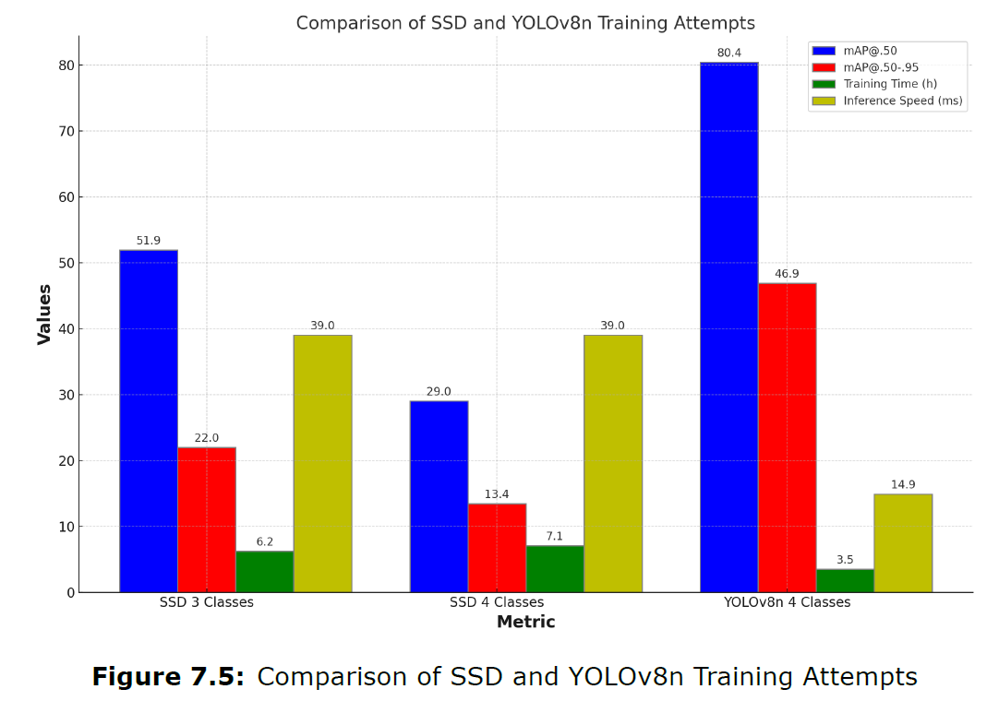
Results
Preliminary Model Comparison and Selection
YOLOv8n out-performs SSD in all metrics
Performance of SSD was also reduced after introduced an additional class
Further training attempts were conducted on all the models from the YOLOv8 family
Models
Notes:
Before I started my official experiments, I was exploring different pre-trained models like I explained earlier to test their capabilities. And eventually I want to decide on which models to do my official experiments on. In this case, I chose the best performing model I tried from TFOD and the smallest model from YOLOv8 as a side by side comparison.
This graph shows a comparison between SSD model and the YOLOv8n model across three key metrics: mean average precision (mAP), training time, and inference speed.
As you can see, YOLOv8n outperforms SSD in all categories. It achieves significantly higher precision (with an mAP of 80.4) and lower inference time, making it a faster and more accurate choice. The performance of SSD was also reduced after introducing an additional class, further highlighting the advantages of YOLOv8n in handling more complex tasks.
These results led me to select YOLOv8 family as the most suitable model for this application. Further training attempts were conducted on all the models from the YOLOv8 families.

Slide 26
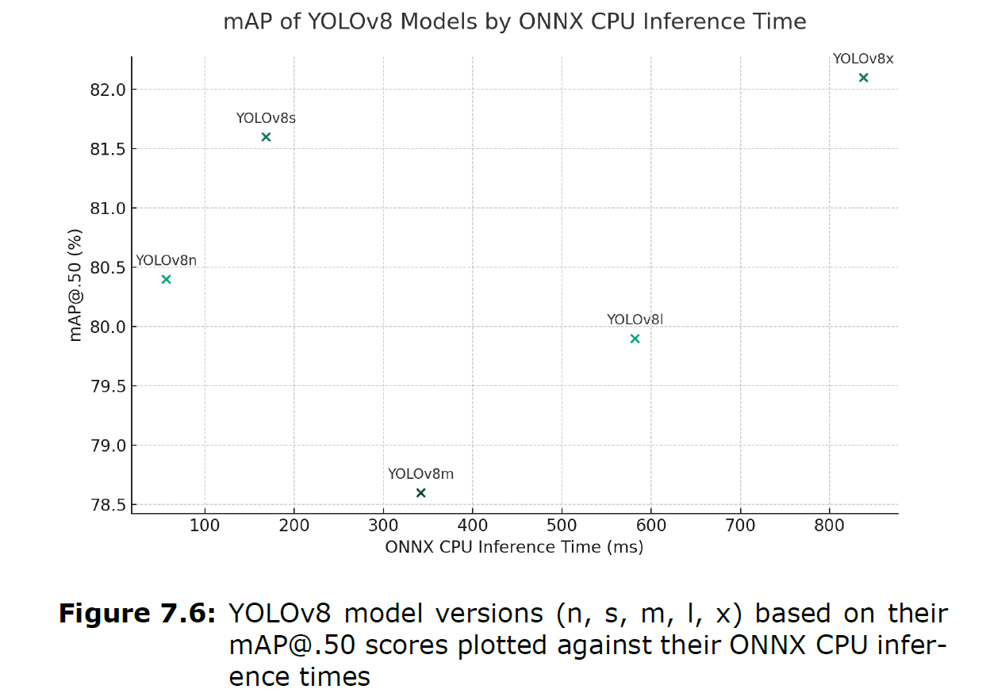
Results
YOLOv8 Model Inference Time vs. mAP
The choice of model depends on the trade-off between speed and accuracy
The n model and the s model is more suitable for industrial environment
Notes:
“So, this is my training result, this graph shows the mAP of different YOLOv8 model variants plotted against their ONNX CPU inference times."
"As you can see, YOLOv8n has the lowest inference time, lesser than 100 ms, while YOLOv8x has the highest mAP, but at the cost of much longer inference time, over 800 ms."
"The choice of model depends on the specific trade-offs you’re willing to make between speed and accuracy. For example, if time is a critical factor, YOLOv8n would be the most suitable option, but if accuracy is more important, you might opt for YOLOv8x."
In our production environment, where inspection speed is critical, the YOLOv8x model is not worth the trade-off. Its significantly slower inference speed provides only marginal improvements in precision, making it less suitable for our needs.
One the other hand, the n model and the s model is more suitable for a industrial environment due to their faster inference speed and promising precision score.

Slide 27
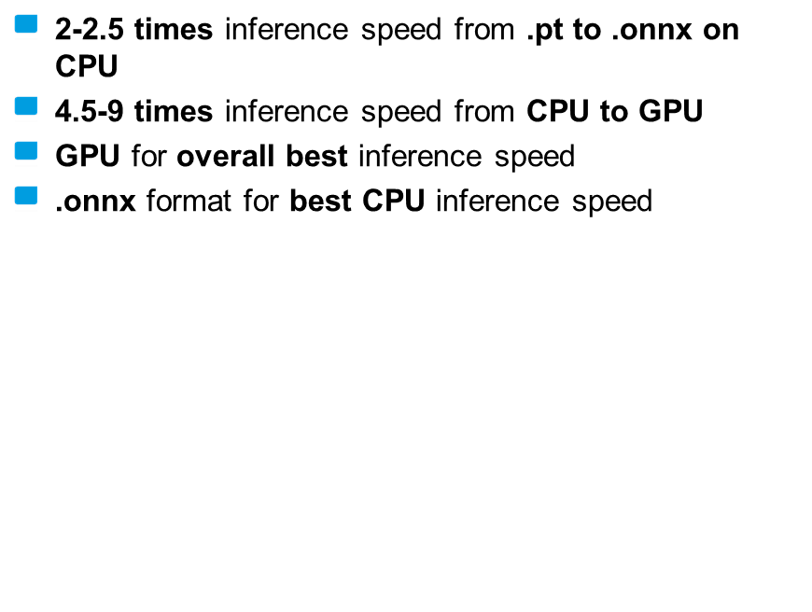
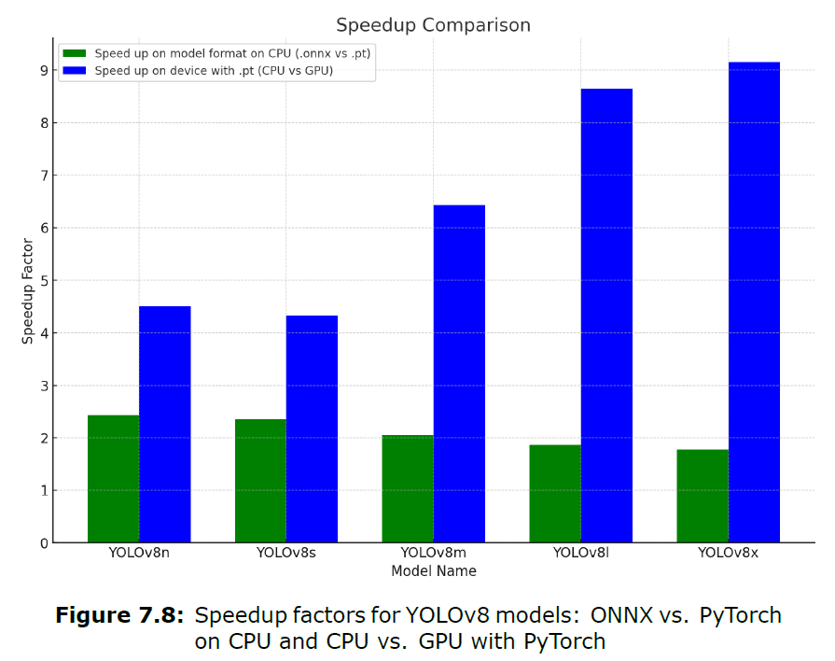
Results
Inference Speed Comparison and Speedup Factors
Notes:
Now let’s take a look at the Inference speed comparison and speedup factors across different model format and devices
The green bar shows that it gives a 2-2.5 inference speed boost from PyTorch format to ONNX format on CPU.
The blue bar shows that it gives a 4.5 up to 9 times inference speed boost from CPU to GPU
And this tells us that if we want to most optimal inference speed, a GPU is required. And if we want optimal speed on CPU, using the .onnx format is optimal.
"This analysis helps to understand how different models and hardware configurations impact the performance of the YOLOv8 models in various scenarios."

Slide 28
Agenda
Introduction
Methodology
Results
Conclusion and Future Work
Notes:
Finally, let’s move on to the Conclusion and Future Work

Slide 29
Conclusion and Future Work
Key Findings & Contributions
Fine-tuning YOLOv8 models for surface defect inspection of sealing products
Development of a user-friendly GUI
Establishment and maintaining a GitHub repository
ONNX detection speed up for CPU-based detection tasks
Notes:
"To summarize the key findings and contributions of my research, I fine-tuned YOLOv8 models specifically for surface defect inspection of sealing products. This model showed significant improvements in detection accuracy and speed."
"In addition, a user-friendly GUI was developed that simplifies interaction with the system, making it more accessible for operators in an industrial setting."
"A GitHub repository was established and maintained to ensure version control and collaboration on this project, facilitating future improvements."
"Finally, detection tasks was optimized and speed up on CPU using the ONNX format, making the system more efficient for environments where GPU resources may not be available."

Slide 30
Conclusion and Future Work
Future Outlook
Expansion of datasets to increase the ability to not only detect lip seals
Increase code base robustness
Continual enhancement of dataset quality
Deployment of the proposed AI system onto hardware or cloud platforms
A more analytical comparison between the proposed system and the currently employed system
Notes:
"Looking forward, several areas will require further attention. First, the expansion of datasets is essential to improve the system's ability to detect a wider range of sealing products beyond just lip seals."
"Additionally, increasing the robustness of the codebase will ensure greater stability and reliability in production environments."
"Continual enhancement of dataset quality is another key factor, as better data will lead to better model performance."
"Lastly, we aim to deploy the AI system onto both hardware and cloud platforms to enhance flexibility and scalability."

Slide 31
Thank you!

Slide 32
Agenda
Introduction
Data Collection
Model Training
Performance Evaluation
Conclusion and Future Work

Slide 33
Agenda
Introduction
System Design and Architecture
Dataset Collection
Model Training
Performance Evaluation
Conclusion and Future Work

Slide 34
Agenda
Introduction
System Design and Architecture
Dataset Collection
Model Training
Performance Evaluation
Conclusion and Future Work

Slide 35
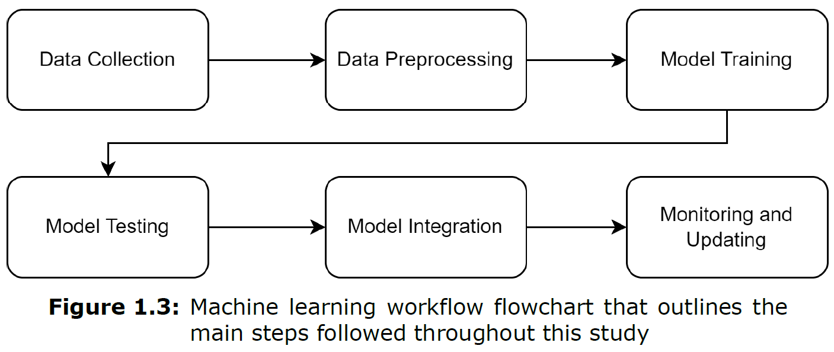
Introduction
Machine Learning Workflow

Slide 36
Agenda
Introduction
System Design and Architecture
Dataset Collection
Model Training
Performance Evaluation
Conclusion and Future Work

Slide 37
System Design and Architecture
KANO model survey
Set up system requirements based on Stakeholder's opinions
Prioritize requirements to "Must-have" and "Good-to-have" requirements

Slide 38
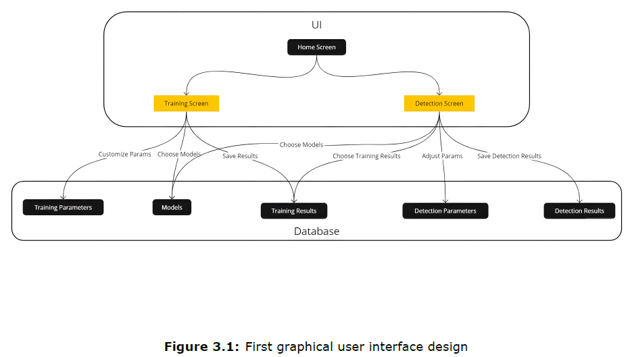
System Design and Architecture
Graphical User Interface Design

Slide 39
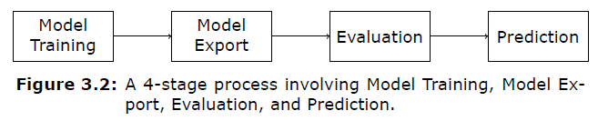
System Design and Architecture
System Pipeline
Managed through Data Version Control (DVC)

Slide 40
Agenda
Introduction
System Design and Architecture
Dataset Collection
Model Training
Performance Evaluation
Conclusion and Future Work

Slide 41
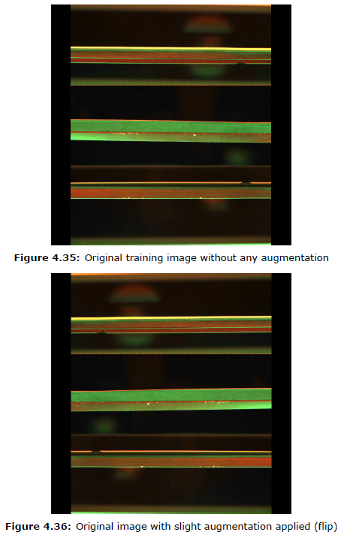
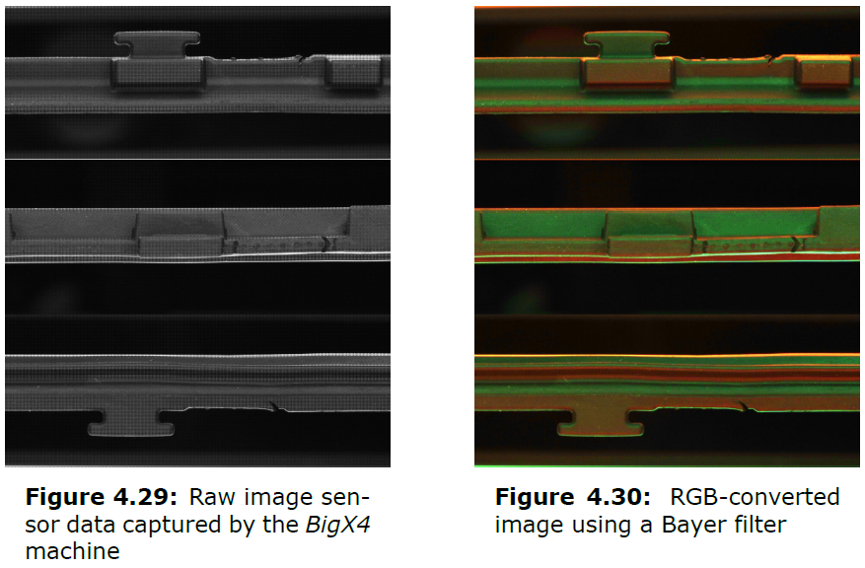
Dataset Collection
Image Preprocessing
Convert .pgm to .jpg
Annotate on roboflow
Apply data augmentation to increase dataset size

Slide 42
Agenda
Introduction
System Design and Architecture
Dataset Collection
Model Training
Performance Evaluation
Conclusion and Future Work

Slide 43
Agenda
Introduction
System Design and Architecture
Dataset Collection
Model Training
Performance Evaluation
Conclusion and Future Work

Slide 44
Agenda
Introduction
System Design and Architecture
Dataset Collection
Model Training
Performance Evaluation
Conclusion and Future Work

Slide 45
Introduction
Headline
enumeration
…
….
…..
…….
text

Slide 46

Agenda
Introduction
System Design and Architecture
Dataset Collection and Preparation
Model Training and Optimization
System Integration and User Interface
Performance Evaluation
Conclusion and Future Work

