Slide 1
DataXLat

Slide 2
CODE
DESKTOP
RAW DATA
CLEAN SHP
GEOJSON
WEB
Conversion platforms
e.g. Carto
Analytics & Visualization
ArcGIS pre-processing
MOBILE APP

Slide 3
FUNCTIONS
PDF reports, excel sheets, maps, etc.
Data Profile
WEB
search location,
simple routing,
Buffer, etc.
Quick Analysis
Combined interactive story-maps.
Customized Web-app

Slide 4


GITHUB
REMOTE
LOCAL
Add Commits
Team
GA
Member A’s
Repo
Clone
Member A’s
Code
Fork
Project #1.0
Member B’s
Repo
Clone
Member B’s
Code
Project #1.1
Member C’s
Repo
Clone
Member C’s
Code
Project #1.2

Slide 5
GITHUB
REMOTE
LOCAL
Synch / Push
Project
Manager
Add Commits
Team
GA
Accept / Decline
Pull Request
Clone
Member A’s
Repo
Member A’s
Code
Fork
Project #1.0
Member B’s
Repo
Clone
Member B’s
Code
Project #1.1
Member C’s
Repo
Clone
Member C’s
Code
Project #1.2

Slide 6
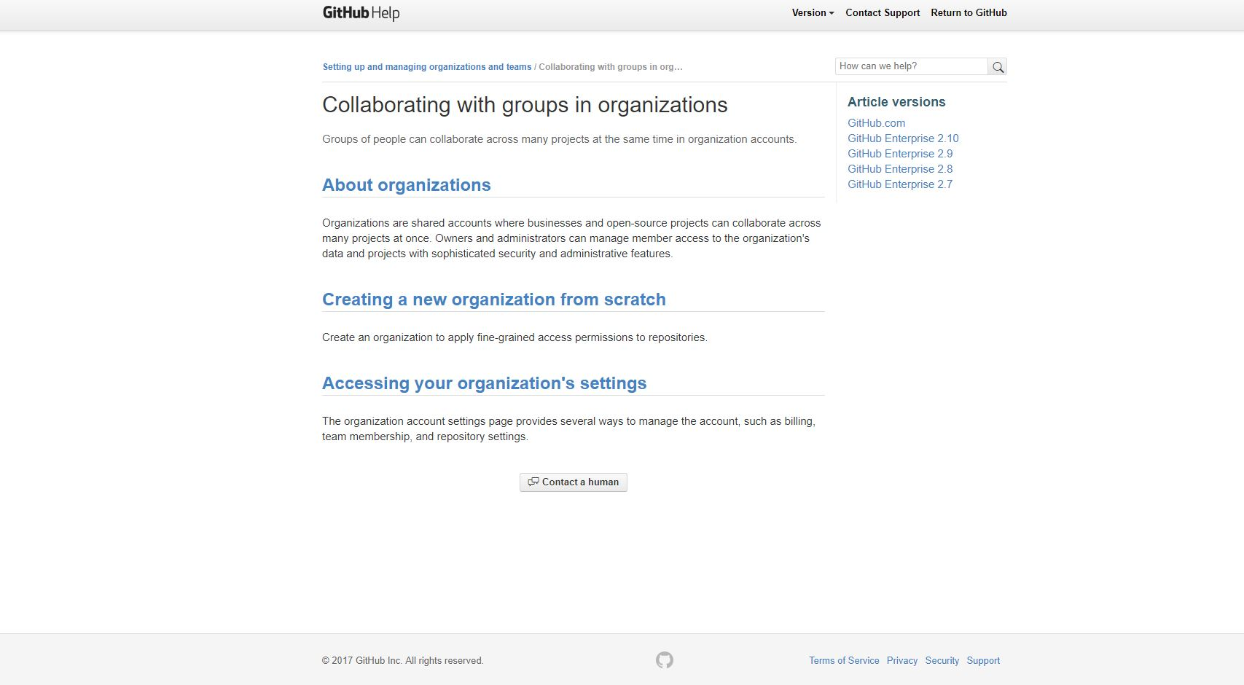

Slide 7
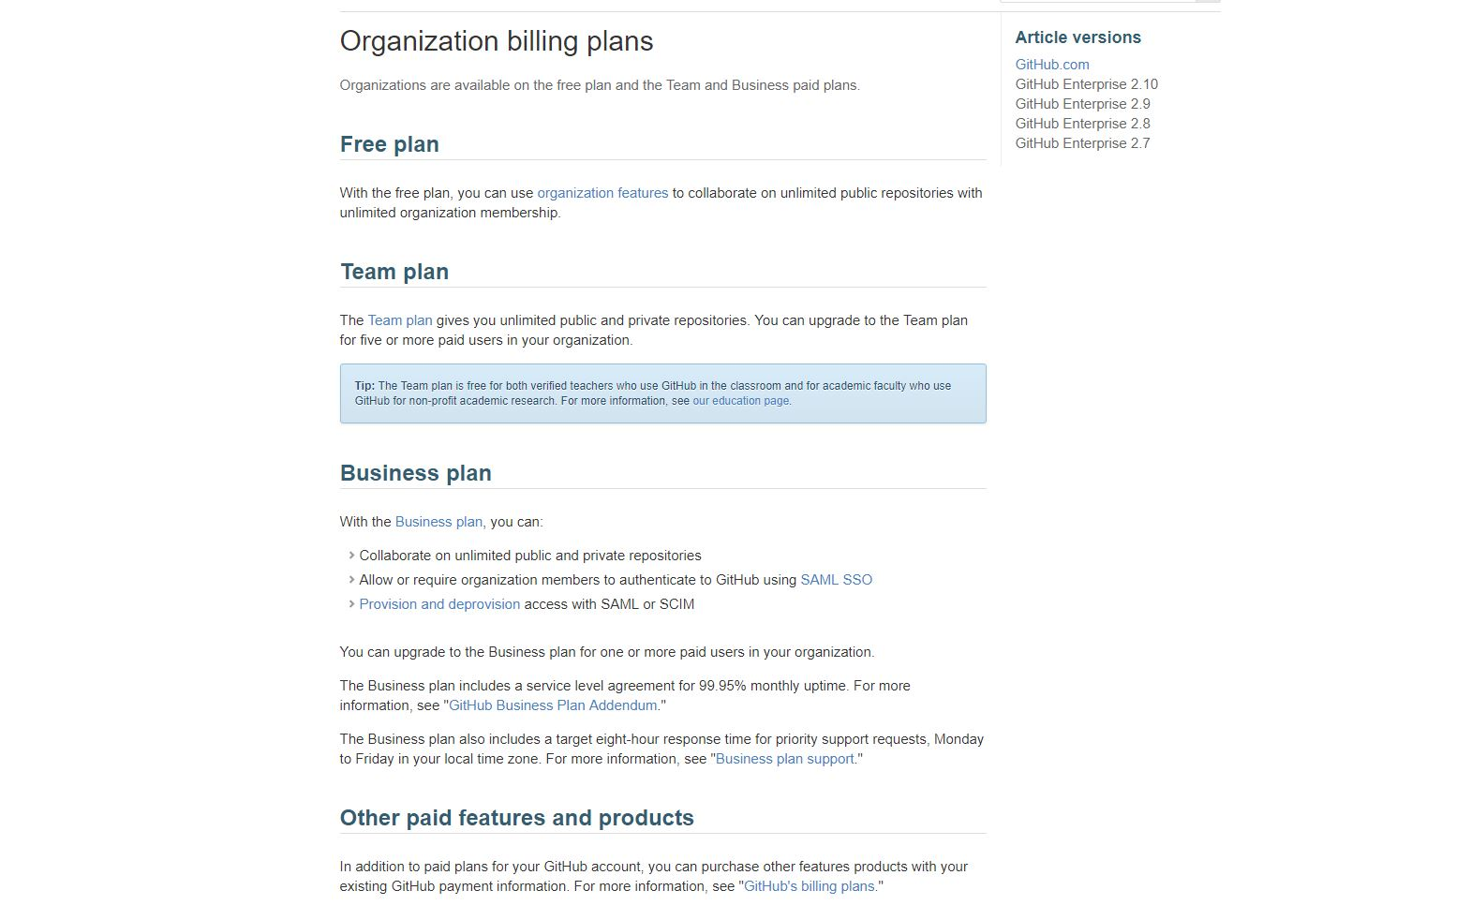

Slide 8
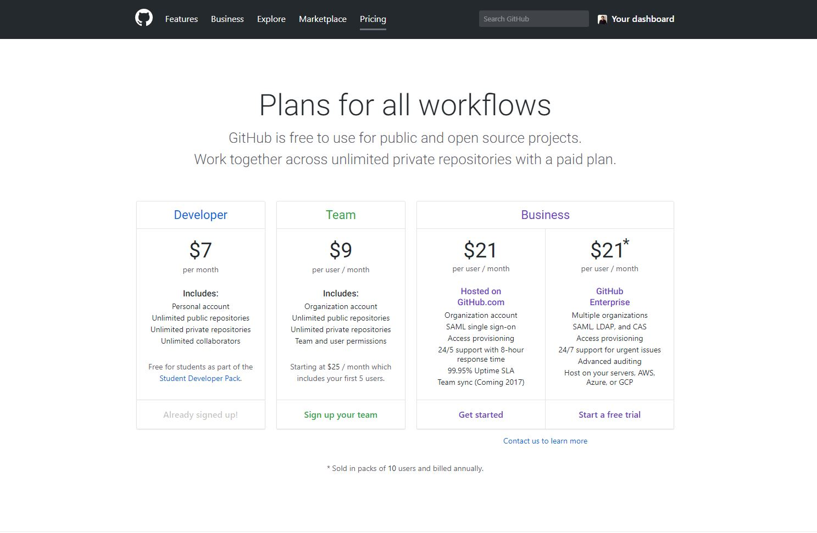

Slide 9
examples.

Slide 10
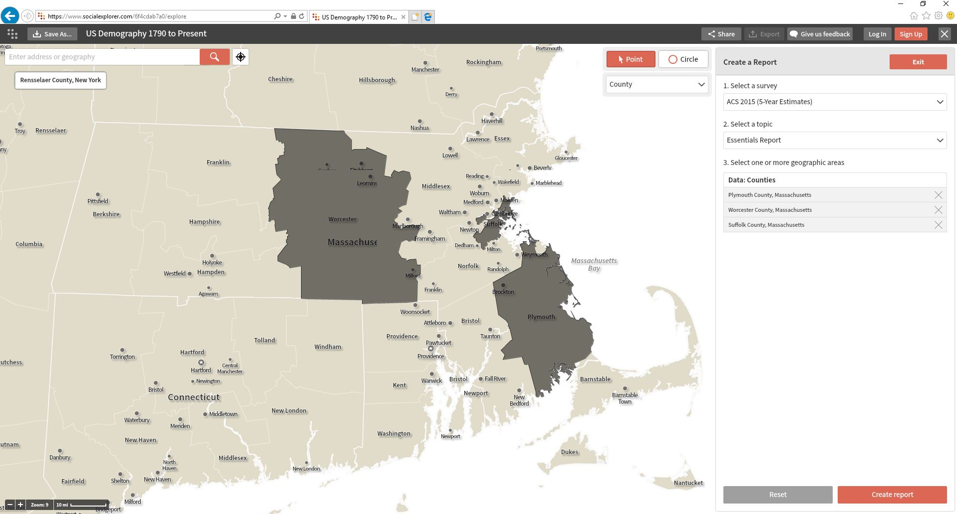
Customizable selection
https://www.socialexplorer.com/

Slide 11
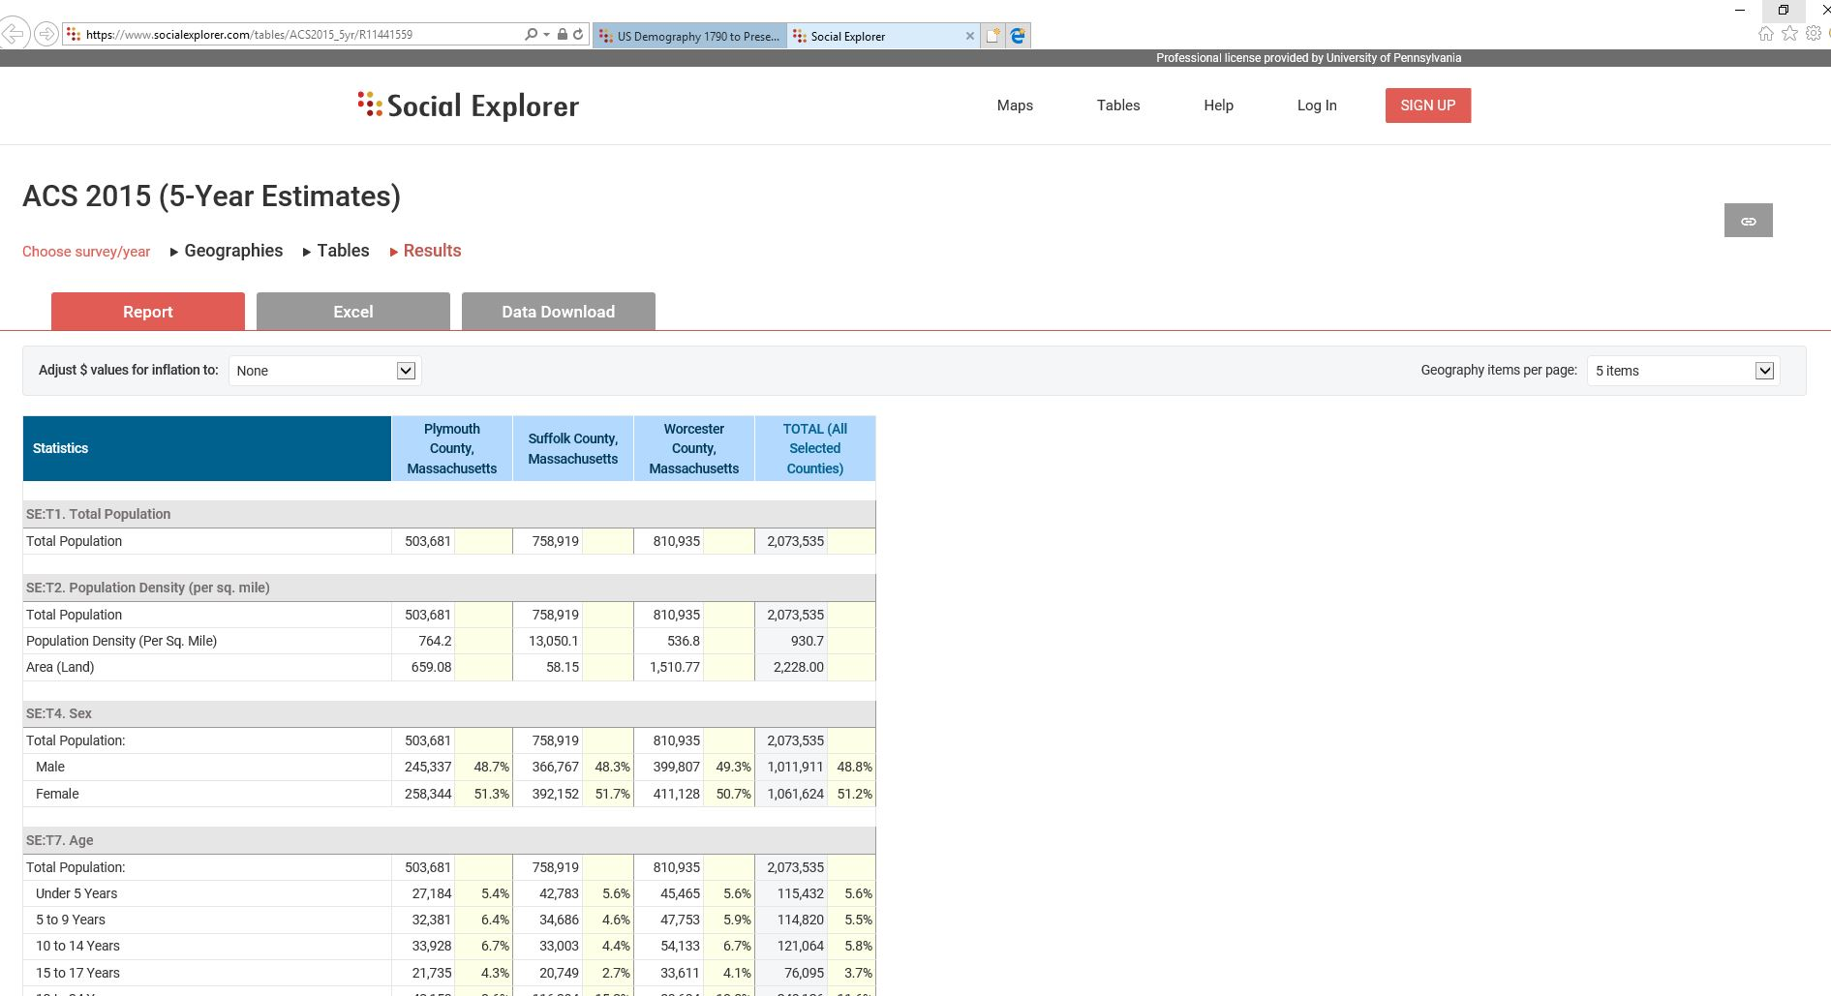
Download
functions

Slide 12
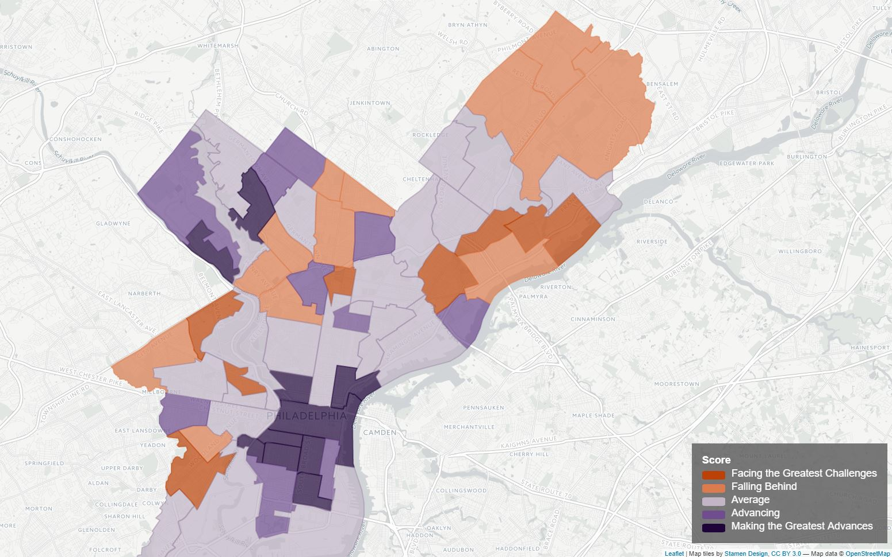
Quick community
info
https://rawgit.com/azavea/nextcity-neighborhood-index/master/webmap/index.html

Slide 13
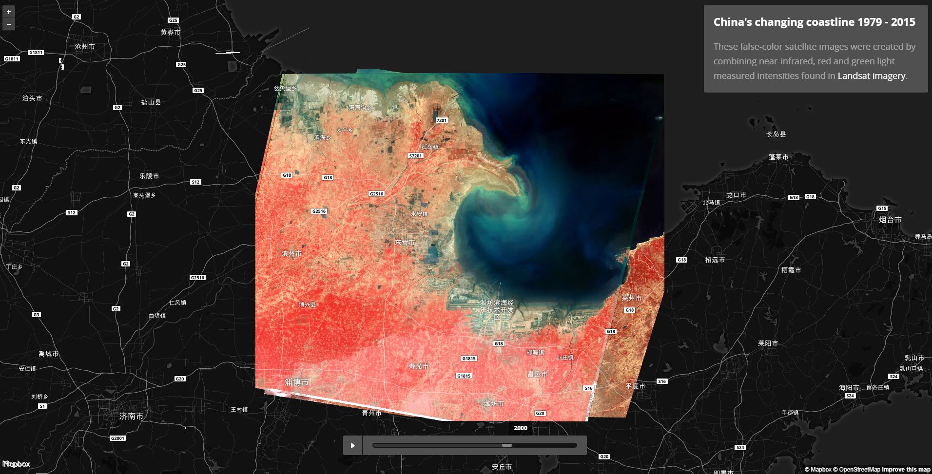
Raster
Landsat
Time-track
https://www.mapbox.com/bites/00224/

Slide 14
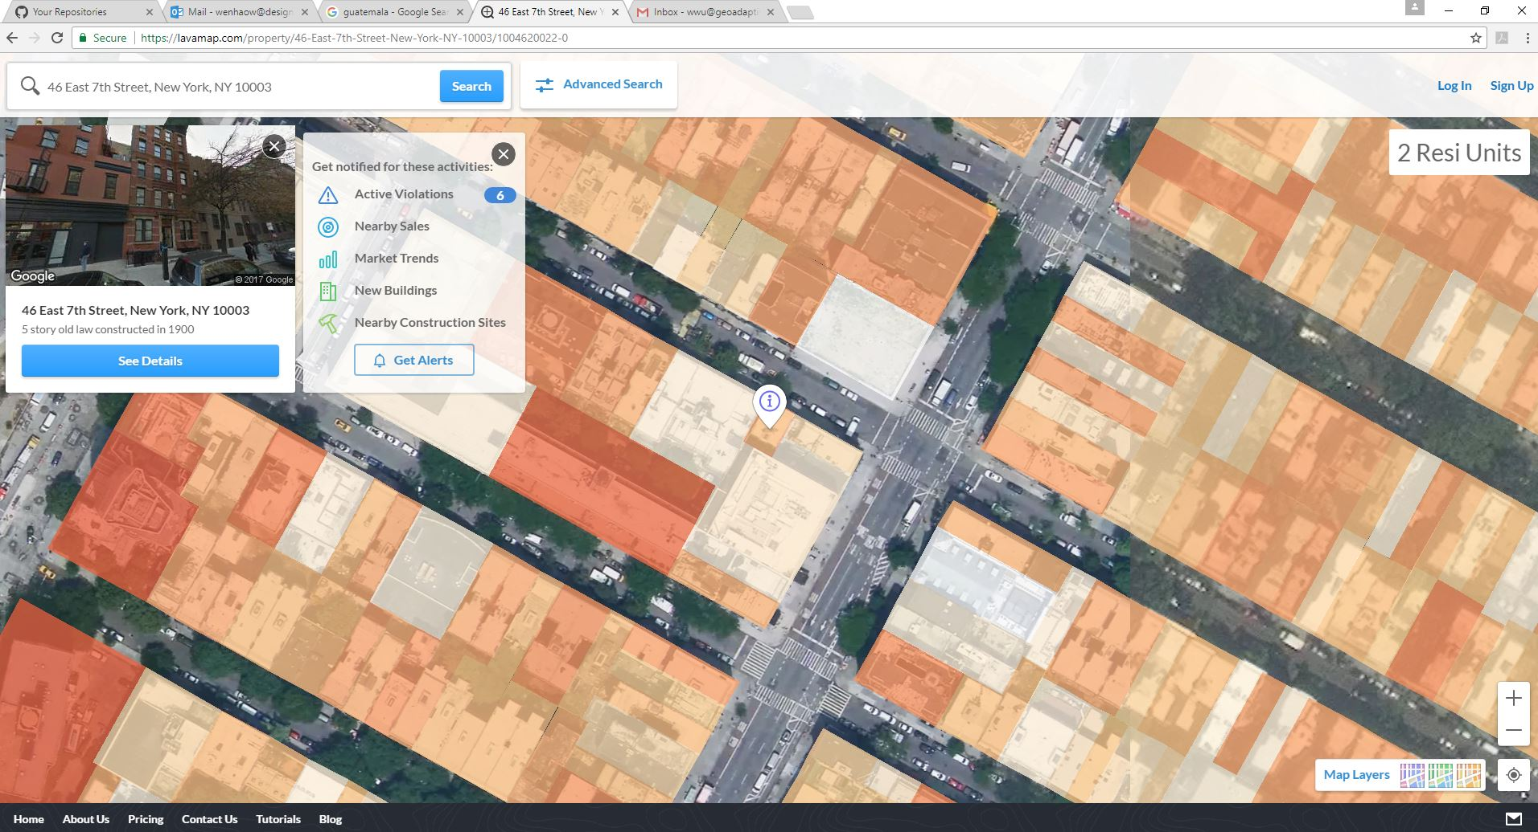
https://lavamap.com/property/46-East-7th-Street-New-York-NY-10003/1004620022-0

Slide 15
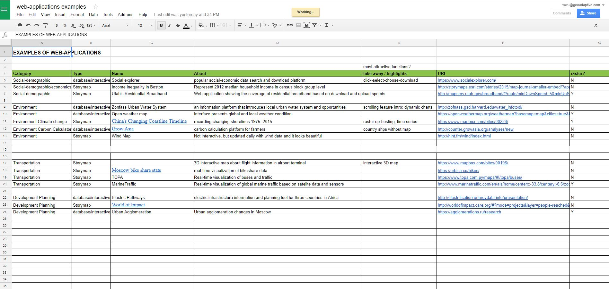
Let’s Brainstorm!

Slide 16
what’s next ?

