Slide 1
DataXLat

Slide 2
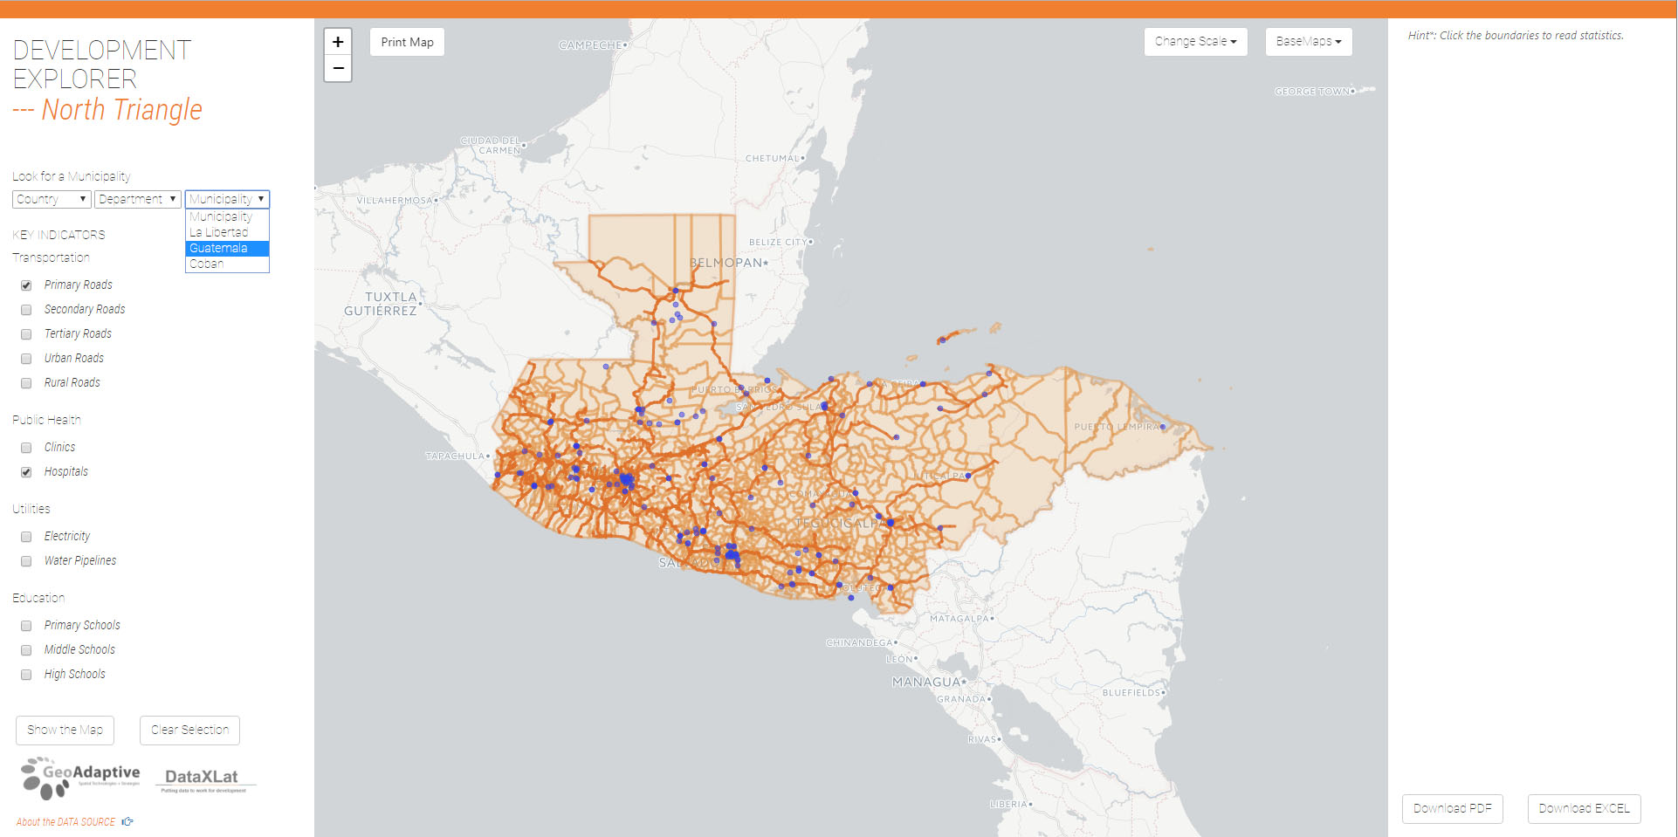
Function #1: User Specified Information
selectable
geographies
selectable
information

Slide 3
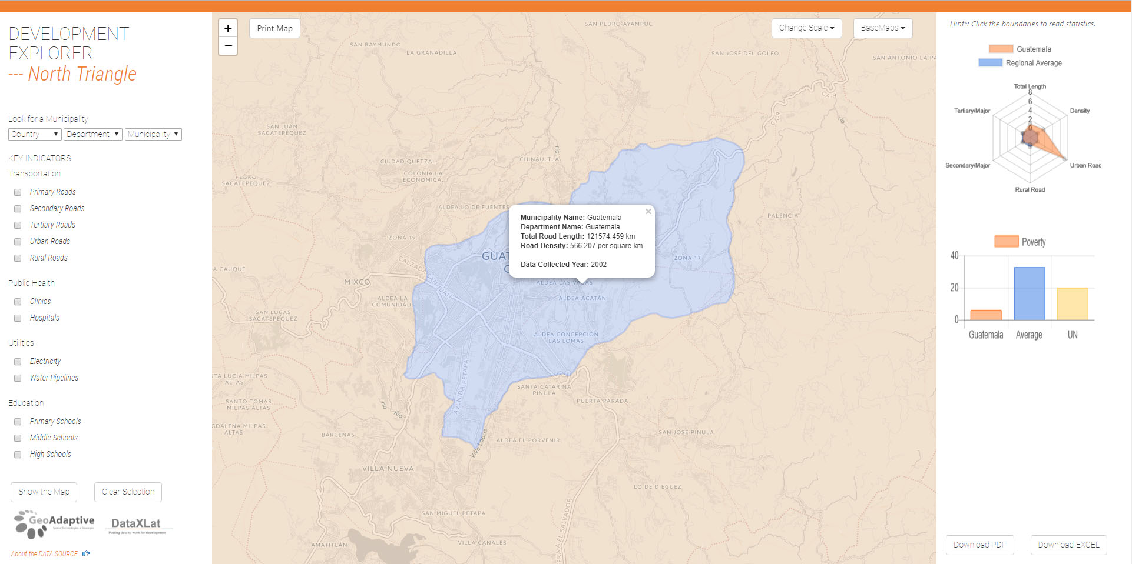
Function #2: Data Visualization and Interactivity
Information of selected municipality
(click / dropdown)

Slide 4
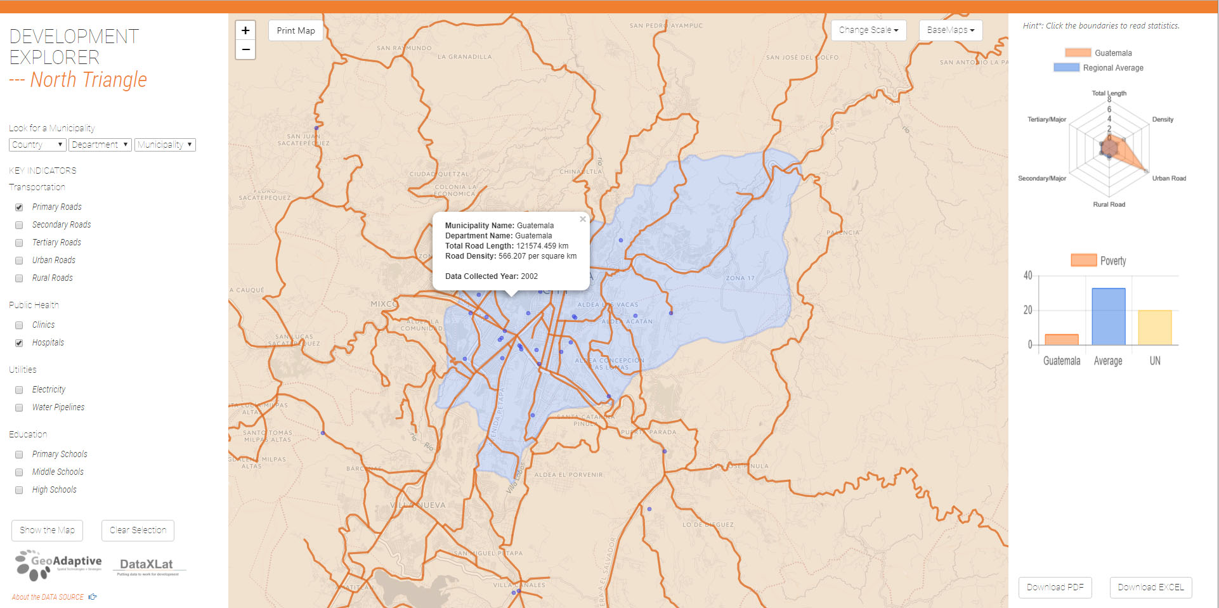
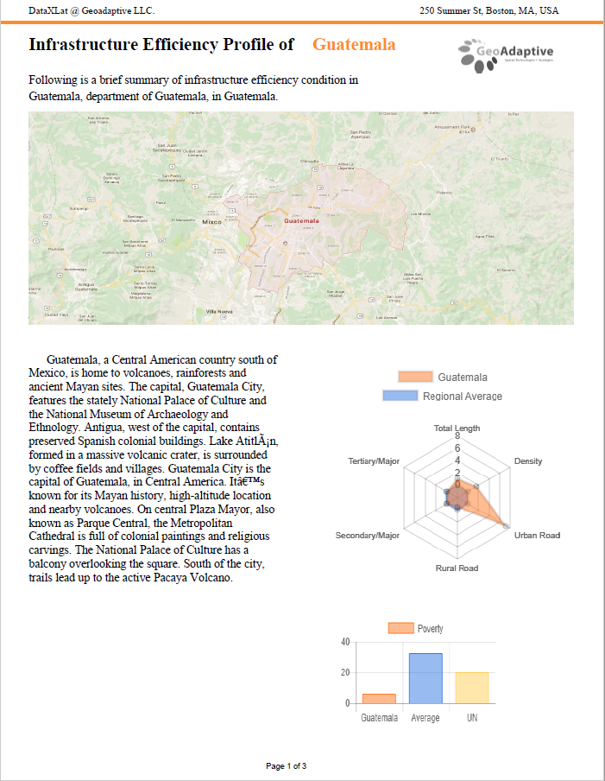
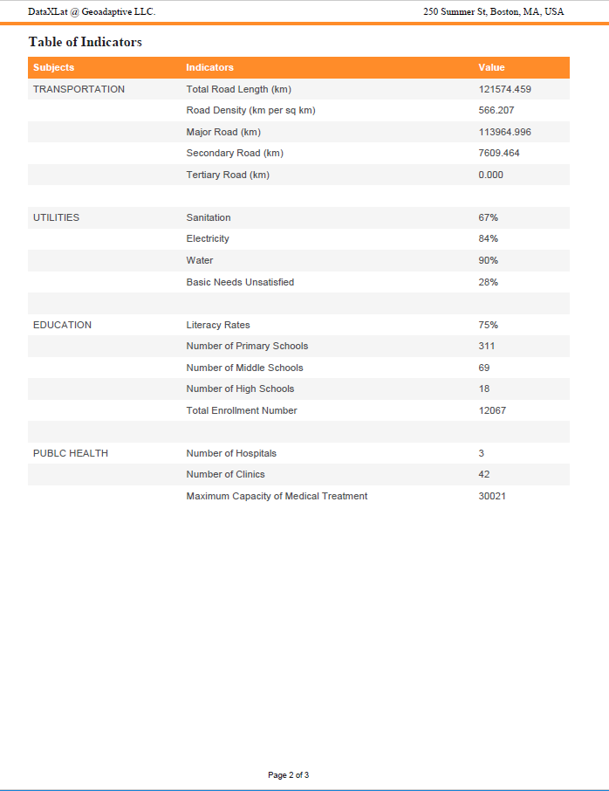
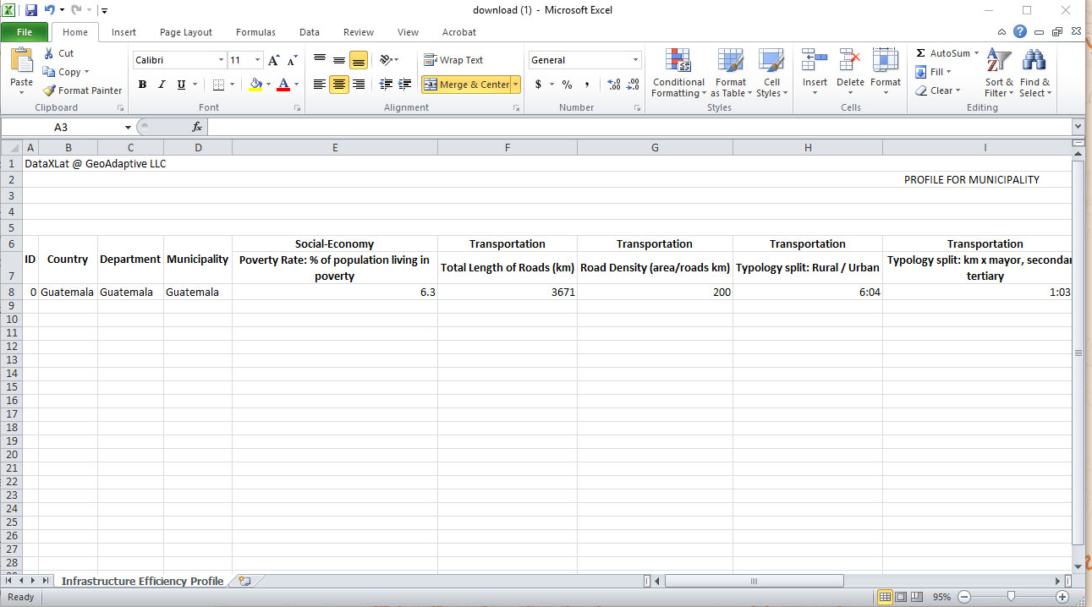
Function #3: Data export in customizable formats
Downloadable information in PDF and excel formats.

