Slide 1
DataXLat

Slide 2
CODE
DESKTOP
RAW DATA
CLEAN SHP
GEOJSON
WEB
Conversion platforms
e.g. Carto
Analytics & Visualization
ArcGIS pre-processing
MOBILE APP

Slide 3
FUNCTIONS
PDF reports, excel sheets, maps, etc.
Data Profile
WEB
search location,
simple routing,
Buffer, etc.
Quick Analysis
Combined interactive story-maps.
Customized Web-app

Slide 4
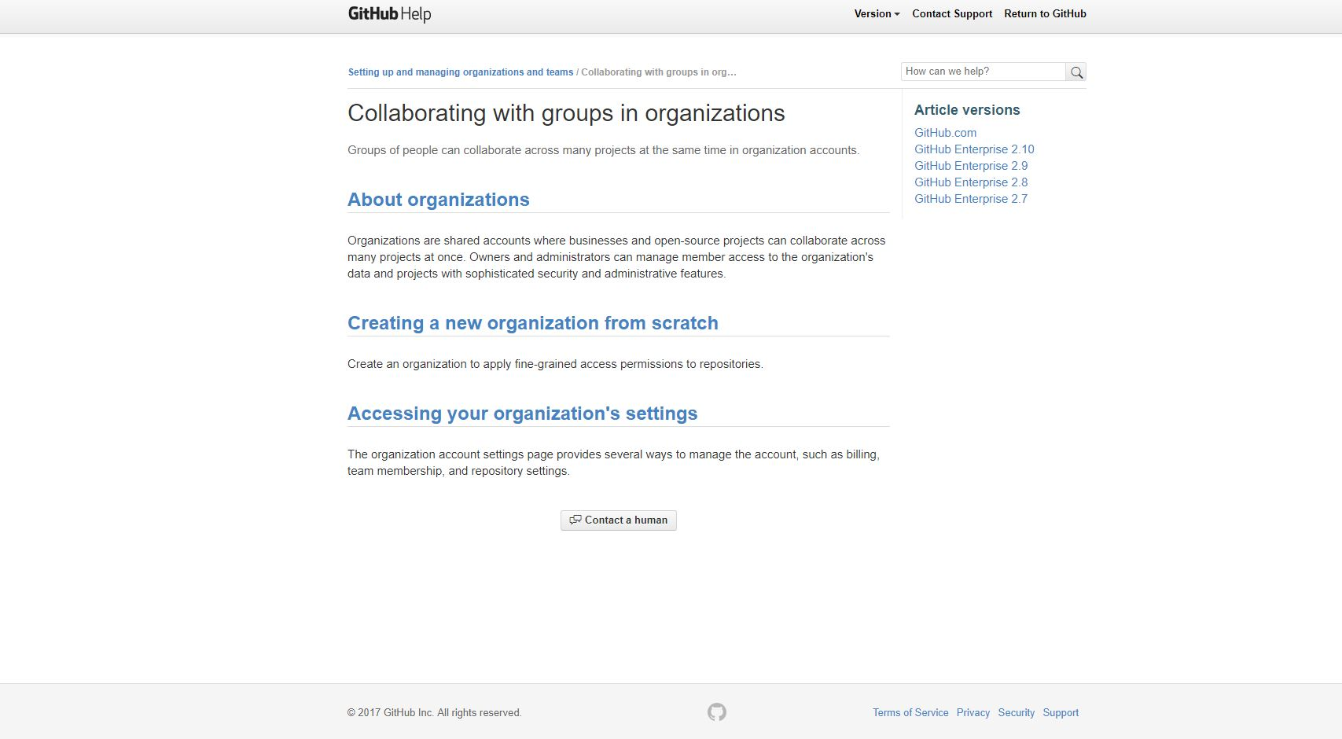

Slide 5
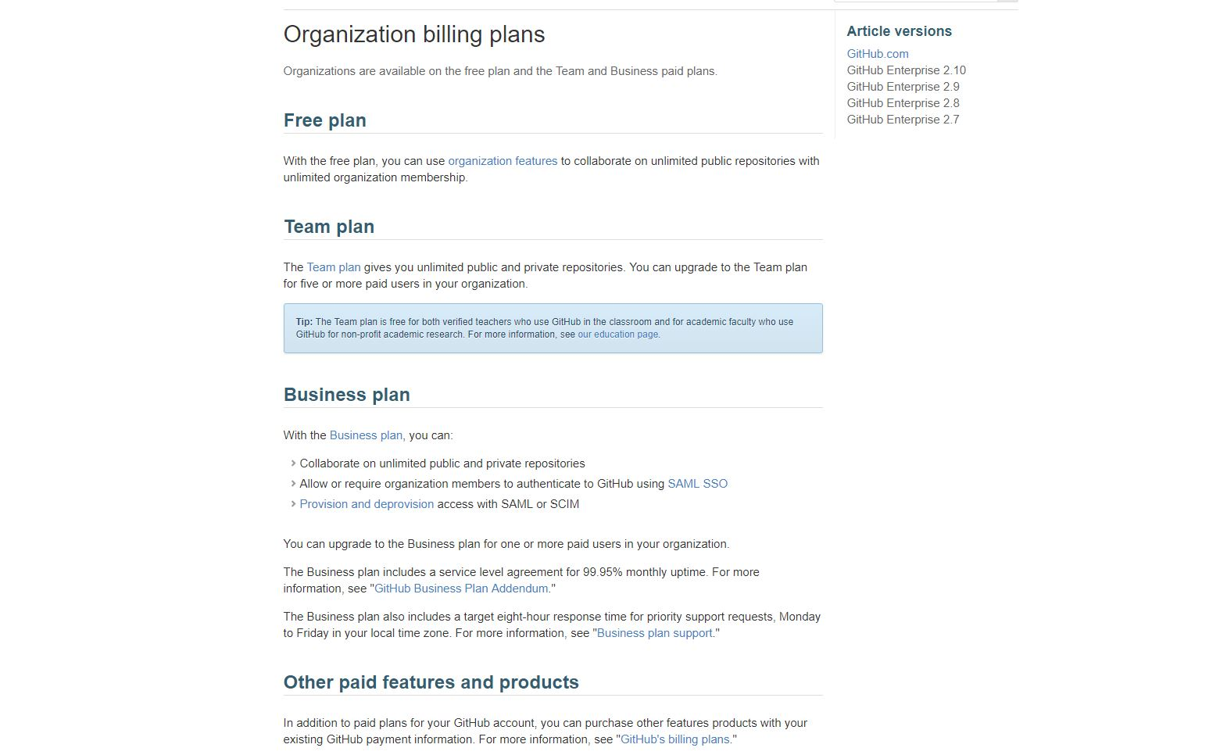

Slide 6
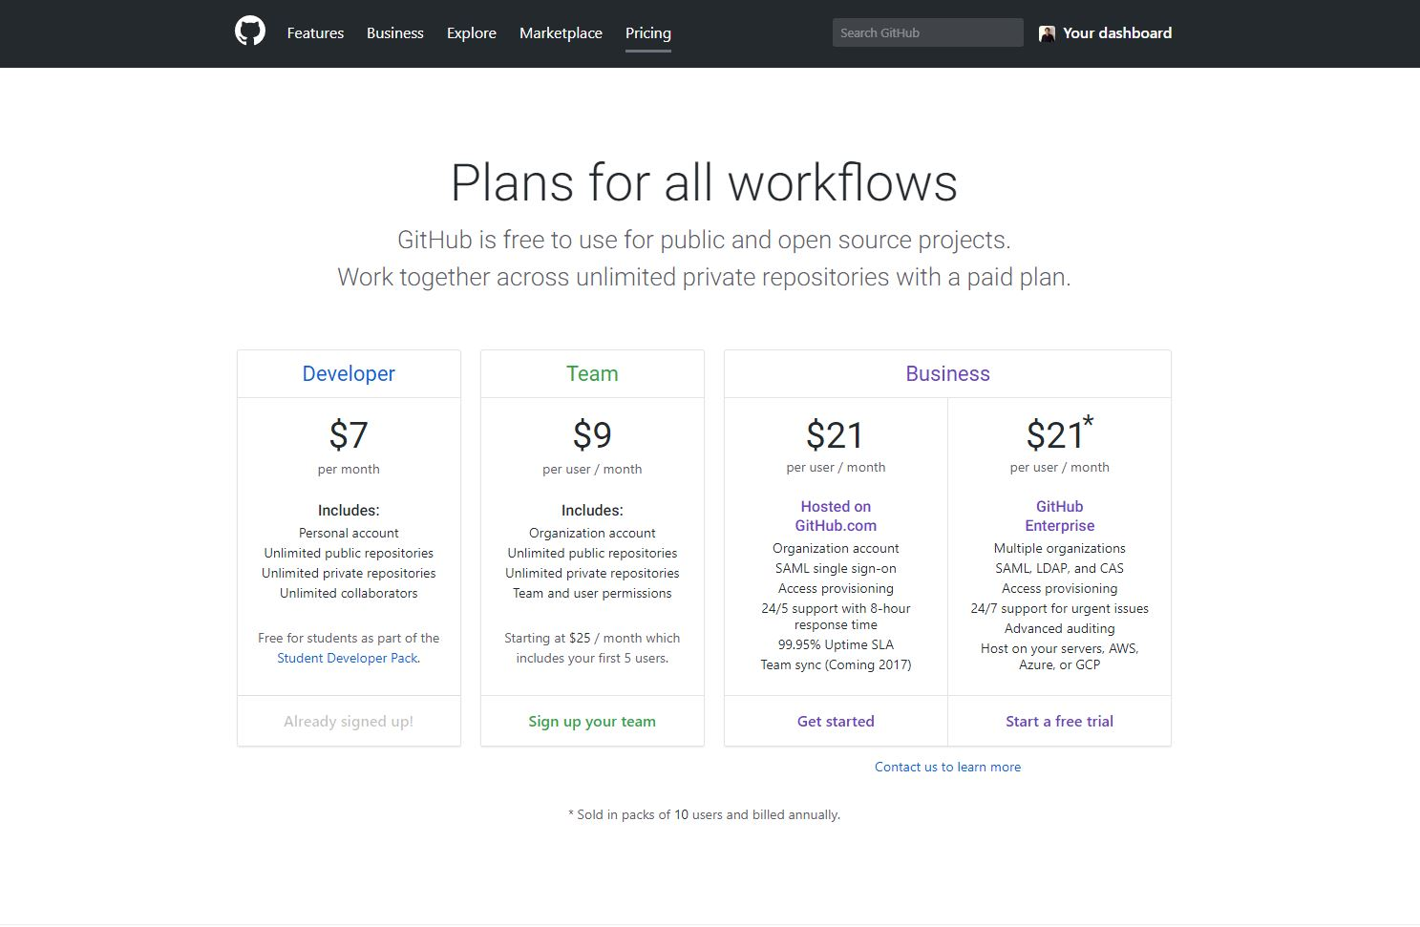

Slide 7
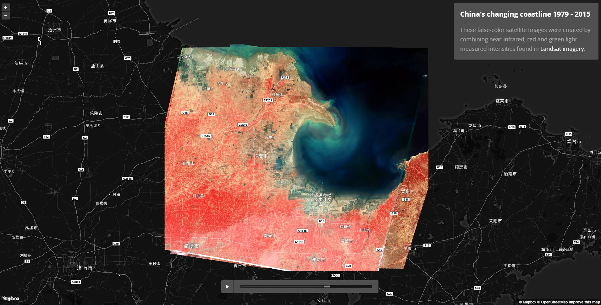

Slide 8
