Slide 1
基于Bi-Directional LSTM的问答技术研究

Slide 2
任务目标
运用记忆网络使机器能够完成GRE verb测试中的单空选择题。例如：
It is a paradox of the Victorians that they were both ______ and, through their empire, cosmopolitan（国际性的、见多识广的）.
Capricious（变化无常的、任性的、突发奇想的）
Insular（狭隘的、与世隔绝的、岛屿的）
Mercenary（唯利是图的、受军队雇用的）
Idealistic（空想的、理想主义的）
intransigent （固执己见的、不妥协的）
The right answer is: B

Slide 3
解决思路
将单空选择问题转化为文本二分类问题，训练模型以实现对正确和错误文本的辨别，例如对以下文本进行分类:
Text | Label
It is a paradox of the Victorians that they were both capricious and, through their empire, cosmopolitan. | 0
It is a paradox of the Victorians that they were both insular and, through their empire, cosmopolitan. | 1
It is a paradox of the Victorians that they were both mercenary and, through their empire, cosmopolitan. | 0
It is a paradox of the Victorians that they were both idealistic and, through their empire, cosmopolitan. | 0
It is a paradox of the Victorians that they were both intransigent and, through their empire, cosmopolitan. | 0

Slide 4
主要技术：
主要模型：双向长短期记忆人工神经网络
网络组成：Input(X)、Input Gate(I)、Forget Gate(F)、State(S)、Output Gate(O)、Output(H)
词嵌套：Google Word2Vec
其中Google Word2Vec是由谷歌训练的一个词嵌套模型，可以将单词转化成为300维的词向量。通过此模型向量化后，不同单词间的逻辑关系可以由线性运算表示，例如：
King – Man + Woman = Queen

Slide 5
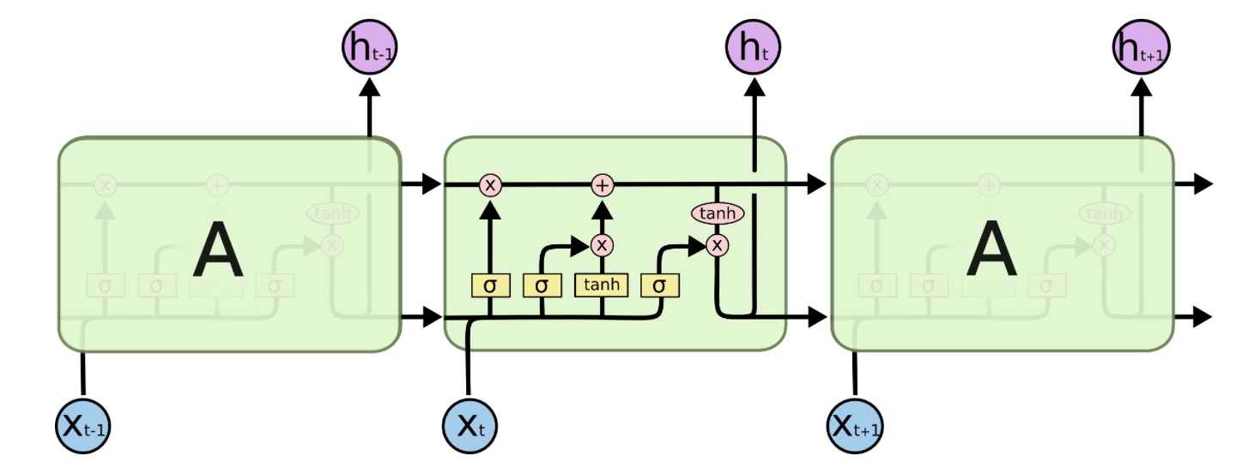
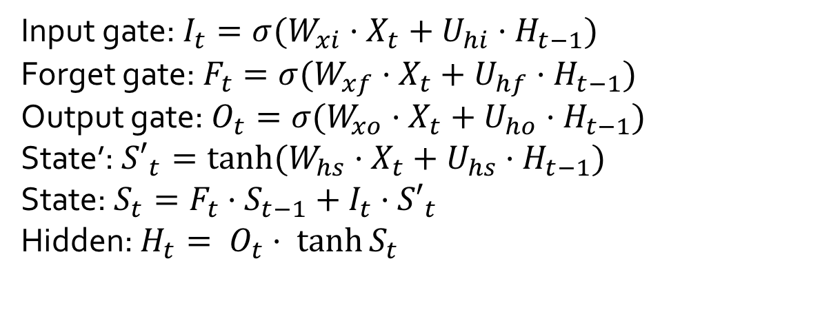
Basic LSTM Cell
Input gate: $I_{t}=σ(W_{xi}·X_{t}+U_{hi}·H_{t−1})$
Forget gate: $F_{t}=σ(W_{xf}·X_{t}+U_{hf}·H_{t−1})$
Output gate: $O_{t}=σ(W_{xo}·X_{t}+U_{ho}·H_{t−1})$
State’: ${S′}_{t}=\tanh{(W_{hs}·X_{t}+U_{hs}·H_{t−1})}$
State: $S_{t}=F_{t}·S_{t−1}+I_{t}·{S′}_{t}$
Hidden: $H_{t}= O_{t}· \tanh{S_{t}}$

Slide 6
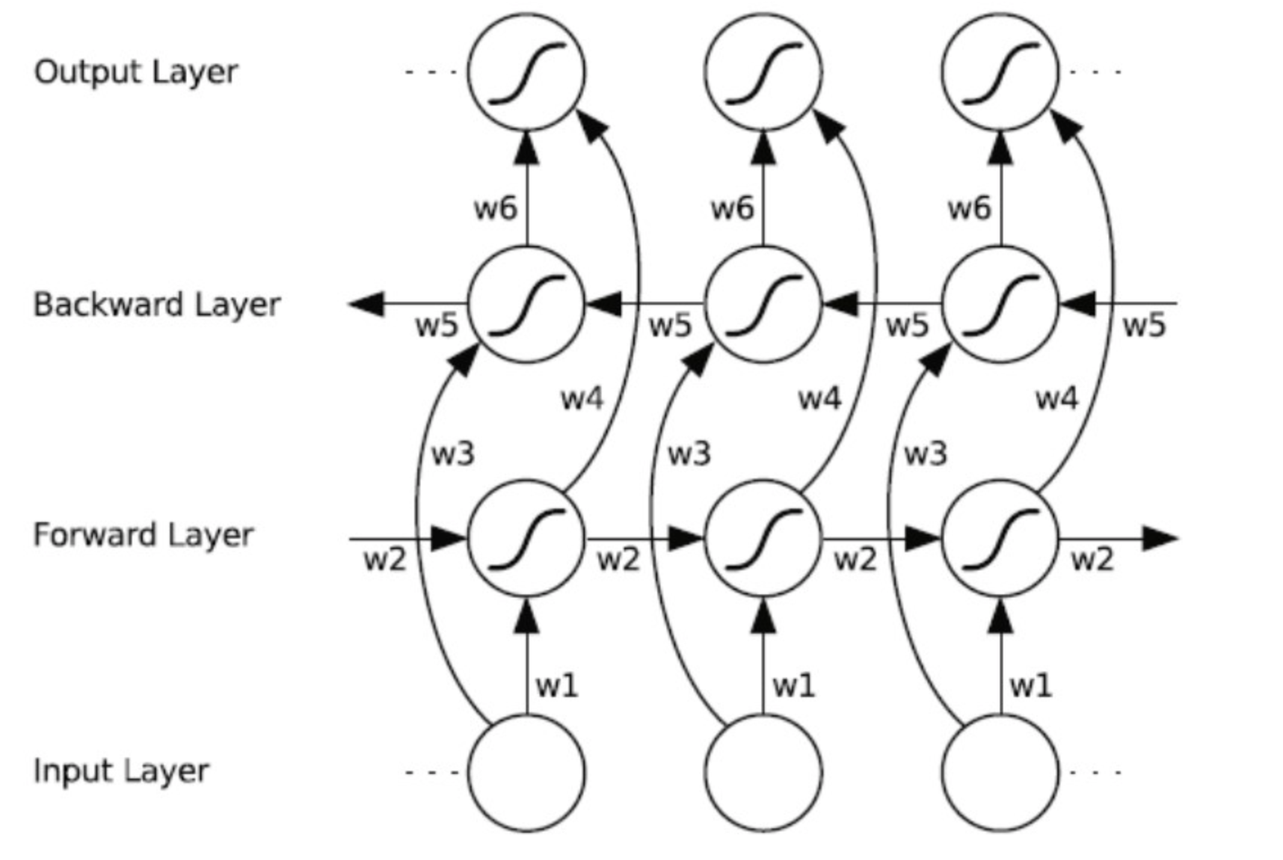
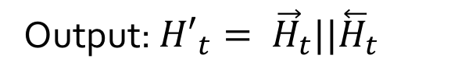
Bi-Directional LSTM
Output: ${H′}_{t}= {\vec{H}}_{t}||{\overset{⃖}{H}}_{t}$

Slide 7

















网络结构
Logits
2维
$$∫$$
2个全连接层
||
N x 600维
$${H′}_{1}$$
$${H′}_{2}$$
$${H′}_{3}$$
$${H′}_{4}$$
$${H′}_{n−3}$$
$${H′}_{n−2}$$
$${H′}_{n−1}$$
$${H′}_{n}$$
600维
······
后向LSTM
······
前向LSTM
$$X_{1}$$
$$X_{2}$$
$$X_{3}$$
$$X_{4}$$
······
$$X_{n−3}$$
$$X_{n−2}$$
$$X_{n−1}$$
$$X_{n}$$
300维
It
is
a
paradox
······
through
their
empire
cosmopolitan

Slide 8
实验内容
数据集：考满分网站中机经及Magoosh中722个题目
训练集与测试集比例：约6：1
正确与错误文本比例 ：1：1
Learning-rate：0.004
Batch-size：256
Iterations:80
Train accuracy：大约96%
Test accuracy：大约93%
Real accuracy：大约93%

