Slide 1
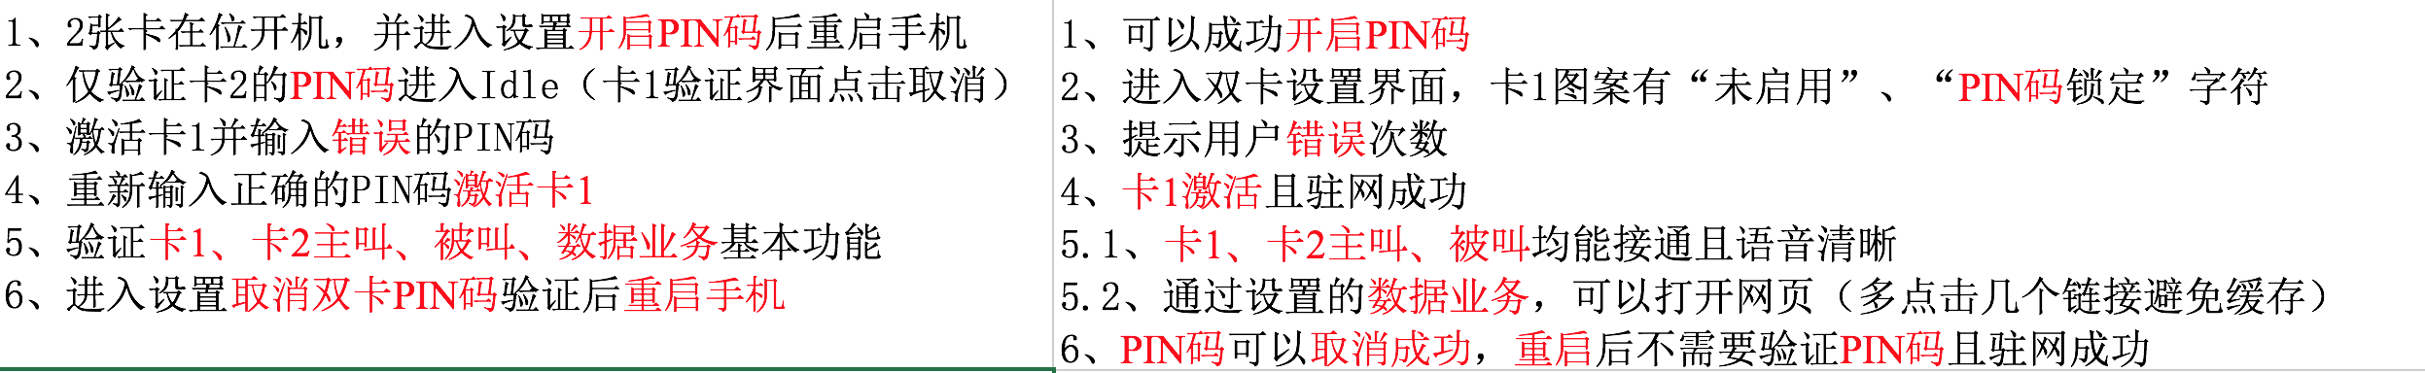
DATA ANALYSE:
The input is related with output by semantic aspect.

Slide 2







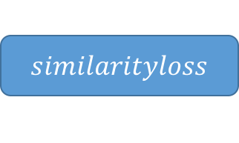









$$similarityloss$$
||
N x 600 dim
$${H′}_{1}$$
$${H′}_{2}$$
$${H′}_{3}$$
$${H′}_{4}$$
$${H′}_{n−3}$$
$${H′}_{n−2}$$
$${H′}_{n−1}$$
$${H′}_{n}$$
600 dim
Attention
Backward LSTM
Foreword LSTM
$$X_{1}$$
$$X_{2}$$
$$X_{3}$$
$$X_{4}$$
$$X_{n−3}$$
$$X_{n−2}$$
$$X_{n−1}$$
$$X_{n}$$
300 dim

Slide 3
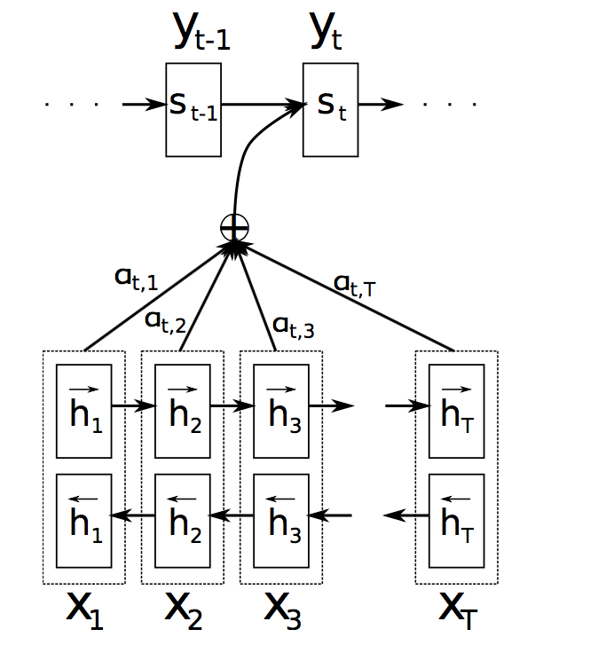

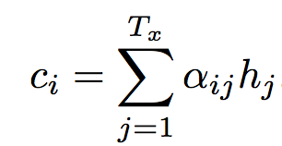
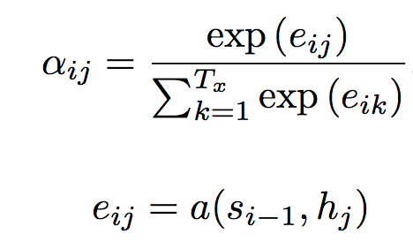
Attention mechanism:

