Slide 1
Lecture 23: Self-Attention and Transformers
Wenhu Chen

Slide 2
Outline
What is attention?
Attention pre-transformers:
  RNN + Attention in machine translation (NLP)
  RNN + Attention in image captioning (CV)
Attention Is All You Need:
  Motivation
  Attention decoupled from the RNN
  Transformer architecture
  Masked training
  Impact
Transformers in other domains (CV):
  Early adoption (Image transformer)
  Visual transformers
Discussion
Notes:
Tackle some misconceptions along the way

Slide 3
What is Attention?
The notion of exploiting context is not new
  CNN – context from spatial locality (useful for images)
  RNN – context from temporal locality (useful for sequences/time-series data)
  Embedding priors into models forces them to pay “attention” to relevant features for a given problem
What we now call “attention” in DL
  The idea of paying “attention” to the most relevant or important parts of the input at a given step
  Very useful in sequence-to-sequence modelling
  Ideally, we’d like to learn this!

Slide 4
What is a Learned Attention Mechanism?
An attention mechanism typically refers to function that allows a model to attend to different content
There are many forms of attention mechanisms
  Additive
  Dot-product
We have names to distinguish attention based on what is attended to
  Self-attention (intra attention)
  Cross-attention (encoder-decoder attention/inter attention)

Slide 5








Sequence to Sequence
Example Scenarios
  Text → Text (e.g. Q/A, translation, text summarization)
  Image → Text (e.g. image captioning)
$$y_{1}$$
$$y_{2}$$
$$y_{3}$$
$$y_{4}$$
Output sequence
magic?
Input sequence
$$x_{1}$$
$$x_{2}$$
$$x_{3}$$
$$x_{4}$$

Slide 6
Sequence to Sequence
Example Scenarios
  Text → Text (e.g. Q/A, translation, text summarization)
  Image → Text (e.g. image captioning)
How? Usually Encoder-Decoder models
  e.g. RNNs, transformers
$$y_{1}$$
$$y_{2}$$
$$y_{3}$$
$$y_{4}$$
Output sequence
ENCODER
state
DECODER
context vector
Input sequence
$$x_{1}$$
$$x_{2}$$
$$x_{3}$$
$$x_{4}$$

Slide 7
































Sequence to Sequence with RNNs
Encoder (LSTM) and decoder (LSTM)
Fixed-length context vector
ENCODER
DECODER
Input: sequence $x_{1},…,x_{T}$
Output: sequence $y_{1},…,y_{T′}$
$$h_{t}=f(x_{t}, h_{t−1})$$
$$s_{t}=g(y_{t−1}, s_{t−1},c)$$
$$y_{1}$$
$$y_{2}$$
$$y_{3}$$
$$y_{4}$$
Initial state
$$h_{1}$$
$$h_{2}$$
$$h_{3}$$
$$h_{4}$$
$$h_{1}$$
$$f$$
$$h_{2}$$
$$f$$
$$h_{3}$$
$$f$$
$$h_{4}$$
$$s_{0}$$
$$s_{1}$$
$$g$$
$$s_{2}$$
$$g$$
$$s_{3}$$
$$g$$
$$s_{4}$$
$$f$$
$$f$$
$$f$$
$$x_{1}$$
$$x_{2}$$
$$x_{3}$$
$$x_{4}$$
c
$$y_{0}$$
$$y_{1}$$
$$y_{2}$$
$$y_{3}$$
Context vector
I. Sutskever, O. Vinyals, and Q. V. Le, “Sequence to sequence learning with neural networks,” in Proceedings of the 27th International Conference on Neural Information Processing Systems (NIPS), 2014, pp. 3104–3112.
Notes:
We saw that using two RNNs for translation achieves close to state-of-the-art performance.
Bottleneck: context vector c is often a fixed-length vector

Slide 8
Sequence to Sequence with RNNs
Encoder (LSTM) and decoder (LSTM)
Fixed-length context vector (bottleneck)
ENCODER
DECODER
Input: sequence $x_{1},…,x_{T}$
Output: sequence $y_{1},…,y_{T′}$
$$h_{t}=f(x_{t}, h_{t−1})$$
$$s_{t}=g(y_{t−1}, s_{t−1},c)$$
$$y_{1}$$
$$y_{2}$$
$$y_{3}$$
$$y_{4}$$
Initial state
$$h_{1}$$
$$h_{2}$$
$$h_{3}$$
$$h_{4}$$
$$h_{1}$$
$$f$$
$$h_{2}$$
$$f$$
$$h_{3}$$
$$f$$
$$h_{4}$$
$$s_{0}$$
$$s_{1}$$
$$g$$
$$s_{2}$$
$$g$$
$$s_{3}$$
$$g$$
$$s_{4}$$
$$f$$
$$f$$
$$f$$
BOTTLENECK
$$x_{1}$$
$$x_{2}$$
$$x_{3}$$
$$x_{4}$$
c
$$y_{0}$$
$$y_{1}$$
$$y_{2}$$
$$y_{3}$$
Context vector
I. Sutskever, O. Vinyals, and Q. V. Le, “Sequence to sequence learning with neural networks,” in Proceedings of the 27th International Conference on Neural Information Processing Systems (NIPS), 2014, pp. 3104–3112.
Notes:
We saw that using two RNNs for translation achieves close to state-of-the-art performance.
Bottleneck: context vector c is often a fixed-length vector (PERFORMANCE BOTTLENECK)

Slide 9
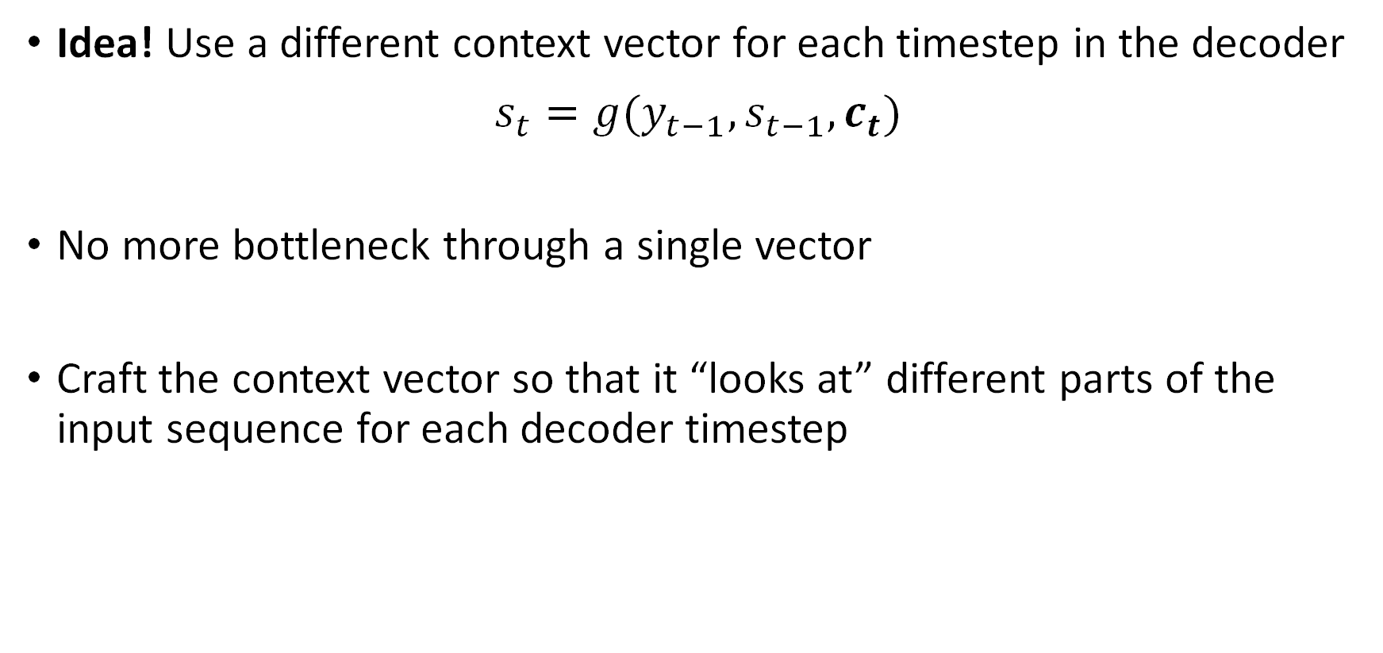
Sequence to Sequence with RNNs + Attention
Idea! Use a different context vector for each timestep in the decoder
$$s_{t}=g(y_{t−1}, s_{t−1},c_{t})$$
No more bottleneck through a single vector
Craft the context vector so that it “looks at” different parts of the input sequence for each decoder timestep
D. Bahdanau, K. Cho, and Y. Bengio, “Neural Machine Translation by Jointly Learning to Align and Translate,” in 3rd International Conference on Learning Representations (ICLR), 2015.

Slide 10




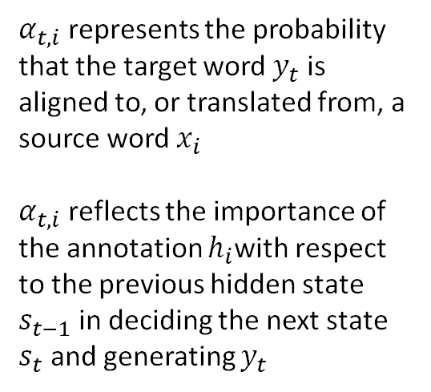













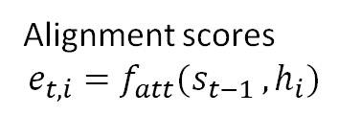

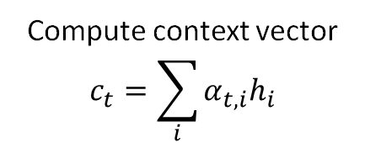
Sequence to Sequence with RNNs + Attention
Compute context vector
$$c_{t}=\sum_{i}{α_{t,i}h_{i}}$$
Find $s_{1}: t=1$
$$×$$
$$×$$
$$×$$
$$×$$
$$+$$
$$α_{1,1}$$
$$α_{1,2}$$
$$α_{1,3}$$
$$α_{1,4}$$
Attention weights
(normalize alignment scores)
DECODER
$$s_{t}=g(y_{t−1}, s_{t−1},c_{t})$$
softmax
$$y_{1}$$
$α_{t,i}$ represents the probability that the target word$y_{t}$ is aligned to, or translated from, a source word $x_{i}$
$α_{t,i}$ reflects the importance of the annotation $h_{i}$with respect to the previous hidden state $s_{t−1}$ in deciding the next state $s_{t}$ and generating $y_{t}$
$$e_{1,1}$$
$$e_{1,2}$$
$$e_{1,3}$$
$$e_{1,4}$$
Alignment scores
$$e_{t,i}=f_{att}(s_{t−1 },h_{i})$$
ENCODER
$$s_{0}$$
$$s_{1}$$
$$h_{1}$$
$$f$$
$$h_{2}$$
$$f$$
$$h_{3}$$
$$f$$
$$h_{4}$$
Initial state
$$x_{1}$$
$$x_{2}$$
$$x_{3}$$
$$x_{4}$$
$$c_{1}$$
$$y_{0}$$
Context vector
D. Bahdanau, K. Cho, and Y. Bengio, “Neural Machine Translation by Jointly Learning to Align and Translate,” in 3rd International Conference on Learning Representations (ICLR), 2015.

Slide 11













Sequence to Sequence with RNNs + Attention
Compute context vector
$$c_{t}=\sum_{i}{α_{t,i}h_{i}}$$
Find $s_{2}: t=2$
$$×$$
$$×$$
$$×$$
$$×$$
$$+$$
$$α_{2,1}$$
$$α_{2,2}$$
$$α_{2,3}$$
$$α_{2,4}$$
Attention weights
(normalize alignment scores)
DECODER
$$s_{t}=g(y_{t−1}, s_{t−1},c_{t})$$
softmax
$$y_{1}$$
$$y_{2}$$
$$e_{2,1}$$
$$e_{2,2}$$
$$e_{2,3}$$
$$e_{2,4}$$
Alignment scores
$$e_{t,i}=f_{att}(s_{t−1 },h_{i})$$
ENCODER
$$s_{0}$$
$$s_{1}$$
$$s_{2}$$
$$h_{1}$$
$$f$$
$$h_{2}$$
$$f$$
$$h_{3}$$
$$f$$
$$h_{4}$$
$$g$$
Initial state
$$x_{1}$$
$$x_{2}$$
$$x_{3}$$
$$x_{4}$$
$$c_{1}$$
$$y_{0}$$
$$c_{2}$$
$$y_{1}$$
Context vector
D. Bahdanau, K. Cho, and Y. Bengio, “Neural Machine Translation by Jointly Learning to Align and Translate,” in 3rd International Conference on Learning Representations (ICLR), 2015.

Slide 12

















Sequence to Sequence with RNNs + Attention
Compute context vector
$$c_{t}=\sum_{i}{α_{t,i}h_{i}}$$
Find $s_{t}: t=t$
$$×$$
$$×$$
$$×$$
$$×$$
$$+$$
$$α_{t,1}$$
$$α_{t,2}$$
$$α_{t,3}$$
$$α_{t,4}$$
Attention weights
(normalized alignment scores)
DECODER
$$s_{t}=g(y_{t−1}, s_{t−1},c_{t})$$
softmax
$$y_{1}$$
$$y_{2}$$
$$y_{3}$$
$$y_{4}$$
$$e_{t,1}$$
$$e_{t,2}$$
$$e_{t,3}$$
$$e_{t,4}$$
Alignment scores
$$e_{t,i}=f_{att}(s_{t−1 },h_{i})$$
$$c_{t}$$
$$s_{t−1}$$
ENCODER
$$s_{0}$$
$$s_{1}$$
$$s_{2}$$
$$s_{3}$$
$$s_{4}$$
$$h_{1}$$
$$f$$
$$h_{2}$$
$$f$$
$$h_{3}$$
$$f$$
$$h_{4}$$
$$g$$
$$g$$
$$g$$
Initial state
$$x_{1}$$
$$x_{2}$$
$$x_{3}$$
$$x_{4}$$
$$c_{1}$$
$$y_{0}$$
$$c_{2}$$
$$y_{1}$$
$$c_{3}$$
$$y_{2}$$
$$c_{3}$$
$$y_{3}$$
Context vector
D. Bahdanau, K. Cho, and Y. Bengio, “Neural Machine Translation by Jointly Learning to Align and Translate,” in 3rd International Conference on Learning Representations (ICLR), 2015.

Slide 13

Sequence to Sequence with RNNs + Attention
All steps are differentiable, so we can backpropagate through everything
Compute context vector
$$c_{t}=\sum_{i}{α_{t,i}h_{i}}$$
Find $s_{t} →t=t$
$$×$$
$$×$$
$$×$$
$$×$$
$$+$$
$$α_{t,1}$$
$$α_{t,2}$$
$$α_{t,3}$$
$$α_{t,4}$$
Attention weights
(normalized alignment scores)
DECODER
$$s_{t}=g(y_{t−1}, s_{t−1},c_{t})$$
softmax
$$y_{1}$$
$$y_{2}$$
$$y_{3}$$
$$y_{4}$$
$$e_{t,1}$$
$$e_{t,2}$$
$$e_{t,3}$$
$$e_{t,4}$$
Alignment scores
$$e_{t,i}=f_{att}(s_{t−1 },h_{i})$$
$$c_{t}$$
$$s_{t−1}$$
ENCODER
$$s_{0}$$
$$s_{1}$$
$$s_{2}$$
$$s_{3}$$
$$s_{4}$$
$$h_{1}$$
$$f$$
$$h_{2}$$
$$f$$
$$h_{3}$$
$$f$$
$$h_{4}$$
$$g$$
$$g$$
$$g$$
Initial state
Encoder is bi-directional: allows for the annotation of each word to summarize both preceding and following words.
$$x_{1}$$
$$x_{2}$$
$$x_{3}$$
$$x_{4}$$
$$c_{1}$$
$$y_{0}$$
$$c_{2}$$
$$y_{1}$$
$$c_{3}$$
$$y_{2}$$
$$c_{3}$$
$$y_{3}$$
Context vector
D. Bahdanau, K. Cho, and Y. Bengio, “Neural Machine Translation by Jointly Learning to Align and Translate,” in 3rd International Conference on Learning Representations (ICLR), 2015.

Slide 14
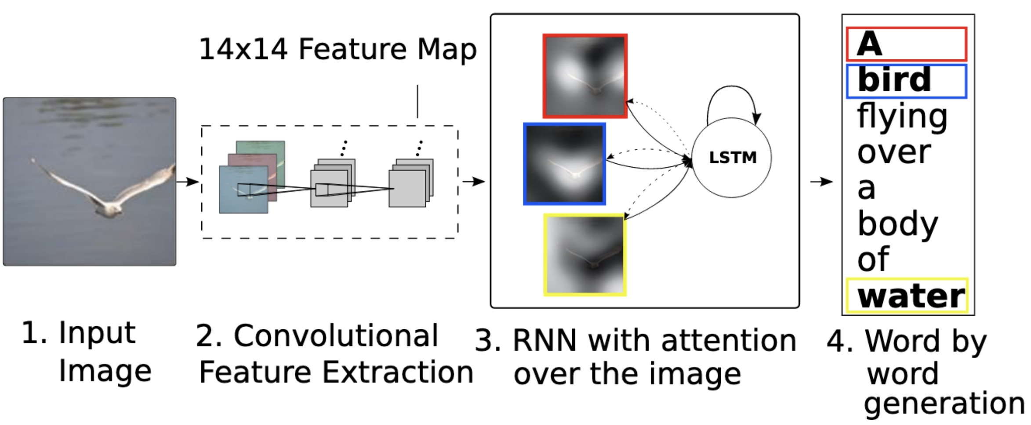
Image Captioning with Visual Attention
We can similarly use attention for image captioning (image → text)
Builds directly on previous work
K. Xu et al., “Show, Attend and Tell: Neural Image Caption Generation with Visual Attention,” in PMLR, 2015, pp. 2048–2057.

Slide 15



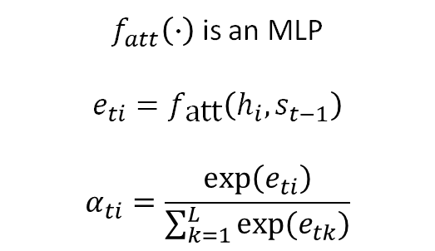







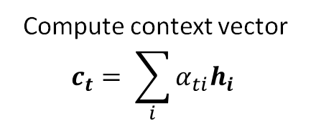
Image Captioning with Visual Attention
$h_{i}$ corresponds to a part of the image
Compute context vector
$$c_{t}= \sum_{i}{α_{ti}h_{i} }$$
$f_{att}\left(∙\right)$ is an MLP
$$e_{ti}=f_{\text{att}}\left(h_{i},s_{t−1}\right)$$
$$α_{ti}=\frac{\exp\left(e_{ti}\right)}{\sum_{k=1}^{L}{exp⁡(e_{tk})}}$$
$$s_{t}=g(y_{t−1}, s_{t−1},c_{t})$$
$$e_{ti}$$
$$α_{ti}$$
A
$$y_{1}$$
$$f_{\text{att}}$$
DECODER
$$s_{0}$$
$$s_{1}$$
Different context vector at every time step
Each context vector attends to different image regions.
ENCODER
CNN
$$h_{i}$$
$$×$$
$$c_{1}$$
$$y_{0}$$
Input image
Feature extraction
Annotation vectors
(feature vectors)
[START]
K. Xu et al., “Show, Attend and Tell: Neural Image Caption Generation with Visual Attention,” in PMLR, 2015, pp. 2048–2057.

Slide 16
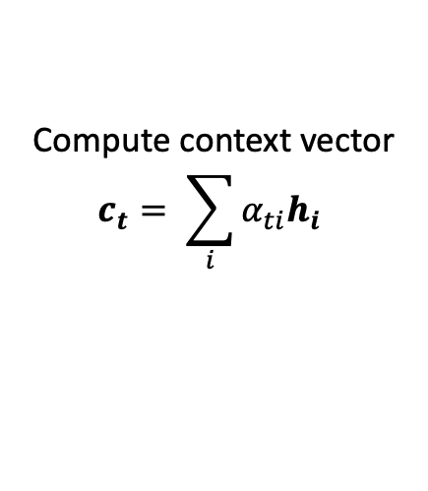













Image Captioning with Visual Attention
$h_{i}$ corresponds to a part of the image
Compute context vector
$$c_{t}= \sum_{i}{α_{ti}h_{i} }$$
$f_{att}\left(∙\right)$ is an MLP
$$e_{ti}=f_{\text{att}}\left(h_{i},s_{t−1}\right)$$
$$α_{ti}=\frac{\exp\left(e_{ti}\right)}{\sum_{k=1}^{L}{exp⁡(e_{tk})}}$$
$$s_{t}=g(y_{t−1}, s_{t−1},c_{t})$$
$$e_{ti}$$
$$α_{ti}$$
A
bird
flying
[END]
$$y_{1}$$
$$y_{2}$$
$$y_{3}$$
$$y_{4}$$
$$f_{\text{att}}$$
$$s_{t−1}$$
DECODER
$$s_{0}$$
$$s_{1}$$
$$s_{2}$$
$$s_{3}$$
$$s_{4}$$
ENCODER
CNN
$$h_{i}$$
$$×$$
$$c_{1}$$
$$y_{0}$$
$$c_{2}$$
$$y_{1}$$
$$c_{3}$$
$$y_{1}$$
$$c_{4}$$
$$y_{1}$$
Input image
Feature extraction
Annotation vectors
(feature vectors)
[START]
A
bird
flying
K. Xu et al., “Show, Attend and Tell: Neural Image Caption Generation with Visual Attention,” in PMLR, 2015, pp. 2048–2057.

Slide 17

Image Captioning with Visual Attention
All steps are differentiable, so we can backpropagate through everything.
Each context vector attends to different image regions.
Compute context vector
$$c_{t}= \sum_{i}{α_{ti}h_{i} }$$
${\text{a}}_{i}$ corresponds to a part of the image
softmax
$f_{att}\left(∙\right)$ is an MLP
$$e_{ti}=f_{\text{att}}\left(h_{i},s_{t−1}\right)$$
$$α_{ti}=\frac{\exp\left(e_{ti}\right)}{\sum_{k=1}^{L}{exp⁡(e_{tk})}}$$
$$s_{t}=g(y_{t−1}, s_{t−1},c_{t})$$
$$e_{ti}$$
$$α_{ti}$$
A
bird
flying
[END]
$$y_{1}$$
$$y_{2}$$
$$y_{3}$$
$$y_{4}$$
$$f_{\text{att}}$$
$$s_{t−1}$$
DECODER
$$s_{0}$$
$$s_{1}$$
$$s_{2}$$
$$s_{3}$$
$$s_{4}$$
ENCODER
CNN
$$h_{i}$$
$$×$$
$$c_{1}$$
$$y_{0}$$
$$c_{2}$$
$$y_{1}$$
$$c_{3}$$
$$y_{1}$$
$$c_{4}$$
$$y_{1}$$
Input image
Feature extraction
Annotation vectors
(feature vectors)
[START]
A
bird
flying
K. Xu et al., “Show, Attend and Tell: Neural Image Caption Generation with Visual Attention,” in PMLR, 2015, pp. 2048–2057.

Slide 18
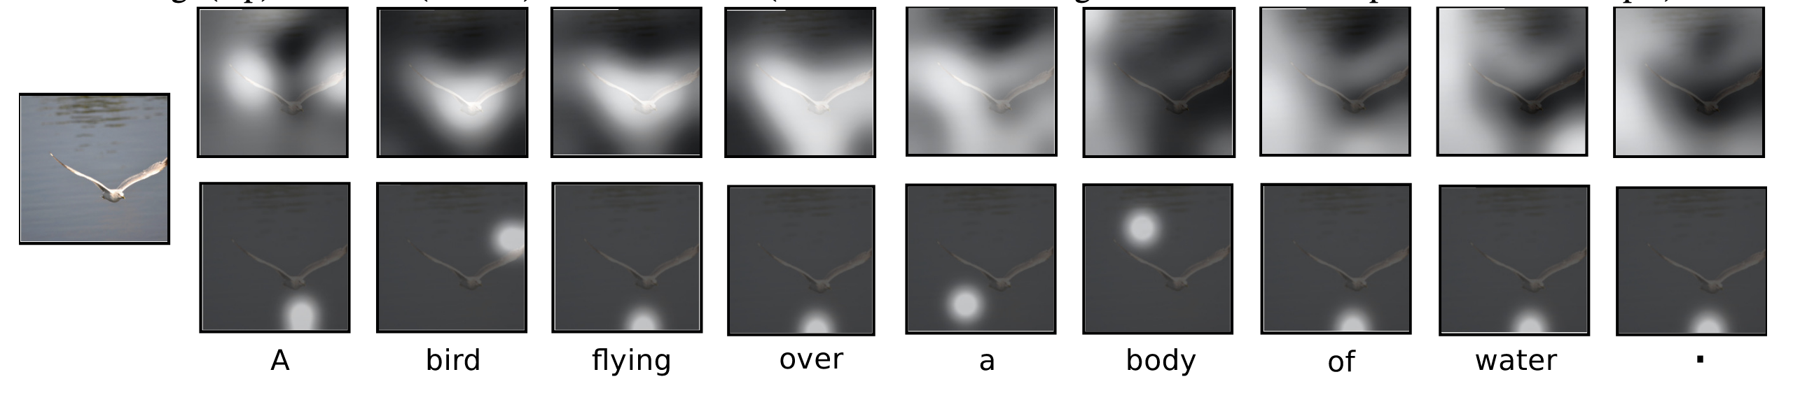
Image Captioning with Visual Attention
Visualization of the attention for each generated word
  Gives insight to “where” and “what” the attention focused on when generating each word
deterministic “soft” attention
stochastic
“hard” attention
(requires RL)
K. Xu et al., “Show, Attend and Tell: Neural Image Caption Generation with Visual Attention,” in PMLR, 2015, pp. 2048–2057.

Slide 19
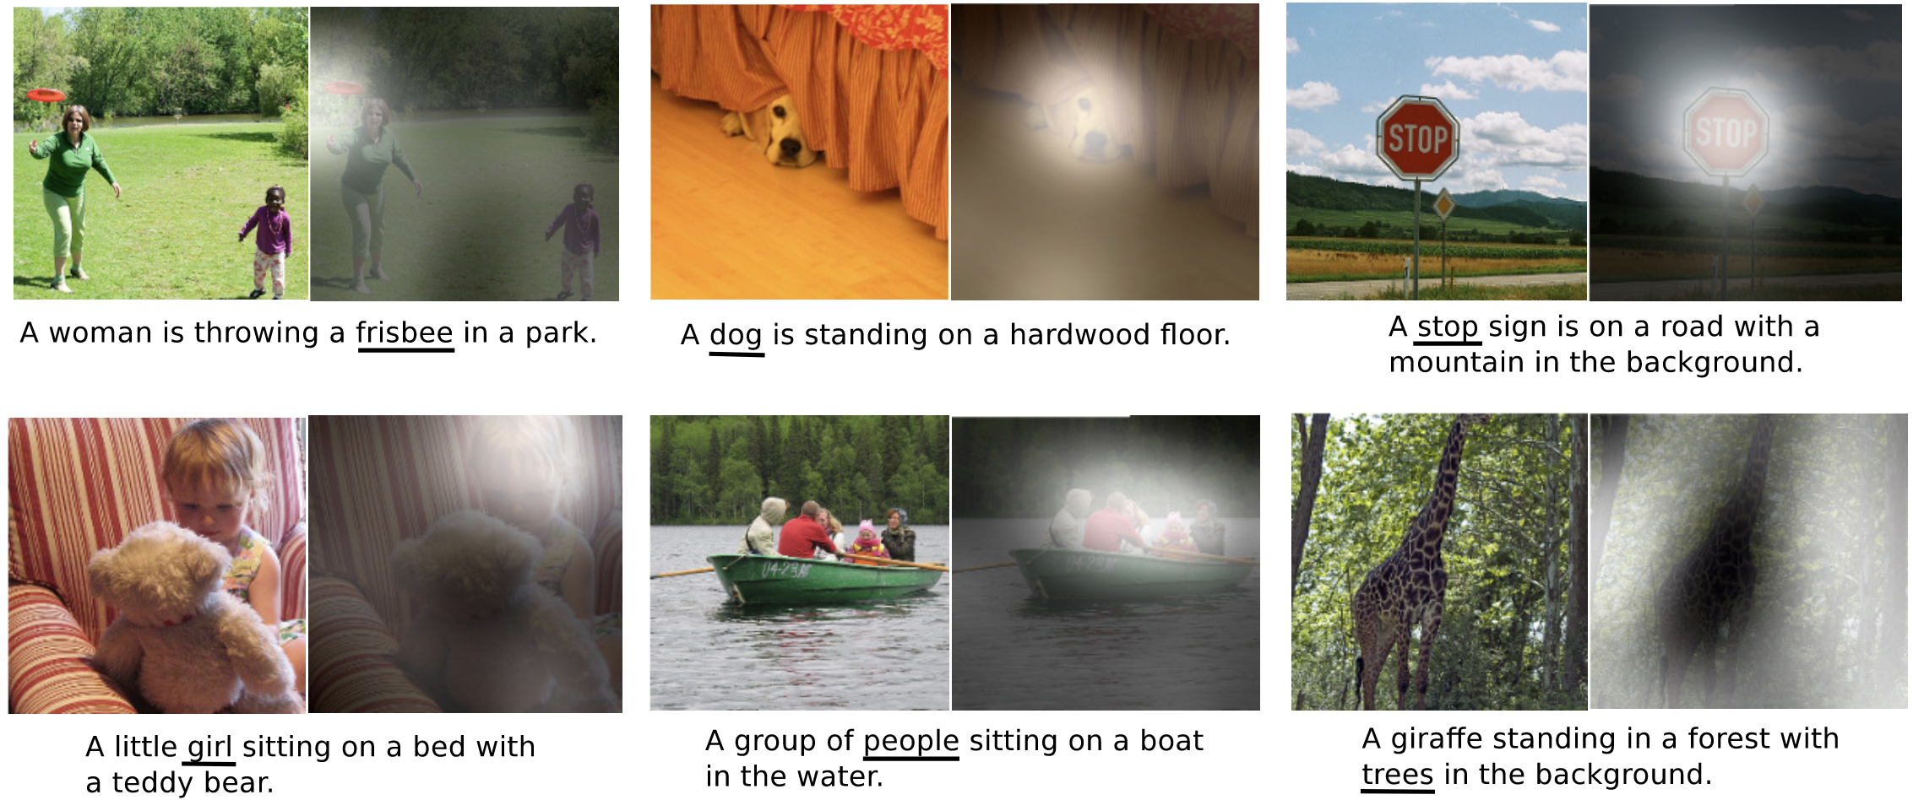
Image Captioning with Visual Attention
K. Xu et al., “Show, Attend and Tell: Neural Image Caption Generation with Visual Attention,” in PMLR, 2015, pp. 2048–2057.

Slide 20
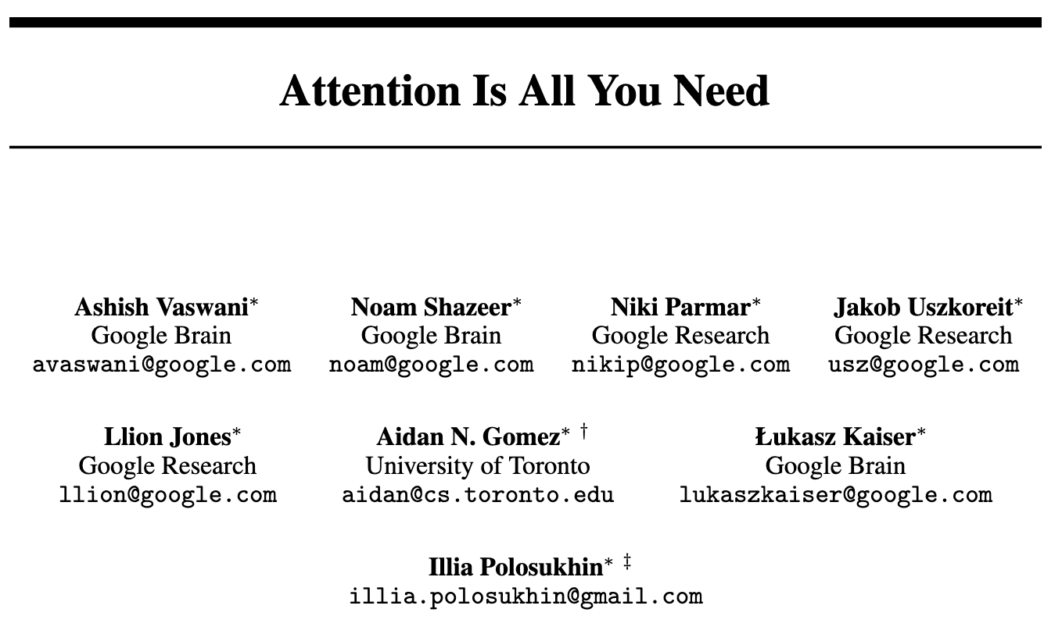
Attention is All you Need (2017)
Key Idea:
  Decouple attention from RNNs
  Use self-attention to make this efficient
Contributions:
  Multi-head attention
  Transformer architecture
Highly impactful (as we’ll touch on later)
A. Vaswani et al., “Attention is All you Need,” in Advances in Neural Information Processing Systems (NeurIPS), 2017.

Slide 21


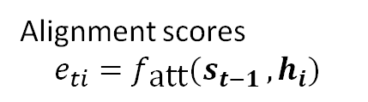

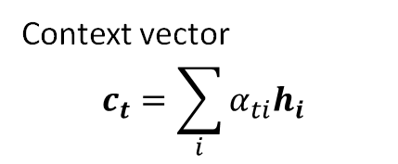










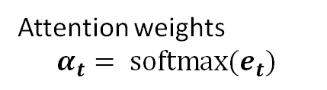



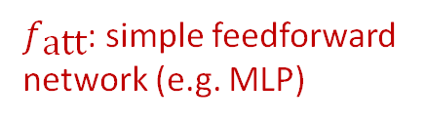
Attention we’ve seen so far
  Now known as “additive” recurrent attention (type of encoder-decoder attention)
$$c_{t}$$
$$s_{t}$$
Context vector
$$c_{t}=\sum_{i}{α_{ti}h_{i}}$$
$$\text{•••}$$
mul + add
Attention
$$α_{t1}$$
$$α_{t2}$$
$$α_{t3}$$
$$α_{t4}$$
Attention weights
$$α_{t}= \text{softmax}(e_{t})$$
softmax
Alignment
$$e_{t1}$$
$$e_{t2}$$
$$e_{t3}$$
$$e_{t4}$$
Alignment scores
$$e_{ti}=f_{\text{att}}(s_{t−1 },h_{i})$$
$$f_{\text{att}}$$
$$f_{\text{att}}$$
$$f_{\text{att}}$$
$$f_{\text{att}}$$
$f_{\text{att}}$: simple feedforward network (e.g. MLP)
Input
$$h_{1}$$
$$h_{2}$$
$$h_{3}$$
$$h_{4}$$
$$s_{t−1}$$

Slide 22
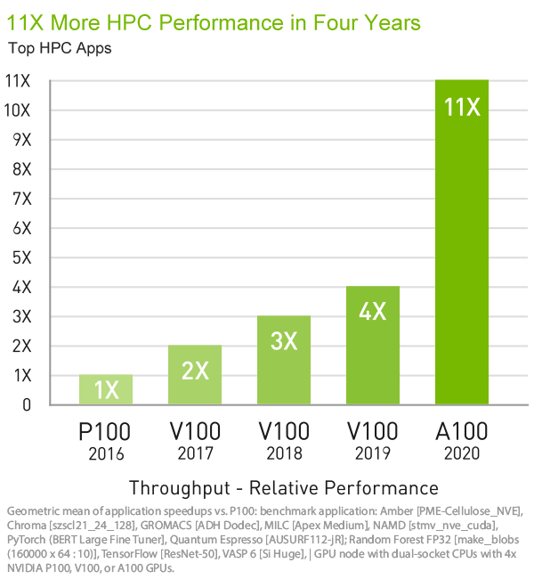
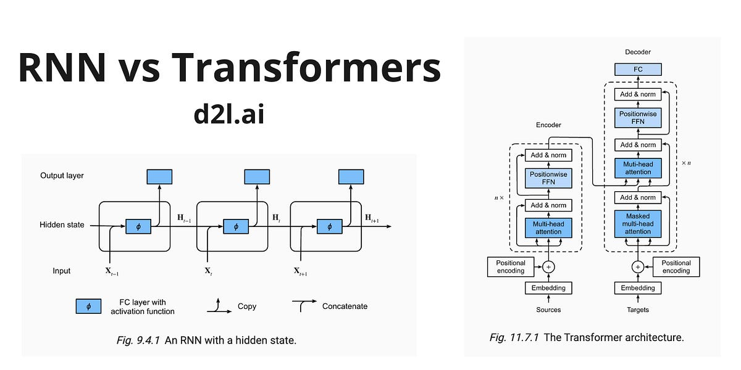
GPU Parallelization

Slide 23
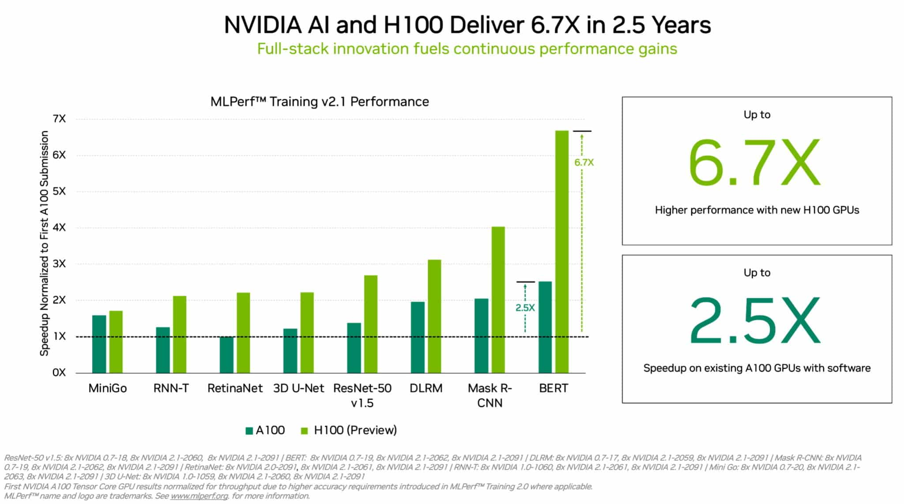
GPU Parallelization

Slide 24
Issues with Recurrent Attention
Scalability issues
  Performance degrades as the distance between words increases
Parallelization limitations
  Recurrent processes lacks ability to be parallelized
Memory constraints
  RNNs have limited memory and struggle with long-range dependencies
  Diluted impact of earlier elements on output as sequence progresses
Potential solution: decouple attention from RNNs
  How? Separate the attention mechanism into smaller, self-contained components
Notes:
Main idea is we want to eliminate the recurrence dependency
And break up attention into independent pieces which are quick to calculate

Slide 25
Decoupling from RNNs
Recall: attention determines the importance of elements to be passed forward in the model.
  These weights lets the model pay attention to the most significant parts of the inputs
Objective: a more general attention mechanism not confined to RNNs
  We need a modified procedure to:
    Determine weights based on context that indicate the elements to attend to
    Apply these weights to enhance attended features

Slide 26





Decoupling from RNNs
RNN Notation
$$x_{i}$$
Input for position $i$ in source sequence
$$h_{i}$$
Hidden states for position $i$ in source sequence
$$s_{t}$$
Hidden states for position $t$ in target sequence
$$c_{t}$$
Context vector for position $t$ in target sequence
$$y_{t}$$
Output for position $t$ in target sequence

Slide 27




Decoupling from RNNs
New Notation
$$x_{i}$$
$$h_{i}$$
$$k_{i}$$
$$s_{t}$$
$$v_{i}$$
$$c_{t}$$
$$q_{j}$$
$$y_{t}$$
$$o_{j}$$

Slide 28




Decoupling from RNNs
New Notation
$$k_{i}$$
Key vector for position $i$ in an arbitrary sequence
$$v_{i}$$
Value vector for position $i$ in an arbitrary sequence
$$q_{j}$$
Query vector for position $j$ in a (same/different) arbitrary sequence
$$o_{j}$$
Output vector corresponding to position $j$

Slide 29






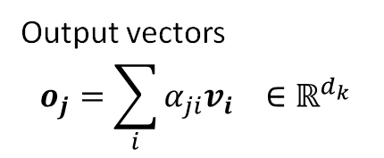

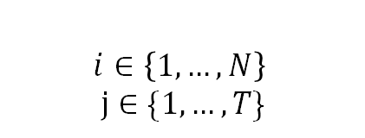
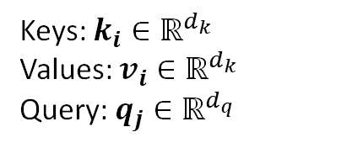



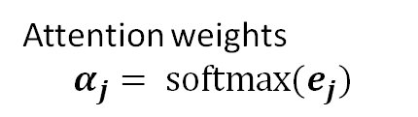







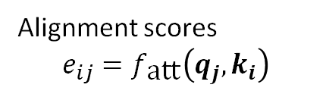
A more general attention
$$o_{j}$$
Output vectors
$$o_{j}=\sum_{i}{α_{ji}v_{i}} ∈ℝ^{d_{k}}$$
$$Attention(q, k, v)$$
mul + add
$$v_{1}$$
$$α_{j1}$$
Attention
$$v_{2}$$
$$α_{j2}$$
Attention weights
$$α_{j}= \text{softmax}(e_{j})$$
$$v_{3}$$
$$α_{j3}$$
softmax
Alignment
$$k_{1}$$
$$f_{\text{att}}$$
$$e_{j1}$$
Alignment scores
$$e_{ij}=f_{\text{att}}\left(q_{j},k_{i}\right)$$
$$k_{2}$$
$$f_{\text{att}}$$
$$e_{j2 }$$
Goal: find the “alignment” or “compatibility” of keys with a query to scale values
$$k_{3}$$
$$f_{\text{att}}$$
$$e_{j3}$$
$$f_{\text{att}}\left(∙\right)$$
$$i∈\left\{1, …, N\right\}$$
$$j∈\{1, …, T\}$$
Keys: $k_{i}∈ℝ^{d_{k}}$
Values: $v_{i}∈ℝ^{d_{k}}$
Query: $q_{j}∈ℝ^{d_{q}}$
$$q_{j}$$
Notes:
Query is asking how much of each of the v’s should it use, based on compatibility with k

Slide 30




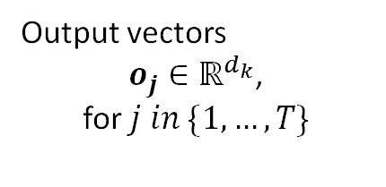







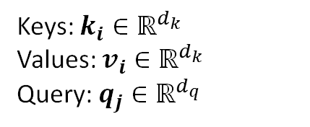


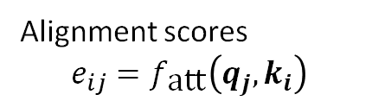












A more general attention
$$o_{1}$$
$$o_{2}$$
$$o_{3}$$
Output vectors
$o_{j}∈ℝ^{d_{k}}$,
for $j in \{1,…,T\}$
$$Attention(q, k, v)$$
mul + add
$$v_{1}$$
$$α_{11}$$
$$α_{12}$$
$$α_{13}$$
Attention
$$v_{2}$$
$$α_{21}$$
$$α_{22}$$
$$α_{23}$$
Attention weights
$$α_{j}= \text{softmax}(e_{j})$$
$$v_{3}$$
$$α_{31}$$
$$α_{32}$$
$$α_{33}$$
softmax
Alignment
$$k_{1}$$
$$e_{11}$$
$$e_{12}$$
$$e_{13}$$
Alignment scores
$$e_{ij}=f_{\text{att}}\left(q_{j},k_{i}\right)$$
$$k_{2}$$
$$e_{21}$$
$$e_{22}$$
$$e_{23}$$
Goal: find the “alignment” or “compatibility” between keys and queries to scale values
$$k_{3}$$
$$e_{31}$$
$$e_{32}$$
$$e_{33}$$
$$f_{\text{att}}\left(∙\right)$$
$$i∈\left\{1, …, N\right\}$$
$$j∈\{1, …, T\}$$
Keys: $k_{i}∈ℝ^{d_{k}}$
Values: $v_{i}∈ℝ^{d_{k}}$
Query: $q_{j}∈ℝ^{d_{q}}$
$$q_{1}$$
$$q_{2}$$
$$q_{3}$$

Slide 31





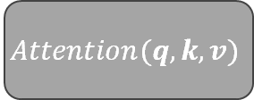














Applying the Attention Mechanism
Self-Attention
Cross-Attention
Keys, values, and queries are all derived from the same source
Keys-values and queries are derived from separate sources
Arbitrary inputs
$$x_{1}$$
$$v_{1}$$
$$v_{2}$$
$$v_{3}$$
$$x_{2}$$
$$v_{1}$$
$$v_{2}$$
$$v_{3}$$
$$x_{1}$$
$$x_{3}$$
$$Attention(q, k, v)$$
$$k_{1}$$
$$k_{2}$$
$$k_{3}$$
$$Attention(q, k, v)$$
$$k_{1}$$
$$k_{2}$$
$$k_{3}$$
$$x_{2}$$
$$x_{3}$$
$$y_{1}$$
$$q_{1}$$
$$q_{2}$$
$$q_{3}$$
$$y_{2}$$
$$q_{1}$$
$$q_{2}$$
$$q_{3}$$
Arbitrary transformation
$$y_{3}$$
** $x,y$ are arbitrary sequences
Notes:
x, y arbitrary

Slide 32
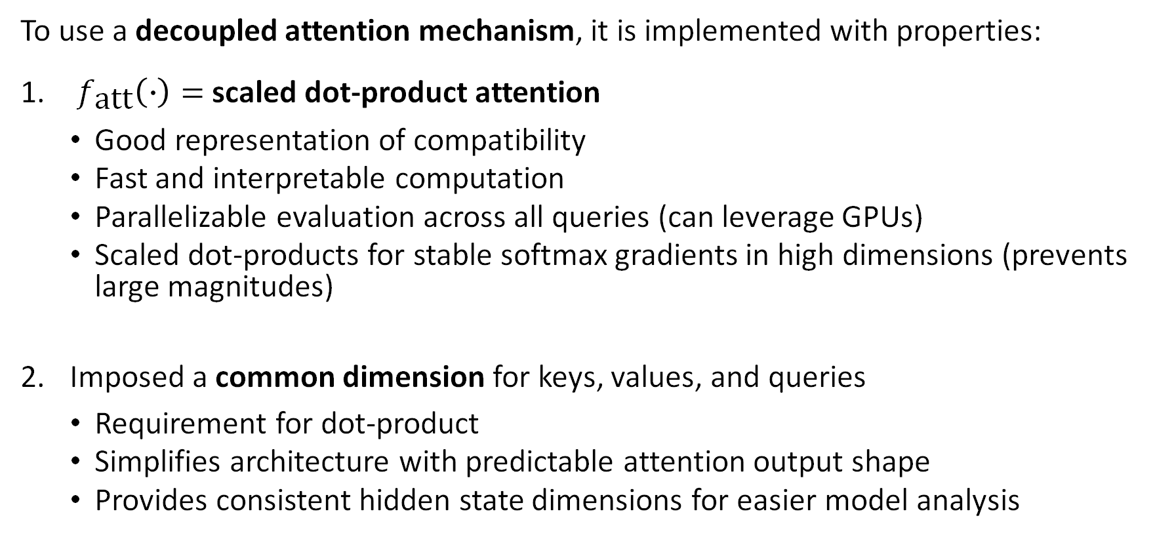
Attention Mechanism in Attention is All You Need
To use a decoupled attention mechanism, it is implemented with properties:
$f_{\text{att}}\left(∙\right)=$scaled dot-product attention
  Good representation of compatibility
  Fast and interpretable computation
  Parallelizable evaluation across all queries (can leverage GPUs)
  Scaled dot-products for stable softmax gradients in high dimensions (prevents large magnitudes)
Imposed a common dimension for keys, values, and queries
  Requirement for dot-product
  Simplifies architecture with predictable attention output shape
  Provides consistent hidden state dimensions for easier model analysis
A. Vaswani et al., “Attention is All you Need,” in Advances in Neural Information Processing Systems (NeurIPS), 2017.
Notes:
Base attention the authors use is scaled dot-product attention

Slide 33
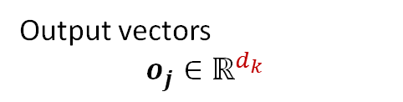
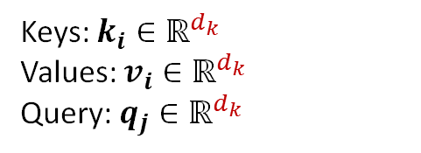
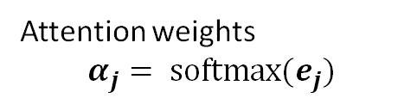

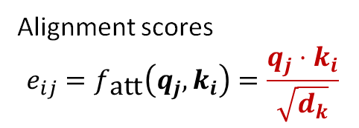
Attention in Attention is All you Need
$$o_{1}$$
$$o_{2}$$
$$o_{3}$$
Output vectors
$$o_{j}∈ℝ^{d_{k}}$$
Scaled Dot-Product Attention
Faster
More space-efficient
mul + add
$$v_{1}$$
$$α_{11}$$
$$α_{12}$$
$$α_{13}$$
Attention
$$v_{2}$$
$$α_{21}$$
$$α_{22}$$
$$α_{23}$$
Attention weights
$$α_{j}= \text{softmax}(e_{j})$$
$$v_{3}$$
$$α_{31}$$
$$α_{32}$$
$$α_{33}$$
softmax
Alignment
$$k_{1}$$
$$e_{11}$$
$$e_{12}$$
$$e_{13}$$
Alignment scores
$$e_{ij}=f_{\text{att}}\left(q_{j},k_{i}\right)=\frac{q_{j}⋅k_{i}}{\sqrt{d_{k}}}$$
$$k_{2}$$
$$e_{21}$$
$$e_{22}$$
$$e_{23}$$
$$k_{3}$$
$$e_{31}$$
$$e_{32}$$
$$e_{33}$$
$f_{\text{att}}\left(∙\right)=$ scaled dot-product
}
Keys: $k_{i}∈ℝ^{d_{k}}$
Values: $v_{i}∈ℝ^{d_{k}}$
Query: $q_{j}∈ℝ^{d_{k}}$
Share the same dimension
$$q_{1}$$
$$q_{2}$$
$$q_{3}$$

Slide 34
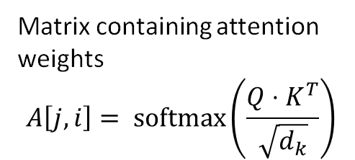



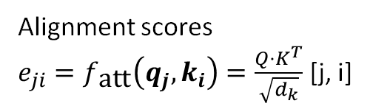


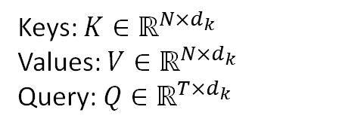

Attention in Attention is All you Need
$$O$$
Matrix of outputs O $∈ℝ^{T×d_{k}}$
Calculate dot-products in parallel with matrix multiplication
High concurrency on modern hardware (GPUs)
Independently calculates each query
matmul
$$v_{1}$$
$$α_{11}$$
$$α_{12}$$
$$α_{13}$$
Matrix containing attention weights
$$A\left[j,i\right]= \text{softmax}\left(\frac{Q⋅K^{T}}{\sqrt{d_{k}}}\right)$$
$$v_{2}$$
$$V$$
$$α_{21}$$
$$α_{22}$$
$$α_{23}$$
$$v_{3}$$
$$α_{31}$$
$$α_{32}$$
$$α_{33}$$
softmax
$$k_{1}$$
scale
Alignment scores
$e_{ji}=f_{\text{att}}\left(q_{j},k_{i}\right)=\frac{Q⋅K^{T}}{\sqrt{d_{k}}}$ [j, i]
matmul
Alignment
$$k_{2}$$
$$K$$
$$k_{3}$$
$$Q$$
$f_{\text{att}}\left(∙\right)=$ scaled dot-product
Keys: $K∈ℝ^{N×d_{k}}$
Values: $V∈ℝ^{N×d_{k}}$
Query: $Q∈ℝ^{T×d_{k}}$
$$q_{1}$$
$$q_{2}$$
$$q_{3}$$

Slide 35
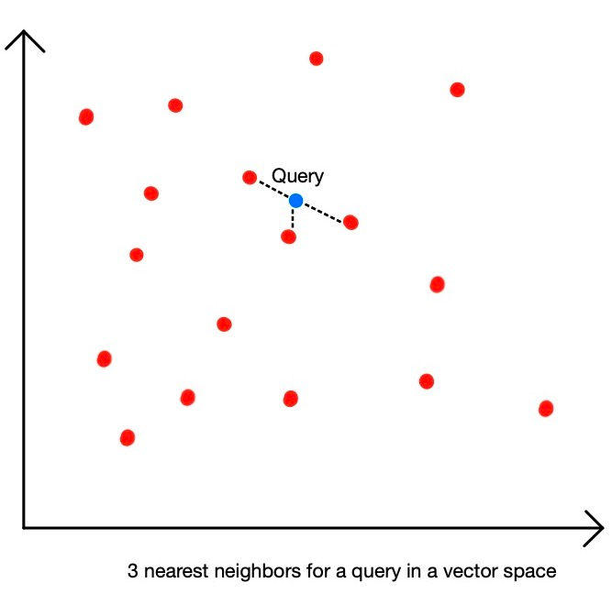
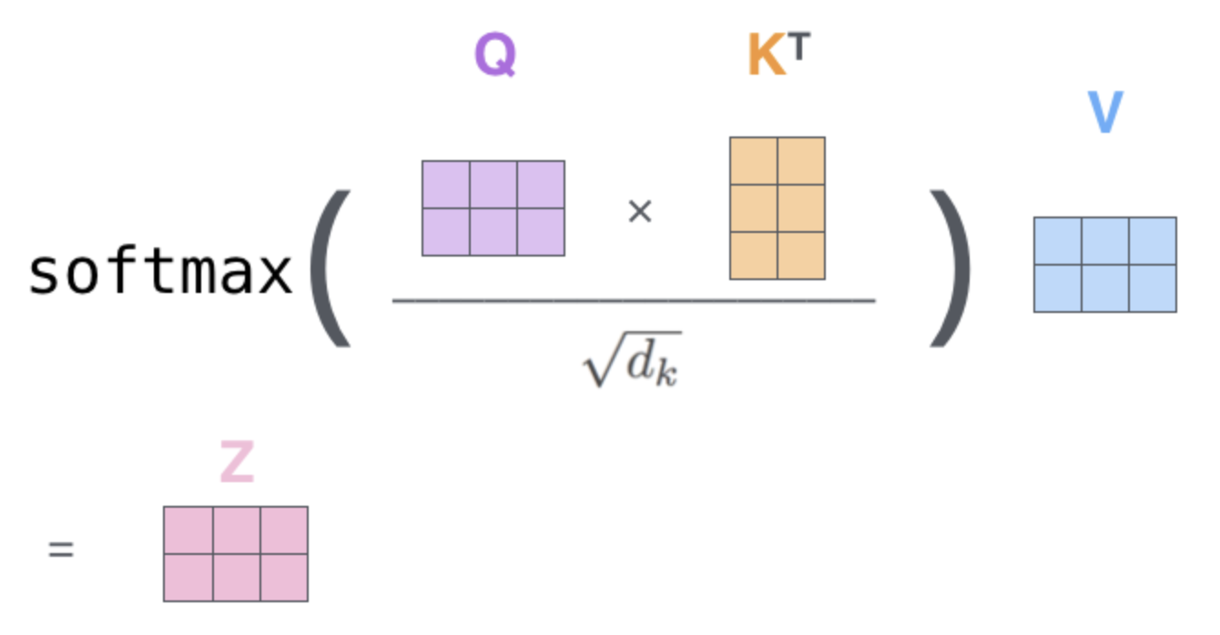
Misconceptions about Transformers (1)
What?
  Attention in transformers performs a vector similarity search
Why?
  Over-simplification in terminology
  The key-query value explanation is convenient, and many don’t know to look past it
Notes:
So now that you know what the attention mechanism looks like I want to talk about it’s use in transformers specifically.
There are a lot of misconceptions on this
Due largely to the query, key-value terminology
We are not performing a vector similarity search
https://www.pinecone.io/learn/what-is-similarity-search/ (left img)
https://jalammar.github.io/illustrated-transformer/ (right img)

Slide 36
Misconceptions about Transformers (1)
What?
  Attention in transformers performs a vector similarity search
Why?
  Over-simplification in terminology
  The key-query value explanation is convenient, and many don’t know to look past it
How do we get Q, K, and V?
What are we learning?
Is this parametric or non-parametric?
Notes:
What the transformer is learning
The vector similarity search is non-parametric (meaning it’s complexity grows with the data it sees)
Transformers are now.

Slide 37
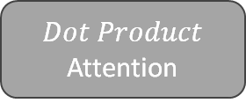
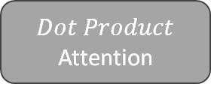
Learning Transformer Attention
Self-Attention
Cross-Attention
Keys, values, and queries are all derived from the same source
Keys-values and queries are derived from separate sources
Arbitrary inputs
$$x_{1}$$
$$v_{1}$$
$$v_{2}$$
$$v_{3}$$
$$x_{2}$$
$$v_{1}$$
$$v_{2}$$
$$v_{3}$$
$$x_{1}$$
$$x_{3}$$
$$Dot Product$$
Attention
$$k_{1}$$
$$k_{2}$$
$$k_{3}$$
$$Dot Product$$
Attention
$$k_{1}$$
$$k_{2}$$
$$k_{3}$$
$$x_{2}$$
$$x_{3}$$
$$y_{1}$$
$$q_{1}$$
$$q_{2}$$
$$q_{3}$$
$$y_{2}$$
$$q_{1}$$
$$q_{2}$$
$$q_{3}$$
Arbitrary transformation
$$y_{3}$$
Nothing to learn inside of this
** $x,y$ are arbitrary sequences
Notes:
The dot product operation isn’t learnable (no parameters)

Slide 38
Learning Transformer Attention
Self-Attention
Cross-Attention
Keys, values, and queries are all derived from the same source
Keys-values and queries are derived from separate sources
We have to learn these
Arbitrary inputs
$$x_{1}$$
$$v_{1}$$
$$v_{2}$$
$$v_{3}$$
$$x_{2}$$
$$v_{1}$$
$$v_{2}$$
$$v_{3}$$
$$x_{1}$$
$$x_{3}$$
$$Dot Product$$
Attention
$$k_{1}$$
$$k_{2}$$
$$k_{3}$$
$$Dot Product$$
Attention
$$k_{1}$$
$$k_{2}$$
$$k_{3}$$
$$x_{2}$$
$$x_{3}$$
$$y_{1}$$
$$q_{1}$$
$$q_{2}$$
$$q_{3}$$
$$y_{2}$$
$$q_{1}$$
$$q_{2}$$
$$q_{3}$$
Arbitrary transformation
$$y_{3}$$
** $x,y$ are arbitrary sequences
Notes:
→ Need to learn the arguments instead before entering it

Slide 39
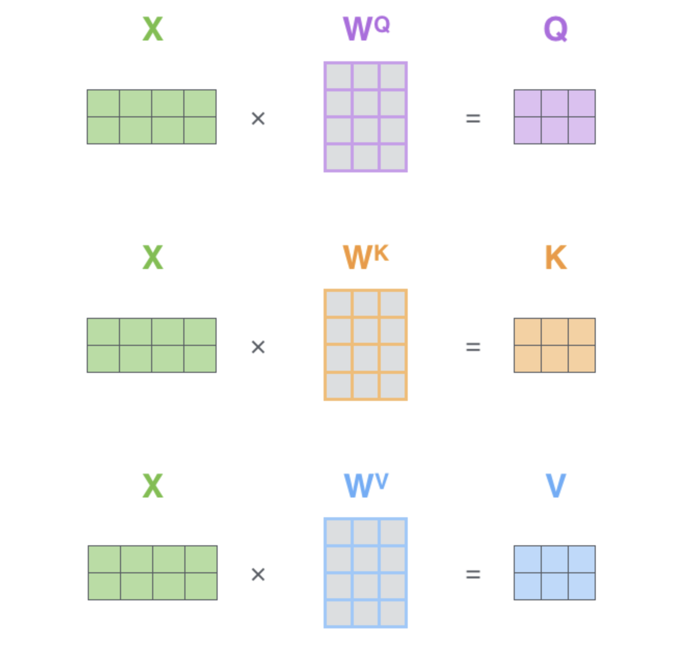







Learning Transformer Attention
Self-Attention
Cross-Attention
X
Q
Y
Q
$$×$$
$$=$$
$$×$$
$$=$$
X
K
X
K
$$×$$
$$=$$
$$×$$
$$=$$
X
V
X
V
$$×$$
$$=$$
$$×$$
$$=$$
** X, Y are matrices of arbitrary sequences
Notes:
Do this through learning matrices
Project our arbitrary inputs to Q,K,V based on learned parameters

Slide 40
Multi-Head Attention
Builds on Scaled Dot-Product Attention
Extension of generalized attention mentioned outlined previously
Leverages multiple heads to attend to different things
Notes:
Authors implement multi-head
allows the model to jointly attend to information from different representation
subspaces at different position

Slide 41







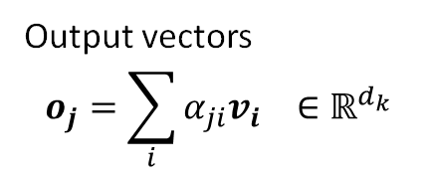
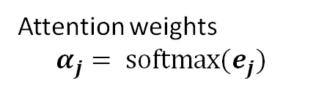
Learning Multi-Head Attention
Why do we need multiple heads?
$$o_{j}$$
Output vectors
$$o_{j}=\sum_{i}{α_{ji}v_{i}} ∈ℝ^{d_{k}}$$
mul + add
$$v_{1}$$
$$α_{j1}$$
Attention
$$v_{2}$$
$$α_{j2}$$
Attention weights
$$α_{j}= \text{softmax}(e_{j})$$
$$v_{3}$$
$$α_{j3}$$

Slide 42





Learning Multi-Head Attention
Why do we need multiple heads?
Output vectors
$$o_{j}=\sum_{i}{α_{ji}v_{i}} ∈ℝ^{d_{k}}$$
$$v_{1}$$
$$α_{j1}$$
$${v_{1}α}_{j1}$$
Attention
$$v_{2}$$
$$α_{j2}$$
$${v_{2}α}_{j2}$$
Attention weights
$$α_{j}= \text{softmax}(e_{j})$$
$$=$$
$$v_{3}$$
$$α_{j3}$$
$$v_{3}α_{j3}$$
Notes:
allows the model to jointly attend to information from different representation
subspaces at different position

Slide 43

Learning Multi-Head Attention
Why do we need multiple heads?
Output vectors
$$o_{j}=\sum_{i}{α_{ji}v_{i}} ∈ℝ^{d_{k}}$$
$$v_{1}$$
$$+$$
$${v_{1}α}_{j1}$$
Attention
$$v_{2}$$
$${v_{2}α}_{j2}$$
Attention weights
$$α_{j}= \text{softmax}(e_{j})$$
$$v_{3}$$
$$v_{3}α_{j3}$$
Notes:
allows the model to jointly attend to information from different representation
subspaces at different position

Slide 44

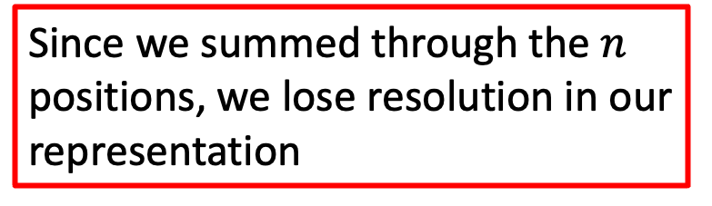
Learning Multi-Head Attention
Why do we need multiple heads?
Output vectors
$$o_{j}=\sum_{i}{α_{ji}v_{i}} ∈ℝ^{d_{k}}$$
$$v_{1}$$
$$o_{j}$$
Since we summed through the $n$ positions, we lose resolution in our representation
$${v_{1}α}_{j1}$$
Attention
$${v_{2}α}_{j2}$$
$$v_{2}$$
Attention weights
$$α_{j}= \text{softmax}(e_{j})$$
$$v_{3}$$
Notes:
Combined values, but lost resolution

Slide 45
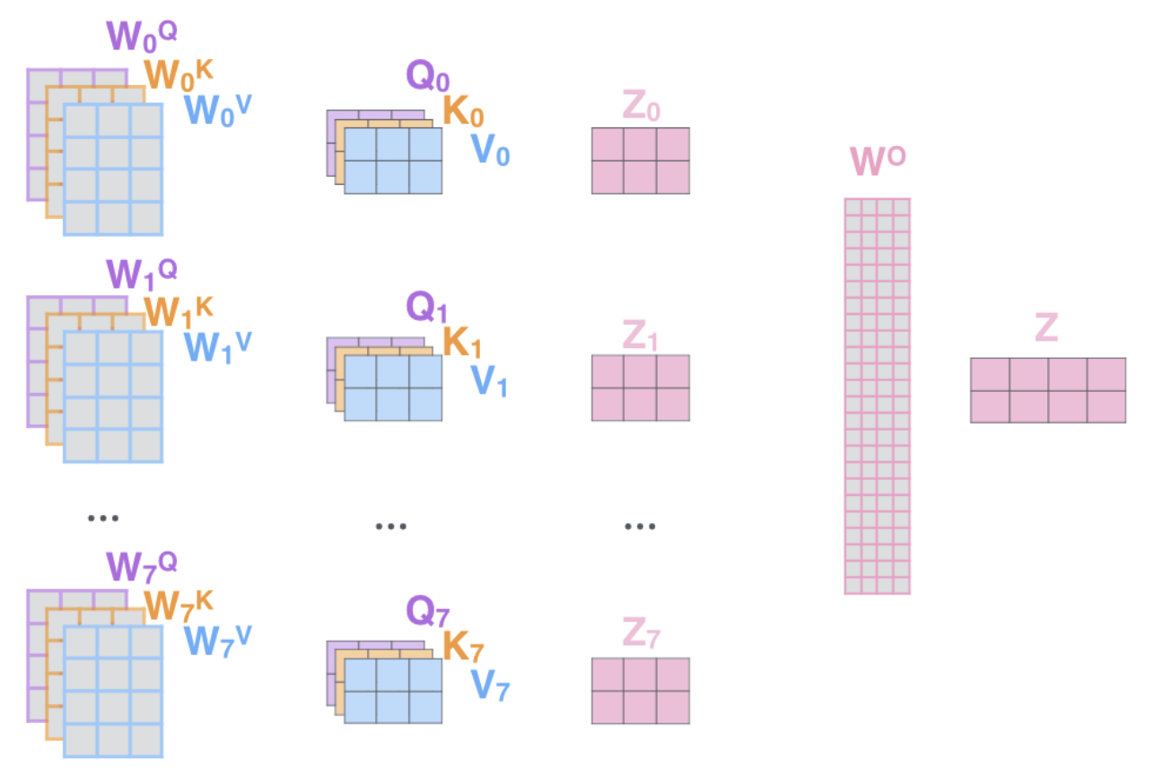



Learning Multi-Head Attention
Main idea:
  Learn multiple sets of weights matrices to attend to different things
  Preserve resolution since more heads increases chance that the information is maintained
Allows model to jointly attend to information from different representation subspaces (like ensembling)
$$O_{0}$$
$$O_{1}$$
$$O_{7}$$
Notes:
Learn multiple weights matrices,
Makes sure we don’t neglect other context that may be important
Learn richer representation of features

Slide 46
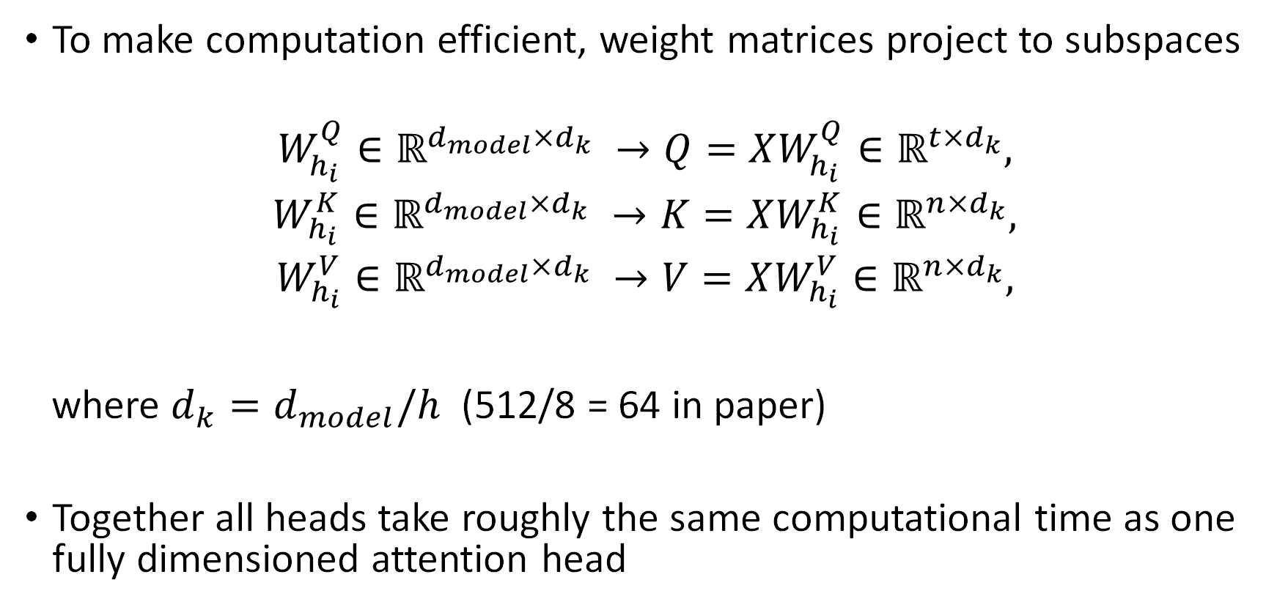
Learning Multi-Head Attention
To make computation efficient, weight matrices project to subspaces
$$W_{h_{i}}^{Q}∈ℝ^{d_{model}×d_{k}} →Q=XW_{h_{i}}^{Q}∈ℝ^{t×d_{k}},$$
$$W_{h_{i}}^{K}∈ℝ^{d_{model}×d_{k}} →K=XW_{h_{i}}^{K}∈ℝ^{n×d_{k}},$$
$$W_{h_{i}}^{V}∈ℝ^{d_{model}×d_{k}} →V=XW_{h_{i}}^{V}∈ℝ^{n×d_{k}},$$
where $d_{k}=d_{model}/h$ (512/8 = 64 in paper)
Together all heads take roughly the same computational time as one fully dimensioned attention head
Notes:
You might ask, well doesn’t adding a whole bunch of heads increase the computational cost?
Each head done in parallel
Need to fit everything in memory + scheduling → still want cheaper computation
Solution is to decrease the dimension of the inputs to attention.
Do this by dividing by num heads
Even though lower dim → only compressed a bit → combination is still able to represent higher resolution
This keeps our time ~= to one full dim head and helps heads learn different things

Slide 47
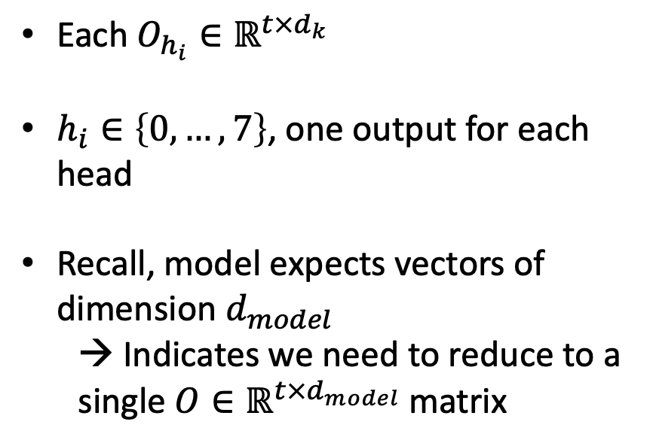



Learning Multi-Head Attention
Each$O_{h_{i}}∈ℝ^{t×d_{k}}$
$h_{i}∈\left\{0, …, 7\right\}$, one output for each head
Recall, model expects vectors of dimension $d_{model}$
  → Indicates we need to reduce to a single $O∈ℝ^{t×d_{model}}$ matrix
$$O_{0}$$
$$O_{1}$$
$$O_{7}$$
Notes:
Get multiple outputs
But need real output to have dim d_model
b/c as Evelien mentioned we impose constant dimension in model

Slide 48
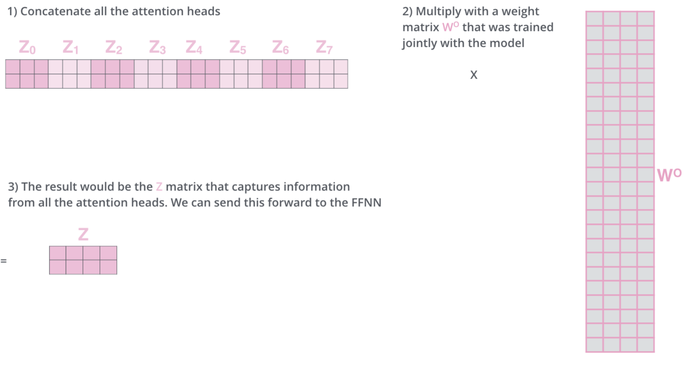




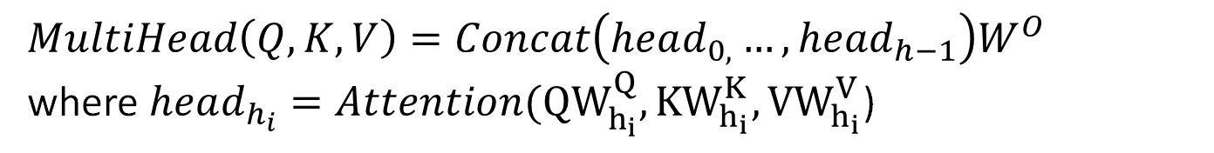




Learning Multi-Head Attention
$$MultiHead\left(Q, K, V\right)=Concat\left(head_{0, }…, head_{h−1}\right)W^{O}$$
where $head_{h_{i}}=Attention({QW}_{h_{i}}^{Q}, {KW}_{h_{i}}^{K}, {VW}_{h_{i}}^{V}$)
$$O_{0}$$
$$O_{1}$$
$$O_{2}$$
$$O_{3}$$
$$O_{4}$$
$$O_{5}$$
$$O_{6}$$
$$O_{7}$$
$$O$$
$$×$$
$$=$$
Notes:
Use final weights matrix to pack rich context back into output weights with proper dim

Slide 49
Transformer Architecture
Ways attention is used in the transformer:
  Self-attention in the encoder
    Allows the model to attend to all positions in the previous encoder layer
    Embeds context about how elements in the sequence relate to one another
  Masked self-attention in the decoder
    Allows the model to attend to all positions in the previous decoder layer up to and including the current position (during auto-regressive process)
    Prevents forward looking bias by stopping leftward information flow during training
    Also embeds context about how elements in the sequence relate to one another
  Encoder-decoder cross-attention
    Allows decoder layers to attend all parts of the latent representation produced by the encoder
    Pulls context from the encoder sequence over to the decoder”
A. Vaswani et al., “Attention is All you Need,” in Advances in Neural Information Processing Systems (NeurIPS), 2017.
Notes:
Now that we understand multihead lets talk how the transformer uses it
We want to still capture the context that would be found in reccurent encoder-decoder attention.
RECALL THIS HAD CUSTOM CONTEXT PER LAYER
BUT WANT TO REDUCE CALCULATING EACH TIME
Ideally, we’d like to pack up as much attention as possible during encoding and decoding, so the cross-attention doesn’t do as much
DECOMPOSE INTO THREE PARTS

Slide 50
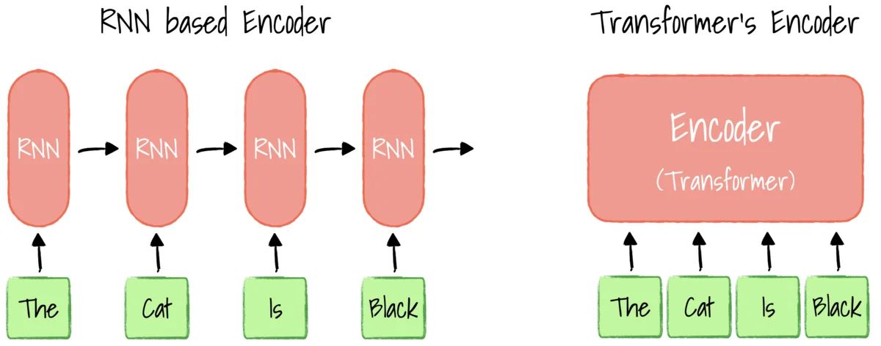
Transformer Architecture
Why Self-Attention?
  Lower computational complexity
  Greater amount of the computation that can be parallelized
  Each representation encodes the positional information of the sequence
Notes:
Lower computational complexity per layer O(n^2 * d + n * d^2)
Greater amount of the computation that can be parallelized (min number of sequential operations) O(1) instead of O(n)
Lower distance signals need to travel to be attended to in the network O(1) vs

Slide 51



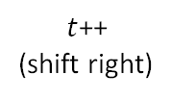




Transformer Architecture
Generator
(prediction head)
Output Probabilities
(for $y_{t}$)
Softmax
Linear
Decoder
Stack
Add & Norm
Feed Forward
Encoder
Stack
Add & Norm
Add & Norm
Multi-Head Cross-Attention
Decoding Procedure
Feed Forward
auto-regressive
decoding
$$y_{t}$$
Add & Norm
Add & Norm
Multi-Head Self-Attention
Masked Multi-Head Self-Attention
$t$++
(shift right)
Positional Encoding
Positional Encoding
$$x_{1}$$
$$x_{2}$$
$$x_{n}$$
Input Embedding
Output Embedding
$$y_{1}$$
$$y_{t−1}$$
$$\text{•••}$$
$$\text{•••}$$
Notes:
Brings us to architecture
High-level glance
Note: sequence is already tokenized/encoded (Byte-pair encoding)
- Initial embeddings (surrounds the transformer not main feature of the transformer itself)
- Encoder-decoder architecture
- Stack encode/decode blocks to get more depth
- Has generator (final prediction head) to take internal representation to external probabilities
!!! Decoding is auto-regressive and depends on the chosen decoding procedure
- arbitrary decoding procedure (greedy often chosen) used to convert back to words
AUTO REGRESSIVE!!!!
ENCODER BLOCK:
!!! Encoder applies self attention to input to extract grammatical/sequential context
-> All about extracting features that have superimposed context
DECODER BLOCK:
!!! Decoder applies self attention to previous outputs to understand context and condition next token prediction on (masking used to prevent future looking)
!!! Decoder uses cross-attention/encoder-decoder attention to attend to the latent representation of input sequence

Slide 52

Transformer Architecture
Generator
(prediction head)
Output Probabilities
(for $y_{t}$)
Softmax
Linear
Decoder
Stack
Add & Norm
Feed Forward
Encoder
Stack
Add & Norm
Add & Norm
Multi-Head Cross-Attention
“Greedy”
$$argmax$$
Feed Forward
auto-regressive
decoding
$$y_{t}$$
Add & Norm
Add & Norm
Multi-Head Self-Attention
Masked Multi-Head Self-Attention
$t$++
(shift right)
Positional Encoding
Positional Encoding
$$x_{1}$$
$$x_{2}$$
$$x_{n}$$
Input Embedding
Output Embedding
$$y_{1}$$
$$y_{t−1}$$
$$\text{•••}$$
$$\text{•••}$$
Notes:
Transformer at a high-level glance
Note: sequence is already tokenized/encoded
- Initial embeddings (surrounds the transformer not main feature of the transformer itself)
- Encoder-decoder architecture
- Stack encode/decode blocks to get more depth
- Has generator (final prediction head) to take internal representation to external probabilities
!!! Decoding is auto-regressive and depends on the chosen decoding procedure
- arbitrary decoding procedure (greedy often chosen) used to convert back to words
ENCODER BLOCK:
!!! Encoder applies self attention to input to extract grammatical/sequential context
-> All about extracting features that have superimposed context
DECODER BLOCK:
!!! Decoder applies self attention to previous outputs to understand context and condition next token prediction on (masking used to prevent future looking)
!!! Decoder uses cross-attention/encoder-decoder attention to attend to the latent representation of input sequence

Slide 53


Transformer Architecture
Generator
(prediction head)
Output Probabilities
(for $y_{t}$)
Softmax
Linear
Decoder
Stack
Add & Norm
Feed Forward
Add & Norm
Add & Norm
Multi-Head Cross-Attention
Greedy
$$argmax$$
Feed Forward
Decoding Procedure
auto-regressive
decoding
$$y_{t}$$
$×$N
Add & Norm
Add & Norm
Multi-Head Self-Attention
Masked Multi-Head Self-Attention
$t$++
(shift right)
Positional Encoding
Positional Encoding
$$x_{1}$$
$$x_{2}$$
$$x_{n}$$
Input Embedding
Output Embedding
$$y_{1}$$
$$y_{t−1}$$
$$\text{•••}$$
$$\text{•••}$$
Notes:
Transformer at a high-level glance
Note: sequence is already tokenized/encoded
- Initial embeddings (surrounds the transformer not main feature of the transformer itself)
- Encoder-decoder architecture
- Stack encode/decode blocks to get more depth
- Has generator (final prediction head) to take internal representation to external probabilities
!!! Decoding is auto-regressive and depends on the chosen decoding procedure
- arbitrary decoding procedure (greedy often chosen) used to convert back to words
ENCODER BLOCK:
!!! Encoder applies self attention to input to extract grammatical/sequential context
-> All about extracting features that have superimposed context
DECODER BLOCK:
!!! Decoder applies self attention to previous outputs to understand context and condition next token prediction on (masking used to prevent future looking)
!!! Decoder uses cross-attention/encoder-decoder attention to attend to the latent representation of input sequence

Slide 54

Transformer Architecture
Generator
(prediction head)
Output Probabilities
(for $y_{t}$)
Softmax
Linear
Decoder
Add & Norm
Feed Forward
Add & Norm
Add & Norm
Multi-Head Cross-Attention
Decoding Procedure
Feed Forward
$×$N
Greedy
$$argmax$$
auto-regressive
decoding
$$y_{t}$$
$×$N
Add & Norm
Add & Norm
Multi-Head Self-Attention
Masked Multi-Head Self-Attention
$t$++
(shift right)
Positional Encoding
Positional Encoding
$$x_{1}$$
$$x_{2}$$
$$x_{n}$$
Input Embedding
Output Embedding
$$y_{1}$$
$$y_{t−1}$$
$$\text{•••}$$
$$\text{•••}$$
Notes:
Transformer at a high-level glance
Note: sequence is already tokenized/encoded
- Initial embeddings (surrounds the transformer not main feature of the transformer itself)
- Encoder-decoder architecture
- Stack encode/decode blocks to get more depth
- Has generator (final prediction head) to take internal representation to external probabilities
!!! Decoding is auto-regressive and depends on the chosen decoding procedure
- arbitrary decoding procedure (greedy often chosen) used to convert back to words
ENCODER BLOCK:
!!! Encoder applies self attention to input to extract grammatical/sequential context
-> All about extracting features that have superimposed context
DECODER BLOCK:
!!! Decoder applies self attention to previous outputs to understand context and condition next token prediction on (masking used to prevent future looking)
!!! Decoder uses cross-attention/encoder-decoder attention to attend to the latent representation of input sequence

Slide 55
Transformer Architecture
Output Probabilities
(for $y_{t}$)
Softmax
Linear
Add & Norm
Feed Forward
Add & Norm
Add & Norm
Multi-Head Cross-Attention
Decoding Procedure
Feed Forward
$×$N
auto-regressive
decoding
$$y_{t}$$
$×$N
Add & Norm
Add & Norm
Multi-Head Self-Attention
Masked Multi-Head Self-Attention
$t$++
(shift right)
Positional Encoding
Positional Encoding
$$x_{1}$$
$$x_{2}$$
$$x_{n}$$
Input Embedding
Output Embedding
$$y_{1}$$
$$y_{t−1}$$
$$\text{•••}$$
$$\text{•••}$$
Notes:
High level glance
- Initial embeddings (surrounds the transformer not main feature of the transformer itself)
- Encoder-decoder architecture
- Stack encode/decode blocks to get more depth
- Each layer has sublayers connected by sublayer connections
- Made up of feed forward NNs (MLP) and MultiHeadAttention blocks
- Has generator (final prediction head) to take internal representation to external probabilities
!!! Decoding is auto-regressive and depends on the chosen decoding procedure
ENCODER BLOCK:
!!! Encoder applies self attention to input to extract grammatical/sequential context
-> All about extracting features that have superimposed context
DECODER BLOCK:
!!! Decoder applies self attention to previous outputs to understand context and condition next token prediction on (masking used to prevent future looking)
!!! Decoder uses cross-attention/encoder-decoder attention to attend to the latent representation of input sequence

Slide 56

Transformer Architecture
Output Probabilities
(for $y_{t}$)
Constant representation size $d_{model}$between model components
Softmax
Linear
Add & Norm
Feed Forward
Add & Norm
Add & Norm
Multi-Head Cross-Attention
Decoding Procedure
Feed Forward
$×$N
auto-regressive
decoding
$$y_{t}$$
$×$N
Add & Norm
Add & Norm
Multi-Head Self-Attention
Masked Multi-Head Self-Attention
$t$++
(shift right)
Positional Encoding
Positional Encoding
$$x_{1}$$
$$x_{2}$$
$$x_{n}$$
Input Embedding
Output Embedding
$$y_{1}$$
$$y_{t−1}$$
$$\text{•••}$$
$$\text{•••}$$
Notes:
Dmodel is fixed so we know the components of the architecture will work
With that high level overview in mind we are now going to take a closer look and talk about building the transformer from the ground up
“like lego house” start small and add on
Next slide is implementation

Slide 57
Results and Impact

Slide 58

Performance
Experimentation on text translation: (1) EN-DE and (2) EN-FR
A. Vaswani et al., “Attention is All you Need,” in Advances in Neural Information Processing Systems (NeurIPS), 2017.

Slide 59

Combined Transformer Figure

Slide 60

Transformer Complexity
We only consider matrix multiplication complexity
  $W_{1}∈R^{d × p} W_{2}∈R^{p × d′}$dot-product uses d*p*d’ float-number multiplication.
  What are the multiplications in the transformer?
    Q/K/V Projection
    O Projection
    FFN up-projection
    FFN down-projection
    Attention map dot-product
    Attention value aggregation
  What is the total amount of multiplication in these six operations?
    2NBd * (6d + N), B is the batch size, N is the sequence length.
    Verify this offline.

