Slide 1
Lecture 22: CNN & RNN
Instructor: Wenhu Chen

Slide 2
What we will cover
Basics of recurrent neural networks.
LSTM, GRU and other variants of RNN.
How the RNNs have been used in different downstream applications.
Basics of convolutional neural networks.
ConvNext, ResNet, ResNext, DenseNet, UNet, MobileNet, etc.
How does CNNs have been used in different downstream applications.

Slide 3
Basics of Recurrent Neural Networks

Slide 4
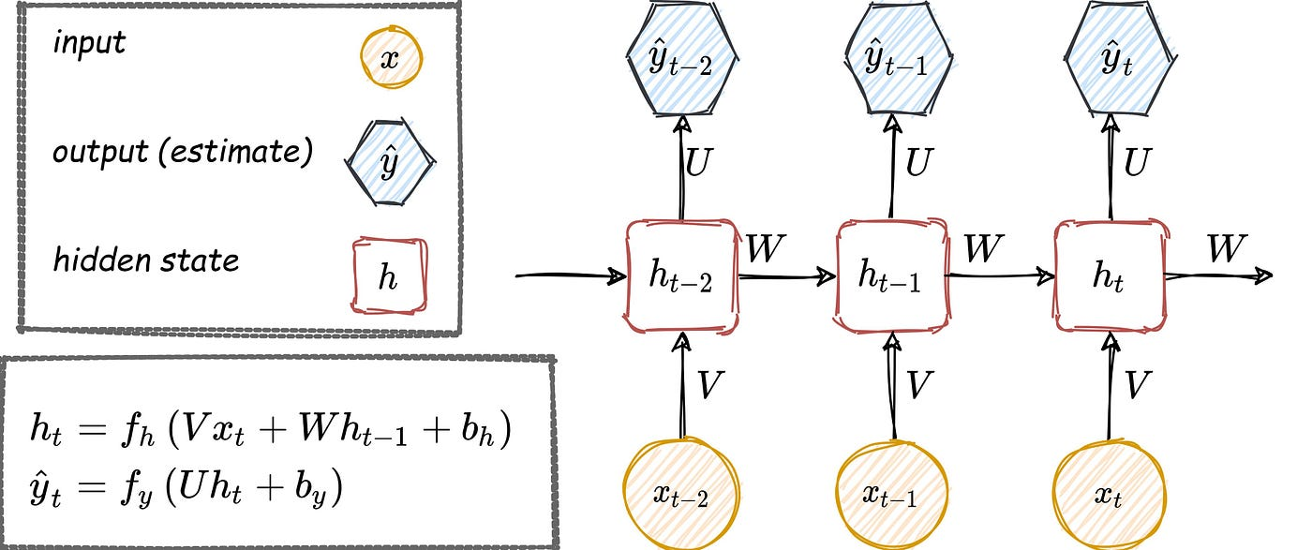
Vanilla RNN

Slide 5
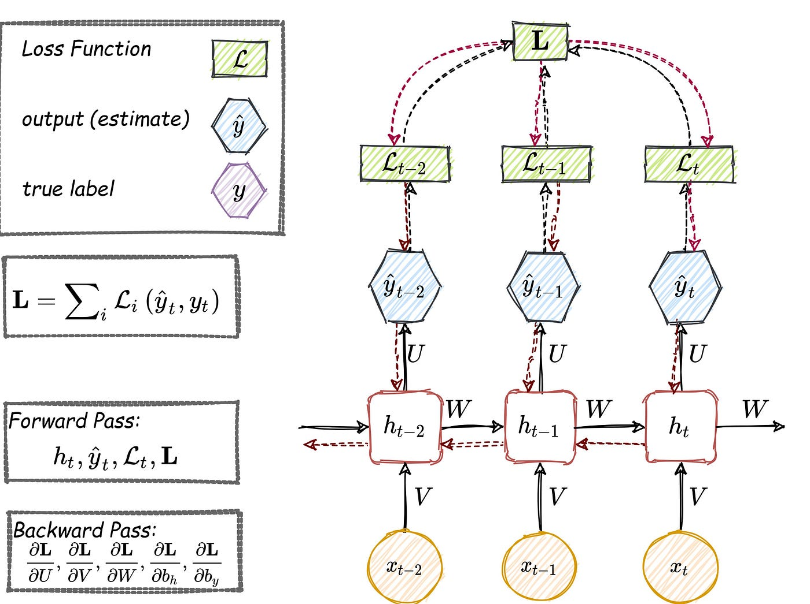
Backward Propagation Through Time

Slide 6
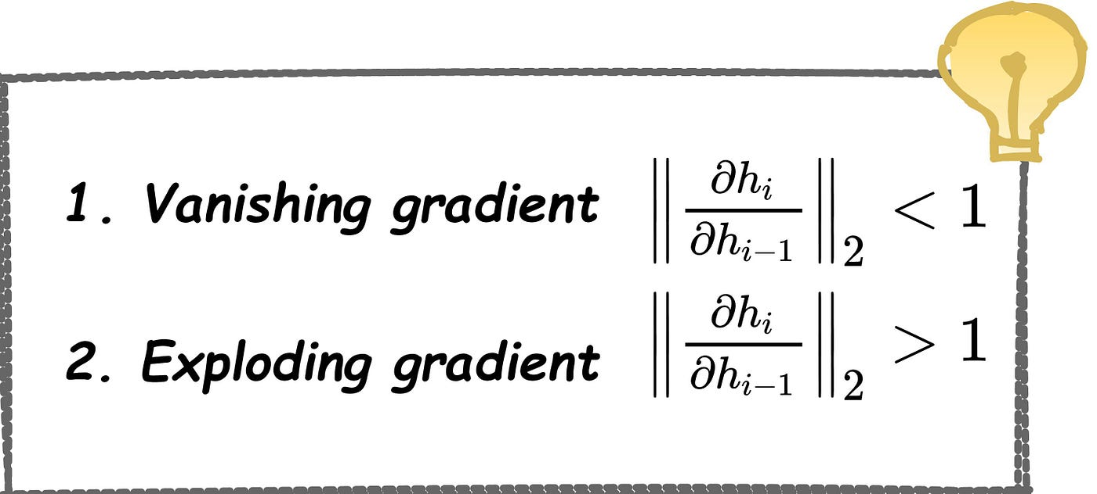
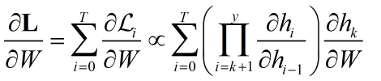

Gradient Vanishing/Explosion Problem
In the first case, the term goes to zero exponentially fast, which makes it difficult to learn some long-period dependencies. This problem is called the vanishing gradient. In the second case, the term goes to infinity exponentially fast, and its value becomes a NaN due to the unstable process

Slide 7
Problems of Vanilla RNNs
Gradient Vanishing and Explosion: These issues arise due to the multiplication of gradients through the many layers of an RNN during backpropagation.
Vanishing gradients make it hard for the model to learn, as updates to the weights become insignificantly small. Exploding gradients can cause the weights to oscillate or diverge wildly.
Long Range Memory: RNNs ideally should remember information from early in the sequence to use much later, which is crucial for tasks like text translation or sentiment analysis

Slide 8
RNN Variant I: Long Short-Term Memory

Slide 9
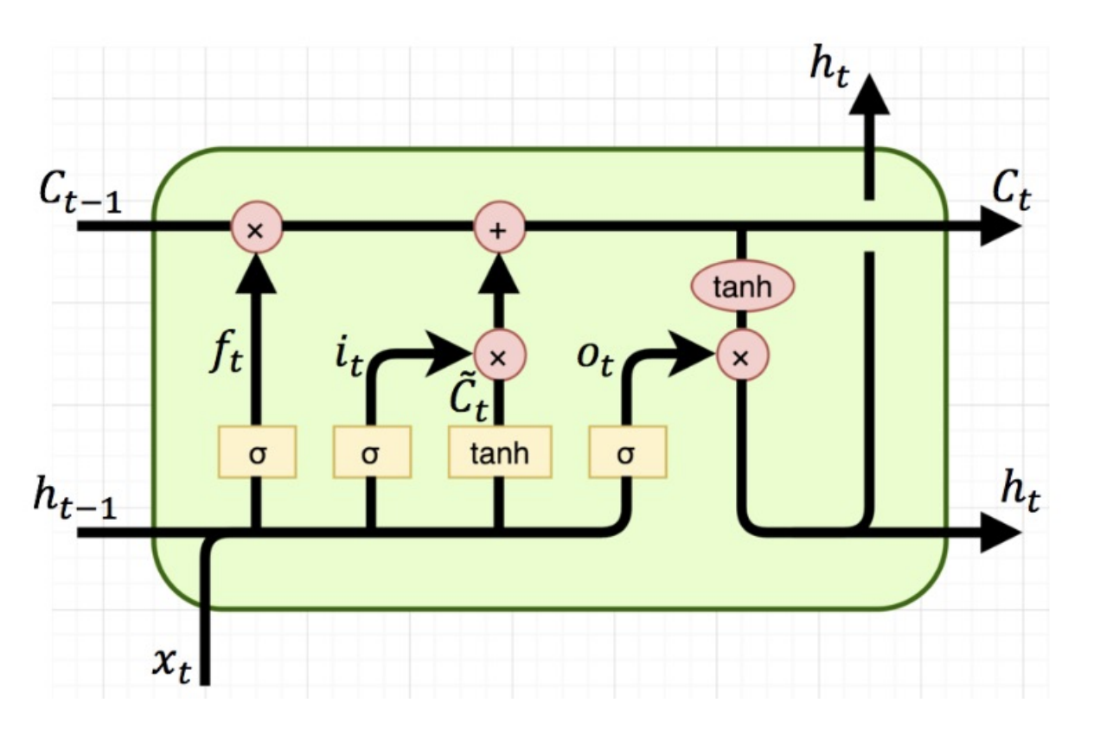
Long Short-Term Memory (LSTM)
Special gated structure to control memorization and forgetting
Mitigate gradient vanishing
Facilitate long term memory
These gates are essentially different neural networks with sigmoid activation functions (outputting values between 0 and 1). They are trained to selectively allow information to pass through.

Slide 10
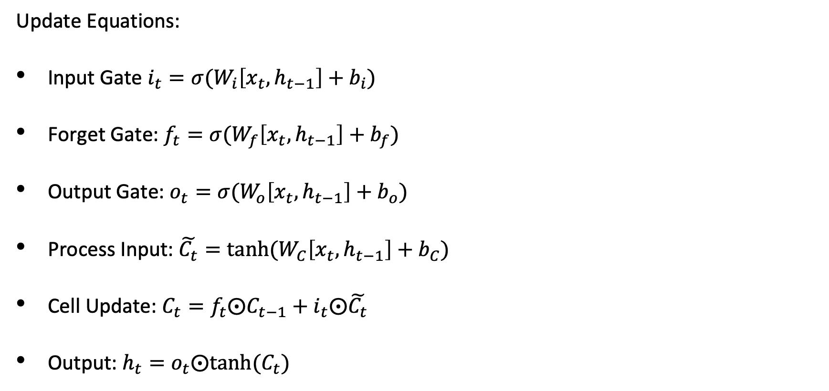
Mathematical Formulations
Update Equations:
Input Gate $i_{t}=σ(W_{i}\left[x_{t},h_{t−1}\right]+b_{i})$
Forget Gate: $f_{t}=σ(W_{f}\left[x_{t},h_{t−1}\right]+b_{f})$
Output Gate: $o_{t}=σ(W_{o}\left[x_{t},h_{t−1}\right]+b_{o})$
Process Input: $\tilde{C_{t}}=tanh⁡(W_{C}\left[x_{t},h_{t−1}\right]+b_{C})$
Cell Update: $C_{t}=f_{t}⨀C_{t−1}+i_{t}⨀\tilde{C_{t}}$
Output: $h_{t}=o_{t}⨀tanh⁡(C_{t})$

Slide 11
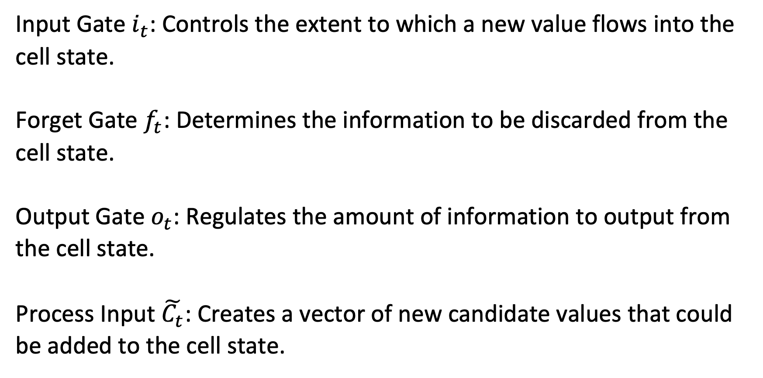
Roles of Different Gates in LSTM
Input Gate $i_{t}$: Controls the extent to which a new value flows into the cell state.
Forget Gate $f_{t}$: Determines the information to be discarded from the cell state.
Output Gate $o_{t}$: Regulates the amount of information to output from the cell state.
Process Input $\tilde{C_{t}}$: Creates a vector of new candidate values that could be added to the cell state.

Slide 12
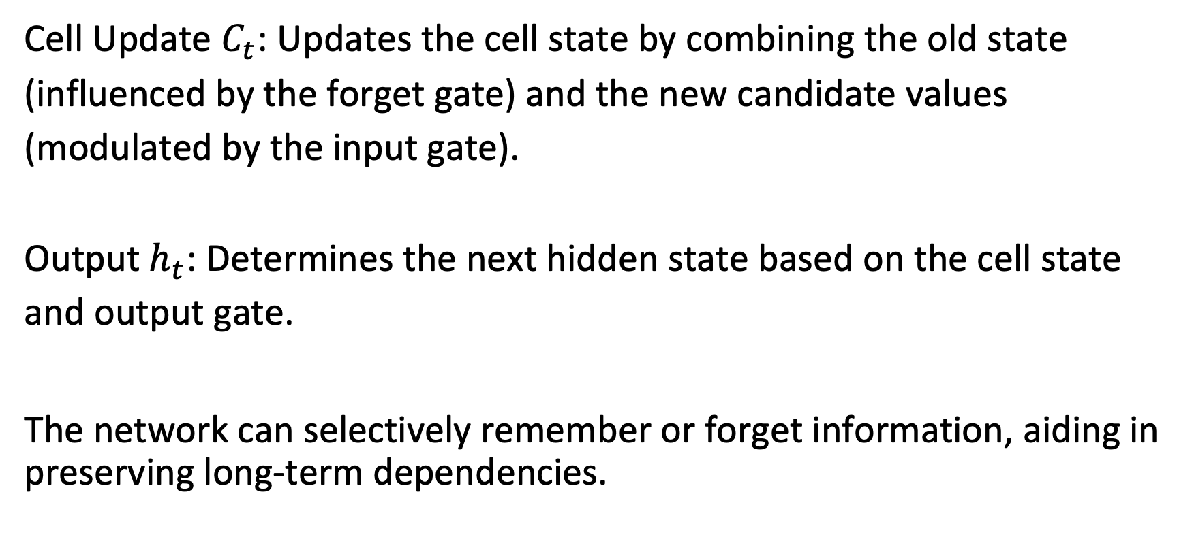
Roles of Different Gates in LSTM Cont’d
Cell Update $C_{t}$: Updates the cell state by combining the old state (influenced by the forget gate) and the new candidate values (modulated by the input gate).
Output $h_{t}$: Determines the next hidden state based on the cell state and output gate.
The network can selectively remember or forget information, aiding in preserving long-term dependencies.

Slide 13
Variant II: Gated Recurrent Unit for
Simplifying LSTM

Slide 14
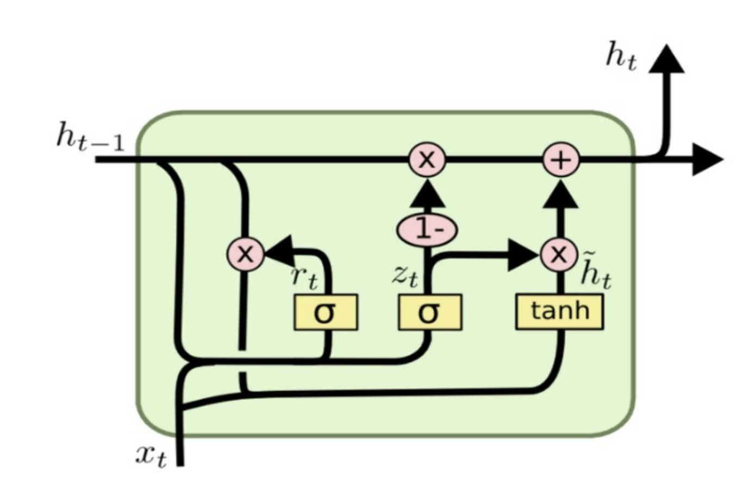
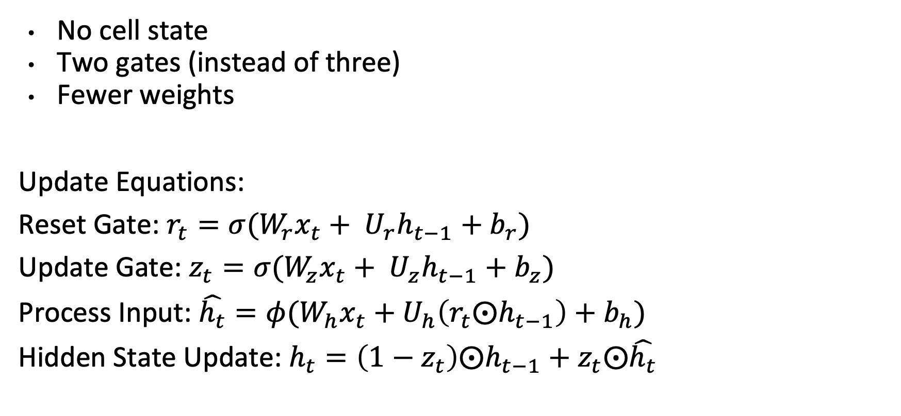
Gated Recurrent Unit (GRU)
No cell state
Two gates (instead of three)
Fewer weights
Update Equations:
Reset Gate: $r_{t}=σ(W_{r}x_{t}+ U_{r}h_{t−1}+b_{r})$
Update Gate: $z_{t}=σ(W_{z}x_{t}+ U_{z}h_{t−1}+b_{z})$
Process Input: $\hat{h_{t}}=φ(W_{h}x_{t}+U_{h}\left(r_{t}⨀h_{t−1}\right)+b_{h})$
Hidden State Update: $h_{t}=\left(1−z_{t}\right)⨀h_{t−1}+z_{t}⨀\hat{h_{t}}$
Notes:
Reset gate controls short term dependencies

Slide 15
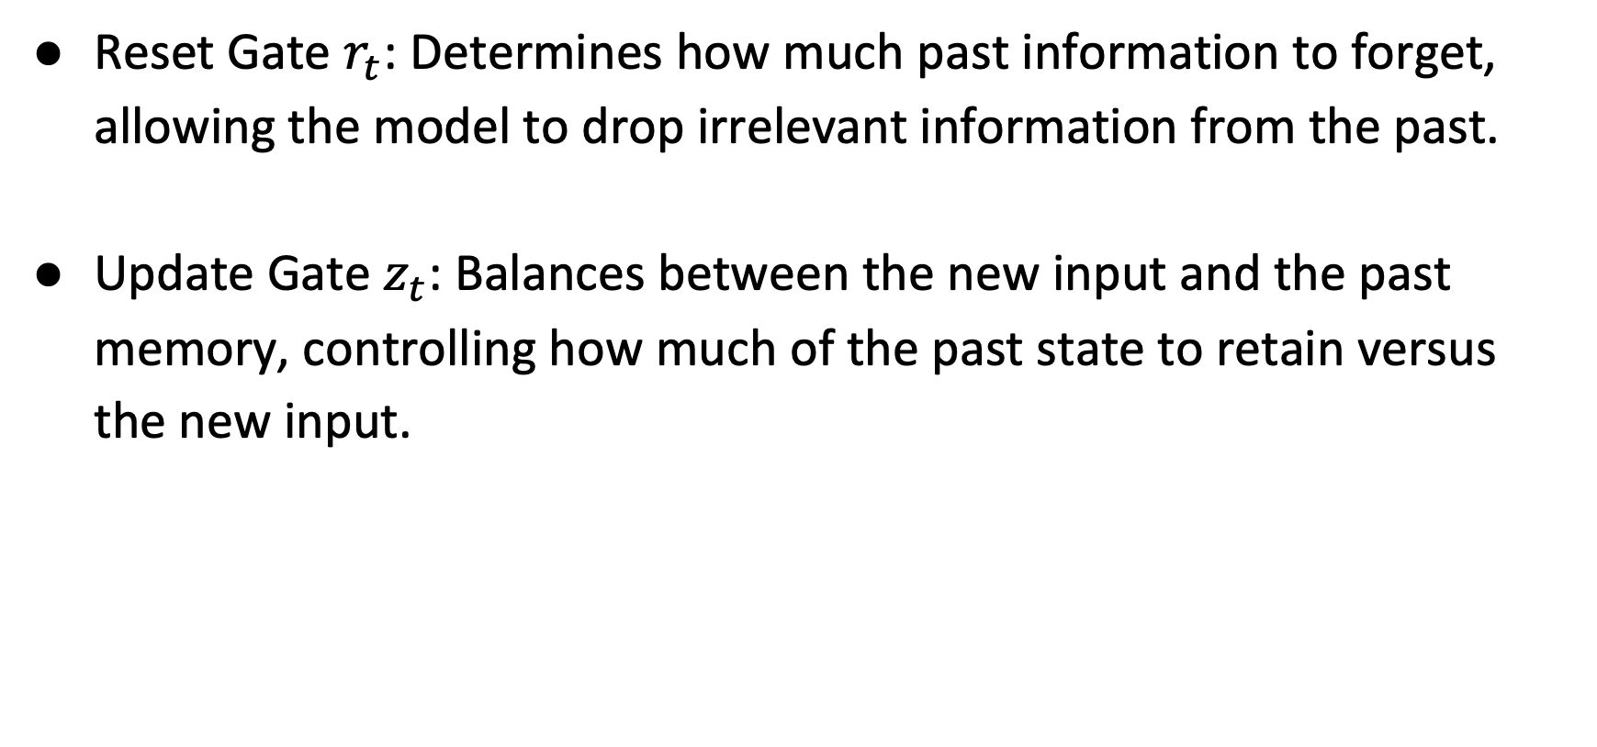
Roles of Gates in GRU
Reset Gate $r_{t}$: Determines how much past information to forget, allowing the model to drop irrelevant information from the past.
Update Gate $z_{t}$: Balances between the new input and the past memory, controlling how much of the past state to retain versus the new input.

Slide 16
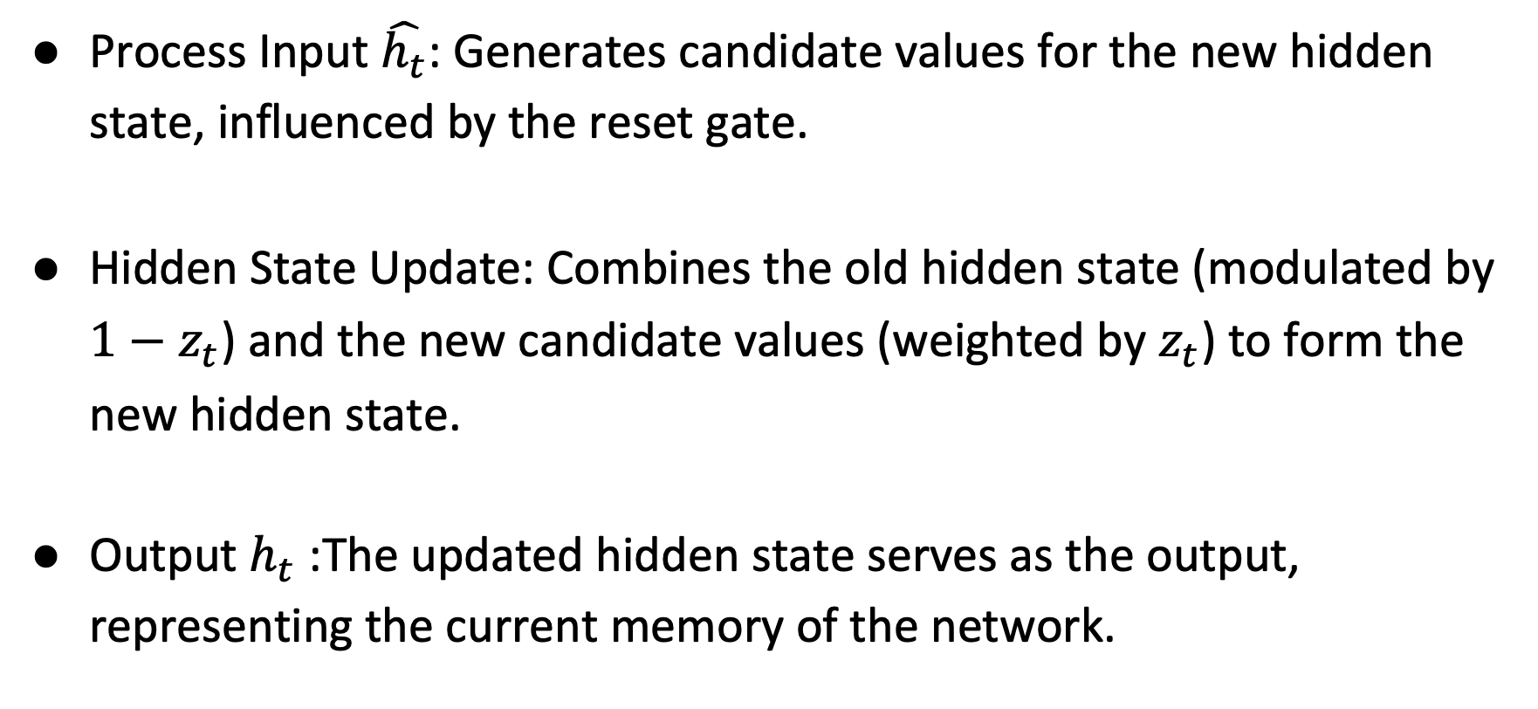
Roles of GRU Cont’d
Process Input $\hat{h_{t}}$: Generates candidate values for the new hidden state, influenced by the reset gate.
Hidden State Update: Combines the old hidden state (modulated by $1−z_{t}$) and the new candidate values (weighted by $z_{t}$) to form the new hidden state.
Output $h_{t}$: The updated hidden state serves as the output, representing the current memory of the network.

Slide 17
Compare LSTM with GRU
Complexity: LSTMs are more complex with three gates (input, forget, output), while GRUs have two gates (reset, update).
Memory Usage: LSTMs generally require more memory due to their complexity.
Training Time: GRUs, being simpler, often train faster than LSTMs.

Slide 18
Compare GRU with LSTM Cont’d
Performance: GRUs might perform better on smaller datasets, while LSTMs often excel on datasets with longer sequences.
Parameters: LSTMs have more parameters, making them more flexible but also more prone to overfitting on smaller datasets.
State Update Mechanism: LSTMs have separate cell and hidden states, whereas GRUs have a single hidden state.
Choice of Model: The choice between GRU and LSTM depends on the specific application and dataset characteristics.

Slide 19
Advantages of GRU
Faster Training: Due to fewer parameters, GRUs can be faster to train, making them more efficient for smaller datasets or when computational resources are limited.
Efficient on Smaller Datasets: GRUs may perform better than LSTMs when the amount of data is not large, as they can capture dependencies without the need for extensive data.
Flexibility in Memory Management: GRUs can adapt to the use of short-term memory through their update and reset gates, potentially capturing information across various time steps efficiently.

Slide 20
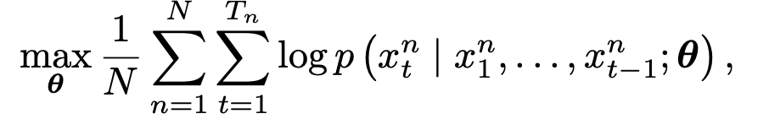
Experiments: Sequence Modeling
Maximizing the log-likelihood of a model given a set of training sequences (theta is a set of model parameters)
Evaluate these units in the tasks of polyphonic music modeling and speech signal modeling.

Slide 21
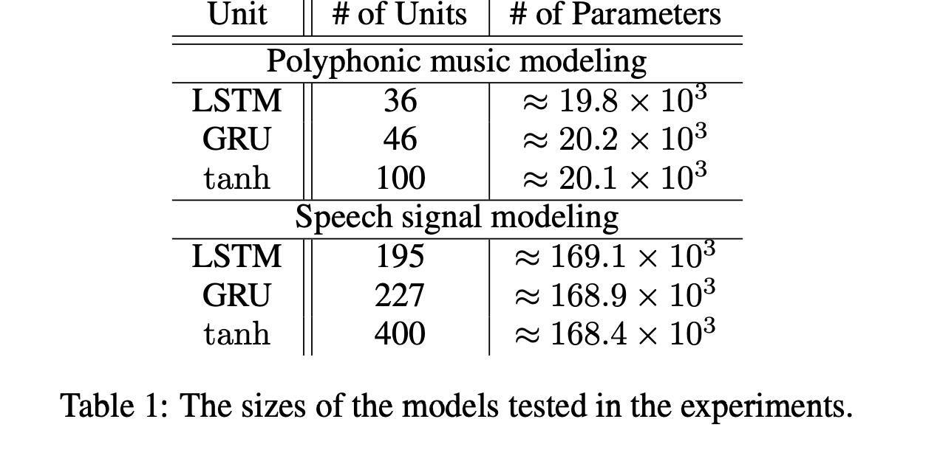
Results

Slide 22
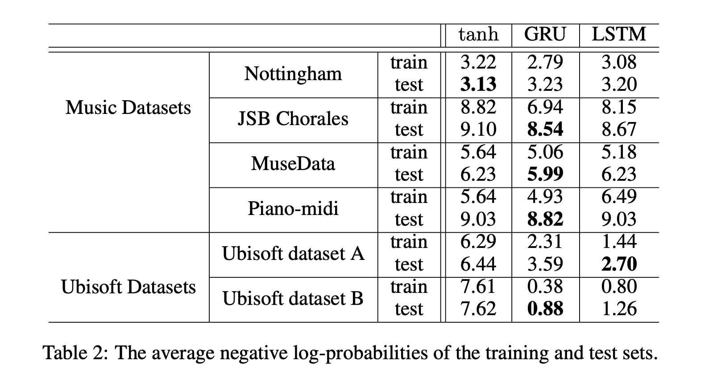
Results Cont’d

Slide 23
RNNs with Attention Mechanism

Slide 24
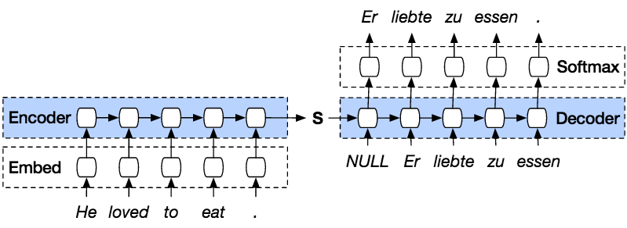
Sequence to sequence (Seq2Seq)

Slide 25
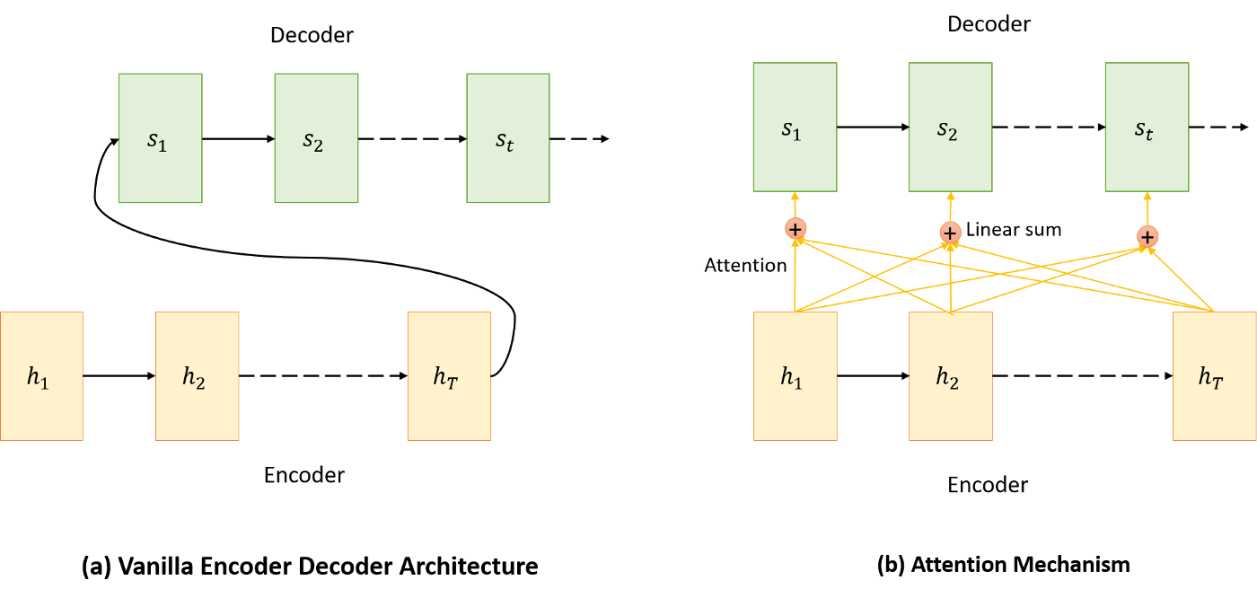
Breaking the Bottleneck

Slide 26
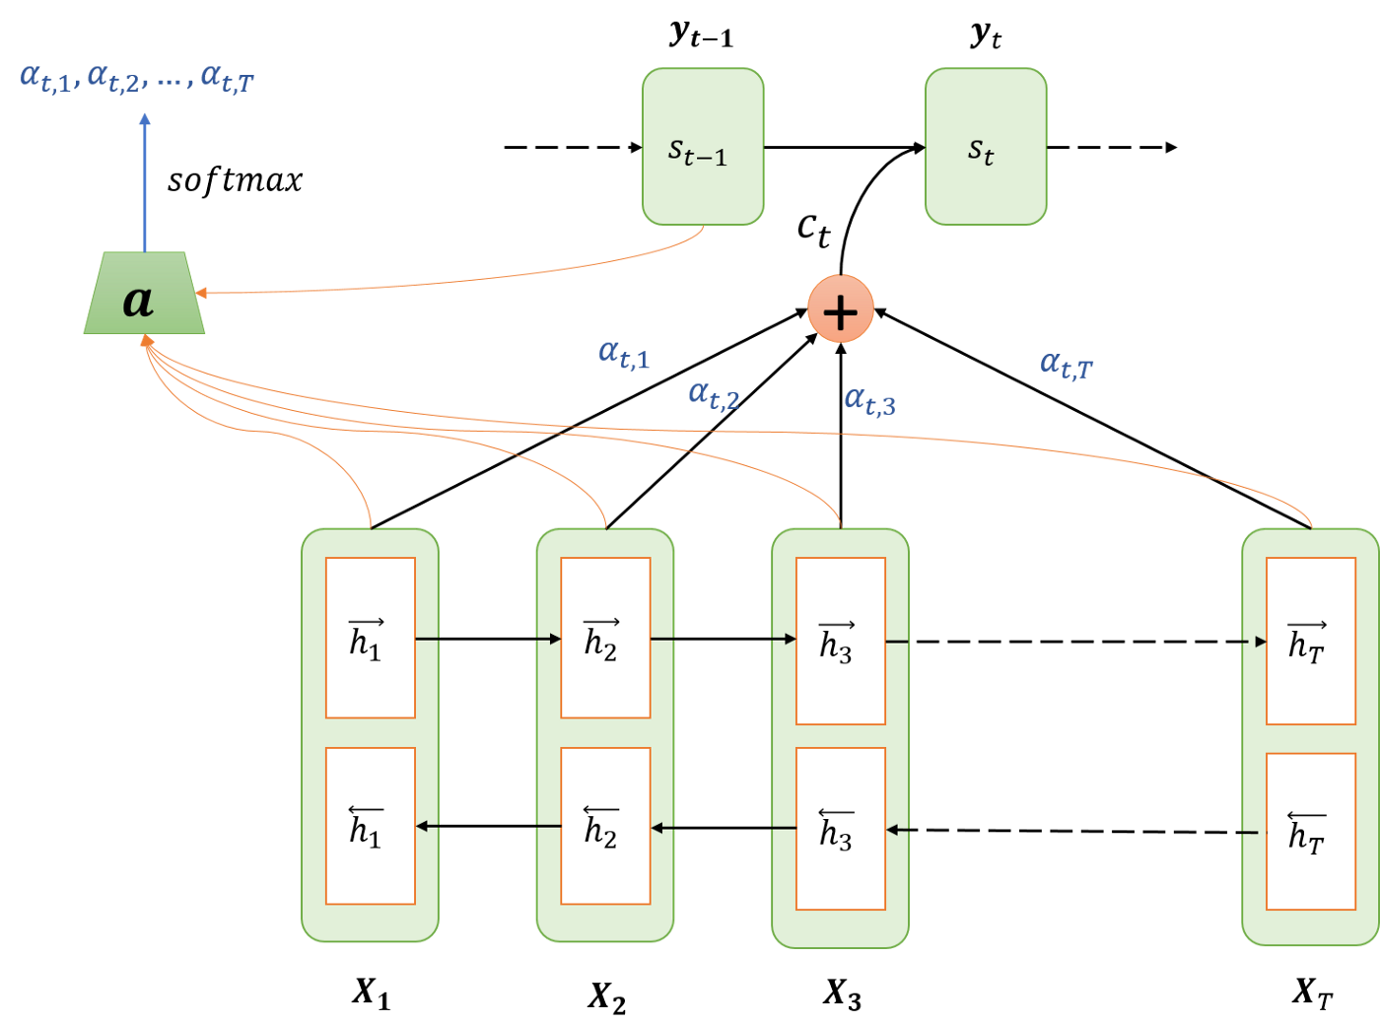
Seq2Seq with Attention
Encoding
Computing Attention weights
Creating context vector
Decoding / Translation

Slide 27
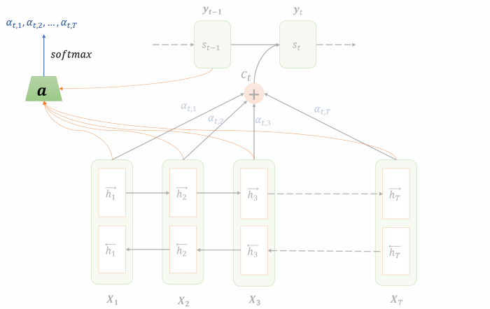
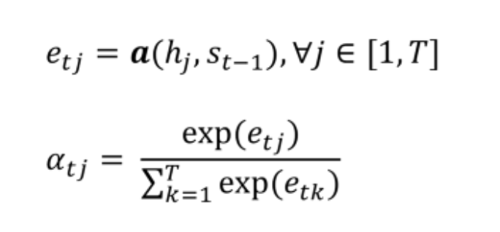
Computing the Attention

Slide 28
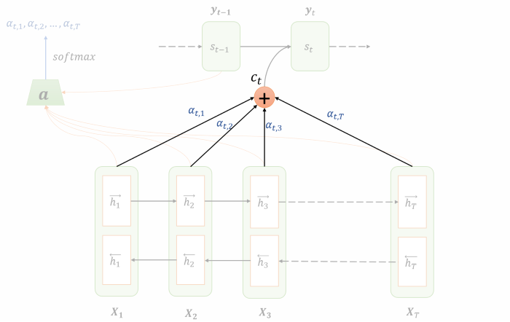

Creating the Context Vector

Slide 29
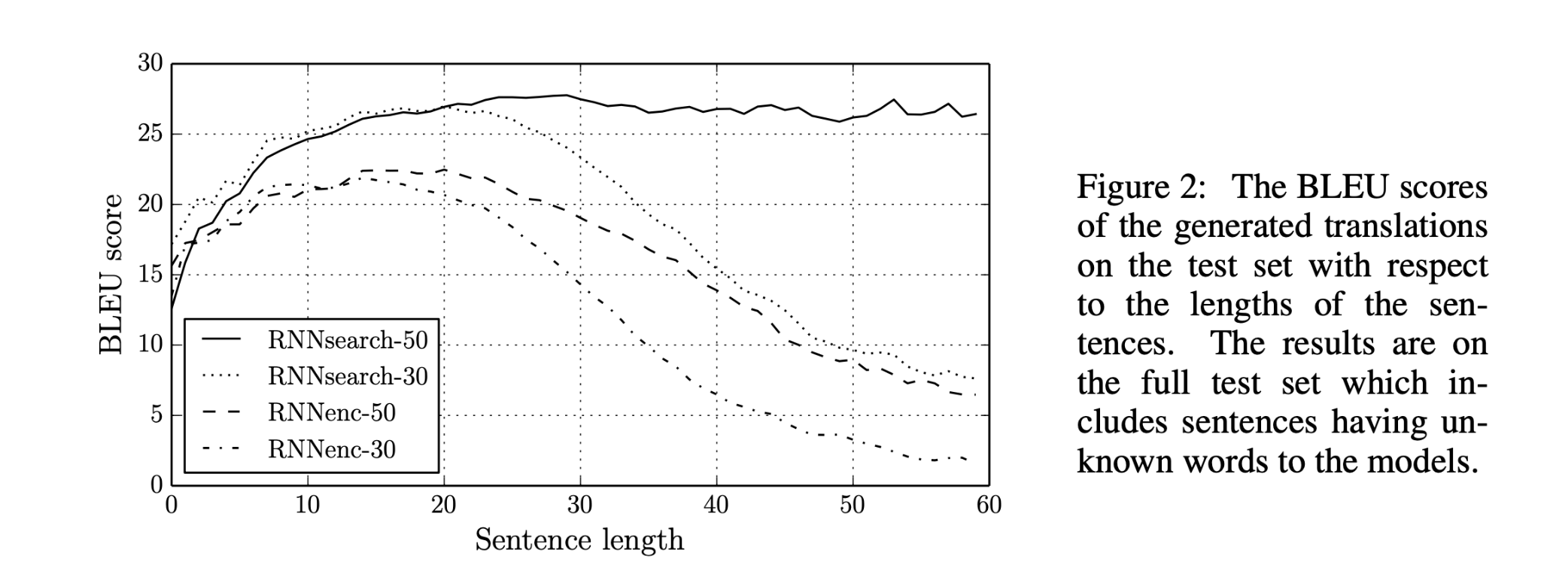
Machine Translation with attention
Bahdanau, Cho, Bengio (ICLR-2015)
Bleu: BiLingual Evaluation Understudy -> Percentage of translated words that appear in ground truth

Slide 30
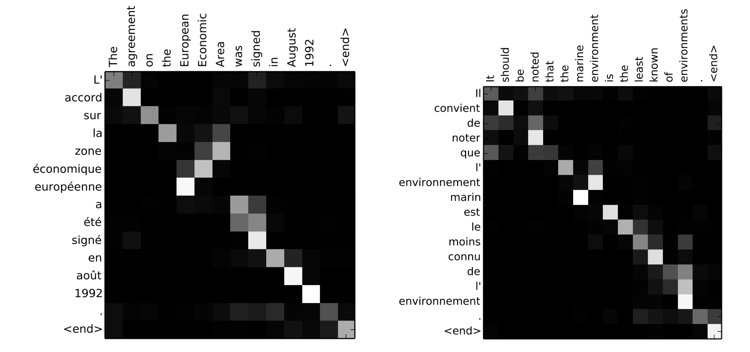
Alignment example

Slide 31
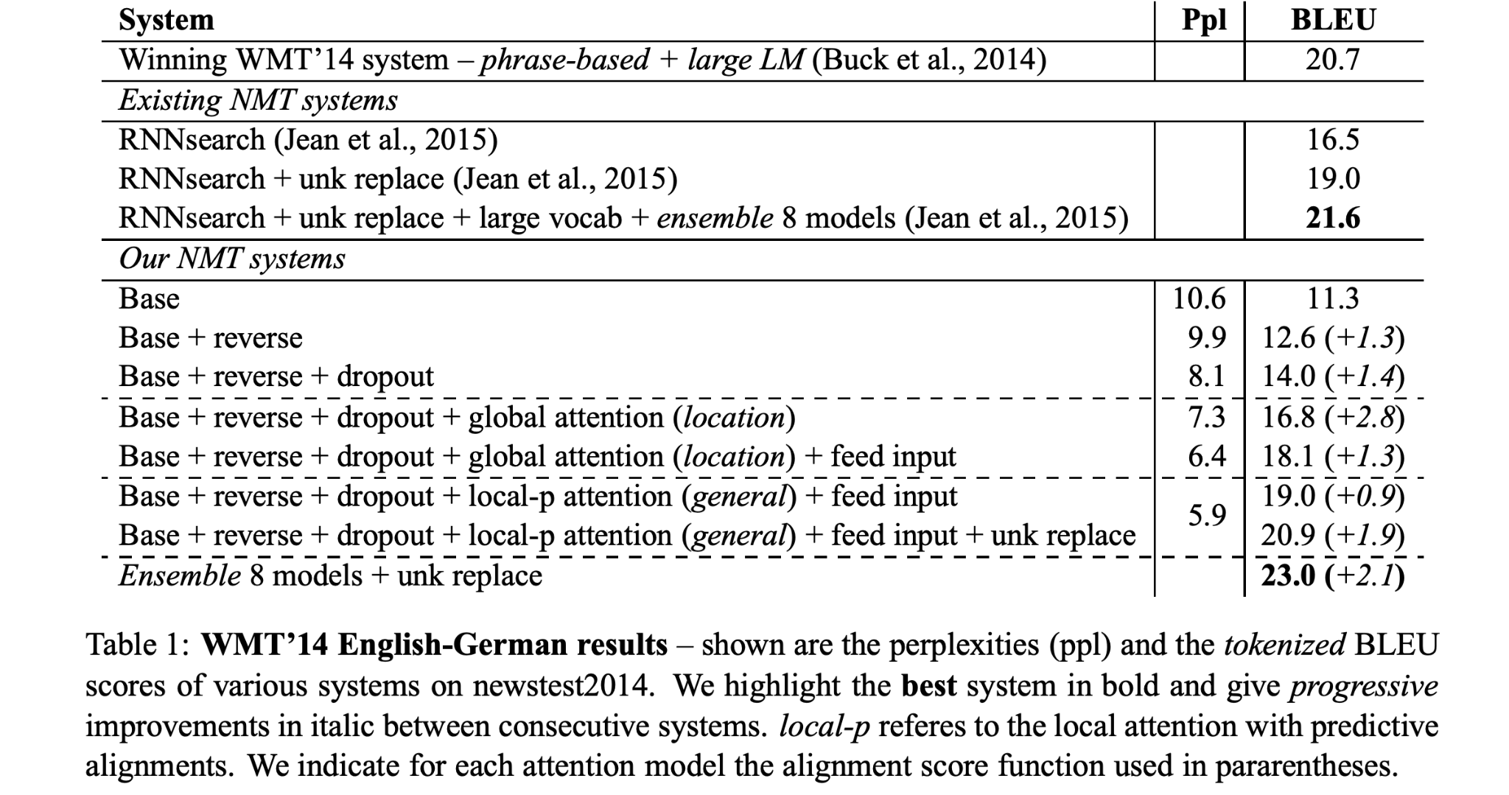
Evaluation Results

Slide 32
Convolutional Neural Networks

Slide 33


Basics of CNN
CNN operation
Pooling operation
0
0
7
7
8
0
4
2
5
1
7
7
8
1
2
1
46
1
6
1
3
1
2
5
1
0
2
1
46
1
4
5
9
0
1
3
1
2
1
1
1
2
7
8
5
0
0
7
7
8
0
4
2
5
1
7
7
8
8
1
6
1
3
1
2
5
1
8
1
4
5
9
0
1
3
1
MaxPooling
1
2
7
8
5
Notes:
7*1 +

Slide 34
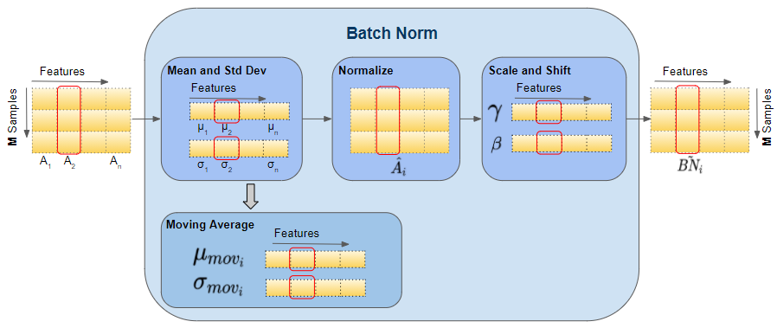
Basics of Batch Normalization (BN)

Slide 35
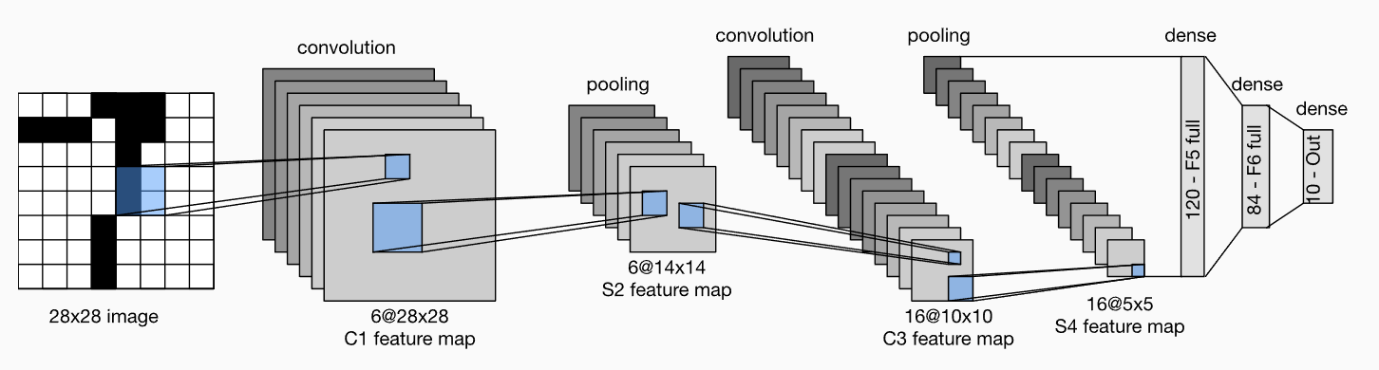
LeNet-5
Sigmoid activation after each convolution operation
Using average pooling
Lecun, Y.; Bottou, L.; Bengio, Y.; Haffner, P. (1998). "Gradient-based learning applied to document recognition" (PDF). Proceedings of the IEEE. 86 (11): 2278–2324
Notes:
Using sigmoid
Average pooling
2 convs + 3 fully connected

Slide 36
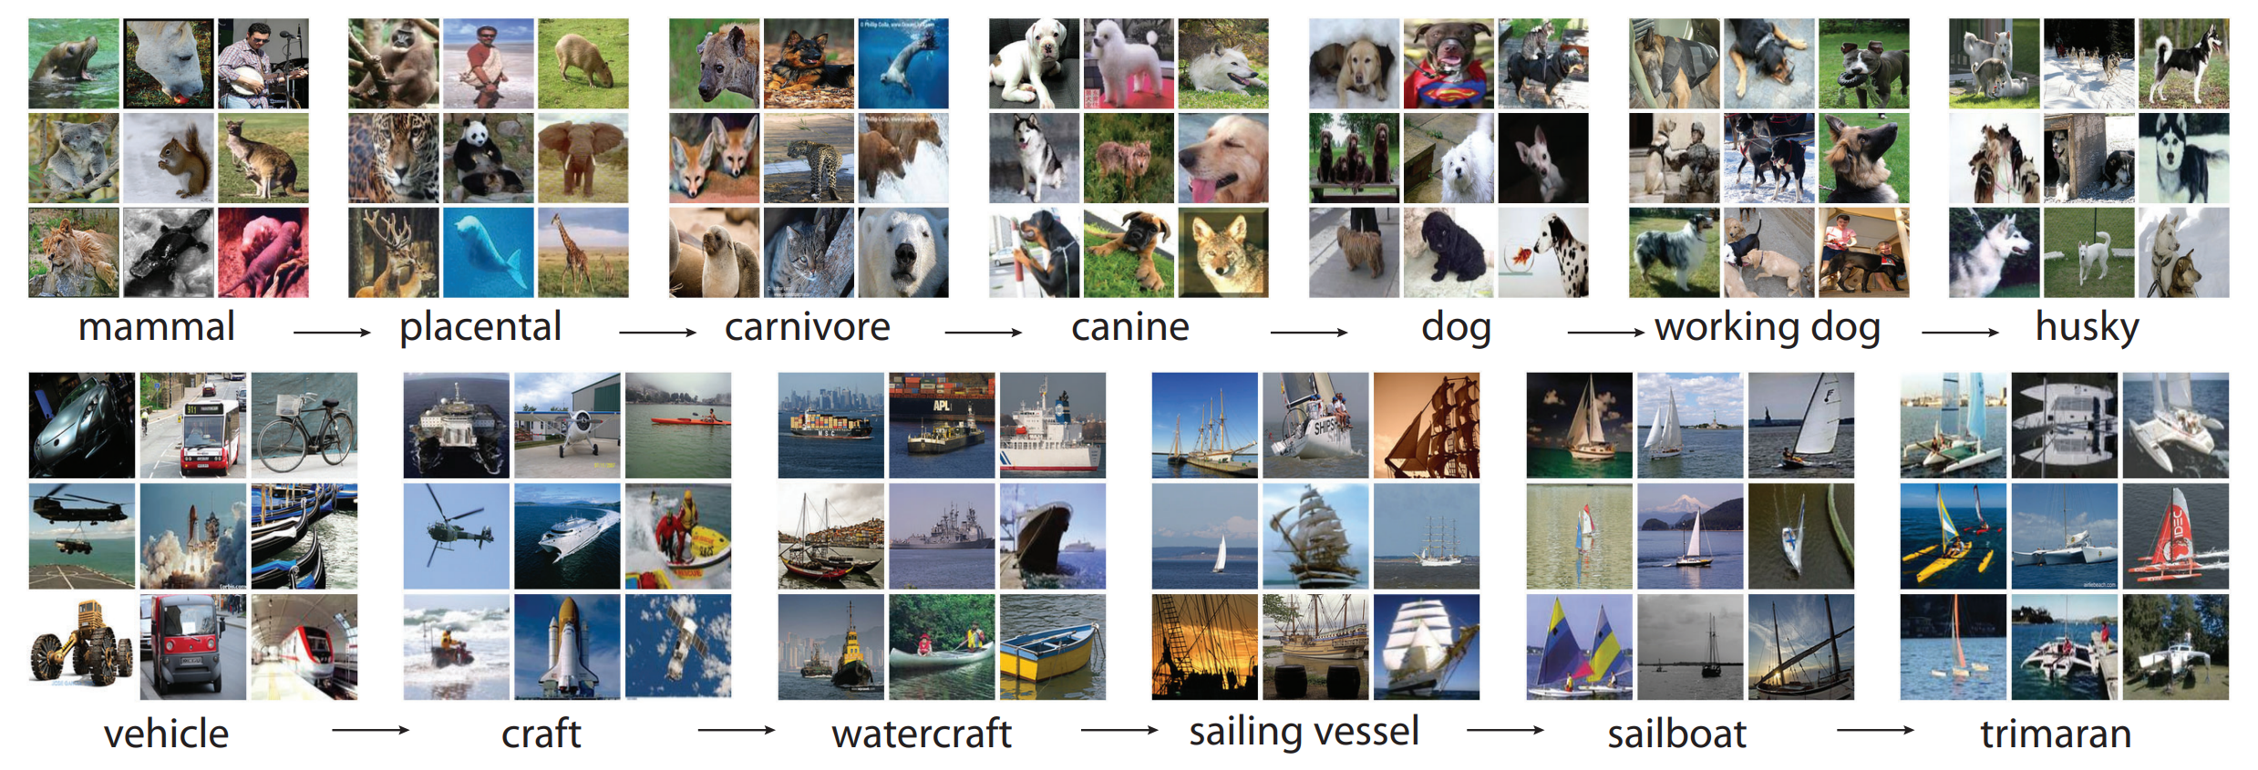
ImageNet
ImageNet is a dataset with over 15 million labeled high-resolution images belonging to roughly 22,000 categories.
J. Deng, W. Dong, R. Socher, L. -J. Li, Kai Li and Li Fei-Fei, "ImageNet: A large-scale hierarchical image database," 2009 IEEE Conference on Computer Vision and Pattern Recognition, Miami, FL, USA, 2009, pp. 248-255, doi: 10.1109/CVPR.2009.5206848.

Slide 37
AlexNet (2012)
Can we train larger deep convolutional neural network using GPU?
Issues and solutions:
  Larger Training Dataset -> ImageNet
  Computation resources -> Implementation of AlexNet on GPU.
It’s the first work that uses GPU to train a deep neural network
Krizhevsky, Alex, Ilya Sutskever, and Geoffrey E. Hinton. "Imagenet classification with deep convolutional neural networks." Advances in neural information processing systems 25 (2012).
Notes:
Using max pooling
Using relu
Using LRN
Use GPU to train and inference
Deeper and wider
Using dropout on fully dense layer

Slide 38
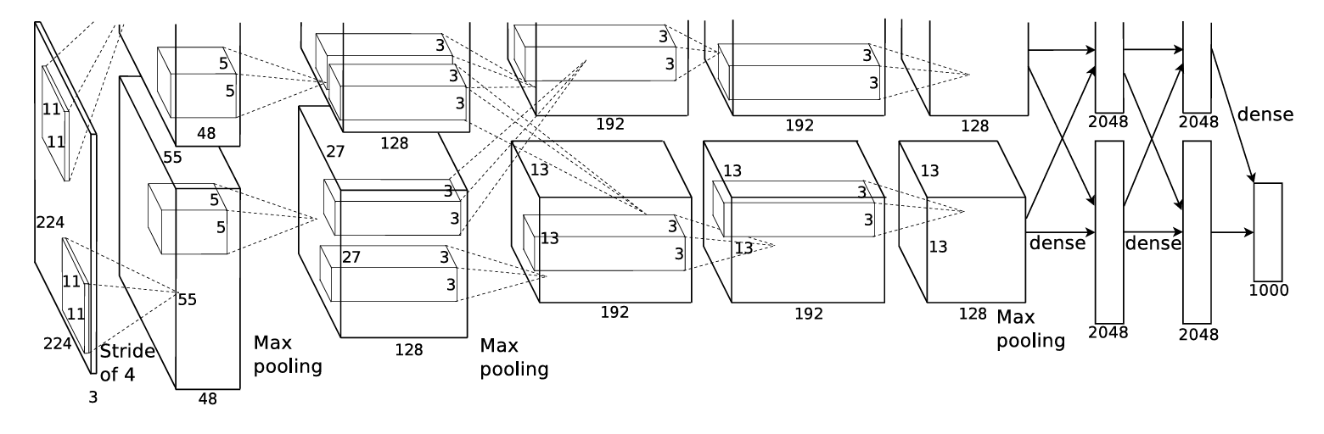
AlexNet (2012)
Technical details
  5 convolutional layers and 3 fully connected layers
  Using ReLU + LRN after each convolutional layer
  3 Max pooling layer
  Dropout = 0.5 for the 2 hidden fully connected layers.
Notes:
Using max pooling
Using relu
Using LRN
Use GPU to train and inference
Deeper and wider
Using dropout on fully dense layer

Slide 39
VGGNet (2014)
What’s the effects of increasing depths of deep CNN network?
  Design a VGG CNN block that can easily increase the depth by stacking blocks.
…
Conv(3x3)-64
…
…
Conv(3x3)-64
…
RELU
maxpool(2x2), stride 2
Fully connected layers
VGG Block
VGGNet
Simonyan, Karen, and Andrew Zisserman. "Very deep convolutional networks for large-scale image recognition." arXiv preprint arXiv:1409.1556 (2014).
Notes:
- CNN block design, CNN + relu + maxpooling

Slide 40
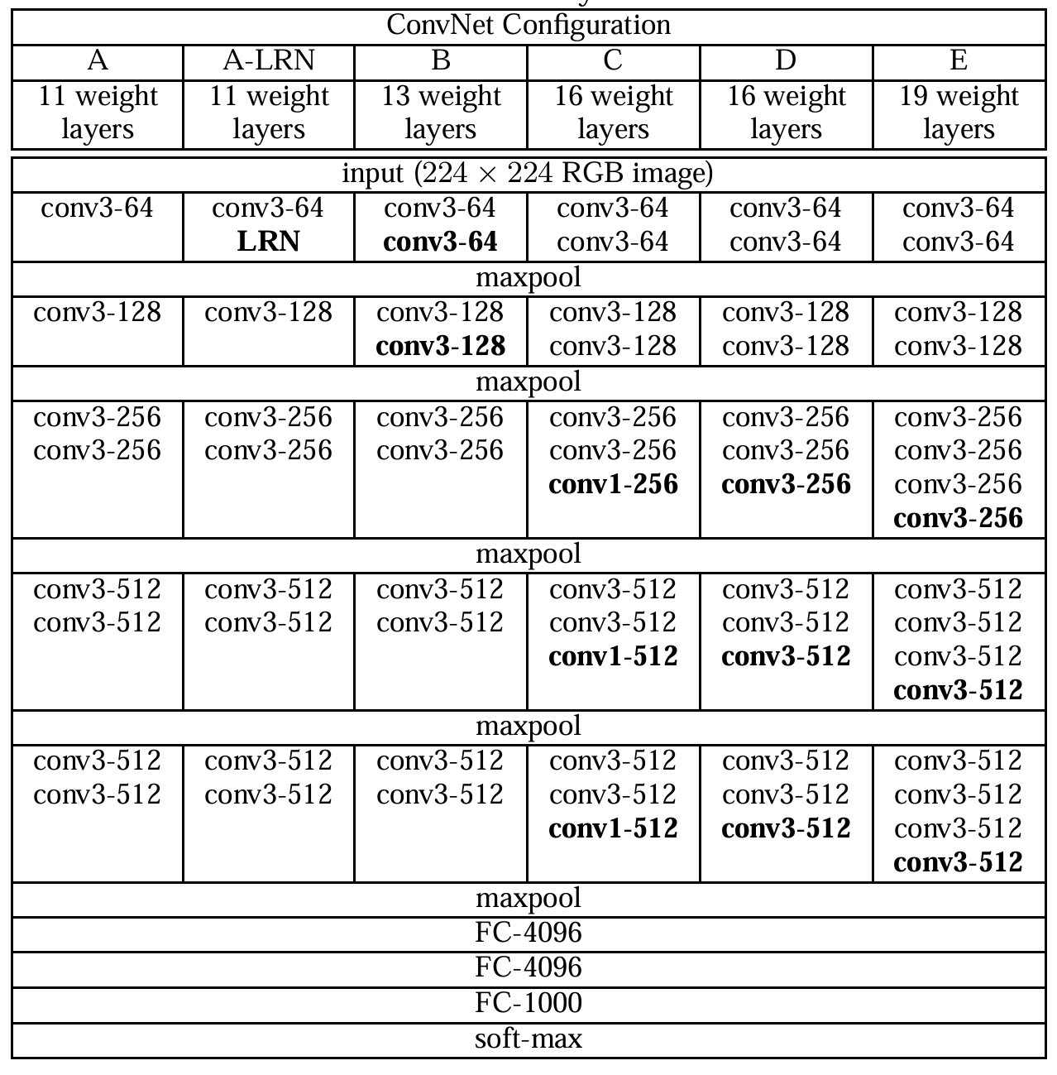
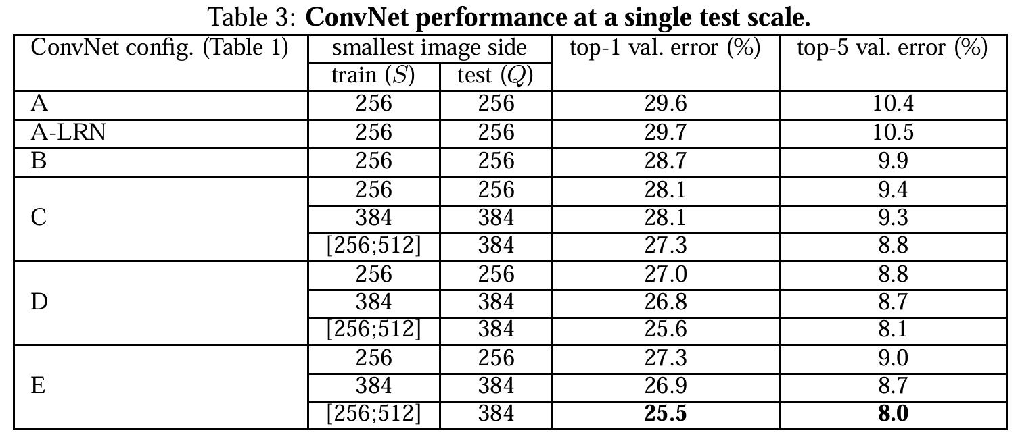
VGGNet (2014)
Conclusion: Deeper is better.
Notes:
- CNN block design, CNN + relu + maxpooling

Slide 41
ResNet (2015)
Is learning better networks as easy as stacking more layers?
Issues:
  Vanishing/exploding gradients -> Well addressed by BatchNorm
  Performance degeneration on deeper networks -> Open Problem
Assumption:
  There exists an Identity mapping from deeper to shallower
  Easier to learn the residual mapping instead of the identify mapping.
Solution:
  Add residual connection to the CNN network.
He, Kaiming, et al. "Deep residual learning for image recognition." Proceedings of the IEEE conference on computer vision and pattern recognition. 2016.
Notes:
What will happen if network goes deeper and deeper?
-

Slide 42
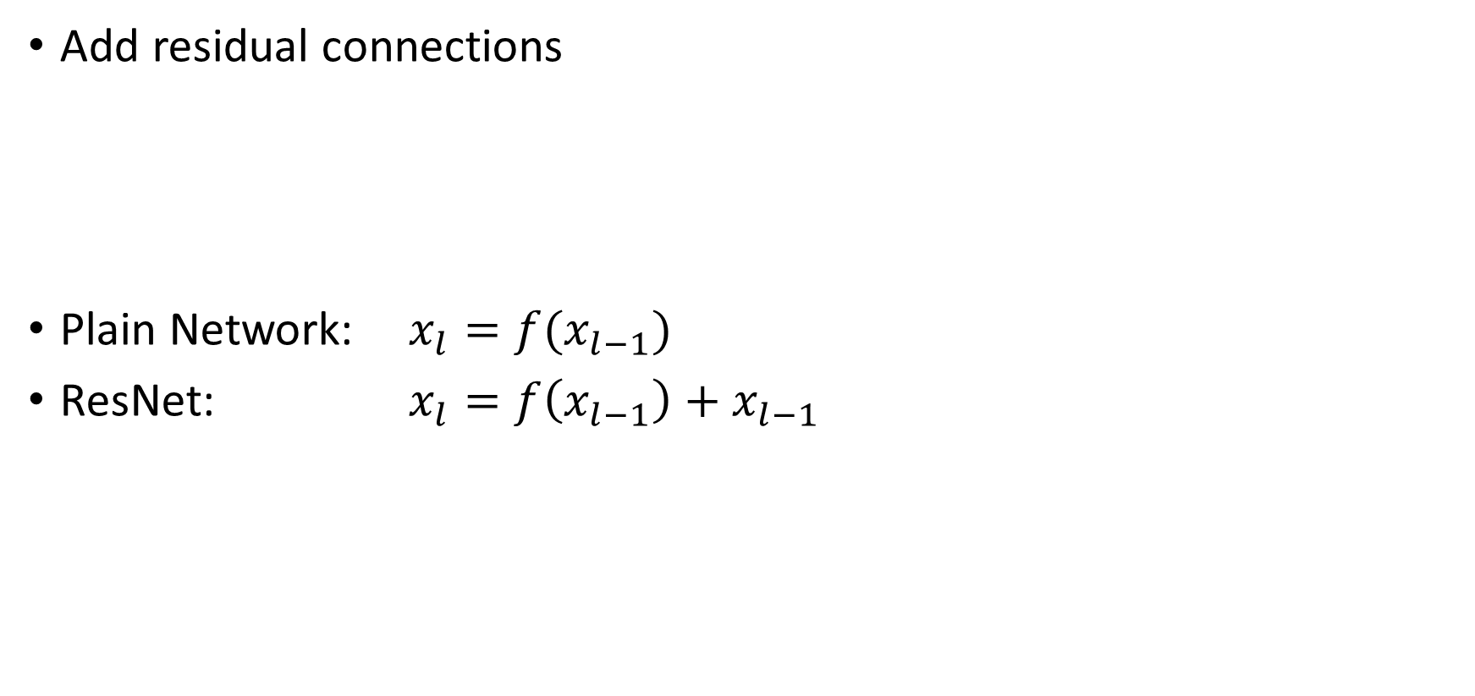




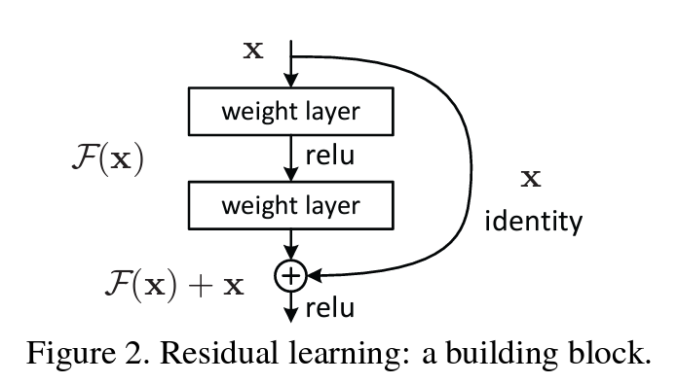
ResNet (2015)
Plain Network
ResNet
Notes:
What will happen if network goes deeper and deeper?
-

Slide 43
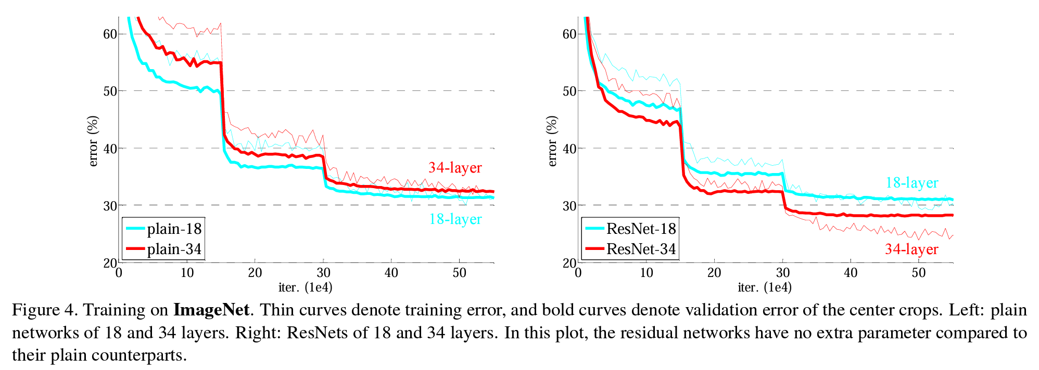
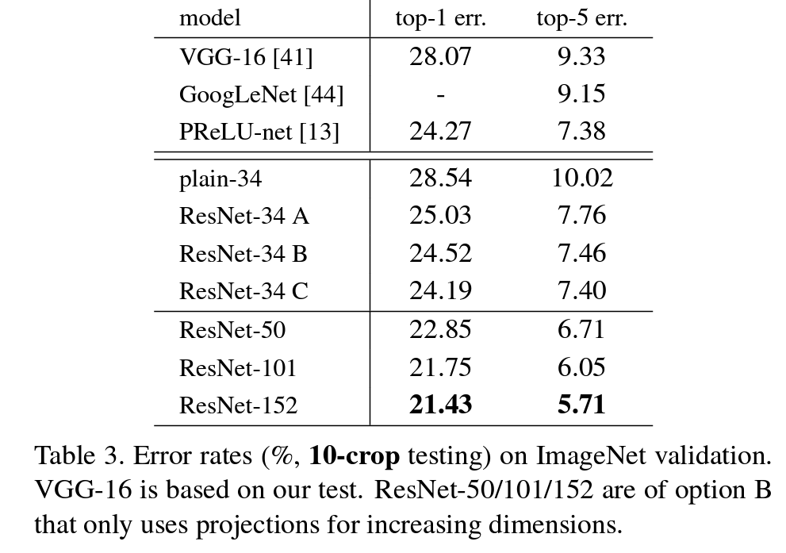
ResNet (2015)
The performance degeneration for deeper network is gone
Deeper Resnet comes with better performance
Notes:
What will happen if network goes deeper and deeper?
-

Slide 44




DenseNet (2016)
What if we extend the residue connections
A logical extension of ResNet
All the layers are connected with dense residue.
ResNet
DenseNet
Huang, Gao, et al. "Densely connected convolutional networks." Proceedings of the IEEE conference on computer vision and pattern recognition. 2017.

Slide 45
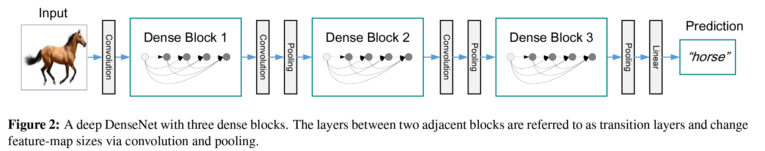
DenseNet (2016)
DenseBlock:
  BN-ReLU-Conv(1x1)-BN-ReLu-Conv(3x3) as basic block
  Introducing Conv(1x1) as Bottleneck layer to reduce the number of inputs
Transition Layer:
  Conv(1x1)-AvgPool(2x2)
  Introducing Conv(1x1) to Half the number of input features.

Slide 46
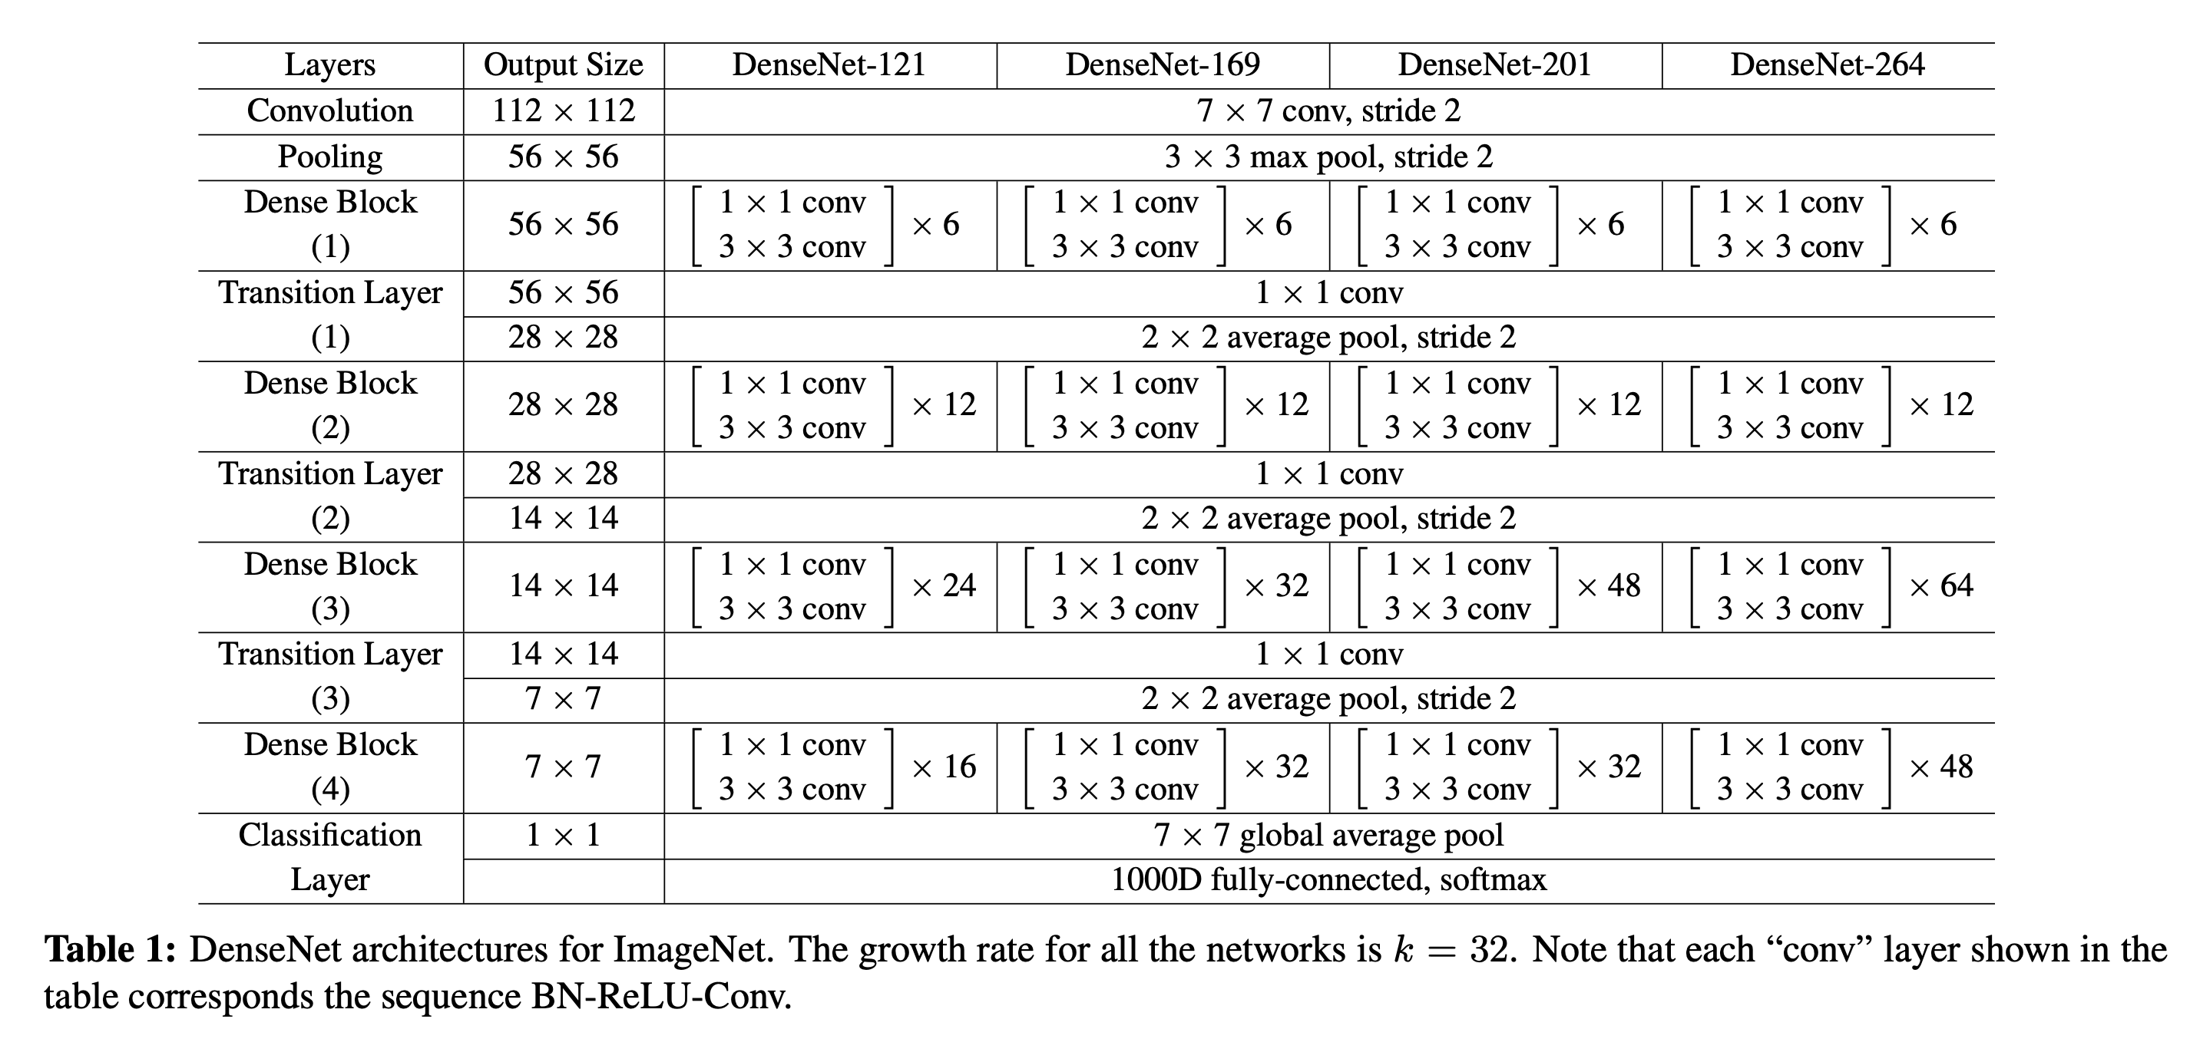
DenseNet (2016)

Slide 47
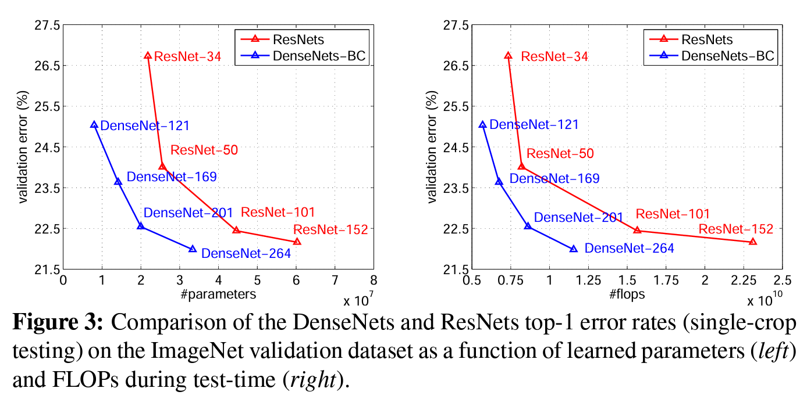
DenseNet (2016)
DenseNet get the same or better error rate compared to ResNet,
But with:
  Fewer parameters.
  Fewer computation resources (flops)

Slide 48
GoogLeNet/Inception (2014)
What if we make the CNN network wider instead of deeper?
  Larger model -> better performance, higher computation cost
  Fully connected architecture (deeper) -> sparsely connected architecture (wider)
  What is the optimal local sparse structure of the CNN block?
Solution: Let model learn.
Filter concatenation
1x1 convolutions
3x3 convolutions
5x5 convolutions
3x3 max pooling
Previous layer
Szegedy, Christian, et al. "Going deeper with convolutions." Proceedings of the IEEE conference on computer vision and pattern recognition. 2015.
Notes:
Find out the optimal local sparse structure in a CNN network.
How to decide the kernel size?
Pooling or not?

Slide 49
GoogLeNet/Inception (2014)
To reduce cost:
  Add Conv(1x1) layer before the highly-cost Conv(3x3) and Conv(5x5) to reduce the computation cost.
  Dubbed as “split-transformation-merge” strategy.
Filter concatenation
1x1 convolutions
3x3 convolutions
5x5 convolutions
1x1 convolutions
1x1 convolutions
1x1 convolutions
3x3 max pooling
Previous layer
Notes:
Find out the optimal local sparse structure in a CNN network.
How to decide the kernel size?
Pooling or not?

Slide 50
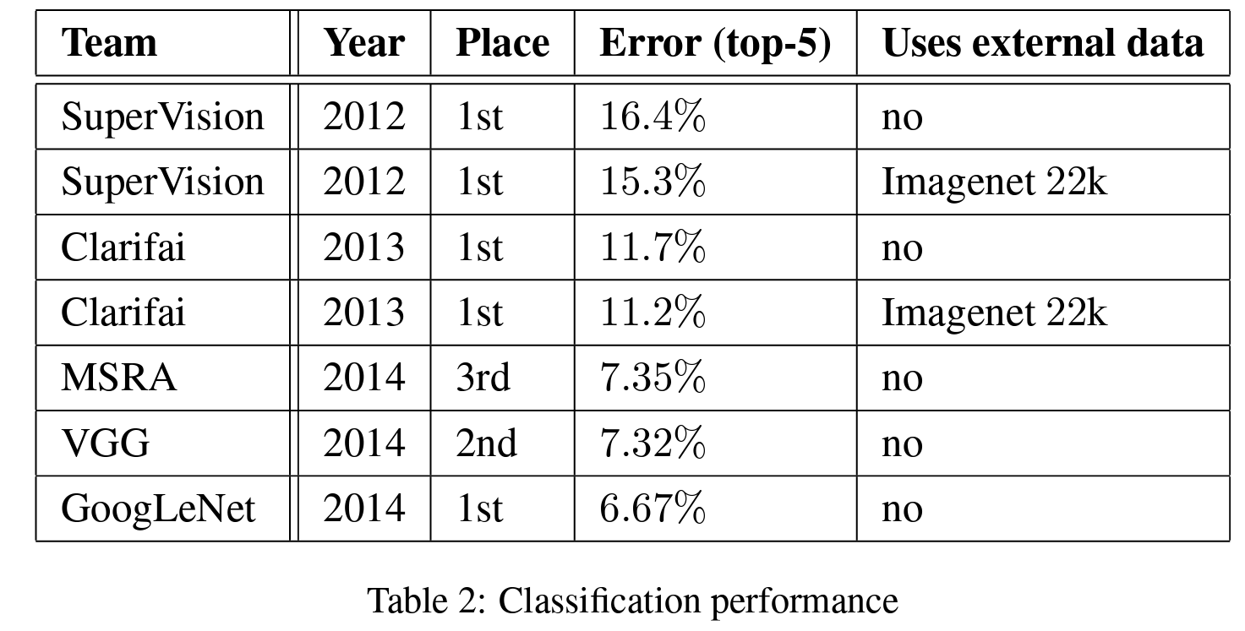
GoogLeNet/Inception (2014)
Results:
  Better performance on ImageNet
Notes:
Find out the optimal local sparse structure in a CNN network.
How to decide the kernel size?
Pooling or not?

Slide 51
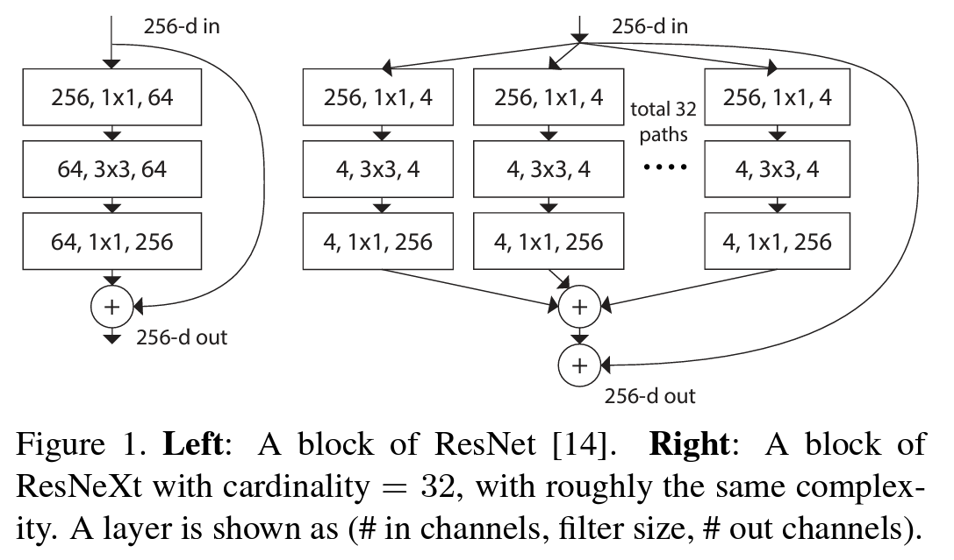
ResNeXt (2016)
Can we develop a wider ResNet?
  Apply “split-transformation-merge” strategy with the same topological branch
  (VGG-style repeating layers)
  Apply residual connection between each block
Xie, Saining, et al. "Aggregated residual transformations for deep neural networks." Proceedings of the IEEE conference on computer vision and pattern recognition. 2017.

Slide 52
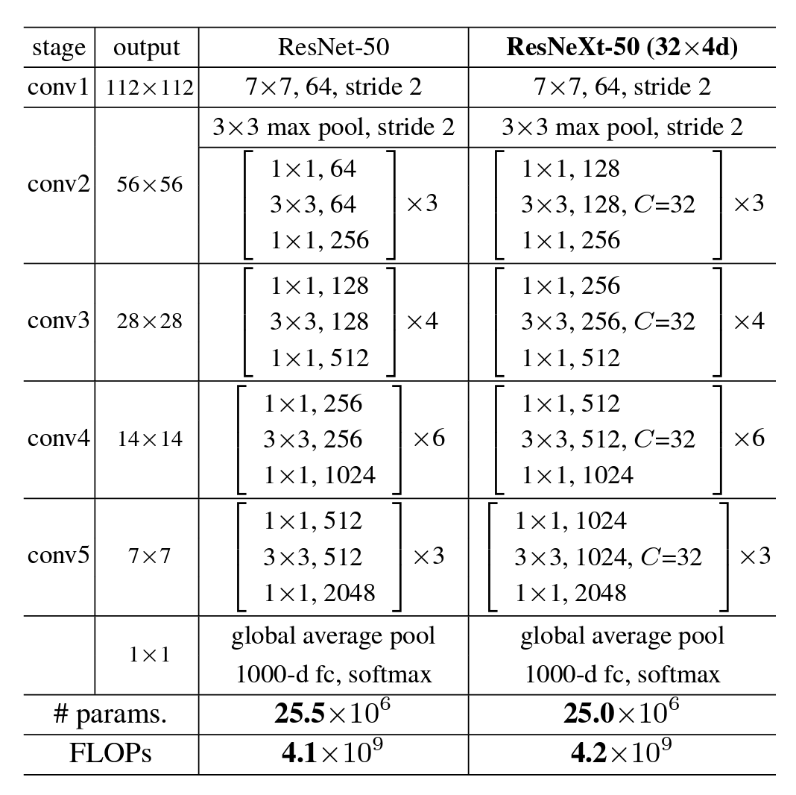
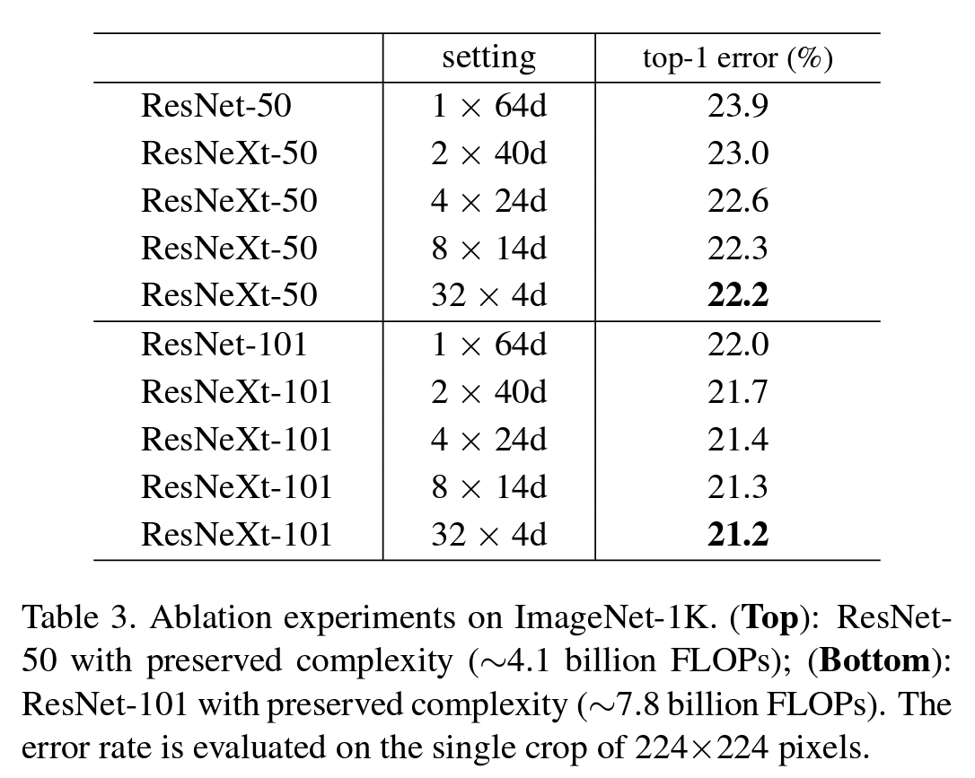
ResNeXt (2016)
Results:
  Lower error rate with the same number of parameters

Slide 53
ConvNeXt (2022)
To bridge the gap between the Conv Nets and ViT
  ViT, Swin Transformer has been the SOTA visual model backbone
  Is convolutional networks really not as good as transformer models?
Investigation
  The author start with ResNet-50 and reimplement the CNN networks with modern designs
  The results showing that ConvNeXt achieves beat the ViT models, again.
Liu, Zhuang, et al. "A convnet for the 2020s." Proceedings of the IEEE/CVF conference on computer vision and pattern recognition. 2022.

Slide 54
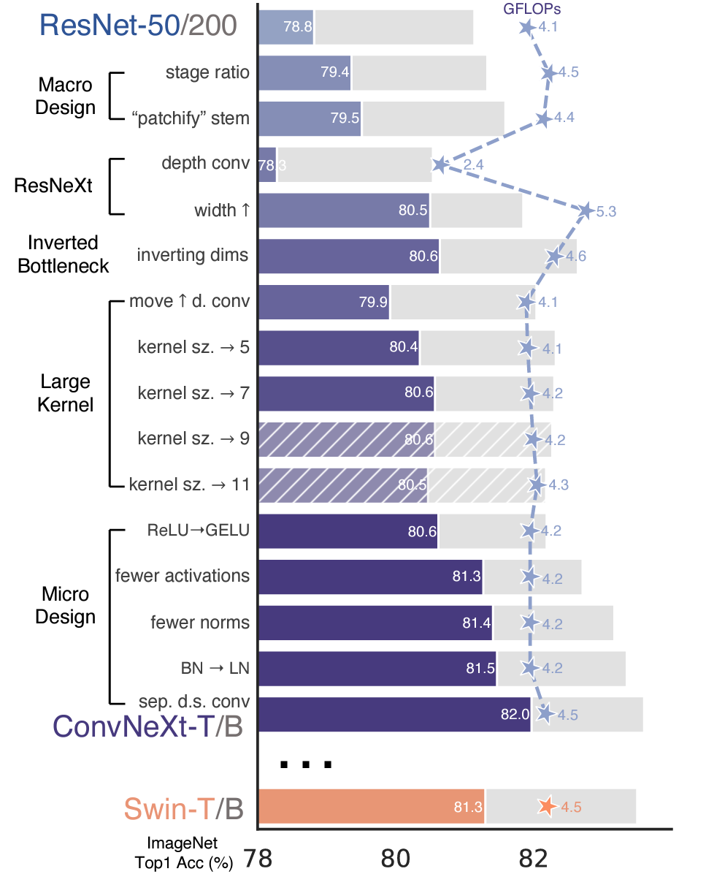
ConvNeXt (2022)
Modern designs added:
Use ResNeXt
Apply Inverted Bottleneck
Use larger kernel size
Training strategy:
  90 epochs -> 300 epochs
  AdamW optimizer
  Data augmentation like Mixup, CutMix
  Regularization Schemes like label smoothing
  …

Slide 55
ConvNeXt (2022)
Modern designs added:
Macro Design
  Changing stage compute ratio
  Changing stem to “patchify”
Micro Design
  ReLU -> GELU
  Fewer activation functions
  Fewer normalization layers
  BatchNorm -> LayerNorm
  Separate downsampling layers

Slide 56
CNN for downstream applications
Downstream tasks
  Image-segmentation: U-Net
  Object Detection: Yolo
  …
CNNs that more cost-effective
  MobileNet
  SqueezeNet
  …

Slide 57
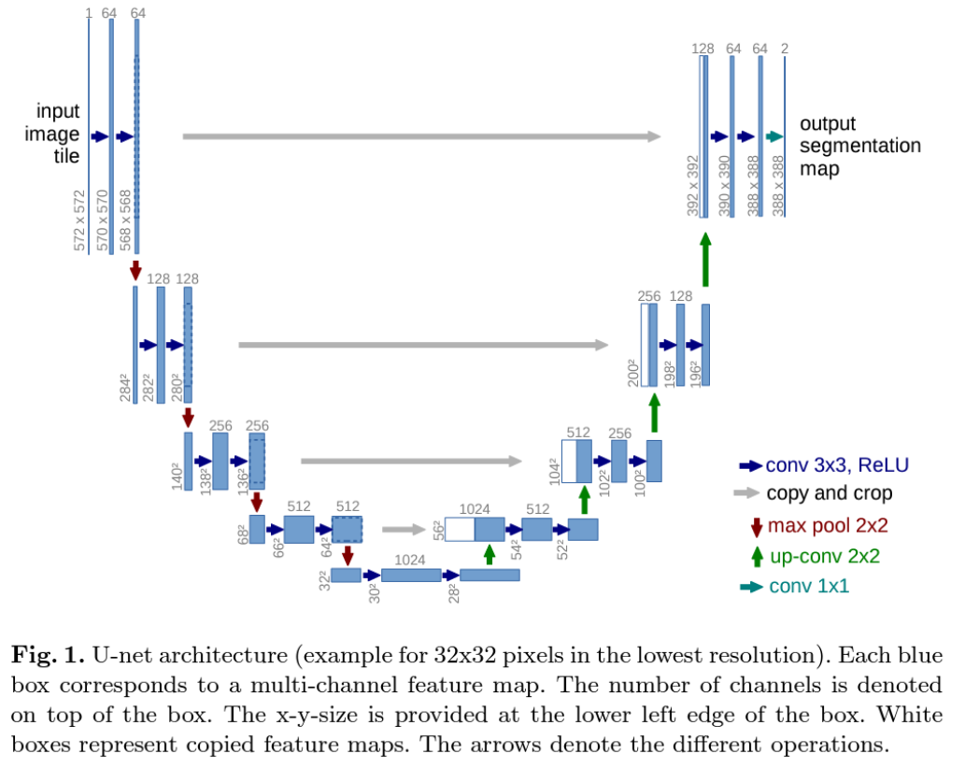
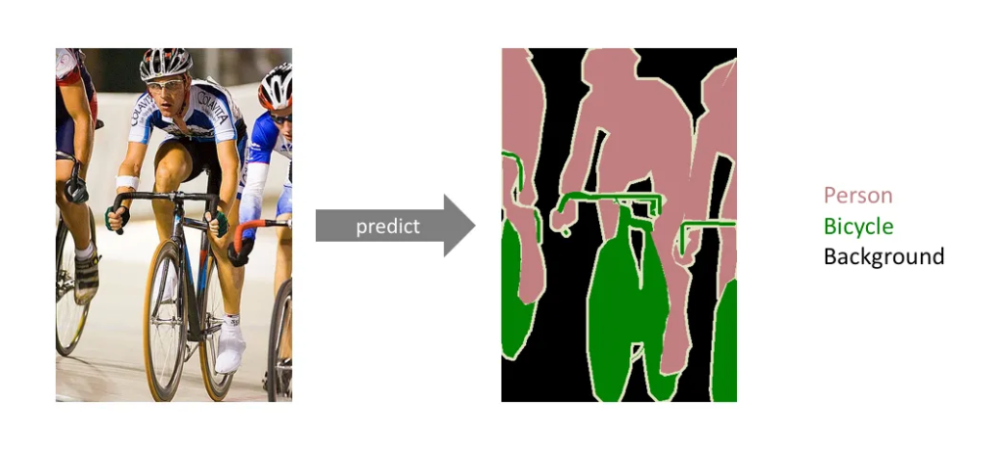
U-Net (2015)
Fully convolutional network for image segmentation
Output is 2 segmentation map
representing the probabilities of
each pixel belongs to either background or the object.
Ronneberger, Olaf, Philipp Fischer, and Thomas Brox. "U-net: Convolutional networks for biomedical image segmentation." Medical image computing and computer-assisted intervention–MICCAI 2015: 18th international conference, Munich, Germany, October 5-9, 2015, proceedings, part III 18. Springer International Publishing, 2015.

Slide 58
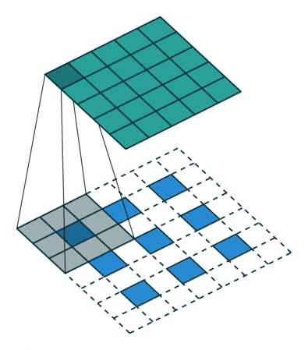
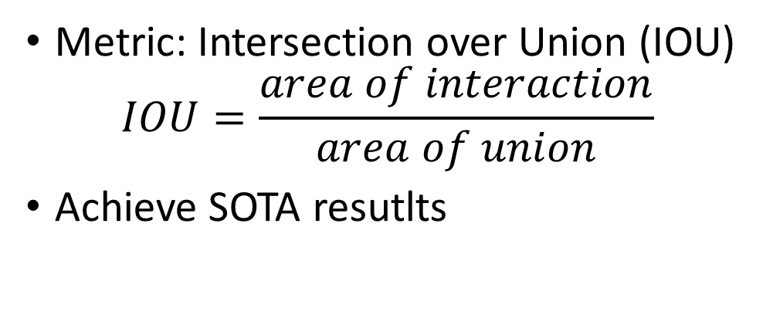
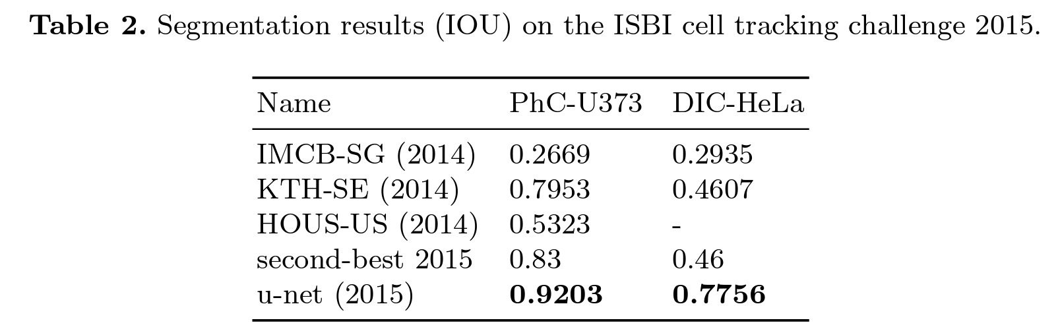
U-Net (2015)
Up-convolution
  Vanila convolution reduce the size of feature map
  Up convolution increase the size of feature map

Slide 59
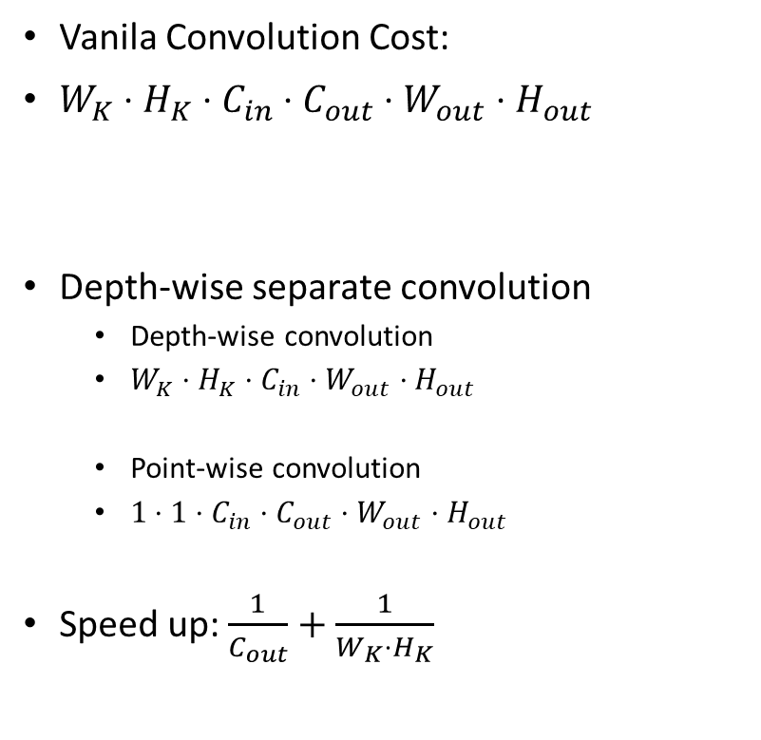
MobileNet (2017)
Efficient Network with depth-wise separate convolution
Kernel Size
# Kernels
Output feature size
Vanilla Convolution
Depth-wise
convolution
Point-wise
convolution
Depth-wise separate convolution

Slide 60
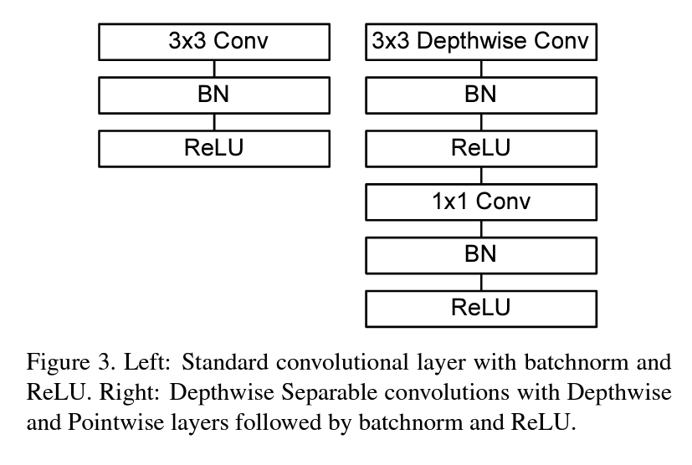
MobileNet (2017)
Vanilla Convolution
Depth-wise
convolution
Point-wise
convolution
Depth-wise separate convolution

Slide 61
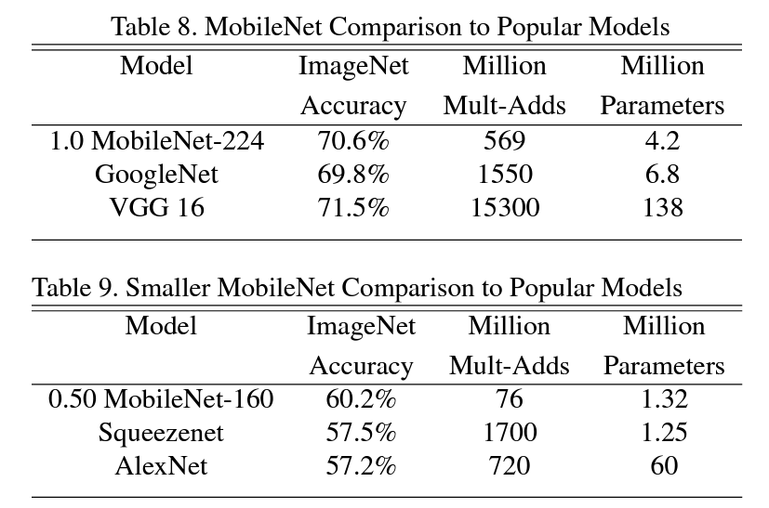
MobileNet (2017)
Evaluation Results:
Howard, Andrew G., et al. "Mobilenets: Efficient convolutional neural networks for mobile vision applications." arXiv preprint arXiv:1704.04861 (2017).

Slide 62
Summary of CNN part
LeNet-5: First CNN network
AlexNet: First CNN network on GPU.
VGGNet: Increasing model depth via repeating blocks
ResNet: Residual connection enable deeper network
DenseNet: Residual connection across all layers
GoogLeNet/Inception: Wider network via “split-transformation-merge”
ResNeXt: ResNet with VGG-style “split-transformation-merge”
ConNeXt: CNN network with modern design techniques.
U-Net: CNN network for image segmentation
MobileNet: More cost-effective CNN network via depth-separate CNN.

Slide 63
Summary of CNN part
Before 2012
2012
2014
2015
2016
2020
LeNet-5
AlexNet
VGGNet
ResNet
DenseNet
Towards deeper network
ConvNeXt
GoogLeNet
ResNeXt
Towards wider network
Downstream Applications
U-Net
MobileNet
Yolo
SqueezeNet
…
Image
segmentation
More
Efficient
Object
Detection
Smaller
Size
Other
Downstream Tasks

