Slide 1


Logical Natural Language Generation from Open-Domain Tables
Wenhu Chen, Jianshu Chen, Yu Su, Zhiyu Chen and William Yang Wang

Slide 2
Background
Natural Language Generation
Generating text from structured data/knowledge
Existing NLG datasets
E2ENLG: generate text from dialog act
WebNLG: generate description from RDF triples
WeatherGov: generate weather report from a infobox.
WikiBio: generate biography from a one-row table
ROTOWIRE: generate sports reports from NBA tables

Slide 3
Background
Example of traditional table-to-text dataset.
Medal Table from Tournament
Nation | Gold Medal | Silver Medal | Rank
Canada | 3 | 1 | 5
Surface Realization
Canada obtained 3 gold medals and 1 silver medal, and ranked 5th position.

Slide 4
Background
SOTA results on different NLG datasets
Extremely high scores over 60%. Does it mean that we already solve the problem of NLG?

Slide 5
Background
Limitations of traditional NLG tasks
No logical inference: the generated texts are simply restating the world facts.
No summarization: the generated texts cannot summarize the most interesting information or aggregate them.
Hallucination: the generated texts are sometimes contradictory to real-world.

Slide 6
Logical NLG
Beyond Surface Realization
Generating summarized text
Concluding trends or implicit information
Involving logical/mathematical operations
Applications
Providing more high-level information to users.
Generating summarized reports from high-quantity data.

Slide 7
Logical NLG
Examples beyond surface realization:
Medal Table from Tournament
Nation | Gold Medal | Silver Medal | Rank
Canada | 3 | 1 | 5
U.S | 7 | 2 | 1
Mexico | 2 | 5 | 6
Beyond Surface Realization
U.S has obtained the most gold medals in the tournament and ranked the 1st.
Mexico had fewer gold medals but more silver medals than Canada .

Slide 8
Logical NLG Dataset
Dataset source
The dataset is collected from TabFact.
We take the logically supported statements as our oracle table description.
Dataset Statistics
Vocab | Examples | Tables | Source | Domain | Schema
122K | 37K | 7.3K | Annotated | Open | Unlimited
TabFact: A Large-scale Dataset for Table-based Fact Verification Wenhu Chen, Hongmin Wang, Jianshu Chen, Yunkai Zhang, Hong Wang, Shiyang Li, Xiyou Zhou and William Yang Wang Proceedings of ICLR 2020, Addis Ababa, Ethiopia

Slide 9
Logical NLG Dataset
Frequent Logical Operations:
Superlative: A is the most …
Average: The average of ... for A is …
Count: There are N people ….
Numeric/Time Comparison: A happens one day before B
Both/Neither: Both A and B are …
Sum/Diff: A team has obtained a total of B medals.
....
Goal: generating sentences not only fluent but also logically entailed by the given table.

Slide 10
Evaluation
Fluency Metrics
BLEU-1/2/3
Perplexity
Factualness Metrics
Model-based Semantic-Parsing (SP) accuracy
Model-based Inference (NLI) accuracy
Adversarial classification accuracy
Human evaluation

Slide 11
Semantic-Parsing Accuracy
Apply semantic parser to parse the generated sentence to verify its logical factualness.
Sentence: Canada obtained 1 more gold medal than Mexico
Parsing [Link->Search]
Eq(Hop(Filter(Nation==Canada), Gold Medal)… 1)
Execute
True
✓
False
✕

Slide 12

NLI Accuracy
Apply natural language inference model to verify the logical factualness
Sentence: Canada obtained 1 more gold medal than Mexico
NLI
Linearize
Table: In the first row …. In the second row, ….
$$p_{NLI}(Y|T)$$

Slide 13


Adversarial Accuracy
Classify the correctness of paired oracle/adversarial text inputs with the trained NLG model.
Original: Canada obtained 1 more gold medal than Mexico
Adv: Canada obtained 1 less gold medal than Mexico
Trained
NLG Model
$$p(Y|T)$$
✓
>
$$p(Y_{adv}|T)$$
✕

Slide 14
Metrics Discussion
Model-based accuracy (SP/NLI accuracy)
Pros: evaluating the peak of generation model’s distribution, not biased.
Cons: evaluation models are prone to errors (60-65%).
Adversarial accuracy
Pros: the evaluation is precise and stable.
Cons: not necessarily evaluating the peak of the generation model’s distribution, can be biased.
The first two metrics are still in a preliminary stage, only for diagnosis purposes.

Slide 15
Non-Pre-trained Baselines
Field-infusing model (Lebret et. al. 2016)
Feeding table header into the cell.
Field-gating model (Liu et. al. 2018)
Feeding table header as an additional gate in LSTM.
[1] Neural Text Generation from Structured Data with Application to the Biography Domain Rémi Lebret, David Grangier and Michael Auli, EMNLP 2016
[2] Table-to-text Generation by Structure-aware Seq2seq Learning Tianyu Liu, Kexiang Wang, Lei Sha, Baobao Chang and Zhifang Sui, AAAI2018

Slide 16
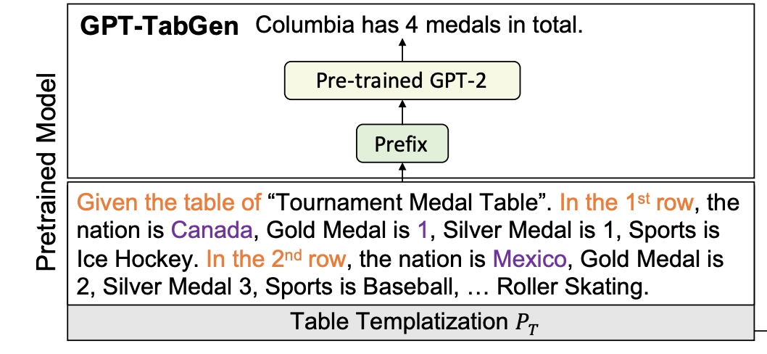
Pre-trained Baselines [GPT-GEN]
Transform the table into a template sentence, use it as prefix of GPT-2 to generate description.

Slide 17
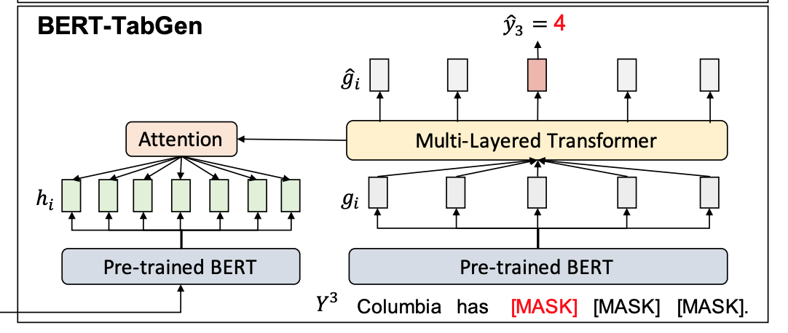
Pre-trained Baselines [BERT-GEN]
Concatenate the table and half-generated text into a `sentence` and mask the following words. Unveil the [MASK] token by token.

Slide 18

Coarse-to-Fine Method
First generate templates with placeholder.
Then realize the placeholders with real entities/numbers.
GPT-2
[ENT]
obtained
[ENT]
more
[ENT]
than
[ENT].
$$P_{T}$$
Canada obtained 1 more gold medal than Mexico.

Slide 19
Training Strategy
Maximum Likelihood Training: Maximize the sequence log-likelihood.
REINFORCE Algorithm: use a Semantic Parser to assign factualness reward.
Adversarial Regularization: randomly synthesize logically refuted sentences and suppress their likelihood as a regularization.

Slide 20
Experiments
Fluency-based metrics [Overall]

Slide 21
Experiments
1. Pre-training helps improve text fluency.

Slide 22
Experiments
2. RL/Adv-Reg training degrade the fluency

Slide 23
Experiments
3. Coarse-to-fine achieves best fluency

Slide 24
Experiments
Factualness metrics [Overall]

Slide 25
Experiments
1. Pre-training can help improve factualness

Slide 26
Experiments
2. RL can help the SP-Acc but no the others

Slide 27
Experiments
3. Adversarial regularization can help Adv-Acc but not the others.

Slide 28
Experiments
4. Coarse-to-fine achieves overall best score.

Slide 29
Human Evaluation
We employ human workers to evaluate the factualness of the generated text.

Slide 30
Human Evaluation
Only 20% of generated sentences from the best model are logically plausible.

Slide 31
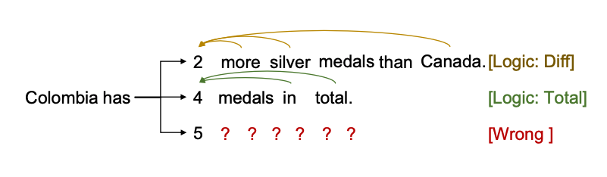
Forward Logical Dependency
When we have a prefix of “Colombia has”, we need to generate the word in sequence order 3.
The value depends on the semantics of the following words.

Slide 32
Challenge
1. The monotonic left-to-right generation models cannot handle the forward logical dependency.
2. The existing probability-driven generation model does not encode symbolic execution, which cannot guarantee correctness.

Slide 33
Takeaway Message
Logical NLG is a new dataset to pose challenge to NLG model’s inference capability.
The existing models can only achieve 20% logical correctness, very premature stage.
Future research could leverage symbolic execution into the text generation procedure.

