Slide 1



Triangular Architecture for Rare Language Translation
Shuo Ren^{1,2*}, Wenhu Chen³, Shujie Liu⁴, Mu Li⁴, Ming Zhou⁴ and Shuai Ma^{1,2}
¹SKLSDE Lab, Beihang University, China
²Beijing Advanced Innovation Center for Big Data and Brain Computing
³University of California, Santa Barbara, CA, USA
⁴Microsoft Research Asia, Beijing, China
* Contribution during internship at Microsoft Research Asia.
Notes:
I am Shuo. Today I am going to present our recent work on triangular architecture for rare language translation. This work is conducted during my internship in Microsoft Research Asia.

Slide 2
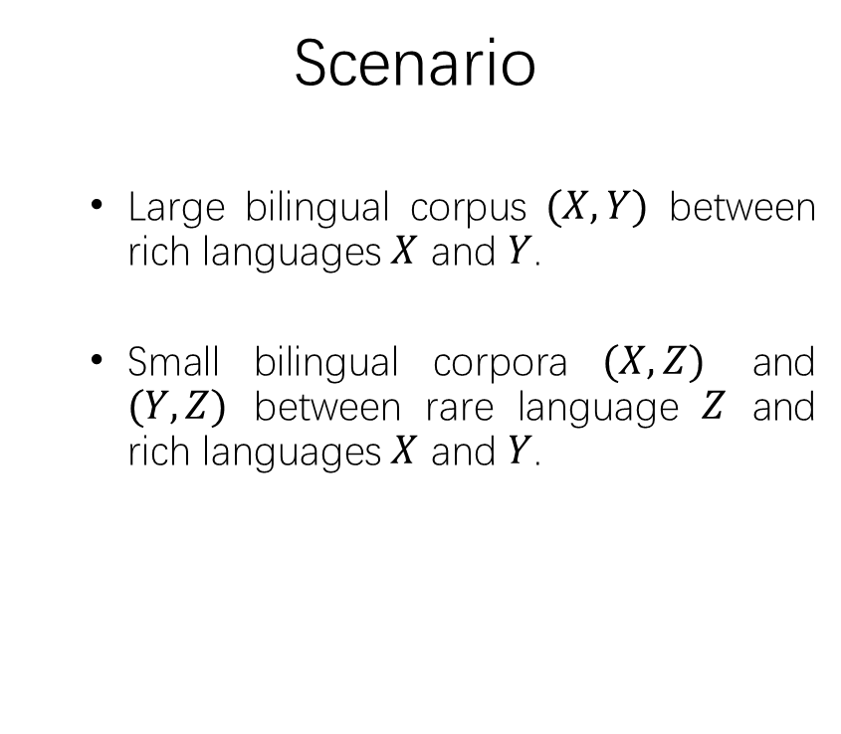



Motivation | Related Work | Method | Experiment
Background
NMT suffers from data sparsity problem.
Rich language pairs have a lot of parallel data while rare languages not.
How to improve rare language translation by leveraging the data of rich languages?
Scenario
Large bilingual corpus $(X,Y)$ between rich languages $X$ and $Y$.
Small bilingual corpora $(X,Z)$ and $(Y,Z)$ between rare language $Z$ and rich languages $X$ and $Y$.
$X$:EN
$Y$: FR
EN: English
FR: French
HE: Hebrew
$Z$: HE
Notes:
We have known that NMT has achieved remarkable performance on many translation tasks, especially on rich resource language resources such as English and French. However, NMT deeply relies on the amount of bilingual data. Without adequate bilingual data, NMT usually falls short on low-resource language pairs.
However, in the real world, rich languages pairs have a lot of bilingual data, while rare languages always not. This will limited the application of NMT on rare language translation.
Imagine a common scenario, where there are two large language X and Y, and a rare language Z. There is a large bilingual corpus between X and Y, while there are only small corpora (X,Z) and (Y,Z) between rare language Z and rich languages X and Y. In this scenario, besides the small corpora of the rare language, we also have the large bilingual corpus (X,Y).
So, here comes the problem, how to improve the translation models from and to the rare language by leveraging the data of rich languages.

Slide 3
Methods to Tackle Low-resource Problem
Motivation | Related Work | Method | Experiment
Just consider the source side and target side from a single language pair.
Exploiting monolingual data
Back-translation to exploit target-side monolingual data. (Sennich et al. 2015)
Self learning and multi-task learning algorithms to exploit source-side monolingual data. (Zhang and Zong, 2016)
Joint training to combine source-target translation model and target-source translation model. (Cheng et al. 2016 and Zhang et al. 2018)
Multilingual neural machine translation
Several encoders and decoders for different languages with a shared attention mechanism. (Firat et al. 2016)
Exploiting other parallel resources
Teacher-student method. (Chen et al. 2017 use this method to address zero-shot NMT.)
Focus on the model architecture rather than the training method.
Notes:
Before our method, let’s look back at the methods to tackle low-resource problem in NMT. They can roughly be divided into three categories.

Slide 4

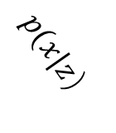


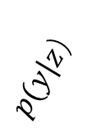

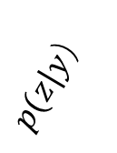
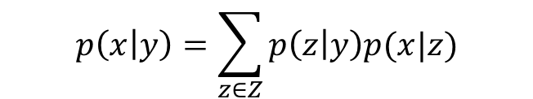
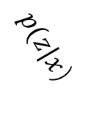
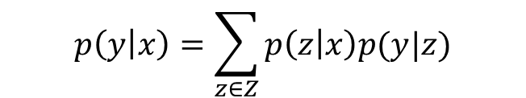
Motivation | Related Work | Method | Experiment
Goal
Improve the translation performance of four models for rare language jointly.
Our Method
Language $Z$ is used as a hidden space to translate a sentence from language $X$ to language $Y$, and from $Y$to $X$.
EM training can be leveraged.
$X$:EN
$Y$: FR
$$p\left(y | x\right)=\sum_{z∈Z}{p\left(z | x\right)p(y|z)}$$
$$p(z|x）$$
$$p(y|z）$$
$$p(x|z）$$
$$p(z|y）$$
$$p\left(x | y\right)=\sum_{z∈Z}{p\left(z | y\right)p(x|z)}$$
$Z$: HE
Notes:
OK. After the related work, let’s get back to our scenario, where there are two rich languages X and Y, and a rare language Z. We propose the problem, how to improve the translation models of rare language Z by leveraging the rich resource pair (X,Y). Here, we step further, how to improve the performance of four models jointly.
In our method, our answer is taking Z as a hidden variable into the process of translation from X to Y or from Y to X. By doing so, we can leverage EM framework to help us.

Slide 5
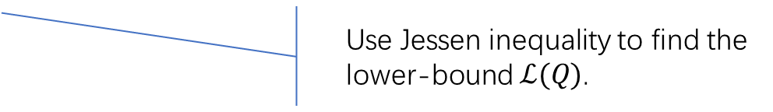
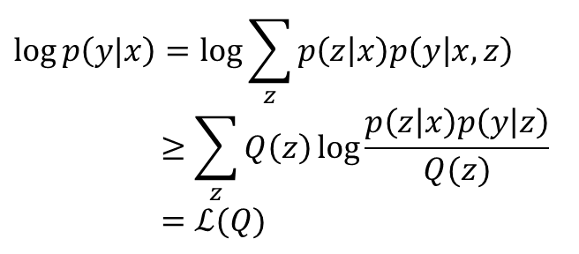

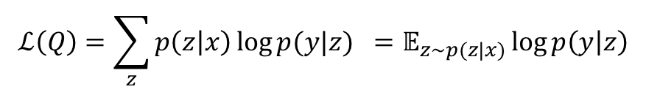
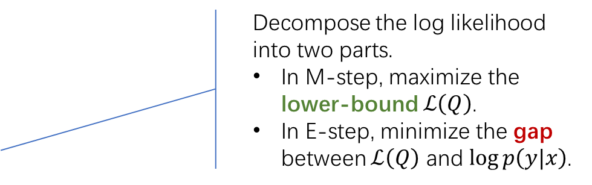

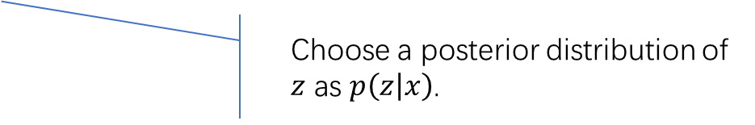
Motivation | Related Work | Method | Experiment
Generalized EM Training
$$\log{p\left(y|x\right)}=\log{\sum_{z}{p\left(z | x\right)p\left(y | x,z\right)}}$$
$$≥\sum_{z}{Q\left(z\right)}\log{\frac{p\left(z | x\right)p\left(y | z\right)}{Q(z)}}$$
$$=ℒ(Q)$$
Introduce z as the hidden variable into the log likelihood.
Use Jessen inequality to find the lower-bound $ℒ(Q)$.
$$Q\left(z\right)=p\left(z | x\right)$$
Choose a posterior distribution of $z$ as $p\left(z | x\right)$.
$$ℒ\left(Q\right)=\sum_{z}{p\left(z | x\right)}\log{p(y|z)} =𝔼_{z\sim p(z|x)}\log{p\left(y | z\right)}$$
Decompose the log likelihood into two parts.
In M-step, maximize the lower-bound $ℒ\left(Q\right)$.
In E-step, minimize the gap between $ℒ\left(Q\right)$ and $\log{p\left(y|x\right)}$.
$\log{p\left(y|x\right)}$- $ℒ\left(Q\right)=KL(p(z|x)||p(z|y))$
$$\log{p\left(y|x\right)}=ℒ\left(Q\right)+KL(p(z|x)||p(z|y))$$
M-step
E-step
Notes:
To be specific. Let’s take the direction of language X to language Y as example. The process for the direction of Y to X is similar.
So, first, we introduce z as the hidden variable to the log likelihood of p(y|x), which is the optimization goal in this problem. Using Jensen inequality, we can derive the lower bound L(Q) of log p(y|x), where Q is an arbitrary posterior distribution of z.
Conditioned on the observed data and current model, the calculation of Q is intractable, so we choose Q(z) = p(z|x) approximately. In this way, we can write this lower bound explicitly, and derive the gap between the likelihood and the lower bound, which is a Kullback-Leibler divergence.
By doing so, we decompose the log likelihood into two parts. Then, we can use generalized EM method to maximize the likelihood. In E-step, we minimize the KL term to find a new lower-bound. And in M-step, we maximize the lower-bound, which will cause a new KL divergence, and increase the likelihood.

Slide 6

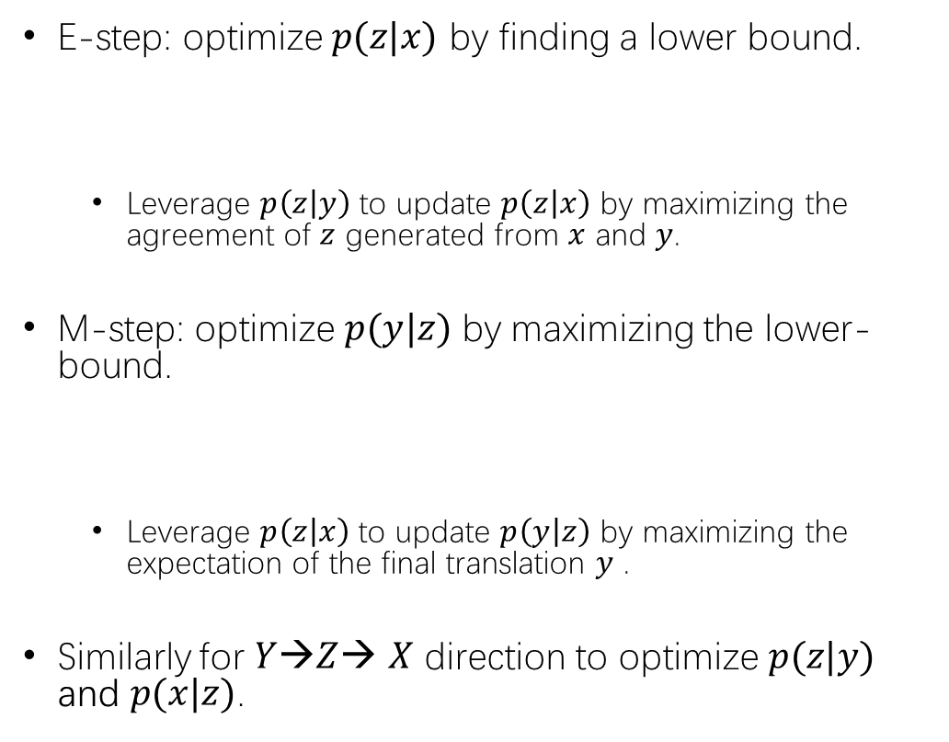

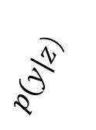



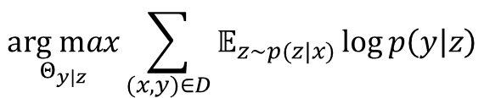




Motivation | Related Work | Method | Experiment
Generalized EM Training
E-step: optimize $p(z|x)$ by finding a lower bound.
Leverage $p\left(z | y\right)$ to update $p\left(z | x\right)$ by maximizing the agreement of $z$ generated from $x$ and $y$.
M-step: optimize $p(y|z)$ by maximizing the lower-bound.
Leverage $p\left(z | x\right)$ to update $p\left(y | z\right)$ by maximizing the expectation of the final translation $y$ .
Similarly for $Y$→$Z$→ $X$ direction to optimize $p(z|y)$ and $p(x|z)$.
$$X$$
$$Y$$
$$\underset{Θ_{z|x}}{arg min}{KL(p(z|x)||p(z|y))}$$
$$p(z|x）$$
$$p(z|y）$$
$$Z$$
$$X$$
$$Y$$
$$\underset{Θ_{y|z}}{arg max}{\sum_{(x,y)∈D}{𝔼_{z\sim p(z|x)}\log{p\left(y | z\right)}}}$$
$$p(z|x）$$
$$p(y|z）$$
$$Z$$
How to train 4 models jointly ? $p\left(z | x\right),p\left(z | y\right),p\left(x | z\right),p(y|z)$.
Notes:
More specificly, in E-step, we optimize the model p(z|x), by minimizing the KL term with respect to its parameters. In this step, we actually leverage p(z|y) to updata p(z|x) by maximize the agreement of z generated from x and y.
In M-step, we leverage $p\left(z | x\right)$ optimize the model p(y|z) by maximize the expectation of the final translation in y.
So, in the direction of X->Z->Y, we use three translation models, p(z|x), p(z|y) and p(y|z) to update models p(z|x) and p(y|z).
So as the direction of Y->Z->X to update models p(z|y) and p(x|z).
Having realized the process, the next problem is how to train 4 models jointly.

Slide 7
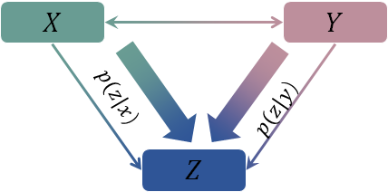
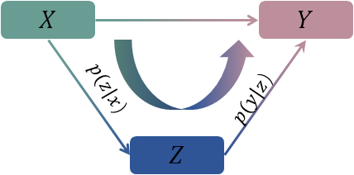
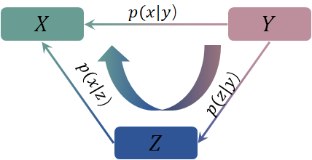
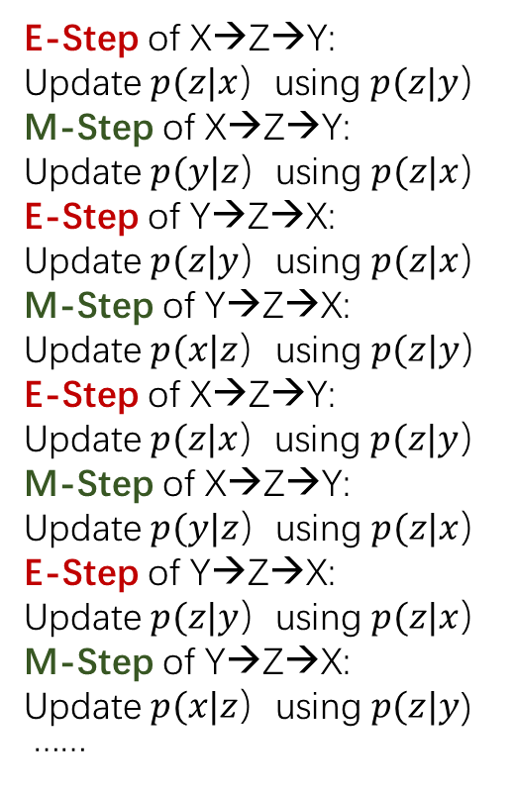
Joint EM Training
Motivation | Related Work | Method | Experiment
TA-NMT
X→Z→Y
E-Step of X→Z→Y:
Update $p(z|x）$using $p(z|y）$
M-Step of X→Z→Y:
Update $p(y|z）$using $p(z|x）$
E-Step of Y→Z→X:
Update $p(z|y）$using $p(z|x）$
M-Step of Y→Z→X:
Update $p(x|z）$using $p(z|y）$
E-Step of X→Z→Y:
Update $p(z|x）$using $p(z|y）$
M-Step of X→Z→Y:
Update $p(y|z）$using $p(z|x）$
E-Step of Y→Z→X:
Update $p(z|y）$using $p(z|x）$
M-Step of Y→Z→X:
Update $p(x|z）$using $p(z|y$)
……
E:Find the lower bound
M:Maxmize the Expectation of y
M:Maxmize the Expectation of x
E:Find the lower bound
X←Z←Y
Notes:
In this framework, two E steps and two M steps are used to update four models. We jointly train these models by alternately use the EM steps of both directions.
For the X to Z to Y direction, the first E step is used to update p(z|x) with the help of p(z|y), followed by the first M step to update p(y|z), with the help of p(z|x). With the updated p(z|x), we optimize p(z|y) in the second E step, which belongs to the direction of y to z to x, we then update p(x|z). Four models are updated one by one in a joint EM process.
We call our method as TA-NMT.

Slide 8
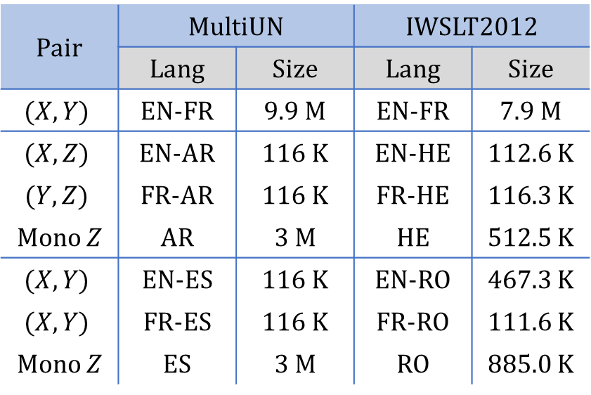
Motivation | Related Work | Method | Experiment
Dataset
Simulated rare language scenario
Real rare language scenario
Pair | MultiUN |  | IWSLT2012
 | Lang | Size | Lang | Size
$$(X,Y)$$ | EN-FR | 9.9 M | EN-FR | 7.9 M
$$(X,Z)$$ | EN-AR | 116 K | EN-HE | 112.6 K
$$(Y,Z)$$ | FR-AR | 116 K | FR-HE | 116.3 K
Mono $Z$ | AR | 3 M | HE | 512.5 K
$$(X,Y)$$ | EN-ES | 116 K | EN-RO | 467.3 K
$$(X,Y)$$ | FR-ES | 116 K | FR-RO | 111.6 K
Mono $Z$ | ES | 3 M | RO | 885.0 K
X
Y
Z
Notes:
Here comes the experiment
In our dataset, we use two datasets. The first is Multilingual United Nations corpus. And the second is IWSLT2012. In both datasets, we use English and French as our rich languages.
In the first dataset, we choose Arabic and Spanish as our rare languages Z. However, we all know that these two languages are not rare at all in the real world, so we simulated the rare language scenario in this dataset by select the small subsets of bilingual corpora (X,Z) and (Y,Z) from the original dataset.
In the second dataset, we choose Hebrew and Romanian as our rare languages. The rare language scenario in this dataset is real.

Slide 9
Motivation | Related Work | Method | Experiment
Baselines
RNNSearch: Singual layer GRU-based NMT system trained only with low-resource bilingual data.
PBSMT: Phrase based statistical machine translation system.
T-S: Teacher-student training method.
BackTrans: Back translation with monolingual data.
Notes:
We use four baselines in our experiment.
The first one is RNNSearch. Single-layer GRU-based NMT system trained only with low-resource bilingual data.
The second one is phrase-based statistical machine translation system. Why we choose this system as one of our baselines. Because it has been demonstrated in the previous work that SMT does better on some low-resource language pairs translation than NMT. So we put it here for comparison.
The third one is T-S training method. In this method, we use large bilingual data (X,Y) to train a teacher model, and use this model to generate some pseudo parallel data for the training on low-resource pair.
The fourth one is back translation, which requires monolingual data of both sides. The monolingual data of X or Y can be got from large bilingual corpus (X,Y). Besides, we need extra monolingual data of Z.

Slide 10
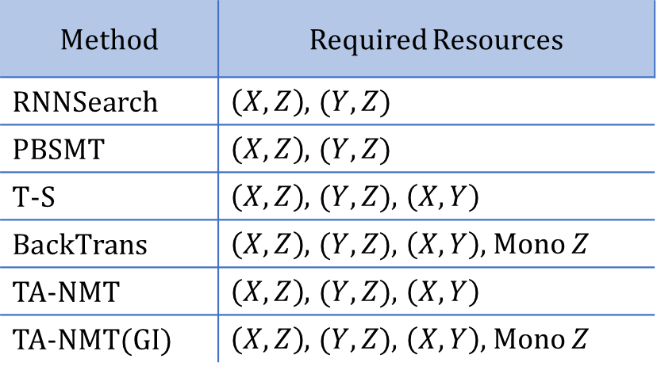
Motivation | Related Work | Method | Experiment
Baselines
RNNSearch: Singual layer GRU-based NMT system trained only with low-resource bilingual data.
PBSMT: Phrase based statistical machine translation system.
T-S: Teacher-student training method.
BackTrans: Back translation with monolingual data.
Method | Required Resources
RNNSearch | $\left(X,Z\right)$, $(Y,Z)$
PBSMT | $\left(X,Z\right)$, $(Y,Z)$
T-S | $\left(X,Z\right)$, $(Y,Z)$, $\left(X,Y\right)$
BackTrans | $\left(X,Z\right)$, $(Y,Z)$, $\left(X,Y\right)$, Mono $Z$
TA-NMT | $\left(X,Z\right)$, $(Y,Z)$, $\left(X,Y\right)$
TA-NMT(GI) | $\left(X,Z\right)$, $(Y,Z)$, $\left(X,Y\right)$, Mono $Z$
X
Y
Z
Our method
Our method combining back-translation as good initialization
Notes:
Notice that, the resources required by different method are also different. We list them in this table. T-S and TA-NMT, requires small corpora (X,Z) (Y,Z) and the large corpus (X,Y). Back-translation need extra monolingual data of Z just as mentioned before. For fair comparison, we combine back-translation as good initialization into our method and we call it as TA-NMT(GI), which uses the same data as back-translation.

Slide 11
Motivation | Related Work | Method | Experiment
Results: MultiUN
BLEU
+1.0
+0.7
+0.7
+1.6
+0.9
+1.4
EN
FR
+1.5
AR
BLEU
+0.4
+1.1
+0.9
+0.3
+1.0
EN
FR
+1.1
+1.0
ES
Notes:
The results are shown in this figure. In the first dataset, we notice that our method TA-NMT, which is represented by the yellow bar, and TA-NMT(GI), which is represented by the green bar, all significantly improve the performance of nearly all four models. Using the same resources, TA-NMT can improve the test BLEU significantly over T-S. And TA-NMT(GI) can also improve the BLEU score over back-translation method.
We also notice that, PBSMT, can do better than NMT on nearly all translation directions. Which also verifies the conclusion of previous work that SMT is better than normal NMT on low-resource pairs.

Slide 12
Motivation | Related Work | Method | Experiment
Results: IWSLT
BLEU
+1.2
+1.4
+1.2
+1.6
EN
FR
+1.2
+0.8
+0.7
+0.6
HE
BLEU
+2.2
+1.6
+1.1
EN
FR
+1.8
+1.1
+0.6
+1.2
+0.7
RO
Notes:
In the second dataset, we can draw the same conclusion as before that our method can significantly improve the BLEU score of all four models over T-S and back-translation, using the same resources

Slide 13
Motivation | Related Work | Method | Experiment
More Discussion
The effect of monolingual Z
The improvements by monolingual Z are different in two datasets.
Method | Dataset
 | MultiUN (Avg. BLEU) | IWSLT(Avg. BLEU)
T-S | 29.49 | 24.59
BackTrans | 30.75 (+1.26) | 24.89 (+0.30)
TA-NMT | 30.22 | 25.54
TA-NMT(GI) | 31.45 (+1.23) | 26.19 (+0.65)
Notes:
After the results, we do some more discussion.
First, let’s talk about the effect of monolingual data of Z. We notice a difference in the two datasets results, which is the improvements by monolingual data Z are different.
Look at the table, T-S and TA-NMT are models that don’t use extra monolingual data of Z while back translation and TA-NMT(GI) use extra monolingual data of Z. The improvement after using monolingual Z in the first dataset are more significant than that in the second dataset.
We speculate this phenomenon is due to the different amount of monolingual data in the two datasets. We use more monolingual Z in the first dataset, so the improvement is more obvious. To prove our conjecture, we conduct this experiments. We change the amount of monolingual Arabic data and find the average BLEU of the four models also changed accordingly. So this can verify the our conjecture that the improvement by monolingual data Z is related to the amount of it.

Slide 14
Motivation | Related Work | Method | Experiment
Dataset
Pair | MultiUN |  | IWSLT2012
 | Lang | Size | Lang | Size
$$(X,Y)$$ | EN-FR | 9.9 M | EN-FR | 7.9 M
$$(X,Z)$$ | EN-AR | 116 K | EN-HE | 112.6 K
$$(Y,Z)$$ | FR-AR | 116 K | FR-HE | 116.3 K
Mono $Z$ | AR | 3 M | HE | 512.5 K
$$(X,Y)$$ | EN-ES | 116 K | EN-RO | 467.3 K
$$(X,Y)$$ | FR-ES | 116 K | FR-RO | 111.6 K
Mono $Z$ | ES | 3 M | RO | 885.0 K
X
Y
Z
Notes:
Here comes the experiment
In our dataset, we use two datasets. The first is Multilingual United Nations corpus. And the second is IWSLT2012. In both datasets, we use English and French as our rich languages.
In the first dataset, we choose Arabic and Spanish as our rare languages Z. However, we all know that these two languages are not rare at all in the real world, so we simulated the rare language scenario in this dataset by select the small subsets of bilingual corpora (X,Z) and (Y,Z) from the original dataset.
In the second dataset, we choose Hebrew and Romanian as our rare languages. The rare language scenario in this dataset is real.

Slide 15
Motivation | Related Work | Method | Experiment
More Discussion
The effect of monolingual Z
The improvements by monolingual Z are different in two datasets.
Method | Dataset
 | MultiUN (Avg. BLEU) | IWSLT(Avg. BLEU)
T-S | 29.49 | 24.59
BackTrans | 30.75 (+1.26) | 24.89 (+0.30)
TA-NMT | 30.22 | 25.54
TA-NMT(GI) | 31.45 (+1.23) | 26.19 (+0.65)
Notes:
After the results, we do some more discussion.
First, let’s talk about the effect of monolingual data of Z. We notice a difference in the two datasets results, which is the improvements by monolingual data Z are different.
Look at the table, T-S and TA-NMT are models that don’t use extra monolingual data of Z while back translation and TA-NMT(GI) use extra monolingual data of Z. The improvement after using monolingual Z in the first dataset are more significant than that in the second dataset.
We speculate this phenomenon is due to the different amount of monolingual data in the two datasets. We use more monolingual Z in the first dataset, so the improvement is more obvious. To prove our conjecture, we conduct this experiments. We change the amount of monolingual Arabic data and find the average BLEU of the four models also changed accordingly. So this can verify the our conjecture that the improvement by monolingual data Z is related to the amount of it.

Slide 16
Motivation | Related Work | Method | Experiment
More Discussion
The EM training Curves
Changes of validation BLEU on (EN, FR, AR) group during training
Four models are improved jointly
Notes:
We also print the EM training curves.

Slide 17
Summary
Motivation | Related Work | Method | Experiment
X
Y
Z
TA-NMT, a triangular architecture to tackle the low-resource problem in NMT.
Jointly train four translation models from and to the rare language with the help of large bilingual corpus between rich languages.
Take the rare language as the hidden variable, and optimize in an EM framework.
The results on MultiUN and IWSLT datasets demonstrate the effectiveness.
Notes:
TA-NMT, a triangular architecture to tackle the low-resource problem in NMT.
TA-NMT can Effectively train translation models from and to the rare language with the help of large bilingual corpus between rich languages, by taking the rare language as the hidden variable, and optimize the rare language translation models in an EM framework.
TA-NMT is a unified bidirectional EM algorithm, in which four translation models can be trained jointly.

Slide 18
Thanks! Q & A

Slide 19
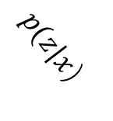
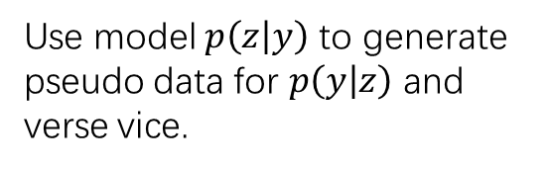
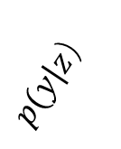
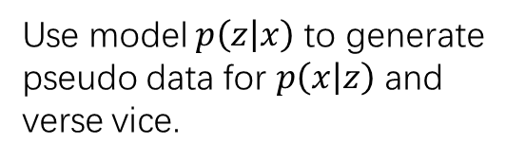
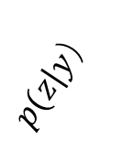
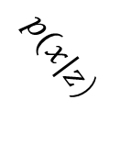
Related work
Exploiting monolingual data
Back-translation to exploit target-side monolingual data (Sennich et al. 2015)
$$X$$
$$Y$$
$$p(z|x）$$
$$p(z|y）$$
$$p(x|z）$$
$$p(y|z）$$
$$Z$$
$$Z$$
Use model $p\left(z | x\right)$ to generate pseudo data for $p\left(x | z\right)$ and verse vice.
Use model $p\left(z | y\right)$ to generate pseudo data for $p\left(y | z\right)$ and verse vice.
Notes:
So the above is our method. Before the experiment, let’s review the related work to tackling the low-resource problem in NMT. These methods can be divided in three categories. The first category is exploiting monolingual data. The most typical method is back-translation. This method tend to use the target-side monolingual data and a reversed translation model to generate the pseudo data for the forward translation model.
In our scenario, for the pair (X,Z), we can alternately choose X and Z as the target language, and use monolingual data from both side to update the two translation models. So as the pair (Y,Z). Noting that, this will require monolingual data of Z, which is not required in our original setting.

Slide 20
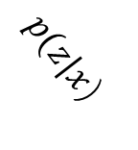
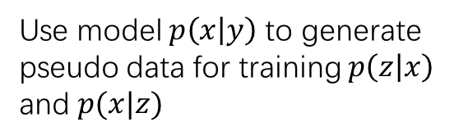

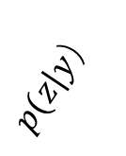
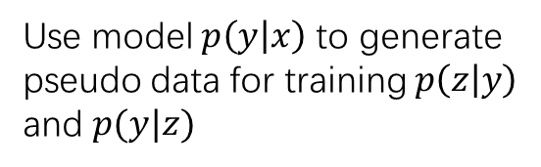
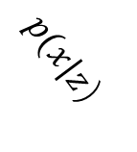

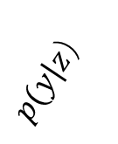
Related work
Exploiting other parallel resources
Teacher-student method
$$X$$
$$Y$$
$$X$$
$$Y$$
$$p(x|y）$$
$$p(y|x）$$
$$p(z|x）$$
$$p(z|y）$$
$$p(x|z）$$
$$p(y|z）$$
$$Z$$
$$Z$$
Use model $p\left(x | y\right)$ to generate pseudo data for training $p\left(z | x\right)$ and $p(x|z)$
Use model $p\left(y | x\right)$ to generate pseudo data for training $p\left(z | y\right)$ and $p(y|z)$
Notes:
And the third category is exploiting other parallel resources, such as teacher-student method. The original scenario for which it is designed is zero-resource setting. But we can use this method to tackle our scenario by some modification.
In our comparison experiment, for the training of pair (X,Z), we use the data of pair (Z,Y) and the translation model p(x|y) to generate pseudo data for models p(z|x) and p(x|z). The model p(x|y) is actually the teacher model. So as the process for pair (Z,Y).

Slide 21
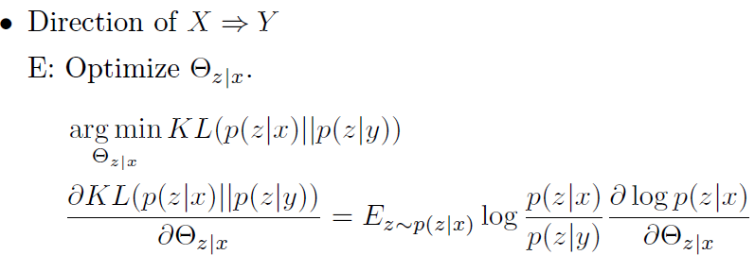
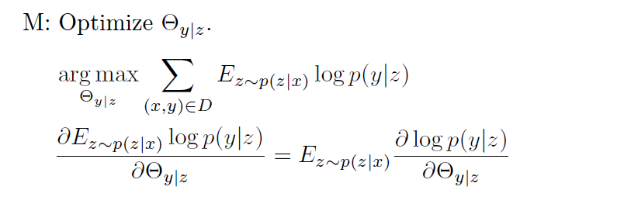
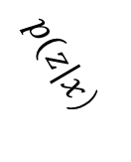
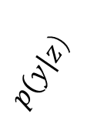
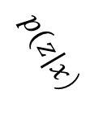
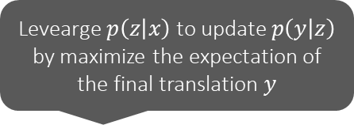
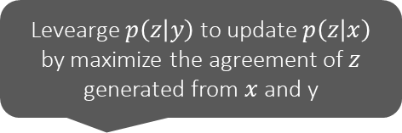
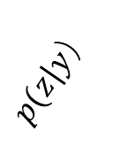
Generalized EM Training
Levearge $p\left(z | y\right)$ to update $p\left(z | x\right)$ by maximize the agreement of $z$ generated from $x$ and y
$$X$$
$$Y$$
$$p(z|x）$$
$$p(z|y）$$
$$Z$$
Levearge $p\left(z | x\right)$ to update $p\left(y | z\right)$ by maximize the expectation of the final translation $y$
$$X$$
$$Y$$
$$p(z|x）$$
$$p(y|z）$$
$$Z$$

