Slide 1
Variational Knowledge Graph Reasoning
Wenhu Chen, Wenhan Xiong, Xifeng Yan, William Wang
Department of Computer Science
UC Santa Barbara

Slide 2
Outline
Introduction to Knowledge Graph Completion
Reinterpret the problem as a generative model
How to resolve the new intractable objective using variational inference
Experimental Results and Conclusion

Slide 3
Knowledge Graph
Las
Vegas
English
serviceLanguage
CA
personLanguages
Caesars Entertain…
Neal McDonough
Tom Hanks
serviceLocation
nationality
castActor
awardWinner
countryOfOrigin
United States
Band of Brothers

Slide 4
Knowledge Graph Completion
serviceLocation
United States
Caesars Entertain
countryOfOrigin
serviceLanguage
Query: ?(Band of Brothers, English)
Band of Brothers
English
castActor
personLanguages
Neal McDonough

Slide 5




Problem Formulation
During Training, we intentionally mask some relations as missing links and use them as training triples:
During Test, we are interested in filling the relation slot given entity pair:
$$D_{train}=(e_{s},e_{d},r)$$
$$KB=({head}_{i},{tail}_{i},{rel}_{i})$$
$$D_{test}=(e_{s},e_{d},?)$$
$$KB=({head}_{i},{tail}_{i},{rel}_{i})$$

Slide 6
Existing KGC methods
Embedding-based methods (fast and efficient)
TransE, Bordes et al, 2013
TransR/CTransR, Lin et al, 2015
DistMult, Yang et al, 2015
ComplEx, Trouillon et al., 2016
Path-based methods (accurate and explainable)
Path-Ranking Algorithm (PRA), Lao et al. 2011
Compositional Vector, Neelakantan et al. 2015
DeepPath, Xiong et al, 2017
Chains of Reasoning, Das et al, 2017
MINERVA, Das et al, 2018

Slide 7





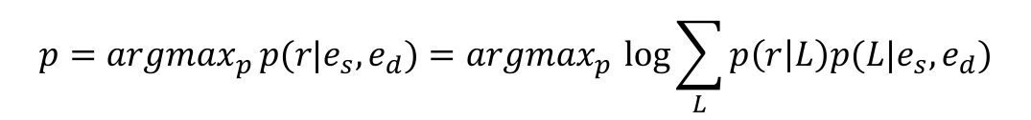

KGC from a generative perspective
$$e_{d}$$
English
$$p(L|e_{s},e_{d})$$
$$L$$
$$p\left(r | L\right)$$
tvProgram
Language
$$r$$
$$e_{s}$$
Band of Brothers
Condition
Observed Variable
KG
Latent Variable
$$p={argmax}_{p }p(r|e_{s},e_{d})={argmax}_{p }\log{\sum_{L}{p\left(r | L\right)p(L|e_{s},e_{d})}}$$
where prior: $p\left(L | e_{s},e_{d}\right)$, and likelihood: $p\left(r | L\right)$

Slide 8
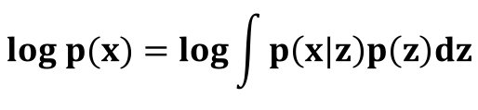


Variational Inference
Variational Bayesian methods: optimizing intractable integrals:
Maximize ELBO as surrogate objective.
$$log p(x)=log{\int{p\left(x|z\right)p\left(z\right)dz}}$$
$KL−divergence≥0$
$$Evidence Lower Bound (ELBO)$$
DM Blei et. al 2016

Slide 9
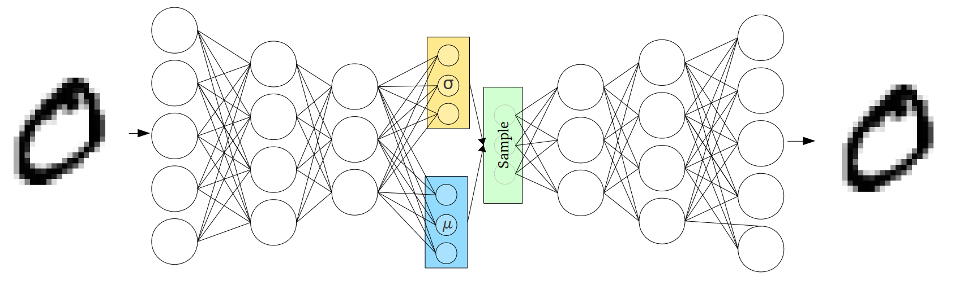
Variational Auto-Encoder (VAE)
Variational Auto-Encoder provides an efficient and practical way to perform variational inference.
Encoder
Decoder
DP Kingma et al. ‎2013

Slide 10
Challenge of VAE in KG
Existing VAE methods only consider continuous latent vectors:
NLP applications:
Machine translation (Biao et al. 2016)
Text generation (K Guu et al. ‎2017)
Dialogue generation (TH Wen et al. 2017)
CV applications:
Image classification (DP Kingma et al. ‎2013)
Image captioning (Liwei et al. 2017)
Visual question generation (Unnat et al. 2017)
We are tackling sequential discrete variables.

Slide 11













KG Variational Inference (KG-VI)
No re-parameterization for $q_{φ}\left(L | e_{s},e_{d},r\right)$
Our prior distribution $p_{β} \left(L | e_{s},e_{d}\right)$ is trainable
We view the sampling of latent variable as a Markov Decision Process
$$a_{τ+2}$$
$$e_{τ+2}$$
$$a_{τ+1}$$
$$e_{τ+1}$$
$$e_{τ+2}$$
$$e_{s}$$
$$e_{1}$$
$$e_{τ}$$
$$e_{τ+1}$$
$$e_{τ+2}$$
$$a_{τ}$$
$$e_{τ+1}$$

Slide 12















KG Variational Inference (KG-VI)
We view likelihood $p_{θ} (r|L)$ as a sequence classification model.
$$e_{s}$$
$$e_{1}$$
$$e_{d}$$
$${relation}_{1}$$
$$CNN/RNN$$
$$softmax$$
$${relation}_{2}$$
$$e_{s}$$
$$e_{2}$$
$$e_{d}$$
$$e_{s}$$
$$e_{3}$$
$$e_{d}$$
$${relation}_{3}$$
$${n/a}_{3}$$

Slide 13





Evidence Lower Bound
ELBO = Reconstruction + KL-divergence
Reconstruction Loss
$$𝔼_{q\left(L | e_{s},e_{d},r\right)}\left[\log{p\left(r | L\right)}\right]$$
$$\text{log}{\text{p}\left(\text{r} | e_{s},e_{d}\right)}≥ELBO$$
$$−$$
$$KL(q\left(L | e_{s},e_{d},r\right)||p(L|e_{s},e_{d}))$$
KL-divergence
where posterior distribution: $q\left(L | e_{s},e_{d},r\right)$
DP Kingma et al. ‎2013

Slide 14



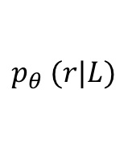





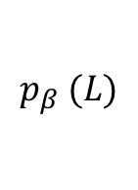

KG Variational Inference (KG-VI)
Training with Gradient Descent
$$𝔼_{q_{φ}\left(L | e_{s},e_{d},r\right)}\left[\log{p_{θ}\left(r | L\right)}\right]$$
KG connected Path
r
$$q_{φ}(L)$$
$$e_{s}$$
$$e_{d}$$
$$p_{θ} (r|L)$$
r
$$e_{s}$$
$$e_{d}$$
$$KL(q_{φ}\left(L | e_{s},e_{d},r\right)||p_{β}(L|e_{s},e_{d}))$$
KG connected Path
$$p_{β} (L)$$
$$e_{s}$$
$$e_{d}$$

Slide 15

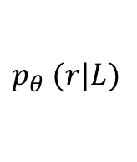
KG Variational Inference (KG-VI)
Testing
r
$$e_{s}$$
$$e_{d}$$
$$p_{θ} (r|L)$$
KG connected Path
$$p_{β} (L)$$
$$e_{s}$$
$$e_{d}$$
$$posterior:q_{φ},likelihood:p_{θ}, prior:p_{β}$$

Slide 16







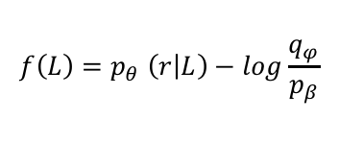
Comparison with MINERVA (Path-Finder)
✔
$$R=1.0$$
Length/
Success
MINERVA
$$e_{s}$$
X
$$R=0.0$$
✔
$$R=1.0$$
Das el al.2018
Path-Finder: $\frac{∂ELBO}{∂φ}=𝔼_{L\sim q_{φ}}[−f(L)\frac{∂logq_{φ}(L|e_{s},e_{d},r)}{∂φ}$]
✔
$$f(L)=0.33$$
Our
Model
Path-
Reasoner
$$e_{s}$$
X
$$f(L)=0.0$$
✔
$$f(L)=0.8$$
$$f\left(L\right)=p_{θ} \left(r | L\right)−log\frac{q_{φ}}{p_{β}}$$

Slide 17
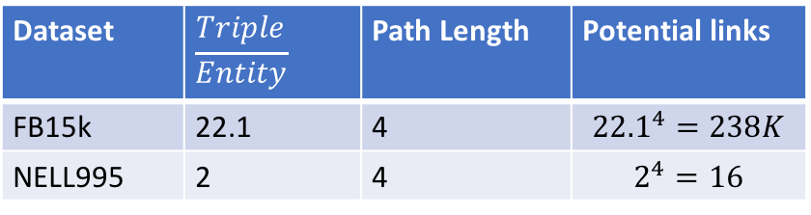
Dataset
FB15k, link prediction for 20 relations.
NELL-995, link predication for 12 relations.
FB15k has more complex reasoning environment
Dataset | Entity | Relation | Triple | Relations
FB15k | 14505 | 237 | 310116 | 20
NELL995 | 75492 | 200 | 154213 | 12
Dataset | $$\frac{Triple}{Entity}$$ | Path Length | Potential links
FB15k | 22.1 | 4 | $${22.1}^{4}=238K$$
NELL995 | 2 | 4 | $$2^{4}=16$$

Slide 18


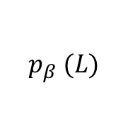














Evaluation
Given a list of entity pairs, compute the rank of positive sample as evaluation score
$$(e_{s},r,e_{1}^{+})$$
$$L_{1}$$
$p\left(r | L_{1}\right)=0.1$4
$$(e_{s},r,e_{2}^{−})$$
$$L_{2}$$
$$p\left(r | L_{2}\right)=0.2$$
Beam-Search
$$(e_{s},r,e_{3}^{−})$$
$$p_{β} (L)$$
$$L_{3}$$
$$p\left(r | L_{3}\right)=0.1$$
$$(e_{s},r,e_{4}^{−})$$
$$None$$
$$p\left(r | L_{3}\right)=0$$
$$(e_{s},r,e_{5}^{−})$$
$$None$$
$$p\left(r | L_{3}\right)=0$$
$$MAP= \frac{1}{\#rank(e^{+})}=\frac{1}{2}=0.5$$

Slide 19
Experimental Results on NELL-995/FB-15k
Variational inference framework performs better under more noisy environment
Model | NELL-995 | FB15k
PRA (Lao el al. 2011) | 67.5 | 54.1
TransE (Bordes et al. 2013) | 75.0 | 53.2
TransR (Lin et al. 2015) | 74.0 | 54.0
TransD (Ji et al. 2015) | 77.3 | -
DeepPath (Xiong et al. 2017) | 81.2 | 57.2
RNN-Chain (Das et al. 2017) | 79.0 | 51.2
MINERVA (Das et al. 2018) | 88.8 | 55.2
CNN Path-Reasoner | 82 | 54.2
Our model | 88.6 | 59.8

Slide 20
Conclusion and Future Work
Conclusions
Our framework can be seen as a new variational inference framework to deal with sequential latent variables.
Our model shows its strength to deal with more complex reasoning envrionments.
Future Directions
Extend our model to resolve more tasks with sequential latent variables.
Das el al. 2017

Slide 21
Thanks!
PPT Link: https://wenhuchen.github.io/images/naacl2018.pptx
Dataset link: http://cs.ucsb.edu/~xwhan/datasets/NELL-995.zip

Slide 22
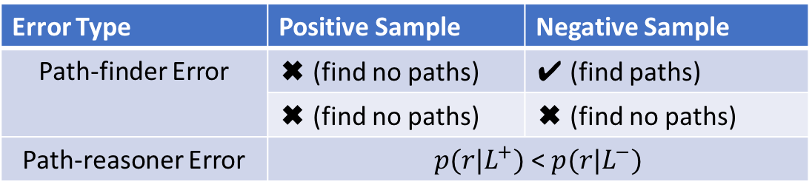
Error Analysis
Error Type | Positive Sample | Negative Sample
Path-finder Error | ✖ (find no paths) | ✔ (find paths)
 | ✖ (find no paths) | ✖ (find no paths)
Path-reasoner Error | $p(r|L^{+})$ < $p(r|L^{−})$

Slide 23
Prior & Posterior
Posterior distribution
L
rel1
rel2
rel3
Prior distribution
L

