Slide 1
Open question answering over tables and text
Wenhu Chen, Eva Schlinger, Ming-Wei Chang,
William Cohen

Slide 2
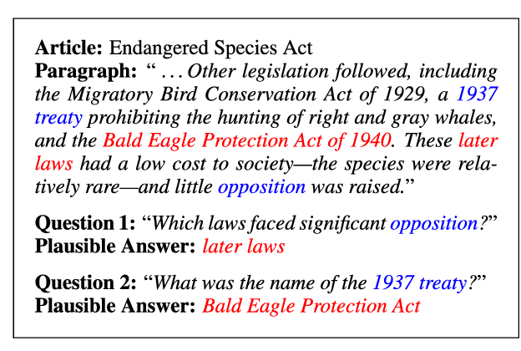
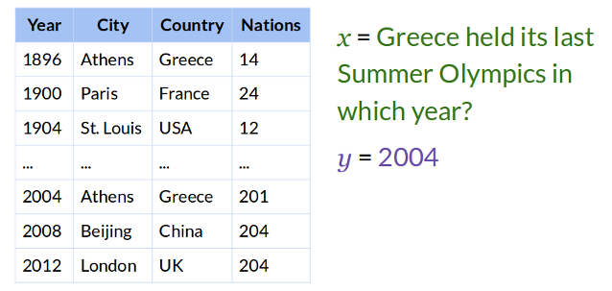
Existing QA Paradigm
Text-only
Table/KB-only
SQUAD (Rajpurkar et. al 2016)
TrivialQA (Joshi et. al 2017)
HotpotQA (Yang et. al 2018)
NQ (Kwiatkowski et. al 2019)
WebQuestion (Berant et. al 2013)
WikiTableQA (Patsupat et. al 2016)
WebQuestionSP (Yih et. al 2016)
WebQComplex (Tamer et. al 2018)

Slide 3


Incompleteness
Q: Which song is the runner-up for Billboard Hot 2019 ?
Text-based QA
Table-based QA

Slide 4
Incompleteness
Q: When was the runner-up song for Billboard Hot 2019 released?

Slide 5
Incompleteness
Q: When was the runner-up song for Billboard Hot 2019 released?
List of songs on Billboard's 2019 Year-End Hot 100 chart
No. | Title | Artist(s)
1 | Old Town Road | Lil Nas X featuring Billy Ray Cyrus
2 | Sunflower | Post Malone and Swae Lee
3 | Without Me | Halsey

Slide 6
Incompleteness
Q: When was the runner-up song for Billboard Hot 2019 released?
List of songs on Billboard's 2019 Year-End Hot 100 chart
No. | Title | Artist(s)
1 | Old Town Road | Lil Nas X featuring Billy Ray Cyrus
2 | Sunflower | Post Malone and Swae Lee
3 | Without Me | Halsey
"Sunflower" is a song performed by American rappers and singers Post Malone and Swae Lee. It was released as a single from the soundtrack to the film Spider-Man: Into the Spider-Verse, and is included on Post Malone's third studio album Hollywood's Bleeding (2019). The song was released on October 18, 2018.

Slide 7




Problem Setup
When was the runner-up
song on Billboard 2019 released?
Table-Text QA

Slide 8


Data Construction
Dancing with the Stars (American season 5)
Dance | Highest scored dancer | Highest score
Cha-cha-cha | Jennie Garth Hélio Castroneves | 30
Foxtrot | Hélio Castroneves | 30
Quickstep | Hélio Castroneves | 30
Mambo | Mel B | 30
Jive | Mel B Sabrina Bryan Cameron Mathison | 27
Tango | Jennie Garth | 28
Cha-cha-cha
Foxtrot
Mambo
Mel B
Tango

Slide 9

Dataset Annotation
(Q, A) Pairs
Hybrid Verifier
Human Quality Checker
Accept?
(Q, A) Pairs

Slide 10
OTT-QA Dataset
Question-Answer: 45K (question, answer) pairs
Candidates: 5M passages and 450K tables
Question types:
Table/Passage-Only: ~13%
Table -> Passage: ~40%
Passage -> Table: ~17%
Passage -> Table -> Passage: ~30%

Slide 11
Retriever-Reader
Question: Which country was the runner-up for …?
Table/Passage Retriever
Table/Passage Reader
Answer-Span

Slide 12
Table Segmentation
1
1
2
3
4
2
3
4
title
Meta Info
section title
caption
Dance | Highest scored dancer | score
Quickstep | Hélio Castroneves | 30
1st row
Global Info
3rd column -> max
Table Segment

Slide 13



Baseline [Iterative Retriever]
$$K_{1}$$
$$K_{2}$$
$$K_{3}$$
Question
Encode
Retrieve
Re-Encode
Retrieve
Re-Encode
Retrieve

Slide 14


Computation Complexity
Query Complexity [Top-K Blocks]
$$𝒪\left(Q+ K_{1}Q+K_{1}K_{2}Q\right) \sim 𝒪(KQ)$$
Encode Complexity [Top-K Blocks]
$$𝒪(Q+ K_{1}Q+K_{1}K_{2}Q)\sim 𝒪(KQ)$$

Slide 15
Our Model [Fusion Retriever]
Lebron James Career Statistics
Year | Team | Blocks
17-18 | Cleveland | 0.9
Augment
Linking
P1: NBA 17-18 Season
P2: Cleveland Cavaliers
Fused Block

Slide 16
Our Model [Fusion Retrieval]
Fused Block1
K
Question
Fused Block2
Fused Block3

Slide 17
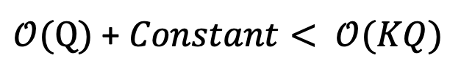
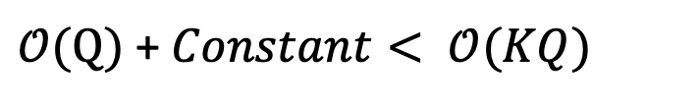
Retrieval Complexity
Query Complexity [Top-K Blocks]
$𝒪(Q)$ + $Constant< 𝒪(KQ)$
Encode Complexity [Top-K Blocks]
$$𝒪(Q)\text{ +} Constant< 𝒪(KQ)$$

Slide 18
Baseline [Single-Block Reader]
Chain-1
Answer
Chain-2
Chain-3
Chain-4
Full Transformer - BERT

Slide 19
Our Model [Cross-Block Reader]
Block A
Block B
Block C
Merge
Answer
Sparse Transformer - ETC

Slide 20

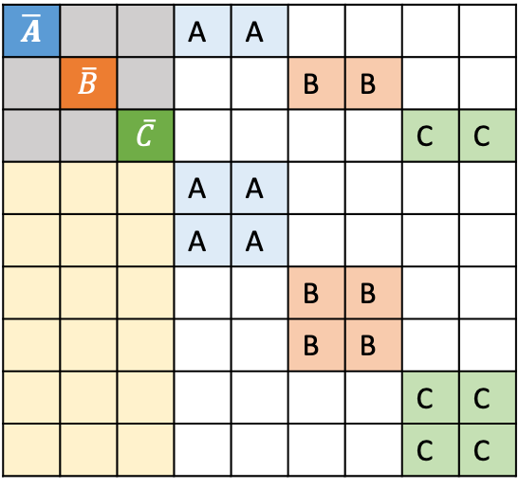

Reading Complexity
$$\overline{A}$$ |  |  | A | A
 | $$\overline{B}$$ |  |  |  | B | B
 |  | $$\overline{C}$$ |  |  |  |  | C | C
 |  |  | A | A
 |  |  | A | A
 |  |  |  |  | B | B
 |  |  |  |  | B | B
 |  |  |  |  |  |  | C | C
 |  |  |  |  |  |  | C | C
Full Transformer - BERT
Sparse Transformer - ETC
$$𝒪(K^{2}{|B|}^{2})$$
$$𝒪(K{|B|}^{2})$$

Slide 21
Experimental Results
28.1
17.1
14.3
9.9
7.6
4.6
Ours
w/o Fusion
Ours
w/o ETC
Table-Only
Text-Only
Baseline
Ours

Slide 22
Performance/Speed Curve

Slide 23
Error Analysis
Low Lexical Overlap: NYU -> New York University
Numerical Reasoning: Who is the largest …
Fusion Error: Linking is wrong
Distraction: 2016 Summer Olympic vs 2016 Winter Olympic
36%
32%
24%
8%
Lexical
Numerical
Fusion
Distraction

Slide 24
Summary
We propose the first open-domain question answering dataset for heterogeneous information.
Our model can greatly decrease the computation complexity while bringing significant boost.
There are still a large room for improvement.

