Slide 1

Security as an Edge Service
Wenhui Zhang, John Craig, Kandan Kathirvel

Slide 2
prob-C: Security Service in Containers
Vulnerabilities in Edges’ Subscribers
Edge as a Defense
Threat Model
System Architecture
Detection: Signatures of Remote CVEs, etc.
Conclusion

Slide 3
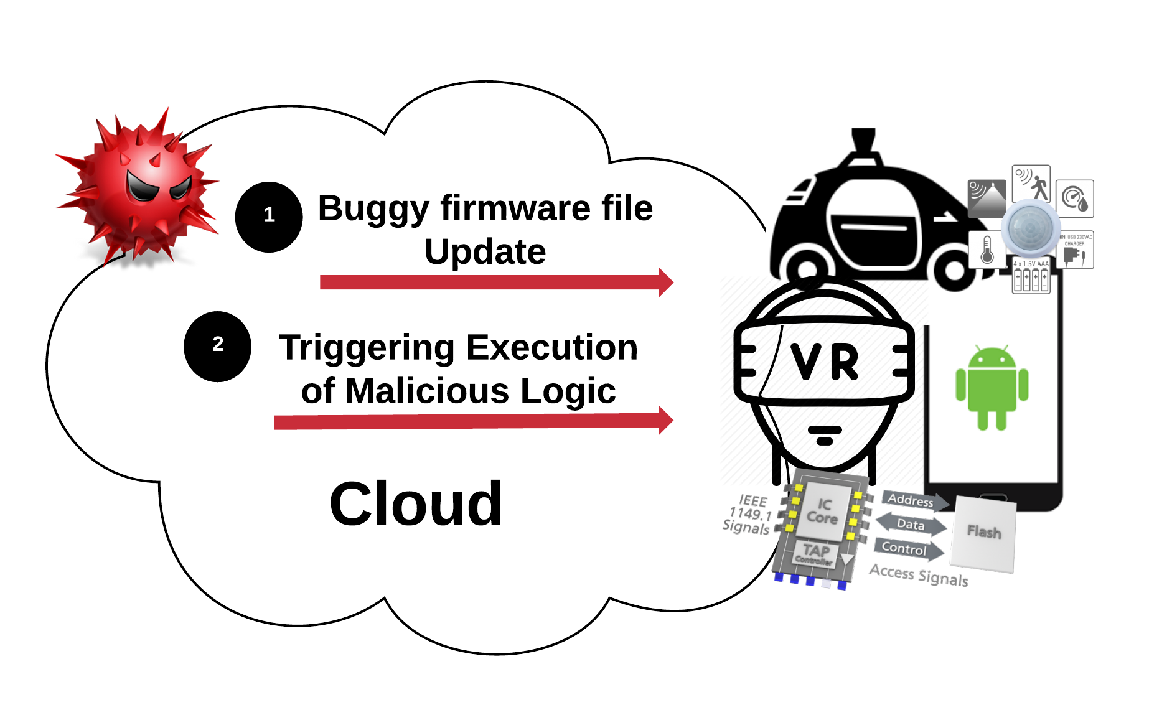
Vulnerabilities in Edge Services’ Subscribers
Cyber crime damage costs to hit $6 trillion annually by 2021
D’Mello, O., Gelin, M., Khelil, F. B., Surek, R. E., & Chi, H. (2018, July). Wearable IoT Security and Privacy: A Review from Technology and Policy Perspective. In International Conference on Future Network Systems and Security (pp. 162-177). Springer, Cham.
Hacking a Edge’s Subscribers is straight forward and painless

Slide 4
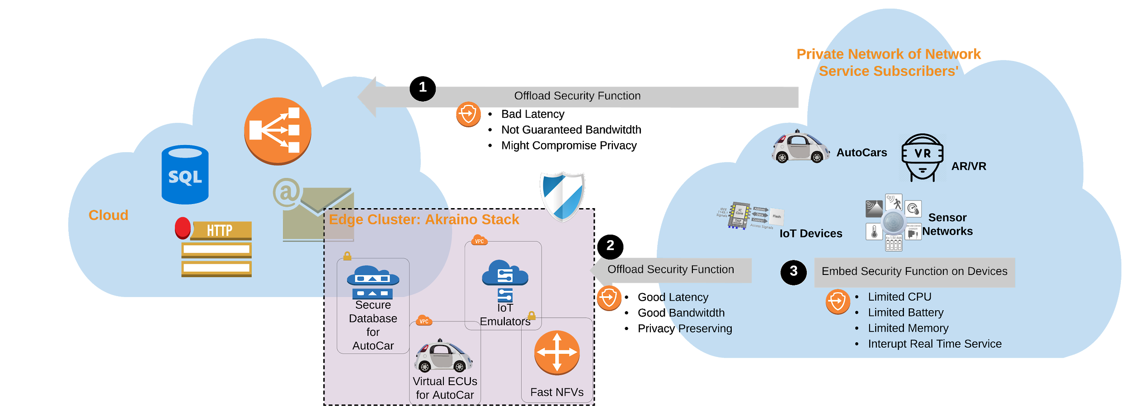
Edge as a Defense
Offload Security Functionalities to Edge

Slide 5
Edge as a Defense
Edge computing subscribers are targets of attacks from internet, however they
require real time processing of their dedicated functionality
have limitate computing power
→ Solution:
subscribe security services
However they want to preserve privacy of sensitive information --> NOT offload to cloud
Offload Security Functionalities to Edge

Slide 6
Threat Model: Intrusion Detection
Intrusion is an authorized action exploits a vulnerability, and causes a compromise. Thus a successful attack.
Stipulations on which our model is built:
Network communication with cloud
is malicious
Akraino Stack is secure
Containers are benign (they are not controlled by active hackers)
Edge Service Subscriber Devices are vulnerable
Authentication and Access Control Are No Help!

Slide 7
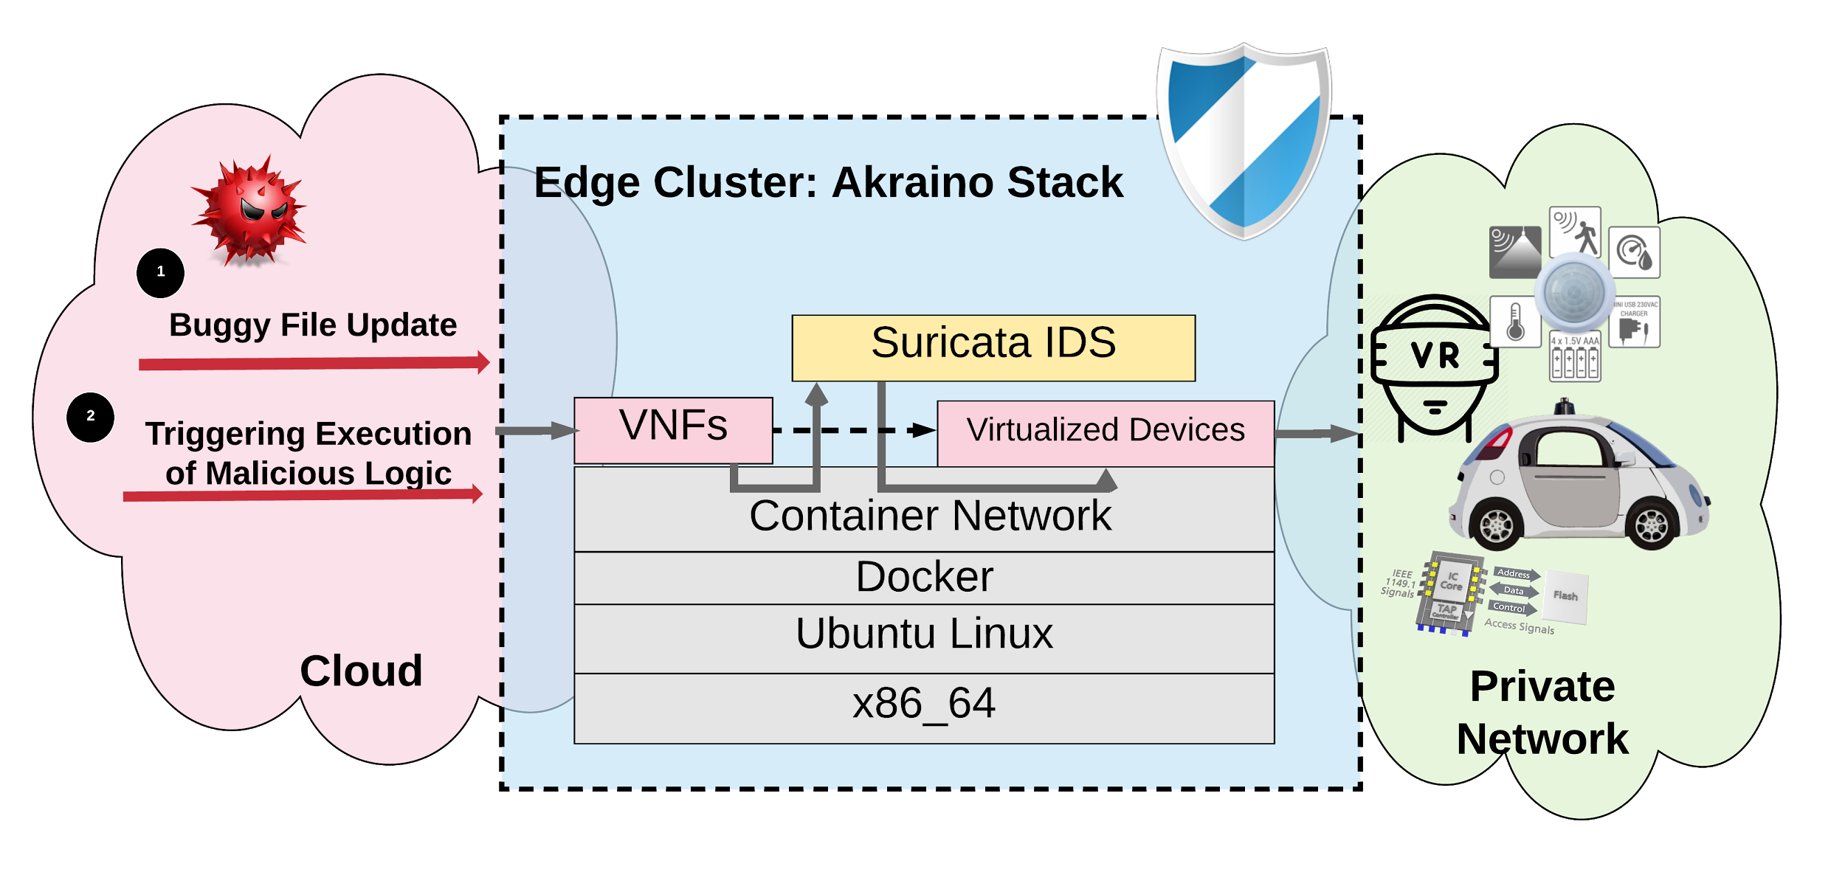
Architecture of prob-C

Slide 8
Understanding Bottlenecks
Design Requirement of Architecture to Support 5G
Peak data rates at 20 Gbits/s
Support low latency with less than 5ms
Understanding Bottlenecks
Network
Disk I/O
CPU
Memory
Two ways of Enhancing Scalability in IDS
Splitted Functionalities in Multi-threaded IDS
Splitted Flows in Multi-threaded IDS
https://www.qorvo.com/design-hub/blog/getting-to-5g-comparing-4g-and-5g-system-requirements

Slide 9
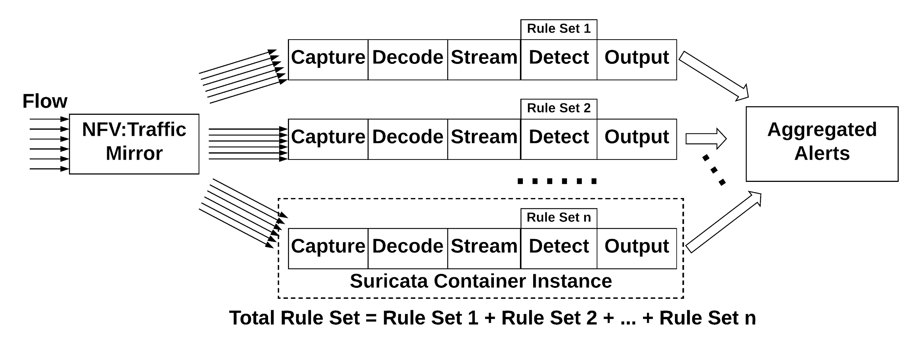
Enhancing Scalability in IDS: Splitted Rule Sets in Multi-threaded IDS

Slide 10
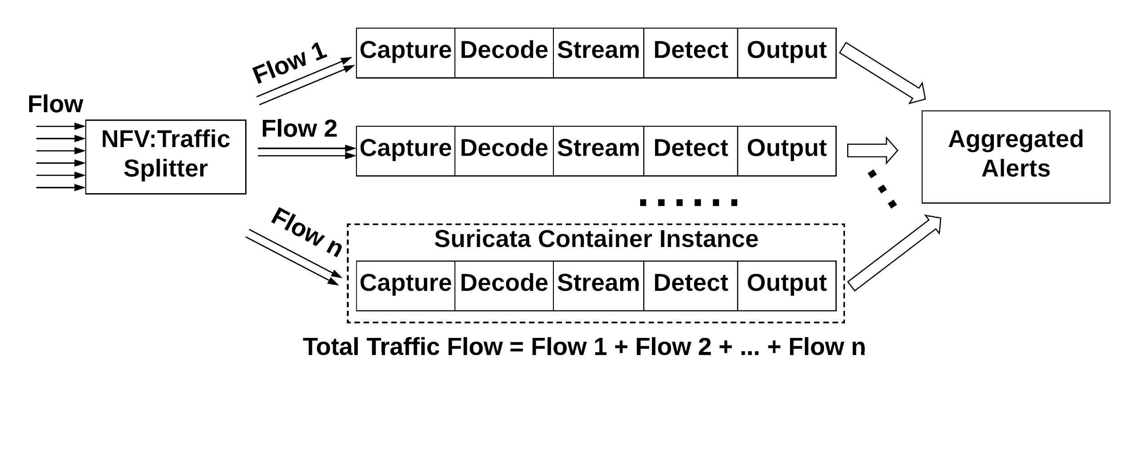
Enhancing Scalability in IDS: Splitted Flows in Multi-threaded IDS

Slide 11
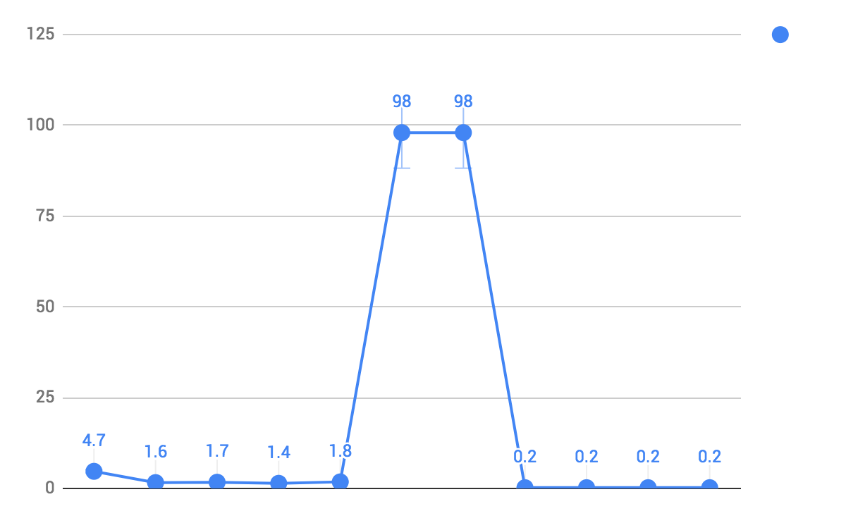
Understanding Bottlenecks: Observation
Understanding Bottlenecks
Memory: 0.2% on average
Disk I/O: N/A
CPU: see fig.
Network
64 bytes/packet, host is 9.8G/s, container is 0.8G/s
1004 bytes/packet, host is 59G/s, container is 2G/s
31 secs for a 2 hours of capture, 21G, 4 secs bootup, 1 secs of joining, avg 5.24G/s [02:23:11.48-04:23:11.42]
CPU Utilization
processing
thread joining
starting
Pinned to one core 0: taskset -p 0x01 pid_suri_docker
Test File: Botnet-capture-20110810-neris.pcap
Network is the Bottleneck

Slide 12
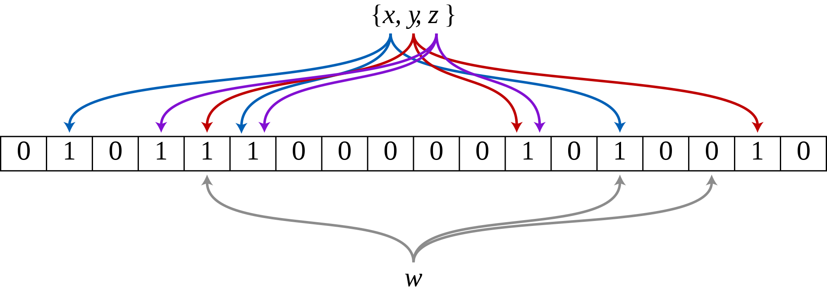
Enhancing Scalability in IDS: Splitted Rule Sets in Multi-threaded IDS
Pattern-matcher:
B2gc: search_algo: B2gSearchBNDMq hash_size: low #Determines the size of the hash-table. bf_size: medium #Determines the size of the bloom- filter.
B3g: search_algo: B3gSearchBNDMq hash_size: low #See hash-size -b2gc. bf_size: medium #See bf-size -b2gc.
wumanber: hash_size: low #See hash-size -b2gc. bf_size: medium #See bf-size -b2gc.
Rule Numbers does NOT influence performance much, as bloomfilter etc. used

Slide 13
Understanding Bottlenecks: Explanation
Hinder Factors:
Copy between userspace and kernel space
alleviated by kernel bypassing techniques, e.g. DPDK + OVS; Netmap + VALE
Context Switch
alleviated by pinning to certain core
Disk I/O
introduced by tcpdump and then replay, alleviated by real time environment test, and adding cached flag with suricata
Lessons from past, no VMs w/ SR-IOV, still prefers containers
Bottleneck between VMs’ traffic forwarding
Dynamic chaining of VMs, booting VMs is slow
Zhang, W., Liu, G., Zhang, W., Shah, N., Lopreiato, P., Todeschi, G., ... & Wood, T. (2016, August). OpenNetVM: A platform for high performance network service chains. In Proceedings of the 2016 workshop on Hot topics in Middleboxes and Network Function Virtualization (pp. 26-31). ACM.
Kernel Bypassing achieves Zero Copy

Slide 14
Comparison of Splitting Traffic v.s. Probs in Parallel
Splitting Efficiency:
Traffic Probs = 1/(Splitting traffic latency + 1/ bandwidth)*N
Probs in Parallel Efficiency:
Traffic Probs = 1-(1-bandwidth/20G)^N
Where N is the number of Suricata Containers, Bandwidth is 5.24G.
Estimation: to achieve 20G/s
Splitting Traffic: if splitting is fast enough, 4 suricata containers will be enough for 20G (4*5.24 > 20G)
Parallel Probs: 12 suricata containers could achieve (1- (1-5.24/20)^12) *20G = 19.48Gbits/s

Slide 15

Understanding Bottlenecks: Conclusion
Enhancing Scalability by Splitting Flows
How about the Effectiveness when Flow is Splitted ?

Slide 16
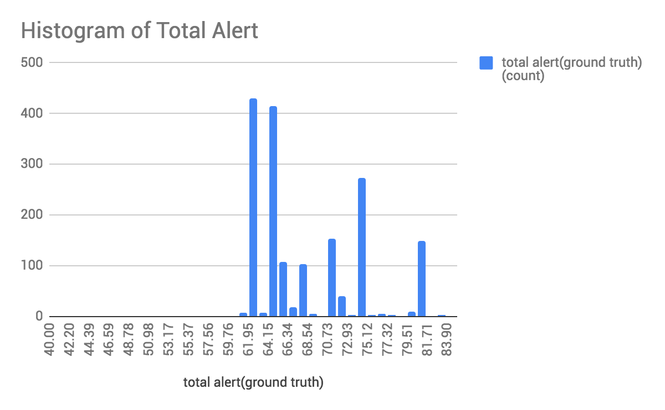
Performance of Suricata with Splitted Flow
Performance:
53,859 pps
Suricata 4.0.4
57 packet processing threads
4 management threads
Machine:
Intel Xeon E5-2680v, 14 cores
Example File:
Botnet-capture-20110810-neris.pcap
Stat:
323154 packets
53096018 bytes
Multithreaded Suricata has High Throughput, yet Unstable Effectiveness.

Slide 17
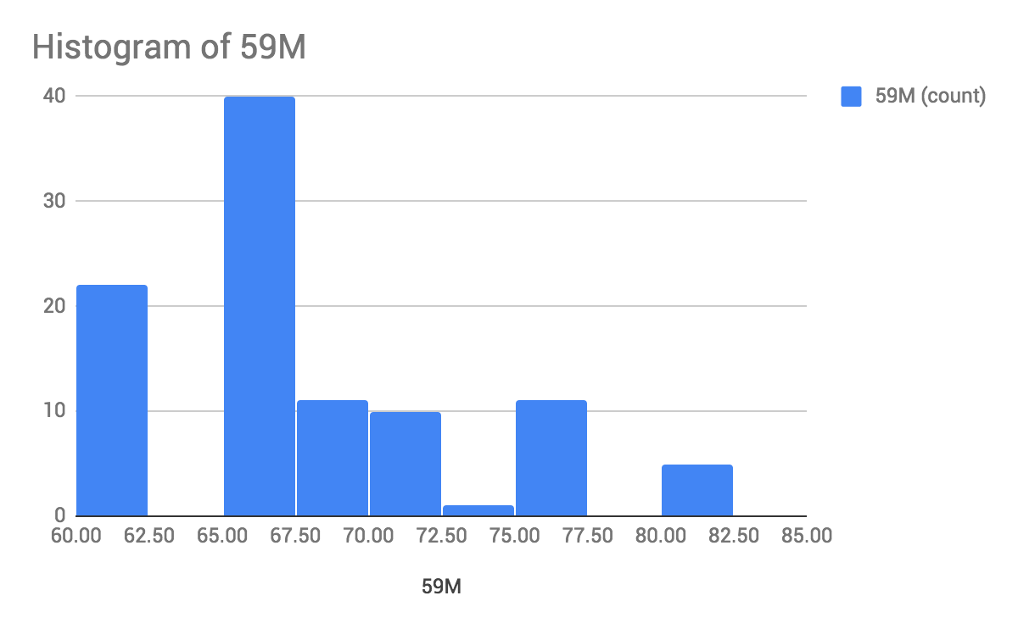
Comparison on Performance (Flow Size 59M)

Slide 18
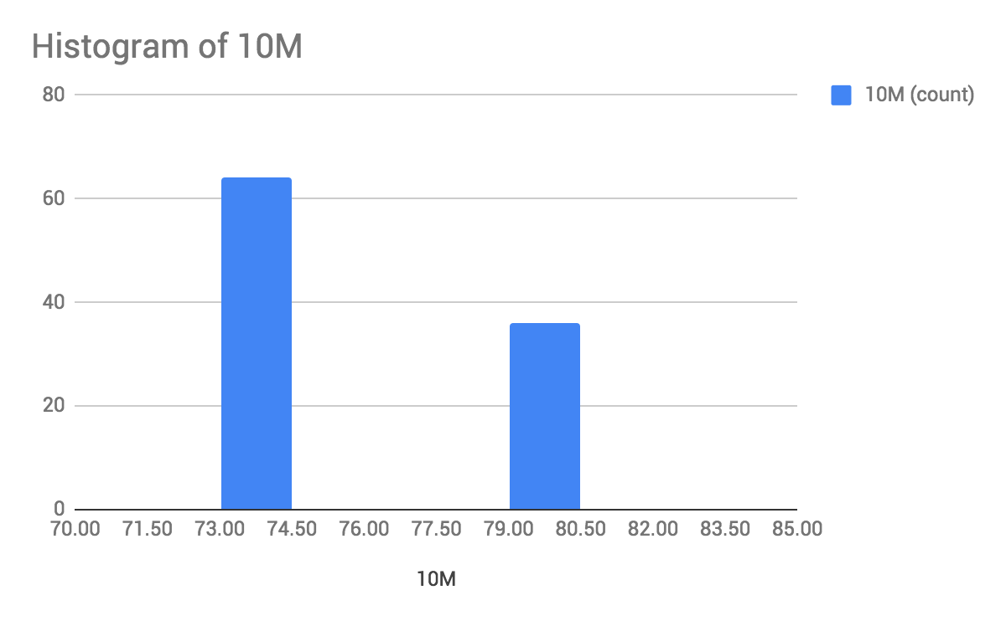
Comparison on Performance (Flow Size 10M)

Slide 19
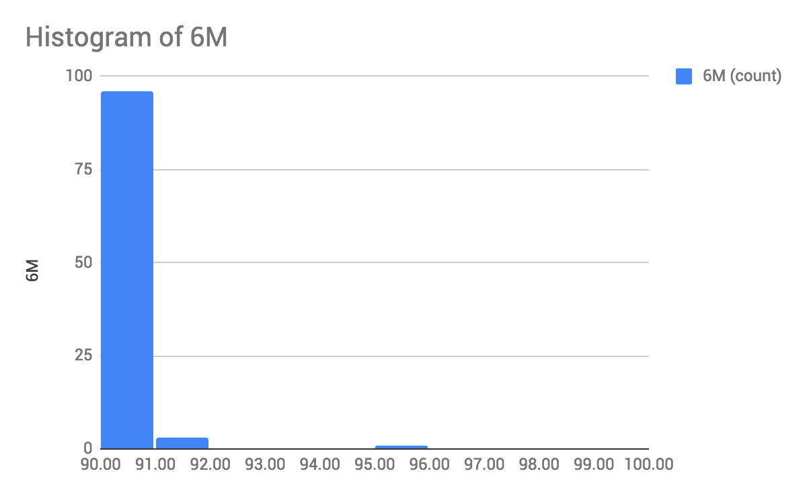
Comparison on Performance (Flow Size 6M)

Slide 20
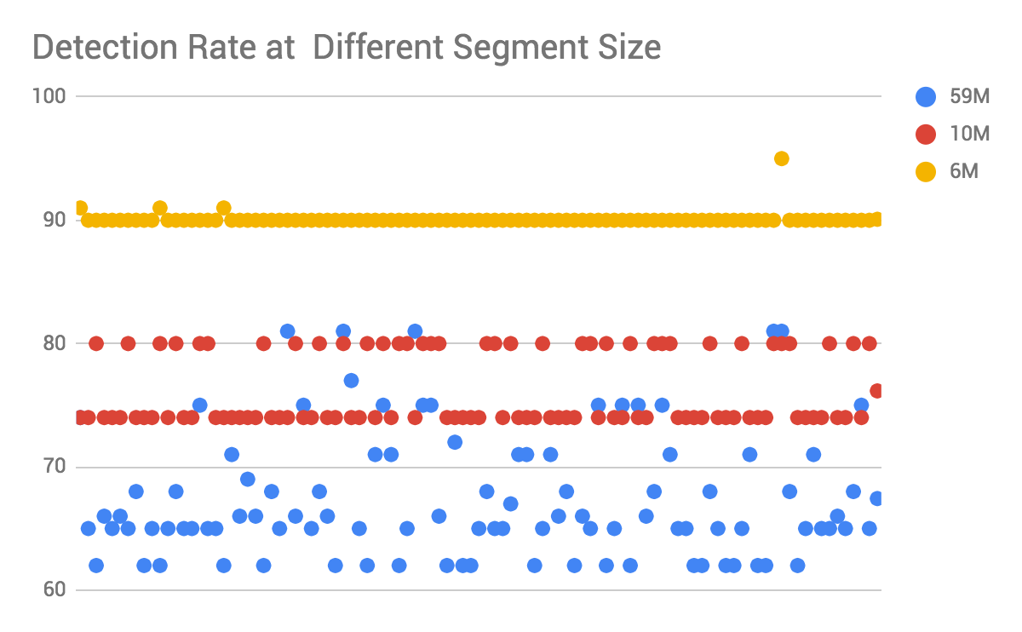
Comparison on Performance

Slide 21
Comparison on Performance
Segments | Size | Alerts Detected | Variance
1 | 59M | 67.43 alerts | 26.33
6 | 10M | 76.16 alerts | 8.38
10 | 6M | 90.08 alerts | 0.28
20 | 3M | 114 alerts | 0
59 | 1M | 169 alerts | 0
Small Segments Size: Better (Stable and More Detected) or Worse (False Positive)

Slide 22

Discussion on Performance
Rule Based：
How many packets are involved in one particular attack detection rule?
Smaller the segments, the better detection rates?
Smaller the segments, more stable detection rates?
Segments | Size | Alerts Detected | Variance
1 | 59M | 67.43 alerts | 26.33
6 | 10M | 76.16 alerts | 8.38
10 | 6M | 90.08 alerts | 0.28
Sampling Rate Matters ???

Slide 23
Understanding Effectiveness Performance: Explained
Pattern-matcher:
B2gc: search_algo: B2gSearchBNDMq hash_size: low #Determines the size of the hash-table. bf_size: medium #Determines the size of the bloom-filter.
B3g: search_algo: B3gSearchBNDMq hash_size: low #See hash-size -b2gc. bf_size: medium #See bf-size -b2gc.
wumanber: hash_size: low #See hash-size -b2gc. bf_size: medium #See bf-size -b2gc.
Detection Algorithms Matters

Slide 24
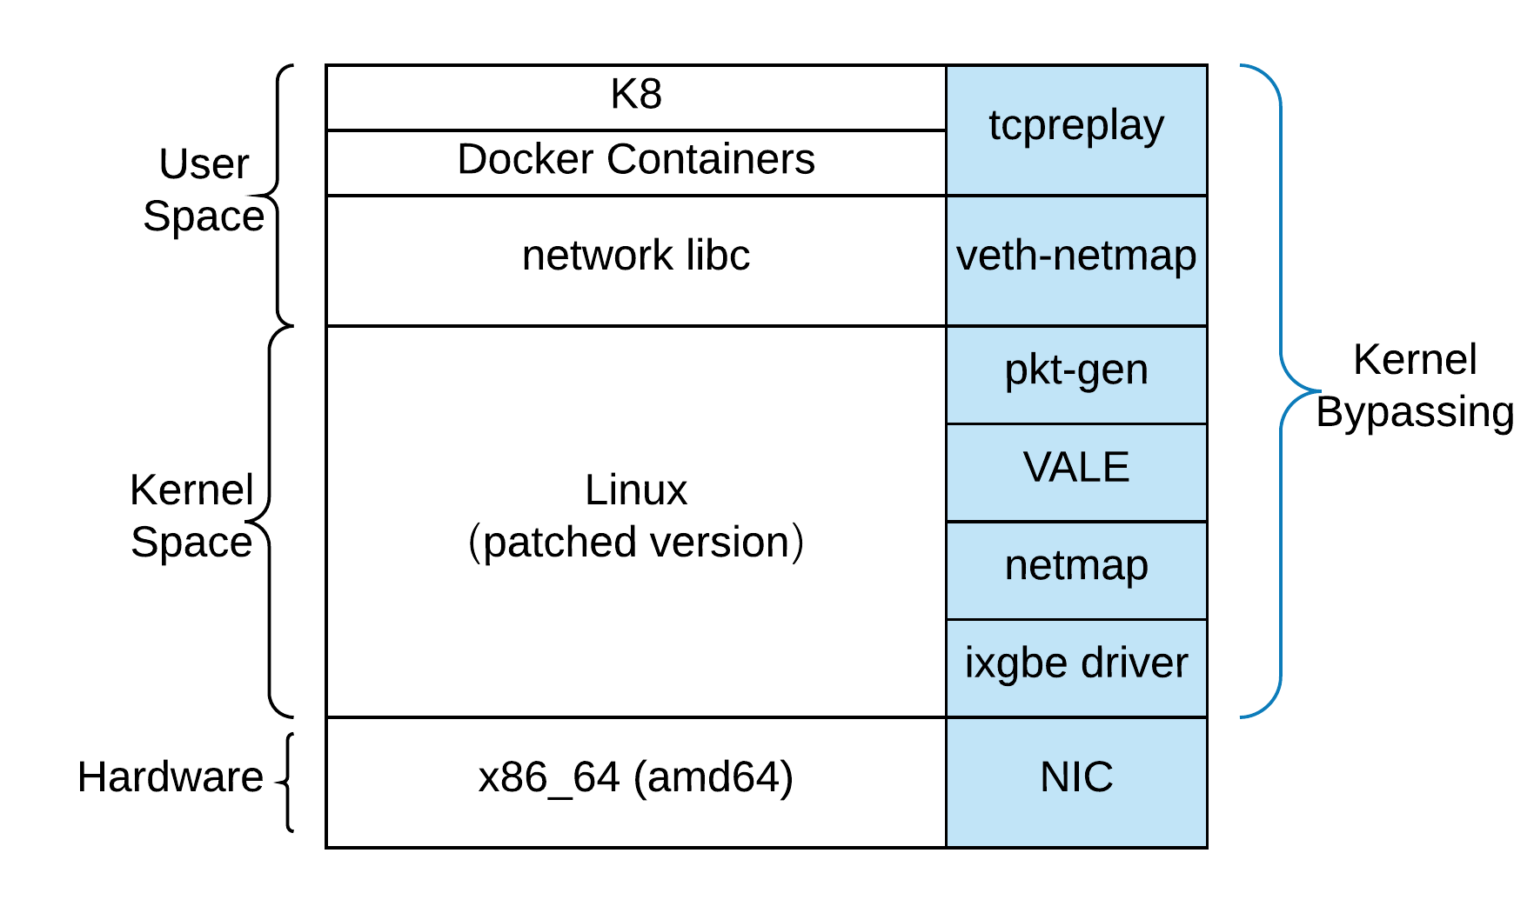
System Setup
Code and Containers are Open Source:
https://github.com/wenhuizhang/Akraino
$ docker pull wenhuizhang/suricata:v6
$ docker run –privileged -v /var/log/suricata/:/var/log/suricata/ -it suricata:v6
Demo Time

Slide 25
Summary
Performance Test with Core Affinity
Stress Test with Kernel Bypassing Netmap + VALE + pkt-gen
Effectiveness Test with Malicious pcap
Developed AutoSplitting and Data Aggregation for Performance Evaluation
Estimation: to achieve 20G/s
Splitting Traffic: if splitting is fast enough, 4 suricata containers will be enough for 20G (4*5.24 > 20G)
Parallel Probs: 12 suricata containers could achieve (1- (1-5.24/20)^12) *20G = 19.48Gbits/s
Understanding Bottlenecks
Memory: 0.2% on average
Disk I/O: N/A
CPU: 1.4% pin to one core, during processing
Network:
64 bytes/packet, host is 9.8G/s, container is 0.8G/s
1004 bytes/packet, host is 59G/s, container is 2G/s
31 secs for a 2 hours of capture, 21G, 4 secs bootup, 1 secs of joining, avg 5.24G/s [02:23:11.48-04:23:11.42]

Slide 26
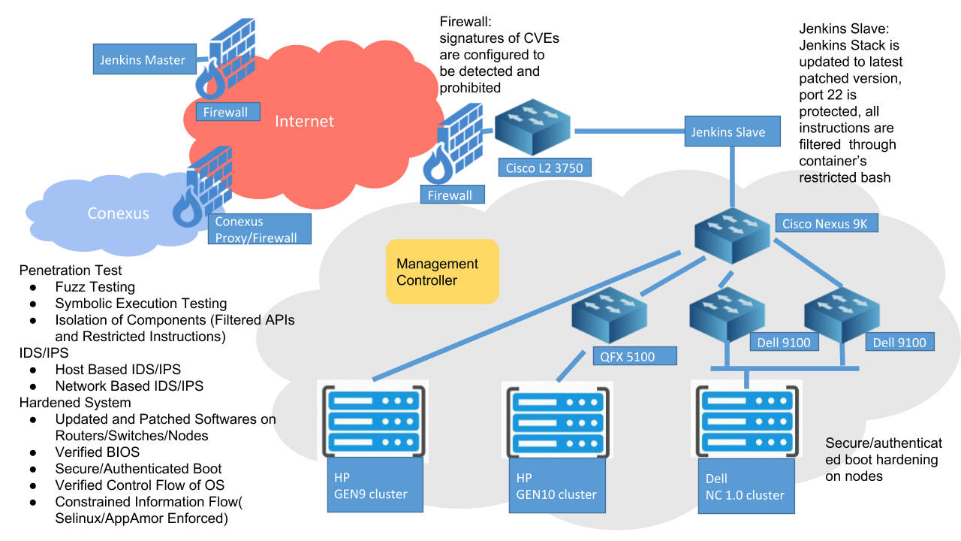
Future Work

Slide 27
Future Work
Security Service Containers
---- security function that could be shipped as containers.
Deep Packet Inspection for CVEs (e.g. Suricata, Bro, Snort )
Image Attestation Server
Secure and Privacy Preserving Database
Static Code Analysis(e.g. Fortify, CheckMax)
Dynamic Code Analysis(e.g. AppScan, BurpSuit)
Fuzz Testing: (e.g. AFL)
Symbolic Execution (e.g. KLEE)
Runtime Audit Log Monitoring
Pen Testing
...

Slide 28
Thank you !
Wenhui Zhang, John Craig, Kandan Kathirvel

