Slide 1

StackGuard: A Historical Perspective
Crispin Cowan, PhD
Senior PM, Windows Core Security
Microsoft

Slide 2
Aleph One Fires The Opening Shot
“Smashing the Stack for Fun and Profit”
Aleph One (AKA Elias Levy), Phrack 49, August 1996
It is a cook book for how to create exploits for “stack smashing” attacks
Prior to this paper, buffer overflow attacks were known, but not widely exploited
“Validate all input parameters” is a security principle going back to the 1960s
After this paper, attacks became rampant
Stack smashing vulns are massively common, easy to discover, and easy to exploit

Slide 3
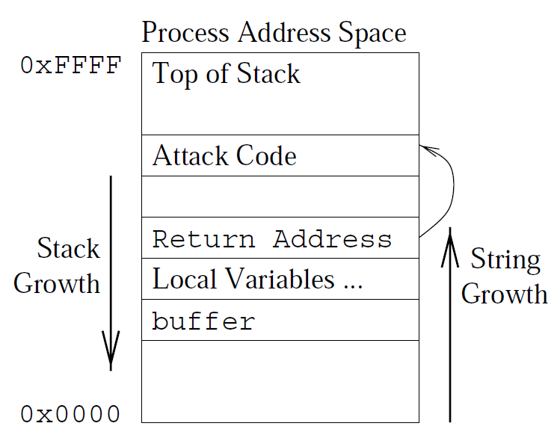
What is a “Stack Smash”?
Buffer overflow:
Program accepts string input, placing it in a buffer
Program fails to correctly check the length of the input
Attacker gets to overwrite adjacent state, corrupting it
Stack Smash:
Special case of a buffer overflow that corrupts the activation record

Slide 4
What is a “Stack Smash”?
Return address
Overflow changes it to point somewhere else
“Shell Code”
Point to exploit code that was encoded as CPU instructions in the attacker’s string
That code does exec(“/bin/sh”) hence “shell code”

Slide 5
Why Are We So Vulnerable To Something So Trivial?
Why are we so vulnerable to something so trivial?
Because C chose to represent strings as null terminated instead of (base, bound) tuples
Because strings grow up and stacks grow down
Because we use Von Neumann architectures that store code and data in the same memory
But these things are hard to change … mostly

Slide 6
Non-Executable Memory
Try to move away from Von Neumann architecture by making key regions of memory be non-executable
Problem: x86 memory architecture does not distinguish between “readable” and “executable” per page
Only memory segments support this distinction
Most other CPU memory systems support non-executable pages, but they also mostly don’t matter ☺

Slide 7
Non-Executable Stack, 1997
“Solar Designer” introduces the Linux non-executable stack patch
Fun with x86 segmentation registers maps the stack differently from the heap and static data
Results in a non-executable stack
Effective against naïve Stack Smash attacks
Bypassable:
Inject your shell code into the heap (still executable)
Point return address at your shell code in the heap

Slide 8
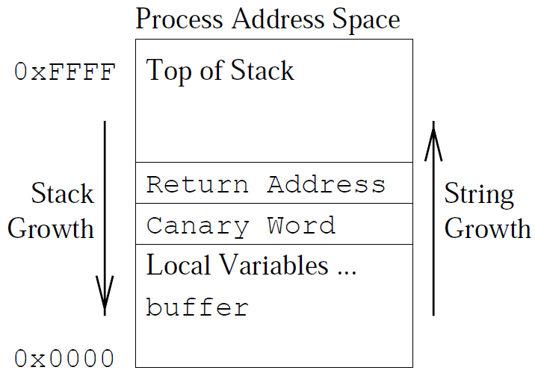
StackGuard, 1998
Compile in integrity checks for activation records
Insert a “canary word” (after the Welsh miner’s canary)
If the canary word is damaged, then your stack is corrupted
Instead of jumping to attacker code, abort the program
Log the intrusion attempt

Slide 9
StackGuard Prototype
Written in a few days by one intern
Less than 100 lines of code patch to GCC
Helped a lot that the GCC function preamble and function post amble code generator routines were nicely isolated
First canary was hardcoded 0xDEADBEEF
Easily spoofable, but worked for proof of concept

Slide 10
Canary Spoof Resistance
The random canary:
Pull a random integer from the OS /dev/random at process startup time
Simple in concept, but in practice it is very painful to make reading from /dev/random work while still inside crt0.o
Made it work, but motivated us to seek something simpler
“Terminator” canary:
CR, LF, 00, -1: the symbols that terminate various string library functions
Rationale: will cause all the standard string mashers to terminate while trying to write the canary → cannot spoof the canary and successfully write beyond it
Still vulnerable to attacks against poorly used memcpy() code, but buffer overflows thought to be rare

Slide 11
XOR Random Canary
1999, “Emsi” creates the frame pointer attack
Frame pointer stored below the canary → corruptible
Change FP to point to a fake activation record constructed on the heap
Function return code will believe FP, interpret the fake activation record, and jump to shell code
Bypasses both Terminator and Random Canaries
XOR Random Canary
XOR the correct return address with the random canary
Integrity check must match both the random number, and the correct return address

Slide 12
Other Stack Smashing Defenses
StackShield:
Copied valid return addresses to safe memory, check them on function return
Implemented as a modified assembler → requires hacking your makefiles
Libsafe: armored variants of the “big 7” standard string library functions
Library code does a plausability check on the parameters; ensure that they are not pointing back up the stack at an activation record
Advantage: no recompile necessary
Disadvantage: no protection for hand-coded string handling, or anything other than the big-7

Slide 13
Other Stack Smashing Defenses
StackGhost: uses SPARC CPU hardware to get OS in the loop to armor the stack
Hardware: numerous papers proposing “slightly” modified CPU hardware to protect against stack smashing
Typically protection about as good as StackGuard
Advantage: don’t have to re-compile code
Disadvantage: do have to re-compile code to run on non-existent hardware, which tends to limit adoption ☺

Slide 14
StackGuard Derivatives: ProPolice
IBM Research Japan
Also a modified GCC
Copied StackGuard defense exactly, and acknowledged it
Enhanced with variable sorting: sort buffers (arrays) up to the top of local variables, so that they cannot overflow other important values
Used a different code generator technique
More compatible with the newer code generator architecture in GCC 2 and GCC 3
Ultimately ProPolice is what is adopted into GCC and became the –fstack_protector feature

Slide 15
StackGuard, uh … Concurrent Innovation ☺
Microsoft Visual Studio: /gs
Uses exactly the StackGuard defense
Introduced in 2003; people who were there say that it was independently innovated
Object lesson: patent your stuff, even if you intend to GPL it!
Even though introduced 5 years after StackGuard, Microsoft beat the Linux/FOSS community into mainstream adoption by several years

Slide 16
All the World Is Not A Stack
As stack protection matured, attackers do what they always do: move to the next soft target
Heap overflows
Pointer corruption
Printf format string vulnerabilities
Integer “underflows”
…

Slide 17
Brute Force Defense: Buffer Bounds Checking
Jones&Kelly built a GCC that had full array bounds checking
Associate a data structure with every buffer and check every read and write against the buffer’s legitimate size
Absolutely memory safe
Costly: between 3X and 30X slowdown

Slide 18
Fun With Memory Defense: DEP and ASLR
DEP: Data Execution Protection
ASLR: Address Space Layout Randomization
Microsoft introduced in XPSP2
Linux introduced bits and pieces in various places:
PAX Project also had NX (Like DEP) and ASLR
Red Hat ExecShield

Slide 19
DEP and ASLR Are Critically Interdependent
ASLR only: not enough bits of randomization
Attacker can inject their code surrounded by a “NOP sled”; long sequence of NOPs followed by shell code
Only have to jump to somewhere in the NOP sled to succeed
Add DEP: cannot inject code into data areas
DEP only: there is lots of code in memory already that can do the attacker’s job
Originally called the “return into LibC” attack; the attacker changes the return pointer to point to some code in LibC that will run exec(“/bin/sh”)
Add ASLR: becomes hard for the attacker to hit that delicate target, because they cannot surround it with a NOP sled

Slide 20
PointGuard
Cowan et al, USENIX Security 2003
Hashed pointers; the dual of ASLR
Pointers in memory: can be corrupted via overflow
Pointers in registers: not overflowable
PointGuard:
Store pointers encrypted in memory
To dereference a pointer, decrypt it as you load it into a register

Slide 21
Normal Pointer Dereference
CPU
1. Fetch Pointer Value
2. Access data referenced by pointer
Memory
Pointer
0x1234
Data
0x1234

Slide 22
Normal Pointer Dereference Under Attack
CPU
2. Access attacker’s data referenced
by corrupted pointer
1. Fetch Pointer Value
Memory
Corrupted Pointer
0x1234
0x1340
Data
Malicious
Data
0x1234
0x1340

Slide 23
PointGuard Pointer Dereference
CPU
1. Fetch Pointer Value
0x1234
2. Access data referenced by pointer
Pointer Decryption
Memory
Encrypted Pointer
0x7239
Data
0x1234

Slide 24
PointGuard Pointer Dereference Under Attack
CPU
2. Access random data referenced
by decryption of corrupted pointer
1. Fetch Pointer Value
0x9786
Pointer Decryption
3. Segfault & Crash
Memory
Corrupted Pointer
0x7239
0x1340
Data
Malicious
Data
0x1234
0x1340

Slide 25
PointGuard Problems
PointGuard had excellent performance
Compatibility not so good: each PG process had its own random cookie
Interfacing PG code with non-PG libraries
Interfacing PG code with the kernel
Bizzarre casting: real code declares a union of two structs
One variant has a field that is a void *
Other variant has that same field as an int
The code expects a NULL pointer to show up as an int value == 0, which is not true under PG
PointGuard abandoned due to insurmountable compat issues
ASLR and DEP can handle this

Slide 26
Buffer Overflows Today
Heap Spray: fill heap with many many copies of the NOP sled/shell code, to defeat ASLR defenses
JIT Spray: Heap Spray applied to the storage for JIT code, so as to bypass ASLR and DEP
Wise but useless: whatever code shared an address space with the JIT buffer should have been written in a type safe language
Research opportunity: find a way to defend against JIT Spray that allows people to share JIT address space with crap code ☺

Slide 27
Conclusion
This is going to keep happening until people adopt type safe languages: Java, C#, Python, Ruby …
Not C++: it has the safety of C, and the performance of SmallTalk ☺
But go ahead, keep writing code in insecure languages
It is job security for us security nerds
Questions?
Crispin@microsoft.com

