Slide 1

CSE 544 Advanced System Security
LMP: Light-Weighted Memory Protection with Hardware Assistance
Wei Huang, Zhen Huang, Dhaval Miyani and David Lie
University of Toronto
Presented by: Asmit De

Slide 2

Motivation
Prevent memory corruption – ROP attacks
Existing CFI techniques are expensive and incur significant overheads (~ 2x)
Leverage Intel MPX hardware extensions to improve CFI performance
Contributions
Alternative usage of Intel MPX assisted pointer checker
Stack protection solution using Intel MPX
Low-overhead shadow stack implementation
CSE 544 Advanced System Security
2

Slide 3
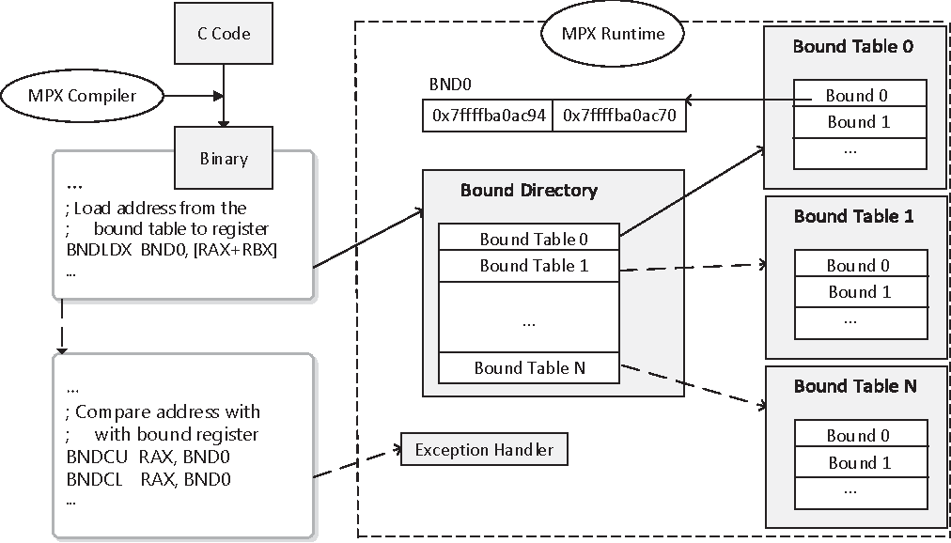
Intel MPX overview
Architectural components
Bound registers
BND0-BND3
Configuration registers
BNDCFGU and IA32_BNDCFGS
Status register
BNDSTATUS
Bound management instructions
BNDLDX and BNDSTX
BNDMK and BNDMOV
Bound check instructions
BNDCU and BNDCL
Software Components
MPX-enabled compiler
MPX support in GCC v5.0+ for C/C++
MPX runtime
API to configure MPX features and manage MPX registers
OS support
Catch exceptions and signal applications
CSE 544 Advanced System Security
3
Notes:
BND0-BND3: 128-bit, lower bound 64 bits and the upper bound 64 bits. Bound registers hold the upper and lower bounds that memory accesses are checked against.
BNDCFGU for user mode and IA32_BNDCFGS for supervisor mode.
BNDSTATUS stores error code when exception occurs.
BNDLDX and BNDSTX: Load/store BND registers from a table of object-speciﬁc address bounds in memory. 1000x NOP
BNDMK and BNDMOV allow a programmer to manually manage the BND registers.
BNDCU and BNDCL: If the pointer falls outside of the bounds, then the MPX hardware raises #BR exception (caught by MPX runtime), saving the need for an instruction to explicitly check the result of the comparison. 1x NOP
Compiler is responsible for inserting bound checks before pointer dereferences. Because bound information must be loaded in a limited number of BND registers before it can be used to check a pointer, the compiler must also load and spill bounds information between the BND registers and memory.

Slide 4
Threat model and assumptions
Attacker can exploit memory corruption vulnerabilities to change values in arbitrary memory locations
Attacker is aware of the address locations of pointers, stacks, etc.
Attacker goal is to corrupt a code pointer to compromise program control flow
Attacker cannot directly modify CPU registers
Attacker cannot modify read-only memory pages
Attacker cannot compromise the loader or the OS
Forward-edge CFI protection is already in place to protect function pointers
CSE 544 Advanced System Security
4

Slide 5
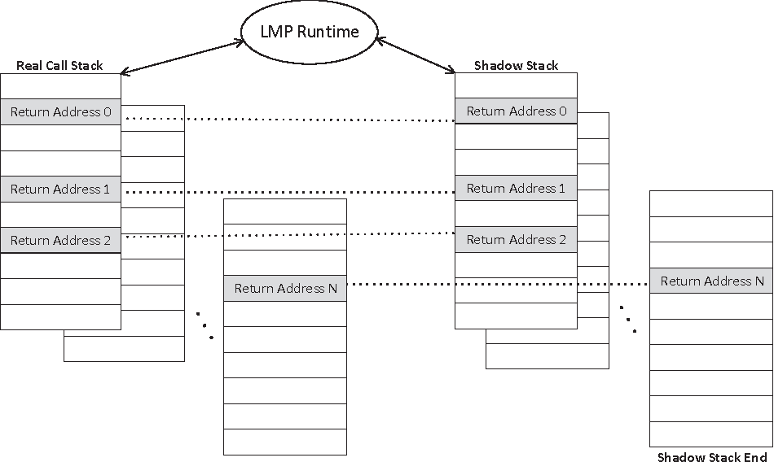
LMP Shadow Stack
Protect return boundaries by using a Shadow Stack
Reserve a specific region of the address space for shadow stacks
Allocate multiple shadow stacks contiguously for multi-threaded applications
Dynamically allocate and map stack space from the reserved area when creating threads and their shadow stacks
Use mapping table to store offset of a thread’s shadow stack from its actual call stack
Partition the reserved area into fixed size shadow stacks and use a table to indicate which ones are active or free
On thread creation, assign an unallocated shadow stack and update mapping table with the offset
On thread destruction, deallocate its shadow stack and clear the offset in mapping table
CSE 544 Advanced System Security
5
Notes:
As I mentioned on the MPX slide, the BNDLDX/STX instructions incur a significant overhead compared to just using the BND chk on the BND registers. The idea is to remove the use of bound table entirely and just use the bound registers. So we implement a shadow stack in a specific region….

Slide 6
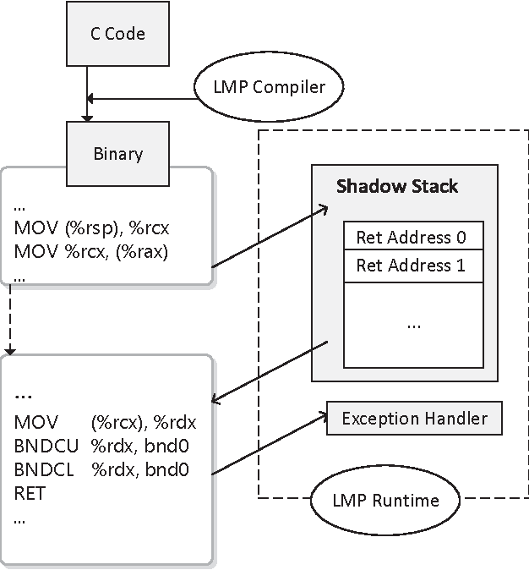
LMP Shadow Stack
Use MPX instructions to perform validation
Instrument function entry code to save return address on the shadow stack
Instrument function exit code to retrieve return address from shadow stack and place in a MPX BND register
Use MPX bounds check instructions to compare return addresses with the BND register value
MPX hardware raises #BR exception if comparison fails
Better than compare/branch instruction in standard shadow stack implementation
CSE 544 Advanced System Security
6

Slide 7
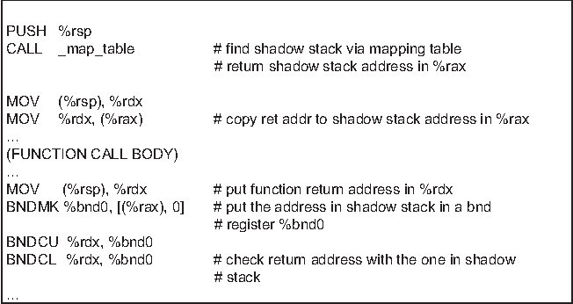
LMP Shadow Stack
Function assembly instrumentation
On function entry
Prepare shadow stack address in %rax
Copy return address at %rsp to shadow stack
Execute function body
On function exit
Copy return address from shadow stack to MPX bound register %bnd0
Use bound checking instructions to compare return address at %rsp and %bnd0
The location of the shadow stack is found by indexing into the stack region using the thread’s TID
The return address from the shadow stack is set as both upper and lower bound in the bound register %bnd0
Using BNDCU and BNDCL to compare instead of series of cmp/jmp instructions improves checking performance
CSE 544 Advanced System Security
7

Slide 8
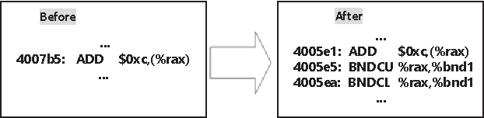
LMP Shadow Stack
Protect the Shadow Stack from attacks
On program initialization, LMP runtime prepares the shadow stack memory region and saves its lower and upper bound addresses in BND1 register
All memory store operations are instrumented using MPX instructions to prevent writing to shadow stack memory
Write address is bounds checked with %bnd1 using BNDCU and BNDCL
CSE 544 Advanced System Security
8

Slide 9
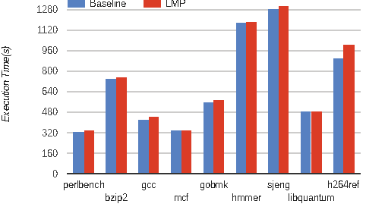
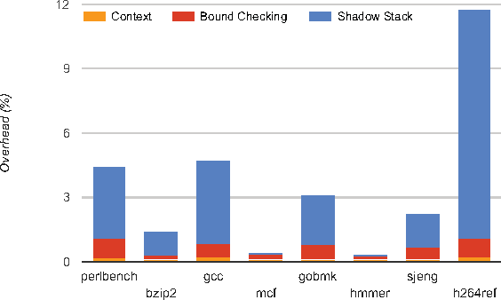
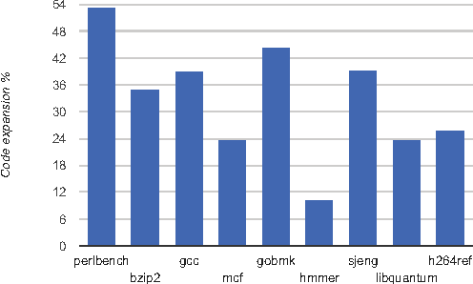
Performance overheads
Execution time
3.9% avg. overhead
12.55% max for h264ref (has significantly more function calls/rets)
2.12% avg. overhead excluding h264ref
Overhead components
Context settings: 0.1%
Bounds checking: 0.52%
Shadow stack ops: 3.27%
84% of overheads is from shadow stack ops
16% is from the memory protection system
Code expansion
39.27% avg. overhead
Major contribution from bounds checking instructions
CSE 544 Advanced System Security
9

Slide 10

Thank You!
Presenter: Asmit De (aud311@psu.edu)
Image credits: All images used in this presentation belong to the authors of the original work, and have been used as-is from the source.

