Slide 1
The Battle of the Neighborhoods

Slide 2
Introduction
1. Background
Some of restaurants couldn’t run for a long time
2. Business Problem
How to easily success run a restaurant
3. Interest
Business man
Restaurant owner

Slide 3
Data
1. Data Sources
https://en.wikipedia.org/wiki/List_of_postal_codes_of_Canada:_M
2. Data clean
Combine different neighborhood into one column
Ignore columns which Borough is Null
Grab Toronto Data

Slide 4
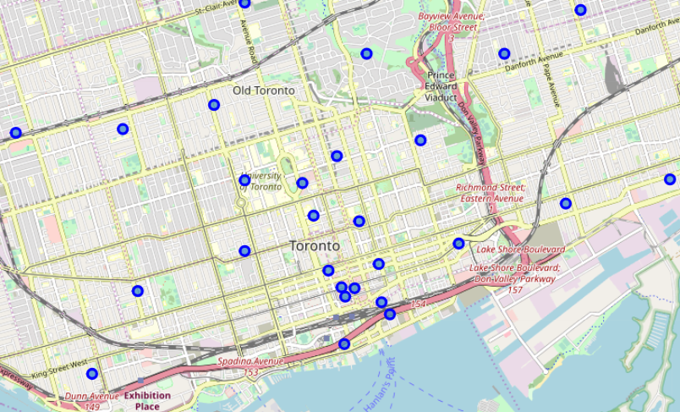
Exploratory Data
After I segmented and clustered the neigborhoods in the map using foilum map, I oberved that there is more neighborhood or boroughs located in the downtown Toronto.

Slide 5
Results and Discussion
As we can see in the map, here is 103 neighborhoods locate at Toronto. When we zoom in the map, we will see there is 6 neighborhoods between Queen Street and Union Street. This area has the most number of neighborrhoods, so the population of this area should be Top 5 in Toronto.
In the other side, there will be some others feature effecting whether restaurant will be successful or not. For example, if a restaurant opening close to school or some bussiness area, though maybe there won't have lots of neigborhoods, the restaurant also can be very successful.

