Slide 1


(CanT-cer): Pioneering Skin Cancer Data Generation to Combat Skin Tone Bias

Slide 2
T cells – Lymphocytes that recognize and attack defective cells

Slide 3


Problem Statement
Current datasets consists majority of light skin
Models develop skin tone bias during detection
There are barely any data that allows fine-tuning

Slide 4


97%
Of Data Sets About Melanoma are Biased!
Dick V, Sinz C, Mittlböck M, Kittler H, Tschandl P. Accuracy of computer-aided diagnosis of melanoma: a meta-analysis. JAMA Dermatology. 2019. Nov 1;155(11):1291–9.

Slide 5

Our Solution
Use A.I to generate synthetic datasets!
(put like input, output pictures here)

Slide 6
How does it work?
Front/Back-End
React, Express, and a lil’glue bootstrapping our hopes and dreams.
Dynamic state allocations render websites and facilitates RESTful routes.
Cool stuff

Slide 7
How does it work?
Classification
Model
Data is from HAM10000
Custom CNN encoder with SoftMax decoder
Trained on Google Colab w/ Nvidia T4
Classifies the image into one of the 7 categories
Final Accuracy: 81.4%

Slide 8
How does it work?
Style Transfer
Model
Data is from HAM10000
Trained on Google Colab w/ Nvidia T4
Classifies the image into one of the 7 categories
Final Accuracy: 81.4%

Slide 9
How does it work?
Segmentation
Model
Data is from ISIC 2018 task 1: Lesion Segmentation
Finetuned pretrained U-Net with Dice Loss
Trained on Kaggle w/ Nvidia P100
Get the contour of the segmentation mask and display on image
Final Accuracy: 86.5%

Slide 10
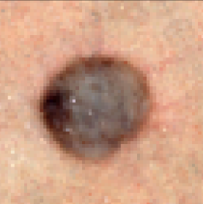

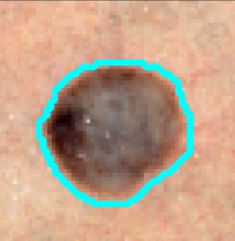
How does it work?
Segmentation
Model

Slide 11
Thanks!
We will now go sleep now :)

Slide 12
Assets Used:
<a href="https://www.flaticon.com/free-icons/people" title="people icons">People icons created by Freepik - Flaticon</a>
<a href="https://www.flaticon.com/free-icons/emotion" title="emotion icons">Emotion icons created by Freepik - Flaticon</a>
<a href="https://www.flaticon.com/free-icons/shock" title="shock icons">Shock icons created by Freepik - Flaticon</a>
<a href="https://www.flaticon.com/free-icons/customer" title="customer icons">Customer icons created by Freepik - Flaticon</a>
<a href="https://www.flaticon.com/free-icons/question" title="question icons">Question icons created by ultimatearm - Flaticon</a>
https://www.slidescarnival.com/jacquenetta-free-presentation-template/1929

Slide 13
Instructions for use
EDIT IN GOOGLE SLIDES
Click on the button under the presentation preview that says "Use as Google Slides Theme".
You will get a copy of this document on your Google Drive and will be able to edit, add or delete slides.
You have to be signed into your Google account.
EDIT IN POWERPOINT®
Click on the button under the presentation preview that says "Download as PowerPoint template". You will get a .pptx file that you can edit in PowerPoint.
Remember to download and install the fonts used in this presentation (you’ll find the links to the font files needed in the Presentation design slide)
More info on how to use this template at www.slidescarnival.com/help-use-presentation-template
This template is free to use under Creative Commons Attribution license. You can keep the Credits slide or mention SlidesCarnival and other resources used in a slide footer.

Slide 14

Hello!
I am Jayden Smith
I am here because I love to give presentations.
You can find me at @username

Slide 15
Transition headline
1.
Let’s start with the first set of slides

Slide 16
Quotations are commonly printed as a means of inspiration and to invoke philosophical thoughts from the reader.

Slide 17
BIG CONCEPT
Bring the attention of your audience over a key concept using icons or illustrations

Slide 18
You can also split your content
White
Is the color of milk and fresh snow, the color produced by the combination of all the colors of the visible spectrum.
Black
Is the color of ebony and of outer space. It has been the symbolic color of elegance, solemnity and authority.

Slide 19
In two or three columns
Yellow
Is the color of gold, butter and ripe lemons. In the spectrum of visible light, yellow is found between green and orange.
Blue
Is the colour of the clear sky and the deep sea. It is located between violet and green on the optical spectrum.
Red
Is the color of blood, and because of this it has historically been associated with sacrifice, danger and courage.

Slide 20
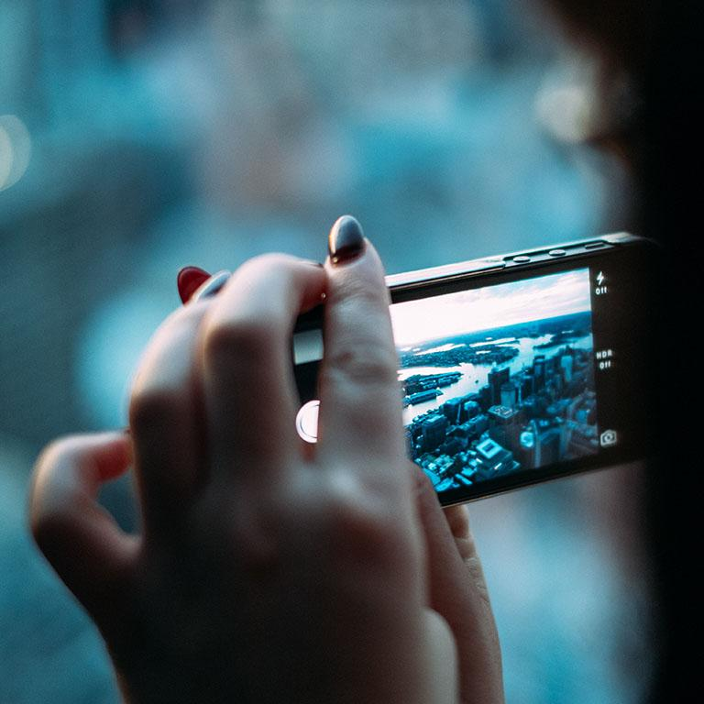
A picture is worth a thousand words
A complex idea can be conveyed with just a single still image, namely making it possible to absorb large amounts of data quickly.

Slide 21
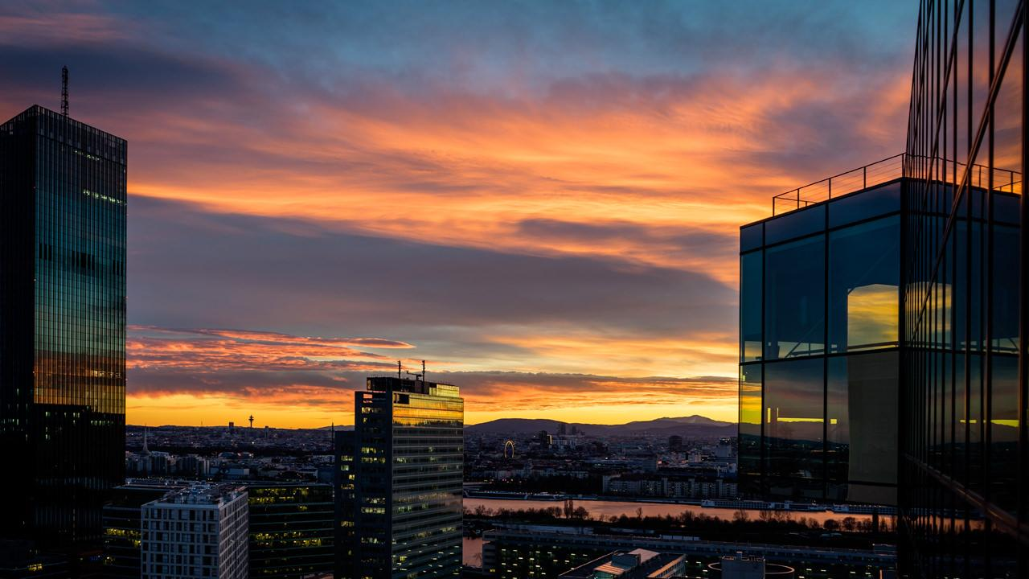
Want big impact?
Use big image.

Slide 22
Use charts to explain your ideas
Gray
White
Black

Slide 23
And tables to compare data
 | A | B | C
Yellow | 10 | 20 | 7
Blue | 30 | 15 | 10
Orange | 5 | 24 | 16

Slide 24
Maps
our office

Slide 25
89,526,124$
185,244 users
100%
That’s a lot of money
And a lot of users
Total success!

Slide 26
Our process is easy
first
second
last

Slide 27
Let’s review some concepts
Yellow
Is the color of gold, butter and ripe lemons. In the spectrum of visible light, yellow is found between green and orange.
Blue
Is the colour of the clear sky and the deep sea. It is located between violet and green on the optical spectrum.
Red
Is the color of blood, and because of this it has historically been associated with sacrifice, danger and courage.
Yellow
Is the color of gold, butter and ripe lemons. In the spectrum of visible light, yellow is found between green and orange.
Blue
Is the colour of the clear sky and the deep sea. It is located between violet and green on the optical spectrum.
Red
Is the color of blood, and because of this it has historically been associated with sacrifice, danger and courage.

Slide 28
4000
3000
2000
1000
0
You can insert graphs from Excel or Google Sheets

Slide 29
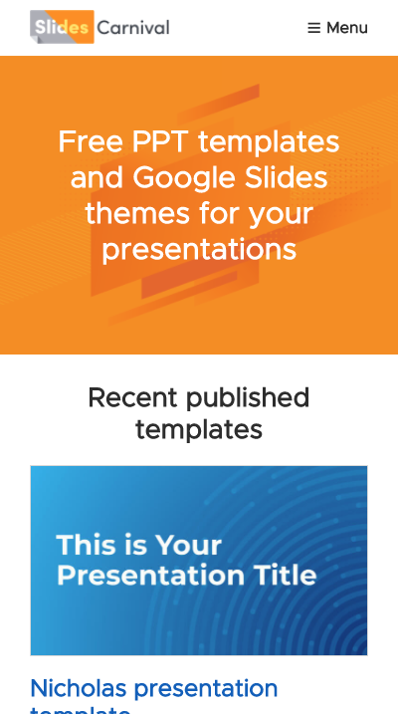
Mobile project
Show and explain your web, app or software projects using these gadget templates.

Slide 30
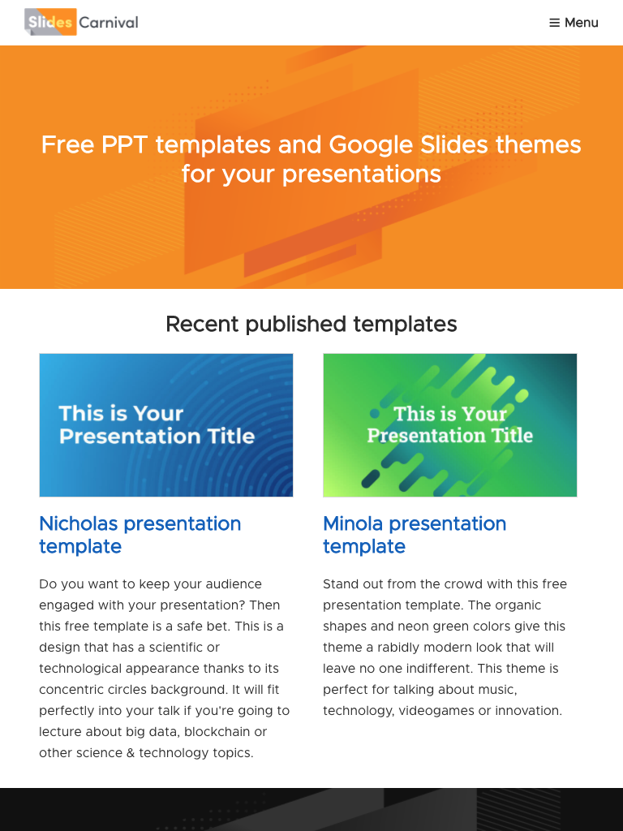
Tablet project
Show and explain your web, app or software projects using these gadget templates.

Slide 31
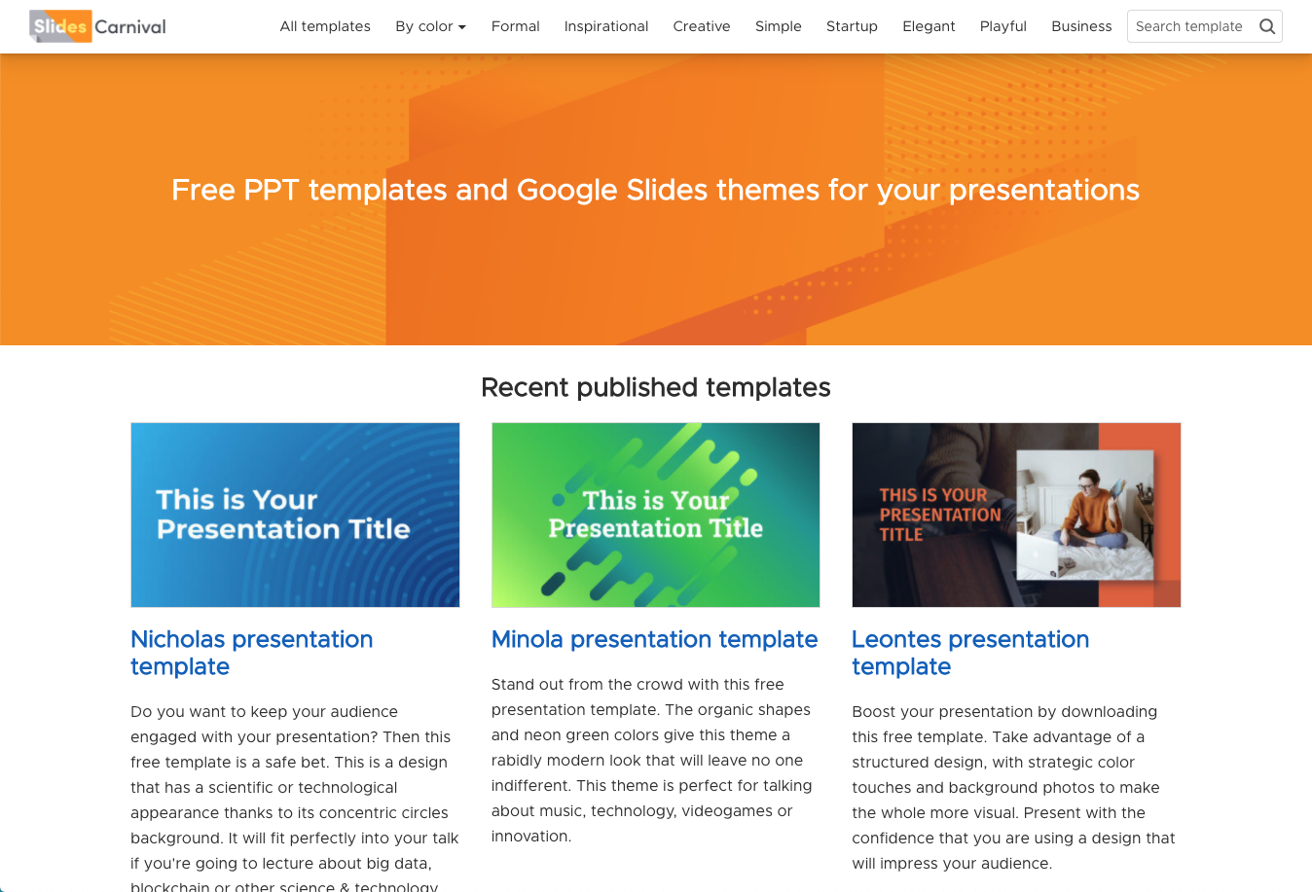
Desktop project
Show and explain your web, app or software projects using these gadget templates.

Slide 32
Thanks!
Any questions?
You can find me at
@username
user@mail.me

Slide 33
Credits
Special thanks to all the people who made and released these awesome resources for free:
Presentation template by SlidesCarnival
Photographs by Unsplash

Slide 34
Presentation design
This presentation uses the following typographies:
Titles: Work sans bold
Body copy: Work sans light
You can download the fonts on this page:
https://github.com/weiweihuanghuang/Work-Sans/tree/master/fonts/desktop
You don’t need to keep this slide in your presentation. It’s only here to serve you as a design guide if you need to create new slides or download the fonts to edit the presentation in PowerPoint®

Slide 35
Extra Resources
2.
For Business Plans, Marketing Plans, Project Proposals, Lessons, etc

Slide 36
Timeline
Blue is the colour of the clear sky and the deep sea
Red is the colour of danger and courage
Black is the color of ebony and of outer space
Yellow is the color of gold, butter and ripe lemons
White is the color of milk and fresh snow
Blue is the colour of the clear sky and the deep sea
JAN
FEB
MAR
APR
MAY
JUN
JUL
AUG
SEP
OCT
NOV
DEC
Yellow is the color of gold, butter and ripe lemons
White is the color of milk and fresh snow
Blue is the colour of the clear sky and the deep sea
Red is the colour of danger and courage
Black is the color of ebony and of outer space
Yellow is the color of gold, butter and ripe lemons

Slide 37
Roadmap
Blue is the colour of the clear sky and the deep sea
Red is the colour of danger and courage
Black is the color of ebony and of outer space
1
3
5
2
4
6
Yellow is the color of gold, butter and ripe lemons
White is the color of milk and fresh snow
Blue is the colour of the clear sky and the deep sea

Slide 38
Gantt chart
 | Week 1 |  |  |  |  |  |  | Week 2
 | 1 | 2 | 3 | 4 | 5 | 6 | 7 | 8 | 9 | 10 | 11 | 12 | 13 | 14
Task 1
Task 2 |  |  |  |  |  | ◆
Task 3
Task 4 |  |  |  |  |  |  |  |  |  |  | ◆
Task 5 |  |  |  |  |  |  |  |  | ◆
Task 6
Task 7
Task 8

Slide 39
SWOT Analysis
STRENGTHS
Blue is the colour of the clear sky and the deep sea
WEAKNESSES
Yellow is the color of gold, butter and ripe lemons
S
W
Black is the color of ebony and of outer space
OPPORTUNITIES
White is the color of milk and fresh snow
THREATS
O
T

Slide 40
Business Model Canvas
Key Partners
Insert your content
Key Activities
Insert your content
Value Propositions
Insert your content
Customer Relationships
Insert your content
Customer Segments
Insert your content
Key Resources
Insert your content
Channels
Insert your content
Cost Structure
Insert your content
Revenue Streams
Insert your content

Slide 41
Funnel
AWARENESS
Insert your content
DISCOVERY
Insert your content
EVALUATION
Insert your content
INTENT
Insert your content
PURCHASE
Insert your content
LOYALTY
Insert your content

Slide 42
Competitor Matrix
HIGH VALUE 2
Competitor
Our company
Competitor
Competitor
LOW VALUE 1
HIGH VALUE 1
Competitor
Competitor
Competitor
LOW VALUE 2

Slide 43
Weekly Planner
 | SUNDAY | MONDAY | TUESDAY | WEDNESDAY | THURSDAY | FRIDAY | SATURDAY
09:00 - 09:45 | Task | Task | Task | Task | Task | Task | Task
10:00 - 10:45 | Task | Task | Task | Task | Task | Task | Task
11:00 - 11:45 | Task | Task | Task | Task | Task | Task | Task
12:00 - 13:15 | ✔ Free time | ✔ Free time | ✔ Free time | ✔ Free time | ✔ Free time | ✔ Free time | ✔ Free time
13:30 - 14:15 | Task | Task | Task | Task | Task | Task | Task
14:30 - 15:15 | Task | Task | Task | Task | Task | Task | Task
15:30 - 16:15 | Task | Task | Task | Task | Task | Task | Task

Slide 44
SlidesCarnival icons are editable shapes.
This means that you can:
Resize them without losing quality.
Change fill color and opacity.
Change line color, width and style.
Isn’t that nice? :)
Examples:

Slide 45
Diagrams and infographics

Slide 46
You can also use any emoji as an icon!
And of course it resizes without losing quality.
How? Follow Google instructions https://twitter.com/googledocs/status/730087240156643328
✋👆👉👍👤👦👧👨👩👪💃🏃💑❤😂😉😋😒😭👶😸🐟🍒🍔💣📌📖🔨🎃🎈🎨🏈🏰🌏🔌🔑 and many more...

Slide 47

Free templates for all your presentation needs
For PowerPoint and Google Slides
100% free for personal or commercial use
Ready to use, professional and customizable
Blow your audience away with attractive visuals

