Slide 1
Aster Lane Payments
Overview of Portfolio Pricing, Revenue, Surcharge Contribution, Sales Productivity, and Onboarding Speed
For the Leadership Team

Slide 2
Data Preparation
FX rate:
Create a new query that populate all dates from 27-10-2024 to 18-08-2026 for the distinct 5 currencies.
Fill up if rate missing.
  Assumption: the transaction happened during weekends will be settled until the next working day (need double-checked with finance team)
Salesperson:
Reference a new DimSalesperson table
Remove merchant_id column and remove duplicates of salesperson
Onboarding status:
Pivot table to get timestamp per process steps
Get onboarding notes in the pivot table
Calculate lead time days between stages
Merchants:
Remove demo accounts
Merge Merchants and Salesperson on merchant_id to add salesperson_id column in Merchants table
Merge Merchants and Onboarding pivot on merchant_id to add onboarding timestamps and notes in Merchants table
Transactions:
Remove duplicate provider reference
  Review_flag of “DATA_INCIDENT”
Remove demo accounts related transactions
Merge with FX rate to get exchange rate to EUR
Calculate amount in EUR
Date:
Create a Date table starts from 01-10-2024 to 18-08-2026

Slide 3
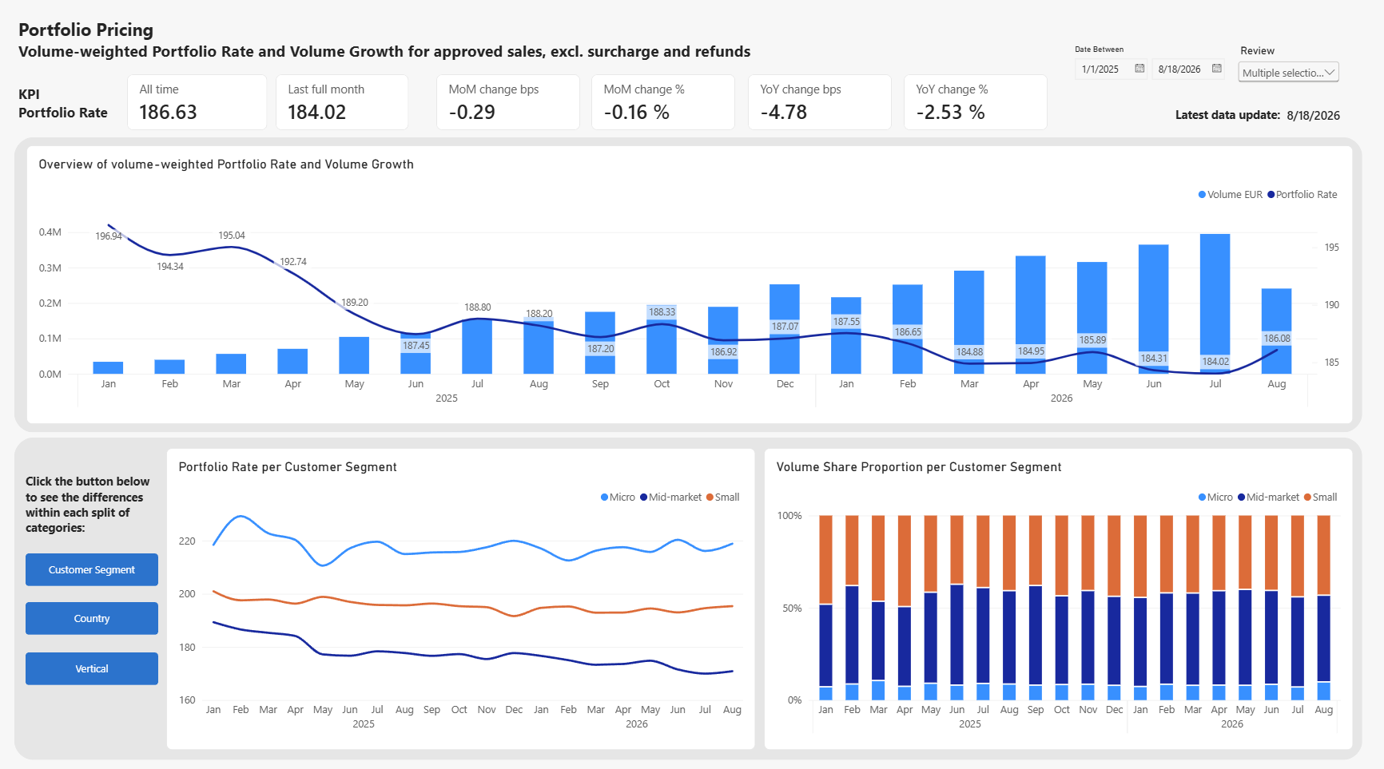
Portfolio pricing
- Development of the portfolio’s average rate each month
Description:
The Portfolio Rate is the average fee the merchant pays Aster Lane for each card payment, as a percentage of the amount.
Surcharge rate is not included here.
Main business question:
Are we earning less per euro we process, and if so, where and why?
Stakeholders:
Head of Pricing (KPI owner):
Are we setting up the prices too low?
CFO / Finance:
Did lower prices boost volume, which eventually led to high revenue?
Is growth "bought" with price?
KPI:
Portfolio Rate (bps) -> what we earned per eur (the weighted average across all payments)
Sum of (amount_eur * rate_bps) / sum of amount_eur
Where status is APPROVED, event_type is SALE
Target:
Finding:
The Portfolio Rate falls from around 198 to 186 bps.
The drop is concentrated in mid-market segment from almost 190 to 171 bps, while its volume share proportion remains flat over time at around 50%.
Further analysis:
Competitor price analysis
Signing rate of new merchants and existing merchants

Slide 4
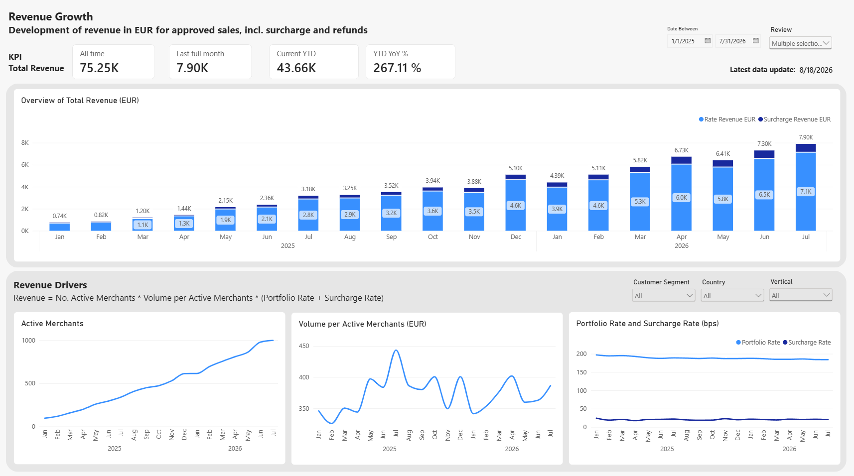
Revenue Growth
- Development of revenue in EUR each month
Description:
The Revenue is the sum of rate multiplied by the amount, in EUR.
Both approved sales and refunds are included.
Main business question:
How much do we earn, is it growing, and is the growth healthy?
Stakeholders:
CFO / Finance (KPI owner):
Monthly revenue for reporting, budget and forecast
CEO / Management:
What is our growth pace? To report to the board and investors
KPIs:
Total Revenue EUR
Sum of (amount_eur * (rate_bps + surcharge_bps)) / 10000
Rate Revenue EUR
Sum of (amount_eur * rate_bps) / 10000
Surcharge Revenue EUR
Sum of (amount_eur * surcharge_bps) / 10000
Target:
Findings:
So far this year, the total revenue increased more than 250% compared with last year. And the main driver is the number of merchants, which we have developed 10 times since start 2025.
Further analysis:
Comparison of new merchants and existing merchants
Split the revenue into different markets

Slide 5
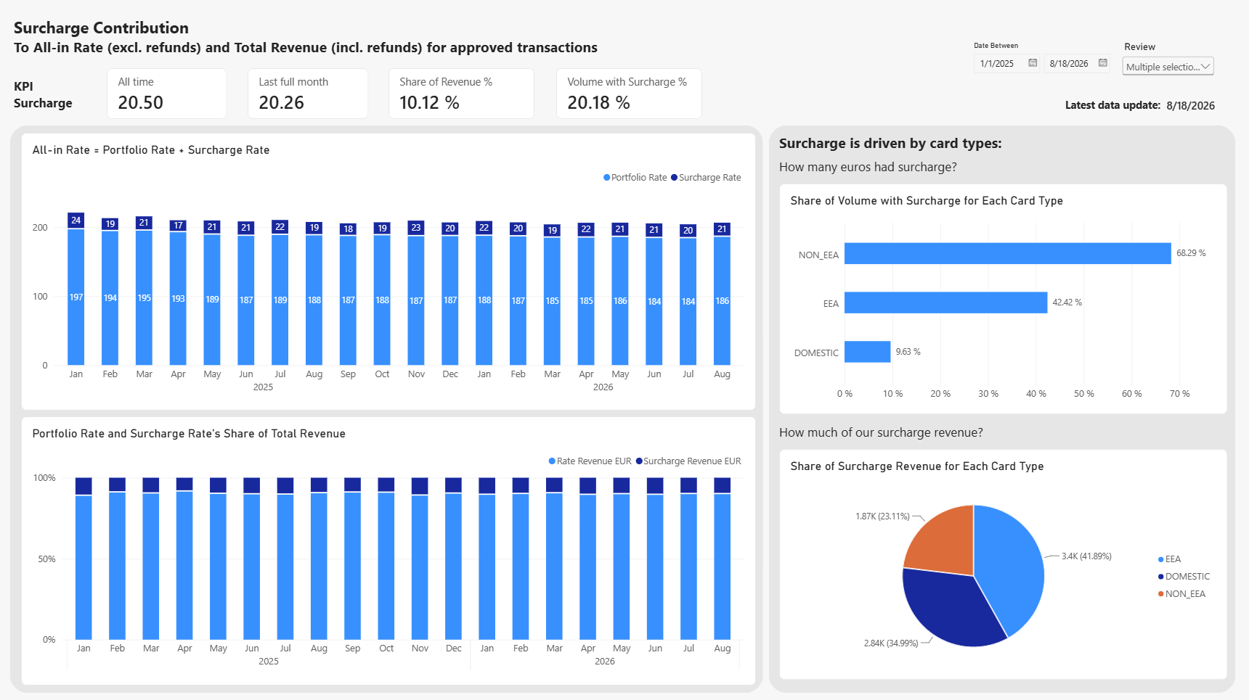
Surcharge Contribution
- How much surcharge as a product adds to the portfolio rate
Description:
Surcharge is an extra fee on top of the base rate, applied on certain card payments.
Surcharge is a way to protect earnings without lowering or raising the headline price: offer a lower base rate to win customers and recover it via surcharge on the expensive cards.
Main business question:
Is the surcharge product worth it, and should we push it harder?
Stakeholders:
Head of Pricing (KPI Owner):
Does the surcharge policy work? Is it applied where it should be?
CFO / Finance:
How much of revenue depends on surcharge? How stable is it?
KPI:
Surcharge Rate
Sum of (amount_eur * surcharge_bps) / sum of amount_eur
Where status is APPROVED, event_type is SALE
Surcharge Share of Revenue %
Surcharge revenue / Total revenue
Volume with Surcharge %
Share of volume with surcharge > 0
Findings:
Surcharge rate adds around 21 bps to the total rate, contributing to 10% of the total revenue, quite stable over time.
Even though we earn more per Euros for Non-EEA card on average, our main surcharge revenue comes from EEA card and Domestic card with almost 80%.
Further analysis:
Legal & Compliance stakeholders: surcharge is regulated in EU. Is it applied correctly?

Slide 6
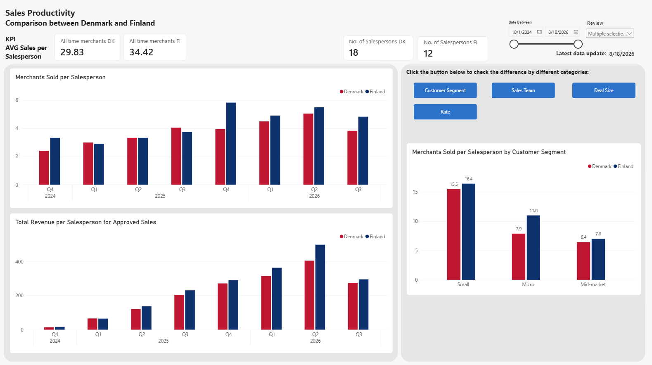
Sales Productivity
- Denmark and Finland
Description:
As in the findings from Revenue Growth, Aster Lane grows by new merchants. So sales productivity is the growth engine.
Main business question:
How productive are our sales teams, and
is one country doing something the other can learn from?
Stakeholders:
Head of Sales (KPI Owner):
Compare teams, set targets, decide on hiring
Country managers (DK and FI):
How their team performs vs. the other country
KPI:
AVG Sales per Salesperson in Merchants
AVG Sales per Salesperson in Revenue
Finding:
Finland is doing better than Denmark for most of the time, whether sales in merchants sold or in revenue merchants brought.
Finland sells more Micro merchants, at a high rate, while Denmark sells fewer, bigger deals, at a lower rate.
Denmark team has a wider spread in terms of sales performance. Denmark South team is the weakest.
Further analysis:
Sales strategy difference in all teams
Salesperson data: time on the job, vacation, etc
Sales quality: churn and activation per salesperson

Slide 7
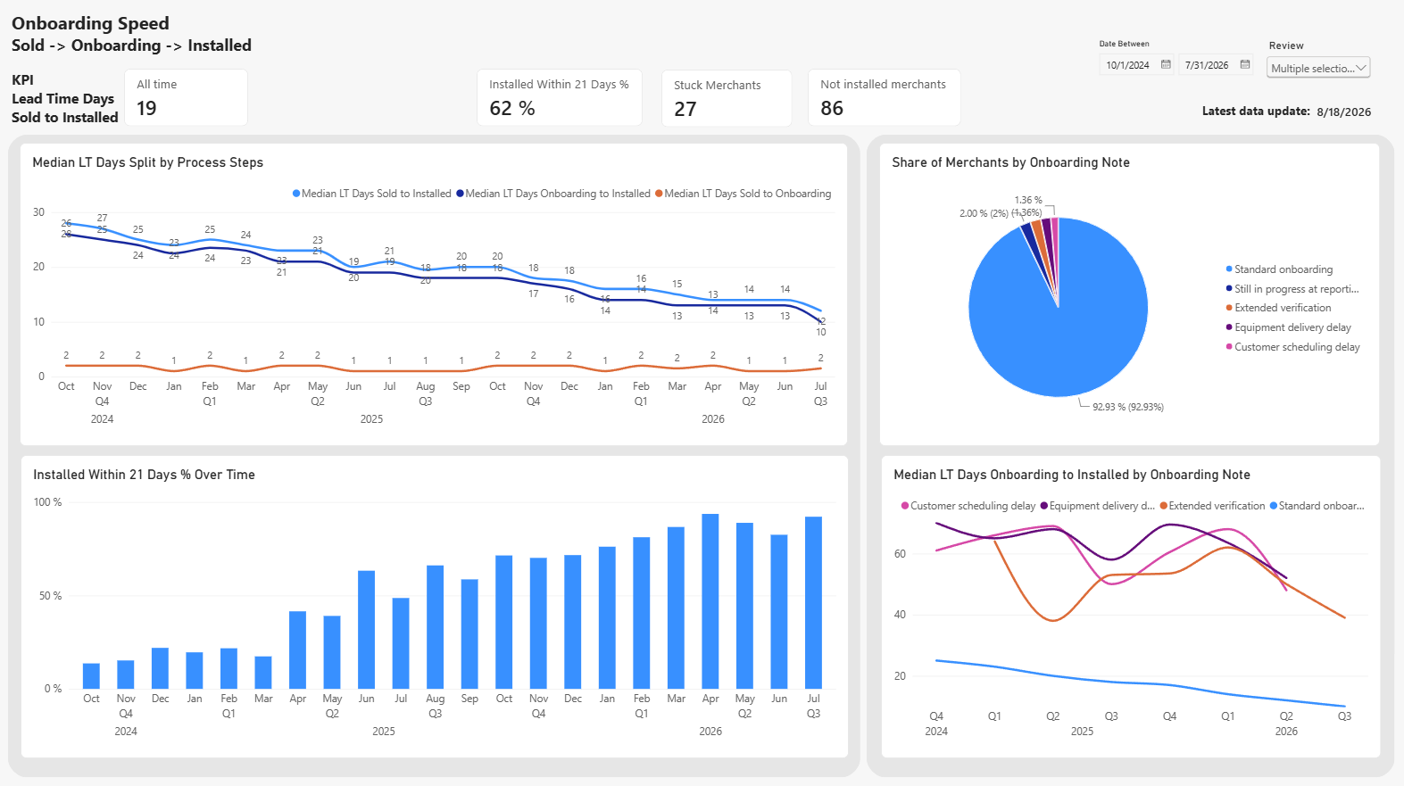
Onboarding Speed
- Is the business getting better at onboarding customers faster?
Description:
Onboarding is the gap between sold and earning.
Main business question:
How quickly does a signed customer start generating revenue,
and is it getting faster?
Stakeholders:
Head of Operations / Onboarding (KPI Owner):
Process efficiency, bottlenecks, capacity
Logistics / hardware:
Equipment delivery, the biggest delay reason
KPI:
Median LT days, sold → installed
Median of (Installed − Sold)
% installed within 21 days
Share of the cohort installed ≤ 21 days after sale
Finding:
The drop is entirely in the process from Onboarding to Installed with median LT from 26 to 10 days, while it always takes 1-2 days from Sold to Onboarding.
93% of the merchants went through standard onboarding, and the median LT for standard onboarding has dropped from 25 to 12 days. There’s a general process improvement in company onboarding process.
Further analysis:
Customer experience
Comparison between different countries
Lead time from installed to first transactions

Slide 8
Key Takeaways
Next Steps
Growth comes from more merchants.
  Active merchants are up 10 times since Jan 2025. Portfolio rate is falling, mainly in mid-market segment.
Finland sold 15% more per salesperson, mainly because they sold more small and quick micro deals. Denmark team’s performance was more widely distributed.
Onboarding time dropped more than 50% over time. 93% merchant went through standard process, 5% facing delays. Improvements in company onboarding process.
Risk: 80% of the surcharge revenue comes from EEA and domestic cards, where EU surcharge rules are strict.
Alignment meetings with stakeholders to confirm on:
  Data quality
  Their expectations and needs
  KPI and dashboard setup
Compliance check on surcharge in EU
Deep dive analysis on operational dashboards & reporting
Dashboard design:
  KPI set up (colours for trends and targets)
  Some more texts that help reading
  Interactions between charts and slicers
  Colour palette: fit for company theme and colour-blindness people

