Slide 1

Chapter 7
Low-Level Programming Languages
Nell Dale • John Lewis

Slide 2

Chapter Goals
List the operations that a computer can perform
Discuss the relationship between levels of abstraction and the determination of concrete algorithm steps
Describe the important features of the Pep/7 virtual machine
Distinguish between immediate mode addressing and direct addressing
Convert a simple algorithm into a machine-language program

Slide 3
Chapter Goals (cont.)
Distinguish between machine language and assembly language
Describe the steps in creating and running an assembly-language program
Convert a simple algorithm into an assembly-language program
Distinguish between instructions to the assembler and instructions to be translated
Describe two approaches to testing
Design and implement a test plan for a simple assembly-language program

Slide 4
Computer Operations
A computer is a programmable electronic device that can store, retrieve, and process data
Data and instructions to manipulate the data are logically the same and can be stored in the same place
Store, retrieve, and process are actions that the computer can perform on data

Slide 5
Machine Language
Machine language: the instructions built into the hardware of a particular computer
Initially, humans had no choice but to write programs in machine language because other programming languages had not yet been invented

Slide 6
Machine Language
Every processor type has its own set
of specific machine instructions
The relationship between the processor and the instructions it can carry out is completely integrated
Each machine-language instruction does only one very low-level task

Slide 7
Pep/7: A Virtual Computer
A virtual computer is a hypothetical machine designed to contain the important features of real computers that we want
to illustrated
Pep/7
  designed by Stanley Warford
  has 32 machine-language instructions
We are only going to examine a few
of these instructions

Slide 8
Features in Pep/7
The memory unit is made up of 4,096 bytes
of storage
Pep/7 has seven registers, three of which we focus on at this point
  The program counter (PC) (contains the address
  of the next instruction to be executed)
  The instruction register (IR)
  (contains a copy of the instruction being executed)
  The accumulator (A register)
Pep/7 has four status bits, of which we examine two:
  N: 1 if the A register is negative, 0 otherwise
  Z: 1 if the A register is zero, 0 otherwise

Slide 9
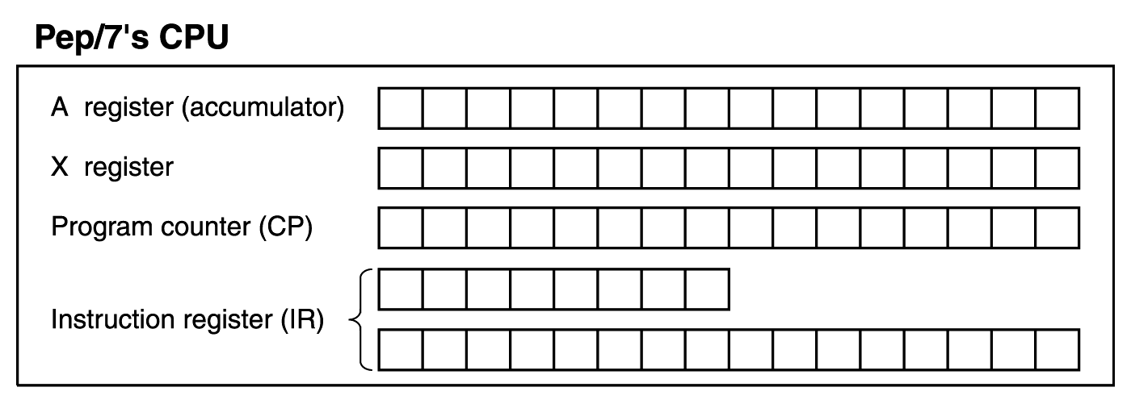
Features in Pep/7
Figure 7.1 Pep/7’s architecture

Slide 10
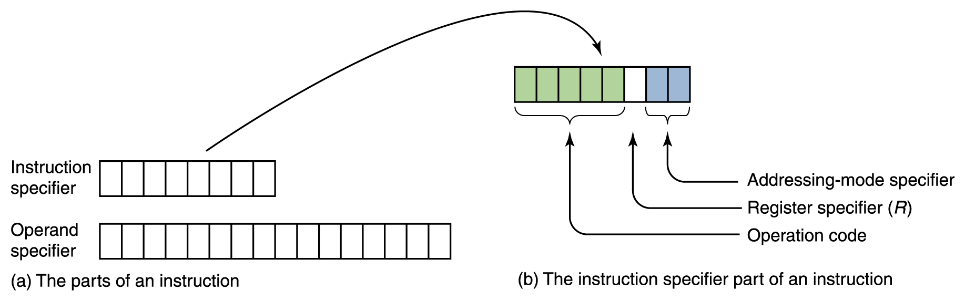
Instruction Format
There are two parts to an instruction
  The 8-bit instruction specifier
  And optionally, the 16-bit operand specifier
Figure 7.2 The Pep/7 instruction format

Slide 11
Instruction Format
The instruction specifier is made up of several sections
  The operation code
  The register specifier
  The addressing-mode specifier

Slide 12
Instruction Format
The operation code specifies which instruction is to be carried out
The 1-bit register specifier is 0 if register A (the accumulator) is involved in the operation and 1 if register X (the index register) is involved. In the examples discussed in the textbook, The register specifier is always 0.
The 2-bit addressing-mode specifier says how to interpret the operand part of the instruction

Slide 13
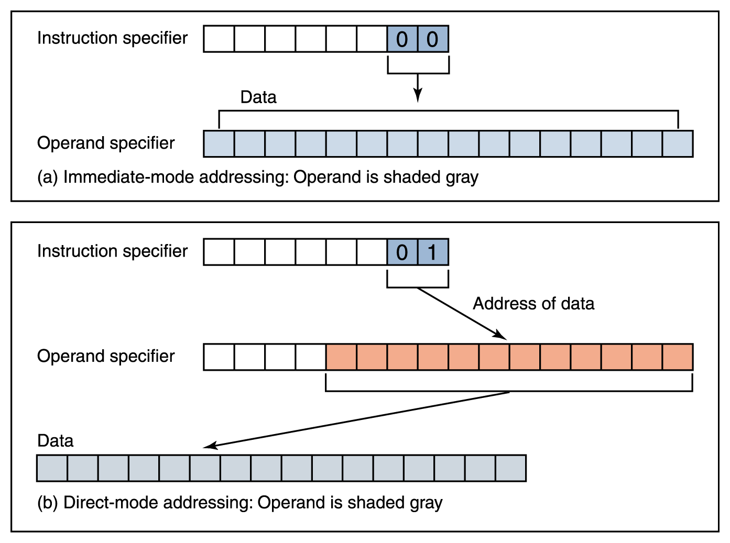
Instruction Format
Figure 7.3 Difference between immediate-mode and direct-mode addressing

Slide 14
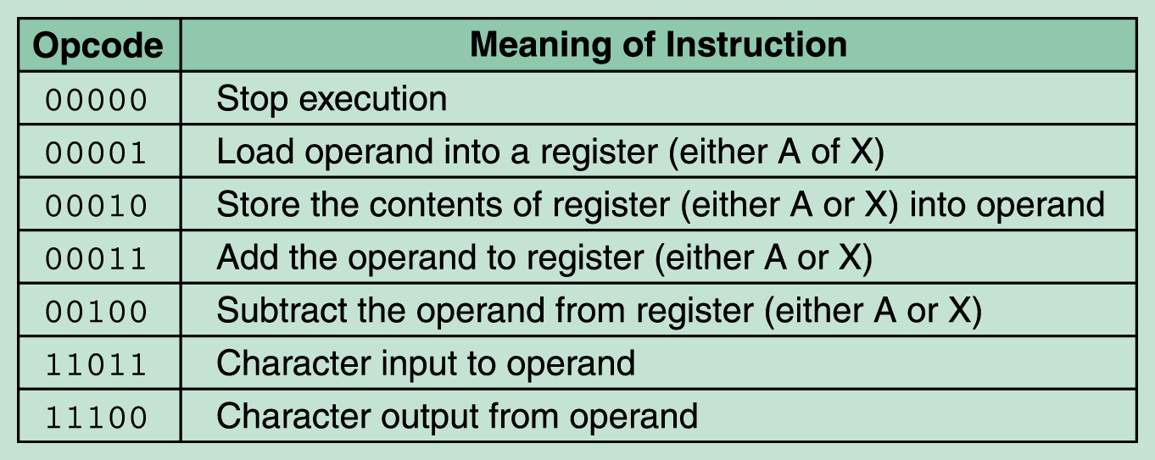
Some Sample Instructions
unary instruction
Figure 7.3 Subset of Pep/7 instructions

Slide 15
Example Instructions
LOAD
  00001 0 00 (08)
  0000 0000 0000 0111 (00 07)
  00001 0 01 (09)
  0000 0000 0001 1111 (00 1F)
STORE
  00010 0 01 (11)
  0000 0000 0000 1010 (00 0A)

Slide 16
Example Instructions
ADD
  00011 0 00 (18)
  0000 0010 0000 1010 (02 0A)
  00011 0 01 (19)
  0000 0010 0000 1010 (02 0A)
Character Input to operand
  11011 0 01 (D9)
  0000 0000 0000 1010 (00 0A)
Character Output from operand
  11100 0 00 (E0)
  0000 0000 0100 0001 (00 41)
  11100 0 01 (E1)
  0000 0000 0000 1010 (00 0A)
(65)₁₀, 參考 第 3 章, A
one byte

Slide 17
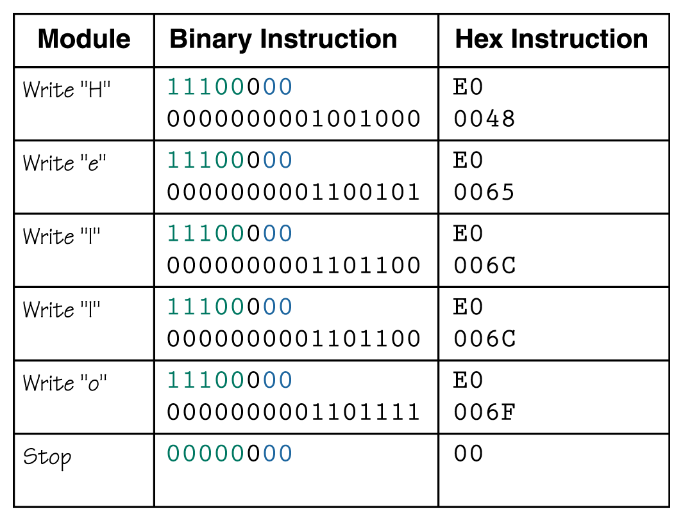
A Program Example
Let’s write "Hello" on the screen
Page 211,
程式 Ch05/Pr0504.odc

Slide 18
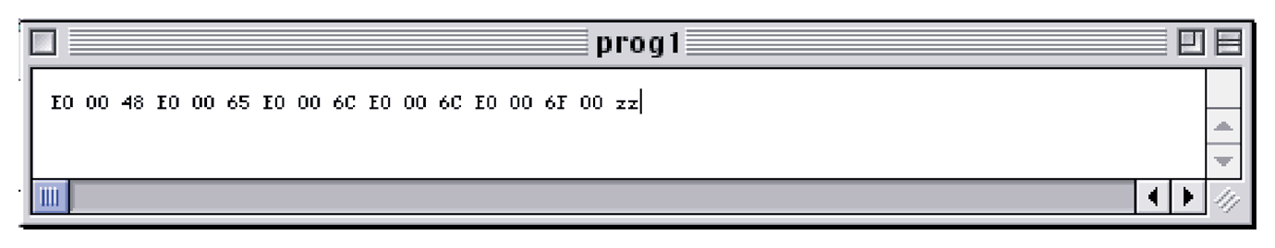
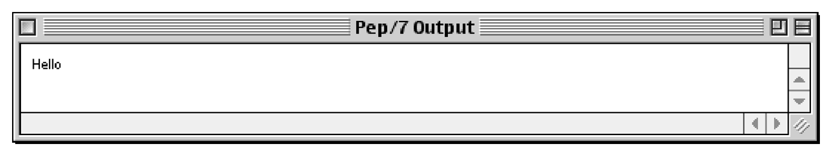
Pep/7 Simulator
A program that behaves just like the Pep/7 virtual machine behaves
To run a program, we enter the hexadecimal code, byte by byte with blanks between each
Page 202

Slide 19
Assembly Language
Assembly languages: assign mnemonic letter codes to each machine-language instruction
  The programmer uses these letter codes in place of binary digits
  A program called an assembler reads each
  of the instructions in mnemonic form and translates it into the machine-language equivalent

Slide 20
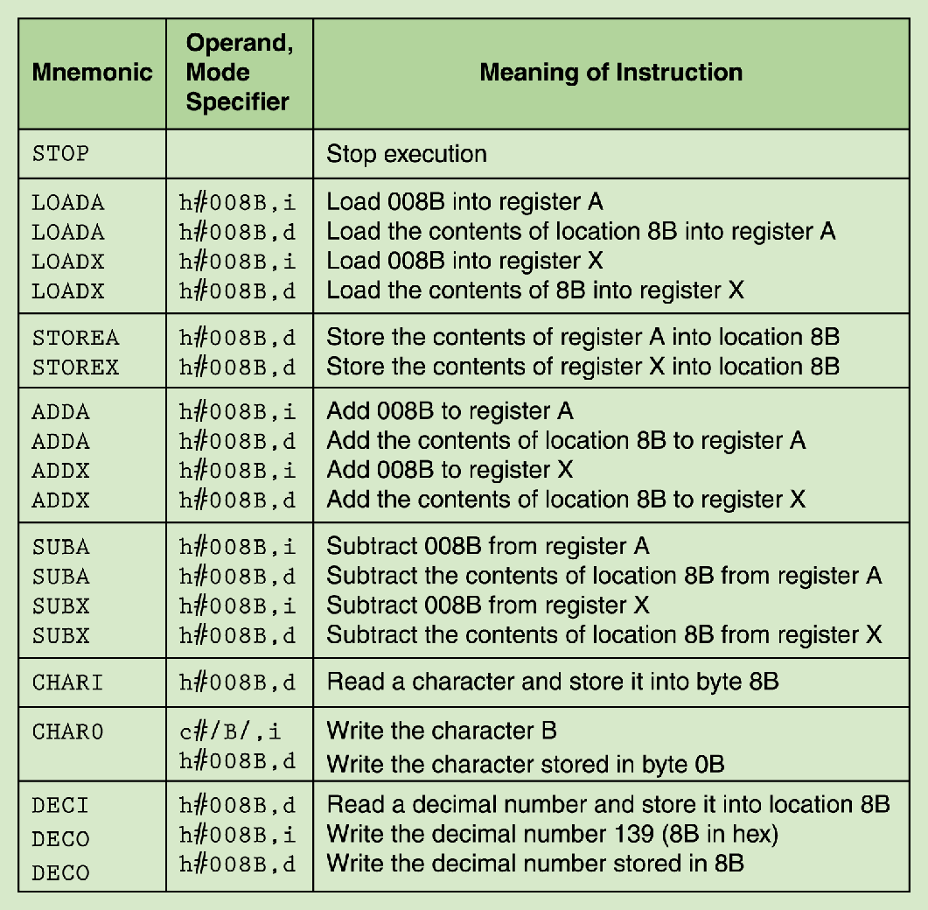
Pep/7 Assembly Language
Page 216

Slide 21
Pseudo-Operations
Pseudo-Op | Operand | Meaning
.ASCII | /…/ | Store the characters between the / / into memory
.BLOCK | d#3 | Generate three bytes of storage and set each byte to zero
.WORD | d#5 | Generate a word with the decimal value 5 stored in it
.WORD | h#0105 | Generate a word with the hexadecimal value 0105 stored in it
.END |  | Signals the end of the assembly-language program

Slide 22
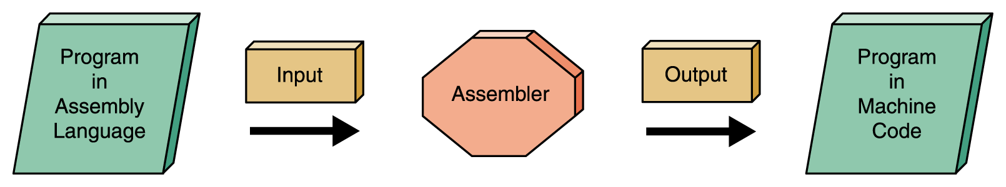
Figure 7.5 Assembly Process

Slide 23
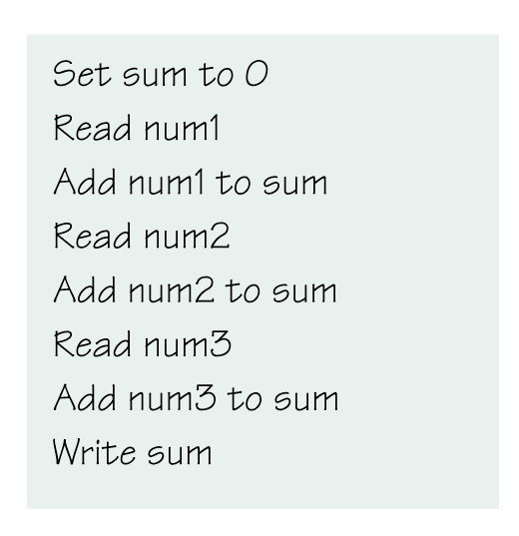
A New Program
Page 219
類似程式 Ch05/Pr0512.odc

Slide 24
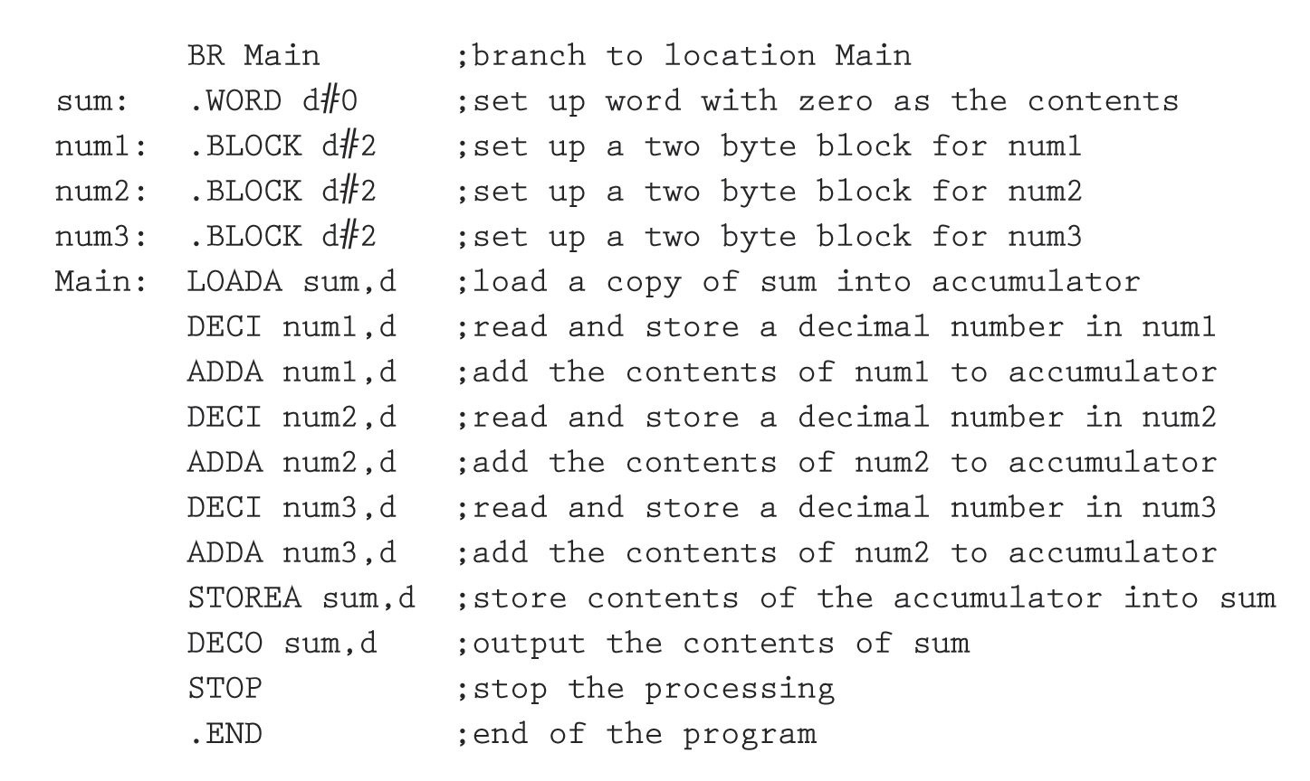
Our Completed Program
Page 221

Slide 25
Status Bits
Status bits allow a program to make a choice
  BRLT: if N is 1, then set the Program Counter (PC) to the operand (N is 1 means A register is less than 0)
  BREQ: if Z is 1, then set the Program Counter (PC) to the operand (Z is 1 means A register is equal to 0)
  Example program
    Ch06/Pr0602.odc
    Ch06/Pr0604.odc

Slide 26
Testing
Test plan: a document that specifies how many times and with what data the program must be run in order to thoroughly test the program
A code-coverage approach designs test cases
to ensure that each statement in the program
is executed. This is also called clear-box testing.
Data-coverage testing is another approach;
it designs test cases to ensure that the limits
of the allowable data are covered. This is also called black-box testing.

Slide 27
Ethical Issues:
Software Piracy, Copyrighting
Research indicated that, globally, 11.5 billion dollars were lost in the year 2000 to pirated software
Advocates of open-source code believe that a program’s original source code should be in the public domain
Respecting the copyrights of software, if it is not open code, is important from a number of perspectives

