Slide 1
Secure MPC API
Linshan Jiang, Wenjun Shen, Tianqi Xu

Slide 2


Client-Server
user
Central router
user
user
Notes:
Each $P_{i}$ sends $r_{i,2}$, $r_{i,3}$ to P1, $r_{i,1}$, $r_{i,3}$ to P2, and $r_{i,1}$, $r_{i,2}$ to P3. So P1 now holds $r_{1,2}$, $r_{1,3}$ , $r_{2,2}$, $r_{2,3}$ and $r_{3,2}$, $r_{3,3}$.

Slide 3
Secure multiparty Addition
Assumptions:
Semi-honest adversary
Scalability: up to any n parties (to make it secure, obviously you want more than 2 parties)
API:
MPCSecretAddition mpc = new MPCSecretAddition(SERVERPORT,SERVER_IP,numParties,secret); int result = mpc.sendMessage();

Slide 4
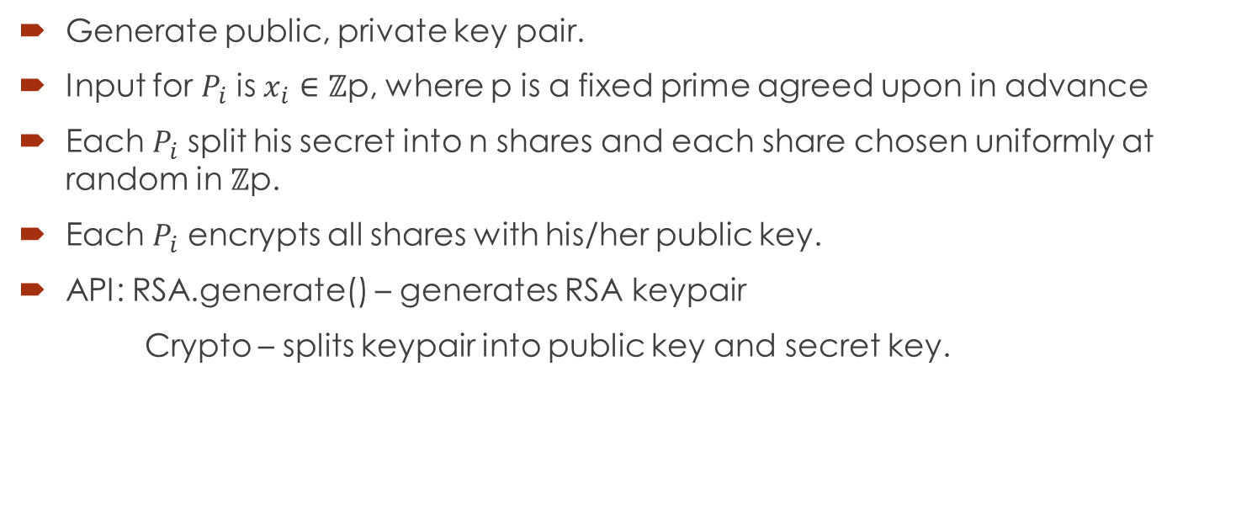
Encryption Phase
Generate public, private key pair.
Input for $P_{i}$ is $x_{i}∈$ ℤp, where p is a fixed prime agreed upon in advance
Each $P_{i}$ split his secret into n shares and each share chosen uniformly at random in ℤp.
Each $P_{i}$ encrypts all shares with his/her public key.
API: RSA.generate() – generates RSA keypair
Crypto – splits keypair into public key and secret key.

Slide 5

Pre-Transfer Phase
$P_{i}$ Connect to server and server echoes back the player with id $P_{i}$.
Wait until all the specified users connect to server successfully.
When all users connect to server, server signals all users it’s ready start transfer messages.

Slide 6

Key Exchange Phase
$P_{i}$ broadcasts public key to all users through the server.
$P_{i}$ receives other user’s public key and stores.

Slide 7

Transfer Phase
Each $P$ sends encrypted $ith$share to $P_{i}$using $P_{i}$’s public key.(Note that P will send the share to himself. In this case, we store the share directly instead of sending it.)

Slide 8
Decryption Phase
Pj decrypts each incoming shares with his/her private key.
Each Pj adds corresponding shares of all shares of secrets and obtains the combined sum.

Slide 9
Broadcast Summed Shares to All Parties
Last phase is broadcasting the summed shares obtained in last phase to all parties (encrypted using their public keys).
Each party receiving all the summed shares, decrypt them and add all up to obtain the final output.

Slide 10
Server Implementation
Server will learn nothing since messages are encrypted.
Functionalities include:
broadcast messages to all users. – used in key exchange phase and last phase
Send message to specific user. – used in transfer phase where parties send ith share to ith party.
Communication through socket.
Notifies parties when all of them are joined.
Need to specify port number and party number.
Deploy on csa2 so far.

Slide 11
Screencast
Applied cases:
Calculate sum of salary
Vote(limit to only 1s and 0s)

Slide 12
Minimum of Summed Vectors
Applied Case: Some friends want to find a coffee shop to meet as close as possible but they don’t want to expose their locations.
Assume each person has a canonical distance vector vi.
We sum up all the vectors and compute the minimum all under MPC.
Difficulties: Using secure addition we already built, we can compute summed vectors. However, since we revealed this sum to all parties, it may leak some user privacy.

Slide 13
Different Approach
What if we don’t need a closed coffee shop to all parties, but compute the best “preferred” shop to all parties.
Say I have a distance vector to shop A,B,C: [10, 5, 7] miles.
I first convert this distance vector to preference vector: [3, 1, 2].
This way I can hide the real distance vector.
And then do a vector sum over all preference vectors among parties.
With all parties know the sum of preference vectors, they can compute min using non-MPC method to determine which shop they should go to.
Again, this approach is not secure when party # < 2, same as addition.

