Slide 1



FIFA AI INNOVATION SHOWCASE
RefVision
Officiating Console
Pose-only referee decision-support for football. Mark the point of contact; it grades the challenge and lays its read beside the referee's on-field call.
Lau Wen Jun (wlau14)
github.com/wenjun78/FIFA
CPU-only · No GPU · On-device · Human-in-the-loop

Slide 2



THE CHALLENGE
Split-second calls, little support
Real-time judgement
VAR is heavy
Calls get contested
Referees rule on contact, speed and intent in a fraction of a second — often from one angle.
Multi-camera rigs, dedicated operators and cost keep full review out of reach for most matches.
Without transparent evidence, marginal decisions are hard to explain and harder to defend.

Slide 3




THE APPROACH
Decision-support that runs on a laptop
RefVision reads body pose from a single clip and finds the moment of contact. The official marks the exact point; it grades the challenge from measurable evidence and shows its read beside the referee's on-field call — never overruling it.
Find contact
Mark the point
CPU-only
No GPU
Grade it
Compare to call
No external model APIs
Human-in-the-loop

Slide 4
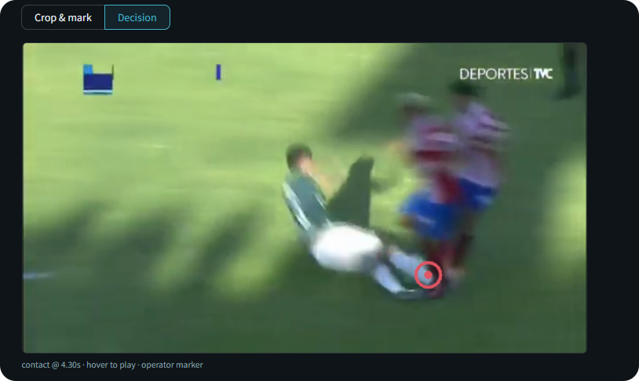


THE CONSOLE
Mark the contact. Get the call.
Click the point of contact
Straight on the frozen frame — the marker snaps there.
Set the ±n replay window
How much slow-mo to show around the contact.
Confirm
The challenge is graded at the point you marked.
Read the call
Beside the referee's signal, with the evidence.

Slide 5
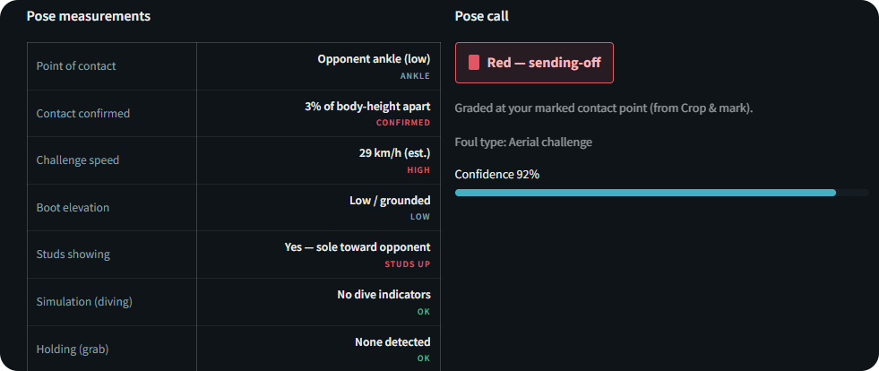
THE READ · LIVE FROM THE CONSOLE
It doesn't just flag. It grades.
RED
92%
29 km/h
STUDS UP
SENDING-OFF
CONFIDENCE
CLOSING SPEED
SOLE TO OPPONENT
A real slide-tackle graded by the pose engine — the call with its evidence, exactly as the console shows it.

Slide 6

PIPELINE
From footage to a defensible call
01
Pose
MediaPipe reads body landmarks across the clip; players are separated by shirt colour.
02
Contact onset
The earliest in-contact frame while both players are upright — the strike, not the collapse.
03
Mark & measure
The official clicks the contact; speed, boot elevation, studs and height are read there.
04
Decide
Severity becomes a call — shown against the referee's on-field signal.

Slide 7


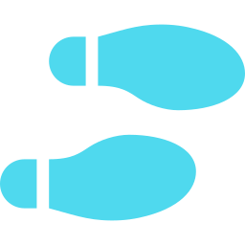

THE EVIDENCE
Readable measurements, not a black box
Closing speed
Boot elevation
Studs
Scaled to each player's height in frame — km/h without a fixed camera.
A raised, airborne lunge — caught even when contact lands low.
Sole orientation toward the opponent.
Contact height
Holding
Aerial & simulation
Where on the body contact lands — set by the marker.
Sustained hand-on-torso across frames.
Arm/elbow to the head; dives with no confirmed contact.

Slide 8
THE WORKFLOW
Two tabs: mark it, then decide
TAB 01
TAB 02
Crop & mark
Decision
Scrub to the contact frame
±n replay that pauses ~2 s at contact
Click the frame to place the contact point
Pose measurements — speed, boot, studs, height
Set the ±n replay window
The call, with confidence and a review flag
Confirm — the challenge is graded there
Laid beside the referee's on-field signal

Slide 9



WHY IT'S DIFFERENT
Built for the touchline, not the data centre
Runs anywhere
Human-in-the-loop
No GPU, no cloud, no external model APIs — it runs on a standard laptop.
The official marks the contact and owns the final call.
Transparent
Support, not automation
Every call is backed by measurements a referee can read and explain.
RefVision measures and compares; the referee decides.

Slide 10


BONUS · THE OFFICIATING GAME
Now you're the referee.
Part demo, part game: turn the camera on yourself, make a referee's signal, and RefVision reads your arms, names the decision, and logs it — live, on-device, no cloud, no LLM.
● LIVE
camera on the referee
IT KNOWS FIVE SIGNALS
Goal
Penalty
Advantage
signal read from the arms
Yellow card
Red card
MATCH DECISION LOG
88:12
Penalty
wenjun78.github.io/FIFA/RefVision/docs/refvision.html
64:30
Yellow card
22:05
Goal

Slide 11




UNDER THE HOOD
On-device, lightweight, reproducible
MediaPipe
OpenCV
Streamlit
Python 3.11
Multi-person body-pose landmarks on CPU.
Frame sampling, cropping and the replay.
The interactive officiating console.
Pure-Python scoring engine, no heavy deps.
~9 MB pose model downloads once on first run. No ffmpeg. No GPU. No external model APIs.

Slide 12
GET STARTED
Try it
Repository
bash
github.com/wenjun78/FIFA
git clone https://github.com/wenjun78/FIFA.git
cd FIFA/RefVision
python -m pip install -r requirements.txt
python -m streamlit run app.py
# opens at http://localhost:8501
Overview page
wenjun78.github.io/FIFA/RefVision/docs/index.html
CPU-only · pose model downloads on first run · pre-screen a clip with check_clip.py.

Slide 13
The official makes the call.
RefVision marks, measures and compares — decision-support for football officiating.
github.com/wenjun78/FIFA
FIFA AI Innovation Showcase

