Slide 1
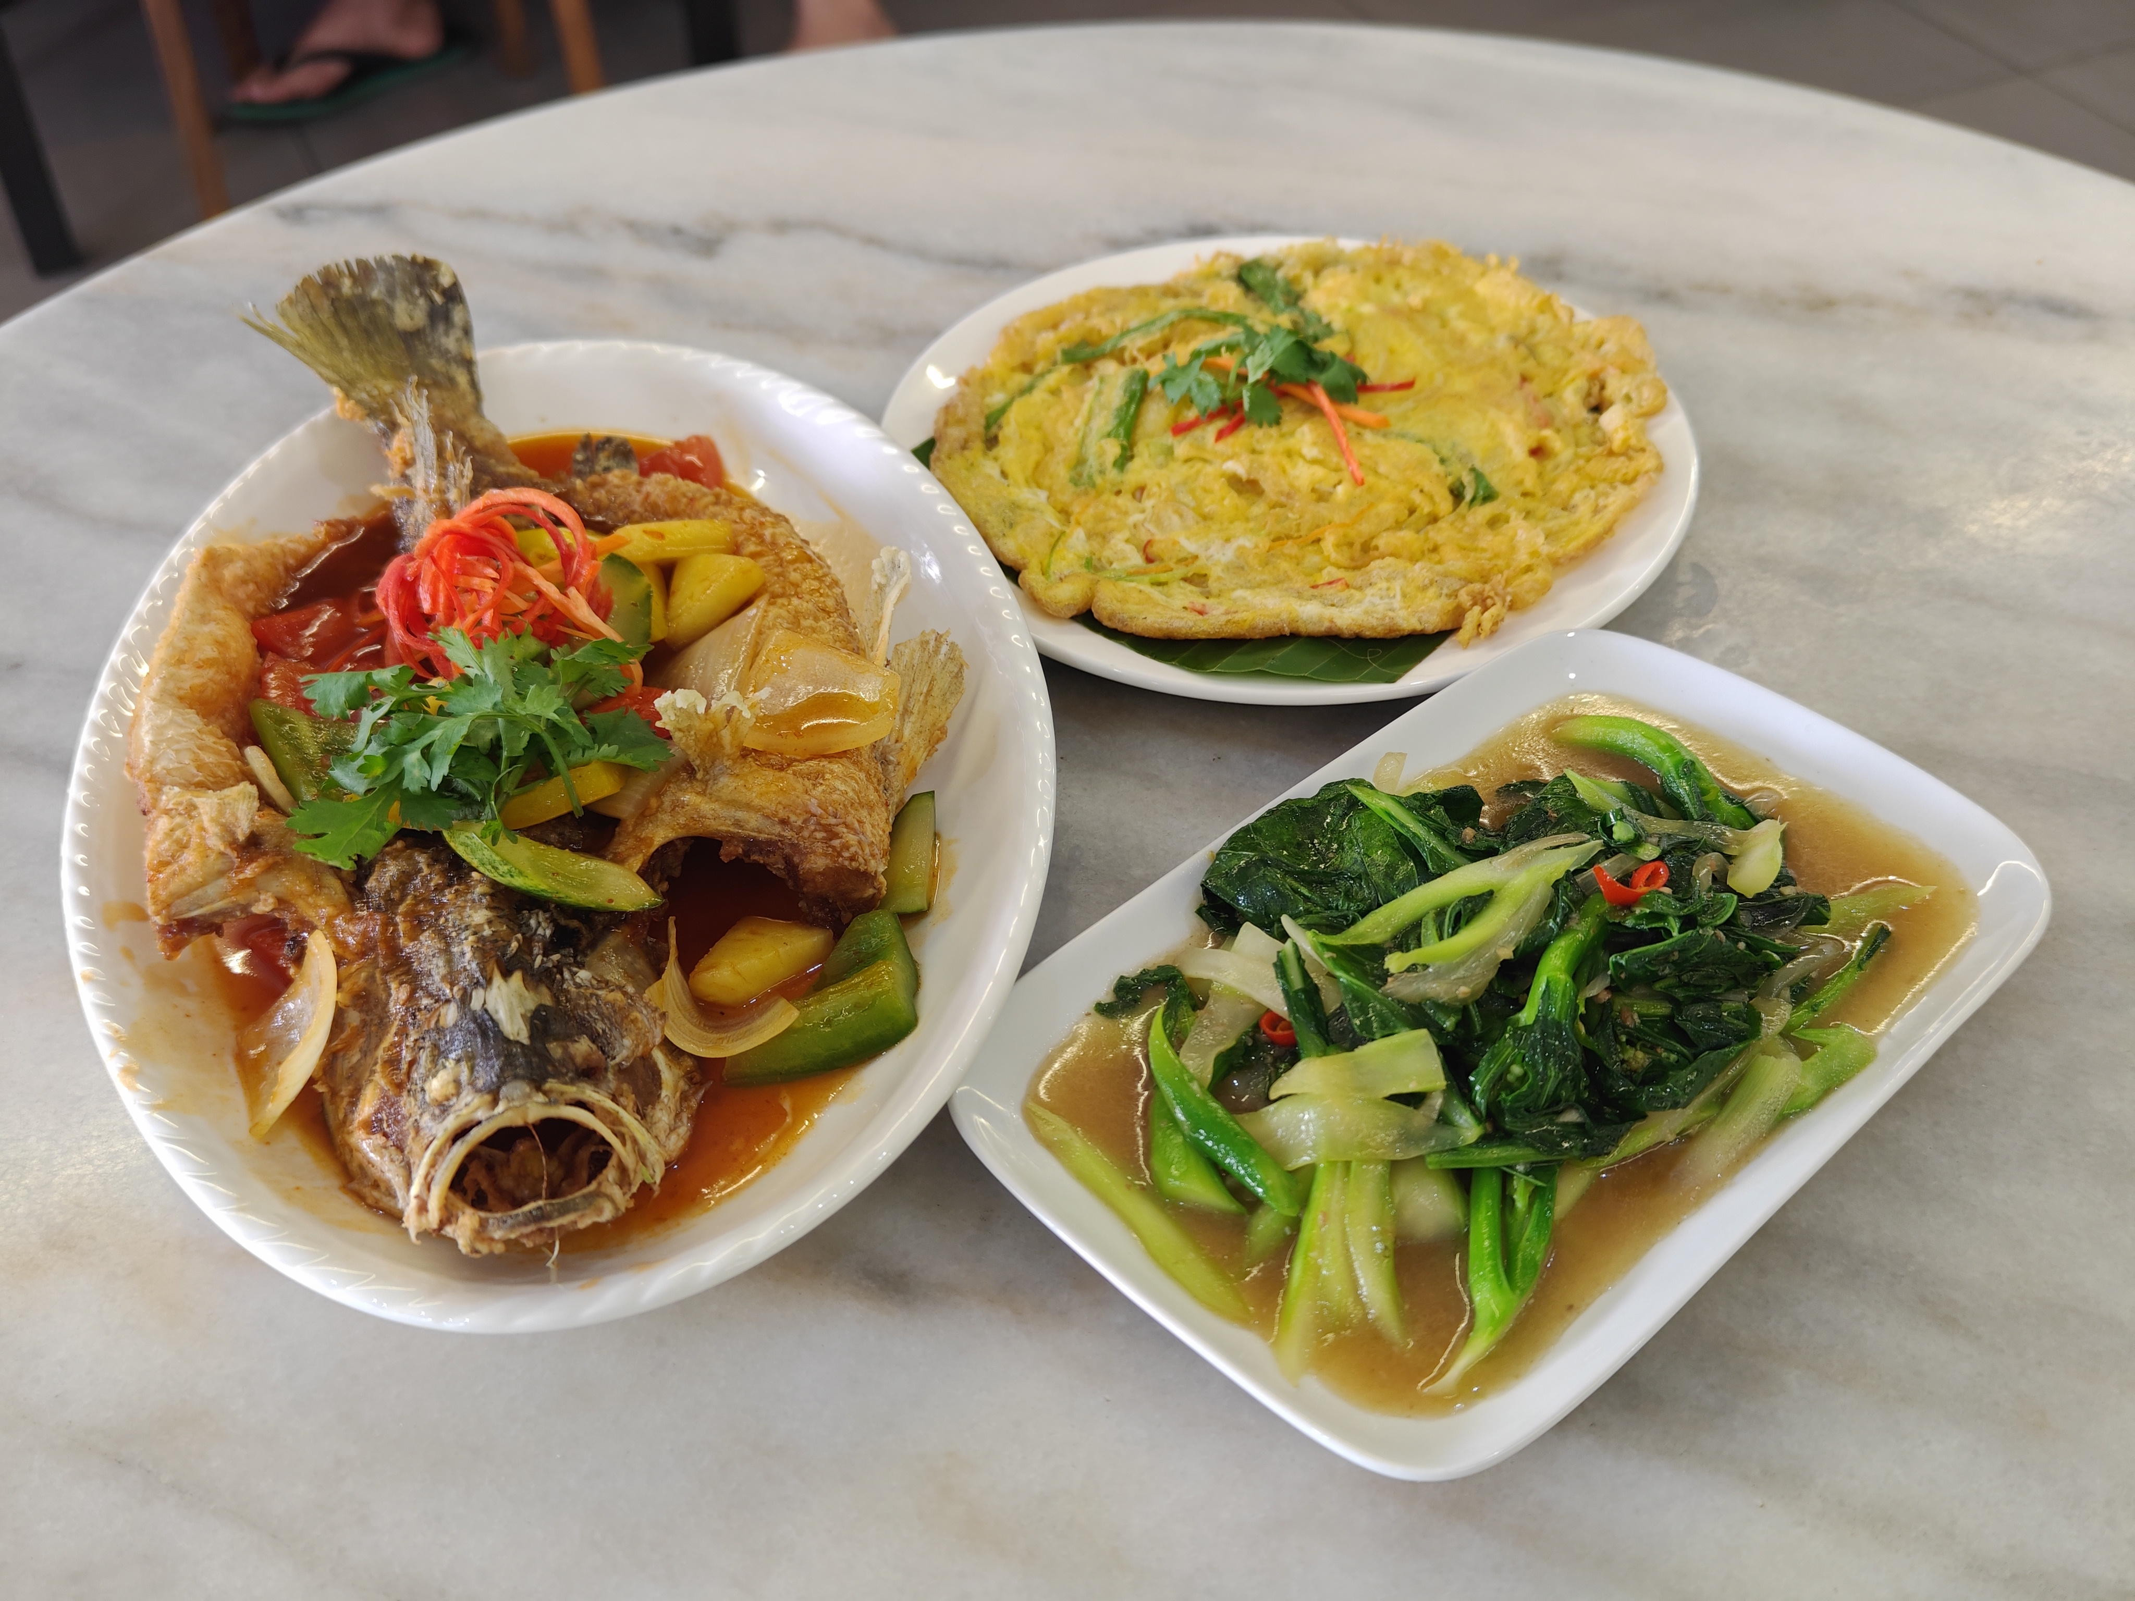
AI-Powered Digital Marketing Specialist
JPK NOSS Course Proposal
3U Pioneer Academy | July 2026

Slide 2
Malaysia's Digital Marketing Skills Gap
4.8 million SMEs in Malaysia — fewer than 20% run structured digital campaigns
AI cuts content creation time by 70% — but only with proper, structured training
HRDC-claimable AI courses are in high demand and oversubscribed nationwide
3U students in F&B, Aesthetic & IT need digital marketing to boost career outcomes
B2B opportunity: Companies like Fitson actively seeking workforce upskilling
REAL RESULT: Pelangi Capsule Hostel achieved 4.9 stars / 5 across Google, Booking.com and Hostelworld — powered by AI content strategy

Slide 3
Course at a Glance
Level 3
RM 8,000
~600 Hours
9 CUs
NOSS Level
Course Fee
Total Duration
Competency Units
30% Theory | 70% Practical | HRDC / PSMB Claimable
HRDC
PSMB
Claimable
Claimable

Slide 4
Who Is This Course For?
SME Owners & Managers
★
Marketing & Content Staff
★
Want to run digital campaigns with AI tools — no coding required.
Create social posts, run ads, engage customers using AI assistance.
F&B, Aesthetic & Hospitality
★
Entrepreneurs & Freelancers
★
Existing 3U students adding digital marketing to their professional toolkit.
Building a personal brand or client services business online.

Slide 5
Course Curriculum — 9 Competency Units
CORE UNITS
ELECTIVE UNITS
C01 Plan Digital Marketing Strategy with AI
✓
E01 Automate Marketing Workflows with AI
C02 Create AI-Assisted Written Content
✓
E02 Optimise Content for AI Search (GEO/SEO)
C03 Generate AI Visual & Graphic Content
✓
C04 Produce AI-Assisted Video & Audio Content
✓
C05 Build AI-Enhanced Digital Presence
Total: 180 hrs Theory + 420 hrs Practical
✓
C06 Execute and Analyse Marketing Campaigns
✓
C07 Implement AI Customer Engagement Strategy
✓

Slide 6
AI Tools You Will Master
AI
IMG
VID
Written Content
Image & Design
Video & Audio
ChatGPT Claude Gemini Copy.ai Multilingual prompts
Lovart AI Midjourney Canva AI DALL-E Magic Eraser
CapCut AI Runway HeyGen ElevenLabs Suno AI
ADS
SEO
AUTO
Social Media & Ads
Website & SEO/GEO
Automation
Facebook Ads TikTok Ads Meta AI Instagram Analytics
Framer WordPress AI GEO Optimisation Google Search Console
n8n Zapier Make WhatsApp Chatbot Scheduled Publishing

Slide 7
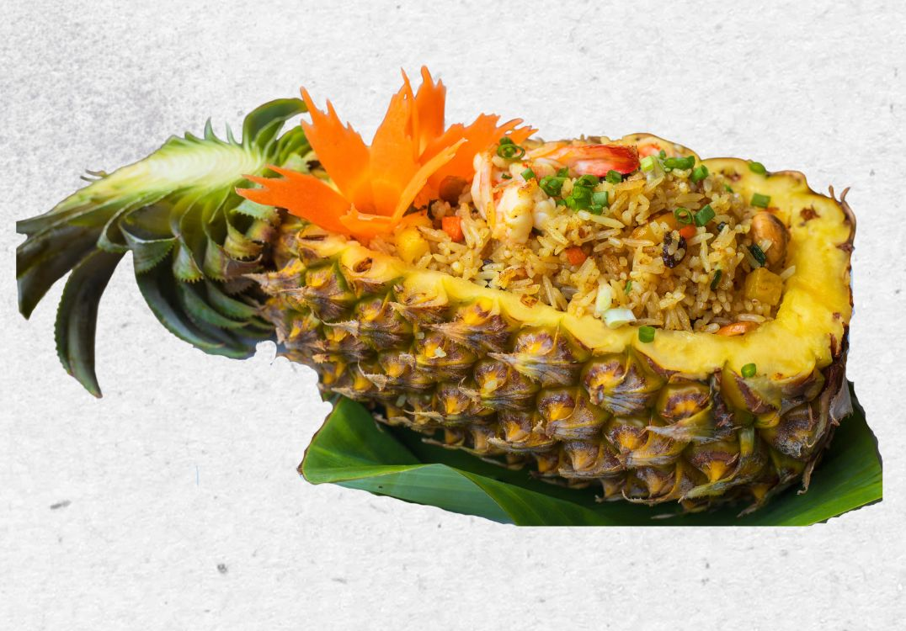
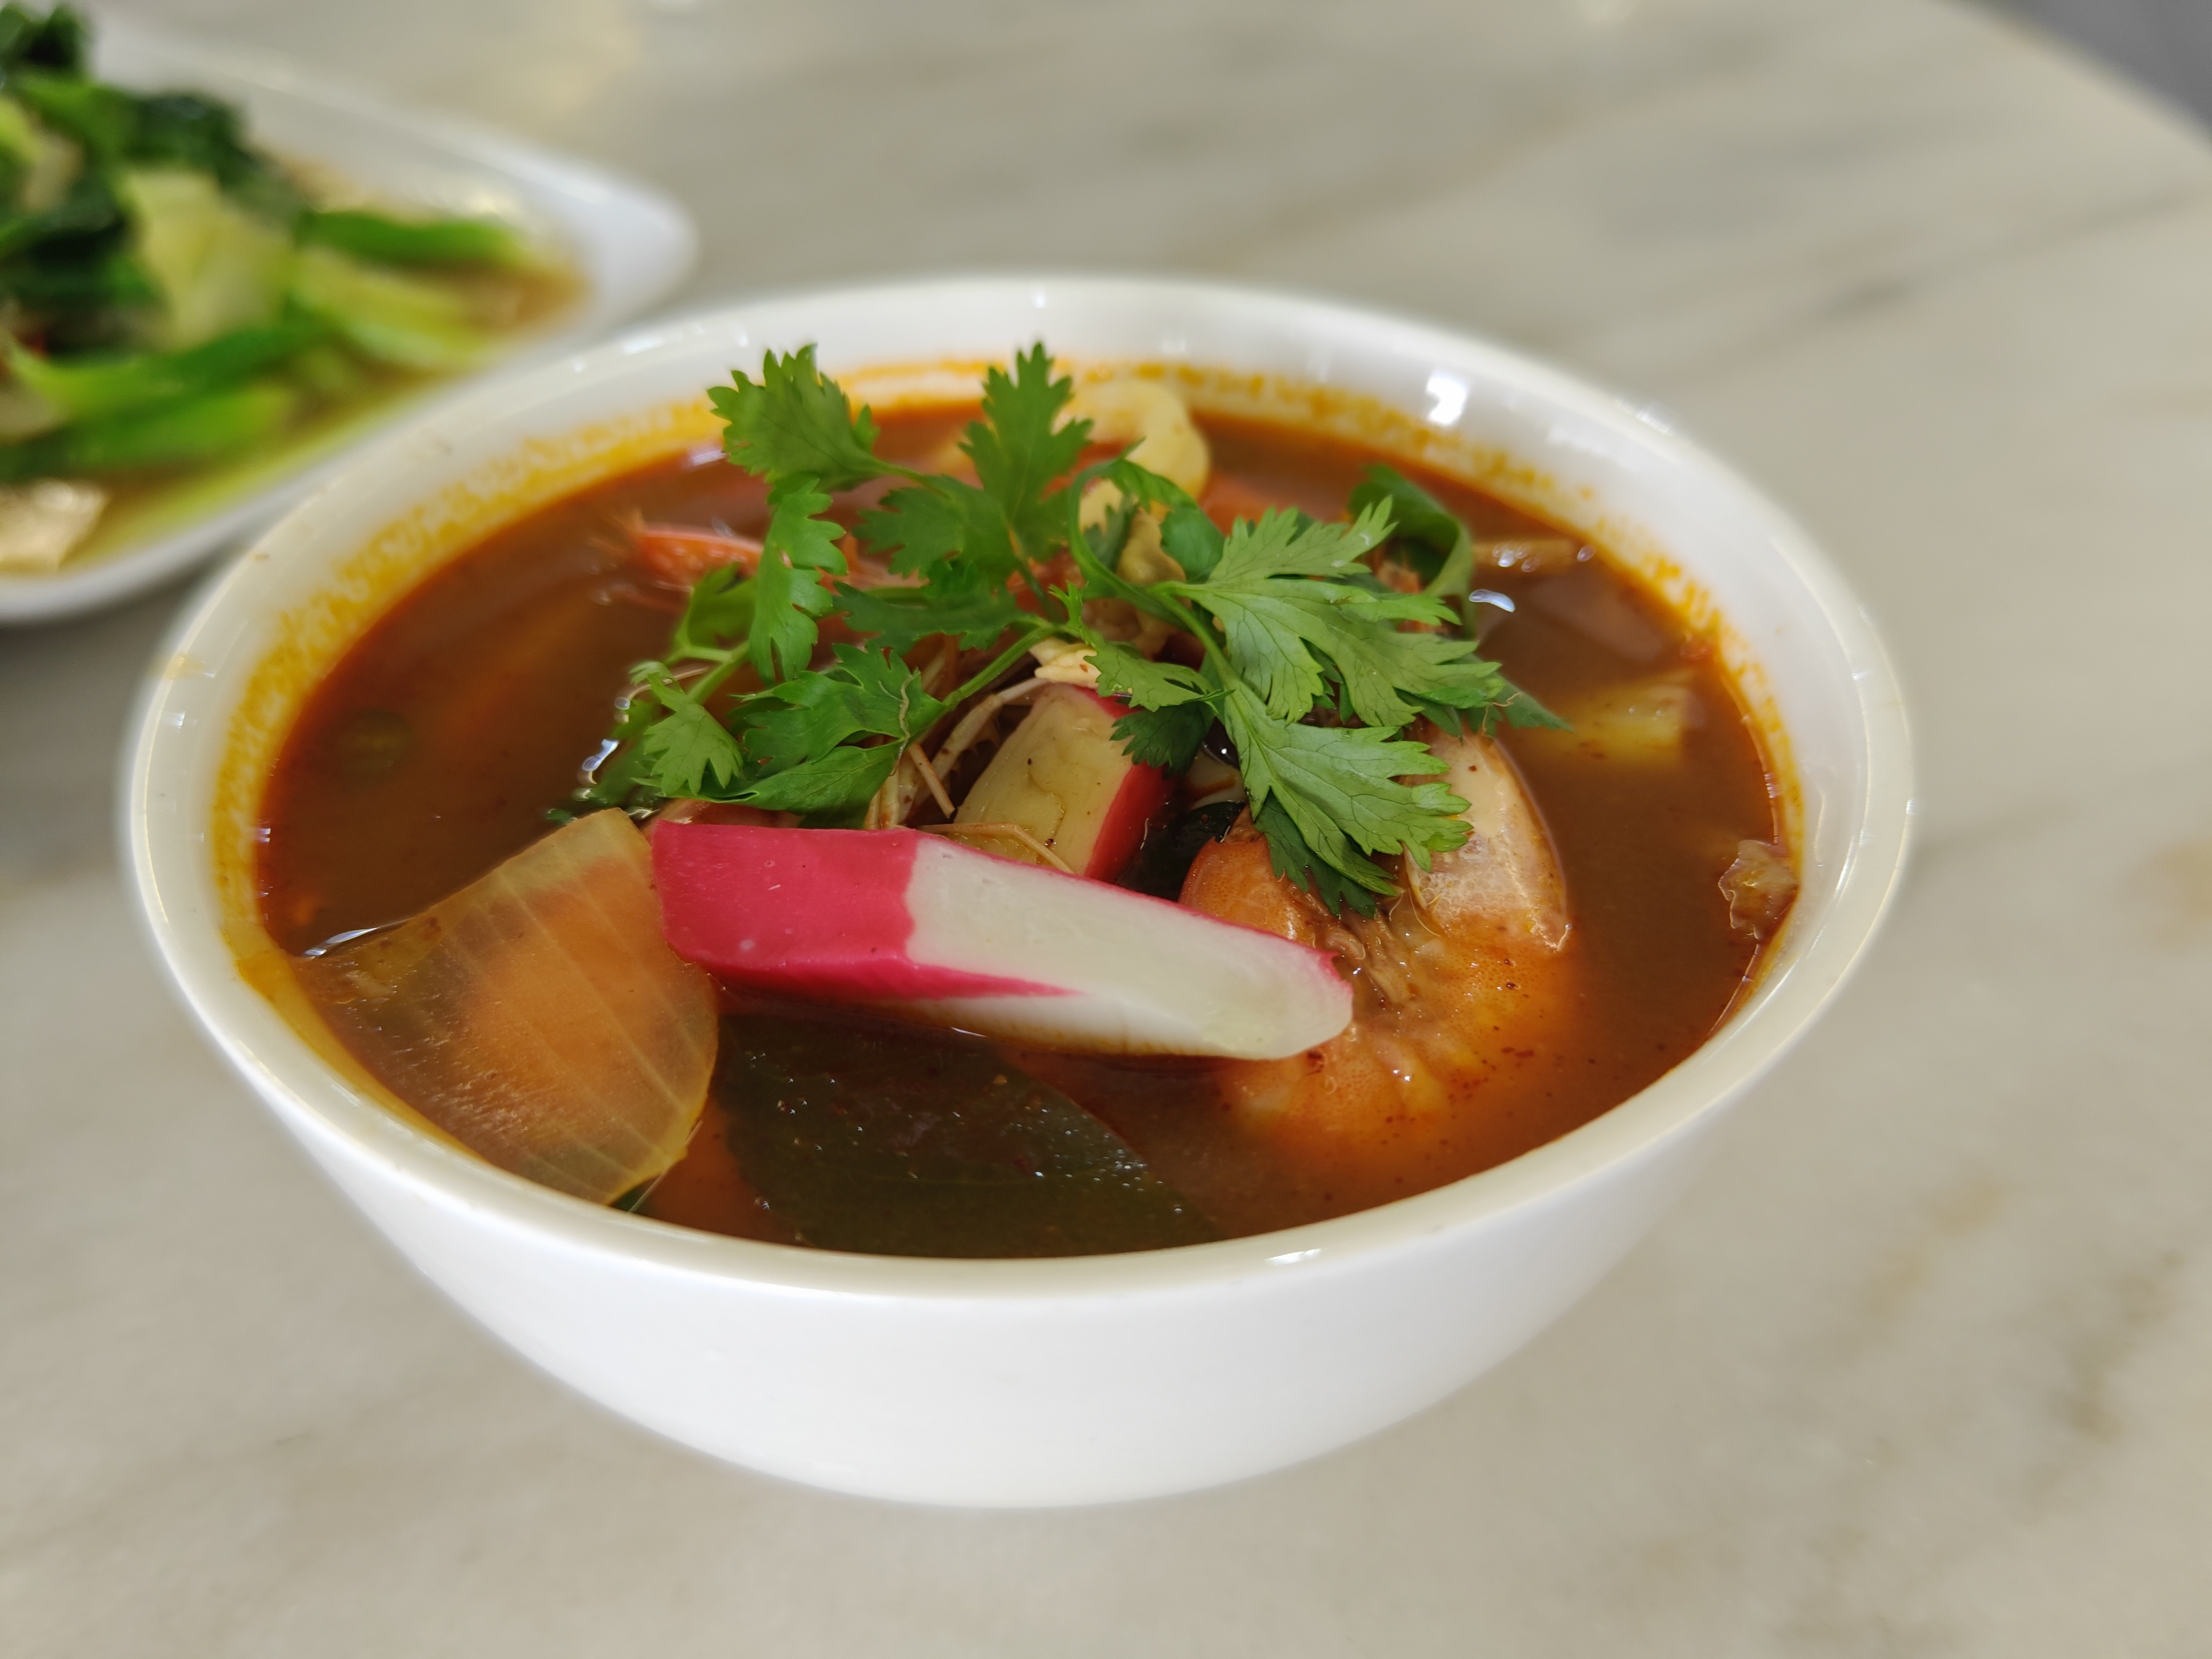
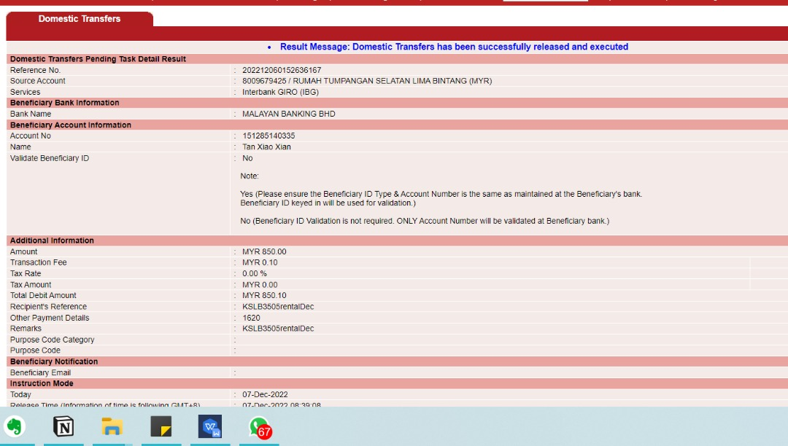
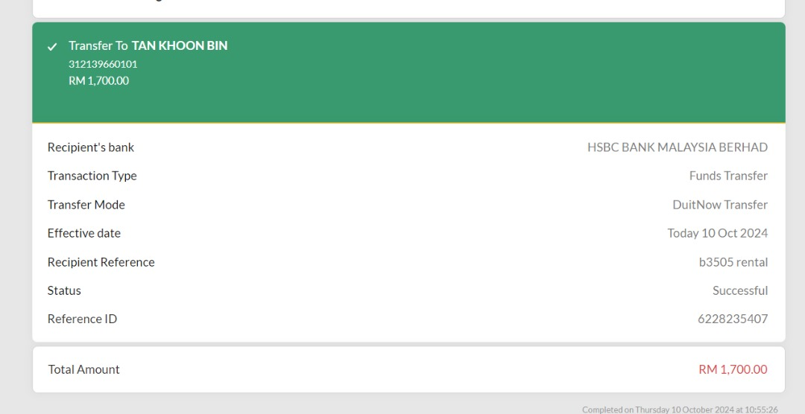
Real-World Case Studies from the Lead Trainer
Makan Moments Cafe — Skudai, Johor
Southern Homestay — KSL D'Esplanade, JB
AI reviews in 7 personas (EN/BM/ZH) for Facebook, TikTok, RedNote, Instagram
AI-generated SEO/GEO blog articles ranking on Google and AI platforms
Full 33-page menu designed with Lovart AI + Canva Pro (SOP documented)
Schema markup (JSON-LD) for AI-cited search visibility (GEO)
Weekly social media content using a 10-category AI prompt library
Multi-language content (EN/BM/ZH) deployed across OTA platforms
Digital QR menu system with AI-designed pages and POS verification
AI campaign analysis, dynamic pricing & OTA strategy
4.9 STARS / 5 | 500+ Reviews
Cafe — AI-generated menu + content
southern-homestay.com | pelangicapsulehostel.com

Slide 8
Revenue Opportunity
Per Student
Per Batch (20 pax)
4 Batches / Year
RM 8,000
RM 160,000
RM 640,000
B2B In-House Training (e.g. Fitson, Manufacturing SMEs)
RM 4,500 per session (up to 15 pax) | Min. 2 sessions per company per year
HRDC / PSMB claimable — reduces effective cost to near zero for employers

Slide 9
Why 3U Pioneer Academy?
Proven Real-World Trainer
✓
Built-In Student Pipeline
✓
The trainer applies every course tool daily across multiple live businesses. Students learn from real case studies.
3U's existing IT, Aesthetic & Multimedia students are natural recruits. No cold marketing needed to fill first batch.
JPK Accreditation Track Record
✓
AI-Ready WIM Pipeline
✓
3U is already accrediting 5 programmes. Adding 1 more reuses the same JPK contacts and workflow.
All teaching materials (KP/KK/WIM) can be generated using 3U's existing AI pipeline.

Slide 10
Next Steps
1
Jennifer checks MySPIKE for existing NOSS code in Digital Marketing (J or K series)
2
If no code exists — apply for COPTPA standard with Prisma Technology as Industry Body
3
Jay drafts CoCU for all 9 CUs using existing Notion workflows and AI tools as reference
4
Generate full WIM documents using the existing 3U AI pipeline — target Q4 2026
5
Submit JPK accreditation — target first student batch Q1 2027
3U Pioneer Academy | Course Enquiry

