Slide 1

APP Recommendation
Wenkai Zheng
Sixin Wang
Team 8

Slide 2
Use Cases
User inputs the app category then give the recommendation of the hottest apps to the user
User enters app name that he wants to download, and recommends the most relevant apps to user

Slide 3
Methodology
Extract the apple store data and google play data from kaggle dataset website
Design aggregate dataset schema with some important attributes (category, count of downloads, count of reviews, rating and …)
Join two dataset from different data source using spark sql
Train the model
Calculating the result from user inputs

Slide 4
Data source
https://www.kaggle.com/lava18/google-play-store-apps
https://www.kaggle.com/ramamet4/app-store-apple-data-set-10k-apps
There are 10,000 unique apps in google play dataset and 7,200 unique apps in apple store dataset
git repository:
https://github.com/sssxxx44/csye7200_finalProject.git

Slide 5
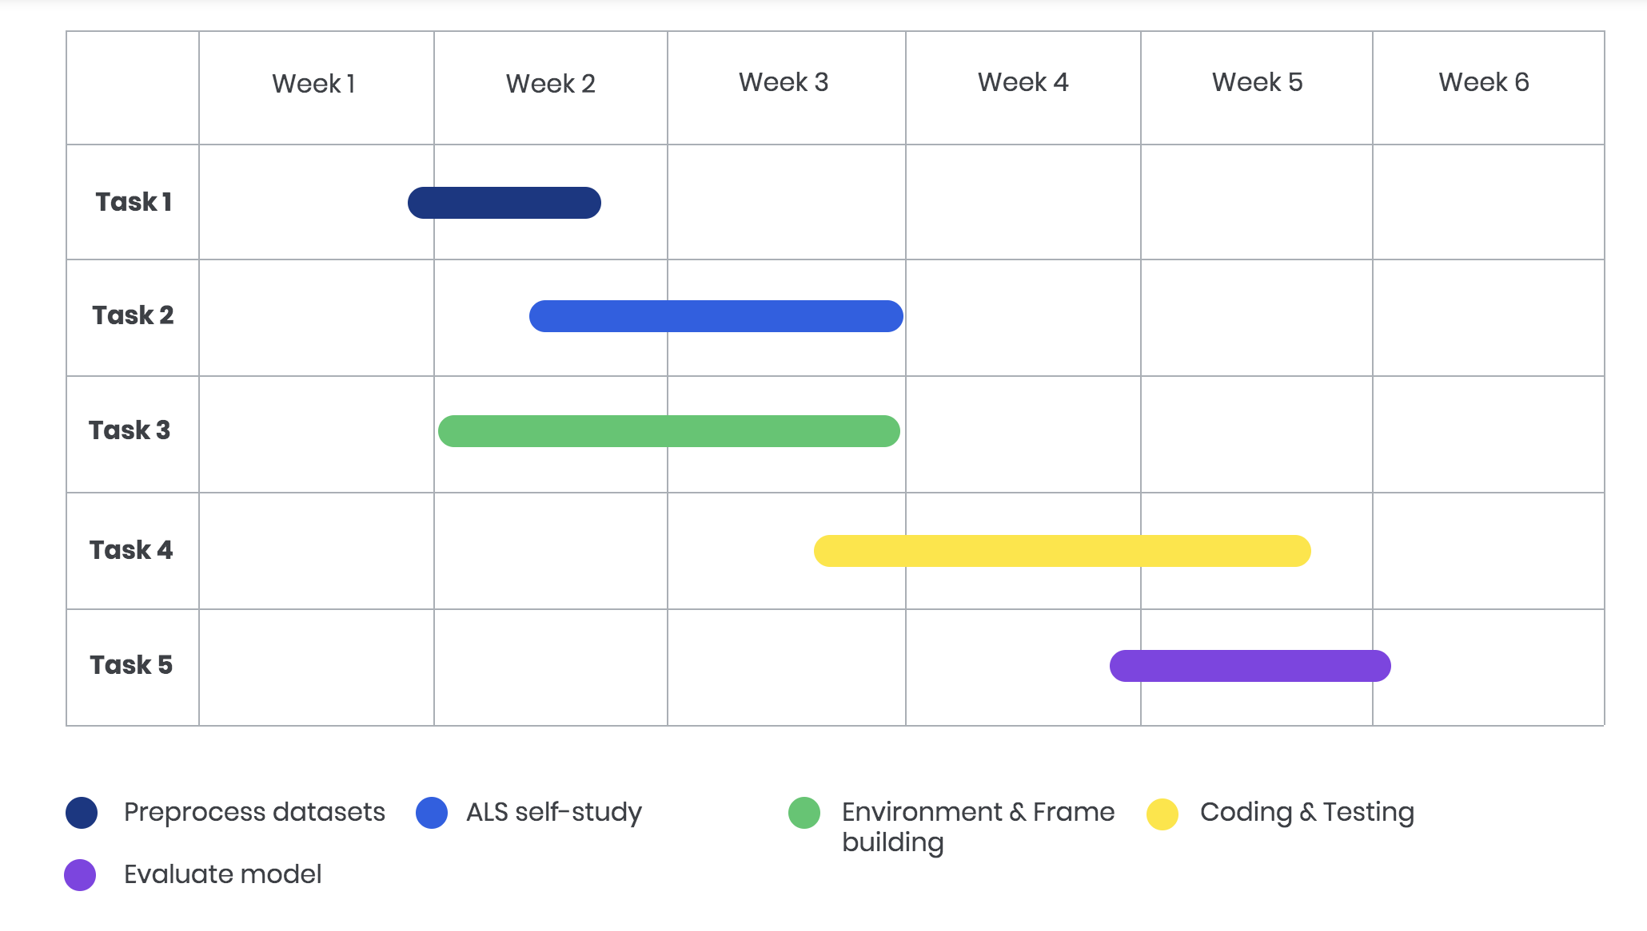
Milestone

Slide 6
Program in scala
The implementations of ALS
All the unit test
Extraction of data
Join different datasets

Slide 7
Acceptance criteria
Root Mean Square Error(RMSE):
The root-mean-square error is a frequently used measure of the differences between values predicted by a model or an estimator and the values observed
The smaller the square error, the better the model is
Response time < 2 seconds

Slide 8
Goal of project
Process the recommendation analysis by using alternating least squares(ALS) algorithm
Furthermore, we want to learn more about the recommendation algorithms and the using of scala

Slide 9
Thank you!

