Slide 1

APP Recommendation
Wenkai Zheng
Sixin Wang
Team 8

Slide 2
Goals of PRoject
For this system, we have two main goals:
App recommendation with ALS
App Searching based on specific input
For us, we want to learn more about recommendation algorithms and the using of scala

Slide 3
Use Cases
User enters the user id to login the system
User inputs the app keywords then give the recommendation of related apps to the user
User get recommendations from system by choosing App recommendation

Slide 4
Methodology
Extract the google app store data from kaggle dataset website
Cleaned and processed the dataset based on our system
Train the model
Calculating the result of recommendation

Slide 5
Data source
https://www.kaggle.com/lava18/google-play-store-apps
There are more than 10,000 apps in google play dataset
And more than 700 users’ rating data
app_metadata: contains informations of the apps
keywords: contains keywords for all apps
ratings: contains rating information for users and apps

Slide 6
Program in scala
Extraction of data
The implementations of ALS
All the unit test
Store the user rating data

Slide 7
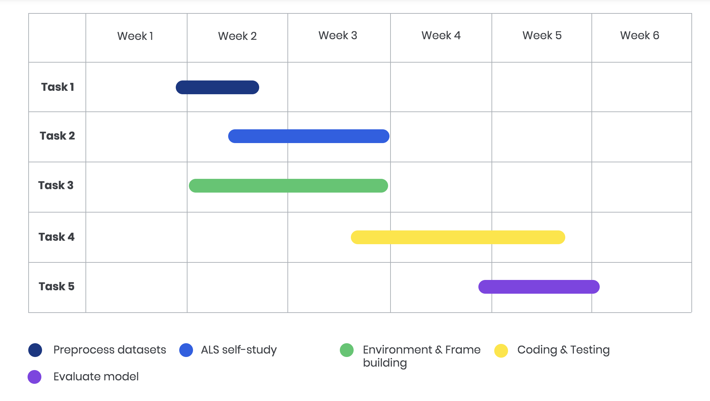
Milestone

Slide 8
Acceptance criteria
Root Mean Square Error(RMSE):
The root-mean-square error is a frequently used measure of the differences between values predicted by a model or an estimator and the values observed
The smaller the square error, the better the model is, target RMSE < 1
Response time < 2 seconds

Slide 9
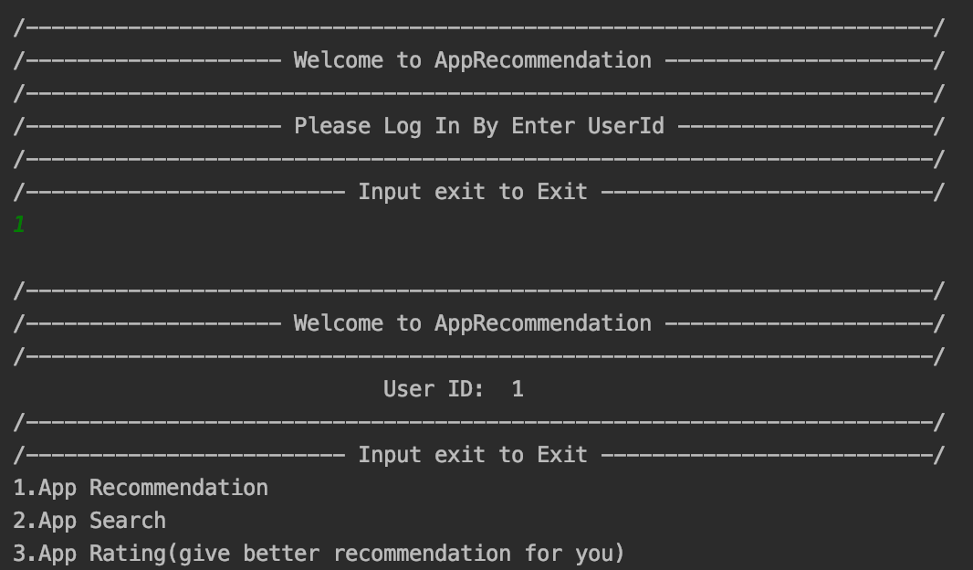
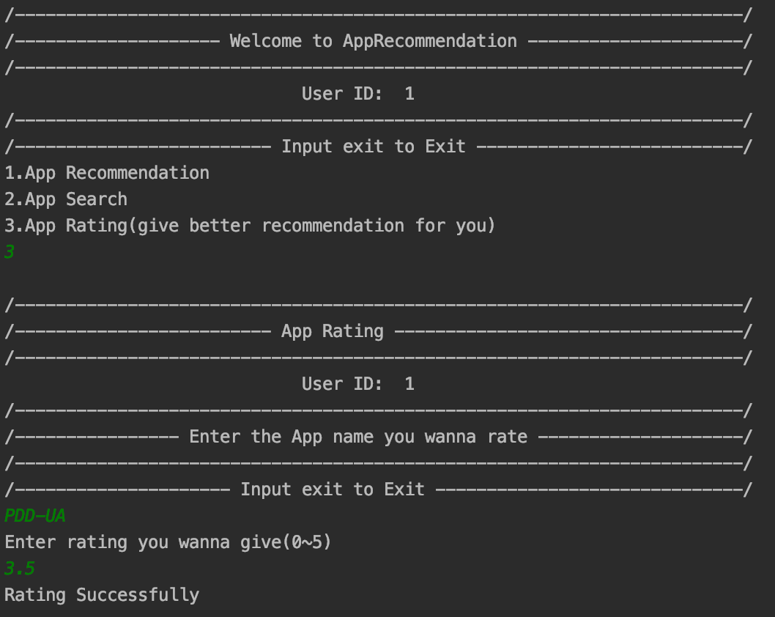
Use cases
User can follow the instruction on the screen including entering user id, select services and entering the rating data to interact with system

Slide 10
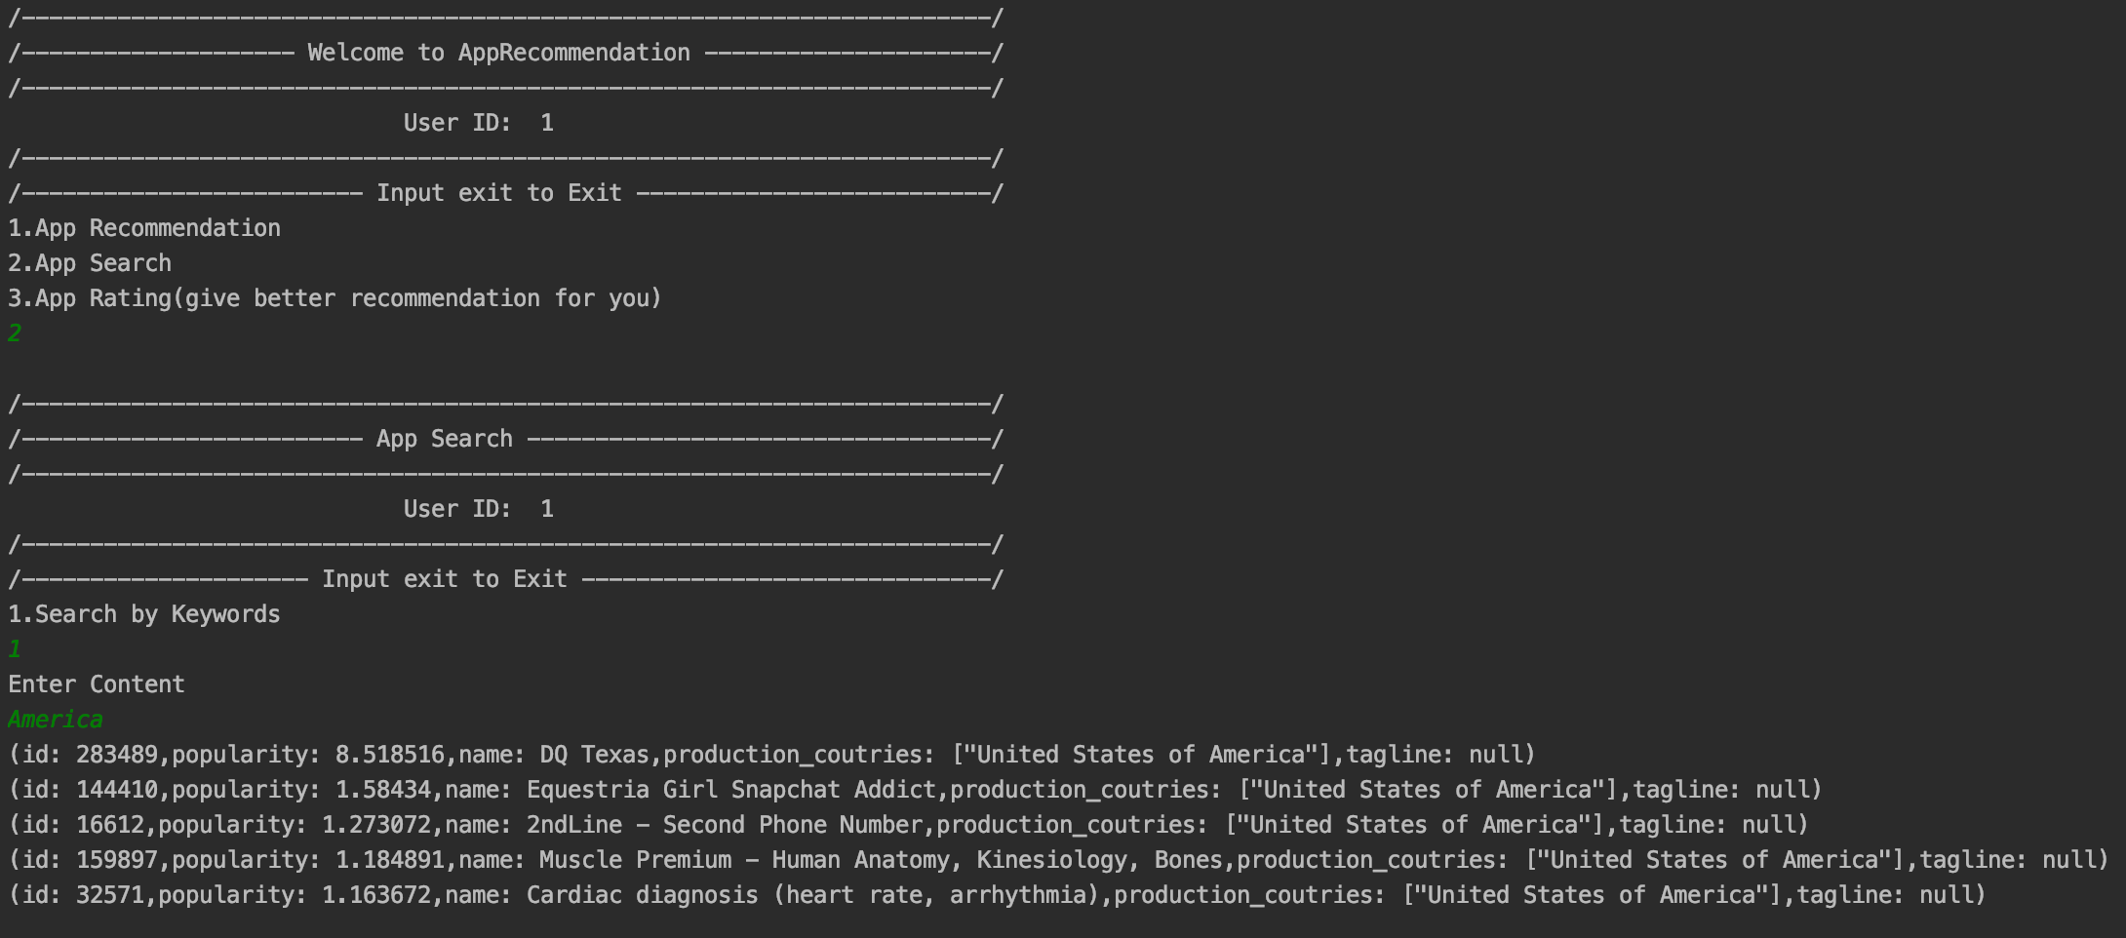
Use cases

Slide 11
Demo

Slide 12
Thank you!

