Slide 1


Recent Advances in Entity Matching
AnHai Doan
University of Wisconsin-Madison
GreenBay Technologies
Informatica

Slide 2
Entity Matching (EM)
Table A
Table B
Name | City | State
Dave Smith | Madison | WI
Joe Wilson | San Jose | CA
Dan Smith | Middleton | WI
Name | City | State
David D. Smith | Madison | WI
Daniel W. Smith | Middleton | WI

Slide 3
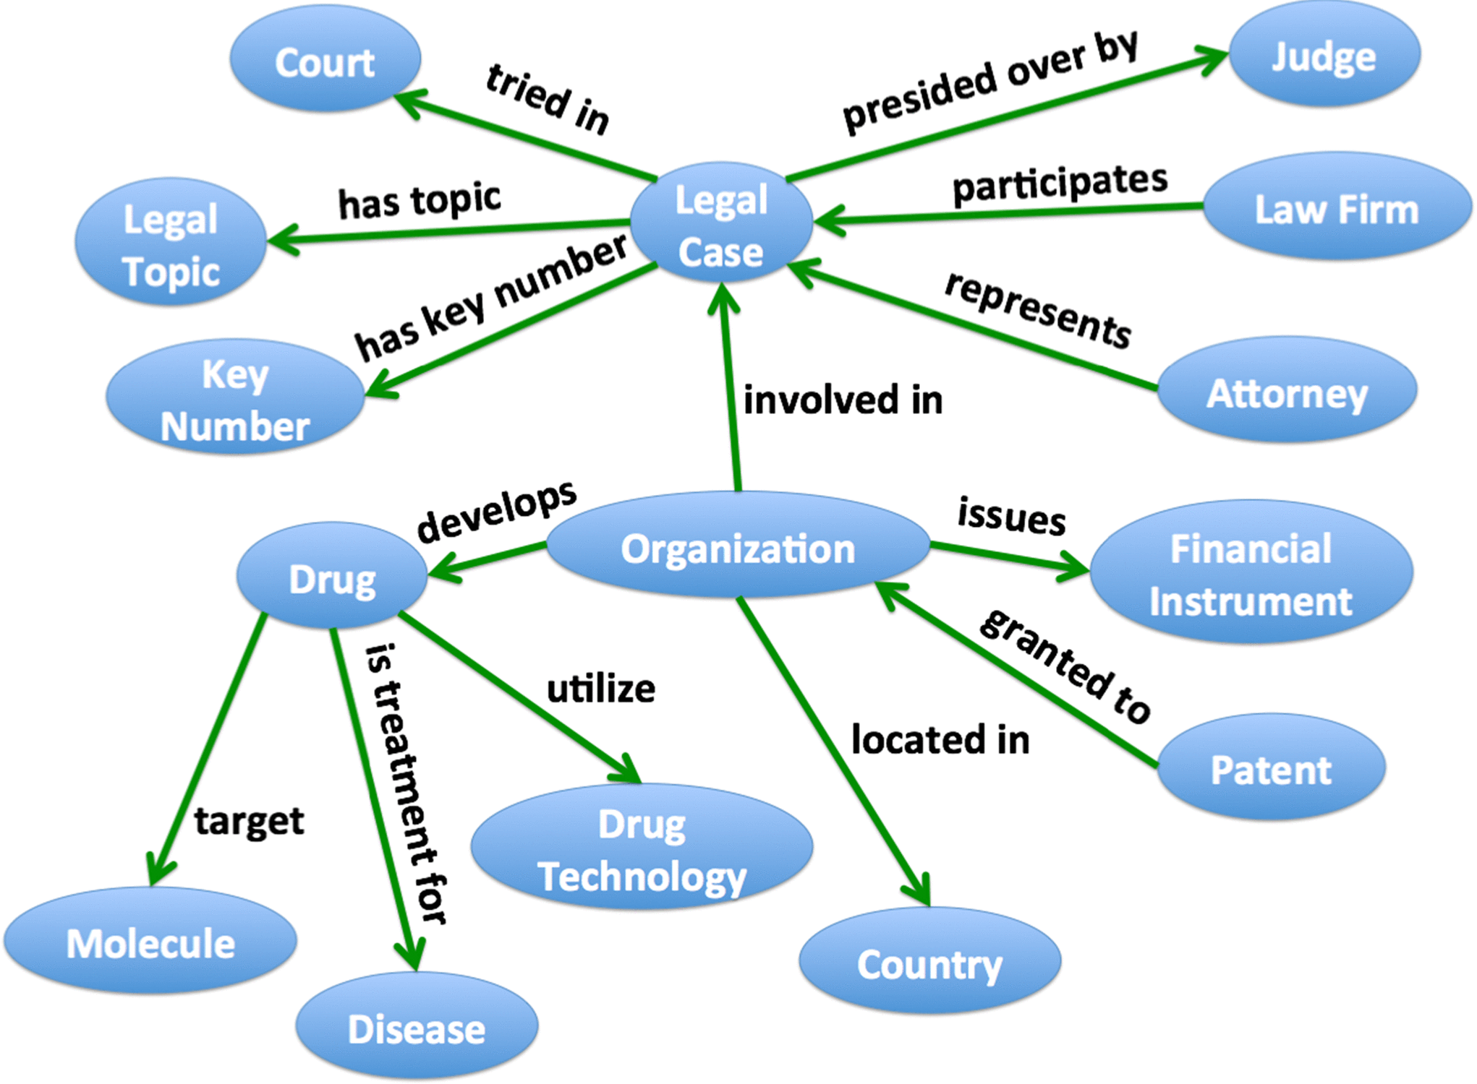
Fundamental Operation in Building Knowledge Graphs

Slide 4

Fundamental Operation in Building Knowledge Graphs
Example: building a Customer 360 MDM database
Name | Phone | …
… | … | …
MDM Database
3M tuples
One tuple per customer
10M tuples
Name | Phone | …
… | … | …
300K tuples
(Dave Smith, 608-695-1138)

Slide 5
Current State of the Art
Vast amount of work in the past five decades
Most of them developed algorithmic solutions
Recent algorithmic solutions are very complex, addressing corner cases
Very few works build end-to-end EM systems
Many such systems are academic prototypes, too weak for real-world uses
Many EM systems were developed in industry
Most of them use hand-crafted rules to match
Very good in certain domains (have a lot of domain knowledge), but hard to generalize
Some recent systems use machine learning, but do not scale

Slide 6
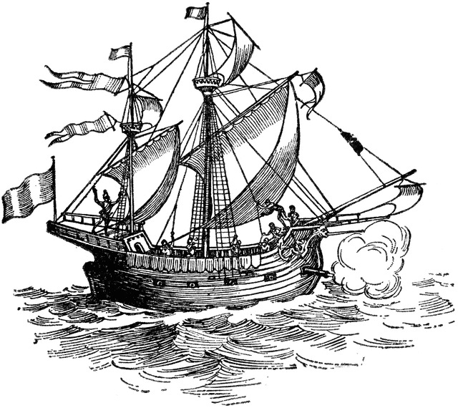
The Magellan Project @ UW-Madison
We want to develop platforms that support EM end to end
Build systems, apply to real-world problems, uncover relevant research challenges, solve them
Incorporate solutions and improve systems
Want to develop the “PostgreSQL” for entity matching
Preliminary work started in 2013
Project formally launched in 2015
Two major systems developed by 2019
PyMatcher: open-source on-prem EM platform (Python)
CloudMatcher: close-source cloud-based EM platform
Used in many different real-world applications

Slide 7
PyMatcher: On-Prem EM Solution for Power Users
Has been in development since 2015
~36 months
13 developers
Includes 6 Python packages
Built on top of 16 different packages from PyData ecosystem
E.g., pandas, scikit-learn, etc.
Exposes 231 commands to users
Code base includes 130 Python files and 37K lines of code
Packages are comprehensively tested
2316 unit test cases
135 performance test cases
Code base is extensively documented
~15K lines of comments
Most advanced and comprehensive open-source EM system for power users

Slide 8
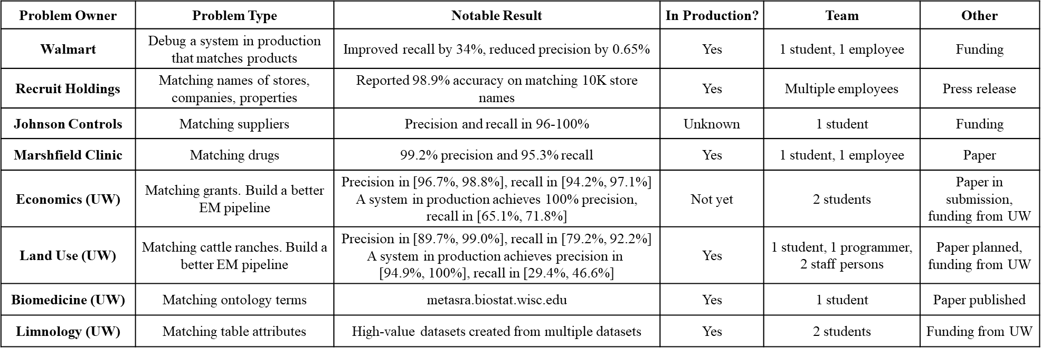
Real-World Deployment
Also in use at American Family Insurance and several other companies.

Slide 9
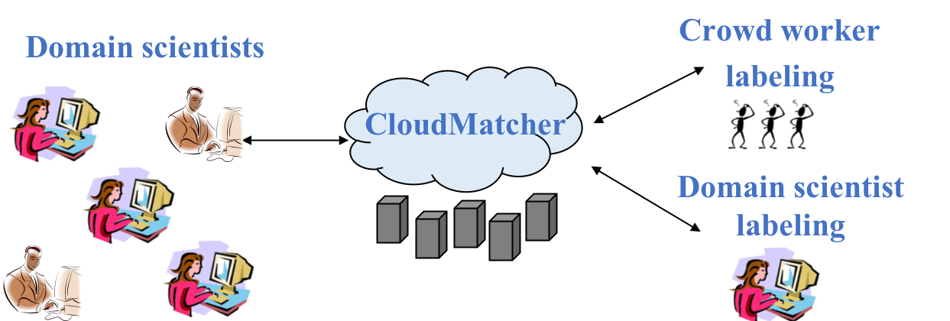
CloudMatcher: Helps Lay Users Do EM

Slide 10
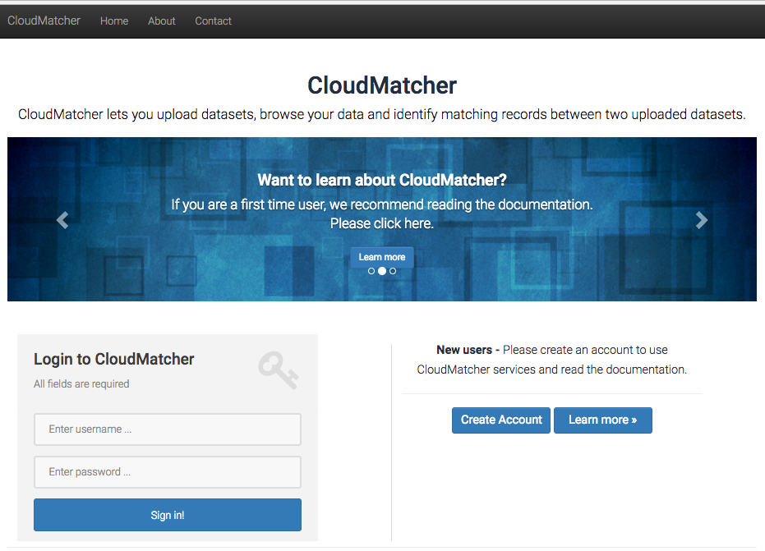

Slide 11
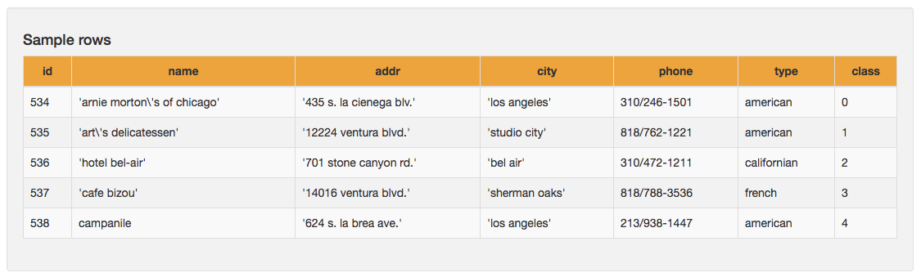
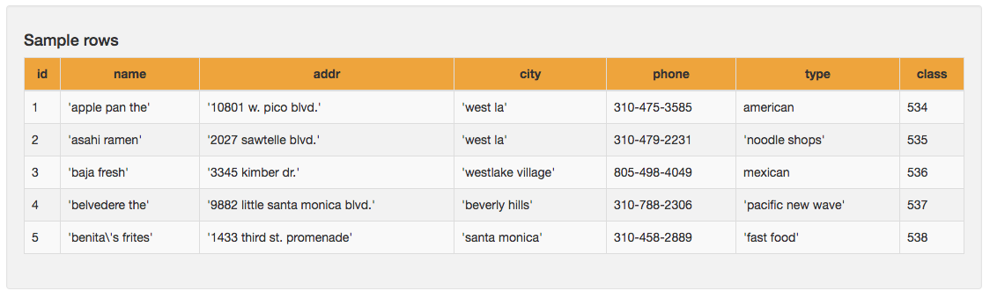
Example: Matching Tables A & B
Table A
Table B

Slide 12
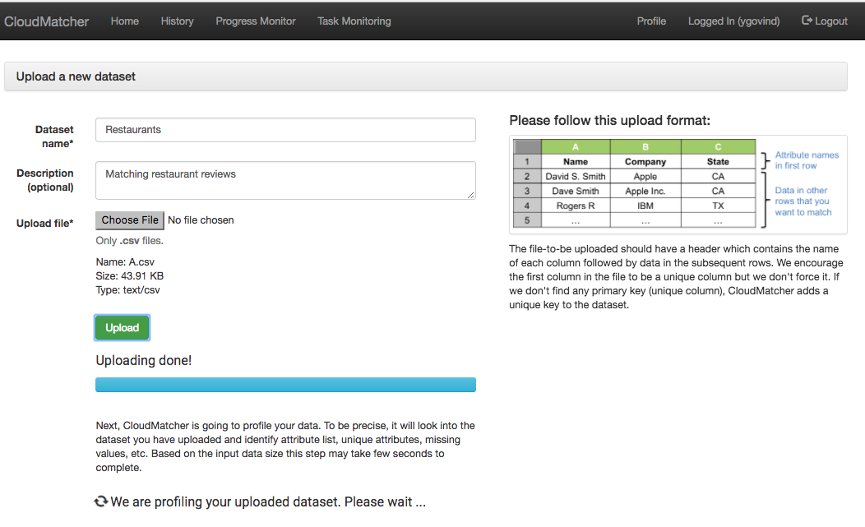
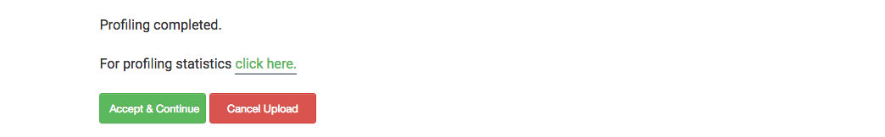
Uploading Table A

Slide 13
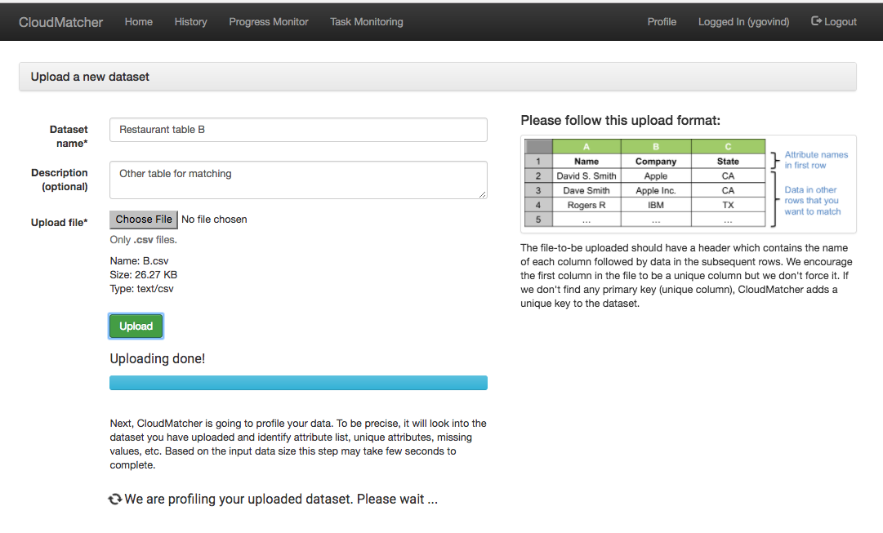
Uploading Table B

Slide 14
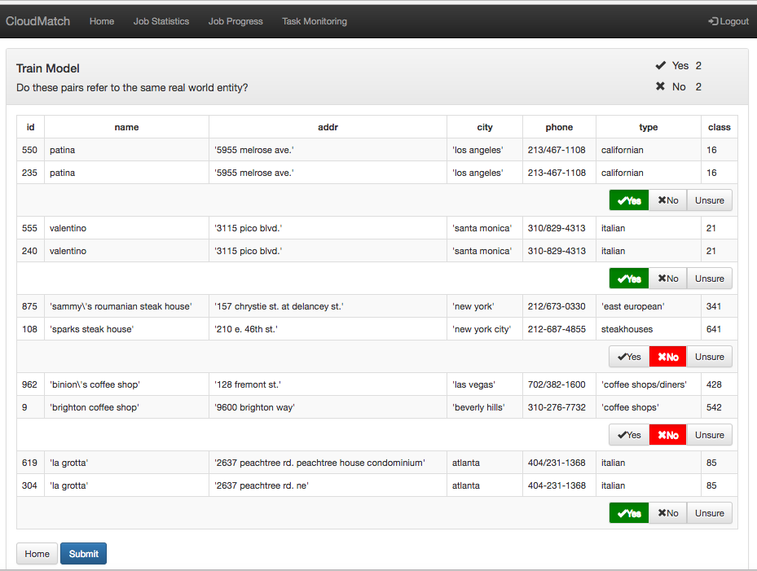
Labeling for Active Learning

Slide 15
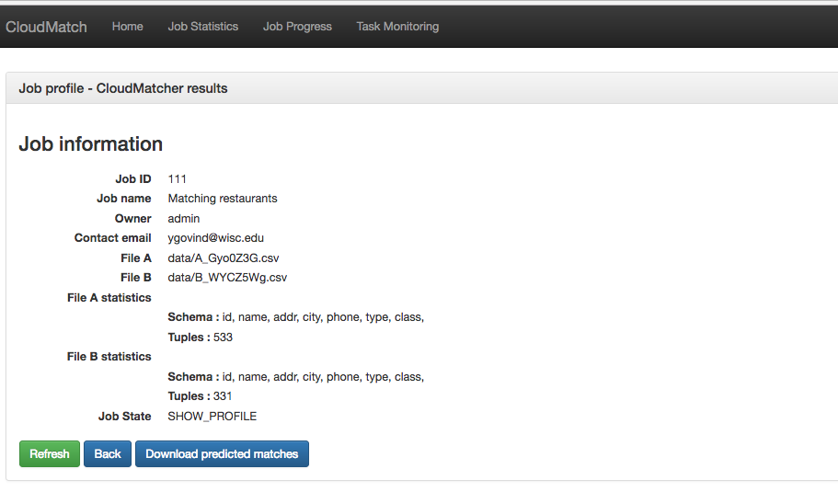
Returning Matches Between Two Tables
Sample matching pairs
Table A id | Table B id
534 | 219
535 | 220
536 | 221
537 | 222
538 | 223
539 | 224

Slide 16
Important Characteristics of CloudMatcher
Straightforward and easy to use
No installation hassles
No need to learn/setup complicated systems
No EM knowledge required to use
User performs simple actions
Labeling tuple pairs as matched/no-matched
Or, outsource labeling to crowd of workers
Scalability
Can handle tables of millions of tuples
Automatically add machine resources as necessary

Slide 17
Real-World Deployment
In 12 problems at 6 companies/organizations and 1 domain science team at UW-Madison
See [SIGMOD-19] paper
Received significant commercial interest and funding

Slide 18


GreenBay Tech

Slide 19
Rest of the Talk Focuses on CloudMatcher

Slide 20
Two Main Steps: Blocking and Matching
Table A
Name | City | State
Dave Smith | Madison | WI
Joe Wilson | San Jose | CA
Dan Smith | Middleton | WI
a₁
a₂
a₃
(a₁, b₁)
(a₁, b₂)
(a₃, b₁)
(a₃, b₂)
(a₁, b₁) +
(a₁, b₂) -
(a₃, b₁) -
(a₃, b₂) +
block on
state = state
match
Table B
Name | City | State
David D. Smith | Madison | WI
Daniel W. Smith | Middleton | WI
b₁
b₂

Slide 21
Blocking and Matching Use Expressive Rules (Which Will Be Learned)

Slide 22
Blocking
Use a variety of similarity measures
Exact_match(city, city)
Jaccard(name, name)
Dice(a,b)
Cosine(a,b)
Overlap(a,b)
Example
Jaccard(“David Smith”, “David D Smith”)
First do alphanumeric tokenizing ➔ “david, smith” vs “david, d, smith”
Next compute intersection over union = 2/3
Overlap(“David Smith”, “David D Smith”) = 2

Slide 23
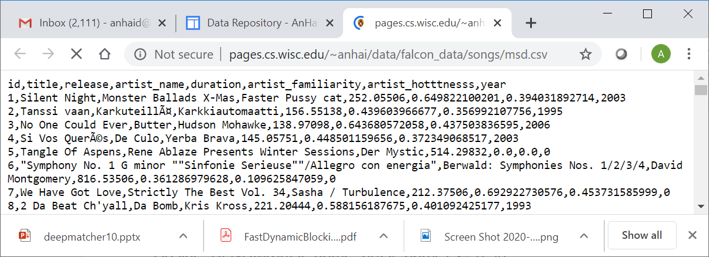
Blocking
Use a set of blocking rules
Example on blocking for Songs
Examle rule sequence
Jaccard_ALNUM(title, title) <= 0.93
Cosine_ALNUM(artist_name, artist_name) <= 0.90
Another rule sequence
Cosine_ALNUM(title, title) <= 0.97
DICE_ALNUM(artist_name, artist_name) <= 0.36
OVERLAP_ALNUM(release, release) <= 1.5 & EXACT_MATCH(title, title) <= 0.5

Slide 24
Blocking
Use a sequence of blocking rules
Example on blocking for Songs
Examle rule set
Jaccard_ALNUM(title, title) <= 0.93
Cosine_ALNUM(artist_name, artist_name) <= 0.90
Another rule set
Cosine_ALNUM(title, title) <= 0.97
DICE_ALNUM(artist_name, artist_name) <= 0.36
OVERLAP_ALNUM(release, release) <= 1.5 & EXACT_MATCH(title, title) <= 0.5

Slide 25
Entity Matching: Blocking and Matching
Table A
Name | City | State
Dave Smith | Madison | WI
Joe Wilson | San Jose | CA
Dan Smith | Middleton | WI
a₁
a₂
a₃
(a₁, b₁)
(a₁, b₂)
(a₃, b₁)
(a₃, b₂)
(a₁, b₁) +
(a₁, b₂) -
(a₃, b₁) -
(a₃, b₂) +
block on
state = state
match
Table B
Name | City | State
David D. Smith | Madison | WI
Daniel W. Smith | Middleton | WI
b₁
b₂

Slide 26
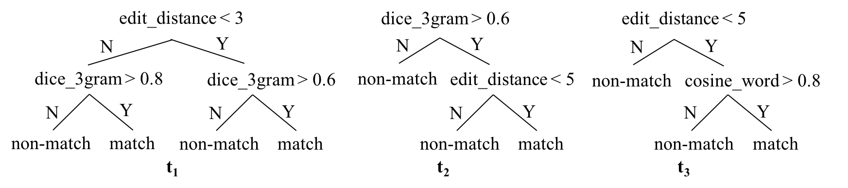
Matching: Random Forest
Ensemble classifier containing a set of decision trees
Return the label output by the majority of trees

Slide 27
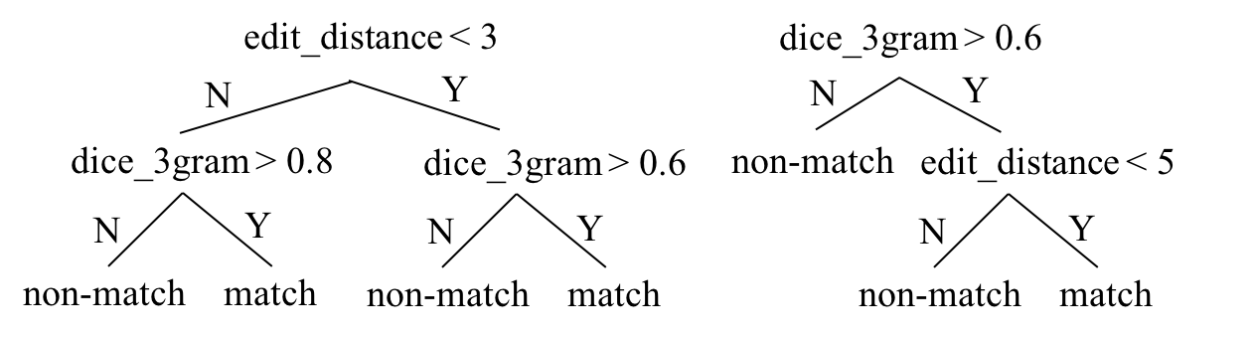
Matching: Use Random Forest
A random forest can be viewed as encoding a set of sets of matching rules
A set of sets of matching rules
r₁: (edit_distance ≥ 3) and (dice_3gram > 0.8) match
r₂: (edit_distance < 3) and (dice_3gram > 0.6) match
r₃: (dice_3gram > 0.6) and (edit_distance < 5) match

Slide 28
How to Do Blocking?

Slide 29
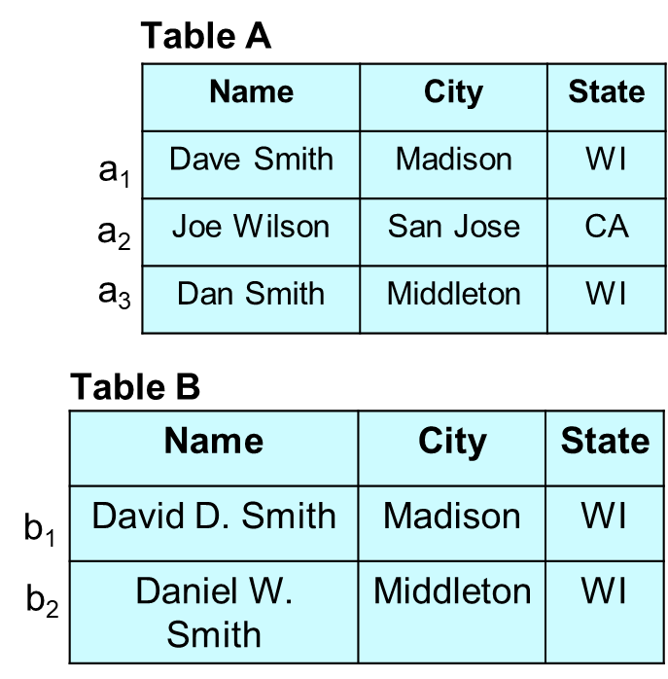
A Baseline Solution
Assume A and B have the same schema
Examine their schemas and create features judged helpful for blocking
Jaccard_word(name, name),
Jaccard_3gram(name, name)
Edit_distance(city, city)
Exact_match(state, state)
Write blocking rules using these features
If Jaccard_word(name, name) < 0.3 ➔ drop
If Jaccard_3gram(name, name) < 0.6 & edit_distance(city, city) > 3 ➔ drop
Apply the blocking rules to A and B
Enumerate all tuple pairs in A x B & convert each pair into a feature vector
(a1, b1) ➔ (f11, f12, f13, f14), (a1, b2) ➔ (f21, f22, f23, f24), etc.
Apply the blocking rules to the feature vectors

Slide 30
Create Features Automatically
Each feature such as Jaccard_3gram(name, name) consists of
Two attributes in tables A and B
The tokenizer to be used
A similarity measure to be used
The typical form: sim_measure(tokenizer(val1), tokenizer(val2))
We can use a set of rules to create features
When applied to the schemas of A and B these rules will generate many features
They enumerate all combinations of tokenizer & sim measures that are appropriate for the types of the attributes

Slide 31
Guiding Rules for Creating Features Automatically
Attribute Type and Characteristic | Similarity Measures | Intuition
Single word string | Jaro, Jaro-Winkler, Levenshtein, Jaccard.3gram, Exact Match | Maybe first names, last names, zip codes, etc.
Multi-word short (#words <= 5) string | Monge-Elkan, Jaccard.word, Jaccard.3gram, Needleman-Wunsch, Smith-Waterman, Smith-Waterman-Gotoh, Cosine | Maybe product titles, full names of people, etc.
Multi-word mid-sized (6 <= #words <= 10) string | Monge-Elkan, Jaccard.word, Cosine | Maybe street addresses, short product descriptions, etc.
Multi-word long (#words >= 11) string | Jaccard.word, TF/IDF, Soft TF/IDF, Cosine | Maybe long product descriptions, product reviews, etc.
Numeric | Absolute Difference, Relative Difference, Levenshtein, Exact Match | Maybe age, size, weight, height, price, etc.
Categorical | Exact Match, Levenshtein | The assumption is that the normalization has been done first (e.g., Paperback = Softcover = Trade Paper) using a dictionary
Set-valued | Jaccard, Dice, Overlap, TF/IDF, Soft TF/IDF | Maybe book authors, ingredients in a food item, etc.

Slide 32
Learning Blocking Rules
Take a sample S of tuple pairs from A x B
Convert each tuple pair in S into feature vector, resulting in S’
Learn a random forest F on S’, using active learning
Extract candidate blocking rules from F
Find and return a good rule sequence

Slide 33
Learn a Random Forest on S’ Using Active Learning
Four examples
supplied by user
(2 pos, 2 neg)
Train a random forest F
Random forest F
Y
Stopping criterion satisfied?
N
Sample S’
from |A x B|
Select q “most informative”
unlabeled examples
Label the q selected
examples
User

Slide 34

Another View of the AL Process
A
Sampling
Sample
S
Gen FVs
Feature
vectors S’
Active
learning
Random
forest F
B
Features
a
b
c
yes
can stop?
RF
A
(a, e)
(b, d)
(b, e)
(0.3, …, 0.6)
(0.0, …, 0.4)
(0.4, …, 0.8)
no
train RF
d
e
select “informative”
unlabeled pairs
B
label selected pairs

Slide 35
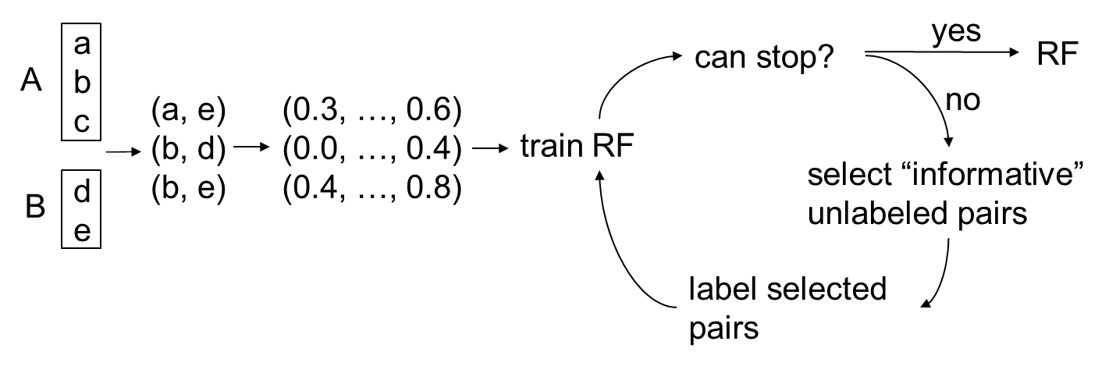
Zooming in on the AL Process
Seeds
(a, d) +
(c, d) -
(a, e) +
(b, d) –
(b, e) +
Iteration 1
(0.2, …, 0.5) +
(0.3, …, 0.7) -
F1
(b, d)
User labels (b, d) +
(a, d) +
(c, d) –
(b, d) +
(0.2, …, 0.5) +
(0.3, …, 0.7) –
(0.0, …, 0.4) +
Iteration 2
(a, e) +
(b, e) -
F2
(b, e)
User labels (b, e) -

Slide 36
Extract Blocking Rules from Random Forest
Example random forest F for
matching books
isbn_match
title_match
N
Y
N
Y
No
#pages_match
No
publisher_match
N
Y
N
Y
No
Yes
No
year_match
N
Y
Extracted candidate blocking rules
No
Yes
(isbn_match = N) No
(isbn_match = Y) and (#pages_match = N) No
(title_match = N) No
(title_match = Y) and (publisher_match = N) No
(title_match = Y) and (publisher_match = Y) and (year_match = N) No

Slide 37
Extract Blocking Rules from Random Forest
Use the user to evaluate the precision of extracted rules
Select a set of precise rules
(isbn_match = N) No
(isbn_match = Y) and (#pages_match = N) No
(title_match = N) No
(title_match = Y) and (publisher_match = N) No
(isbn_match = N) No
(title_match = N) No

Slide 38
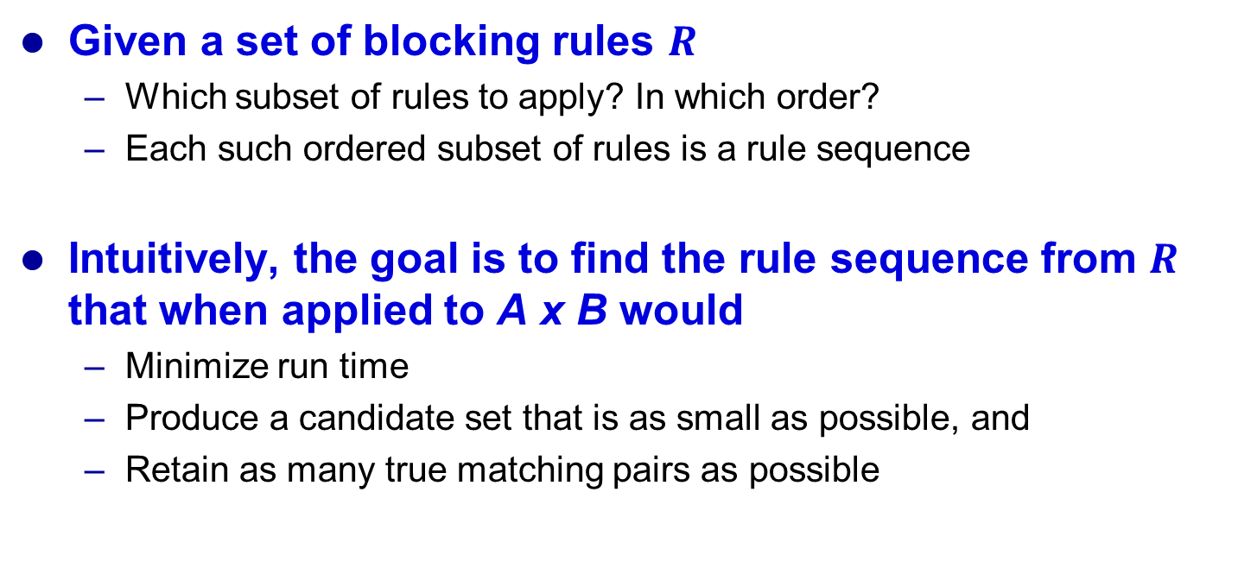
Selecting Optimal Rule Sequence
Given a set of blocking rules $R$
Which subset of rules to apply? In which order?
Each such ordered subset of rules is a rule sequence
Intuitively, the goal is to find the rule sequence from $R$ that when applied to A x B would
Minimize run time
Produce a candidate set that is as small as possible, and
Retain as many true matching pairs as possible

Slide 39
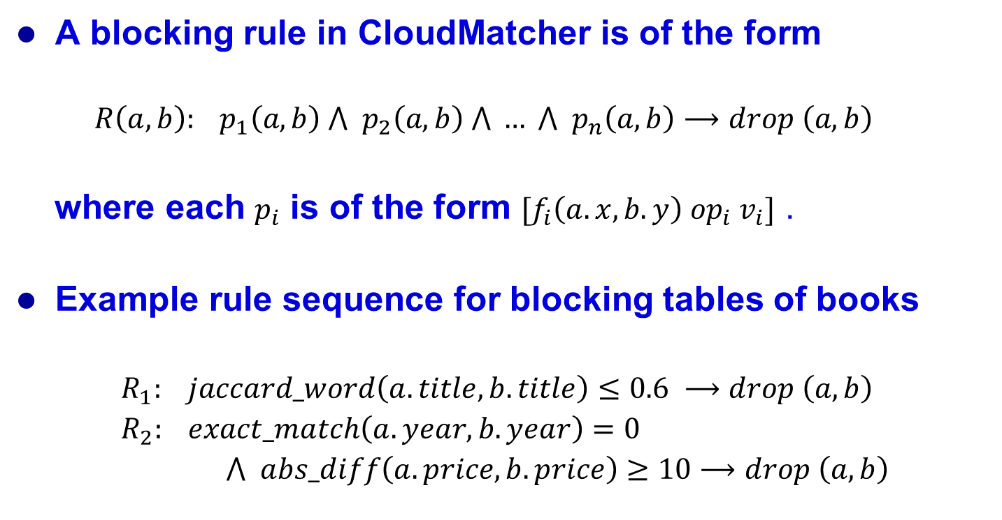
Applying the Blocking Rules
A blocking rule in CloudMatcher is of the form
$$R\left(a,b\right): p_{1}\left(a,b\right) ⋀{ p}_{2}\left(a,b\right) ⋀ … ⋀{ p}_{n}\left(a,b\right)⟶drop \left(a,b\right)$$
where each $p_{i}$ is of the form ${[f}_{i}\left(a.x, b.y\right) {op}_{i} v_{i}]$ .
Example rule sequence for blocking tables of books
$R_{1}: jaccard_word\left(a.title, b.title\right)≤0.6 ⟶drop \left(a,b\right)$
$R_{2}: exact_match\left(a.year, b.year\right)=0$
$⋀ abs_diff\left(a.price,b.price\right)≥10⟶drop \left(a,b\right)$

Slide 40
Key Idea Underlying Our Solution: Using Indexes
Assume rules contain well-known similarity functions
E.g., edit distance, Jaccard, cosine
Exploit properties of these functions
Build indexes, then use them to avoid enumerating A x B
Example of index using size
jaccard_word(a.movie, b.movie) >= 0.7
String: “The Big Short”
Number of tokens = 3
Spirited Away
non-match
Possible size range: 3*0.7 <= x <= 3/0.7
3 <= x <= 4
The Big Lebowski
potential match

Slide 41
Key Idea Underlying Our Solution: Using Indexes
jaccard_word(a.movie, b.movie) >= 0.7
Table A
ID | Movie
1 | Matrix
2 | The Good, The Bad, And The Ugly
3 | The Big Lebowski
4 | Spirited Away
5 | The Big Short
6 | Night At The Museum
Movie name from B: “The Big Short”
Number of tokens = 3
Possible size range: 3*0.7 <= x <= 3/0.7
3 <= x <= 4
Size Index for A.movie
Potential matches
The Big Lebowski
The Big Short
Night At The Museum
Size | ID list
1 | 1
2 | 4
3 | 3, 5
4 | 6
5 | 2

Slide 42
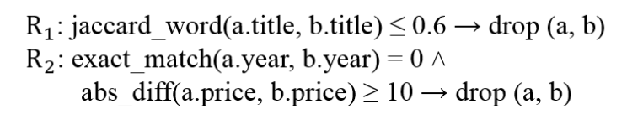
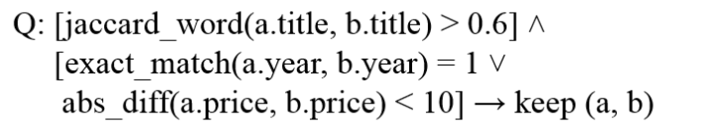
Example
Convert the rule sequence into a “positive” CNF rule
Infer indexes for each predicate in Q (on table A)
Build indexes J for jaccard, E for exact_match, D for absolute_difference
This is done by running MR jobs
For each tuple t in B, probe the indexes
Obtain J(t), E(t), and D(t)
Compute C(t) = J(t) intersect [E(t) union D(t)]
Apply the original blocking rule Q to all pairs in C

Slide 43
How to Do Matching?

Slide 44
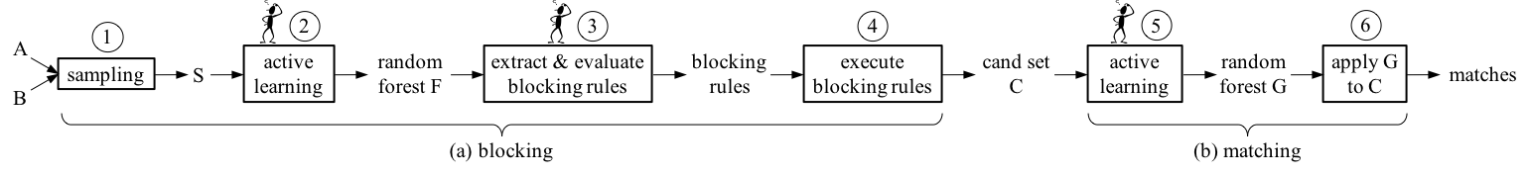
How to Do Matching
Assume applying blocking to tables A and B produce the set of pairs C
Define a set of features based on the schemas of A and B
This set of features is typically richer than the set of features for blocking
Convert C into a set of feature vectors C’
Do active learning on C’ to learn a random forest G
Use all labeled pairs in the blocking step as seeds
G is the matcher, apply G to all remaining pairs in C’ to make predictions of match / non-match

Slide 45
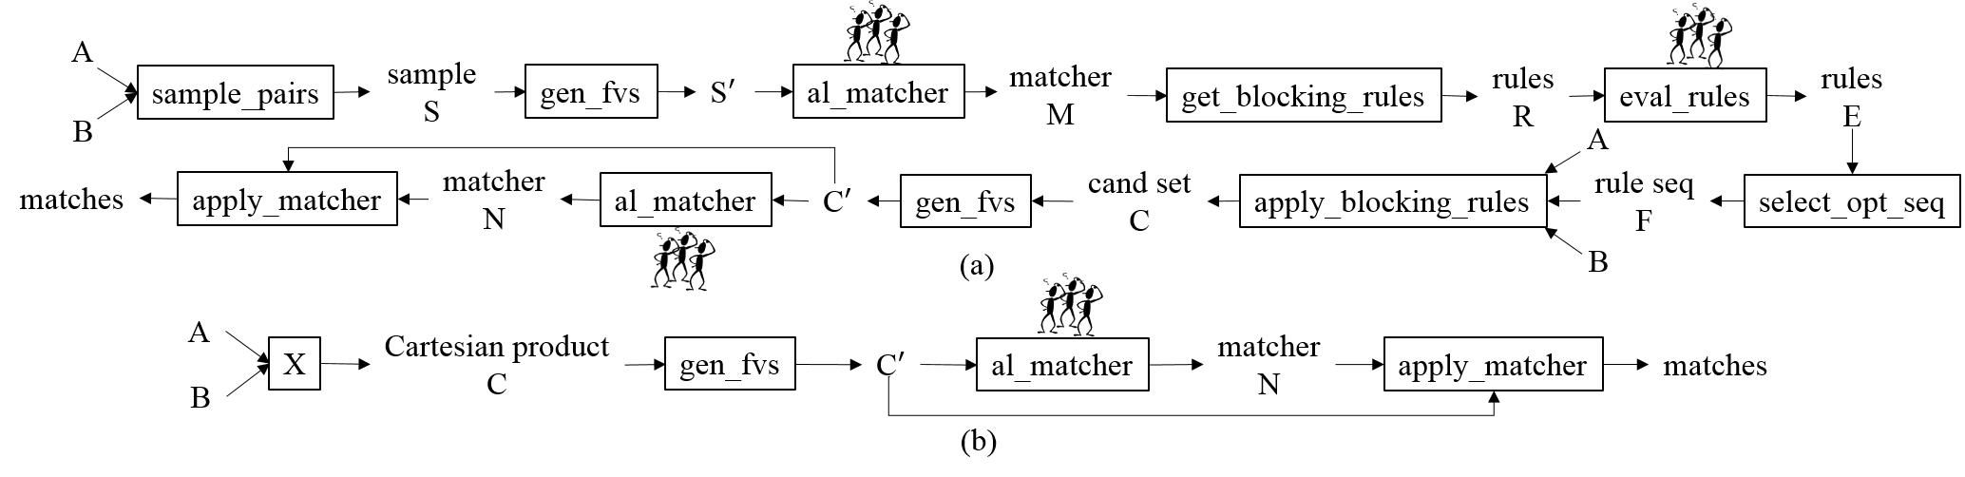
Two Workflow Templates

Slide 46
Conclusions
We are developing Magellan, a “PostgreSQL” for entity matching
Two major systems developed by 2019, with many real-world users
PyMatcher: open-source on-prem EM platform (Python)
CloudMatcher: close-source cloud-based EM platform
CloudMatcher
Uses very expressive & powerful blocking and matching rules
Learns these rules from labeled data via active learning
Needs to combine ML, big data technologies, and effective user interaction
Magellan is being commercialized
in GreenBay and in partnership with Informatica
A major step forward for entity matching R&D
New innovative system platforms, demonstrates how ML can be used effectively
Research Highlight in Communications of the ACM
Suggests similar system-centric solutions for other data cleaning and integration tasks

Slide 47
Relevant Papers
Overall Magellan project
Magellan: Toward Building Entity Matching Management Systems, P. Konda, S. Das, P. Suganthan G.C., A. Doan, A. Ardalan, J. R. Ballard, H. Li, F. Panahi, H. Zhang, J. Naughton, S. Prasad, G. Krishnan, R. Deep, V. Raghavendra. VLDB-16
Toward a System Building Agenda for Data Integration (and Data Science), A. Doan, P. Konda, P. Suganthan G.C., A. Ardalan, J. Ballard, S. Das, Y. Govind, H. Li, P. Martinkus, S. Mudgal, E. Paulson, H. Zhang. IEEE Data Engineering Bulletin, Special Issue on Large-Scale Data Integration, 2018. Invited paper.
Entity Matching Meets Data Science: A Progress Report from the Magellan Project, Y. Govind, P. Konda, and others. SIGMOD-19. Industrial paper.
A forthcoming paper in Research Highlight in CACM
CloudMatcher
Corleone: Hands-off Crowdsourcing for Entity Matching, C. Gokhale, S. Das, A. Doan, J. Naughton, N. Rampalli, J. Shavlik, J. Zhu. SIGMOD-14
Falcon: Scaling Up Hands-Off Crowdsourced Entity Matching to Build Cloud Services, S. Das, P. Suganthan G.C., A. Doan, J. Naughton, G. Krishnan, R. Deep, E. Arcaute, V. Raghavendra, Y. Park. SIGMOD-17
CloudMatcher: A Cloud/Crowd Service for Entity Matching, Y. Govind, E. Paulson, M. Ashok, P. Suganthan G.C., A. Hitawala, A. Doan, Y. Park, P. Peissig, E. LaRose, J. Badger. BIGDAS Workshop @ KDD-17
Ongoing Work in Deep Learning for EM and others
Deep Learning for Entity Matching: A Design Space Exploration, S. Mudgal, H. Li, T. Rekatsinas, A. Doan, Y. Park, G. Krishnan, R. Deep, E. Arcaute, V. Raghavendra. SIGMOD-18
Deep Entity Matching with Pre-Trained Language Models, Yuliang Li, Jinfeng Li, Yoshihiko Suhara, AnHai Doan, Wang-Chiew Tan, in Arxiv, 2020

