Slide 1
SIMULATION AND ANALYSIS OF SPECTRUM SENSING IN COGNITIVE RADIO
By
K. SWARNA LATHA 17191A0423
Y. NARENDRA REDDY 17191A0459
G. MUNI VENKATESH 17191A0415
T. VASAIAH 17191A0454
Under the esteemed guidance of
Mr. P.G Varna Kumar Reddy,
Assistant Professor (Adhoc),
Department of ECE.
JNTUA College of Engineering, Pulivendula.

Slide 2
AGENDA
Abstract
Introduction
Cognitive Radio
Functions of cognitive radio
Monte Carlo Simulation
Spectrum Allocation
Single threshold technique
Double threshold CSS
Result
Conclusion
References

Slide 3
ABSTRACT
To satisfy future bandwidth demands, existing cognitive radio with wireless communication must be upgraded to make the best use of the bandwidth.
The primary objective of IEEE 802.22 standard is to determine vacant spectrum bands available in Digital television channel (DTV) and to utilize them for wireless rural broadband connectivity.
Cognitive Radio (CR) aims at maximizing the utilization of the limited radio bandwidth while accommodating the increasing number of services and applications in wireless networks.
Cognitive Radio is a new paradigm in wireless communication to tackle the problem of spectrum underutilization. Cognitive radio technology gives the ability to use licensed bands by means of spectrum sensing technique.
There are many spectrum sensing algorithms available in the literature. we propose simulation methodology for spectrum sensing technique to meet the requirements of IEEE 802.22 standard. The detection performance is described through extensive simulation using the MATLAB simulation tool.

Slide 4
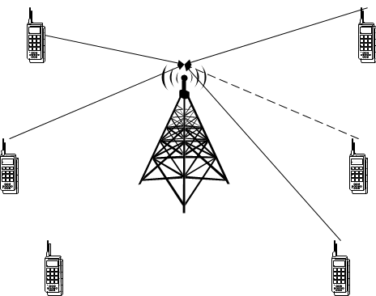
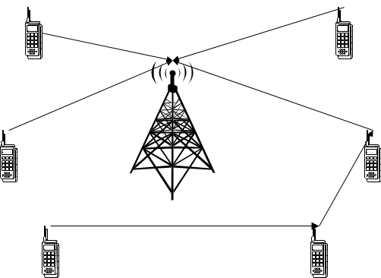
introduction
In the prosperous world we are living in right now, communications enter our daily lives in manifold ways that it is easy to overlook the multitude of its facets.
Mobile devices are only allowed to certain frequencies which are getting crowded. With cognitive radio technology, we can use all available frequencies even though those are dedicated to TV or satellites.
Cognitive radio can understand the language of any radio, this combined with new single radios embedded in any object, would allow any interaction with any physical objects, this can also provide solutions for communications between people of different languages and cultures.
Before cognitive radio After cognitive radio

Slide 5
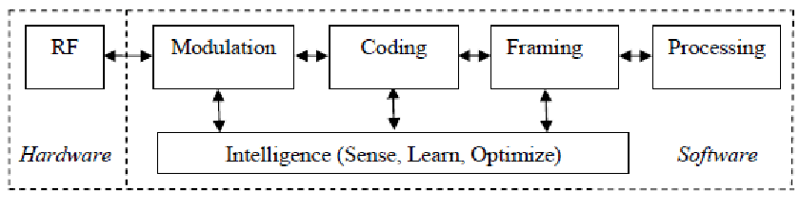
Cognitive radio
Cognitive radio is defined as “a radio or system that sense its electromagnetic environment and can dynamically and autonomously adjust its radio operating parameters to modify system operation, such as maximize throughput, mitigate interference, facilitate interoperability, access secondary markets".
A cognitive radio has two key features that distinguish it from a traditional radio: the cognition capability (intelligent adaptive behaviour) and the reconfigurability.
Cognitive Radio assigns the unused spectrum (spectrum hole) to the secondary user (SU) as long as the primary user (PU) does not use it.
Fig.1 Scientific block diagram of Cognitive Radio

Slide 6
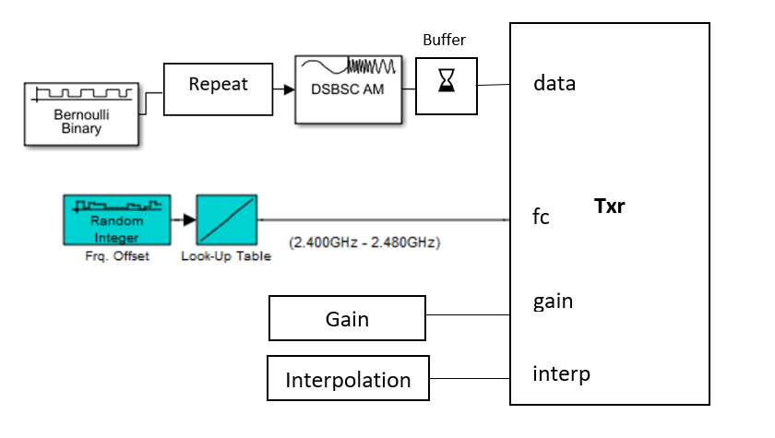
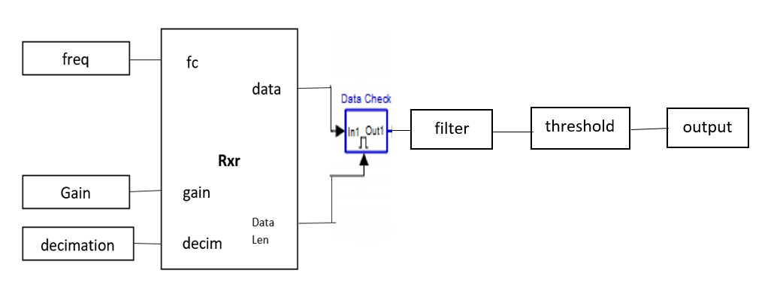
Fig 1.1 Block diagram of Cognitive Radio Transmitter
Fig 1.2 Block diagram of Cognitive Radio Receiver

Slide 7
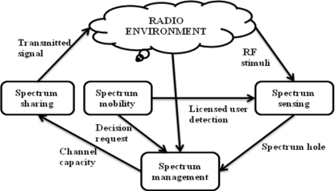
Functions of cognitive radio
There are four major functions of Cognitive Radio. They are:
Spectrum Sensing
Spectrum Management
Spectrum Sharing
Spectrum Mobility
Fig.1.4 Basic cognitive cycle

Slide 8
SPECTRUM SENSING:
Spectrum sensing is that it determines the presence of the primary user on a band. The cognitive radio is able to share the result of its detection with other cognitive radios after sensing the spectrum.
The goal of spectrum sensing is to find out the spectrum status and activity by periodically sensing the target frequency band.
Particularly, a cognitive radio transceiver detects the spectrum which is unused or spectrum hole and also determines method of access without interfering with the transmission of licensed.
Two types of spectrum sensing techniques :
1. Signal processing techniques (or) non-Cooperative Spectrum Sensing
2. Cooperative Spectrum Sensing

Slide 9
SPECTRUM MANAGEMENT:
Provides the fair spectrum scheduling method among coexisting users. The available white space or channel is immediately selected by cognitive radio if once found.
This property of cognitive radio is described as spectrum management. Spectrum sensing, spectrum analysis and spectrum decision fall in spectrum Management.
Spectrum decision refers to a cognitive radio that decides the data rate, determines the transmission mode and the transmission bandwidth.
Then the appropriate spectrum band is selected according to the spectrum characteristics and user requirements.

Slide 10
SPECTRUM SHARING:
Cognitive Radio assigns the unused spectrum (spectrum hole) to the secondary user (SU) as long as the primary user (PU) does not use it. This property of cognitive radio is described as spectrum sharing.
Underlay Spectrum Sharing: Underlay spectrum sharing is the availability of the radio spectrum access with minimal transmission power that the interference temperature above its pre-designed thresholds wouldn’t be raised.
Overlay Spectrum sharing: Unlicensed users can utilize a spectrum band for the fraction of time where this band is under-utilized by the licensed users in Overlay Spectrum sharing technique.

Slide 11
SPECTRUM MOBILITY:
When a licensed (Primary) user is detected the Cognitive Radio (CR) vacates the channel. This property of cognitive radio is described as the spectrum mobility and also called handoff.
This is the process that allows the Cognitive Radio user to change its operating frequency.
Cognitive Radio networks try to use the spectrum dynamically to operate in the best available frequency band and maintain the transparent communication.
Spectrum sensing is an important and a sensitive job out of these four functions in Cognitive Radio since interfering with other users is illegal.

Slide 12
Monte Carlo simulation
Monte Carlo simulation is a computerized mathematical technique to generate random sample data based on some known distribution for numerical experiments.
This method is applied to risk quantitative analysis and decision-making problems.
Monte Carlo Simulation ─ Important Characteristics
1.Its output must generate random samples.
2.Its input distribution must be known.
3.Its result must be known while performing an experiment.
Monte Carlo Simulation ─ Advantages
1.Easy to implement.
2.Provides statistical sampling for numerical experiments using the computer.
3.Provides approximate solution to mathematical problems.

Slide 13
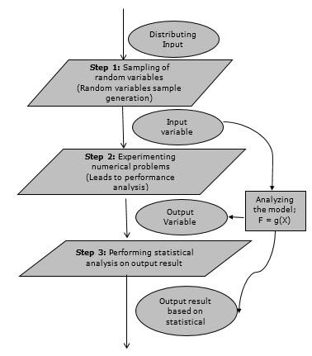
The following flowchart shows generalized function of Monte Carlo simulation.
Fig 2. Flowchart of Monte Carlo simulation

Slide 14
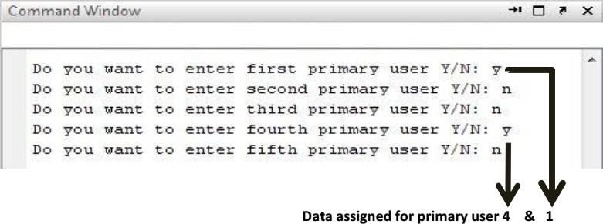
Spectrum Allocation for Cognitive Radio Network by Using MATLAB and SIMULINK
MATLAB:
Matrix Laboratory or MATLAB for short is a multi-paradigm numerical computing environment and proprietary programming language developed by MathWorks. It combines computation, visualization, and programming in an easily usable environment and is all expressed in mathematical equations.
Spectrum Holes: In some locations or at some times of the day, 70 percent of the allocated spectrum may be sitting idle.
Assigning Primary User to the Frequency Spectrum: We have designed our system to have 5 different frequency channels and each User is assigned a particular frequency band.
Once we run our program it will ask to add a User and assign it a particular band in ascending order.
Fig. 3.1 Addition of primary user in the frequency spectrum in Command Window.

Slide 15
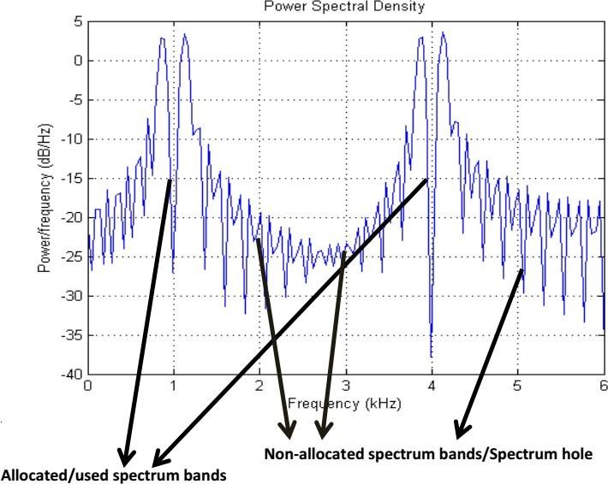
Here in Fig.3.1 we have not entered User 2, 3 & 5, thus their respective bands are still un-allocated. We can see them below in the power spectral density graph of our carrier signal.
Fig.3.2 Power spectral density curve.
Assigning new user to the Spectrum Holes: Now we are adding another User, the system will search the first available gap in the spectrum and automatically assign it to the new user. As the first available gap was after User-1 as User-2 was not sending any data so the band reserved for User-2 at start is now assigned to this new User.

Slide 16
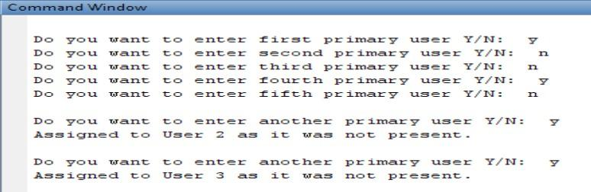
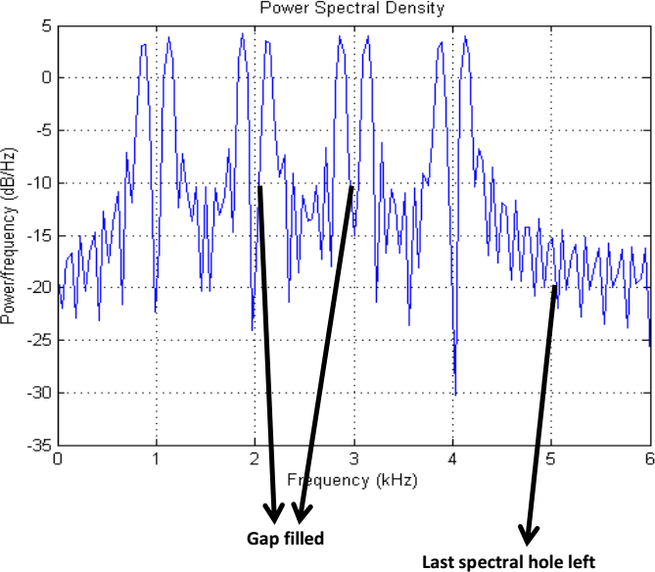
Fig. 3.3 Assigning new users to the Spectrum Holes in Command window.
Here we can see that the first spectral gap has been filled by assigning the new incoming User’s data. The first spectral gap belonged to User-2.
Fig. 3.4 Power spectral density curve: one slot remaining in the frequency spectrum

Slide 17
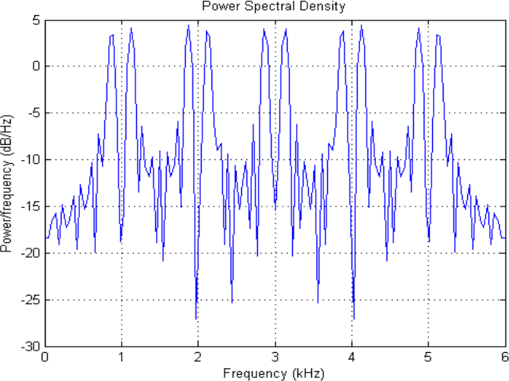
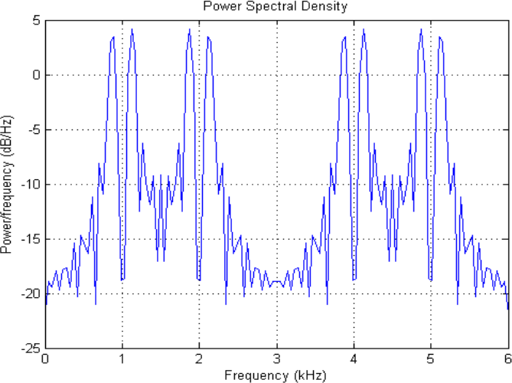
Fig. 3.5 All of the frequency bands are efficiently in use. Fig. 3.6 From the frequency spectrum
3rd slot has been eliminated.
Elimination of a Slot: Once all the slots are being assigned, our system will entertain no other User and will be able to free up the slots one by one as shown in fig 3.6. If we ask it to empty a slot, it will remove the data of that slot and make it ready for the next assignment.

Slide 18
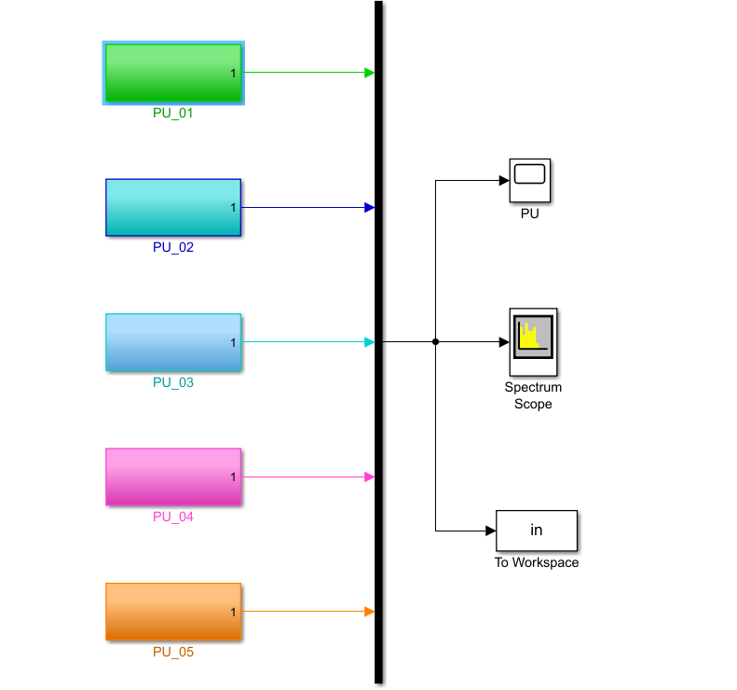
Simulink:
MATLAB Simulink is developed by the MathWorks. The Simulink library browser contains the collection of multiple tools and their functions.
It is useful for the simulation of the dynamic system in the MATLAB environment.
Fig.4.1 Block diagram of cognitive radio taking 5 users at a time.

Slide 19
Simulink diagram of Cognitive Radio:
The block diagram of cognitive radio is shown in the above fig 4.1. It consists of Primary User (PU), mux, spectrum scope and workspace blocks.
Mux: The Mux block combines inputs with the same data type and complexity into a vector output. The output mux signal is flat, even if you create the mux signal from other mux signals.
Spectrum Analyzer: The Spectrum Analyzer block, referred to here as the scope, displays the frequency spectra of signals.
To workspace: The Workspace block writes input signal data to a workspace. During simulation, the block writes data to an internal buffer.
Scope: The two blocks have identical functionality, but different default settings. The Time Scope is optimized for discrete time processing. The Scope is optimized for general time-domain simulation. For a side-by-side comparison.
Primary User: The PU block describes the user who is accessing the spectrum at that time.

Slide 20
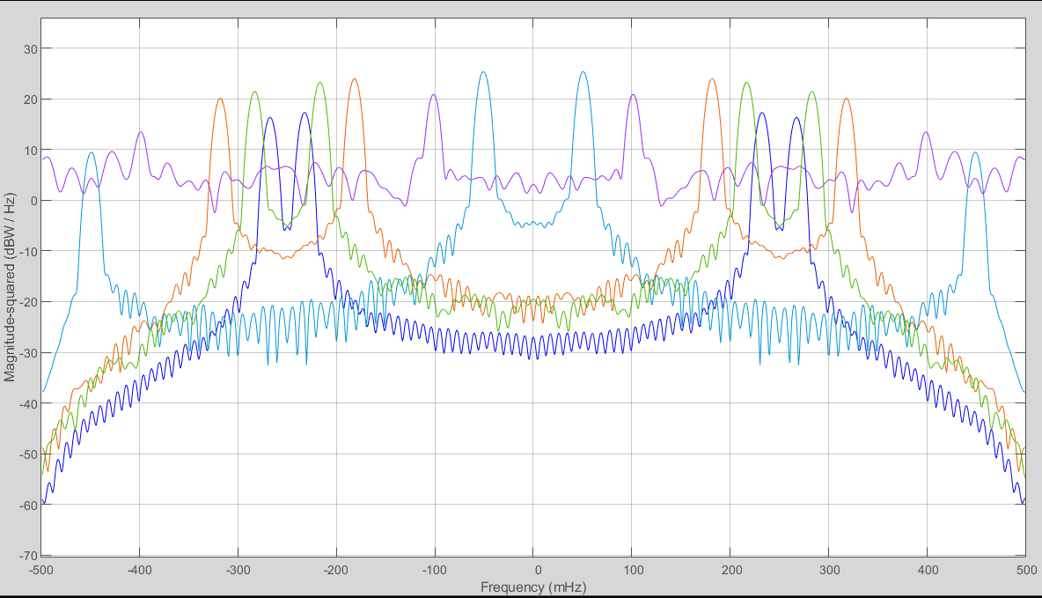
Spectrum Allocation using Simulink:
The spectrum allocation using the above Simulink model is shown in below fig.4.2 which was taking 5 users at a time.
Fig.4.2 Spectrum allocation of Primary Users (PU’s)

Slide 21

Non-cooperative Spectrum Sensing Technique(Single Threshold) for Cognitive Radio using MATLAB
ENERGY DETECTION:
It is a non-coherent and non-cooperative detection method that detects the primary signal based on the sensed energy.
Due to its simplicity and no requirement on a priori knowledge of primary user signal, energy detection (ED) is the most popular sensing technique in cooperative sensing.
Fig.5 Energy detector block diagram

Slide 22
The block diagram for the energy detection technique is shown in the Figure 5. It is composed of four main blocks:
1.Band Pass Filter
2.Squaring Device
3.Integrator
4.Threshold device
In this method, the signal is passed through a band pass filter of the bandwidth W, then multiplied by itself (squaring device) and is integrated over the time interval.
The output from the integrator block is then compared to a predefined threshold.
This comparison is used to discover the existence of absence of the primary user. The threshold value can be set to be fixed or variable based on the channel conditions.
It estimates the presence of the signal by comparing the energy received with a known threshold Vt derived from the statistics of the noise. Analytically, signal detection can be reduced to a simple identification problem, formalized as a Binary Hypothesis Testing Problem.

Slide 23
Binary Hypothesis Testing Problem
Depending on the idle state or busy state of the primary user, with the presence of the noise, the signal detection at the secondary user can be modeled as a Binary Hypothesis Testing Problem, given as:
Hypothesis 0 (H₀): signal is absent
Hypothesis 1 (H₁): signal is present
If the received signal, y, is sampled, the n^{th} (n= 1, 2, 3 ) sample, y(n) can be given as:
y(n) = w(n)…… H₀
y(n) = x(n) + w(n)……H1
where x(n) is the signal transmitted by the PU, x(n)= h s(n) where his channel gain and w(n) is the noise sample.
Then a decision rule can be stated as:
H₀ if ε < Vt
H₁ if ε > Vt
Where ε is the test statistic. Energy detection differentiates between the two hypotheses H₀ and H₁ by comparing ε with threshold voltage Vt as shown. Setting the right threshold value is of critical importance.

Slide 24
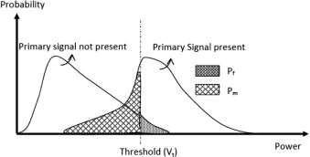

Fig 5.1 Threshold setting in ED: trade-off between missed detection and false alarm
Hence if the selected Vt is too low, the false alarm probability i.e
P_{f} = Pr (ε > Vt | H₀) increases, which results in low spectrum utilization. On the other hand, if Vt is kept unnecessarily high, the probability of missed detection.
Pm= Pr(ε < Vt | H1 ) is increased which may result in interference with an active PU. Hence, a careful tradeoff is considered while setting the threshold for ED.
The output of the integrator (Fig. 5) is called decision (test) statistic. The test statistic is compared with the threshold to make the final decision on the presence/absence of the primary signal.
The test statistic of the energy detector can be given as
ε=$\frac{1}{2σ2w}$ $\sum_{n=1}^{N}{\left|y(n)\right|}2$

Slide 25
Simulation results
ROC(Receiver operating characteristics) plots. For Energy Detector based spectrum sensing
Pmd = Probability of missed detection
Pd = Probability of detection
Pf = Probability of false alarm
N = Number of samples
SNR = Signal to noise ratio
Detection probability (Pd), False alarm probability (Pf) and missed detection probability (Pmd) are the key measurement metrics that are used to analyse the performance of spectrum sensing techniques.
The plot of Probability of false alarm versus Probability of detection:
The plot of Probability of false alarm versus Probability of detection is illustrated in Figure.5.1&.5.2 Probability of false alarm (Pf) is on X-axis and probability of detection (Pd) is on Y-axis.
In the simulation, the study input random bit stream is multiplied by 1 MHz sinusoidal carrier signal to get 1 MHz BPSK modulated signal, which is transmitted in AWGN channel.

Slide 26
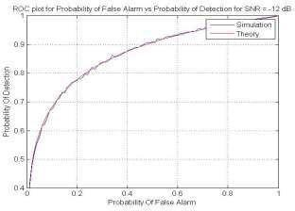
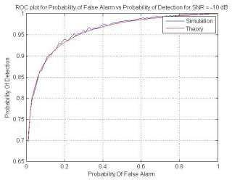
Fig.5.2 ROC curve for Pf vs Pd at SNR= -12dB Fig.5.3 Plot between Pf and Pd at SNR= -l0db
It can be interpreted that the performance of energy detector improves with increase in SNR and degrades with the decrease in SNR for the increase in probability of false alarm respectively.

Slide 27
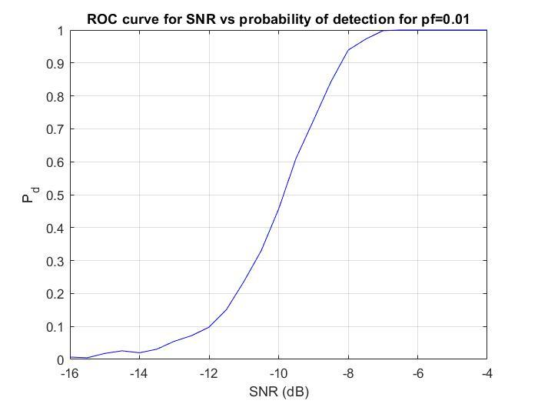
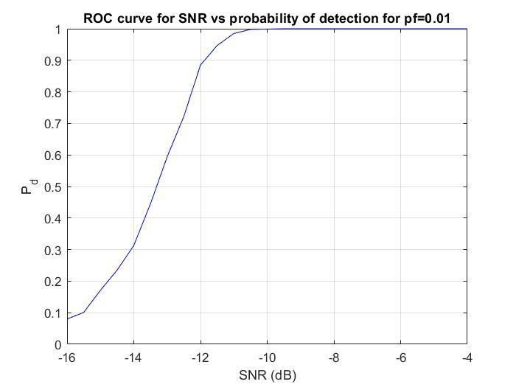
The plot of Probability of detection (Pd) versus Signal to Noise Ratio (SNR):
The plot of Probability of detection (Pd) and Signal to Noise Ratio (SNR) is illustrated in Figure.5.3&5.4. Signal to Noise Ratio (SNR) is on X-axis and probability of detection (Pd) is on Y-axis.
Fig.5.4 Plot for Pd vs SNR at N= 1000 Fig.5.5 Plot for Pd vs SNR at N= 5000
It can be interpreted from Fig.5.3&5.4 that the performance of energy detector improves with increase in the number of sample points. That is Pd increases with the increase in N for the same values of SNR at fixed Pf.

Slide 28
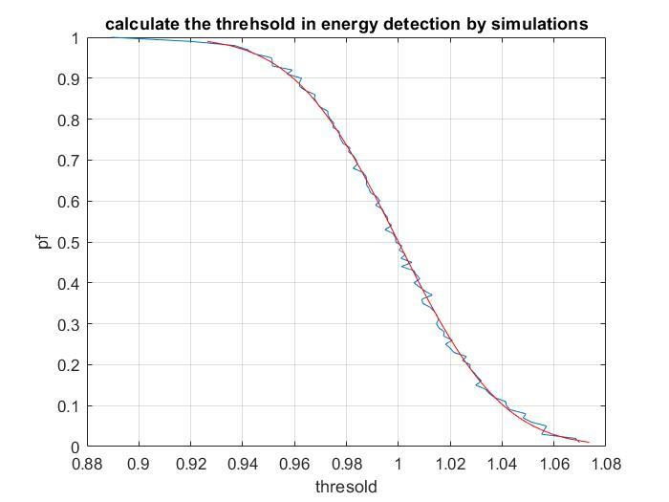
The Plot of Threshold versus Probability of false alarm (Pf):
The plot of Threshold vs probability of false alarm (Pf) is illustrated in Figure.5.5. Threshold of the energy detector is on the X-axis and the probability of false alarm (Pf) is on the Y-axis.
Assume only noise is received, i.e., the primary user is absent. If the only noise energy lies above the threshold, it corresponds to a false alarm.
Probability of False Alarm = energy above threshold/No. of Iteration.
Fig.5.6: plot of Threshold vs probability of false alarm (Pf)

Slide 29
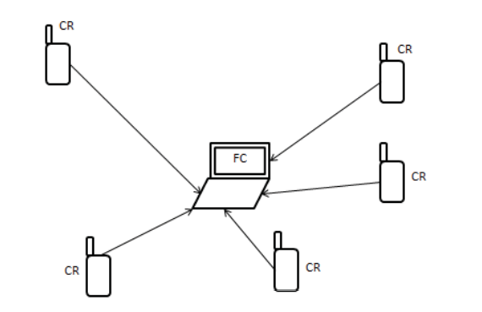

Cooperative spectrum sensing technique(double threshold) for cognitive radio network using matlab
CSS is illustrated in figure 6 In this diagram, each SU sends its local decision to the FC. FC then combines the result from each CR under certain fusion rules i.e., OR rule, AND rule and Majority rule. Probability of detection (Pd) and probability of false alarm (Pf) for the cooperative scheme under OR rule is given
Q_{d} = 1- $\prod_{i=1}^{M}{(1−Pdi)}$
Q_{f} = 1- $\prod_{i=1}^{M}{(1−Pfi)}$
Where Pd and Pf are the probability of detection and probability of false alarm of ith SU respectively and M is the number of CRs participating in CSS.
fig. 6 Cooperative spectrum sensing

Slide 30

Proposed double threshold energy detection in cooperative spectrum sensing
In conventional energy detector as already discussed, each CR makes their local decisions based on a single threshold as shown in fig 6.1(a).
If the energy calculated X (or observed energy O_{i}) is more than threshold λ then hypothesis H₁ is true otherwise H₀.
Double threshold energy detection method can be illustrated with the help of figure 6.2(b).
Here hypothesis H1 is true if X is more than λ₂ and hypothesis H₀ is true when X is less than λ₁ and in case observed energy X lies in between the two thresholds i.e., λ₁<X<λ_{2,} no decision is taken and CR will go for sensing again.
Threshold λ can be calculated
λ = Q⁻¹(P_{fa})$\sqrt{2Nσ4w}$+N$σ2w$
And thresholds λ1 and λ2 can be found as:
λ = (1 – ρ) λ
λ = (1 + ρ) λ
Here ρ is the uncertainty parameter.

Slide 31
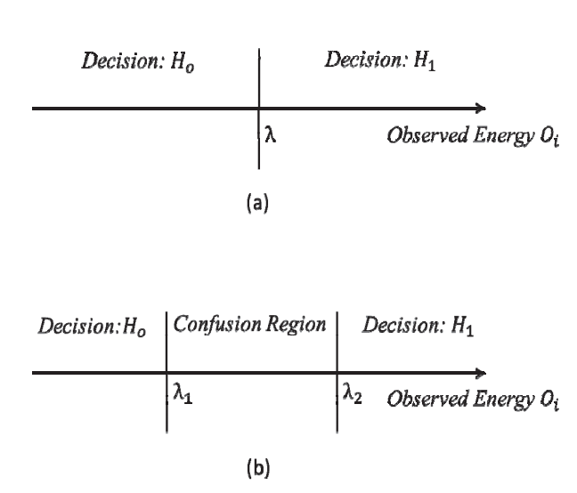
COMPARISON BETWEEN SINGLE THRESOLD AND DOUBLE THRESHOLD:
Fig.6.1 (a) Conventional energy detector with a single threshold.
(b) Double threshold-based energy detector

Slide 32

In this project, we have developed a simulation model for double threshold CSS which works as follows:
Each SU (i=1……M) will make a decision if and only if observed energy X_{i} lies above Z₂ or below Z₁ which is given by
L_{i} = $\left\{\begin{aligned}\text{1 }\text{Xi} \text{€ }\text{h}\text{1} \\ 2 \text{X}\text{i} \text{Σ} \text{h}\text{2} \end{aligned}\right.$
If X lies between Z₁ and Z₂, then SU does not make a decision and report the observed energy X_{i} to the FC.
Let us assume that FC receives K local decisions and M-K energy values. FC will now take the average of all the energy values received and compare it with the threshold Z to make a decision H_{o} or H₁ as
X_{avg} =$\frac{1}{M−K}\sum_{i=1}^{M−K}{Xi}$
L_{f} = $\left\{\begin{aligned}0 \\ 1\end{aligned}\right.$ X_{avg} < λ
X_{avg} > λ
Now FC will be having K+1 decision: K decisions from the SUs which have made the decisions and one from the FC itself based on the observed energy received from the confused SUs.
Now FC can combine these K+1 decision by OR fusion rule with the help of equation.

Slide 33
No
yes
Fig.6.2 Flow chart of the proposed scheme.
Find λ, λ_{1,} λ₂ and Xi
If Xi> λ2 or Xi< λ1
Don’t take decision Send Xi to the FC
Take local decision Li and send it to the FC
Take average of all Xi’s received and compare it with λ and take decision Lf.
Combine the decisions Li’s and Lf by OR rule

Slide 34
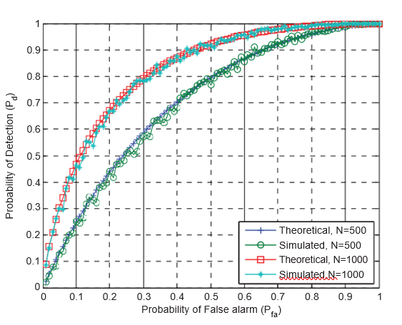
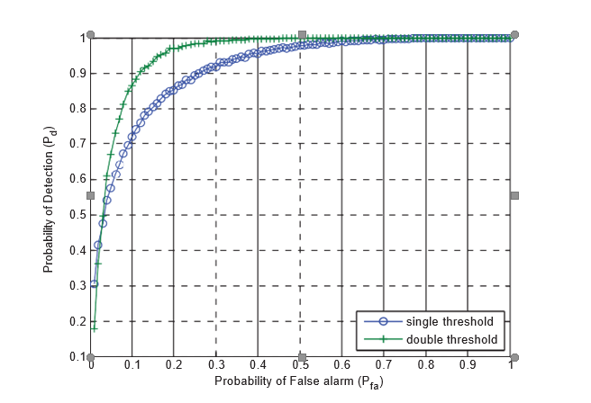
Simulation results
We have performed a simulation study to evaluate the performance of the proposed scheme.
First, we developed a simulation model in MATLAB for a single threshold energy detection method and compared the results with the theoretical results to validate the simulation model.
Fig. 6.3 Pd vs Pfa for a single energy detector. Fig. 6.4 Pd vs Pfa for a single energy detector
Figure 6.3 shows the ROC (Receiver Operating characteristics) for theoretical and simulation model with N=500 & 1000.
Figure 6.4 shows the ROC (curve between Pd vs Pf) for single and double threshold at -5 dB SNR with 200 samples.

Slide 35
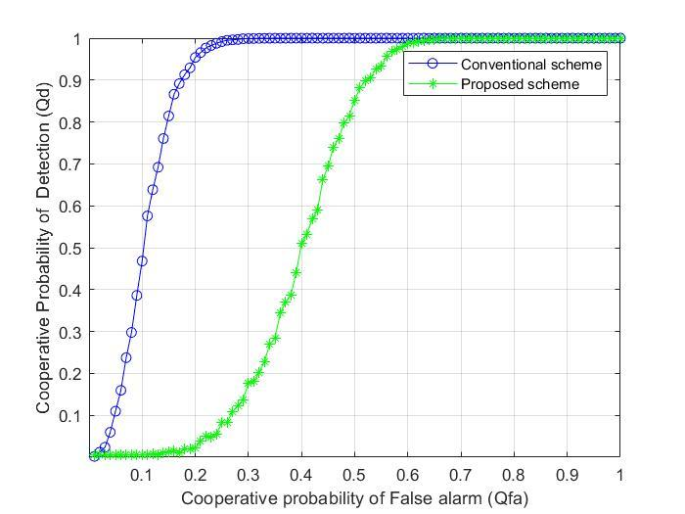
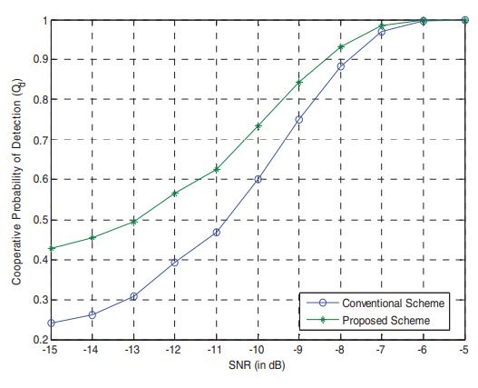
Fig. 6.5 Qd vs Qfa for conventional CSS and Proposed CSS Fig. 6.6 Qd vs SNR (in dB)
Figure 6.5 shows the ROC for the conventional and proposed scheme. We have assumed the number of SUs participating in the cooperation, M=5. This figure clearly shows that the proposed scheme outperforms the conventional CSS. This curve is drawn at -8dB SNR with 100 samples. It has been clearly observed from the graph that the proposed scheme is giving an almost 10% improvement in the probability of detection at P_{fa}=0.1.

Slide 36
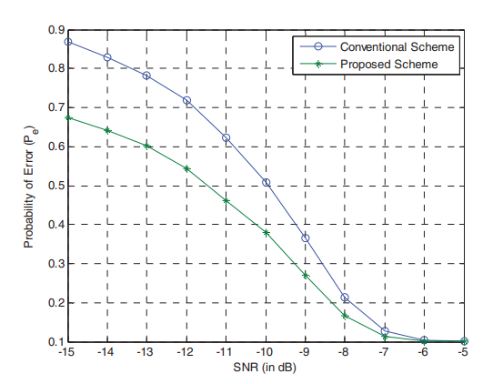
Figure 6.6 shows the graph between Q_{d} and SNR by fixing P_{fa}=0.1 and it has been observed from the graph that at low SNR, the proposed scheme performs better.
Fig. 6.7 Pe vs SNR (in dB)
Figure 6.7 shows the curve between probability of decision error (P_{e}) and SNR and it has been observed that the proposed scheme is minimizing the decision error in the low SNR region.

Slide 37
result
FC receives two types of decisions i.e., local decisions and observed energy values.
We have proposed a scheme under which FC averages the observed energy values and compare it with threshold Z to make a decision L_{f}.
Then FC combines all the local decisions received from SUs and decision L_{f} by OR rule of fusion to make a global decision.
It has been observed that there is a significant improvement in the detection performance by employing the proposed scheme. Moreover, the problem of sensing failure has also been removed.
In future, optimization between the spectrum sensing performance and overhead burden because of sending the energy values to the FC can be explored.

Slide 38
conclusion
Cognitive Radio is one of the efforts to utilize the available spectrum more efficiently through opportunistic spectrum usage has become an exciting and promising concept.
By using previous Energy detector, we implemented the concept in cooperative spectrum sensing for better performance.
Hybrid spectrum sensing techniques like any two combinations of spectrum sensing techniques with improved Double threshold Energy detection in both cooperative , non cooperative sensing needed for better detection performance.
It is well known that energy detector’s performance is susceptible to uncertainty in noise power under such cases alternate detection schemes such as cyclic feature detection.
We conclude that the Double threshold cooperative spectrum sensing is based on the conventional energy detection technique is the best technique where it can reduce the total error rate by finding 2 thresholds in the conventional energy detection.

Slide 39
references
Mitola, Joseph (2000), "Cognitive Radio - An Integrated Agent Architecture for Software Defined Radio", Diva (Ph.D. Dissertation), Kista, Sweden: KTH Royal Institute of Technology, ISSN 1403-5286.
V. Valenta et al., "Survey on spectrum utilization in Europe: Measurements, analyses and observations", Proceedings of the Fifth International Conference on Cognitive Radio Oriented Wireless Networks & Communications (CROWNCOM), 2010.
"Cognitive Functionality in Next Generation Wireless Networks"(PDF). Archived from the original (PDF) on 18 November 2008. Retrieved 6 June 2009.
H. Sun, A. Nallanathan, C.-X. Wang, and Y.-F. Chen, "Wideband spectrum sensing for cognitive radio networks: a survey", IEEE Wireless Communications, vol. 20, no. 2, pp. 74–81, April 2013.
Carlos Cordeiro, Kiran Challapali, and Dagnachew Birru. Sai Shankar N. IEEE 802.22: An Introduction to the First Wireless Standard based on Cognitive Radios JOURNAL OF COMMUNICATIONS, VOL. 1, NO. 1, APRIL 2006.
Z. Li, F.R. Yu, and M. Huang, "A Distributed Consensus-Based Cooperative Spectrum Sensing in Cognitive Radios", IEEE Trans. Vehicular Technology, vol. 59, no. 1, pp. 383-393, Jan. 2010.

Slide 40
Any Queries?

Slide 41
THANK YOU

