Slide 1
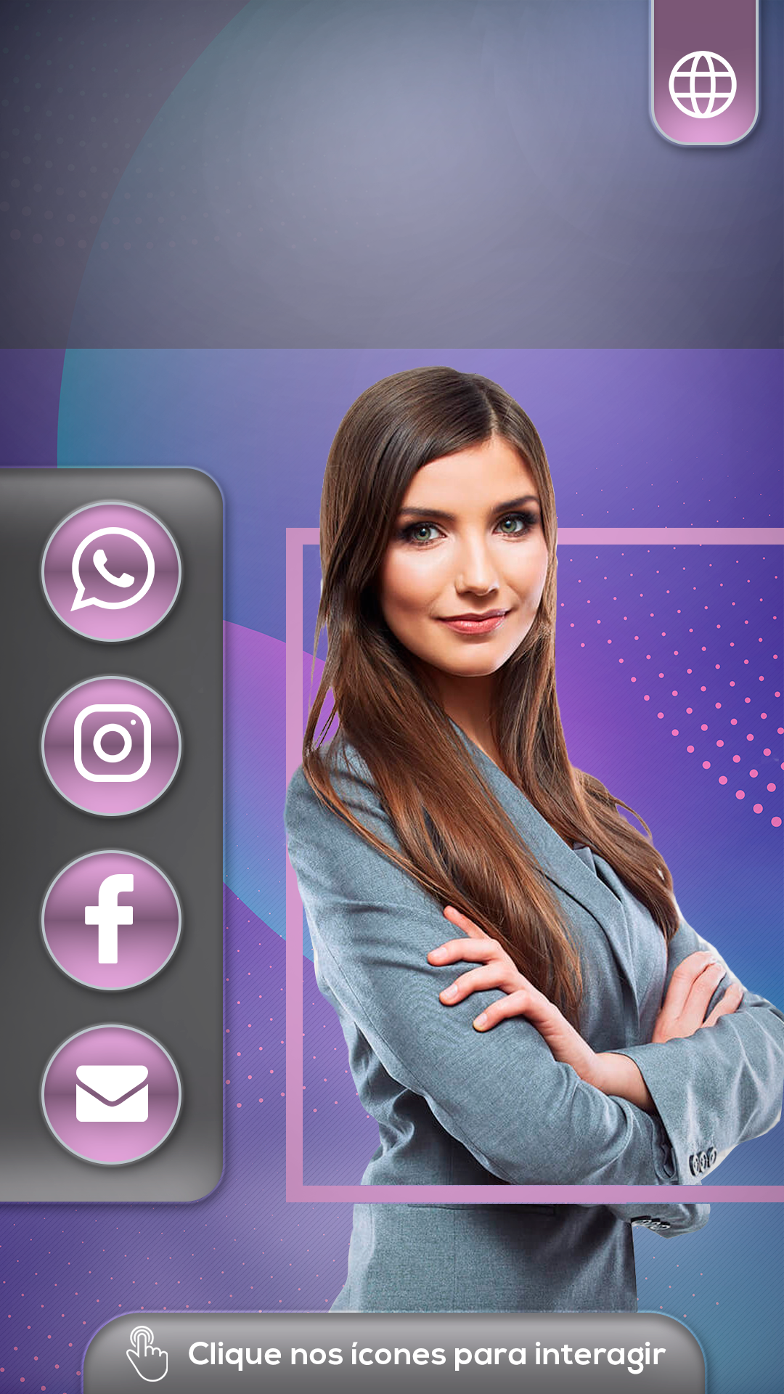
Mary França
COACH

