Slide 1

Neural Net Verification with Z3 in Python
Sabina M. Jedrzejczyk, MEng Software Engineering
Supervisor: Prof. Ekaterina Komendantskaya
Co-Supervisor: Wen Kokke
Advisors: Daniel Kienitz, Matthew Daggitt

Slide 2
Contents
Brief Introduction to Neural Networks
Issues with Neural Networks
Tools for Verification
Z3 API Tutorial
Sapphire Tutorial
Summary

Slide 3

Aim
To learn about the Sapphire library, which was developed in Python by HWU's Lab for AI and Verification (LAIV - http://laiv.uk/), that allows to verify neural networks implemented in Python, via Python's API to the SMT-solver Z3.

Slide 4
Learning Objectives
Understand Neural Net Verification
Use the Z3 API in Python
Understand and Use the Sapphire Python library
Verify a Neural Network using the Sapphire library

Slide 5
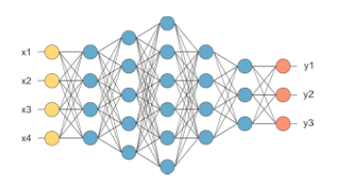
Neural Networks
Neural Networks belong to range of intelligent algorithms in the Artificial Intelligence (AI) field, and can be described as a function, which can separate inputs (data points) into classes. The standard feed-forward model, which is also called a multilayer perceptron, is composed of an input layer, and output layer, and an N number of hidden layers, where each layer consists of neurons [1]:

Slide 6
NN are often used in perception tasks such as:
classification,
pattern recognition,
computer vision,
natural language processing,
function approximation,
tasks in which the data is incomplete or noisy
However, the solutions are not easily conceptualised, and Neural Networks, due to their statistical nature, are prone to errors and adversarial attacks, which is why there is an urgent need for their verification, as these issues pose a threat for their use in areas like safety-critical systems such as self-driving vehicles, autonomous systems, robotics, medical applications etc. [2,3]

Slide 7
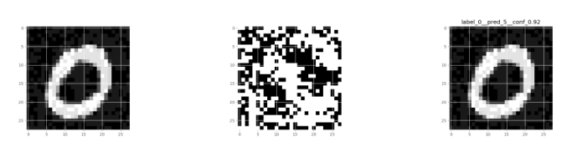
Adversarial Attack Example
For a given neural network and a correctly classified image of “0” (on the left), adding noise/some distortion to the original image can cause that very same neural network to predict a “3” with 92% confidence (on the right). [1]

Slide 8
Tools for Verification
One of the most popular tools for Neural Net verification is the SMT-solver Z3, which is available in Python.
SMT stands for Satisfiability Modulo Theories, which is a decision problem for logical formulas with respect to combinations of background theories such as arithmetic, bit-vectors, arrays, and uninterpreted functions. [4]
The first half of this masterclass focuses on an introduction to Z3.

Slide 9
Z3 API Tutorial
Google Collab link: https://colab.research.google.com/drive/1F6gu8ka5IaFDmpx1tMmZyFq1EOf4dnvG?usp=sharing
Note: Click on File > Open in Playground Mode

Slide 10
Sapphire Tutorial
Google Collab link: https://colab.research.google.com/drive/1S1lpoi5gNNZ_MEyvfD_Pw1B3D9D0fz-e?usp=sharing
Note: Click on File > Open in Playground Mode

Slide 11
Summary
Testing can only prove that something works for a finite number of points. Verification proves that it works for an infinite number of points.
Z3 is used in many applications, and is a popular tool for verifying Neural Networks.
Sapphire can be used to translate a Neural Network model into Z3, which can then be verified using a set of verification conditions.
The larger and complex the Neural Network model, the longer Z3 will take to verify it, so the size of the Neural Network matters.
Using a "logical" style and an epsilon-ball style of verification is possible for small datasets e.g. Iris, but only methods like epsilon-ball may be possible for more complex/semantically opaque data sets e.g. MNIST.

Slide 12
References
1. Komendantskaya E, Stewart R, Duncan K, Kienitz D, Hen PL, Bacchus P. Neural Network Verification for the Masses (of AI graduates). 2019 Jul 2
2. Abiodun OI, Jantan A, Omolara AE, Dada KV, Mohamed NA, Arshad H. State-of-the-art in artificial neural network applications: A survey. 2018 Nov 23
3. Xiang W, Musau P, Wild AA, Lopez DM, Hamilton N, Yang X, et al. Verification for Machine Learning, Autonomy, and Neural Networks Survey. 2018 Oct 3
4. Programming Z3 [Internet]. [cited 2020 Nov 7]. Available from: http://theory.stanford.edu/~nikolaj/programmingz3.html

