Slide 1
Logistic Regression Model to predict a stock for a buy or sell
Wenliang Zhang
MET CS777 Big Data Analytics Term Project
2021 Spring
Github: https://github.com/wenliangz/cs777-term-project

Slide 2
Content
DATA Exploratory Analysis
Feature Engineering
Logistic Model Implementation
Model Metrics
Summary

Slide 3
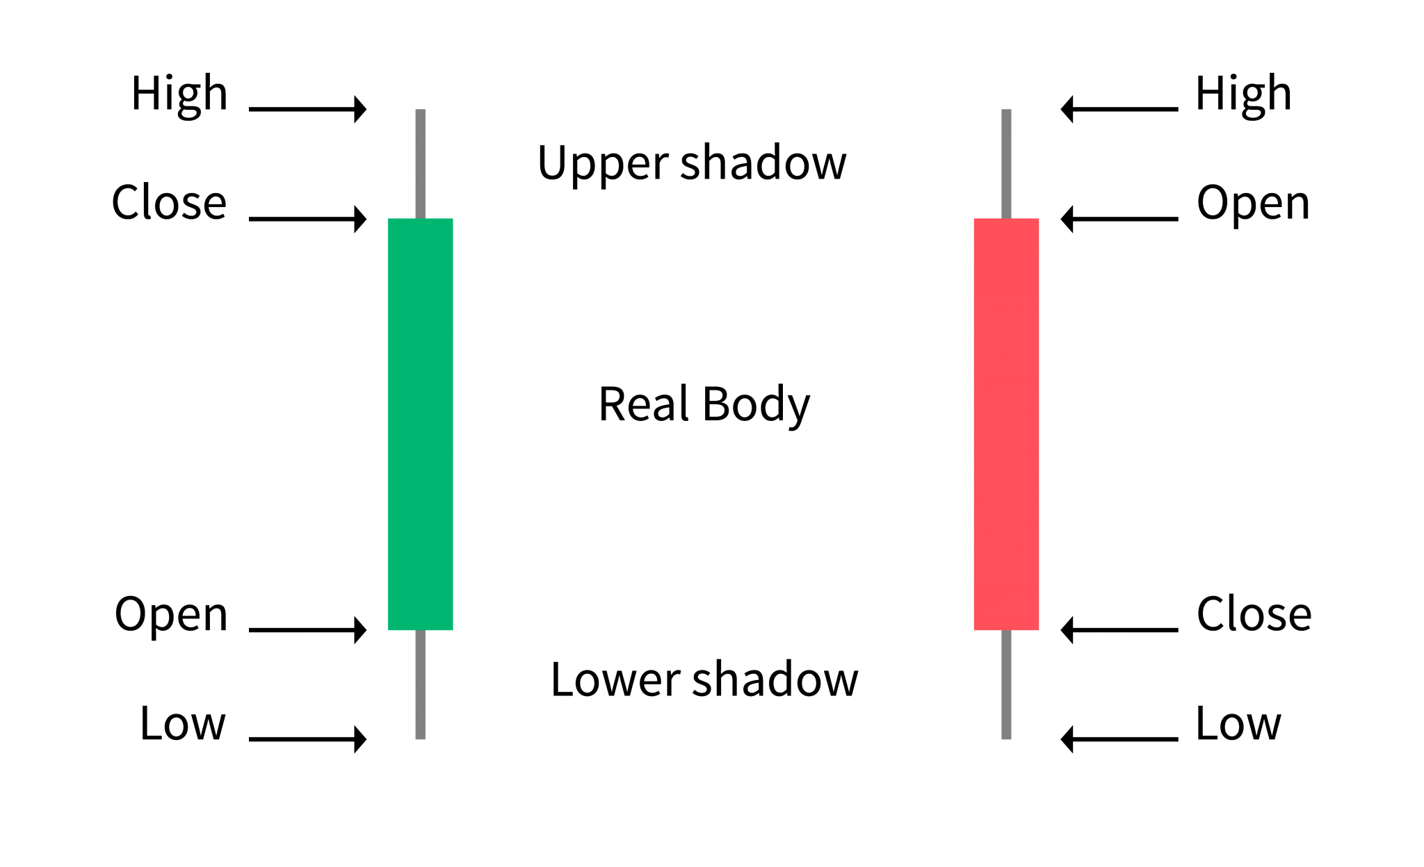
Stock data representation
Stock price (Candlestick)
Volume data
Volume or trading volume, is the total number of shares that are actually traded (bought and sold) during the trading day or specified set period of time
Very important indicator for trading and price prediction

Slide 4
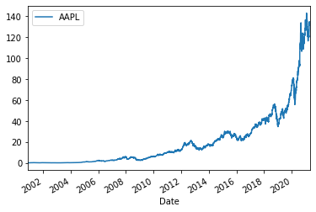
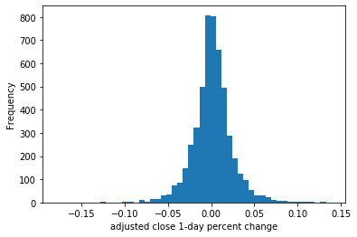
History data of APPLE stock
Line Plot of raw Adj_close price
Histogram of 1-d-pct of Adj_Close

Slide 5
Train and Test split
The raw data used are the history data of APPL stock, from 2000-12-01 to 2021-4-30.
We split the data into Train and Test dataset at the ratio of 0.8:0.2
2000-12-01
2021-04-30
• • • • • • • • • • • • • • • • • • • • • • • • • • • • • • • • • • • • • • • • • • •
Feature Engineering
• • • • • • • • • • • • • • • • • • • • • • • • • • • • • • • • • • • • • • • • • • •
Train and Test split
2000-12-01
2017-05-24
2021-04-30
• • • • • • • • • • • • • • • • • • • • • • • • • • • • • • • • • • • • • • • • • • •
Training
Testing

Slide 6
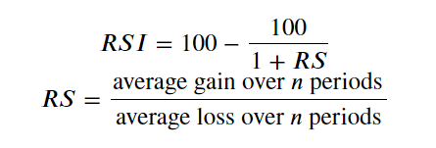
Feature Engineering
Moving Averages (MA)
Relative Strength Index (RSI)
Simple Moving Average is similar to rolling mean
Use N past days to get an average
Common values for N: 14, 30, 50, 200
Measures the average percentage gain or loss during a look-back period
Here we using the same values as the ones for moving averages

Slide 7
Features and Target
Features
Target
Primary Features
5d_close_pct
1d_volume_pct
Engineered features
14, 30, 50, 200 moving average for both Adj_close and 1d_volume_pct
14, 30, 50, 200 rsi for 1d_volume_pct
the percentage change of 5-day future Adj_close price, `5d_future_pct`
If it is positive, we label as 1, to buy
if it is negative we label as 0, to sell

Slide 8
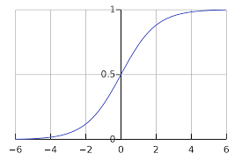


Logistic Regression Model
Features
Prediction
x₁
$y= σ(w^{T}x^{(i)}+b$), where $σ$(z) = $\frac{1}{1+e^{−z}}$
x₂
…
$$w^{T}x^{(i)}+b$$
σ
p=0.6
buy
X_{n-1}
x_{n}

Slide 9

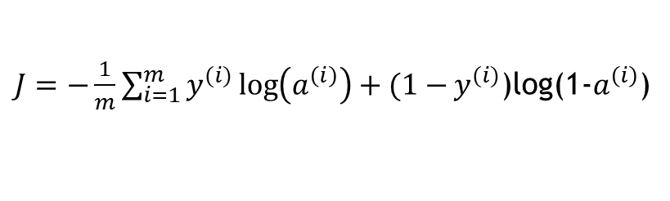
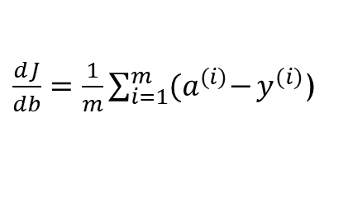
Cost Function and Gradient
COST
$J=−\frac{1}{m}\sum_{i=1}^{m}{y^{(i)}\log\left(a^{\left(i\right)}\right)+(1−}y^{(i)}$)log(1-$a^{\left(i\right)}$)
$\frac{ⅆJ}{dw}=\frac{1}{m}X{(A−Y)}^{T}$)
Gradient
$\frac{ⅆJ}{db}=\frac{1}{m}\sum_{i=1}^{m}{{(a}^{(i)}−}y^{(i)}$)

Slide 10
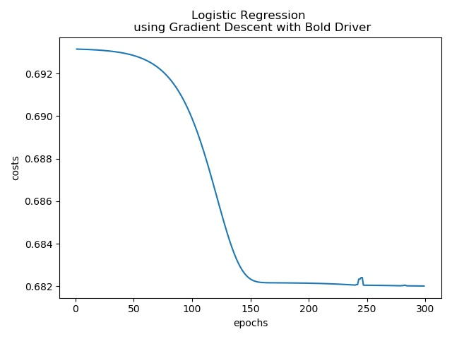
Training curve
Model Parmaeters:
initialization_value=0
num_terations=300
initial_learningRate=0.0001
lambda=0.1
weights=None
bold_drive=True

Slide 11
Metrics of model prediction
Logistic Model implemented from scratch
LogisticRegressionWithLBFGS using MLlib library
Precision = 0.6223350253807106
Recall = 1.0
F1 score: 0.7672090112640801
Precision = 0.6219512195121951
Recall = 0.99836867862969
F1 Score = 0.7664370695053224

Slide 12
Summary
We engineered features using Moving Average and RSI to predict a stock
We get fairly good prediction accuracy and F1 score, considering the time-series data and the limited feature we used
Our model is comparable to the model implemented using Spark Mllib library

