Slide 1
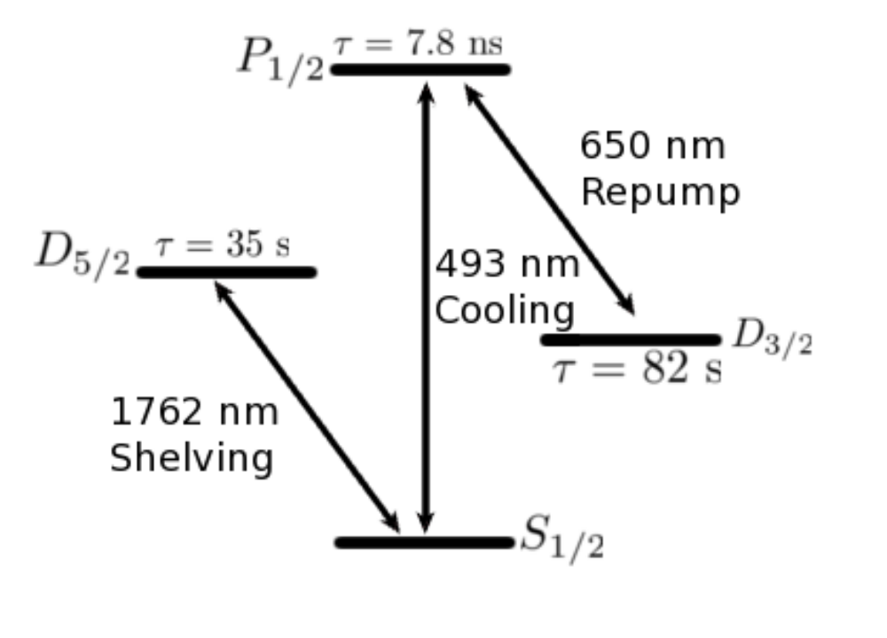
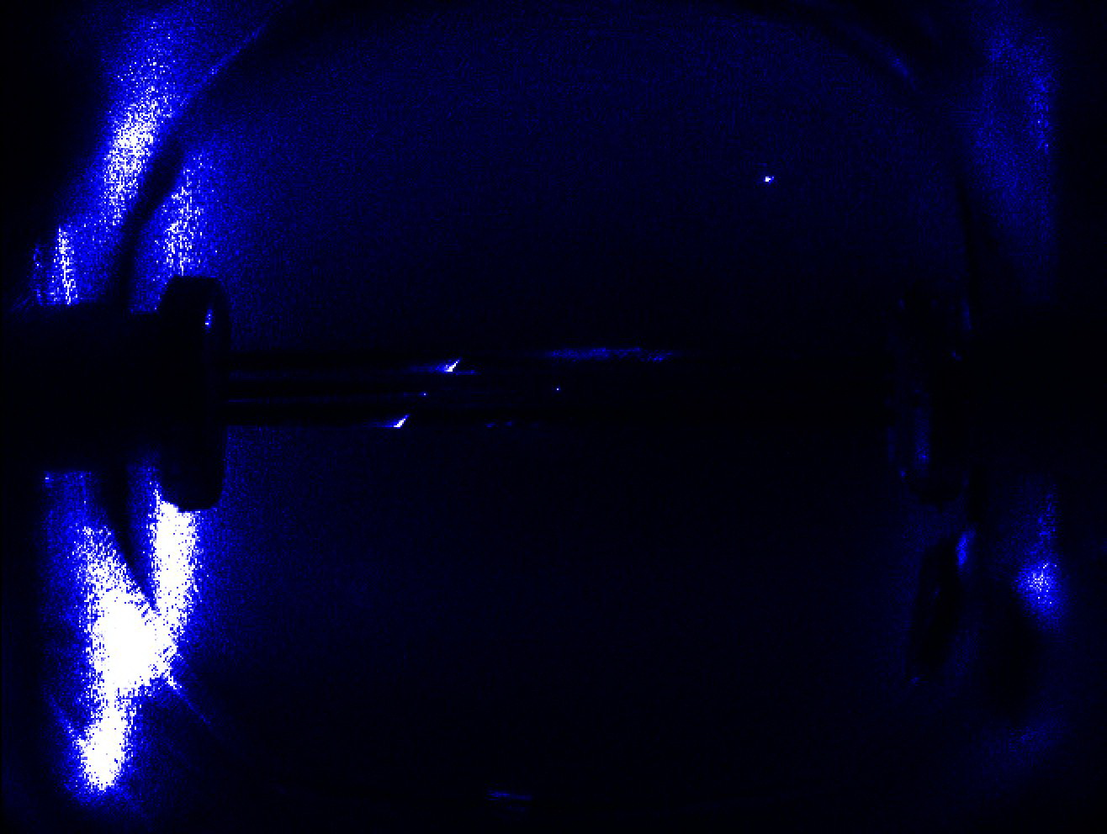
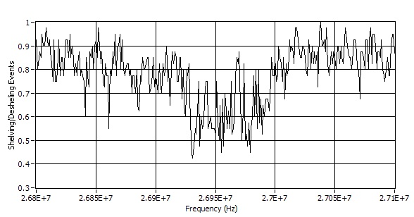
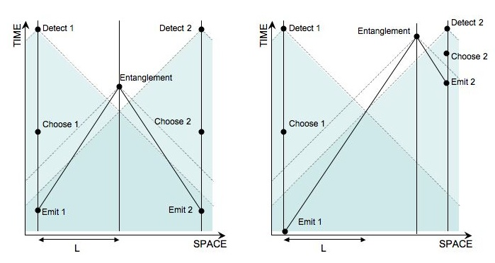
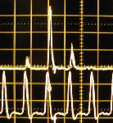
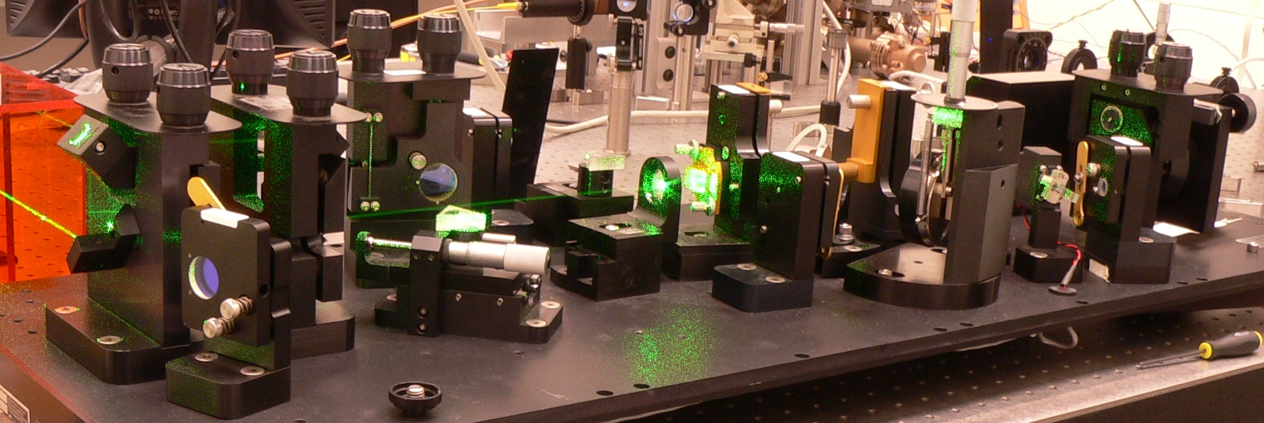
Manipulations of the ¹³⁸Ba⁺ Zeeman Qubit
John Wright, Nathan Kurz, Tom Noel, Gang Shu, Chen-Kuan Chou, and Boris Blinov
University of Washington Physics Department
Introduction
We report on progress towards using ¹³⁸Ba⁺ for quantum computation and Bell's Inequality verification. Barium ions are trapped in a linear Paul trap, and cooled with 493 nm light frequency doubled from a diode laser with a 650 nm diode laser re-pumping the long-lived D_{3/2} state. We have successfully trapped both common barium isotopes. ¹³⁷Ba⁺ can be trapped very similarly but its nuclear spin requires the addition of sidebands to the 493 nm light. Using a 791nm diode laser, we can selectively excite either isotope and then ionize it with a nitrogen laser flash. A 1762 nm fiber laser is locked to a Zerodur cavity and used to excite the ion from 6S_{1/2} to the 5D_{5/2} state, which is a metastable state outside of the cooling cycle.
Zeeman Qubit Manipulations
In our magnetic field, the ground state Zeeman levels are separated by approximately 25 MHz. Initialization of the qubit is performed by controlling the polarization of the 493nm light. By exposing the ion to only σ-polarized light for hundreds of microseconds we see initialization probabilities greater than 95 percent. Readout of the qubit is achieved by selective excitation to 5D_{5/2} using the stabilized 1762 nm fiber laser. Since this “shelved” state is outside of the cooling cycle the ion fluorescence indicates whether the excitation was successful. We have driven the transition with high probability using both π-pulses and rapid adiabatic passage (see talk by Tom Noel).
To manipulate the qubit, RF pulses were originally applied to a wire loop placed outside of the vacuum chamber. The loop was driven with more than 1 W of RF power but no effect on the ion was observed due to shielding from the chamber and trap. Instead the RF was applied directly to the trap electrodes. The two opposite electrodes normally grounded in a linear Paul trap were instead driven with the Zeeman RF frequency. The application of RF to these ground electrodes does cause significant ion heating, but we can apply sufficient power to drive the transition without raising the ion temperature enough to disturb readout. Although we have not yet driven the transition coherently, we have observed that exposure past the coherence time destroys the prepared state of the ion as expected.
Remote Entanglement with an Ultrafast Ti:Sapphire Laser
The 493 nm photon emitted from the decay of the 6P_{1/2} state is observed by our normal ion florescence detection hardware. The polarization of the photon is entangled with the resulting Zeeman state of the ion. Using polarization dependent beam splitting and two PMT detectors, a partial Bell state measurement can be made to project two ions into an entangled state. With our current cooling rate, we expect the repetition rate for this operation to be approximately 10 KHz. Unfortunately, the probability for successful entanglement is low because of the low solid angle collected as well as timing constraints and the low quantum efficiencies of the PMTs at 493 nm. We are working towards improving the fraction of the solid angle that can be imaged to increase this probability (see poster by Chen-Kuan Chou).
Barium as a Qubit
The two Zeeman levels of the 6S_{1/2} state can be used as a quantum bit. The energy splitting between them in a reasonable magnetic field is in the RF range. The simplicity and lifetime of this qubit are advantageous, but unfortunately it is obviously magnetically sensitive and line triggering reduces the possible repetition rate for experiments.
Loophole-free Bell's Inequality Test
The most significant loophole in current experimental tests of Bell's Inequality is the fair sampling assumption. Under this assumption, photon detectors treat all photons of the same frequency, direction, and polarization identically. In most photon-based verifications of Bell's inequality, the fraction of photons actually detected is so small that there is no other basis to assume it is statistically relevant. In the case of entangled ions, once the entangled ion pair is generated the Bell measurements can be performed with high enough probability to overcome this statistical objection. Further by using distant ion traps, the test can be performed before light speed particles could propogate the parameters as shown below.
Fig 1: Energy level diagram for ¹³⁷Ba⁺ or ¹³⁸Ba⁺. Hyperfine and Zeeman levels not shown. Energy levels not to scale.
Fig 2: Barium ion in linear Paul trap and fluorescing under cooling lasers. The ion can be observed in the center while other light is scattering from the cooling beams.
Fig 3: Single selected pulse from the ultrafast laser. The bottom trace is the output of the ultrafast laser, and the upper trace is the pulse picker output. The intensity of the residual side pulses is greatly reduced after the later doubling stage.
Fig 5: Probability of shelving to 5D5/2 as a function of frequency of RF applied. The ion was prepared in the state accessible to the 5D_{5/2} transition. The expected signal is a drop to 50 percent shelving efficiency because the prepared state of the qubit is destroyed by the RF.
Fig 7. Space-time diagram demonstrating the experimental timing difficulties in Bell's Inequality tests.
In order to realize this experiment, we hope to develop the ability to trap Barium at the Center for Experimental Nuclear Physics and Astrophysics on the UW campus. Optical fiber would be run through existing tunnels and entanglement would be performed as described above. The CENPA facility is almost a kilometer distant, which will allow for the experimental procedure to last on the order of microseconds. Fortunately, we believe that we can reliably manipulate the state of the Zeeman qubit on this timescale, and we have already demonstrated state detection on the order of tens of microseconds using 1762 nm π-pulses.
Femtosecond Ti:Sapphire laser
A Ti:Sapphire ultrafast laser is pumped by a 532 nm Millennia Pro to obtain 500 mW of 910 nm pulses which are then doubled using BBO. The 400 fs pulses have a repetition rate of 76 MHz, and can be used to excite the ion to the 6P_{1/2} state. A single pulse is selected using a home built FPGA based pulse picker. The photon emitted during the decay from this state is entangled with the resulting state of the ion and can be used for remote entanglement and Bell's Inequality tests. We have also driven the 6S_{1/2} to 6P_{3/2} transition and observed the branching ratio to 5D_{5/2} with this laser in previously presented results.
Future Work
The near-term goals include coherently driving the Zeeman transition and improving the repetition rate of entanglement generation. In a longer term we intend to perform entanglement of distant atomic qubits by Bell measurement of single photons emitted by the ions, and loophole-free Bell inequality tests.
Fig 4: Ti:Sapphire ultrafast laser. See right.
Supported by National Science Foundation

