Slide 1
Observing the Aluminum Clock Transition
A report on the observation of a long-known clock transition in Aluminum that in addition to a long lifetime, is insensitive to many problematic sources of noise in other elements
John Wright
Quantum Optics

Slide 2
Atomic Clocks
18th Century – Marine Chronometers measure longitude
20th Century – GPS measure positions on the Earth
21st Century – Gravitational redshift, ?

Slide 3
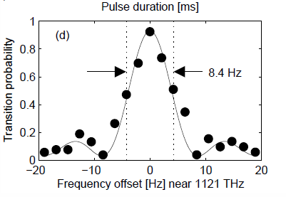
What is a clock?
In atomic systems - narrow transition
Isolated from environment as much as possible
Low frequency shifts from electromagnetic fields

Slide 4
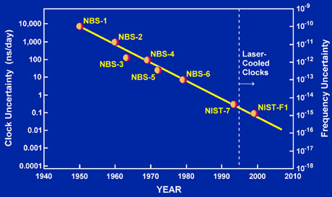
Aluminum Clock
The important measure of the precision of a clock is
Linewidth of .3 mHz and transition frequency at 1121 THz
Aluminum can achieve 10⁻¹⁹
$\text{\%}\frac{Δf}{f}$

Slide 5
Insensitive to normal noise sources
Al-26 has states that have no linear magnetic field dependence (not Al-27)
Clock transition is a J=0 to J=0 transition that is insensitive to electric field gradients
Relatively insensitive to black-body infrared radiation

Slide 6
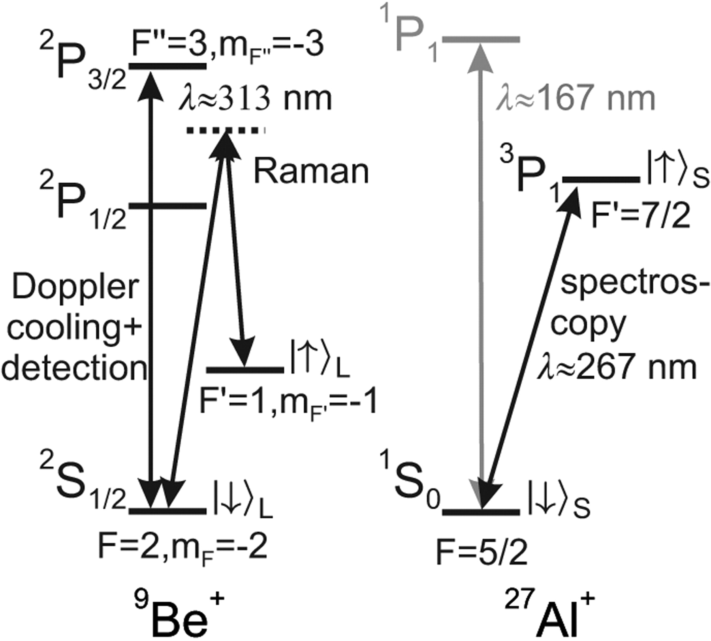
A little more complicated
No easily accessible cooling transition in Aluminum
Instead form Beryllium-Aluminum crystal and cool the Beryllium

Slide 7
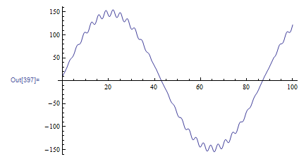
Ion Crystals
Obey Mathieu equation
Y''[t] =
-(a -2qcos(2x))Y[t]
Have both secular and micromotion frequencies

Slide 8
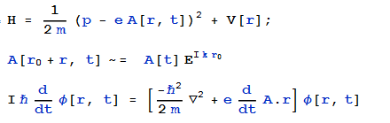
Interaction Hamiltonian
Have an exponential term that will act on ions motion
Ions are in a quantum harmonic oscillator

Slide 9
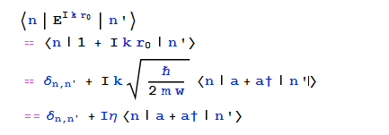
Interaction Hamiltonian
Can drive “carrier” and “sideband” transitions
Lamb Dicke parameter scales with photon wavevector and inversely with trap strength

Slide 10
Experimental Procedure
Clock transition
Ground state cooling
Blue sideband Aluminum
Red sideband Beryllium
Detect Beryllium state

Slide 11
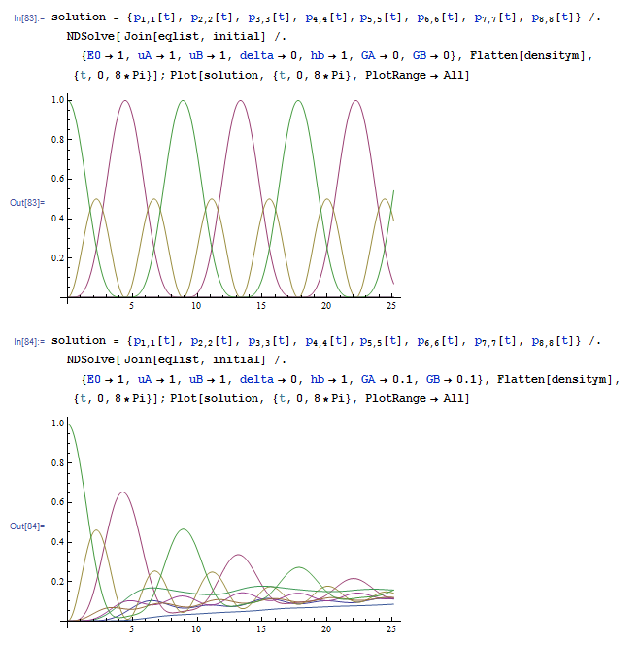

Slide 12
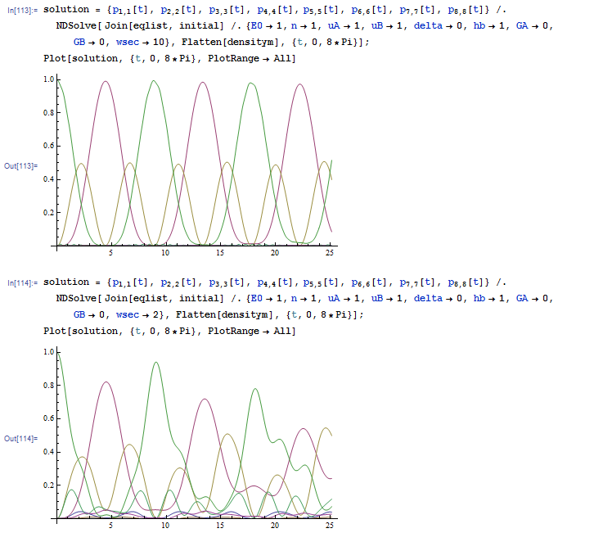

Slide 13
Final Result
Clock transition frequency:
1 121 015 393 207 851(8) Hz
State lifetime:
20.6 seconds

