Slide 1
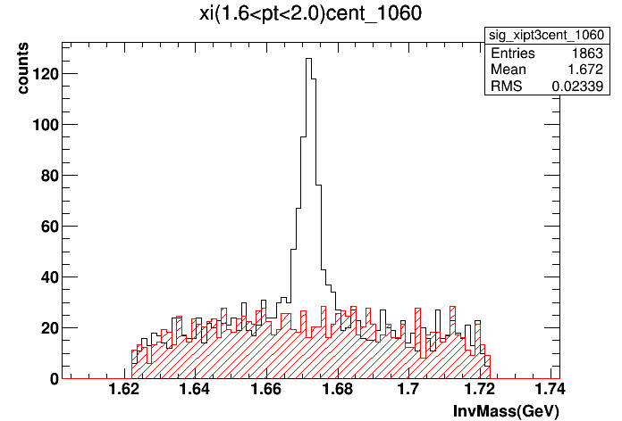
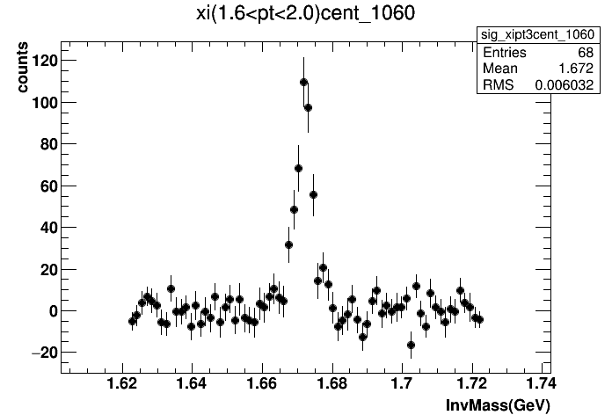

Slide 2
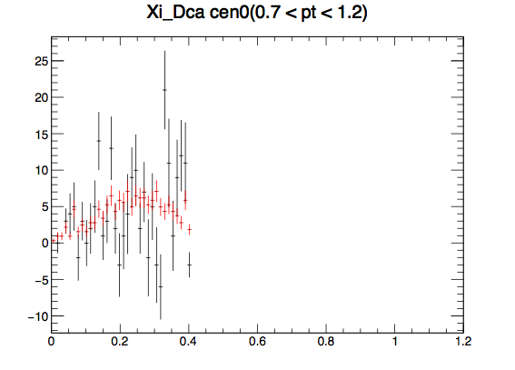
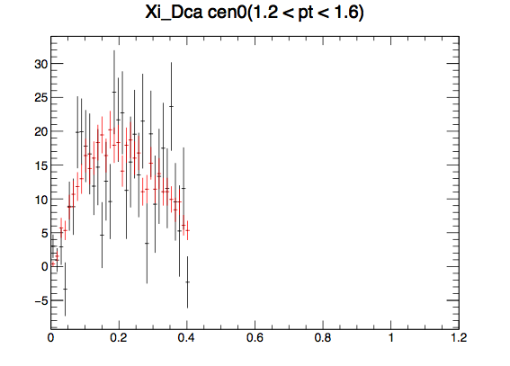
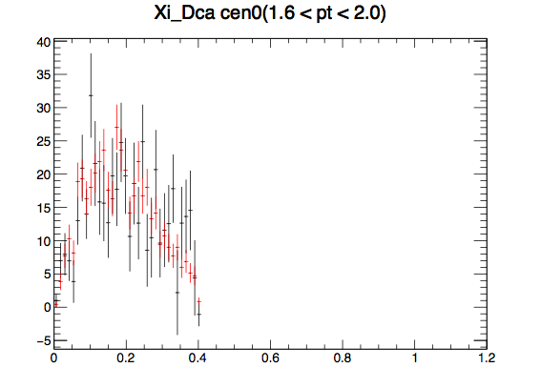
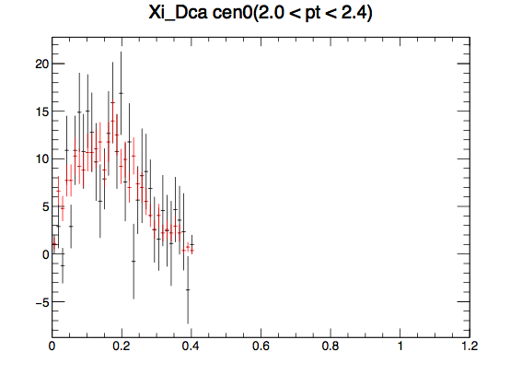
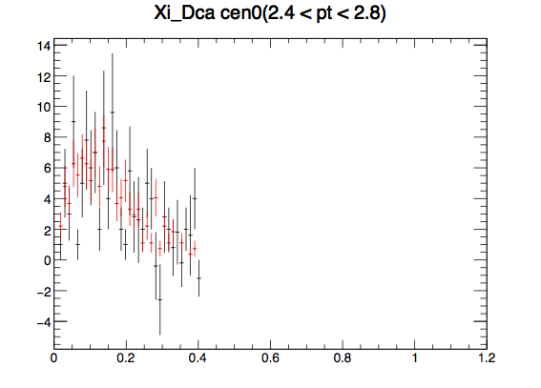
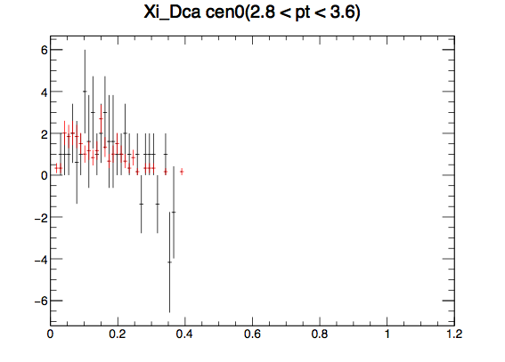
reds: MC
blacks: Data

Slide 3
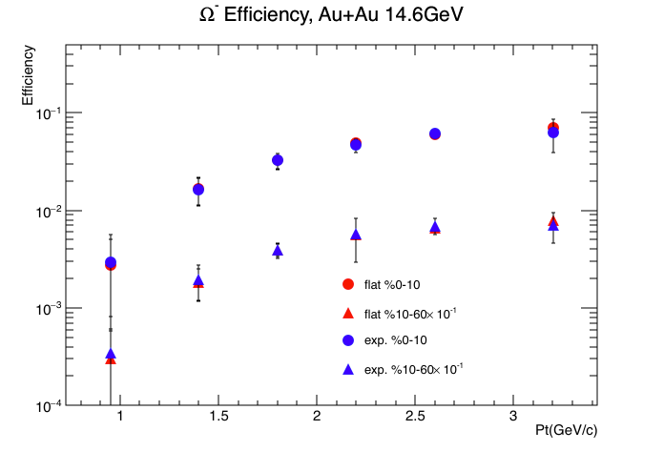

Slide 4
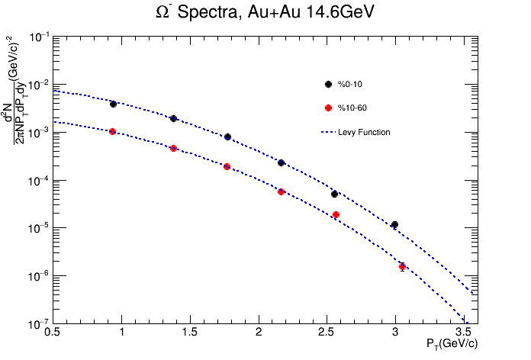

Slide 5
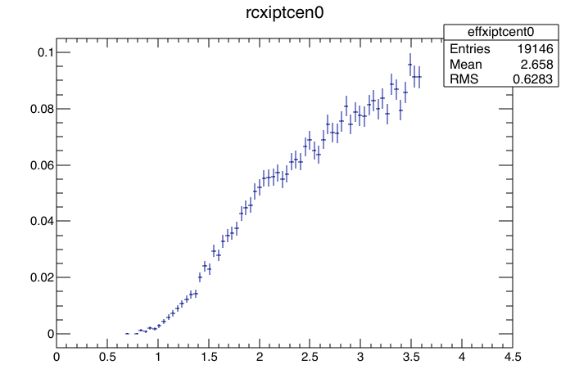


Using Pt*Levy to weight
a fine pt efff. dist. , fill the wide Pt
bin efficiency histogram.
Levy Function(d^2N/(PtdPtdy))Parameters
Efficiency for Each wide Pt Bin
Repeat until
Fitting Parameters
Converges
Fit the corrected spectra with Levy function to get a new set of fitting parameters
Divide the total signal counts by efficiency for the corresponding pt bin
Corrected Spectra

Slide 6
todo list
Apply same procedures to Anti-Omega and Phi
Do comparisons with other BES energies.

