Slide 1
Update on Omega Production in AuAu 14.5GeV Collisions

Slide 2

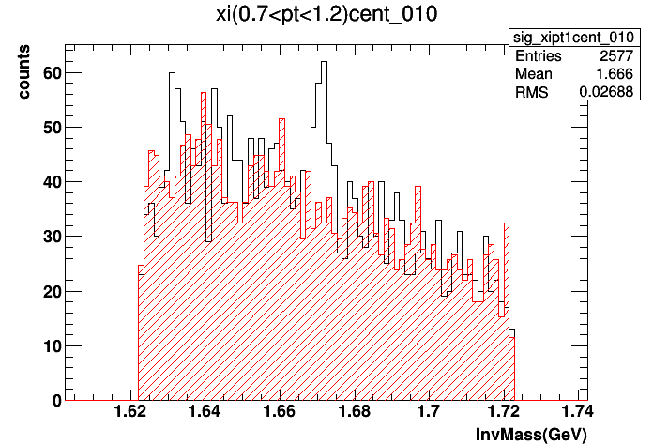
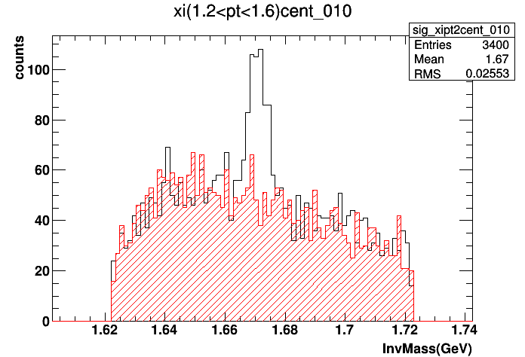
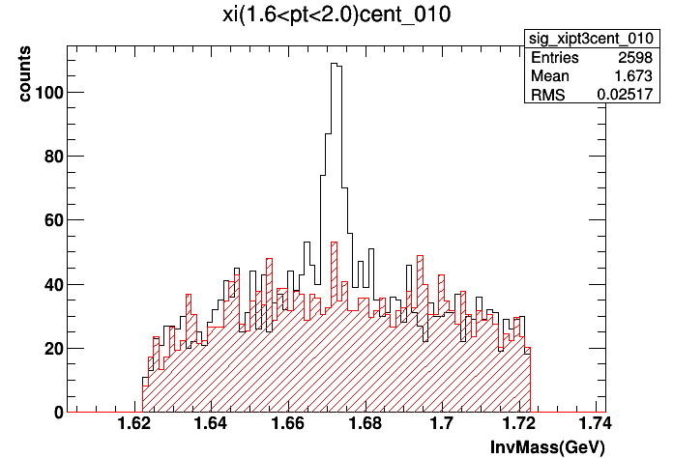
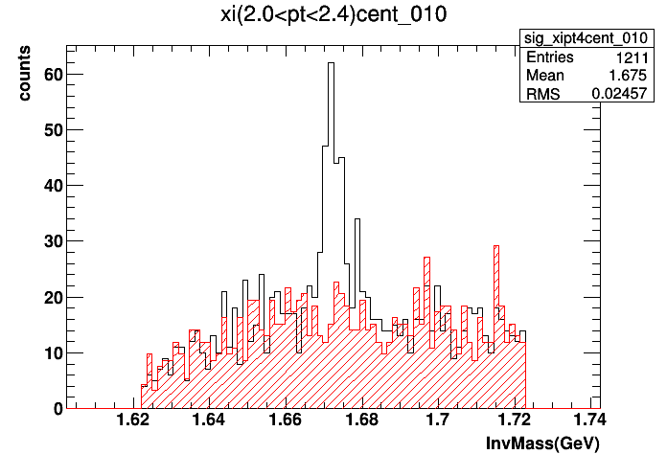
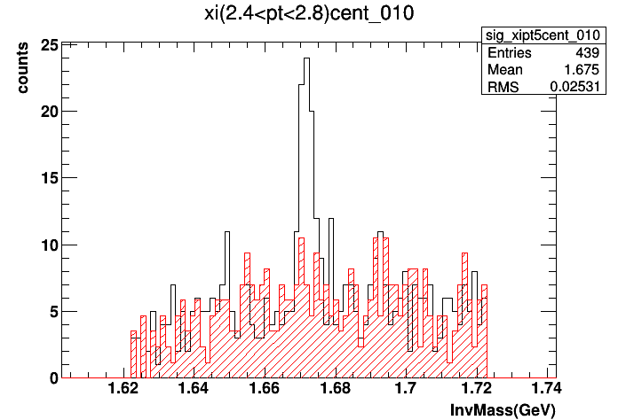
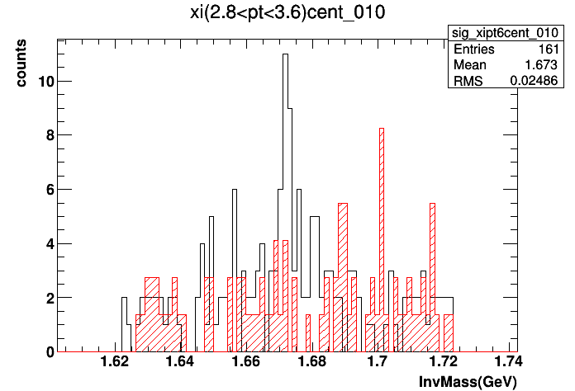
Rotational Background

Slide 3

Rotational Background

Slide 5
Efficiency Correction

Slide 6
How to Get the Corrected Spectra?

Slide 7
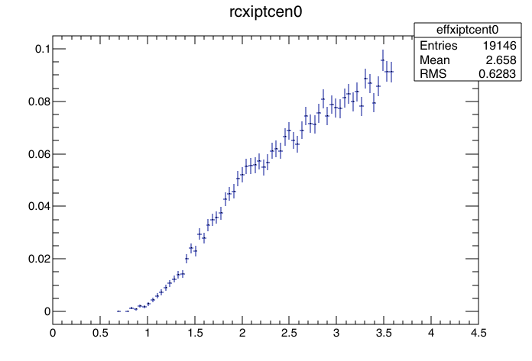
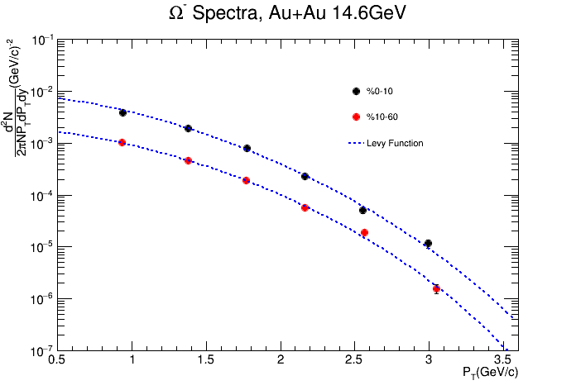
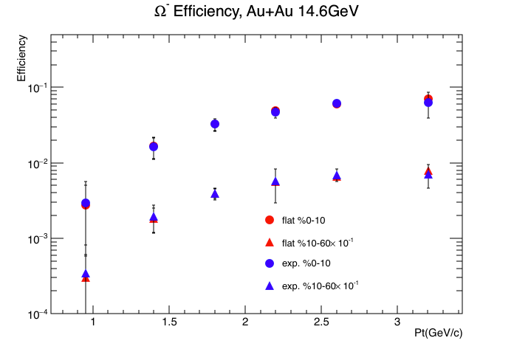


weight
a fine pt bin efficiency distribution.
fill the wide Pt bin efficiency
Histogram.
Levy Function(d^2N/(PtdPtdy))Parameters
Efficiency for Each wide Pt Bin
Repeat until
fitting parameters
Converges.
Fit the corrected spectra with Levy function to get a new set of fitting parameters
Divide the total signal counts by efficiency for the corresponding pt bin
Corrected Spectra

