Slide 1
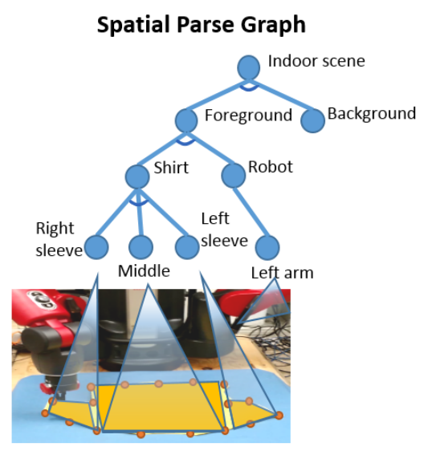
Robot Learning with a Spatial, Temporal, and Causal And-Or Graph
Caiming Xiong*, Nishant Shukla*, Wenlong Xiong,
and Song-Chun Zhu
Center for Vision, Cognition, Learning, and Autonomy
University of California, Los Angeles, United States
We introduce a stochastic grammar to ground human demonstrations into hierarchical knowledge
Spatial, temporal, and causal representations are jointly learned
The robot simulates its plan and compares it to reality while in motion
We teach our robot to fold shirts, and it generalizes the skill to fold arbitrary clothes

